Slide 1
Gastroccult Testing
Gastric Occult Blood Testing

Slide 2
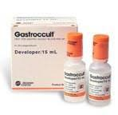
Supplies needed: Gastroccult Cards Gastroccult Develop Syringe or Applicator Stick

Slide 3
***Special Note***
All developers must have expiration dates checked before use
All cards must have expiration dates checked before use
All tests performed must be ordered and resulted in patient EMR

Slide 4
Label each card with patient information

Slide 5
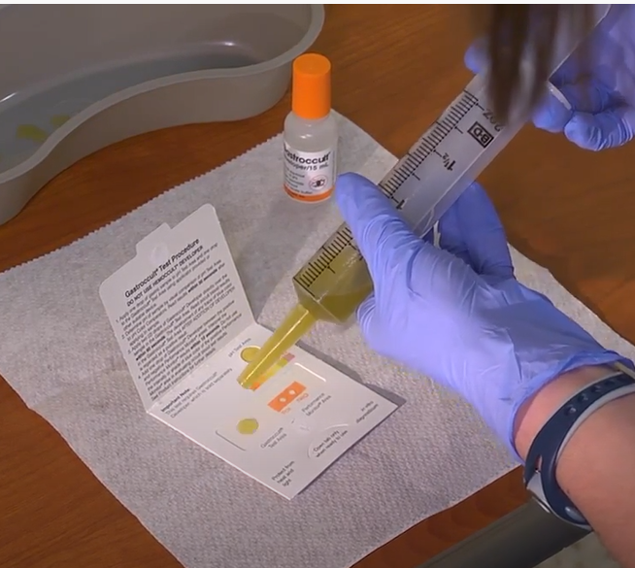
Applying specimen from a syringe: Open front cover when ready to add specimen Add one (1) drop of specimen to the Gastroccult Test Area

Slide 6
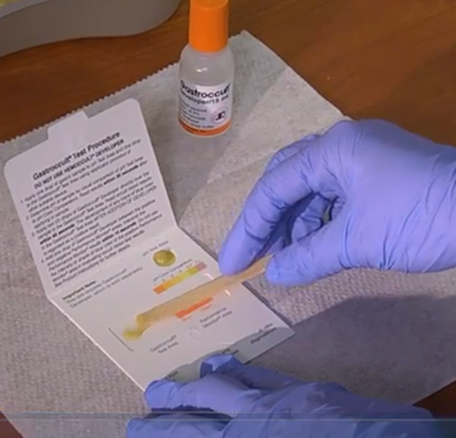
Applying specimen from applicator provided: Open front cover when ready to add specimen Apply specimen to the Gastroccult Test Area

Slide 7
NOTE: Although there is an option to also perform pH testing on the patient sample, we DO NOT perform or report pH testing of patient samples or proficiency samples using the Gastroccult® card. The pH parameter is not read or reported.

Slide 8
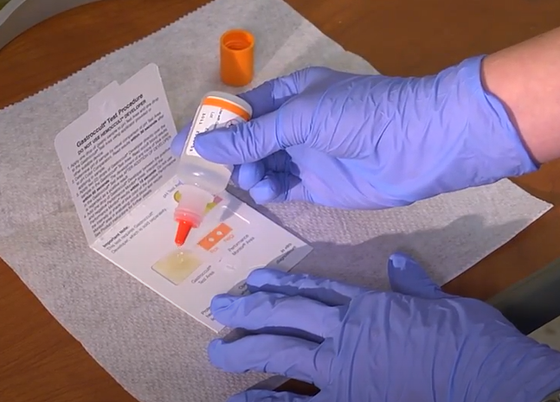
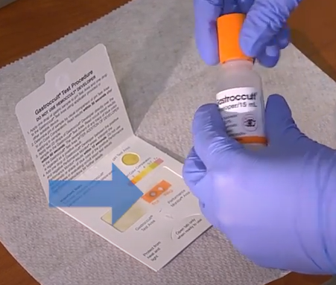
Apply two (2) drops of Gastroccult Developer directly over the sample in the Gastroccult Test Area. Read Occult blood results within 60 seconds. Add one (1) drop of Gastroccult Developer between the positive and the negative Performance Monitors areas (internal QC). Interpret the Performance Monitors results within 10 seconds. DO NOT use the intensity or shade of blue color of the positive Performance Monitors area in evaluating occult blood test results. The Positive Performance Monitor result must be positive (blue) and the Negative Performance Monitor result must be negative (not blue) in order for test to be valid. If not, repeat with a new card, checking expiration dates on both the card and the developer.
Internal QC must be blue (for positive QC) and not blue (for negative QC) for patient results to be valid.
1 Drop
2 Drops

Slide 9
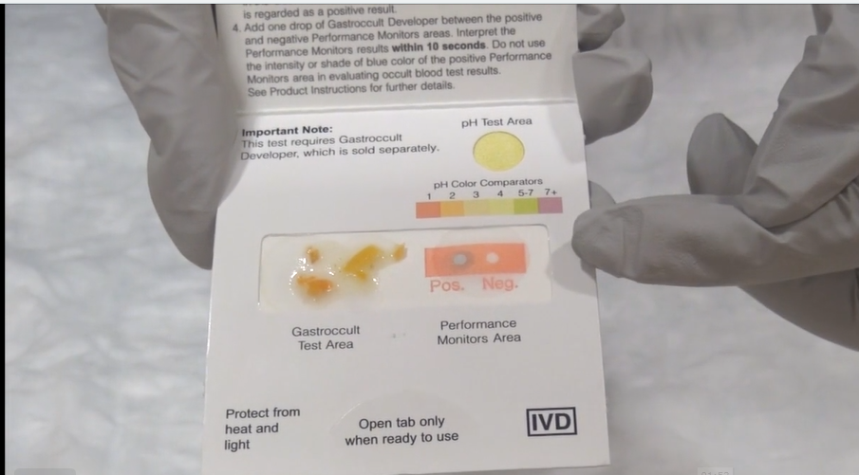
Positive patient results will turn any shade of blue. Negative patient results will NOT have any shade of blue.
Positive patient result
Negative patient result

Slide 10
ED Supplies for Fecal Occult Blood and Gastric Occult Blood testing
Supplies must be ordered via Logi-D
Or contact Materials Management
POCT/Main Lab doesn’t keep ED supply

