Slide 1
Hemoccult Sensa
Fecal Occult Blood Lab Test

Slide 2
Supplies Needed: Hemoccult Cards Hemoccult Developer Applicator Stick

Slide 3
***Special Notes***
All developers must have expiration dates checked before use.
All cards must have expiration dates checked before use.
All tests performed must be ordered and resulted in patient EMR.

Slide 4
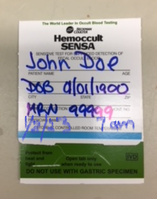
Label each card with patient full name, DOB or MRN, date and time of collection.

Slide 5
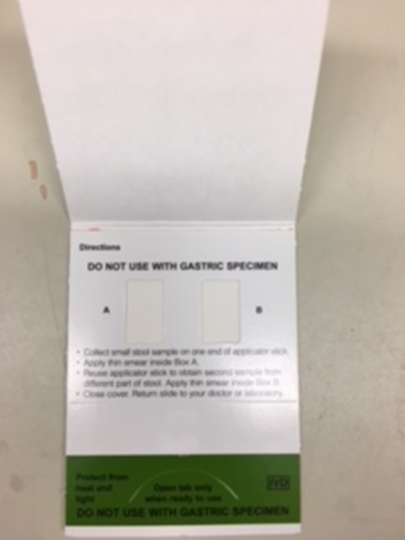
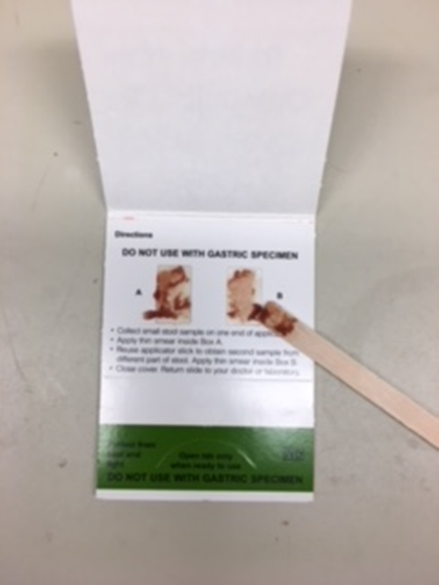
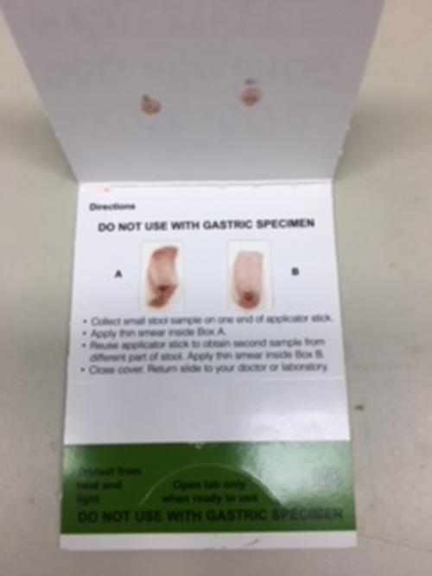
Open front cover where patient information is written. Apply stool specimen to A & B areas. Close card cover. Wait 3-5 minutes before testing.

Slide 6
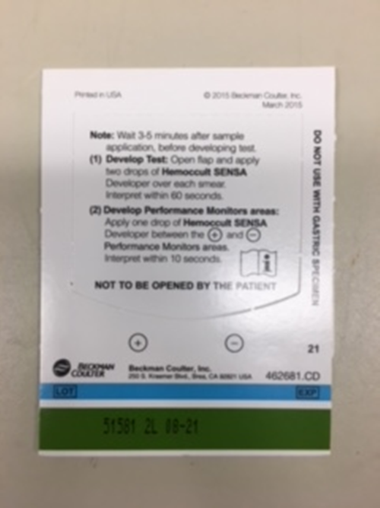
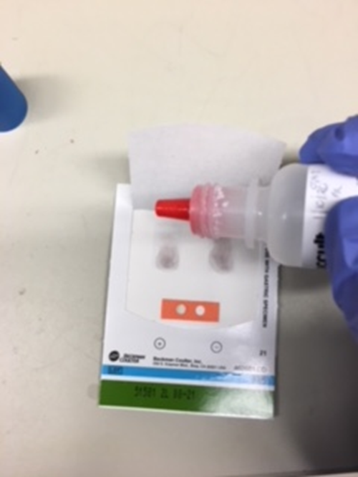
To test, open the flap in back of the test card (the side with instructions) and apply 2 drops of Hemoccult® SENSA® developer to the guaiac paper directly over each fecal smear. Add 1 drop of developer to the center of internal QC area (between the positive and negative circles). Interpret within 60 seconds.
2 drops per application area
1 drop for QC area

Slide 7
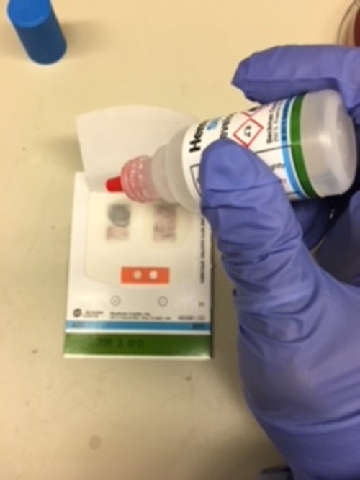
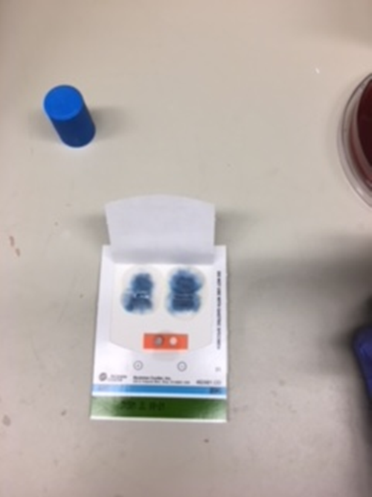
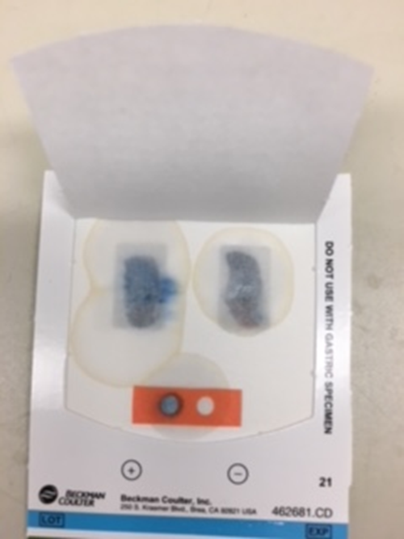
After adding reagent look for a blue color which indicates a positive result. The test is positive even if only on one side of the card shows blue.
One side has blue = Positive result
Both sides have blue = Positive result

Slide 8
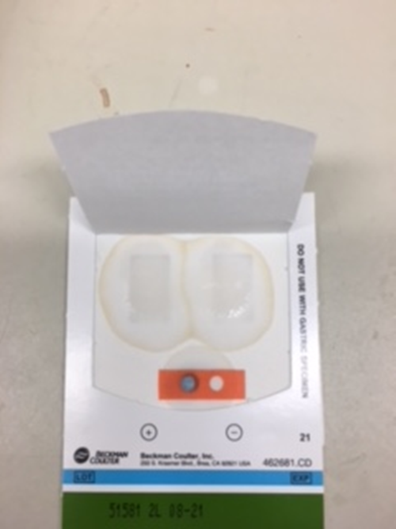
No blue color indicates a negative patient result. Positive QC area must be positive (blue) and the negative QC area must be negative (not blue) in order for patient results to be valid.
Positive QC must be positive (blue) and Negative QC must be negative (not blue).

Slide 9
ED Supplies for Fecal Occult Blood and Gastric Occult Blood testing
Supplies must be ordered via Logi-D
Or contact Materials Management
POCT/Main Lab doesn’t keep ED supply

