Slide 1
Abbott Point of Care Piccolo Xpress Chemistry Analyzer

Slide 2
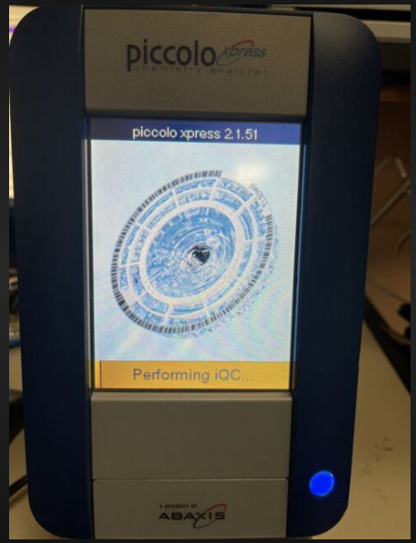
* Power on the analyzer using the Power button on the front of the analyzer * The Analyzer will Auto perform the iQC * Warming will begin * Once ready, the ANALYZE screen will appear

Slide 3
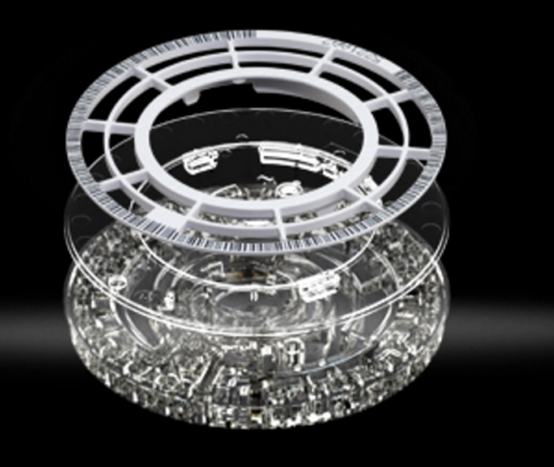
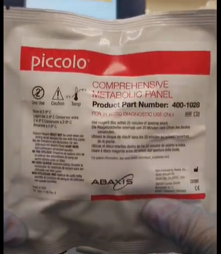
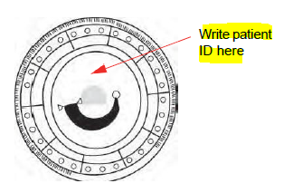
Comprehensive Metabolic Panel Disc

Slide 4
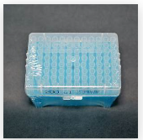
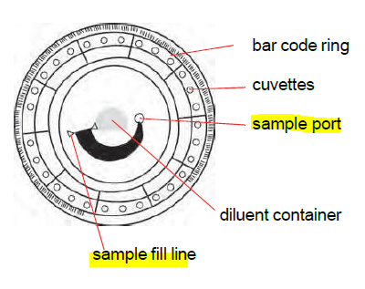
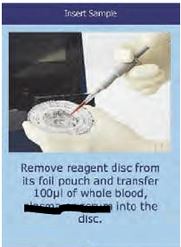
Fill Disc with 100μL using Micropipette & tips
Pipette Tips

Slide 5
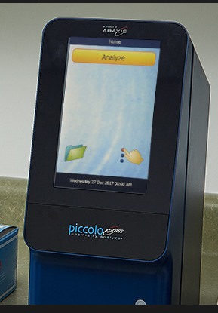
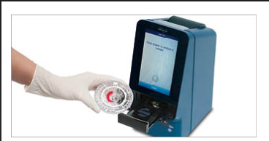
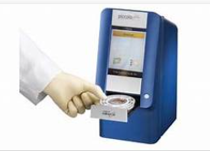
Select Analyze on screen to open drawer Insert disc barcode side up, be sure it is seated correctly (flat) in the drawer Select CLOSE on screen to close drawer ***Do NOT PUSH the drawer closed***

Slide 6
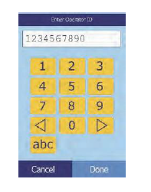
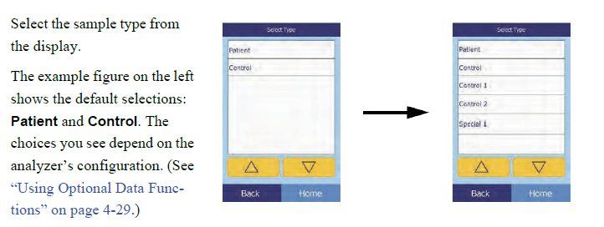
Running a Patient or Control
Enter the operator ID, then select Done.

Slide 7
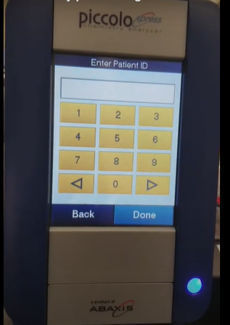
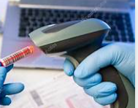
Using barcode scanner only-Scan Patient Specimen Label Barcode for entering Patient ID

Slide 8
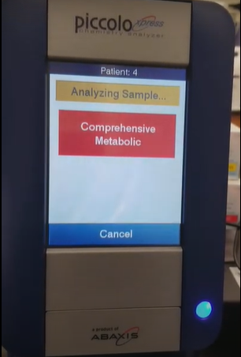
Select Test- Comprehensive Metabolic on the screen to start test

Slide 9
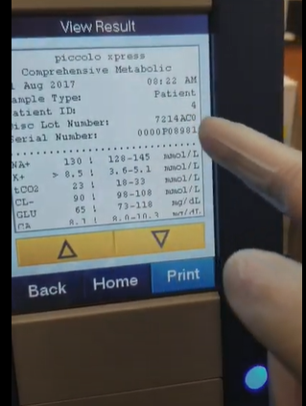
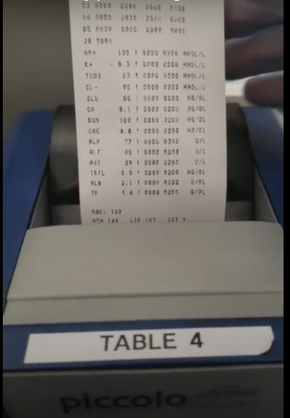
Results will appear on the screen and autoprint to the sticky back printout paper
Results will display in < 14 minutes

Slide 10
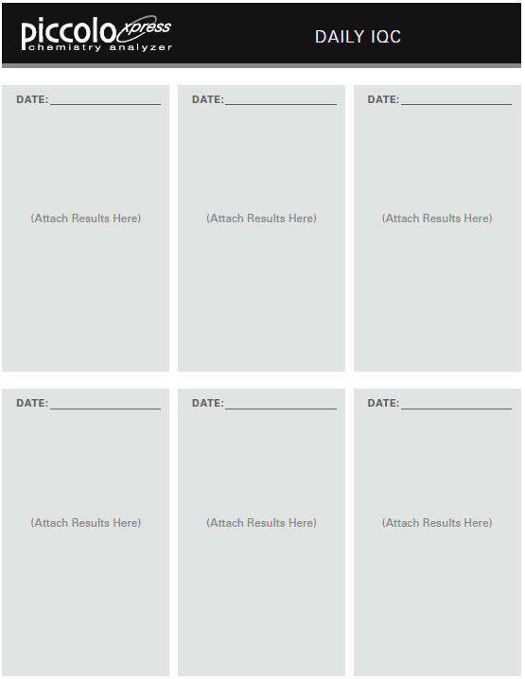
Place printout into logbook for Patient results, QC and Daily iQC
Patient Log
QC Log
Daily iQC Log

Slide 11
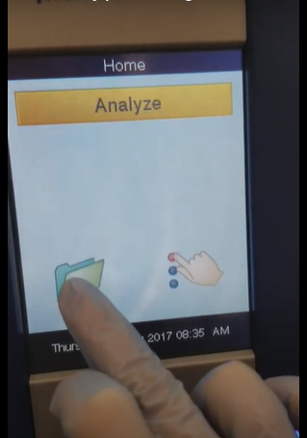
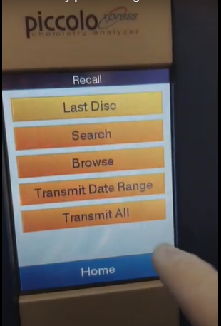
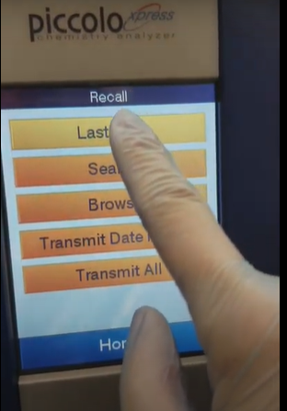
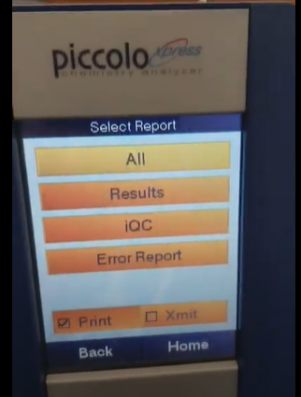
For Daily iQC print out after 1st run of the day
Select the folder on the Home screen
Select Last Disc on the Recall screen
Select iQC on the Select Report screen

Slide 12
Recalling Patient or QC results for Printing or Retransmitting
Select the folder on the Home screen
Select Last Disc on the Recall screen or search/browse to find result needed
OR
This screen can also be used to retransmit
Select results on the Select Report screen
OR
Select Xmit button

Slide 13
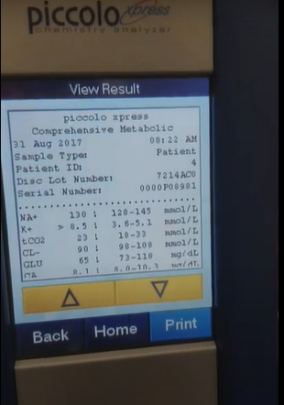
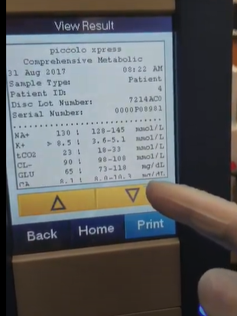
Select Print if needed or scroll using the to view the results

Slide 14
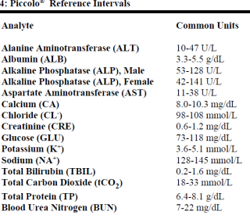
Expected Values (Reference Intervals):Concord Hospital uses the Common Units for all values

Slide 15
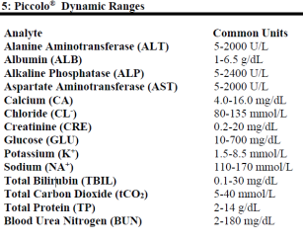
Linearity (Dynamic ranges)

Slide 16
Interpreting Results
Review > and < signs. These indicate results that are out of the dynamic range. If any result for a particular test exceeds the dynamic range, collect Plasma tube (PST) tube and send it to Main laboratory for analysis per physician request. Do not attempt to dilute the sample and re-run it on the analyzer.
Review three tildes. (~ ~ ~) Indicates results that cannot be determined. This is known as chemistry value suppression. This may happen due to improper mixing of a reagent bead with diluted sample, a nonlinear reaction, an endpoint of a particular reaction not reached, or a concentration outside the analyzer’s capabilities. When a chemistry is suppressed (~~~), the analyzer will prompt to print an error report. Collect Plasma tube (PST) and send the sample to main laboratory.
Review the asterisk (*). Indicates the results are outside of the reference range. Collect Plasma tube (PST) and send the sample to main laboratory if results are questioned.
Review (!) “confirm low recoveries”. (!) Next to any or all analytes indicates that at least one of the analytes has a lower concentration that would normally be expected. This may indicate fluid distribution issues in the disc causing over dilution or that the sample has been diluted through contamination. Specimen may be problematic. Repeat, recollect or collect Plasma tube (PST) and send the sample to main laboratory.
Review Sample Integrity Alerts-Repeat or redraw the sample to confirm test results. If the message reoccurs, the sample may be problematic. Collect Plasma tube (PST) and send the sample to main laboratory.
Review sample indices 0, 1+, 2+, 3+ (qualitative). Repeat any unexpected test result(s). The result will be automatically suppressed, and in its place HEM, ICT, or LIP will be indicated if the test results will be negatively affected. Review whenever test results do not match patient symptoms. Collect Plasma tube (PST) and send the sample to main laboratory.

Slide 17
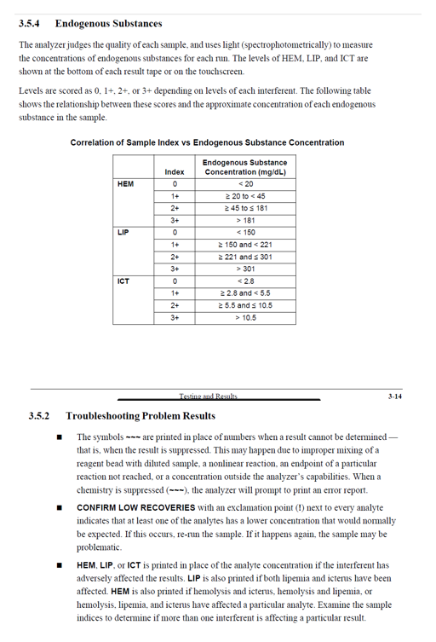
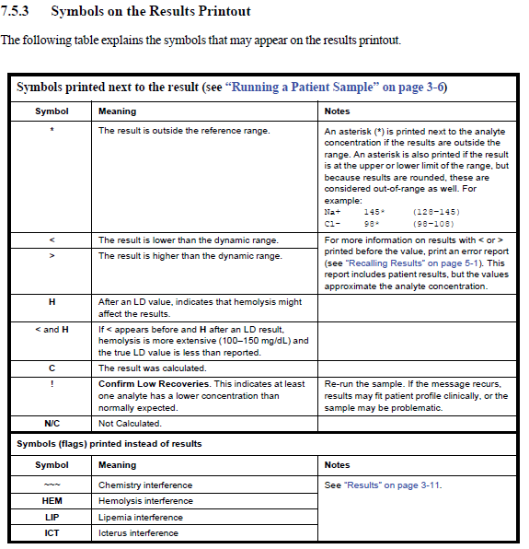

Slide 18
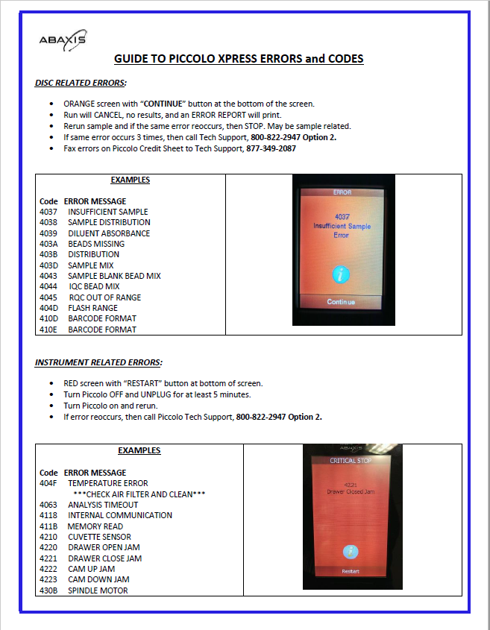
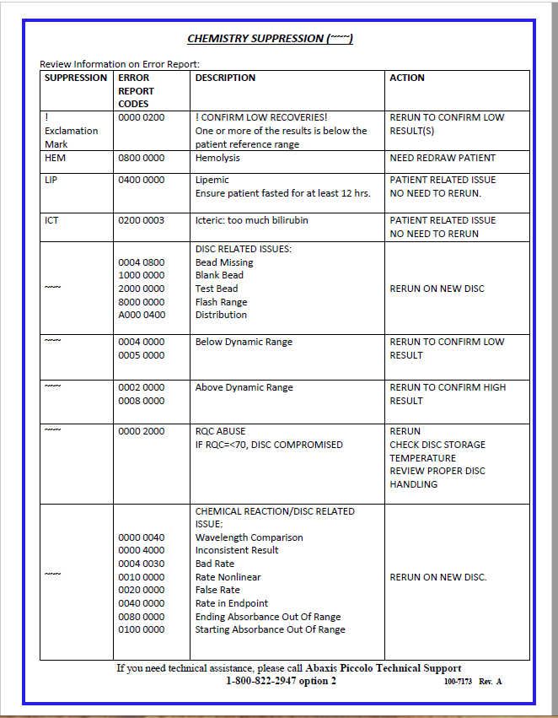

Slide 19
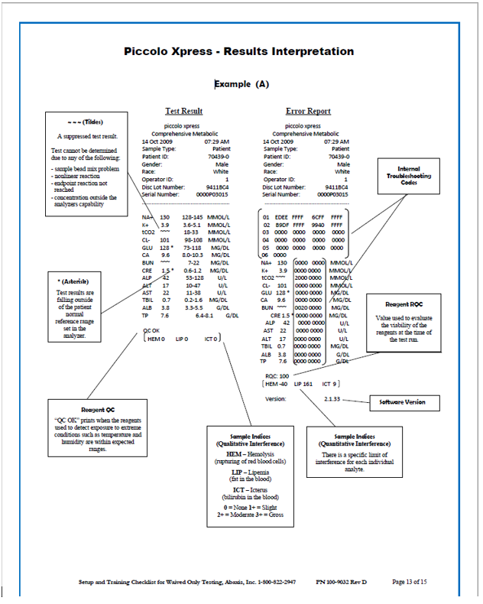
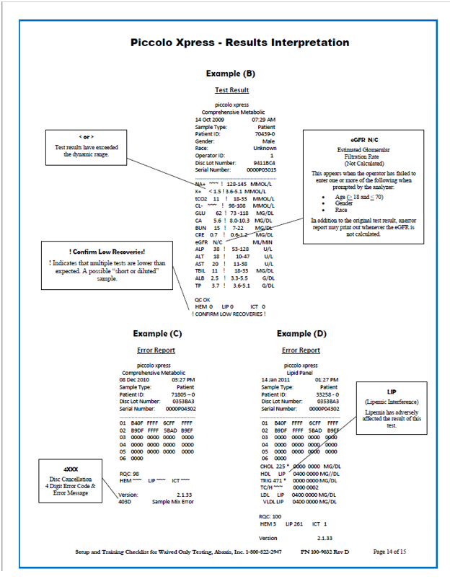

Slide 20
Installing a Printer Paper Roll

