Slide 1
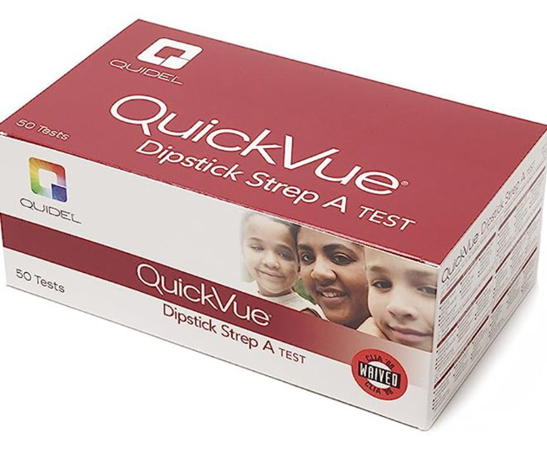
Quidel QuickVUE dipstick Strep a test

Slide 2
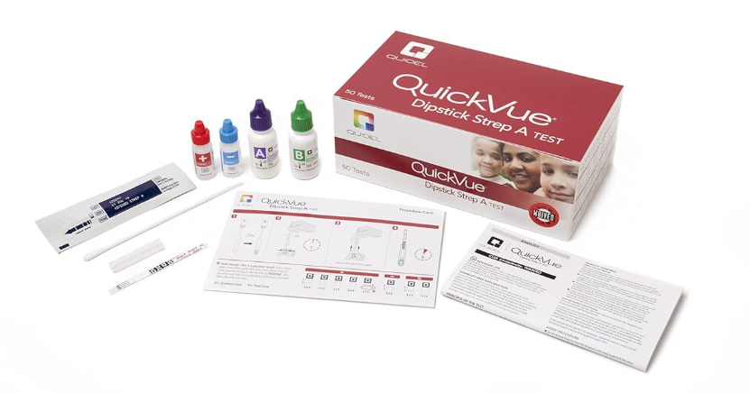

Test kit includes:
Individually packaged Dipsticks, coated with rabbit polyclonal anti-Group A
Streptococcus
• Test Tubes
• Extraction Reagent A 4 M Sodium Nitrite
• Extraction Reagent B 0.2 M Acetic Acid
• Positive Control Nonviable Group A Streptococci, 0.1% Sodium Azide
• Negative Control Nonviable Group C Streptococci, 0.1% Sodium Azide
• Sterile Swabs
Kit components are not interchangeable. Lot/Kit Specific.
*Timer is also required. Not included in kit. *Point of Care does not keep any supply.

Slide 3

Storage:
Store at room temperature (15-30C), out of direct sunlight.
Kit contents are stable until the expiration date printed on the outer box.
Do not freeze.

Slide 4
Specimen:
Patient Preparation: None
Specimen requirement: Throat or nasopharynx swab.
Collection: Solid plastic shaft sterile swab with Dacron or Rayon tip, submitted dry or in liquid transport medium, e.g. Modified Stuart’s Transport Medium.
• Swabs must be properly labeled with the following:
  1. Patient’s full name
  2. Date of Birth or MRN
  3. Date of collection
  4. Time of collection
  5. Collector’s Cerner user name (or first initial and full last name)
Minimum specimen requirement: One swab for antigen testing. A second swab is needed for culture.
Storage of specimen: Room temperature (15-30C) or refrigerated (2-8C) up to 72 hours.

Slide 5
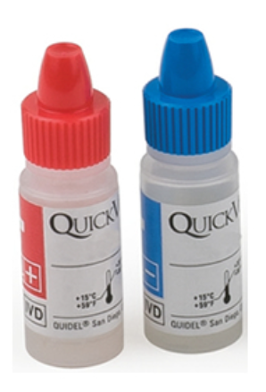
Quality Control (QC) :
Kit Controls (External Controls)
Positive Control = Non-viable Group A streptococcus in solution
The control will produce a pink-to-purple Test Line and a blue Control Line.
Negative Control =Non-viable Group C streptococcus in solution
The control will produce a blue Control Line only.
Run both controls on each kit when the box is opened, following this written procedure. These controls serve as a check on product and technique performance.
Record all QC results on the Group A Strep QC Log sheet.

Slide 6
Running internal QC
Each QuickVue® Dipstick Strep A Test contains both internal positive and negative procedural controls.
The color of the Extraction Reagent changes from clear to green as the reagents are when these are functioning properly.
The appearance of a blue Control Line provides an internal positive procedural control that validates the immunological integrity of the device, assures proper reagent function, and assures that the correct test procedure was followed.
A clear background on the Dipstick is the internal negative procedural control for the device.
The lack of significant color development in this background area to obscure the Control Line indicates that the test has been performed correctly.

Slide 7

Troubleshooting QC issues
When the positive control is not reactive, or the negative control is reactive, repeat the control test.
If results upon re-testing are unacceptable, open new kit and test controls.
If control results are still un-acceptable, contact the Point of Care Specialist.
Record all unacceptable QC results on the Manual Testing Quality Control Action Log.

Slide 8
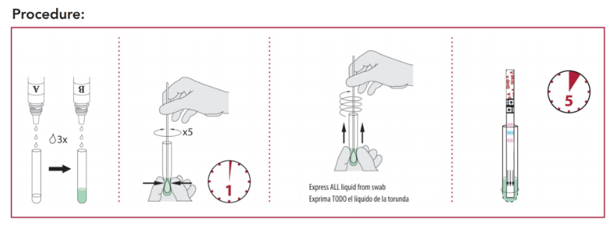
Testing Procedure:
Mix each reagent gently before use.
Test tubes must be labeled with at least one unique specimen identifier.
If refrigerated, allow all reagents and samples to come to room temperature before use.
Do not use Reagent B if that solution is green prior to mixing with Reagent A.
1. Add 3 drops of Reagent A and 3 drops of Reagent B to a Test Tube. The solution should turn green.
2. For External QC—Vigorously mix Control Bottles.
Add one (1) drop of the Negative Control and one (1) drop of the Positive Control to their respective tubes.
Place a clean swab into each tube and continue as with the patient testing instructions.
3. For Patient Testing--Insert the patient swab sample into the Test Tube and thoroughly mix by stirring and pinching the swab through the tube. Rotate the swab a minimum of 5 times.
4. Incubate 1 minute at room temperature.
5. Express liquid from the swab by squeezing the sides of the Test Tube as the swab is withdrawn. Discard the swab in appropriate biohazard waste receptacle.
6. Remove a Dipstick from the foil pouch. Place the Dipstick with arrows pointing down into the extracted sample Tube.
7. Incubate 5 minutes at room temperature. A positive result may be read as soon as the pink-to-purple Test Line and the blue Control Line appear. Weak positive and negative results require the entire 5 minutes incubation.
8. Dispose of test tube and test strip in appropriate biohazardous waste receptacle.

Slide 9

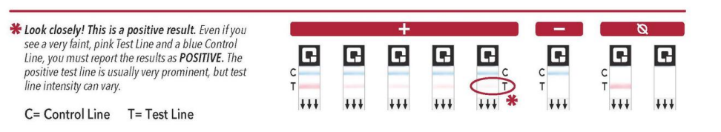
Interpretation:
Negative (-) = a blue Control Line but no pink-to-purple Test Line.
Positive (+) = a pink-to-purple Test Line and a blue Control Line.
The color shade, color intensity, and/or the density of the bands may vary. Consider a pink-to-purple or blue line that appears uneven in color density a valid result. Some pink color behind the Test Line may be seen with moderate or high positive specimens; results are valid if the Test Line and Control Line are visible.
Invalid = no blue Control Line or background color obscures the pink-to-purple Test Line. This may be due to a reagent/device problem or a procedural error. Repeat the test. If the problem still occurs, call the Point of Care Specialist, ext. 4643.
Record all invalid results and repeat patient testing on the Manual Testing Quality Control Action Log.

Slide 10


Recording results:
Record on Patient Result Log (if applicable).
CHMG practices – Record internal positive and negative control results on the Cerner Powerform with the patient test result.
ED and Walk In Urgent Care – Record internal positive and negative control results in Cerner Accession Result Entry (ARE) with the patient test result.
Report test results only when satisfactory control results are achieved.
Unsatisfactory control results and all repeat testing should be recorded on the Manual Testing Quality Control Action Log.
Both POC Specialist can be reached at pointofcare@crhc.org with any questions or concerns.

