Slide 1
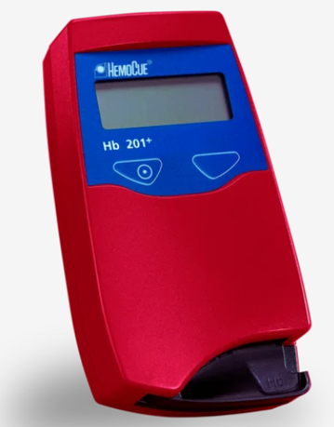
HemoCue Hb 201+ System

Slide 2
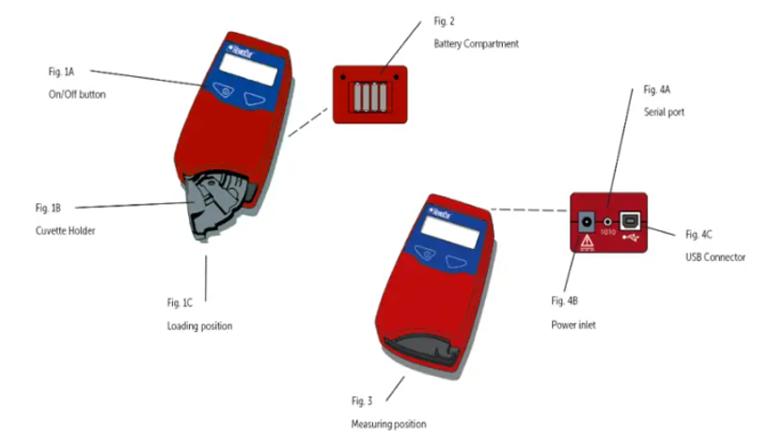
HemoCue Hb 201+ Analyzer Overview

Slide 3
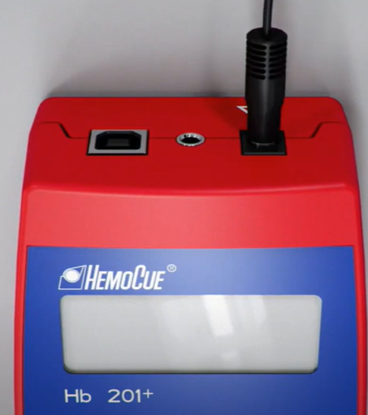
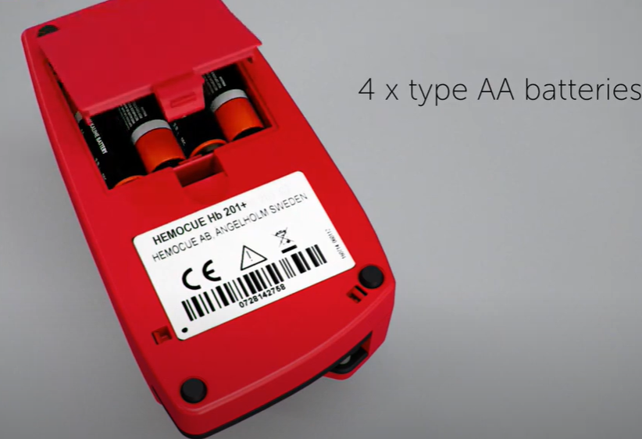
The HemoCue analyzer can be powered using an A/C power cord or using 4 AA batteries.

Slide 4
HemoCue Hb 201+ system provides determination of hemoglobin quickly and easily.
The microcuvette cavity contains reagents deposited on its inner walls.
The blood sample is drawn into the cavity by capillary action and is mixed spontaneously with the reagents.
The microcuvette is then placed in the analyzer in which the transmittance is measured and the hemoglobin level calculated.
The technique makes it possible to sample the blood, mix and chemically react it with the reagents in the same microcuvette as is used for measurement.

Slide 5
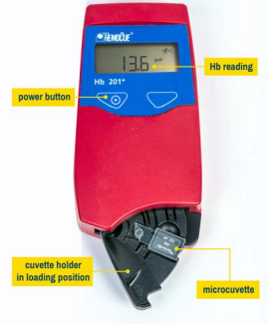
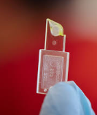
HemoCue Hb 201+ System

Slide 6
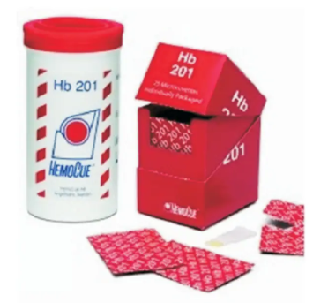
Two ordering options for HemoCue Microcuvettes
Four Canisters of microcuvettes
contains 50 microcuvettes per canister
Expires 30 days after opening canister
Store at room temperature
Box of individually wrapped cuvettes
Contains 100 individually wrapped microcuvettes
Stable until expiration date printed on package
Store at room temperature
* Point of Care does not keep any supply.

Slide 7
Specimen types
Fresh capillary whole blood collected from a finger stick or heel stick.
Capillary specimens need to be analyzed immediately.
Wipe away 2 or 3 drops of blood (use the 4th drop of blood).
Anticoagulated venous may be used.
Appropriate anticoagulants (e.g. EDTA or heparin) may be used, preferably in solid form to avoid dilutional effects.
Mix samples thoroughly by inversion 8-10 times just prior to testing.
Venous specimens with an anticoagulant need to be analyzed within 24 hours.
If refrigerated, the sample should be allowed to warm to room temperature before mixing.

Slide 8
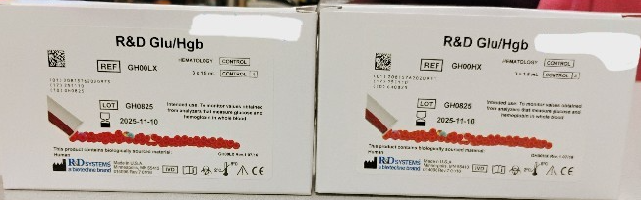
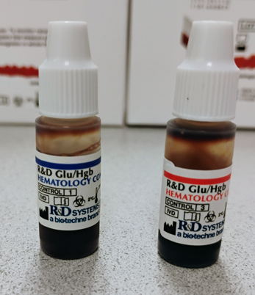
Liquid Quality Controls
Level 1 (low) control
Level 3 (High) control
QC is stored refrigerated at 2-8°C.
Unopened, QC is good until manufacturer’s printed expiration date.
Once opened QC is good for 30 days or manufacturer’s expiration date (whichever is sooner).
* Point of Care does not keep any supply. QC supply is on an annual standing order.

Slide 9
HemoCue QC Frequency
Liquid quality controls (low and high levels) are performed:
Weekly
With new lots of microcuvettes
With new shipments of microcuvettes
Control results are recorded on the QC log sheet.

Slide 10
Running Liquid QC
Refrigerated vials are to warm to room temperature for 15 minutes before mixing.
Put on gloves.
Turn the analyzer “On” and wait for the 3 flashing dashes to proceed with testing.
Holding the vial horizontally between palms, roll the vial back and forth for 30 seconds. Occasionally invert the vial. Mix vigorously, but do not shake. Continue to mix in this manner until the red cells are completely suspended. No red cells should be visible on the bottom of the vial when inverted. Gently invert 8-10 times immediately before sampling.
Dispense a drop of the control onto a hydrophobic surface such as parafilm or glass slide. (Do not fill the cuvette directly from the vial.)
Remove a microcuvette from the individual package or the canister (recap immediately).

Slide 11
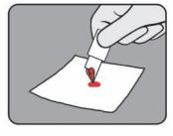
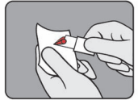
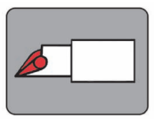
Running Liquid QC
Introduce the tip of the microcuvette into the center of the drop of control. Fill the microcuvette in one continuous process. Never top off the cuvette after the first filling.
Wipe off any excess control material on the outside of the microcuvette with clean, dry gauze. Do not allow the gauze to touch the slit of the microcuvette, as it will draw out the specimen.
Visually inspect the microcuvette for air bubbles. Small air bubbles around the edge do not interfere with testing. If there are air bubbles within the testing area, recollect another microcuvette sample.

Slide 12
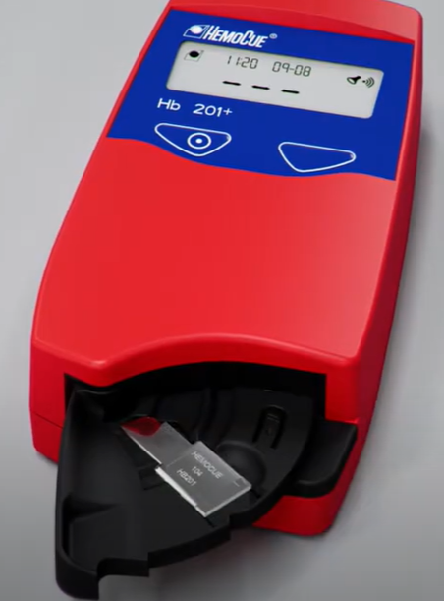
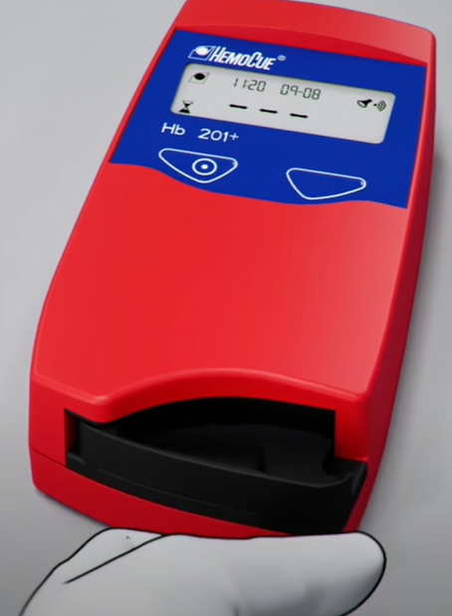
Running Liquid QC
Place the filled microcuvette into the cuvette holder while in the loading position.
Push the cuvette holder to the measuring position. The display will show 3 fixed dashes.
After 15-60 seconds, a hemoglobin value will be displayed in g/dL. The result will be displayed as long as the cuvette holder is in the measuring position.
Verify that the obtained control value falls within expected range found on the assay sheet.
After each test is performed, pull out the cuvette holder to the loading position and dispose of the microcuvette in a biohazard sharps receptacle.
Repeat with the other level of quality control.
Both levels of QC must be run and results must be within the acceptable ranges in order to use the instrument for patient testing.
Dispose of expired/opened controls in biohazard waste container.

Slide 13
If QC is out of acceptable ranges
If the control value is not within the acceptable range on the assay sheet:
Verify that the lot number on the vial matches the lot number on the assay sheet.
Verify that the vial is within the manufacturer’s, as well as, the 30 day opened expiration date.
Repeat the test with a new drop of control and a new microcuvette.
If the control value still fails, open a new vial of control and/or a new canister of microcuvettes and repeat testing.
If acceptable values are still not obtained, the instrument cannot be used for patient testing. Notify the Point of Care Specialist.

Slide 14
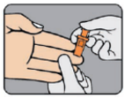
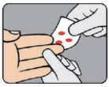
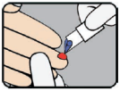
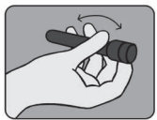
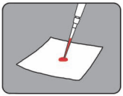
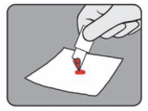
Running patient samples
Capillary sample
Put on gloves.
Turn the analyzer “On” and wait for the 3 flashing dashes to proceed with testing.
For capillary samples:
Obtain the capillary sample according to the standard fingerstick procedure.
Wipe away 2 – 3 drops of blood with clean gauze.
Apply light pressure until another drop of blood appears. Make sure the drop of blood is big enough to fill the microcuvette completely.
For venous samples:
Use a fresh, well-mixed anticoagulated blood specimen.
With a pipette, place a drop of this blood onto a hydrophobic surface (such as parafilm or glass slide).
Introduce the microcuvette tip into the middle of the drop of blood and fill the microcuvette in one continuous process. It should never be topped off after the first filling.
Venous sample

Slide 15
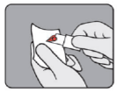
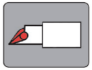
Running patient samples
Once the microcuvette is filled, wipe off any excess blood on the outside of the microcuvette with clean, dry gauze. Do not allow the gauze to touch the slit of the microcuvette, as it will draw out the specimen.
Inspect the microcuvette for air bubbles. Small air bubbles around the edge do not interfere with testing. Air bubbles within the testing area of the microcuvette are not acceptable. Another sample needs to be recollected using another microcuvette.
Always keep filled microcuvettes horizontal.

Slide 16
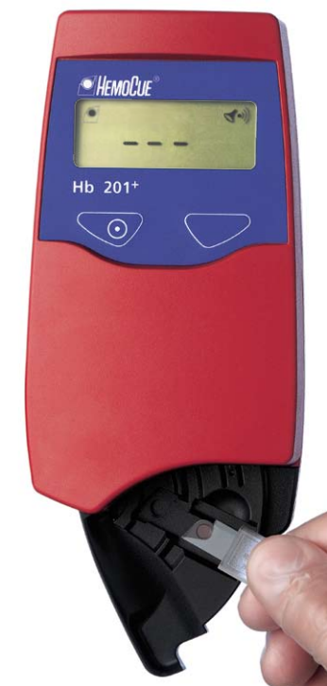
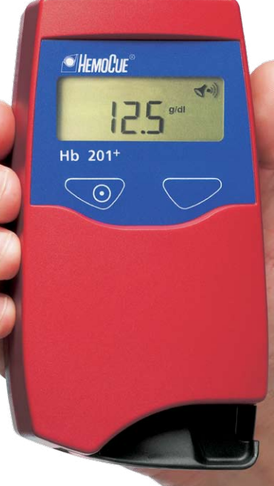
Running patient samples
Place the microcuvette in the cuvette holder and slide the cuvette holder to the measuring position.
The display will show 3 fixed dashes. The filled microcuvette should be analyzed immediately, but at least within 10 minutes after being filled.
After 15-60 seconds, the hemoglobin result is displayed in g/dL.
Record results in patient result log and transcribe result into patient electronic medical record. (The analyzer does not store results, so you must record results on the log sheet.)
Pull the cuvette holder back out to the loading position and remove the microcuvette.
Dispose of the microcuvette and retractable caps stick device in biohazard sharps container.

Slide 17
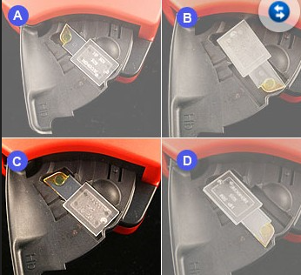

Proper orientation of microcuvettes in cuvette holder
When loading a microcuvette in the HemoCue analyzer, the microcuvette should sit in the cuvette holder as shown in picture C.
Seating the microcuvette as shown in picture A, B and D will not give a valid hemoglobin reading. It could also damage the analyzer’s optical components.

Slide 18
Recording patient results
The test is linear from 3.7-23.2 g/dl.
The reported hemoglobin value is read directly from the display of the analyzer and reported as grams per deciliter (g/dl), provided that it falls within the linearity range.
Record results in patient result log and transcribe result into patient electronic medical record.
If the hemoglobin value falls outside of the linearity range, the patient sample is to be recollected and the test is to be repeated. If the repeated value is still outside of the linearity range, a venous blood specimen is to be collected and sent to the main laboratory for evaluation.

Slide 19
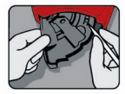

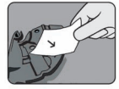
Daily Maintenance
Cleaning the cuvette holder.
The cuvette holder should be cleaned after each day of use.
Turn the analyzer OFF.
Pull the cuvette holder out to the loading position.
Carefully press the small catch positioned in the upper right corner of the cuvette holder, and rotate the cuvette holder towards the left as far as possible.
Clean the cuvette holder with either alcohol or a mild soap solution.
Wait 15 minutes before replacing the cuvette holder and using the analyzer. Make sure the cuvette holder is dry before inserting.

Slide 20
As Needed Maintenance
Cleaning the exterior of the analyzer.
Inspect the exterior of the analyzer.
Clean as necessary with a mild soap solution or alcohol.

Slide 21
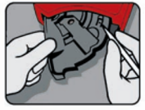

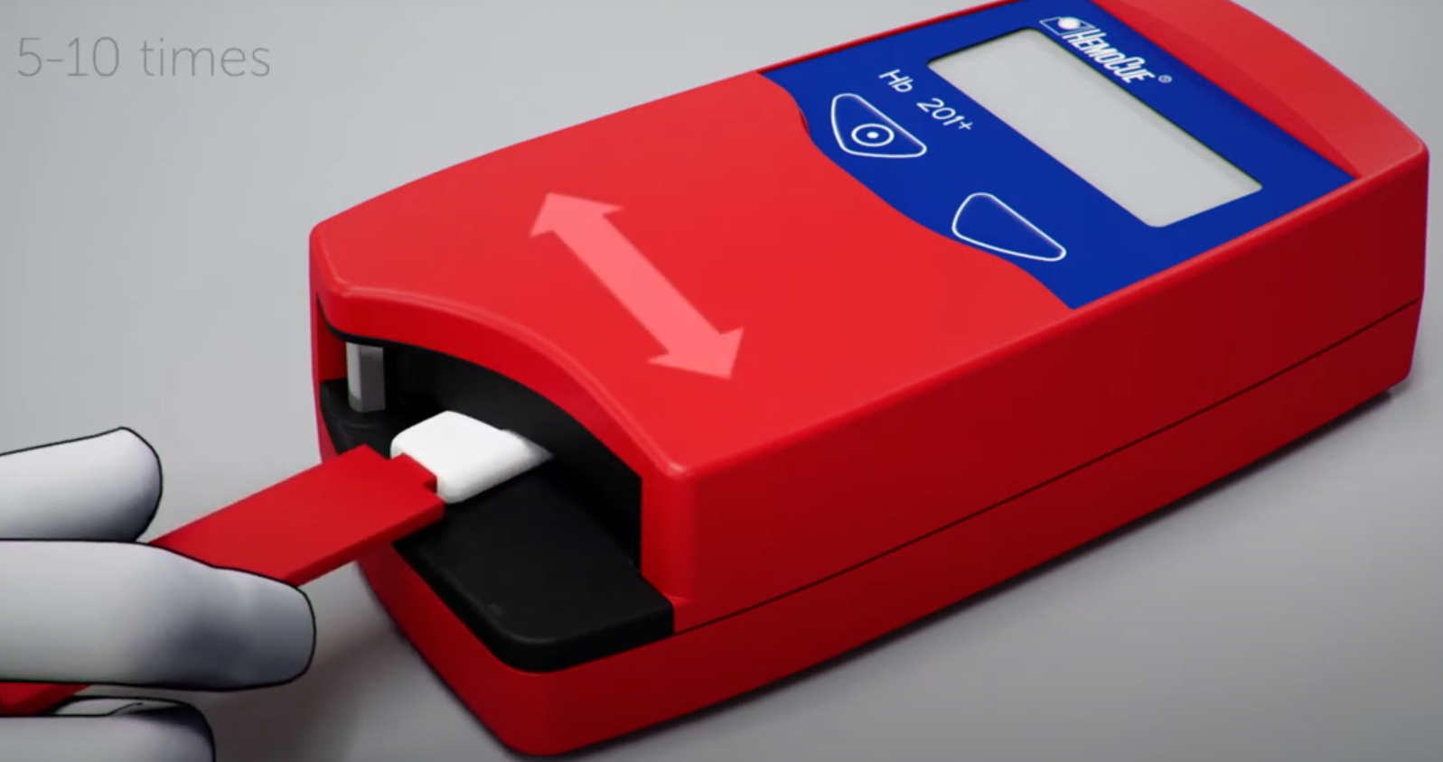
As Needed Maintenance
Cleaning of the optronic unit is done when instructed to do so in the Troubleshooting guide or if getting error codes on the analyzer. Dirty optical parts may cause error codes.
Turn the analyzer OFF.
Pull the cuvette holder out to the loading position.
Carefully press the small catch in the upper right corner of the cuvette holder, and rotate the cuvette holder towards the left as far as possible.
Remove the cuvette holder from the analyzer, it will come off the stainless steel pin it rotates on.
Using HemoCue Cleaner swabs or two cotton tipped swabs dampened with water, push the swab into the opening of the optronic unit as far in as possible.
Move the swab from side to side 5-10 times.
Remove the swab.
If the swab is stained, repeat with a new swab.
No further action is required when the swab remains clean.
Dispose of dirty swabs in biohazard waste container.
Wait 15 minutes before replacing the cuvette holder and using the analyzer. Make sure the cuvette holder is dry before inserting it back into the analyzer.
* Point of Care does not keep any Hemocue Cleaner swabs. They must be ordered through workday.

