Slide 1
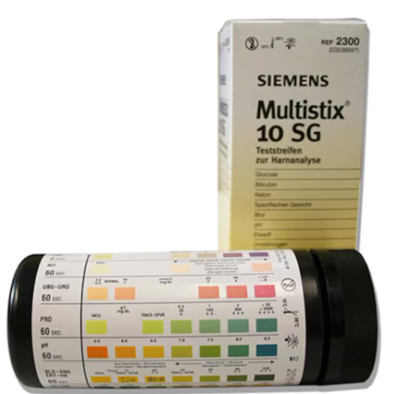
Urinalysis Visual Read Multitix 10SG

Slide 2

Specimen
All body fluids should be handled as if capable of transmitting infectious diseases. Use universal precautions when in contact with such materials. Refer to Laboratory Infection Control Policy.
Patient Preparation: None
Specimen Collection and Labelling:
Random urine collected in a sterile, screw capped urine container.
The urine container must be properly labeled with patient’s full name, date of birth/medical record number, date, and time of collection. (Patient and collection information must be placed on the sample container, not the lid.)
Minimum Requirement: 10 ml of urine.
Storage: Sample is stable 2 hours at room temperature. Refrigerated stability is 24 hours. Refrigerated samples must come to room temperature before testing.
For optimal results, use fresh, well-mixed, un-centrifuged urine.

Slide 3
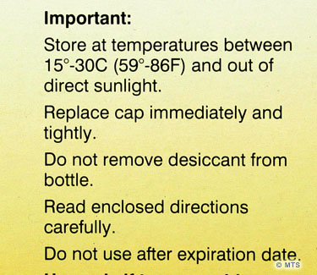
REAGENTS AND SUPPLIES:
Siemens Multistix®10 SG reagent strips
All unused reagent strips must remain in the original bottle. Immediately cap the bottle after use and do not remove desiccant from the bottle.
Store strips at room temperatures between 15-30°C (59-86°F).
Do not use the strips after their expiration date.
Do not store the bottle in direct sunlight. Protect from exposure to light, heat and ambient moisture which may alter reagent reactivity.
Do not touch test areas of reagent strips.

Slide 4
QUALITY CONTROL (QC)
BioRad qUAntify Advance controls (Level 1 and Level 2) are used to ensure the strips are reacting correctly.
Use QC within manufacturer’s expiration.
Write date when opened on bottles.
When stored refrigerated, QC is good until expiration date. When opened for use, reassign a 31 day expiration date and continue to store refrigerated.
QC Frequency:
Test both levels of controls with new lots and new shipments of reagents, and when you first open a new bottle of reagent strips.
Test reagent strips monthly that are stored for more than 30 days.
QC can be run to ensure reagent strip integrity; train new user; confirm test performance; and when patients’ clinical condition or symptoms do not match results.

Slide 5
Control samples are run in the same manner as patient samples.
Acceptable limits:
Compare QC results to the manufacturer’s assay sheet for the current lot in use.
Document QC results on the QC log sheets.
Actions to take if QC results are not acceptable:
− Confirm expected assay values with lot number in use.
− Check open date stability for both QC and reagent containers.
− Ensure that material was handled according to manufacturer’s specifications.
− Rerun the control using a new test strip.
− If necessary, retest with another test strip from another container.
− If QC is still out of range, open and use a new bottle of control material.
− Record any corrective actions on the QC log sheet.
− If QC is still out of expected range, contact Point of Care Specialist for guidance.
DO NOT PERFORM ANY PATIENT TESTING UNTIL QC IS ACCEPTABLE

Slide 6
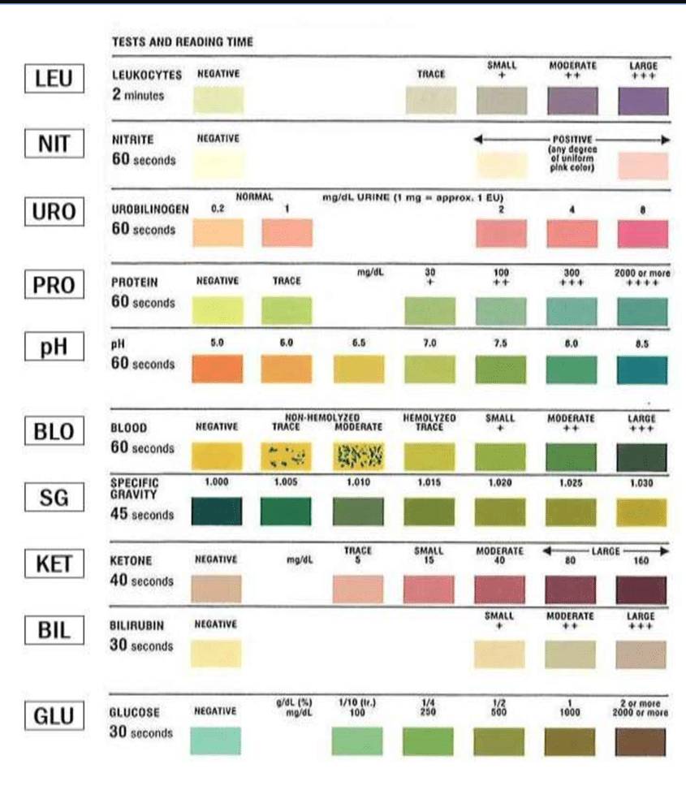
Color/time chart for reading strip

Slide 7
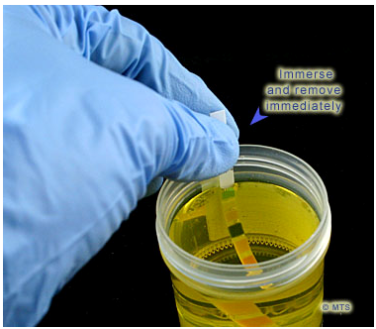

Procedure:
• Patient samples and QC must be at room temperature prior to testing.
(Remove the QC or patient samples from the refrigerator and allow to sit at room temperature (20°-25°C) for approximately 15 minutes prior to testing.)
• Mix the sample or control by inverting the container several times.
• Note the color and clarity of the urine sample.
• Remove a test strip from bottle and replace cap.
For QC: Open the vial cap and apply directly onto the reagent strips ensuring good pad saturation.
For urine samples: Completely immerse reagent areas of the strip in the urine sample, and remove immediately to avoid dissolving out reagents. While removing, run the edge of the strip against the rim of the specimen tube to remove excess urine.
• Remove excess control or sample by tilting the reagent strip on its edge on a paper towel. Do not drag the strip across the paper towel; touch the edge only.
• Read the test strip visually by comparing reagent pads to corresponding color chart on the bottle label at the times specified.
Hold strip close to color blocks and match carefully.
• Avoid laying the strip directly on the color chart, as this will result in the QC or urine soiling the chart.
Proper reading time is critical for optimal results.
• Record results on log sheet.

Slide 8

INTERPRETATION / REPORTING RESULTS:
• All patient results are recorded in the patient record.
CHMG practices – Record results on Cerner Powerform.
Walk In Urgent Care – Manually record results in Cerner Accession Result Entry (ARE).
• Reportable ranges- See Reportable Results chart.
• QC results are recorded on the QC log sheets and reviewed for acceptable performance.
• Document any issues, repeats, and troubleshooting on action log.
• The color of the urine specimen can interfere with the visual interpretation of test results on the test strip causing a false positive interpretation. See “Interfering Substances and Limitations of Procedure”.

Slide 9
REFERENCE RANGES:
• Glucose ------------------ Negative
• Bilirubin ----------------- Negative
• Ketone ------------------- Negative
• Specific Gravity ---------------------- 1.003 -1.030
• Blood --------------------- Negative
• pH ------------------------- 5.0 - 8.5
• Protein ------------------- Negative
• Urobilinogen ----------------------- 0.2 EU
• Nitrite --------------------- Negative
• Leukocyte Esterase ---------------Negative

Slide 10

CONFIRMATORY TESTING OF UNUSUAL OR UNEXPECTED RESULTS:
• When encountering unusual results or when there is uncertainty about a conclusion, collect a new patient sample and repeat the test.
• Using a new test strip, re-dip to confirm any results that exceed the upper limit.
(See Confirmation Values for repeat parameters)
• At the discretion of the ordering provider, the patient sample can be sent to Concord Hospital Laboratory for analysis or other follow up tests may be ordered.
• CONFIRMATION VALUES:
Upper limits of test results for repeat verification are as follows:
• Glucose…….>= 1000
• Bilirubin……Large
• Ketone………>=80
• Protein……...>=300
• Blood……….Large
• Nitrite………Positive
• Leukocytes…Large

Slide 11
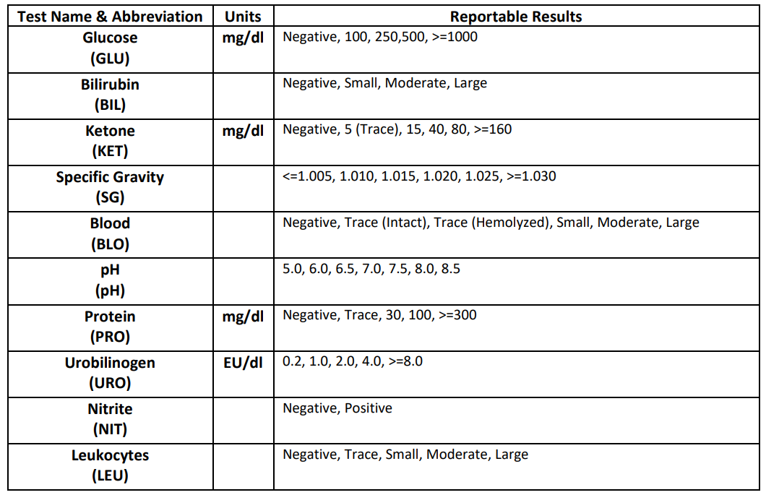

Reportable Results:

Slide 12
INTERFERING SUBSTANCES AND LIMITATIONS OF PROCEDURE:
Ensure complete saturation of all test pads with specimen.
The side edge of the test strip needs to be blotted so that chemical contamination between the test pads does not occur.
The color of the urine specimen can interfere with the interpretation of test results on the test strip causing a false positive interpretation. Red (bloody), Blue, Green, Orange (pyridium), and brown colored urine may cause interference in interpretation. When the color of a urine specimen is anything other than shades of yellow, it can cause the results to look positive when in fact they are not.
Grossly turbid and mucoid specimens may also interfere with reading strips due to pad saturation.
In these situations inform the provider the results of the urine dip tests are suspect and further follow-up testing can be done at the Concord Hospital Laboratory.
See Appendix A and B at the end of the Point of Care - Visual Reading of MultiStix 10SG Urine Dipsticks - Concord Policy in PolicyTech for more information on interfering substances and limitations.

Slide 13
Trouble Shooting: If you suspect the strips have been compromised, open and QC a new bottle of strips and discard the bottle in question. POC does not keep supply. If you have other questions or concerns, POC specialists can be reached via email pointofcare@crhc.org for the office.

