Slide 1
Hemoccult Sensa
Fecal Occult Blood Testing

Slide 2
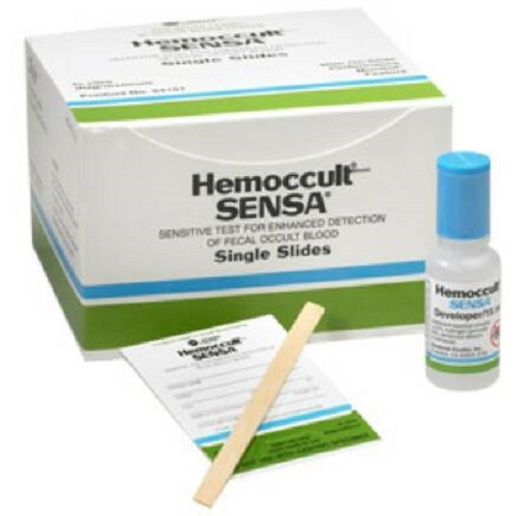
Supplies Needed:
Hemoccult Cards
Hemoccult Developer
Applicator Sticks

Slide 3
***Special Notes***
Check the expiration date on the SENSA kit box. Do not use expired kits.
The test cards and developer bottles have expiration dates also, but the SENSA box will have the expiration date of the component that expires first.
Throw away all components of the kit when the kit expires.
All tests performed must be ordered and resulted in patient EMR.

Slide 4
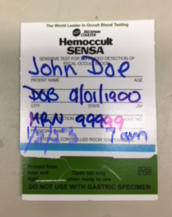
Label each card with:
Patient full name
DOB or MRN
Date and time of collection.

Slide 5
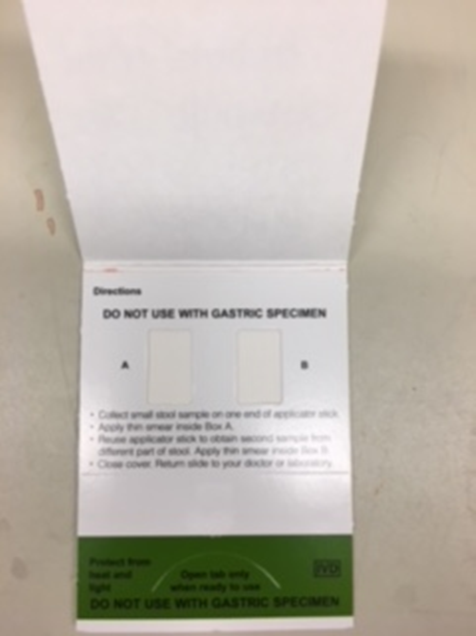
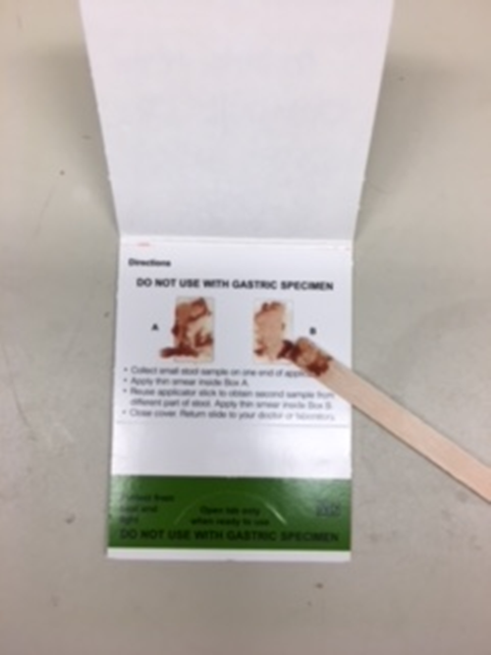
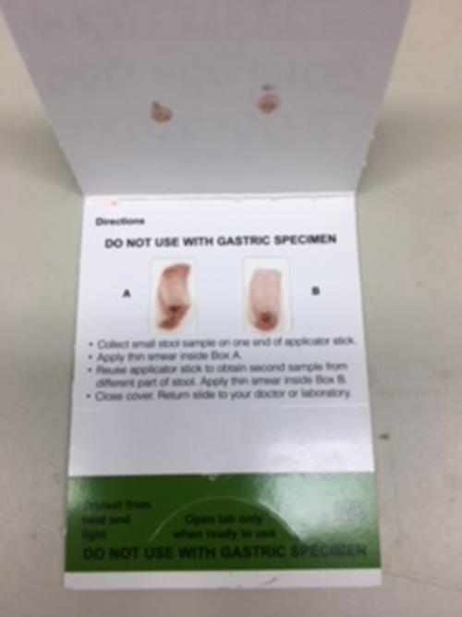
To apply fecal sample to test card:
Open front cover where patient information is written.
Apply stool specimen to A & B areas.
Close card cover.
Wait 3-5 minutes before testing

Slide 6
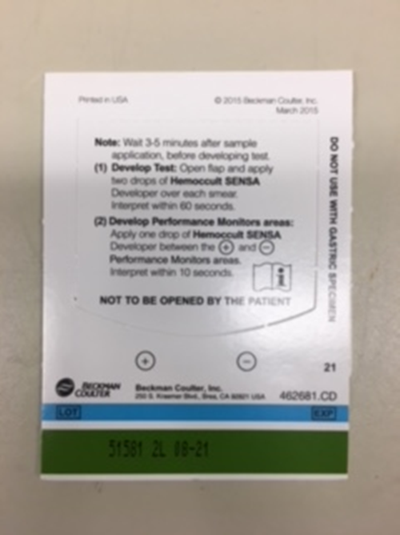
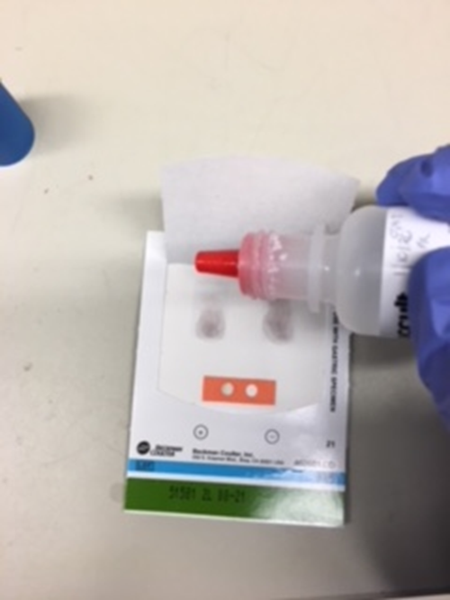
To perform occult blood test:
To test, open the flap in back of the test card (the side with instructions).
Apply 2 drops of Hemoccult® SENSA® developer to the guaiac paper directly over each fecal smear. Interpret results within 60 seconds.
Add 1 drop of developer to the center of internal QC area (between the positive and negative circles). Interpret within 10 seconds.
2 drops per application area
1 drop for QC area

Slide 7
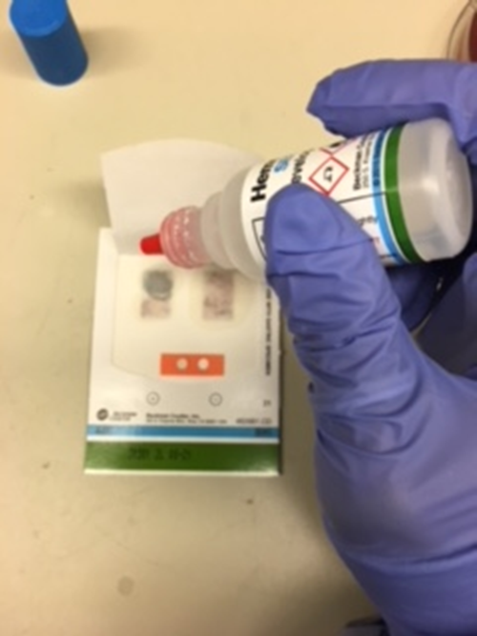
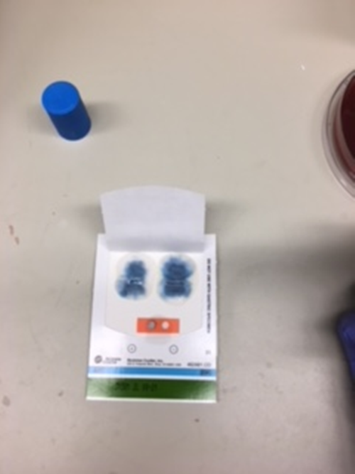
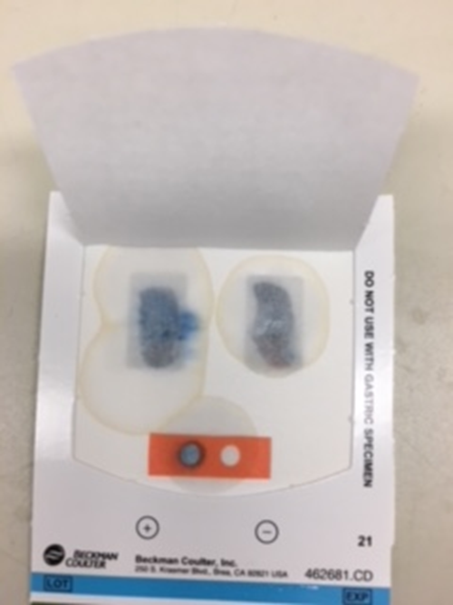
Interpreting results:
After adding reagent look for a blue color which indicates a POSITIVE result.
The test is positive even if there is blue on only one side of the card.
One side has blue = Positive result
Both sides have blue = Positive result

Slide 8
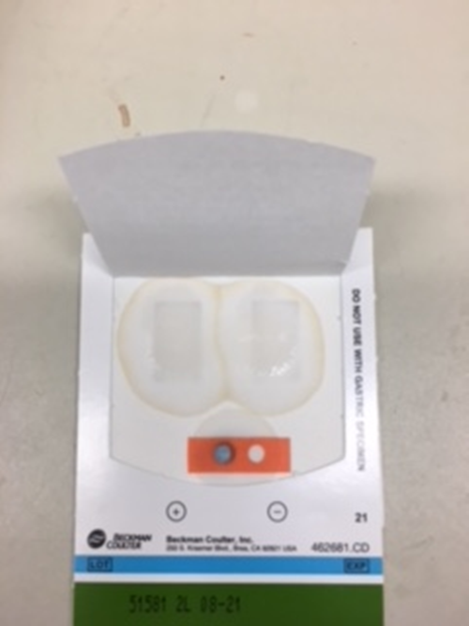
Interpreting results:
No blue color indicates a NEGATIVE patient result.
Positive QC area must be positive (blue) and the negative QC area must be negative (not blue) in order for patient results to be valid.
Positive QC must be positive (blue) and Negative QC must be negative (not blue).

Slide 9
Supplies for Fecal Occult Blood
Supplies must be ordered via Logi-D
Or contact Materials Management
POCT/Main Lab doesn’t keep supply

