Slide 1
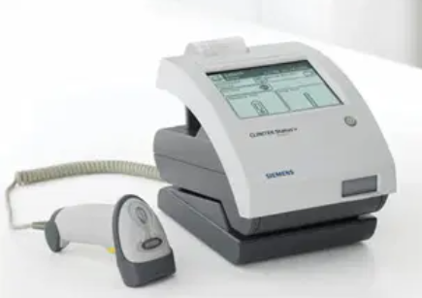
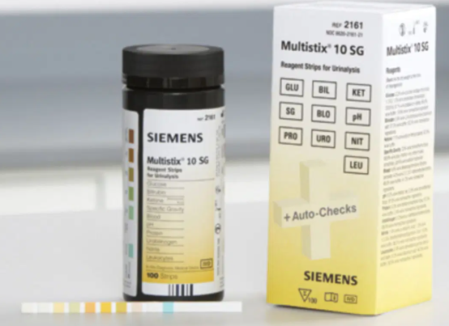
Clinitek Status and Clinitek Status Plus (+) Analyzers
Urine Dipstick Analyzers

Slide 2
Clinitek Status and Clinitek Status Plus (+) Analyzers
The Clinitek Status and Clinitek Status Plus (+) (manufacturer name change for newer model) analyzers are used for the semi-quantitative detection of glucose, bilirubin, ketone (acetoacetic acid), specific gravity, blood, pH, protein, urobilinogen, nitrite and leukocytes in urine samples.
Test results may provide information regarding the status of carbohydrate metabolism, kidney and liver function, acid-base balance, and urinary tract infection.
The analyzer utilizes a touch screen for data entry, as well as, the barcode scanner option.
Once the test strips are loaded, the analyzer automatically times and reads the results.
The analyzer also has an integrated printer for printing test results.

Slide 3
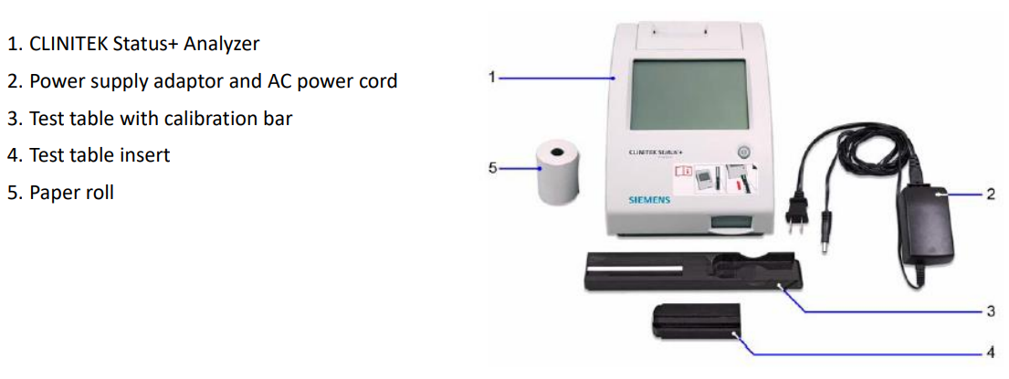
Clinitek Status and Status Plus (+) Systems Components

Slide 4
Siemens Multistix 10SG Reagent Strips
Siemens Multistix® 10 SG reagent strips are used with the Clinitek Status analyzers.
Strip storage and handling:
Store strips at room temperatures between 15-30°C (59-86°F).
All unused reagent strips must remain in the original bottle.
Immediately cap the bottle after use and do not remove the desiccant from the bottle.
Do not store the bottle in direct sunlight.
Protect from exposure to light, heat and ambient moisture which may alter reagent reactivity.
Do not touch test areas of reagent strips.
Strip expiration:
Strips are good until the expiration date printed on the strip canister.
Do not use the strips after their expiration date.

Slide 5

Principle and Internal Checks
The analyzer will run an automatic system diagnostic test and calibration each time it is turned on.
The Multistix 10 SG reagent strips used with this analyzer are read through an optical system. The optical system consists of six light emitting diodes, a light guide, a mirror, a lens, and a detector. Light from the LEDs travels along the light guide and is reflected off the calibration bar or test strip onto the mirror. It is then directed through an aperature on the lens, from where it is focused onto the detector. The light intensity detected is then converted into electrical impulses, which are processed by the instrument’s microprocessor and converted into clinically meaningful results.
Each time a test strip is read, the instrument positions the table correctly and checks the electronics and signals. It then takes reference readings off the white calibration bar located on the end of the test table. The readings are taken at all six wavelengths and are then used to calculate the sample readings.

Slide 6
Specimen collection, labeling and storage
Specimen collection:
Collect random urine sample in a sterile, screw capped urine container.
Minimum Requirement: 10 ml of urine.
The urine container must be properly labeled with
Patient’s full name
Date of birth or medical record number
Date of collection
Time of collection
(Patient and collection information must be placed on the sample container, not the lid.)
Storage:
Sample is stable 2 hours at room temperature.
Sample is stable 24 hours refrigerated.
Refrigerated samples must come to room temperature before testing.

Slide 7

Quality Controls
BioRad qUAntify Advance controls (Level 1 and Level 2) are used to ensure the strips are reacting correctly and to verify the instrument is functioning properly.
QC Stability:
Unopened controls are good until manufacturer’s expiration date when stored refrigerated.
Opened controls expire 31days after the bottle is opened. Write the open expiration date on the control bottles. Continue to store the controls refrigerated when not in use.
QC Frequency:
Test both levels of controls with:
Each new lot of reagents
Each new shipment of reagents
When you open a new bottle of reagent strips.
Monthly for reagent strips that are in use for more than 30 days.
QC can also be run to ensure reagent strip integrity; train new users; confirm test performance; and when patients’ clinical condition or symptoms do not match results.

Slide 8
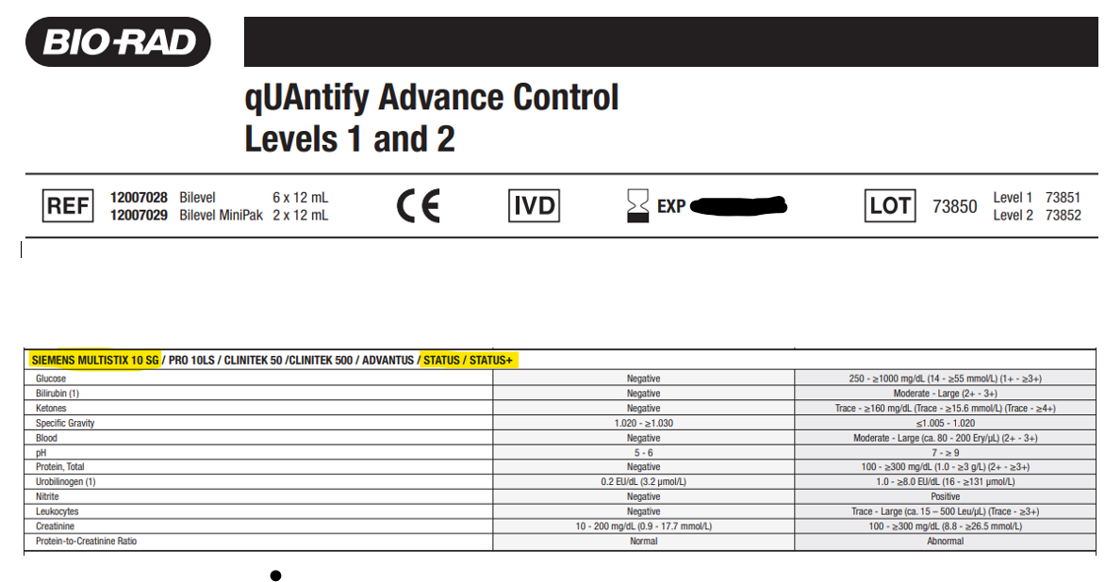
Acceptable Limits for QC
Acceptable limits: Compare your QC results to the manufacturer’s assay sheet for the current lot in use.
Make sure that you are looking at the ranges for the Siemens Multistix 10SG with the Clinitek Status analyzers.
Document QC results on the QC log sheets.

Slide 9
What to do if QC is out of acceptable ranges
Actions to take if QC results are not acceptable:
Confirm expected assay values with lot number in use. Make sure that you are looking at the ranges for the Clinitek Status analyzers.
Check open date stability for both QC and strip containers.
Ensure that material was handled according to manufacturer’s specifications.
Rerun the control using a new test strip. If necessary, retest with another test strip from another container.
If QC is still out of range, open and use a new bottle of control material.
If results are still not acceptable, perform QC by Visual Method (see POC-Visual Reading of Multistix 10SG Urine Dipsticks-Concord policy for details).
If the results are within range, perform patient testing by Visual Method ONLY. (Contact Point of Care Specialist for guidance on Clinitek Status QC.) Record corrective action on the QC log sheet.
If results of Visual Method are unacceptable, contact Point of Care Specialist for guidance. DO NOT PERFORM ANY PATIENT TESTING UNTIL QC IS ACCEPTABLE.

Slide 10
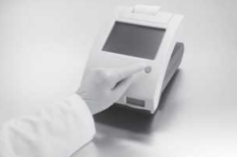
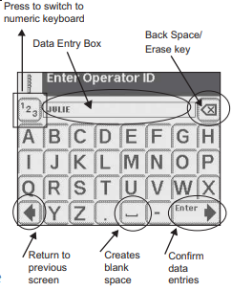
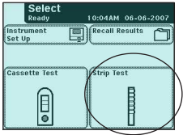
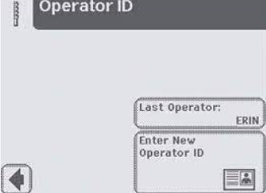
Testing Samples and Controls
Patient samples and QC must be at room temperature prior to testing.
Remove the QC or patient samples from the refrigerator and allow to sit at room temperature for approximately 15 minutes prior to testing.
DO NOT USE CENTRIFUGED URINE FOR DIPSTICK TESTING.
Press the ON/OFF button located on the front of the instrument.
On the SELECT screen, select STRIP TEST.
On the OPERATOR ID screen, select ENTER NEW OPERATOR ID.
Enter your operator ID number and then select ENTER.

Slide 11
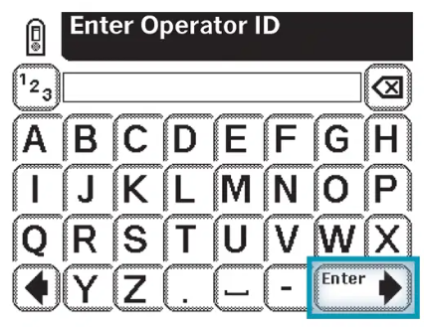
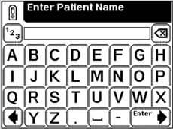
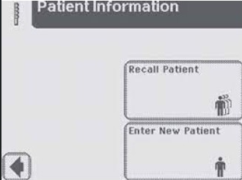
Testing Samples and Controls
On the PATIENT INFORMATION screen, select ENTER NEW PATIENT.
On the ENTER PATIENT ID screen:
For patient samples, enter sample ID number or patient’s MRN.
If running controls, enter the lot number on the QC bottle.
If ENTER PATIENT NAME screen is displayed, enter the patient’s last name. (If running controls, you can enter QC1 or QC2).
Press ENTER on each screen to save the data entered.

Slide 12
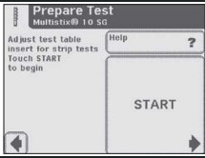
Testing Samples and Controls
Mix the sample or control by inverting the container several times.
Note the COLOR and CLARITY of the urine sample. See Interfering substances and limitations.
Do not run bloody, turbid, or mucusy specimens.
At the PREPARE TEST screen, select START

Slide 13
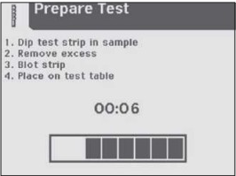
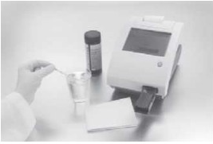
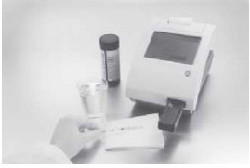
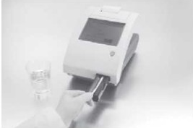
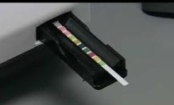
Testing Samples and Controls
The analyzer will show an 8 second countdown. You have 8 seconds to complete the following steps:
Dip the reagent strip into urine sample, wetting all pads and immediately remove strip from urine. (QC material can be applied to strip directly from the bottle, making sure to wet all pads.)
Drag the edge of the strip against the side of the sample container as you remove it.
Blot strip by touching the edge to a paper towel to remove the excess urine. (Do not lay pads on the paper towel or cover the pads by the paper towel.)
Place the strip in the channel on the test table with the pads facing up. Slide the strip all the way to the end of the channel. (Do not touch the pads on the strip.)

Slide 14
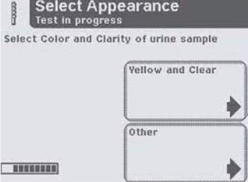
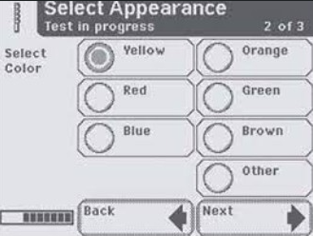
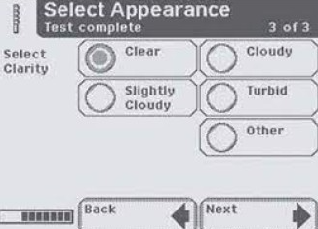
Testing Samples and Controls
At the end of the 8 seconds countdown, the test table and strip will be automatically pulled into the analyzer.
The SELECT APPEARANCE screen will be displayed.
Choose either “Yellow and Clear” or “Other”. See Interfering substances and limitations.
If Other is selected, another screen will display. Select appropriate color of urine, then select NEXT.
Select appropriate clarity of urine, then select NEXT.

Slide 15
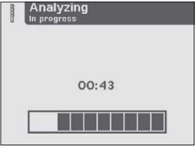
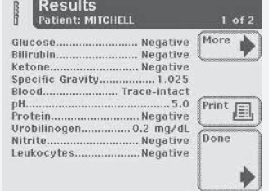
Testing Samples and Controls
A timer will count down the time remaining for analyzing the strip results. Total testing time is 60 seconds.
When analysis is complete, the test results will display on screen.
Select MORE to view the remainder of the test information.
Select DONE to return to the SELECT screen in order to perform another test.
Remove the used strip and discard.
Clean the table by wiping it with a piece of gauze moistened with water before placing another test strip on the table.
Make sure the test table is completely dry before performing another test.

Slide 16
Interpretation/Reporting Results
An * will appear next to all results marked as positive.
QC results are recorded on the QC log sheets and reviewed for acceptable performance.
All patient results are recorded in the patient record.
CHMG practices – Record results on Cerner Powerform.
Walk In Urgent Care – Results cross into Cerner via an interface or results can be entered via Accession Result Entry (ARE).
For any Clinitek Status or Clinitek Status + that is not interfaced, the results should be printed. Printouts need to be saved for 2 years.

Slide 17
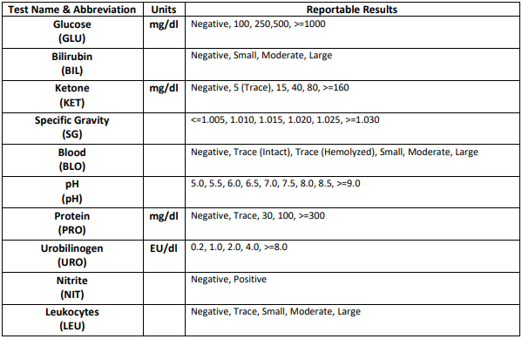
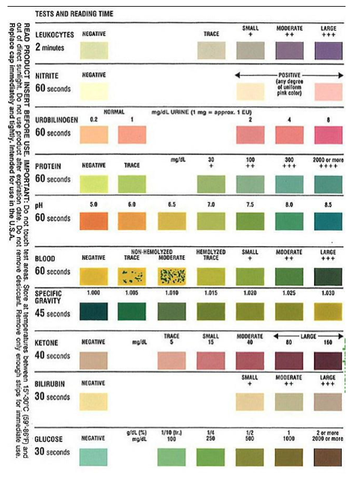
Multistix 10SG Visual Read Chart
(located on the side of Multistix bottle)
Clinitek Status/Staus + Reportable Results

Slide 18
Confirmatory Testing of Unusual or Unexpected Results
When encountering unusual results or when there is uncertainty about a conclusion, collect a new patient sample and repeat the test.
Using a new test strip, re-dip to confirm any results that exceed the upper limit. (see Confirmation Values below)
At the discretion of the ordering provider, the patient sample can be sent to Concord Hospital Laboratory for analysis or other follow up tests may be ordered.
Document any issues, repeats, and troubleshooting on action log.
CONFIRMATION VALUES: Upper limits of test results for verification are as follows:
Glucose…….>= 1000
Bilirubin……Large
Ketone………>=80
Protein……...>=300
Blood……….Large
Nitrite………Positive
Leukocytes…Large

Slide 19
Interfering Substances and Limitations of Procedure
Ensure complete saturation of all test pads with specimen.
The side edge of the test strip needs to be blotted so that chemical contamination between the test pads does not occur.
The color of the urine specimen can interfere with the interpretation of test results on the test strip causing a false positive interpretation.
Dipstick results are based on a color change proportional to the concentration of the analyte. If the sample is highly pigmented, it will cause an interference.
Red (bloody), Blue, Green, Orange (pyridium), and brown colored urine may cause interference in interpretation.
When the color of a urine specimen is anything other than shades of yellow, it can cause the results to look positive when in fact they are not.
Grossly turbid, bloody and mucoid specimens may also interfere with reading strips due to pad saturation.
In these situations inform the provider the results of the urine dip tests are suspect and further follow-up testing can be done at the Concord Hospital Laboratory.

Slide 20
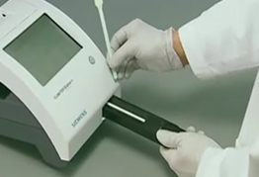
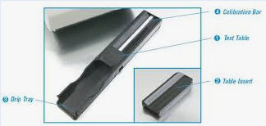
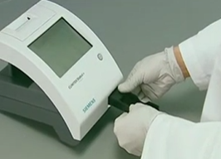
Cleaning and Maintenance - Weekly
Cleaning of Test Table and Test Table Insert
Remove test table by pulling it straight out of the analyzer slowly.
Lift the table insert to remove it from the test table.
Drain the drip tray, if necessary.
Clean test table insert and test table with cotton tipped swab or gauze moistened with water. If necessary, rinse both sides of the table insert and test table under running water. (DO NOT clean the white calibration bar. Care should be taken not to scratch or scuff the white bar.)
Allow to air dry or dry thoroughly with a lint free cloth (gauze), avoiding the white calibration bar. Do not use paper towel.
Examine the white calibration bar on the test table for dirt or discoloration.
Do not touch the calibration bar while examining it. Your fingerprints or lint on the bar could cause unreliable test results.
If the white calibration bar appears dirty or discolored, clean the white calibration bar as described on next page.
If the white calibration bar appears clean and unmarked, proceed with steps below.
Insert the table insert into the test table.
Reinsert the test table into the analyzer by holding the table at the end opposite the white calibration bar (with the white bar facing upward), and push the test table firmly but slowly and gently into the analyzer until it in just over halfway in.
Power down to reset the table.

Slide 21
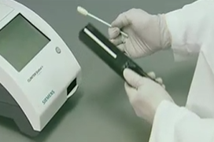
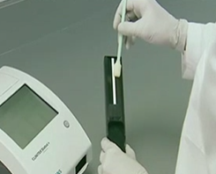
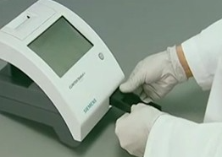
Cleaning and Maintenance - As Needed Maintenance
Cleaning the White Calibration Bar
If the white calibration bar appears dirty or discolored, perform the following steps:
Wet a new cotton-tipped stick or lint-free cloth with distilled water and gently wipe and clean the calibration bar.
Do not scratch the white calibration bar. Marks and stains could cause inaccurate test results.
Do not use solvents of any kind to clean the calibration bar. They could destroy the bar.
Allow the calibration bar to air dry.
Inspect the surface for dust, foreign materials, scratches or scuffs.
If you cannot completely clean the calibration bar or if the bar has scratches, contact Point of Care to order a new test table.
If the calibration bar looks clean with no scratches, reinsert the test table by holding the table at the end opposite the white calibration bar (with the white bar facing upward), and push the test table firmly but slowly into the analyzer until it in just over halfway in.

Slide 22
Cleaning and Maintenance - As Needed Maintenance
Cleaning the Outside of the Analyzer
Always keep the outside of the Clinitek Status analyzer clean and free of dust.
To clean the outside of the analzyer:
Press the Power button for at least 2 seconds to turn off the analyzer.
Wipe the outside (including the display) with a damp (not wet) cloth and a mild detergent.
Dry with a clean cloth.
Do not use any type of solvent, oil,grease, silicone spray or lubrication on the analyzer.
Do not spray glass cleaner directly onto screen.
Do not use laboratory wipes, such as Kimwipes, because they might scratch the screen.
Prevent liquid from entering the printer compartment which could damage the analyzer or the printer.

Slide 23
Powering Down the Analyzer
Before turning the analyzer off, ensure that there are no test strip on the test table and that the test table is clean.
Press and hold the on/off button for at least 2 seconds.
The test table will retract into the analyzer, the door will close, and the analyzer will switch off.

