Slide 1
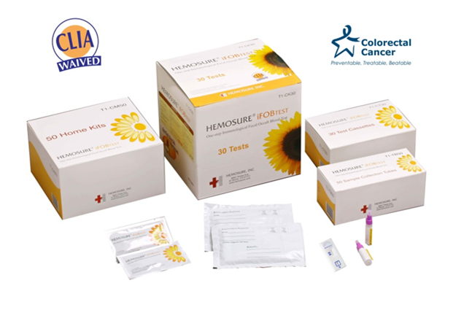

Training Module
Immunochemical Fecal Occult Blood Testing

Slide 2



Training Overview
In this training module we will be covering the following topics:
    What is Hemosure iFOBT
    Patient Instructions
    Materials Included
    Test Procedure for Hemosure iFOBT
    Reading the Results
    Storage
    Quality Control
    Summary and Comparison
    FAQ’s

Slide 3
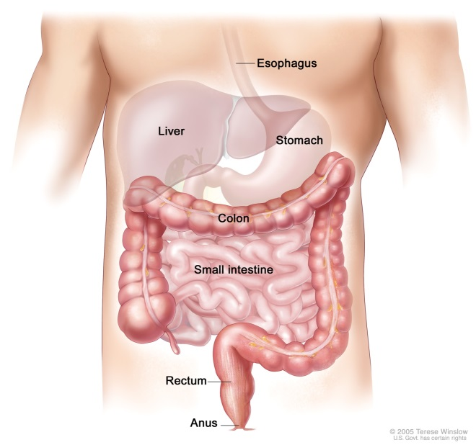
What is Hemosure’s iFOBT?
Hemosure® Immunochemical Fecal Occult Blood Test (FIT) is a rapid, convenient and odorless qualitative, sandwich dye conjugate immunoassay for the determination of human hemoglobin in feces, and is a useful aid in the diagnosis of gastrointestinal (GI) bleeding in a number of GI disorders, e.g. diverticulitis, colitis, polyps, and colorectal cancer.

Slide 4
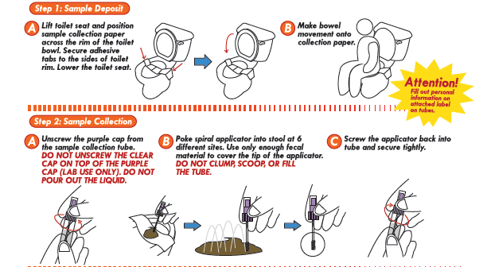
Patient Instructions

Slide 5
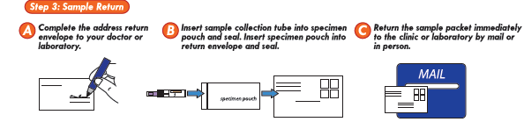
Patient Instructions continued
Your patients instructions include the above directions on how to return their samples to your facility. Patients also have the option to bring their samples directly to your facility.

Slide 6


Materials
Hemosure® Immunological Fecal Occult Blood Test contains:
One test Cassette individually sealed in a foil pouch.
One Fecal Collection Tube containing 2.0 mL of extraction buffer.

Slide 7
Hemosure Test Procedure
If refrigerated, allow to come to room temperature.
Unscrew cap of the Fecal Collection Tube and remove Applicator Stick.
Randomly insert the Applicator Stick into the fecal sample from three (3) to six (6) times.
Do not clump, scoop, or fill the tube.
Return the Applicator Stick into the Fecal Collection Tube and tighten the cap thoroughly. Shake the tube to mix the sample with the Extraction Buffer.

Slide 8
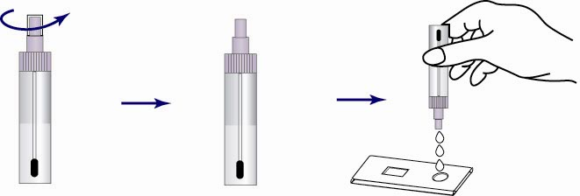
Hemosure Test Procedure
Remove the Test Cassette from its foil wrapper by tearing along the slice.
Shake the Fecal Collection Tube to ensure that the fecal sample is well mixed.
Twist off the tip of the cap on the Fecal Collection Tube.
Add three (3) drops of the Extraction Buffer mixture to the Sample Well.
Shake the sample collection tube well
Twist Off Tip
Fecal Sample suspended
in Extraction Buffer
Test Cassette with Sample Well

Slide 9
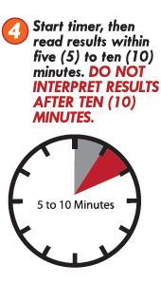
Hemosure Test Procedure
  Start timer.
  Read results within five (5) to ten (10) minutes.
  Do not read after ten (10) minutes.

Slide 10



Reading the test results
Positive
One band appearing in the (C) region, the other in the (T) region.
Negative
Only one band appearing in the (C) region.
Invalid
No bands appearing in the window at all. The Test result is invalid. The test should be repeated. Also if there is a band in the (T) region and not the (C) region, it would still be considered invalid.
Note: Color blind users may see the Control and Test lines as gray rather than pink-rose lines.

Slide 11

Storage for Hemosure iFOBT
Store Hemosure test device at 39.2°F-86°F (4°C -30°C).
The test device is stable until the date printed on the pouch label.
If Fecal Collection Tube is not used immediately after sampling, it may be safely stored up to fourteen (14) days at ambient room temperature as high as 98.6ºF (37 ºC), up to six (6) months in refrigerator at 39.2°F (4°C) or for twelve (12) months in freezer at -4°F (-20°C).
External Controls need to be in refrigerator at 39.2°F (4°C)

Slide 12
Hemosure Quality Control
Internal Quality Control
Hemosure iFOB test contains a built-in Control--C Line. This line appears next to the C on the Test Window. The presence of C line indicates that an adequate sample volume was used and that the Test Cassette worked properly. If no C Line appears the test is invalid and must be repeated.
External Quality Control
The appropriate local, state and federal guidelines regarding external quality controls should be followed.
NOTE: External Controls need to be in refrigerator at 39.2°F (4°C)

Slide 14
FAQ’s
Can a stool sample be tested when there is visible blood?
No, this test should be used to detect occult “hidden” blood
How many samples are required to be collected for this test?
Hemosure is specific to Human Hemoglobin so only 1 test is required.
How should the product be disposed?
The device itself may be disposed as solid waste.
The device tested with a patient sample should be handled as potentially bio-hazardous materials in accordance with state, federal and local regulations.

