Slide 1
Primary Gram Stain

Slide 2
Reason behind Gram Stain
Used as a pre-analytical indicator of specimen quality and acceptability for culture
Give clinician preliminary information:
  Informs them of potential pathogens present in patient sample
  Offers a guide for empirical therapy

Slide 3
Factors that can cause errors in primary GS reporting
A highly complex procedure
Manual nature of staining process
Subjectivity of GS interpretation
Inherent nature of certain organisms
Prior antibiotic therapy
Presence of stain precipitate or artifacts

Slide 4
Factors that can impact the quality of primary GS
Sampling of specimen for stain preparation
Specimen processing (direct vs. cytospin)
Fixation method (heat vs. methanol)

Slide 5
What is a “Discrepant” Gram Stain
Positive GS with negative culture result:
  Fastidious or nonviable organism
  Inappropriate test order (Aerobic culture vs. Anaerobic culture)
  Inappropriate specimen collection, transportation, or culture processing
  Failure of test media to enable growth of organism
Negative GS with Positive culture growth:
  Inadequate specimen/smear preparation
  Failure to examine adequate number of fields
  Failure to mark on slide where specimen was smeared
  Low volume of organism present in patient sample

Slide 6
Steps that can be taken to reduce errors
Specimen sampling for slide:
  Vortex/mix specimen to get a homogenous sampling
  Try to choose area of specimen that is more suspicious for infection (i.e. purulent, bloody, areas of necrosis in tissue)
    Tissue/bone should be minced/stomached

Slide 7
Steps that can be taken to reduce errors
Demarcation of slide for smear:
  Swabs:
    Make a smaller etched circle on the slide
      Smaller area to review – increases fields examined
    Add drop just over the etched slide and allow to spread naturally
      Helps concentrate the specimen
      Only spread out if a lot of cellular material is observed causing the slide to be too thick

Slide 8
Steps that can be taken to reduce errors
Thickness of slide:
  Slide should not be so thick that a printed label cannot be visible through the slide
  Cytospin vs. direct smear of fluids:
    Sterile body fluids (SBF) that are clear/non-viscous and BAL specimens should ALWAYS be cystospin (helps concentrate specimen and low number microorganisms)
      Exceptions:
        High Cellular Material
        Extremely bloody specimen
        Highly viscous specimen

Slide 9
Steps that can be taken to reduce errors
Allow slide to dry
  Air dry in BSC
  Dry on slide warmer
    Do not use excessive heat or extended period on slide warmer since this can affect cell morphology

Slide 10
Tips for Staining slides
Methanol fix slides:
  Allow Methanol to fully dry before adding Crystal Violet stain
    Reduces the presence of precipitated stain
  Reduces the distortion of cellular morphology
  Reduces the lysis of RBCs if present
  Reduces background debris
    Increases likelihood for detection of microorganisms on smear

Slide 11
Tips for Staining slides
Don’t wash between Crystal Violet (CV) and Iodine Steps
  Tip the slide instead and allow CV to flow off slide, excessive washing at this step can wash the CV out of the cells
    Iodine is a mordant and will bind with CV
  Allow same time for CV and Iodine on slide

Slide 12
Tips for Staining Slides
Rinse slide after Iodine step
  Make sure you shake the slide to get excessive water off
    Water will help accelerate the alcohol decolorization process
Use the decolorizer on backside of slide and rinse with water
  This helps to clear off any excessive stain that got on the back of slide during the first steps and makes reading the slide easier

Slide 13
Tips for Staining Slides
Hold the slide at an angle and gently apply decolorizer to the slide evenly until it runs clear
  Too thick of a slide will be hard to decolorize and cause you to potentially over-decolorize slide
Rinse of decolorize with water and shake off excess water
Apply safranin to the slide
Remove excess stain with a gentle flow of water
Blot dry the slide
  Make sure to use clean filter paper so that you do not transfer cells/bacteria from another slide

Slide 14
Review of slide – 10X objective
  Is the slide properly stained
    Background pink, PMNs pink with slight purple in lobes
      If background/PMN too purple re-make slide
    Epis if present should have pink cytoplasma and a purple nucleus
      If epis are too pink slide may be over-decolorized
      If epis are mostly purple slide maybe under-decolorized
  Is the slide too thick
    If it is difficult to see through the background, remake the slide

Slide 15
Review of slide – 10X objective
  Quantify PMN/Monos, and Epithelial cells
    Presence of PMN a good indication of bacterial infection
    Monocytes
      Report in Sterile Body Fluids if seen
      Indication of viral infection
    Presence of Epithelial Cells
      Indication of poor quality specimen collection - Squamous
        The exception is the presence of “Ciliated” (columnar) epis

Slide 16
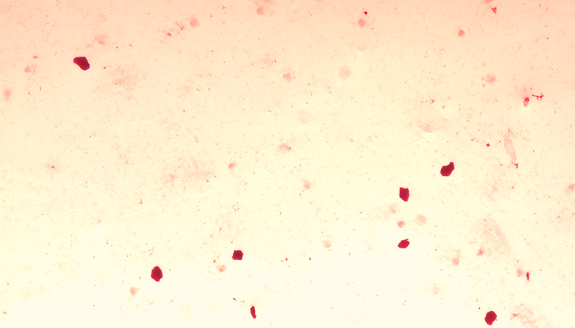
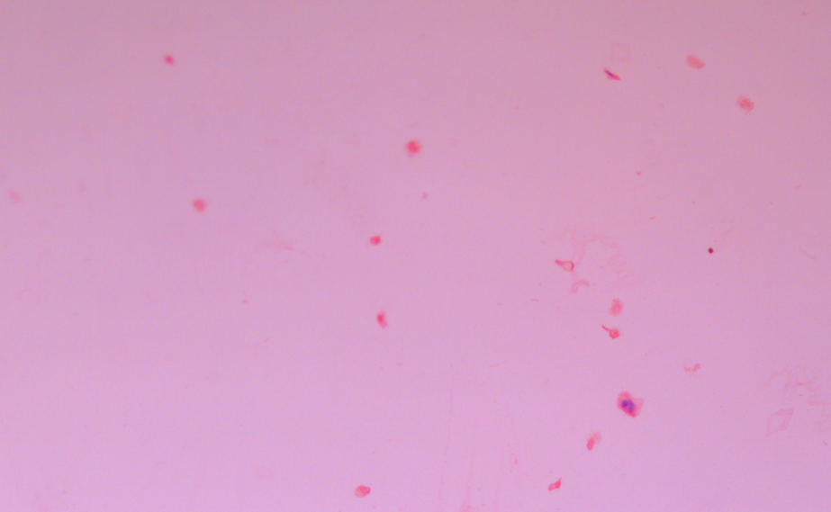
Squamous Epithelial Cells 10X

Slide 17
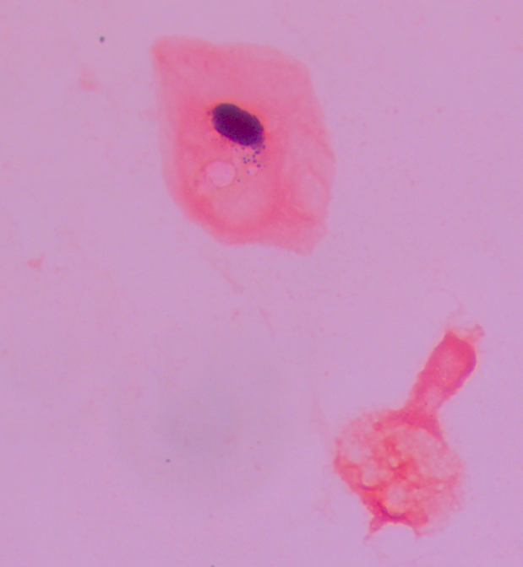
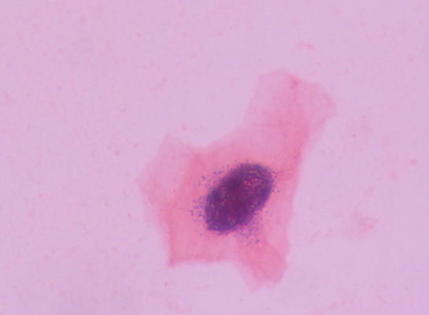
Squamous Epithelial Cells –Under Oil

Slide 18
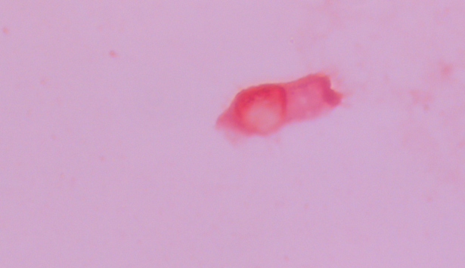
Ciliated Epi – Under Oil

Slide 19
Review of slide
  10X objective:
    Is there cellular material present:
      Lack of cellular material indicates poor sampling of specimen or specimen washed off during staining process
      Look for certain cellular material to focus oil objective on:
        Mucus
        Elastin/collagen fibers/fibroblasts:
          Connective material in tissues, breakdown of material could indicate necrosis/infection
        Respiratory specimens showing Curschman’s spiral:
          Mucus plug in bronchi, common in asthmatic patients
        Charcot–Leyden crystals:
          Crystals found in people who have allergic diseases such as asthma parasitic infections
        Red Blood Cells
        Leukocytes (PMN, MONO)
        Pockets of potential microorganisms (cluster of purple, yeast cells, cluster of branching GPR)

Slide 20
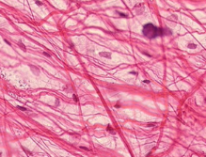
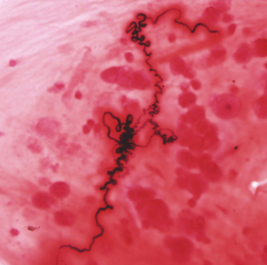
Images of Elastin/Collagen Fibers and Curschman’s spirals
Elastin Fiber
Fibroblast
Collagen Fiber

Slide 21
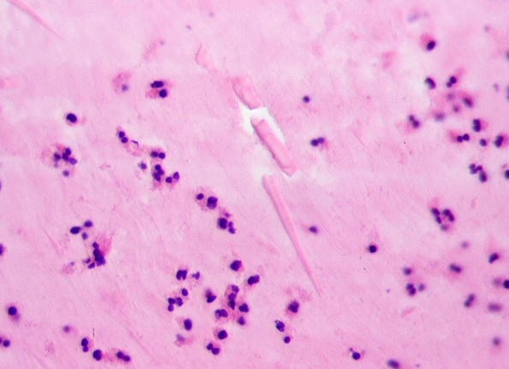
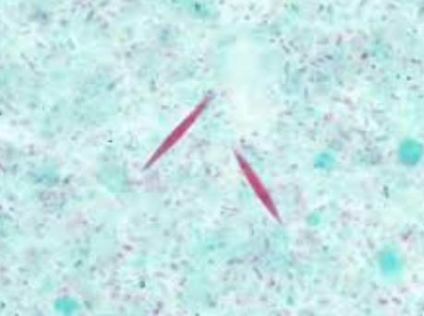
Charcot-Leyden Crystals
In Sputum Gram Stain
In Trichrome

Slide 22
Review of slide – Sputum specimen
Check your PMN/EPI ratio for inpatient specimens
  Reject specimens if the PMN:Epi ratio exceeds 1:2 and oral contamination is evident
    Delete SA RESP if ordered
    Do not delete other testing if ordered (any Viral NAAT, C AFB, C FUN)
  Exceptions to this rule:
    Patient is immunocompromised (difficulty in producing PMN)
    If > 25 PMN/field is seen under 10X
    Ciliated Epithelial cells are observed

Slide 23
Review of slide – Sputum specimen
Find an area on 10X that has a lot of PMN and no epis present
  If PMNs cannot be found, find an area with no to light Epis present
Report microorganisms that are around PMN area.
  Remember to add the “Associated with PMN” comment if the microorganisms are inside the cell
    Sometimes it is hard to tell if inside PMN vs. on top of PMN. If the microorganism is inside the PMN the internal structures (lobes) or cellular material will be pushed over
  Indicating the presence of bacteria around/in PMN is important for the culture work up of certain microorganisms as well as indicating potential pathogens to the clinician

Slide 24
Review of slide – Sputum specimen
If there is a mixture of microorganisms:
  Look for a predominant microorganisms
  If nothing predominant, or microorganisms are present around epithelial cells report the following:
    Quantify as “Light”, “Moderate”, or “Heavy”
    Use “Mixed Bacterial Flora” if only bacteria present
    Use “Mixed Oral Flora” if yeast also present
      NOTE: Sputum specimens are the only type of specimen where you can use these mnemonics, all other cultures require you to quantify and report individual morphologies

Slide 25
Cytospin specimens – SBF and BAL
You need to read the entire area of the cytospun specimen on the slide
For SBF an acridine orange should be made if any amount of PMN is present
Make sure you look closely inside PMN – especially on CSF in case GNDC (N. meningitidis) is present
Report out all morphologies present with quantitation
  Organism should be seen in at least 5 fields to call Rare.
  Make an additional slide if presence is questionable

Slide 26
Direct smear
At least 40 fields under Oil should be examined
  Examine more if <5 fields show microorganisms to confirm presence
To quantify (Rare, Few, Moderate, Many) use the average of microorganisms over 20 – 40 fields
Report and quantify all morphologies seen

Slide 27
General rules
Microorganisms will be in the same field of view as the background
  Focus up and down with the microscope. The image should be “in focus” when the background is “in focus”
The size and shape should be uniform
  Purple precipitated stain can look like GPC but will not be uniform in size, it can also be in a different field of focus as well
  Do not report GPC if looks singular – should at least be in pairs
Perform additional stains to confirm microorganisms if needed
  Acridine Orange, Kinyoun, Calcoflour

Slide 28
Reporting Rules
Confirm that accession number, patient name, and specimen type is correct
Enter quantity of PMN (No, Rare, Few, Mod, Many)
Epithelial cells:
  Sputum report absence or presence. Indicate if Ciliated epis present
  Report if present in other sources
Report microorganisms seen and quantity –
  If multiple present, report in descending quantity order
    If fungal elements present and no bacteria, make sure to report quantity of fungi and add “No Bacteria Seen” at the end

Slide 29
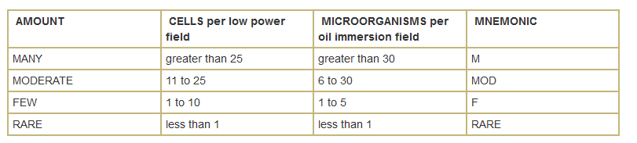
Quantitation Rules

Slide 30
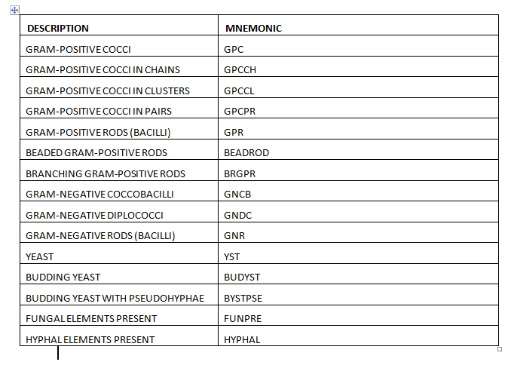
Microorganism Morphology

Slide 31
Morphological descriptions -GPR
Corynebacterium spp.:
  Pleomorphic club-shaped, irregularly staining bacilli or coccobacilli with palisading and/or angular arrangements
Listeria monocytogenes:
  Small – medium coccobacilli that may be pleomorphic; occur in short chains or palisades; may be confused with Corynebacteria or Enteroccocus spp.

Slide 32
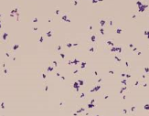
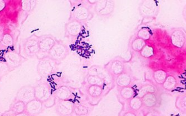
Corynebacterium spp
Listeria

Slide 33
Morphological descriptions -GPR
Bacillus spp.:
  Medium to large square-ended GPR with parallel sides with or without spores; some species have spores that swell sides; may stain gram variable or gram negative with age

Slide 34
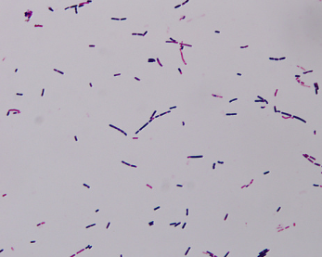
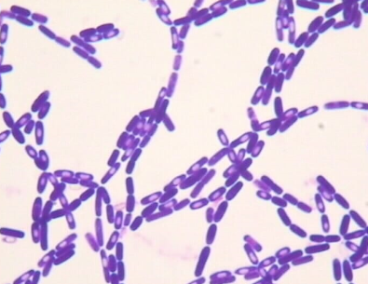
Bacillus spp
Without spores/GVB
With spores

Slide 35
Morphological descriptions – Anaerobic GPR
Lactobacillus:
  Medium, straight, uniform GPR with rounded ends; may form chains or spirals; sometimes short and coccobacilliary
Clostridium spp.:
  Stain Gram positive, variable, or negative; with or without spores; rods may be large, slender/short, or “boxcar” (blunt, squared off ends); sometimes forms coils; often slightly smaller than Bacillus spp.

Slide 36
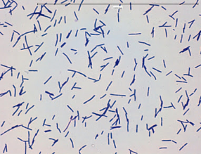
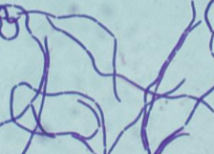
Lactobacillus spp

Slide 37
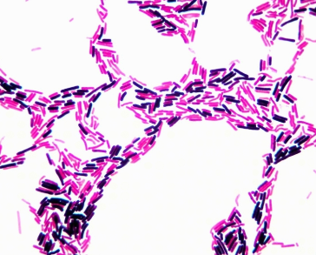
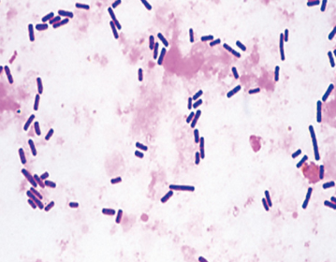
Clostridium spp

Slide 38
Morphological descriptions – Anaerobic GPR
Cutibacterium (Propionibacterium) spp.:
  Very pleomorphic “diphtheroid” forms that may branch (described as “spidery” branching)
Bifidobacterium spp.:
  Pleomorphic, coryneform rods. They usually appear clubbed or branching and may display bifurcated (“Y”- shaped)ends. Some species occasionally exhibit swollen coccoid forms.

Slide 39
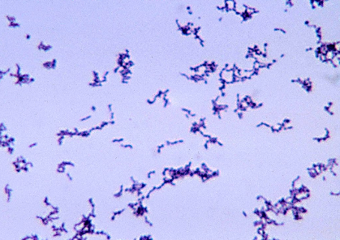
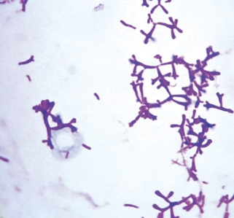
Cutibacterium spp
Bifidobacterium spp

Slide 40
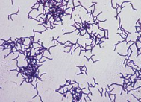
Morphological descriptions – Anaerobic GPR
Actinomyces spp.:
  Nonsporulating, gram-positive bacteria that tend to form short branching rods and filaments

Slide 41
Morphological descriptions – Beaded/Branching GPR
Aerobic “Actinomyces”:
  Gram-positive rods that grow under aerobic and anaerobic conditions, they all exhibit at least rudimentary branching. Some appear “beaded” on Gram stain due to the presence of mycolic acid in cell wall. Additional testing/review should be performed.
Mycobacterium spp.:
  Pleomorphic rods (small to long) that appear as poorly staining “beaded” GPR due to the mycolic acid and lipids in cell wall. Additional testing/review should be performed.

Slide 42
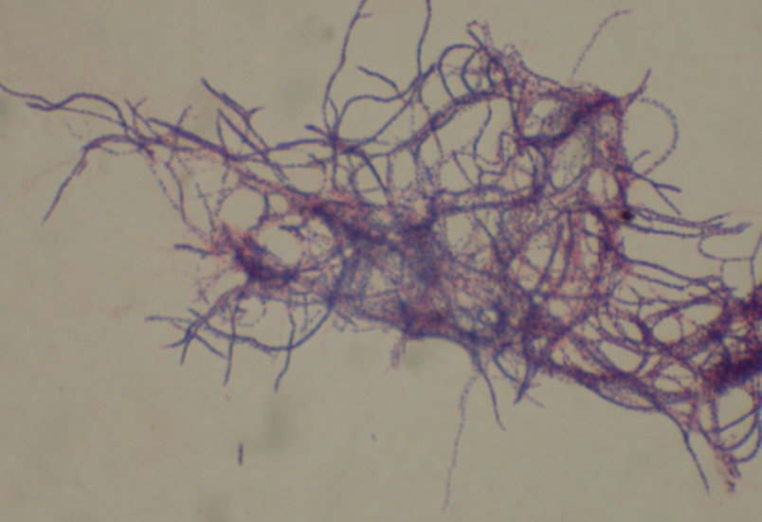
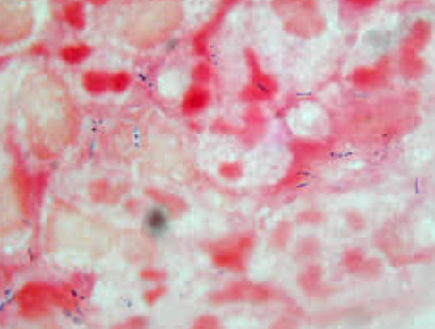
“Beaded” Branching GPR (Nocardia spp)
Mycobacterium spp

Slide 43
Morphological descriptions - GPC
Streptococcus pneumoniae:
  GPC in pairs, lancet shaped, short chains
Streptococcus spp.:
  Round to oval GPC, occasionally elongated (can be mistaken as short GPR); in pairs, short or long chains; nutritionally variant streptococci often seen as highly pleomorphic, gram-variable to gram-negative coccobacilli with pointed ends and spindle shapes

Slide 44
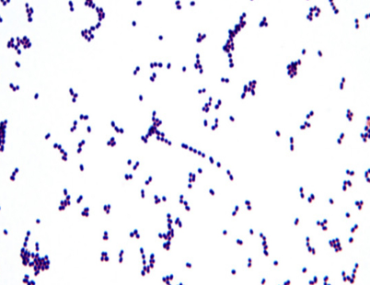
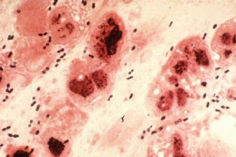
S. pneumoniae
Streptococcus spp

Slide 45
Morphological descriptions - GPC
Enterococcus spp.:
  GPC in pairs to short chains; may resemble pneumococci
Staphylococcus spp.:
  GPC in pairs, tetrads, clusters. S. aureus may often be characterized by very uniform, geometric clusters of small cocci, whereas coagulase negative Staph are often irregular and more pleomorphic, with greater size variation

Slide 46
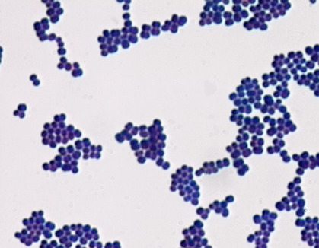
Staphylococcus spp

Slide 47
Morphological descriptions - GNR
Enterobacteriaceae:
  Straight thick bacilli; short – medium length with rounded ends; antimicrobial agent – affected organisms may be pleomorphic, filamentous, and/or irregularly staining
Pseudomonas spp.:
  Thin bacilli; medium – long length with rounded to pointy ends; often in pairs; antimicrobial agent – affected organisms may appear filamentous, coiled, and/or pleomorphic

Slide 48
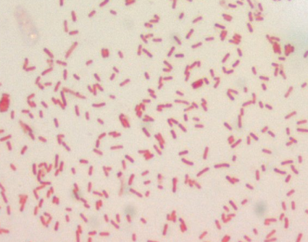
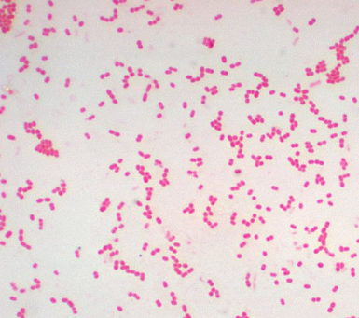
Different types - Enterobacteriaceae

Slide 49
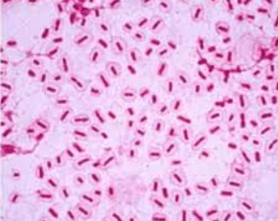
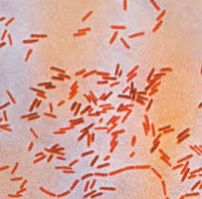
Different types - Enterobacteriaceae

Slide 50
Morphological descriptions - GNR
Haemophilus spp., Pasteurella spp., and other fastidious GNR:
  Small coccoid to bacillary forms; pleomorphic; often with filamentous forms; may be faintly staining
Acinetobacter spp.:
  Medium to large cocci in pairs; occasionally coccoid, bacillary, and filamentous forms; often resistant to decolorization

Slide 51
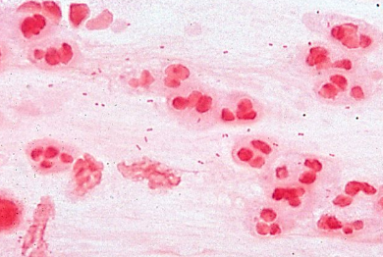
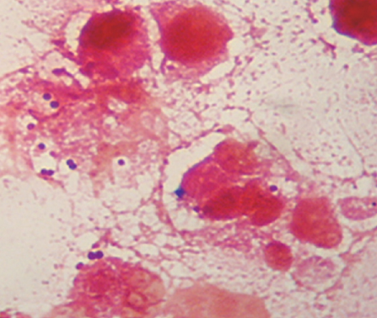
Acinetobacter spp
Haemophilus spp

Slide 52
Morphological descriptions - GNR
Neisseria spp., Moraxella catarrhalis:
  Medium to large cocci in pairs and tetrads, coffee bean shaped; no bacilli seen (other species of Moraxella can be more elongated)

Slide 53
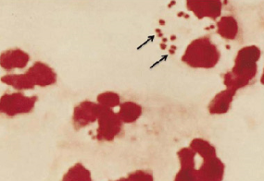
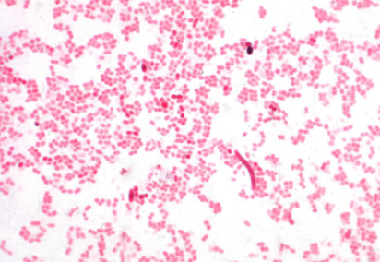
Neisseria spp
Moraxella spp

Slide 54
Morphological descriptions – Anaerobic GNR
Bacteriodes spp.:
  Pleomorphic straight bacilli with possible irregular to bipolar staining
Fusobacterium spp.:
  Very thin, long, faintly staining, bacilli with tapered to rounded ends

Slide 55
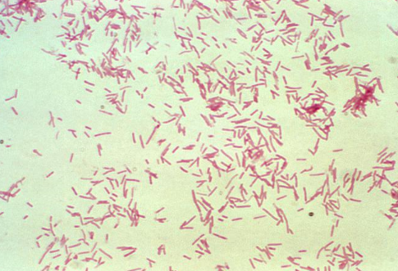
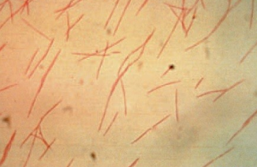
Bacteroides spp
Fusobacterium spp

Slide 56
Morphological descriptions - Fungal
Candida spp.:
  Gram-positive yeast cell with or without budding and/or pseudohyphae; may also appear “stippled”/”beaded” or gram neutral
Cryptococcus neoformans:
  Partially or completely gram-positive round yeast cell with clear or red-orange halo; may also appear “stippled”/”beaded” or gram neutral

Slide 57
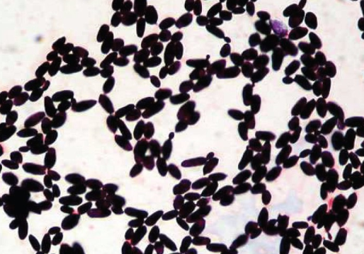
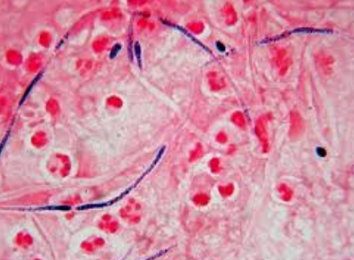
Candida spp
Budding yeast
Psuedohyphae

Slide 58
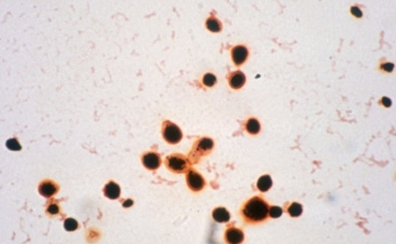
Cryptococcus neoformans

Slide 59
Morphological descriptions - Fungal
Blastomyces dermatitidis (yeast form):
  Gram-variable to gram neutral, broad-based, thick-walled yeast with figure-eight appearance. Requires additional review.
Hyphae:
  Long Gram-negative to Gram-variable to gram neutral, parallel/thick walled tubular filaments; with or without visible septation. Can perform additional stain to confirm.

Slide 60
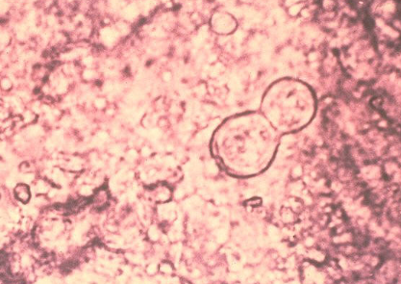
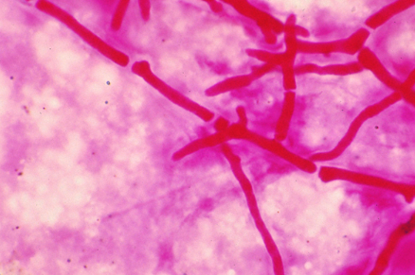
B. dermatitidis
Septate hyphae

