Slide 1
Downtime Refresher

Slide 2
Short Term Downtime
Patient Testing/ Product Handling/ System Recovery
**Follow Instructions in the Order Written**
Complete All Downtime Paperwork Concurrently
with Testing and Product Handling

Slide 3
Short Term Downtime Patient Testing
Testing in Process
Complete a Downtime Patient Testing Face Sheet for all patients with non-performed/ non-verified procedures when the system went down.
Repeat ALL non-performed procedures if done on the bench. Echo procedures do not need to be repeated.
Record testing with interpretations on the applicable Downtime Patient Result Entry Worksheet

Slide 4
Downtime Patient Testing Face Sheet
Downtime Result Entry Worksheet (TS Example)

Slide 5
Short Term Downtime Patient Testing
Testing Without Prior Order
Complete Downtime Patient Testing Face Sheet, obtaining patient history from a downtime backup report
Assign a “BB Downtime Accession Number”
Electronic XM CANNOT be performed during computer downtime
Retain the following documentation
Downtime Patient Testing Face Sheet (on top)
Patient Blood Bank Lab Request Form
Downtime Patient Result Entry Worksheets

Slide 6
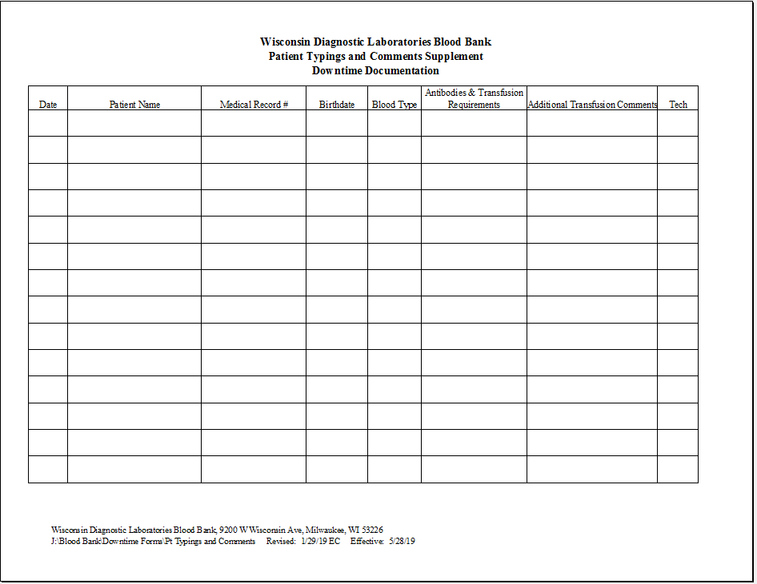
Short Term Downtime Patient Testing
Refer to Open Patient Sample Report to Determine if “Open” Patient Samples are Available for:
Crossmatching additional blood (add-ons)
Converting TS to TC
All XMs MUST be serologic during Downtimes
Call Patient Floors with STAT patient results
Add new patients to PTC Supplement Form (and attach to PTC Report)
Add this info to Downtime Patient Testing Face Sheet in red ink
Any new transfusion requirements, transfusion related comments, or antibodies must be added to the Downtime Patient Testing Face Sheet in red ink

Slide 7
File All Downtime Testing Documentation Alphabetically in Binder #1 For Entry When System is Restored

Slide 8
Short Term Downtime Product Handling
Receiving Products
Date/Time/Initial all shipping invoices from the blood supplier. Place in Binder #2 under the Shipping Invoices Tab to be used for logging in product upon system restoration.
Perform Reconfirmation ABORh typings on RBCs using the ABORh Unit Downtime Result Entry Worksheet. Place in the ABORh Unit section of Binder #2.
Prior to setting up any products on a patient, use the Auto/Directed Unit Report to look for “reserved” patient products
For Product Modifications, complete a Modify Products worksheet.
One sheet for each patient product transaction
If multiple modifications are being performed on a single unit, staple the worksheets together in the exact order the modifications were performed.
File alphabetically by name of modification under the Mod Tab of Binder #2.

Slide 9
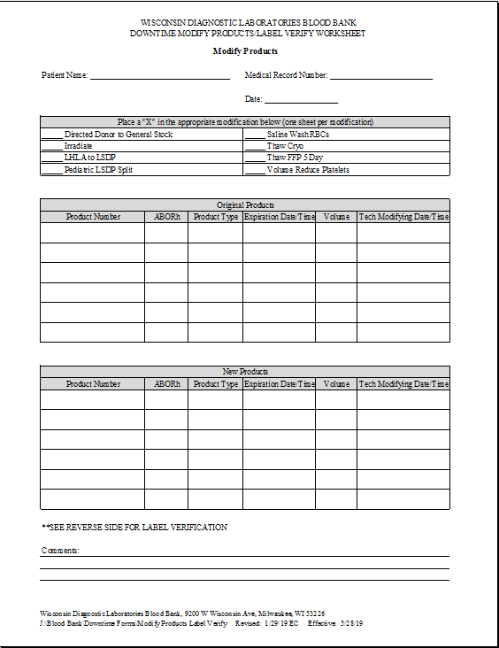
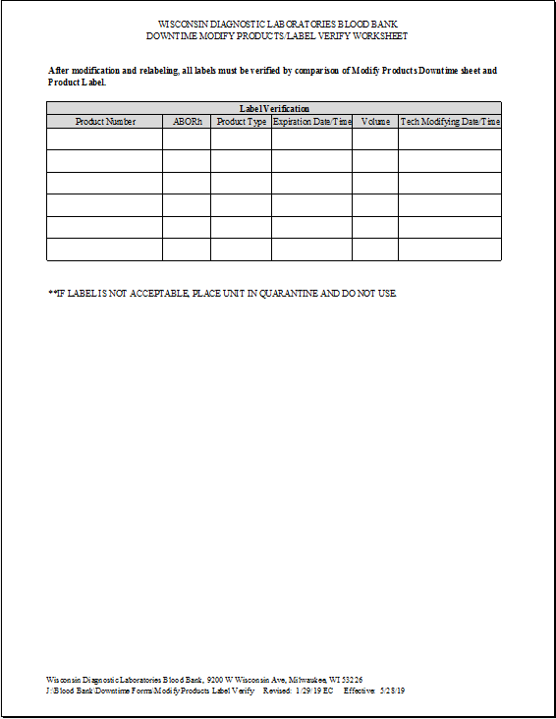
Modify Product Worksheet

Slide 10
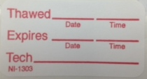
Short Term Downtime Product Handling
Labeling Units
After modification, locate correct label in downtime labels storage rack and affix label over the original product code label.
If the expiration date changes, cross out original expiration date/time with a single line and write the new expiration date/time on the product.
For cryo, a new product label is not required during downtime. Use the “Thawed Product” sticker for the new expiration date/time.
Label Verify
All labels must be verified using the Modify Products Worksheet and the product label. Include: product number, ABORh, new product type, expiration date/time, and volume.
Use ISBT 128 Product Code Modification Map to verify product code.
If unsatisfactory, place unit in Quarantine.

Slide 11
Short Term Downtime Product Handling
Choose applicable “blank-formatted” Cert Form and complete all blank areas of information.
Affix handwritten tag to unit. Quarter fold the Cert form and rubber band to the unit, displaying patient demographics to the face of product.
Visual inspection of the crossmatched refrigerator shelves will need to be made to determine patient crossmatched product availability.
Reserved product availability will be determined via the current Auto/Directed Unit Report, the blood supplier’s reserved product packing lists (stored in Binder #2), and visual inspection of the “Reserved Product” refrigerator.

Slide 12
Short Term Downtime Product Handling
At Product Dispense:
Verify patient to product compatibility by:
Verifying patient antibodies and ABORh against the computerized PTC backup, current daily/shift PTC Report, and the Downtime Patient Typings and Comments Supplement Form
Decide whether the product special needs and product ABORh are compatible with the patient requirements
Cert Form must include all dispense information requested in the Product Issue and Visual Inspection area of the form.
Pink ply is removed at dispense and filed alphabetically in the DIS tab of Binder #2.

Slide 13
Short Term Downtime Product Handling
Product Return
Products Dispensed BEFORE downtime:
Find pink ply in the Dispense Product stackable bin
Match pink ply to Cert Form, record return inspection information in the designated box.
Products Dispensed AFTER downtime:
Find pink ply in the DIS tab of binder #2
Match pink ply to Cert Form, record return inspection information in the designated box.
For products returned/not wasted- copy the pink ply, indicate on copy “product-not wasted.” Place copy in Return Products tab of Binder #2
For products returned/wasted- copy pink ply, indicate on copy “wasted” and place copy in Return Products tab of Binder #2. Discard product.

Slide 14
Short Term Downtime System Restoration
**Perform System Restoration in the exact order listed. **
1. Receive products using supplier invoices- back date to date/time of receipt
2. Product Result Entry using downtime worksheets
3. Modify Products
Enter modifications in the order in which the Modify Products worksheets were assembled for the unit number.
Back date to date/time of actual modification.
4. Label Verify

Slide 15
Short Term Downtime System Restoration (cont.)
5. Department Order Entry + Patient Result Entry
For testing in process when system went down:
Re-enter all results not performed/verified before downtime
Order any additional tests as an “add-on” to the accession number
Result all procedures and include a non-chartable note via “DOWNTIME” template
For testing done without entry into the computer
For testing with a downtime accession number, order procedures via DOE.
If downtime accession number was preassigned, indicate that number in the order entry format field designated Downtime Accession
If downtime accession number was assigned by BB, add the order to the scratch pad. Highlight the orderable and select comments from the toolbar. Add an order note by inserting “Downtime” template.
Affix the computer generated labels to their corresponding downtime patient sample, taking care not to cover the downtime accession sticker.
Affix one computer generated label to the Downtime Patient Testing Face Sheet in the System Restored- Order Entry section.
Result all procedures
For testing with a TSCL accession number, add on procedures to this accession number

Slide 16
Short Term Downtime System Restoration (cont.)
6. Complete “System Restored- Order Entry” section of Downtime Patient Testing Face Sheet
7. Update PPI- compare to Downtime Patient Testing Face Sheet and PTC Supplement form
8. Dispense Products- back date to dispense date/time
9. Return Products- back date to the return date/time
10. ORV, Pending Inquiry- confirm that all patient orders have been resulted and verified
11. Complete “System Restored- Result Entry” section of Downtime Patient Testing Face Sheet
12. Run PTC Report and verify that all information updated on the PTC Reports used during downtime and the information on the PTC Supplement Form has been successfully updated to the online history. Make corrections if necessary
13. Archive downtime paperwork- all downtime paperwork is placed in BB Leadership mailbox.
14. Paperwork is reviewed by BB Leadership. BB Leadership periodically fills out the Periodic Downtime Testing Checklist.

Slide 17
Extended Downtime
Patient Testing/ Product Handling/ System Recovery
**Follow Instructions in the Order Written**
Complete All Downtime Paperwork Concurrently with Testing and Product Handling

Slide 18
Extended Downtime Patient Testing
Follow Short Term Downtime Patient Testing
If extended downtime eliminates chart generation, manual patient reports will be distributed to patient care areas
BB will document results on Blood Bank Lab Request Form
Copy the “resulted” Blood Bank Lab Request Form
Copies will be sorted into Clients/ Inpatients
Clients- copies taken to Support Services and sorted by clinic/client. Support Services will coordinate the delivery of the reports.
Inpatients- copies are delivered via pneumatic tube system
When downtime lasts longer than 24 hours, BB leadership will review all downtime patient testing results and indicate their initials/date on the Downtime Patient Testing Face Sheet. Any discrepancies will be resolved. Corrected results are called to the patient care area and a corrected manual report is forwarded to the applicable area.

Slide 19
Extended Downtime Product Handling
Follow Short Term Downtime Product Handling
If extended downtime moves into the midnight teardown, manual teardown must be performed.
TRANSFUSED- Pink Cert form from all products dispensed to non-refrigerated areas will be rubber banded and labeled “Transfused” with current date.
RELEASE FROM XM/RESERVATION
Manually inspect crossmatched inventory
Products with expired crossmatches will be returned to general inventory
Pink Cert forms are rubber banded and labeled “Release” with current date
Pink Cert forms are pulled from all products being dispensed to OR and stored in their location specific “dispensed to” bins. Pink ply will be reattached to units when products are returned.

Slide 20
Extended Downtime System Restoration
Follow Short Term Downtime Restoration
DOE- the collection date/time of the Department Order Entry format must match the date/time of collection for the downtime patient sample.
After system restoration is complete, handwritten Cert forms will be replaced with computer generated forms.
Final disposition all “Transfused” products using the pink ply, enter the date indicated on the packet in the “Transfused Date” field. Start with the earliest date.
Return all “Returned” products in the computer, starting with the earliest date, using the correct date/time of the return.

Slide 21
Downtime Supplies
Worksheets are located in the file drawer by workstation 3.
Blank Cert Forms are located in the cabinets above workstation 3.
Binders are located on the bookshelf in the irradiator room.
Blood Bank Downtime Accession Number sticker are located in the cabinet above the plasma thaw baths.
ISBT Blood product label stickers (product codes, ABORh, and supplier) are located in the gray box between stations 7 and 10.

