Slide 1
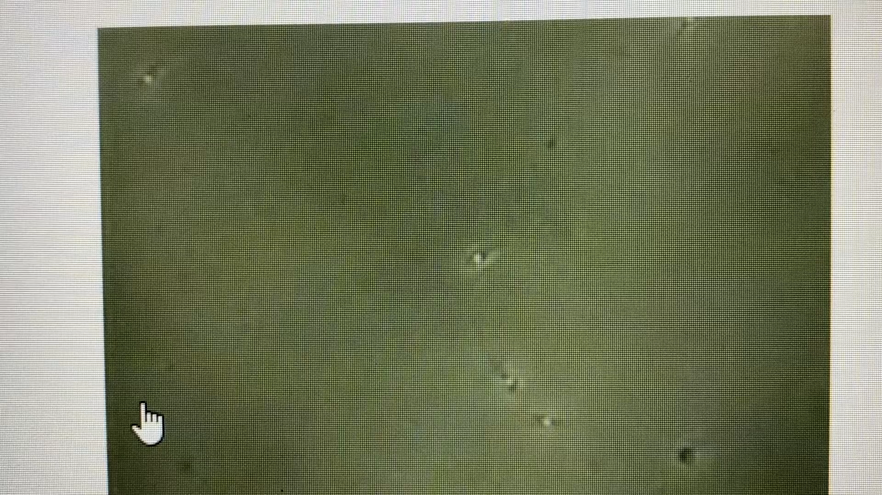
This is a video of a post vasectomy sample that was received within 1 hour of collection and was maintained at body temperature during transport. Click the play button below the screen and assess how the results should be reported.

