Slide 1
Pipette Use in the Clinical Laboratory Carolyn Webb, MT (ASCP) Colleen Turtenwald, MLS (ASCP) ^{CM} Karen Wagner, MLS (ASCP)^{CM} 1/31/2025

Slide 2
Types of Pipettes Used in CP Labs: In order from least accurate to most accurate measurement
Plastic Transfer Pipette:
Used for transferring sample, or other fluids, from one container to another. These must not be used when required volumes are mandated.
Serologic Pipette:
Used when accurate volume measurement of a solution is needed, especially in larger volumes. Coagulation reagents are an example of serologic pipette use.
Adjustable Volumetric Pipette (MLA, Eppendorf, Ovation):
Used for reconstitution of materials, such as rinse solutions, that may not require strict dilution protocols, but where accuracy is still needed. These are often used as back ups when fixed volumetric pipettes are not available. Adjustable pipettes can be just as accurate but are not as preferred.
Fix Volumetric Pipette (MLA, Eppendorf):
Used for reconstitution of materials, such as calibrators, reagents, QC materials, and proficiency testing samples that require accurate dilution protocols

Slide 3
Plastic Transfer Pipette
Plastic disposable (one-use) transfer pipettes are the least accurate of the pipettes. They are not calibrated. Uses include:
Transferring plasma or urine from mother tubes or cups to aliquot containers
Transferring samples to testing cups
Mixing contents of samples
NOTE: These pipettes often have markings on the side of the pipette indicating volumes. These are to be used a guide only. They are not accurate when precise volumes are needed. Do not use for reconstitution of reagents, calibrators, QC materials, proficiency sample, etc.

Slide 4
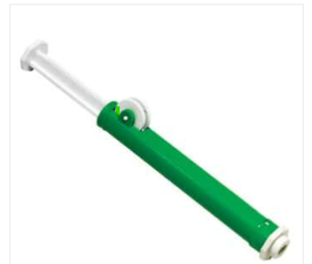
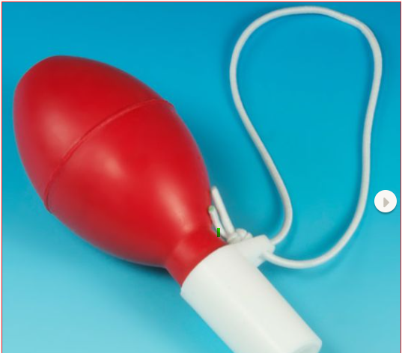
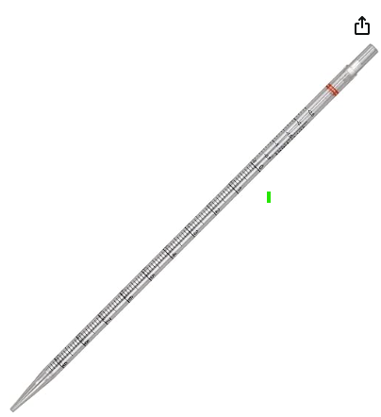
Serologic Pipette
These pipettes require the most skill to achieve accuracy of larger quantity solution measurements in the laboratory.
The plastic serologic pipette is disposable and comes in a variety of higher volumes. A reusable bulb or roller pump is used to draw liquid into the pipette.
These pipettes are used when a high level of accuracy is needed in larger volumes, and a fixed or adjustable volumetric pipettes is not available to dispense at those volumes. They are used primarily for reagent preparation.
NOTE: Use a right-size pipette to reduce error in number of dispenses by not using a large enough pipette volume, or one that is too large for the volume needed. (Ex: don’t use a 10mL pipette for a 1mL volume, or vice versa.)

Slide 5
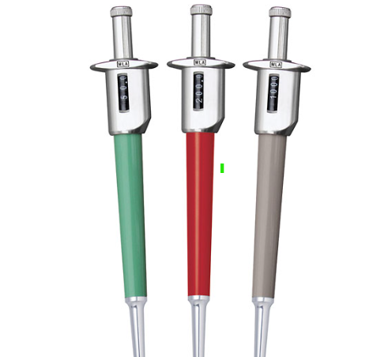
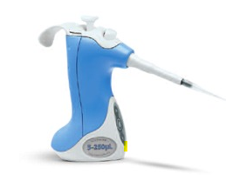
Adjustable Volumetric Pipette
Adjustable Volumetric Pipettes may be used for pipetting solutions where accuracy is important. Accuracy tends to be higher at the highest volume, and lower in the more minute volumes. Periodic calibration is required. These are used in place of the fixed volume pipettes when needed.
These are volumetric, but as the title states, they are adjustable to the volume needed. The plastic pipette tips are disposable and should be changed after each use. Do not store or drop on their tips. This could cause damage to the pipette.
Each pipette will have a range printed on them that indicates the validated volume able to be dispensed. There is a window on each pipette that displays volume selected by turning the dial. Tech error occurs most often when the volume is dialed incorrectly.
NOTE: It is necessary to check the window before and after each pipette dispense to ensure the dial did not move, causing inaccurate volume. Tech error occurs most often in adjustment of volume.

Slide 6
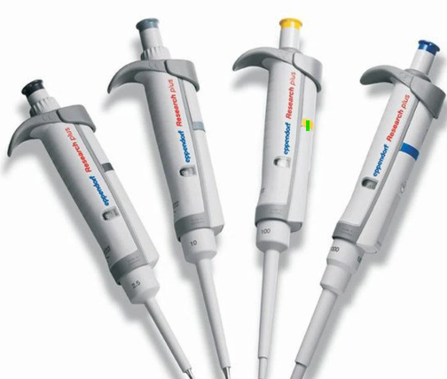
Fixed Volumetric Pipette
Fixed Volumetric Pipettes are reliable and accurate only for the volume that is stamped on the side of the pipette. The plastic tip is disposable. These pipettes are calibrated periodically for accuracy. Do not store or drop on their tips as this could cause damage to the pipette. They are the preferred pipette in the lab setting for smaller volumes.
They are used for applications requiring high accuracy and precision when reconstituting materials such as calibrators, QC materials, and proficiency testing samples in smaller volumes.
NOTE: Use the highest volume pipette needed to achieve the need. For example, it is more accurate to use a 1000uL pipette instead of a 500uL twice to reach a volume of 1mL.

Slide 7
MLA Pipettes
MLA pipettes are available in fixed, and adjustable volumetric pipettes.
Most often used for reconstitution of smaller-volume calibrators, controls, proficiency samples and linearity materials.
Pipetting Procedure¹
For adjustable pipettes, rotate the plunger to display the desired volume (clockwise to decrease and counterclockwise to increase for adjustable volume pipette). Double check volume display before proceeding.
Using pipette tips, press the pipette nozzle firmly into a fresh tip. Ensure tip is firmly in place.
Ensure pipette is in full upright position. Fully depress the pipette plunger and then immerse the tip into the solution (approximately1/8 inch - 3mm deep).
Smoothly release the plunger and allow the solution to enter the pipette tip.
Remove the tip from the solution and touch the tip against the side of the vessel to remove any solution that may have adhered to the outside of the tip.
While holding the pipette upright, place the tip against the side of the receiving vessel as close to the bottom as possible or, if the vessel contains liquid, as close to the liquid as possible. Smoothly depress the plunger.
While holding the plunger depressed, slowly withdraw the tip keeping it against the wall of the container. Release the plunger.
Remove the tip by applying a slight upward pressure to the bonnet over waste container.
NOTE: Use a new pipette tip for each bottle to be reconstituted.

Slide 8
Eppendorf Pipettes
Eppendorf pipettes are available in fixed, and adjustable volumetric pipettes.
Most often used for reconstitution of smaller-volume calibrators, controls, proficiency samples and linearity materials.
Pipetting Procedure²
For adjustable pipettes, rotate the plunger to display the desired volume (clockwise to decrease and counterclockwise to increase for adjustable volume pipette). Double check volume display before proceeding.
Using pipette tips, press the pipette nozzle into a fresh tip. Ensure tip is firmly in place.
Ensure pipette is in full upright position. Depress the pipette plunger to the first stop only. Then immerse the tip into the solution (approximately1/8 inch - 3mm deep).
Smoothly release the plunger and allow the solution to enter the pipette tip.
Remove the tip from the solution and touch the tip against the side of the vessel to remove any solution that may have adhered to the outside of the tip.
While holding the pipette upright, place the tip against the side of the receiving vessel as close to the bottom as possible or, if the vessel contains liquid, as close to the liquid as possible. Smoothly and slowly depress the plunger to the first stop only.
While holding the plunger depressed, slowly withdraw the tip keeping it against the wall of the container. Release the plunger.
Remove the tip by pressing the operating lever all the way down over waste container.
NOTE: Use a new pipette tip for each bottle to be reconstituted.
NOTE: Do not press the plunger beyond the 1st stop . This will cause erroneous volumes to be dispensed.

Slide 9
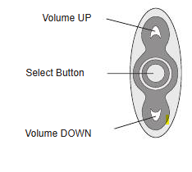
Ovation Pipettes
Ovation pipettes are available only in adjustable volumetric pipettes.
Most often used for reconstitution of smaller-volume calibrators, controls, proficiency samples and linearity materials.
Pipetting Procedure³
Using the volume tabs, select desired volume. Double check volume display before proceeding.
Using pipette tips, press the pipette nozzle firmly into a fresh tip. You will hear/feel a “click”. This ensures tip is firmly in place.
Press the plunger down to the first stop only and immerse pipette tip in the sample in an upright position.
Smoothly release the plunger and allow the solution to enter the pipette tip.
Remove the tip from the solution and touch the tip against the side of the vessel to remove any solution that may have adhered to the outside of the tip.
While holding the pipette tip upright, place the tip against the side of the receiving vessel as close to the bottom as possible or, if the vessel contains liquid, as close to the liquid as possible. Smoothly depress the plunger to the second stop.
While holding the plunger depressed, slowly withdraw the tip keeping it against the wall of the container. Release the plunger.
Remove the tip by pressing the tip ejection button (on top of the pipette) over waste container.
NOTE: Use a new pipette tip for each bottle to be reconstituted.
NOTE: Do not press the plunger past the first stop as this will cause erroneous volumes to be dispensed.

Slide 10
Errors in Pipette Use
Selecting a wrong size pipette for the need. Do not use a 1mL fixed volumetric pipette for a 10mL need by dispensing 10 times. Use a 10mL serologic pipette to accomplish this. Alternatively, do not use a 10mL pipette for a 1mL need. Inaccuracies can occur in either situation.
Using a plastic transfer pipette with line indicators for reconstitution of solutions that need accurate amounts of water (calibrators, QC materials, etc…). These marks are guides only and are not accurate. Transfer pipettes are only used for transferring samples or solutions.
Using a fixed/adjustable volumetric pipette that is overdue for calibration, or it was dropped and may have a damaged tip, may cause inaccurate volumes. These pipettes may not be drawing up or dispensing the correct volumes.
When using an adjustable volumetric pipette, ensure the correct volume has been dialed in and locked (if available). Check the pipette with each use to verify volume setting.
When using volumetric pipettes, ensure tip is firmly attached to pipette. Air can leak in around the plastic tip if attached loosely. Pipettes should be held upright for intake and dispelling of liquid materials. If not done properly, this may result in inaccurate volumes.
Eppendorf and Ovation Only: Do not press the plunger beyond the first stop when drawing up liquid. This will cause too much liquid to be drawn into the pipette, and volume will be inaccurate when dispensing. (The second stop when drawing up sample is for highly viscous samples not encountered in CP.)

Slide 11
Sources
Vista Lab MLA Series Operator’s Manual; 326720 Rev. C; VISTALAB MLA SERIES OPERATOR'S MANUAL Pdf Download | ManualsLib
Eppendorf Reference Operating Manual; 2022; Copyright Eppendorf SE, Germany; Eppendorf_Liquid-Handling_Operating-manual_Reference-2_Eppendorf-Reference-2.pdf
Ovation QS BioNatural Pipette - Adjustable Volume-Set Operator's Guide; L057-0144-001 Rev. H; VISTALAB OVATION QS OPERATOR'S MANUAL Pdf Download | ManualsLib

