Slide 1
Preventing Contamination during NAAT Tests
NAAT = Nucleic Acid Amplification Testing

Slide 2
Purpose
Review potential sources of false positive results in NAAT testing
Reinforce proper use of Personal Protective Equipment
Explain revisions to cleaning and maintenance procedures
Explain steps to take when external QC fails

Slide 3
Nucleic Acid Amplification Testing Basics
The NAAT procedure works by first amplifying – or making many copies of – an organism’s genetic material, if any is present in a person’s specimen.
Amplifying those nucleic acids enables NAATs to detect very small amounts of the DNA or RNA in a specimen, making these tests highly sensitive.
NAAT cannot differentiate between organisms present as part of normal flora and organisms causing disease.

Slide 4

Normal Flora
Normal flora is a potential source of false positive results for NAAT testing
Everyone has Candida on their skin and in parts of their body (like the mouth, throat, gut, and vagina).
Candidiasis Basics | Candidiasis | CDC
5-15% of people as carry Strep Group A as part of their normal flora without being sick.
People can also carry and transmit viruses without being ill.

Slide 5

Infectious Materials
Biological specimens, transfer devices, and used cartridges should be considered capable of transmitting infectious agents requiring standard precautions.

Slide 6
Personal Protective Equipment
Cepheid procedures require use of lab coat. This serves two purposes:
It protects the sample from contamination from your body.
It protects you and all the other people you come into contact with from the potentially infectious organisms present in patient samples when you remove the lab coat before leaving the lab.
Hand hygiene and gloves are also required when performing Cepheid testing.

Slide 7
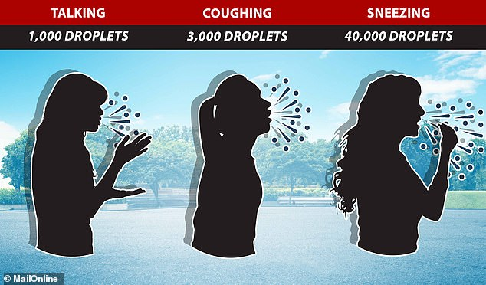
Talking
The emission from speech might sound small, but, unlike sneezes, words rarely occur in isolation. “Within about two to twenty seconds of speaking you can produce as many [drops] as in a single cough,” said Zu Puayen Tan of the National Chiao Tung University in Taiwan.
As we have learned through the Covid pandemic, we all spray a little when we talk.
Even if you are not infectious, the droplets from talking may get into the sample/test system and organisms you are carrying can cause a false positive result for the patient.
If you cannot refrain from talking when setting up Cepheid tests, wear a mask.

Slide 8

Consequences of False Positive Results
Patients pay the price when false positive results are reported:
Treatment for organism that isn’t actually causing illness
Wasted Money
Potential unpleasant side-effects from medication

Slide 9
Cepheid Test System Design
The Cepheid test system is designed to prevent cross contamination.
  Closed cartridge design minimizes the risk of contamination.
Maintenance procedures are required to ensure accurate results.
  Work surfaces
  Instrument surfaces
  Probe
  Touch Screen

Slide 10
Maintenance Revisions
Having experienced false positive results at multiple locations on API samples, we took a close look at our procedures compared to the GeneXpert Operator’s Manual. The following procedures have been revised.
Operations and Maintenance Procedure:
  Daily Cleaning & Disinfection will be performed each morning before patient testing.
  Cleaning the touchscreen is added to the quarterly maintenance procedure.
Revision of QC Section of each procedure to include corrective actions for failed quality control

Slide 11

Cleaning Changes
Daily Cleaning
Clean & Disinfect each morning before starting any patient testing:
  Disinfect countertops with bleach wipes for minimum of 2 minutes and allow to dry.
  Repeat bleach wipes & dry two more times.
  Wipe with 70% ethanol to remove bleach residue
Quarterly Cleaning
Added cleaning of the touchscreen to the quarterly maintenance procedure

Slide 12
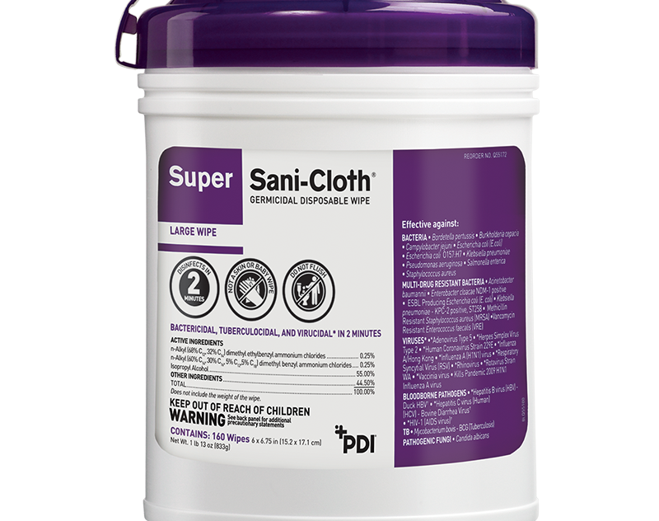
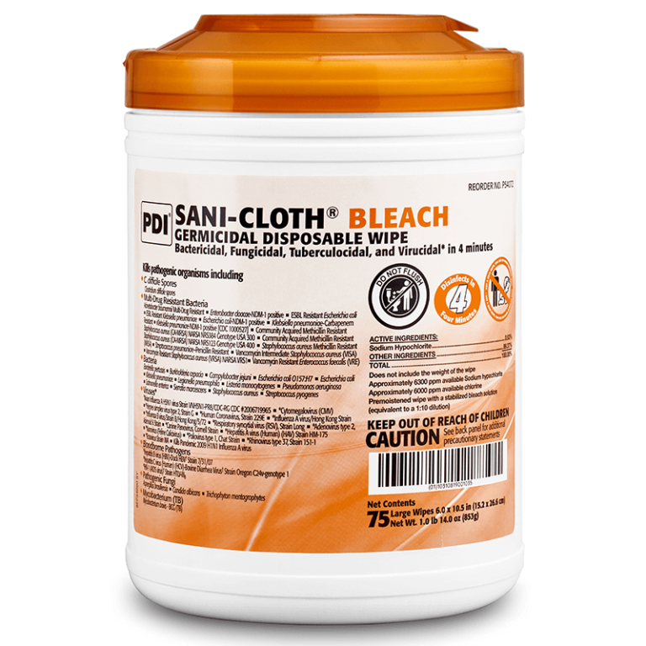
Proper Cleaning
Purple Sani-Cloth =
2-minute wet time
10% Bleach wipes =
4-minute wet time
Ensure that the disinfectants are used for the full wet time indicated on the container.
If any sample droplets come in contact with the work surfaces, follow the bleach & alcohol disinfecting process provided in the Cepheid Operations & Maintenance procedure.
If you get a positive result on a negative control, perform the quarterly cleaning procedure before repeating the control and do a patient look back.

Slide 13
Quality Control Corrective Actions
Instructions for QC corrective action are added to each of the Cepheid test procedures.
  Always double-check to ensure correct control material was used.
  Perform quarterly cleaning if positive result is obtained on negative control.
  If control material is not the source of error, perform patient lookback to investigate impact on patient results.

Slide 14
QC Corrective Action Details
If a negative control yields a positive result,
  verify that the correct control material was tested.
  perform “Disinfect Syringe Plungers and Cartridge Bays” procedure outlined under quarterly maintenance in the GeneXpert with Touchscreen Instrument Operation and Maintenance Policy before repeating the testing.
  After successful QC results are obtained, perform a patient look back by retesting most recent previously positive patient sample. (Patient look back is not needed if the reason for QC failure was “wrong control material”.)
    If patient sample retests as positive, no further action is needed
    If patient sample retests as negative, result correction is required and additional positive patient samples must be tested until no false positive results are identified.
If positive control yields a negative result,
  ensure that the correct control material was tested.
  put on new gloves, ensure that there is no bleach or alcohol on the gloves or on any of the work surfaces.
  repeat the QC test.
  After successful QC results are obtained, perform a patient look back by retesting most recent previously negative patient sample. (Patient look back is not needed if the reason for QC failure was “wrong control material”.)
    If patient sample retests as negative, no further action is needed
    If patient sample retests as positive, perform disinfection procedures and retest to ensure it is not a false positive result. Result correction is required if sample confirms as positive and additional negative patient samples must be tested until no false negative results are identified.

Slide 15
Conclusion
Nucleic Acid Amplification Tests (NAAT) are extremely sensitive and specific.
NAAT tests cannot distinguish between organisms that are part of normal flora and organisms that are causing infection.
Your actions make a difference in preventing contamination in the NAAT testing and ensuring accurate results.

