Slide 1
Preventing Contamination during NAAT Tests
NAAT = Nucleic Acid Amplification Testing

Slide 2
Purpose
Review potential sources of false positive results in NAAT testing
Reinforce proper use of Personal Protective Equipment
Explain revisions to cleaning and maintenance procedures
Explain steps to take when external QC fails

Slide 3
Nucleic Acid Amplification Testing Basics
The NAAT procedure works by first amplifying – or making many copies of – an organism’s genetic material, if any is present in a person’s specimen.
Amplifying those nucleic acids enables NAATs to detect very small amounts of the DNA or RNA in a specimen, making these tests highly sensitive.
NAAT cannot differentiate between organisms present as part of normal flora and organisms causing disease.

Slide 4

Normal Flora
Normal flora is a potential source of false positive results for NAAT testing
Everyone has Candida on their skin and in parts of their body (like the mouth, throat, gut, and vagina).
Candidiasis Basics | Candidiasis | CDC
5-15% of people as carry Strep Group A as part of their normal flora without being sick.
People can also carry and transmit viruses without being ill.

Slide 5

Infectious Materials
Biological specimens, transfer devices, and used cartridges should be considered capable of transmitting infectious agents requiring standard precautions.

Slide 6
Personal Protective Equipment
Cepheid procedures require use of lab coat. This serves two purposes:
It protects the sample from contamination from your body.
It protects you and all the other people you come into contact with from the potentially infectious organisms present in patient samples when you remove the lab coat before leaving the lab.
Hand hygiene and gloves are also required when performing Cepheid testing.

Slide 7
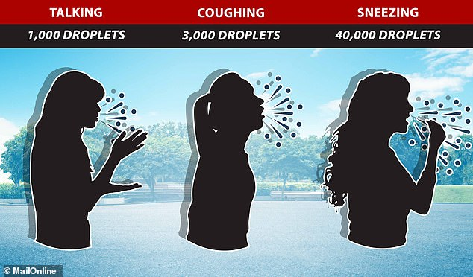
Talking
The emission from speech might sound small, but, unlike sneezes, words rarely occur in isolation. “Within about two to twenty seconds of speaking you can produce as many [drops] as in a single cough,” said Zu Puayen Tan of the National Chiao Tung University in Taiwan.
As we have learned through the Covid pandemic, we all spray a little when we talk.
Even if you are not infectious, the droplets from talking may get into the sample/test system and organisms you are carrying can cause a false positive result for the patient.
If you cannot refrain from talking when setting up Cepheid tests, wear a mask.

Slide 8

Consequences of False Positive Results
Patients pay the price when false positive results are reported:
Treatment for organism that isn’t actually causing illness
Wasted Money
Potential unpleasant side-effects from medication

Slide 9
Cepheid Test System Design
The Cepheid test system is designed to prevent cross contamination.
  Closed cartridge design minimizes the risk of contamination.
Maintenance procedures are required to ensure accurate results.
  Work surfaces
  Instrument surfaces
  Probe
  Touch Screen

Slide 10
Maintenance Revisions
Having experienced false positive results at multiple locations on API samples, we took a close look at our procedures compared to the GeneXpert Operator’s Manual. The following procedures have been revised.
Operations and Maintenance Procedure:
  Daily Cleaning & Disinfection will be performed each morning before patient testing.
  Wipe Testing added as every other month maintenance. Wipe testing procedure included at the end of this powerpoint.
  Cleaning the touchscreen is added to the quarterly maintenance procedure.
Revision of QC Section of each procedure to include corrective actions for failed quality control

Slide 11

Cleaning Changes
Daily Cleaning
Clean & Disinfect each morning before starting any patient testing:
  Disinfect countertops with bleach wipes for minimum of 2 minutes and allow to dry.
  Repeat bleach wipes & dry two more times.
  Wipe with 70% ethanol to remove bleach residue
Quarterly Cleaning
Added cleaning of the touchscreen to the quarterly maintenance procedure

Slide 12
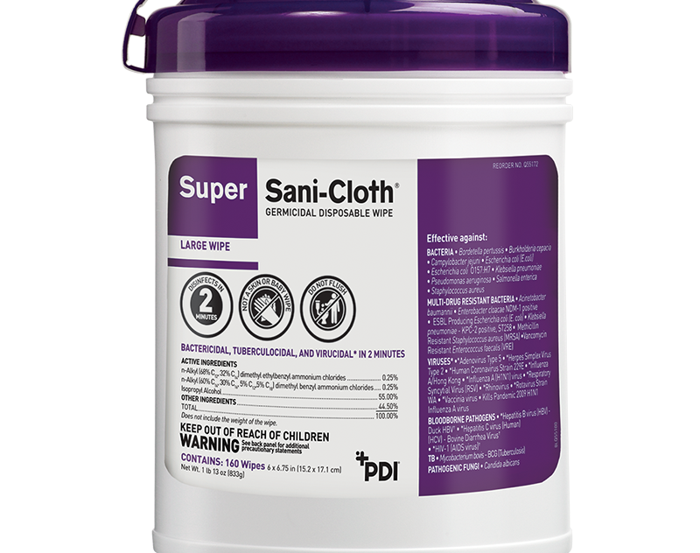
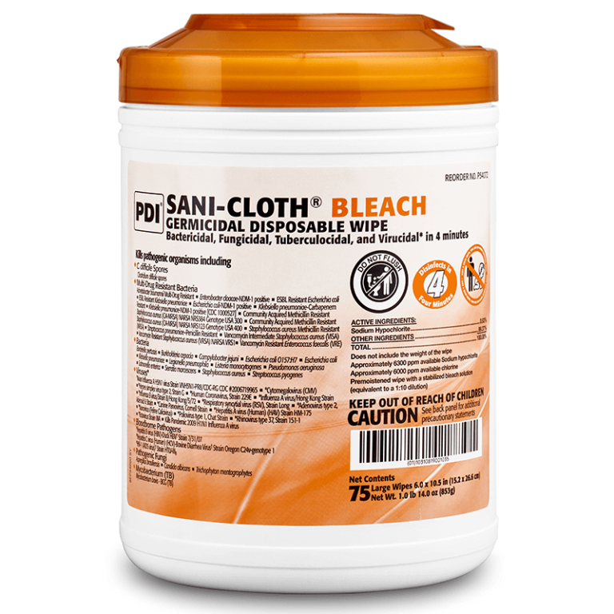
Proper Cleaning
Purple Sani-Cloth =
2-minute wet time
10% Bleach wipes =
4-minute wet time
Ensure that the disinfectants are used for the full wet time indicated on the container.
If any sample droplets come in contact with the work surfaces, follow the bleach & alcohol disinfecting process provided in the Cepheid Operations & Maintenance procedure.
If you get a positive result on a negative control, perform the quarterly cleaning procedure before repeating the control and do a patient look back.

Slide 13
Quality Control Corrective Actions
Instructions for QC corrective action are added to each of the Cepheid test procedures.
  Always double-check to ensure correct control material was used.
  Perform wipe testing if positive result is obtained on negative control.
  Alert technical specialist to determine if a lookback is needed.

Slide 14
QC Corrective Action Details
If a negative control yields a positive result,
  Verify that the correct control material was tested.
  Perform Wipe Test
  If contamination is found in Wipe test, perform disinfection and cleaning, and repeat QC test.
  If contamination is not found in the Wipe test, Perform “Disinfect Syringe Plungers and Cartridge Bays” procedure outlined under quarterly maintenance in the GeneXpert with Touchscreen Instrument Operation and Maintenance Policy and then repeat testing.
  If repeat test still yields a positive result, contact Cepheid Tech support and technical specialist for troubleshooting assistance.
  After successful QC results are obtained complete SBAR and notify technical specialist to determine if a lookback needs to be completed.
If positive control yields a negative result,
  Ensure that the correct control material was tested.
  Put on new gloves, ensure that there is no bleach or alcohol on the gloves or on any of the work surfaces.
  Repeat the QC test.
  After successful QC results are obtained complete SBAR and notify technical specialist to determine if a lookback needs to be completed.

Slide 15
Wipe Testing
Wipe testing involves collecting samples from surfaces in a
laboratory to check for contamination.
Wipe testing serves as a quality assurance measure, helping
laboratories identify and mitigate contamination risks.
Wipe testing will be performed every other month, and when a negative QC result yields a positive result (contamination event).

Slide 16
Wipe Testing Procedure
Prepare 2 sterile conical tubes: label one tube Area 1 and the other tube Area 2. Add 0.5mL molecular grade water into each tube.
Swab Area 1: Dip a sterile swab into the molecular grade water. Swab the area representing Area 1: Bench top used to set up samples. Plastic Sample rack used to store samples. Place swab back in molecular grade water container.
Swab Area 2: Dip a sterile swab into the molecular grade water. Swab the area representing Area 2: Touchscreen and outside of GeneXpert instrument. Place swab back in molecular grade water container.
If Wipe test is being completed as part of every other month maintenance, combine conical tubes from Area 1 and Area 2 into one tube to test together.
If Wipe test is completed as part of QC troubleshooting or contamination assessment, keep conical tubes separate and perform 2 tests separately.

Slide 17
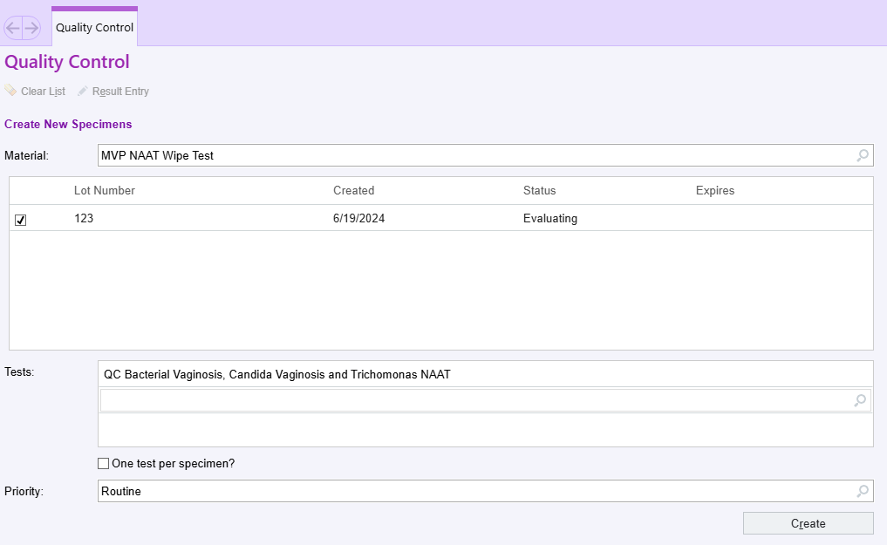
Wipe Testing Procedure
Order QC wipe test in Beaker for necessary tests.
  If wipe test is being completed as part of every other month maintenance, perform test for Cov/Flu/RSV, MVP, and Strep A.
  If wipe test is being completed as part of QC troubleshooting, perform tests only for the assay in question.

Slide 18
Wipe Testing Procedure
Mix container with molecular grade water and swab.
Load into cepheid cartridges as you would a patient.

Slide 19
Wipe Testing Results
All components Negative or Not Detected: No contamination detected--Wipe Test Passes.
  If this procedure is performed as part of every other month QC, maintenance is complete.
  If this procedure is performed due to a contamination event, continue to the next step of QC troubleshooting in the test specific procedure.
One or more component Positive or Detected: Contamination detected--Wipe Test Fails.
  If this procedure is performed due to QC failure or contamination event:
    Disinfect the area where contamination was found as described above. Use daily maintenance procedure for cleaning area with bleach if contamination was found in Area 1. Use quarterly maintenance to clean touchscreen, clean instrument and disinfect syringe plungers and cartridge bays if contamination was found in Area 2.
    Repeat the wipe test in the contaminated area and ensure that the contamination is eliminated (e.g. negative wipe tests). If the contamination is not eliminated, perform disinfection procedure again and repeat wipe testing. If problem persists discuss the next steps with technical specialist.
  If this procedure is performed as part of every other month maintenance:
    Perform daily maintenance to disinfect the area around the instrument.
    Perform quarterly maintenance to clean touchscreen, clean instrument and disinfect syringe plungers and cartridge bays.
    Repeat the wipe test in the contaminated area and ensure that the contamination is eliminated (e.g. negative wipe tests). If the contamination is not eliminated, re-clean the appropriate surfaces and repeat wipe testing. If problem persists discuss the next steps with a technical specialist.

Slide 20
Conclusion
Nucleic Acid Amplification Tests (NAAT) are extremely sensitive and specific.
NAAT tests cannot distinguish between organisms that are part of normal flora and organisms that are causing infection.
Your actions make a difference in preventing contamination in the NAAT testing and ensuring accurate results.

