Slide 1
Scabies identification
PROVIDER PERFORMED MICROSCOPY
COMPETENCY 2016

Slide 2
Purpose
Scabies is a contagious skin condition caused by various species of an eight-legged mite, (i.e. Sarcoptes scabiei var. hominis) that is less than 0.5 mm long.
The mite lays eggs in human skin, which hatch and grow into adult mites
Scabies causes generalized, potentially severe, itching and skin lesions/rash. Skin lesions vary and may include short, linear, or nodular "burrows", tiny red bumps and/or blisters on the skin, or widespread, crusted lesions
Burrowing and movement of the mites causes intense itching due an allergic reaction to mite proteins.

Slide 3
Purpose (continued)
Scabies can be transmitted through any skin-to-skin contact, sexual contact or less commonly through the sharing of clothes and bedding.
Scabies can affect anyone, but it is particularly common in congested areas, such as nursing homes and hospitals, where it can spread widely.
The mite can only survive for three days in the environment. Once on a human body, the mite may reproduce and cause symptoms for years.
Many other skin rashes may look like scabies including allergic drug reactions, contact dermatitis, and viral rashes such as shingles. The diagnosis of scabies is confirmed by visualization of the mite microscopically.

Slide 4
Reagents and Equipment
Ethyl alcohol- 70%
Mineral oil
Microscrope-10X and 40X objectives
Stereoscope
Glass slides
Cover slips
Pipettes
Petri dishes
Scalpel
All reagents / equipment should be stored at room temperature.

Slide 5
Specimen
Samples of mites or skin scrapings. Preferred sites of infestation are the interdigital and popliteal folds, wrist and inguinal regions, and the infra-mammary folds.

Slide 6
Quality control is not applicable for this procedure.
QC

Slide 7
Procedure
Properly identify patient to be tested.
Use hand magnifying lens to identify recent burrows or papules. A bright light and magnifying lens will assist in visualizing the tiny dark speck (mite) at the end of the burrow.
Obtain skin scraping, using a scalpel coated with mineral oil, from terminal portion of a fresh burrow that has not been scratched. Vigorous scraping appropriately results in a few red blood cells visible under the microscope but not frank bleeding.

Slide 8
Procedure (continued)
Transfer scraping (from at least 6 different sites) in oil to a clean microscope slide.
Apply coverslip and examine using bright field microscopy under low and high power
Examine the specimen for presence of scabies mites.
Dispose of all Biohazards into an appropriate Biohazard container.

Slide 9
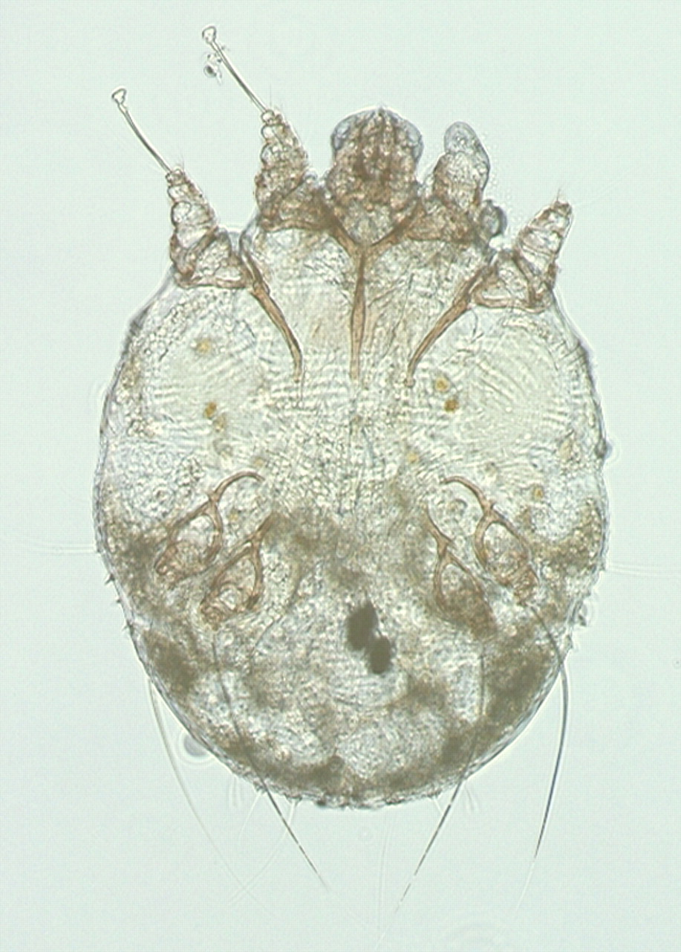
Figure 2: Traditional microscopic image of a female scabies mite suspended in oil (original magnification × 200).

Slide 10
NOTE:
This procedure is performed and interpreted ONLY by providers. Providers include physicians, nurse practitioners, nurse midwives, and physician assistants. No other individuals may perform microscopy procedures under a PPMP certificate, including laboratory and nursing professionals, even though they may be qualified to perform microscopy procedures under a moderately complex license.

Slide 11
Results / Interpretation:
Scabies Mites
Visualization of Eight-legged, oval saclike body, no antennae, 300 to 400 μm in length, first and second pairs of legs are widely separated from the third and fourth pairs.
Body has dorsal transverse parallel ridges, spines and hairs. Species include – Sarcoptes scabiei, Demodex folliculorum and Demodex folliculorum.

Slide 12
Reporting Results
Negative:
No Scabies
Positive:
Scabies identified.
(Results are recorded by the provider in the EPIC Electronic Medical Record)

Slide 13
Diagnosis
Although observation of scabies mite, eggs, or feces confirms the diagnosis of scabies, absence of findings does not exclude the diagnosis of scabies.

Slide 14
Maintenance
Microscopes should be cleaned each day of use as stated in the Microscope Care – Provider Performed Microscopy procedure.
Microscopes may also be cleaned periodically by a contracted microscope cleaning service.

Slide 15
References
emedicinehealth. (2014). Scabies, Causes, Symptoms, Treatment. Web MD Inc. Retrieved from:
http://www.emedicinehealth.com/scabies/page2_em.htm#scabies_symptoms_and_signs
Garcia, Lynne Shore. 2007. Diagnostic Medical Parasitology, 5th ed., AMS Press, Washington, D.C.
Murray, Patrick, Rosenthal, Ken, Pfaller, Michael. 2009. Medical Microbiology, 6th ed., Mosby Elsevier, Philadelphia, PA.

