Slide 1
Directive to Performing a PPD.

Slide 2
Time Line:
6/14/17 Start PPD procedure training.
Laboratory technical staff have been assigned to read the following two PPD policies via MTS;
PPD Skin Test Collection (CCP120)
PPD Requisitioning (CCP150)
Clinical portion of PPD procedure training will be held in CP.
7/1/17 Go Live
Additional Laboratory Staff will be available to perform a PPD.
PPD PROTOCOL

Slide 3
Requisitioning;
Requisitioning defines a standardized procedure for ordering a PPD Skin Test which will provide guidelines and responsibilities in regards to OCC Health PPD Skin Test orders.
-Ref CCP150

Slide 4
Administering;
Administering PPD antigen aids with the diagnosis of the possibility of exposure to Tuberculosis. It is a procedure which requires both knowledge and skills and should be performed in manner to reduce patient anxiety and provide accurate results for proper diagnosis and proper patient treatment.
-Ref CCP120

Slide 5
Compliance Expectation
New associates must have an initial Two-step PPD testing. Occupational Health will register a new hire associate, enter the LIS order and administer first PPD. PPDs can be read and resulted at any of CHRISTUS Spohn Health System facilities. Resulting site will need to be changed to ordering site to complete order.
Reaction of first PPD must be read 48-72 hours after administration and administration of second PPD must be 2-3 weeks following the first PPD.
Associates will report to lab for annual, biannual, and exposure to MTB PPD skin testing. If associate does not provide the PPD order from OCC Health, associate must fill out the Associate PPD Information Registration Sheet which provides information needed for registration. Full name, SS#, DOB, Associate #, Department name, Department #, and reason for PPD.

Slide 6
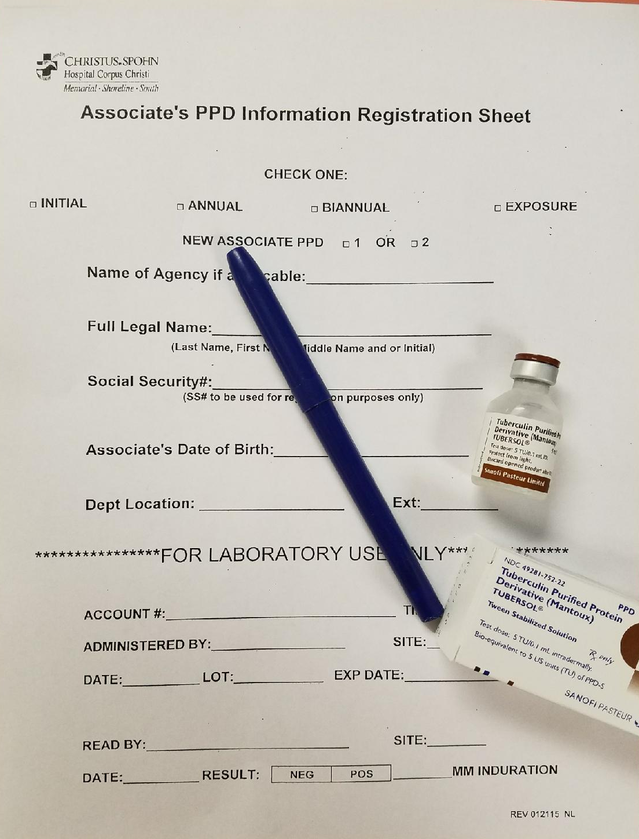
Note Name of Agency if applicable line on registration sheet. Charges for the service is billed to “Client” however result prints to “Location” as required by CHRISTUS.
CHRISTUS associates are registered to Client -AS.EMP
Location AS.OCC.
Agency associates are registered to
-Client-AS.CBRE (BioMed/Maintains)
Location AS.OCC
-Client-AS.ARAMARK (Dietary)
Location AS.OCC
The reason for administering the PPD, Dept Location and Extension information will be enter in the comment window at registration.
i.e. “Annual”, “New Hire #2”, “TB Exposure”

Slide 7
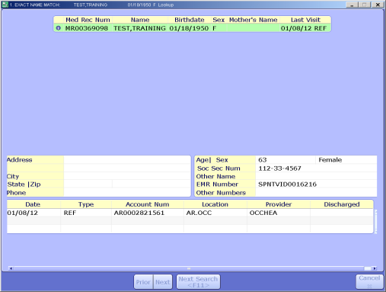
Registration
The pathway for the PPD to be registered;
Specimen Desktop or Registration Desk Top
Enter associate’s #SS to start look up.
LIS will provide a list of
accounts. Review list (Medical Record # to avoid duplication) and verify
previous visit. Note left top corner which reads “Exact Name Match” use
enter key. If it reads “Account look up” use Esc key to avoid selecting old
account and entering new order. (BAR will reject due to Registration
date and Order date do not match)
Ref. section 2.0 of PPD Requisitioning CCP150
*Order the PPD5TU once registration is completed.

Slide 8
Administering PPD Antigen
(MANTOUX METHOD SKIN TESTING)
Antigen Storage and stability
The PPD solution is stored between 2-8 C. A new vial must be dated when opened. The solution expires after 28 days.
Follow the CDC recommended hand hygiene technique and Hospital policy for patient ID.
*Ask patient if they have ever had a
positive TB skin test
*If the answer is “YES” do not give
skin test. Refer to Occ Health nurse.
*Out Patient/Associate- Verify if
patient/associate can return for PPD
reading 48 hours (max 72 hours)
*If answer is “NO” do not administer
antigen and reschedule for a later date

Slide 9
*If answer is “YES” select site.
**Gloves should be worn.**
*Prepare 1cc tuberculin syringe with 0.1 ml of test antigen
Because of absorption onto plastic, the antigen should be
drawn into the syringe immediately before use.
*Clean selected site, and allow to dry. The left forearm is the
standard site, if another site must be used, the
specific site must be documented in the record
*Stretch the skin taut between thumb and index
finger. Face bevel upward and hold needle
and syringe almost parallel to insure proper
intradermal puncture
*Carefully insert needle just below skin surface.
The tip of the needle should be seen through
the skin
*Slowly inject the antigen. Firm resistance is
felt as the antigen enters the skin. Inject all
of the antigen

Slide 10
*A tense white wheal 5-10 mm in
diameter appears over the point of the
needle. It is important that the needle
is positioned properly
*Wipe away any blood that appears.
A small amount of bleeding is
normal. Too much bleeding indicates
improper administration.
*Mark site, remind patient/associate to
return for reading
*Dispose of needle according to
protocol and document accordingly.
If a wheal does not appear,
repeat PPD at least 2” from
the original site
If left or right forearm
is unavailable, back shoulder
area may be used

Slide 11
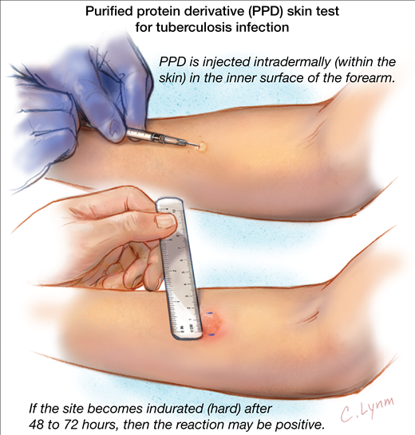
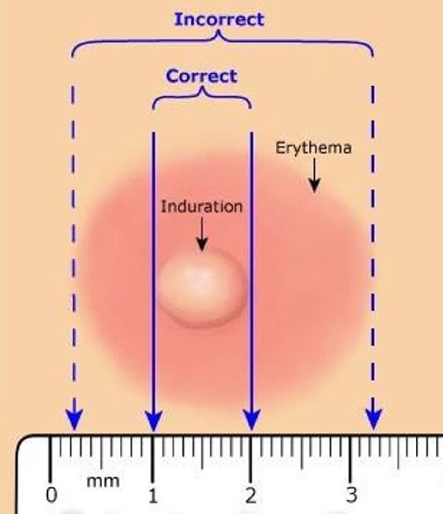
Reading the PPD
*Follow Hospital Policy to ID the patient.
*Read the skin test at 48-72 hours
*A reaction consists of induration, a firm
nodule under and around the site of
injection. This induration is measured
transverse to the long axis of the arm with a
flexible ruler
divided into millimeter (mm)
*Redness (erythema) at the site is ignored. *Any question regarding reading, ask for a
consultation from a microbiology associate
*No reaction is reported as “0 mm” - not as
negative.
*When the associate has a positive reading ask
them to report to Occ Health Nurse. Occ
Health Nurse needs to witness reaction and
do additional assessments.

Slide 12
False Negative TB Skin Test
*Out-of-date tuberculin is used.
*Tuberculin leaks at the injection site.
*Testing is undertaken too early in cases of primary exposure, before
hypersensitivity has developed. (A hypersensitivity reaction generally
takes six to eight to develop.)
*The injection is too deep.
*The test reading is undertaken to early (before 48 hours) or too late (after
one week.)
*The person has an inter current viral infection (such as measles) or has
had a current live viral immunization.
*The person is undergoing corticosteroid therapy (especially if long term) or immunosuppressive therapy.

Slide 13
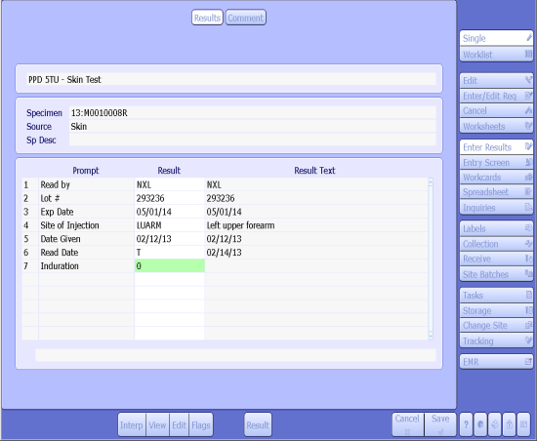
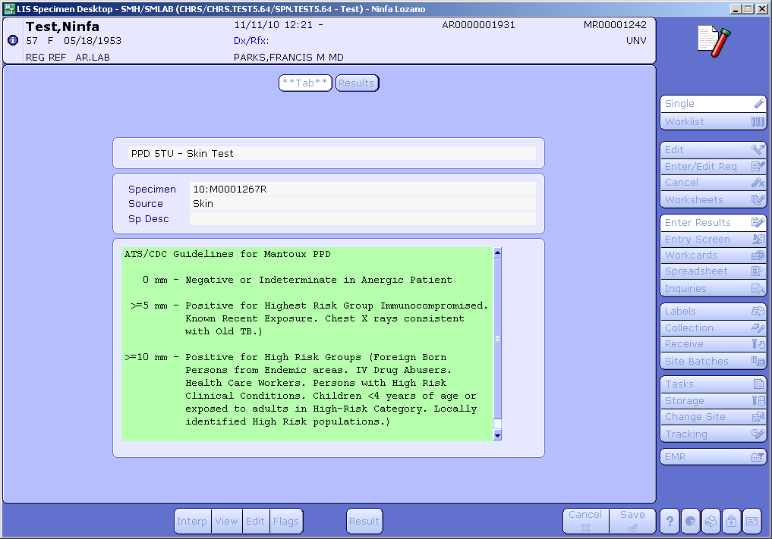
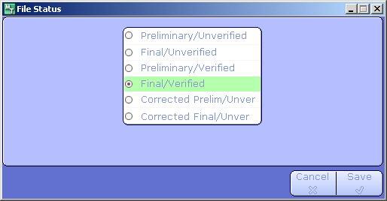
Resulting the PPD
The pathway for the PPD to be resulted;
Specimen Desktop
Enter Result
Enter account number/specimen number
Verify LIS information with reading to be entered.
Ref section 4.0 of PPD Skin Test Collection CCP 120
Provide the associate with a print out of the completed PPD order.

Slide 14
One last detail to completing the PPD directive.
Please report to CP to complete PPD clinical portion.

