Slide 1
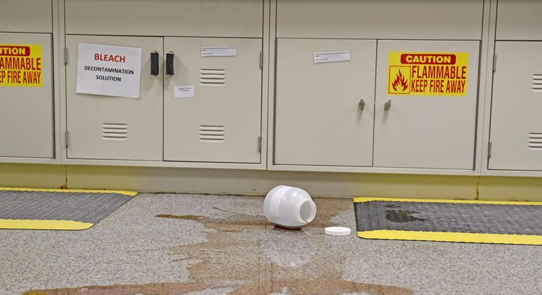
Annual Chemical Hygiene In-service
Notes:
Thank you for joining! This is the 2024 Annual Chemical Hygiene In-service.

Slide 2
Required Objectives
1. I know where to locate laboratory safety policies online and in my lab area.
2. I have read and understand the laboratory CHEMICAL HYGIENE PLAN, Policy SM-05.
3. According to OSHA, I have the right to know about chemicals I may be exposed to in my job. Therefore, I know where to locate:
SDS (online and downtime access)
Laboratory Annual Chemical Inventory, including health hazard information listed.
Copy of OSHA Laboratory Standard (on eSource below lab safety policies)
4. MY INSTRUCTOR HAS ASKED ME TO LOCATE AN SDS ON A SPECIFIC CHEMICAL, CLEANER, OR REAGENT AND HAS ASKED ME TO USE THIS TO EXPLAIN WHAT TO DO IN CASE OF A SPLASH OF THIS CHEMICAL INTO MY EYE.
5. I have been educated about the OSHA label requirements and symbols and the format of SDS sheets which aligns with the UN Globally Harmonized System of Classification and Labeling of Chemicals (GHS). I know that section two of the SDS is where to locate the hazard warnings, especially for chemical mixtures and reagents.
6. I know the location of my laboratory’s FLAMMABLE AND/OR ACID CABINETS, understand the allowable contents, and know how to locate the maximum capacity of chemicals.
MY INSTRUCTOR HAS ASKED ME TO POINT OUT THE MAXIMUM CAPACITY INFORMATION ON THE CABINET.
7. I understand the storage of CORROSIVES and proper handling of HAZARDOUS CHEMICALS. I know where to locate this information. MY INSTRUCTOR HAS ASKED ME TO LOCATE THE FUME HOOD AND EXPLAIN ITS USE.
8. I know to immediately take measures to confine a CHEMICAL SPILL. I know where to locate and understand the use of LABORATORY SPILL KITS AND PILLOWS. I know to notify other lab staff, Risk Management, and Security if a CHEMICAL SPILL occurs. I know to refer to the SDS BEFORE cleaning up a spill.
9. I have read SM-16 and know that dry ice should not be put in sinks or toilets. I am aware that it should be handled in well-ventilated areas and not touched with bare hands.
10. I am aware of signs/symptoms of exposure to chemicals. I have read laboratory safety policy SM-10 and understand signs of exposure specific to xylene and formalin, how exposure is monitored in the lab, and what the PELs are for each.
11. I know that I can look up PERMISSIBLE EXPOSURE LIMITS (PELs) on the OSHA website: https://www.osha.gov/annotated-pels
12. I am aware that I can minimize my exposure risk by using standard PPE and by following handling and additional PPE guidelines found in the Chemical Hygiene Plan.
Notes:
These are the required objectives as outlined in the Chemical hygiene policy SM-05. This is part of the safety policies that are checked off each year in your annual safety tour.

Slide 3
Review the following policies
SM-05 Chemical Hygiene Plan
SM-10 Formaldehyde/Xylene Vapor Monitoring
SM-16 Handling of Cryo Materials
Notes:
These policies encompass all of the chemical hygiene guidelines. You are required to review them annually and this is part of the annual safety tour form that staff have read and understood these policies.

Slide 4
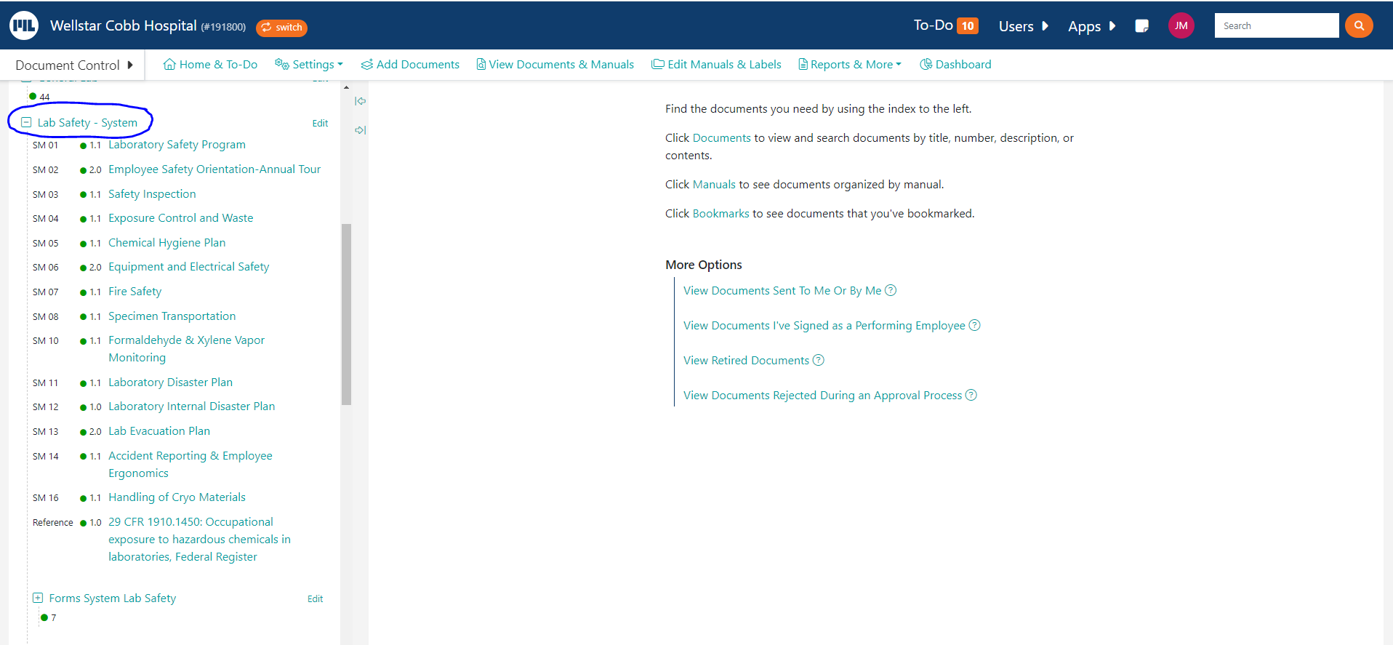
I know where to locate laboratory safety policies online and in my lab area.
System safety policies are located on the education shelf in red binders (education shelf next to safety shower) and in Media Lab.
Notes:
Does everyone know where to locate the system lab safety policies? They are located in MediaLab under the Lab Safety-System manual and in a red binder on the education shelf.

Slide 5
You have the right to know about chemicals you may be exposed to in your job. Therefore, all team members should know where to locate the following:
SDS (online and downtime access)
Laboratory Annual Chemical Inventory, including health hazard information listed.
It is located on the F Drive (F:\Shr_data\LB\COBB\CHEMICAL INVENTORY\CHEM INV 2024)
Copy of OSHA Laboratory Standard (on eSource below lab safety policies.
Esource>departments>laboratory services>manuals>laboratory safety policy manual>OSHA laboratory standard
Notes:
You have the right to know about any chemical that you could be exposed to in the lab. Do you know where to locate the SDS? On the esource home page on the bottom. There is an example on the next slide. There is unlikely to be a time where you would need to access the SDS during a downtime. If you do, there is a USB drive located in the red safety procedures notebook in gen lab that will have copies of our entire binder. It will be on the inside in the pocket of the notebook. We also perform an annual chemical inventory that includes health hazard information. If you would like to view it, the pathway is below. A copy of the OSHA lab standard is on esource on the pathway below as well.

Slide 6
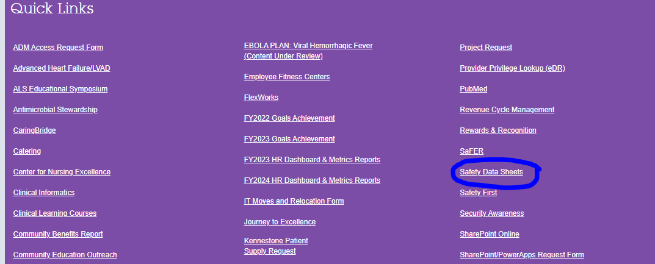
Locate an SDS
Notes:
Go to the bottom of the esource home page and select ‘safety data sheets’, this takes you directly to the HSI platform where you can search for a chemical. Let’s locate an SDS for bleach since this is used in most departments.

Slide 7
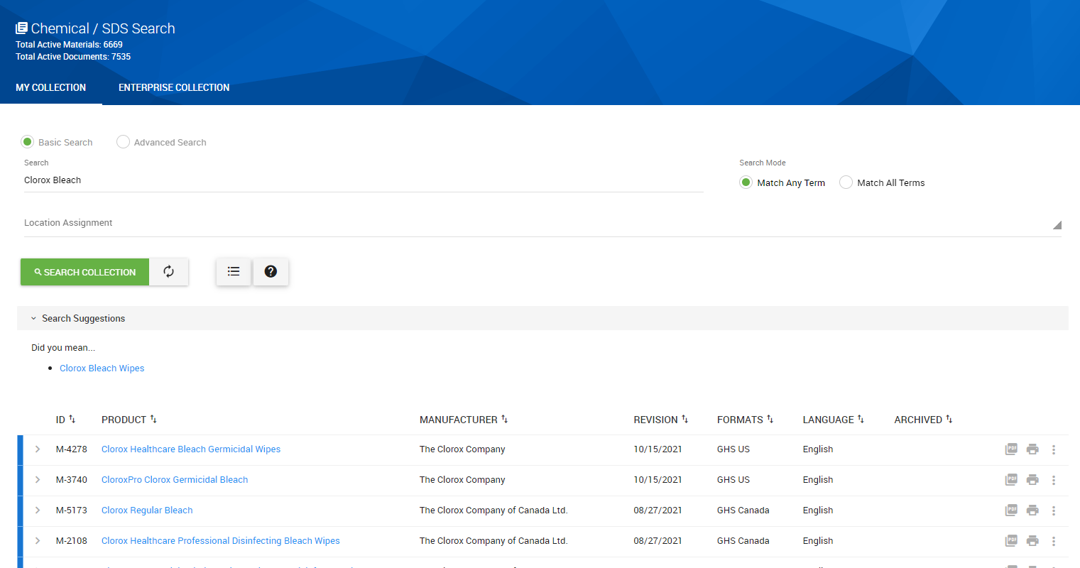
Clorox Bleach SDS
Notes:
You will likely have several options for chemicals with the same name, try to choose the one with the correct concentration. It will not likely change first aid for any employee, but it could change how a spill is cleaned up.

Slide 8
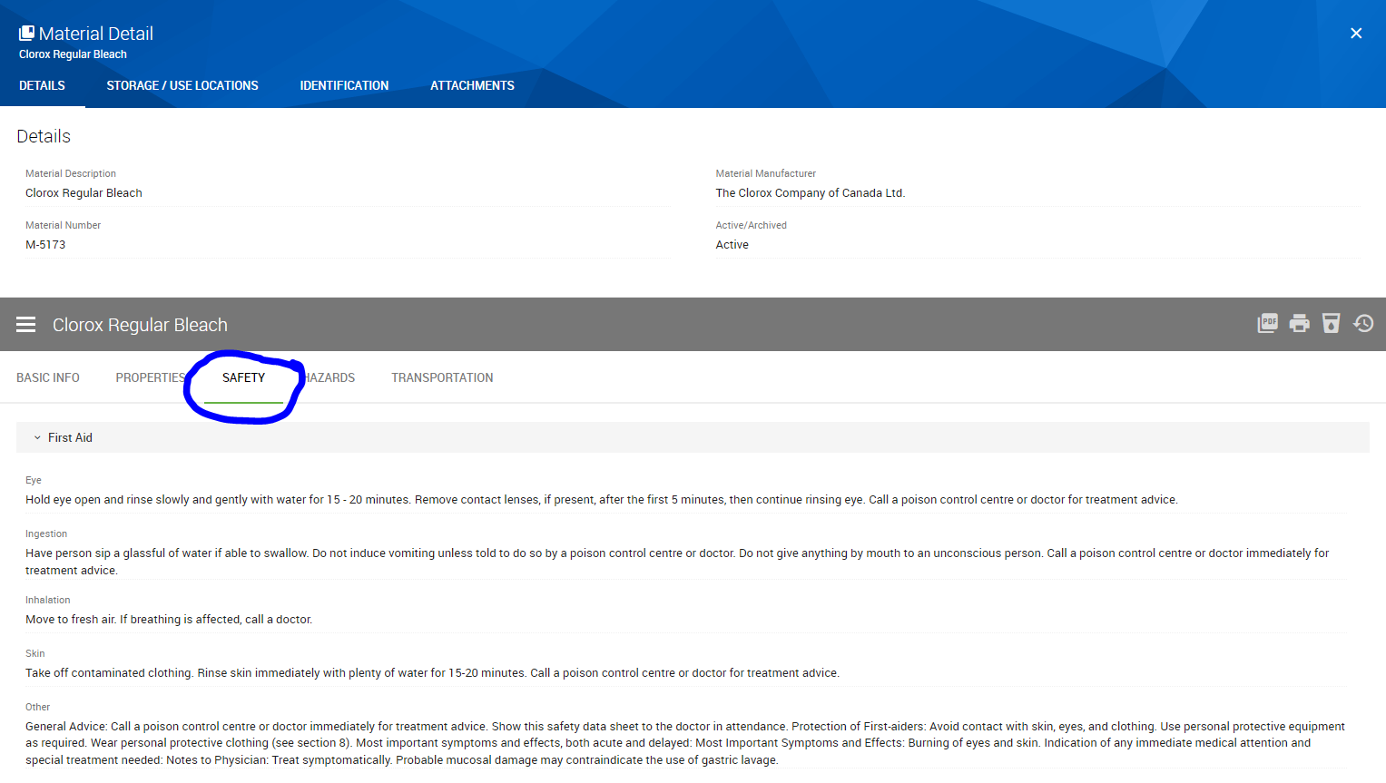
Notes:
When you bring up the chemical, the green tab will automatically default to basic info, you can click on safety, and it will take you to the immediate first aid measures. If you want to view the full SDS, just click on the gray PDF button on the right. You can also print any necessary secondary container labels from here.

Slide 9
OSHA Labeling Requirements-Secondary Containter
Product Identifier (chemical name)
Supplier Identification (manufacturer’s name, address, contact info)
Pictogram(s)
Signal Word
Precautionary Statements
Hazard Statements
Notes:
These are the OSHA labeling requirements for secondary containers.

Slide 10
Secondary Container label example
Notes:
The secondary labels can be printed directly from the SDS program HSI. After you have located the correct chemical, select the print button, choose label size and print the number of labels needed. HSI will auto-populate the necessary information for the label.

Slide 11
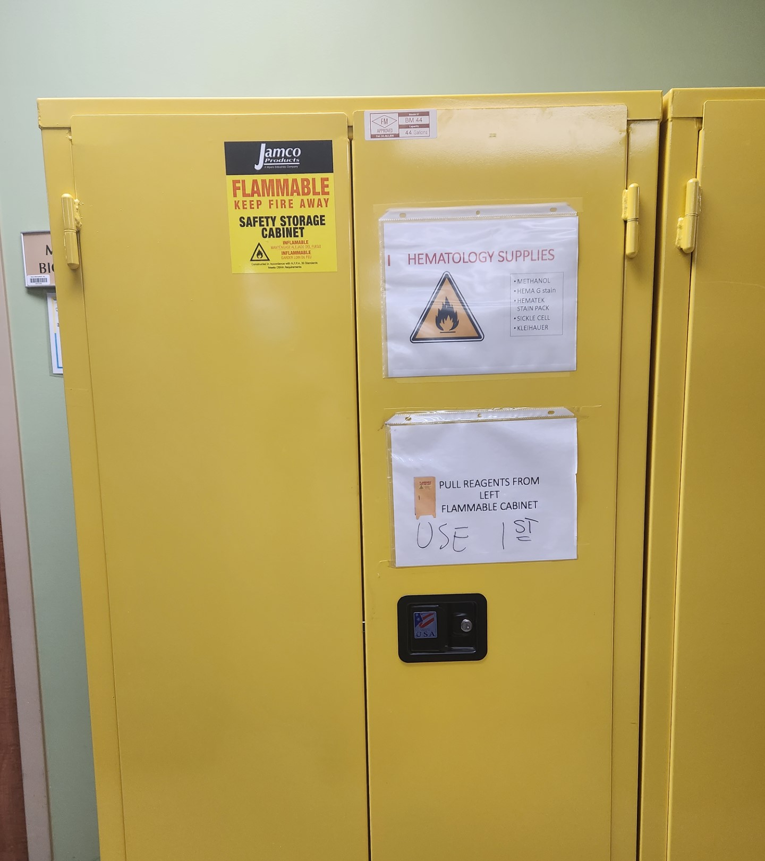
Where are the flammable storage cabinets located?
What is the purpose of a flammable storage cabinet?
Where can you find the maximum capacity on the cabinet?
Notes:
Where are the flame cabinets located? Flame cabinets are located in the hallway, next to walk-in fridge entrance, hematology, blood bank, histology, and cytology. What is the purpose of the flame cabinet? The purpose of the flame cabinet is to protect flammable contents for a certain amount of time during fire conditions. This allows for extra time for evacuation and gives emergency responders more time to control the fire before it gets to the dangerous material. Where can you find the maximum capacity on the cabinet? (go to next slide for answer)

Slide 12
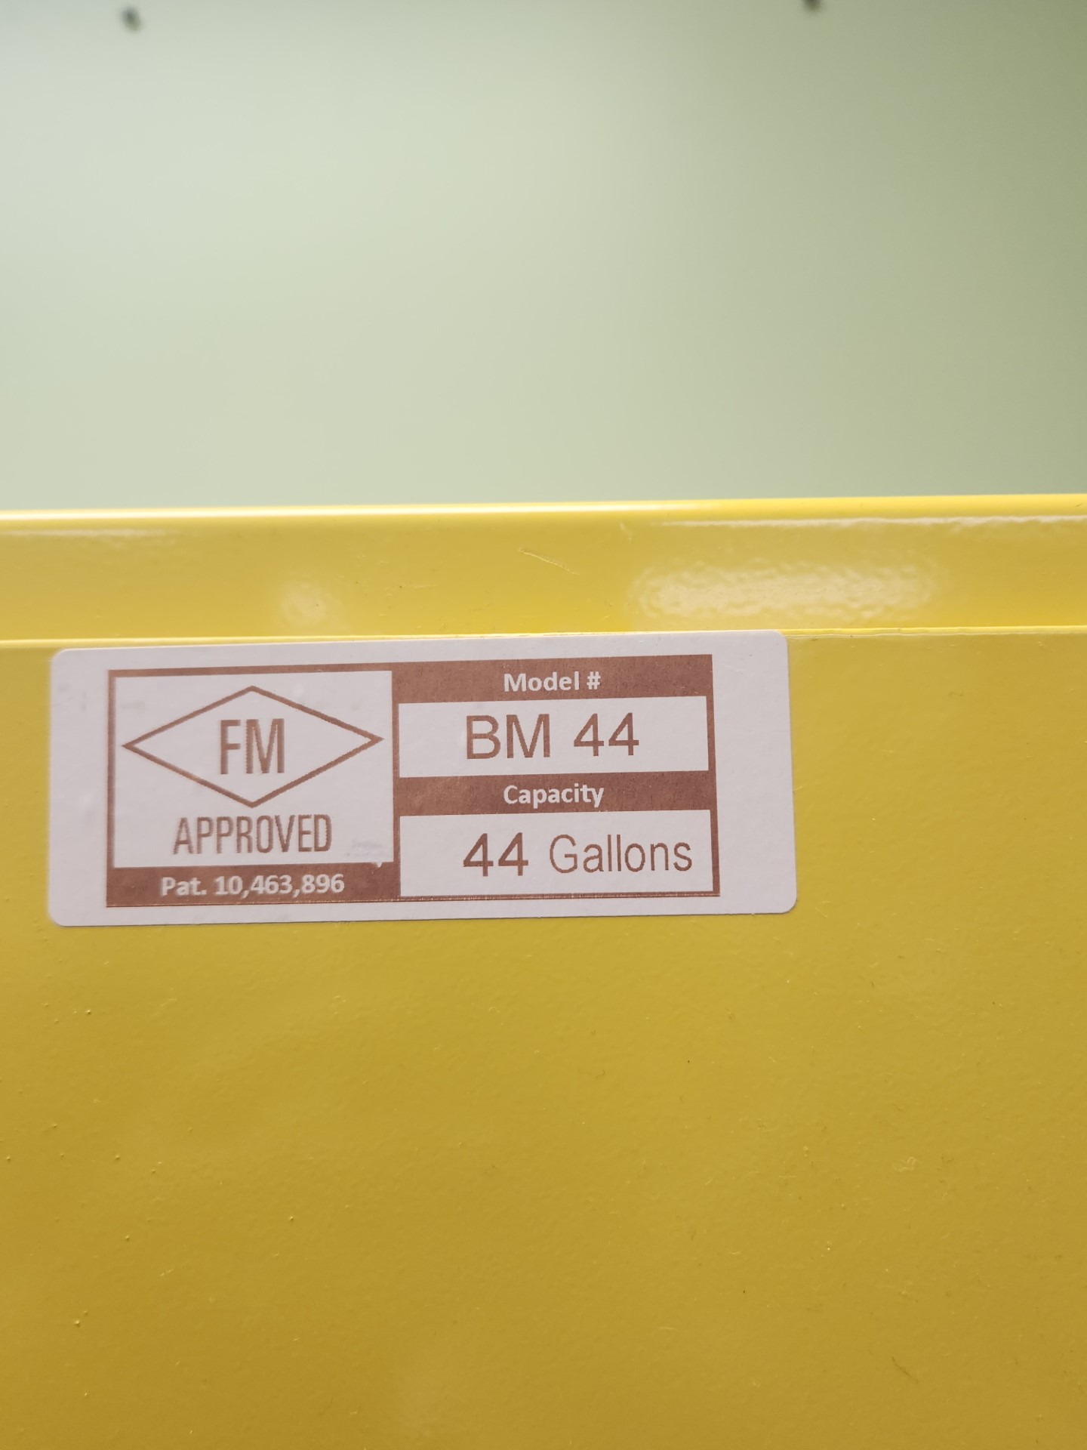
The storage capacity should be on the front of the flame cabinet.
Notes:
The maximum capacity is either located on the front of the cabinet or on the door on the inside of the cabinet.

Slide 13
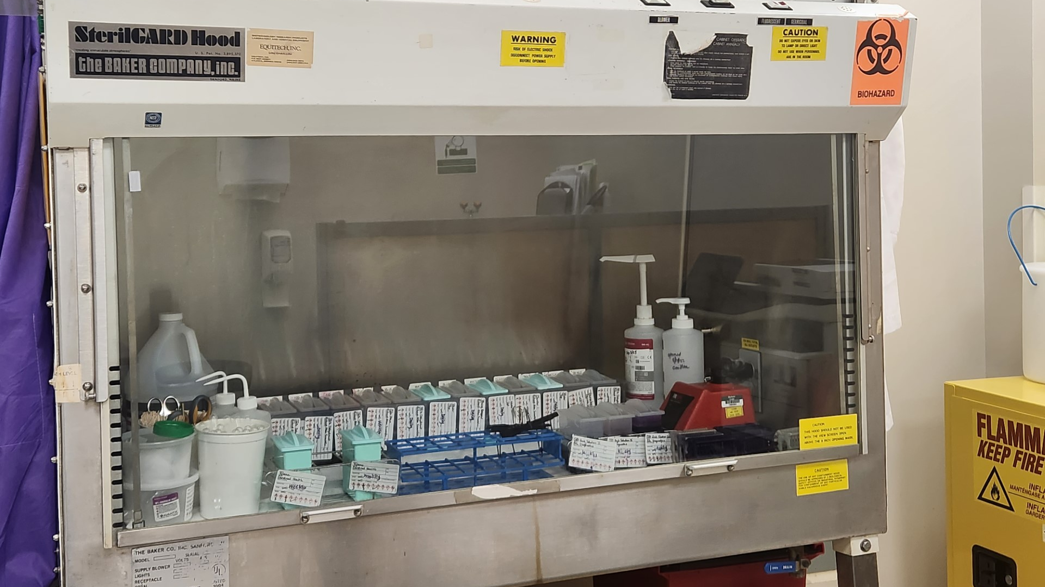
Where is the fume hood located and what is its purpose?
Notes:
Where is the fume hood located and what is its purpose? The fume hood is located in cytology. The purpose of a chemical fume hood is to prevent the release of hazardous substances into the general laboratory space by controlling and then exhausting hazardous and/or odorous chemicals.

Slide 14
What is the significance of the blue flame cabinet? What makes it different from the yellow cabinets?
Notes:
What is the difference between the blue and yellow flame cabinets? The blue ones are used to store corrosive chemicals like acids, and they are vented to evacuate hazardous vapors. The yellow ones are not vented.

Slide 15
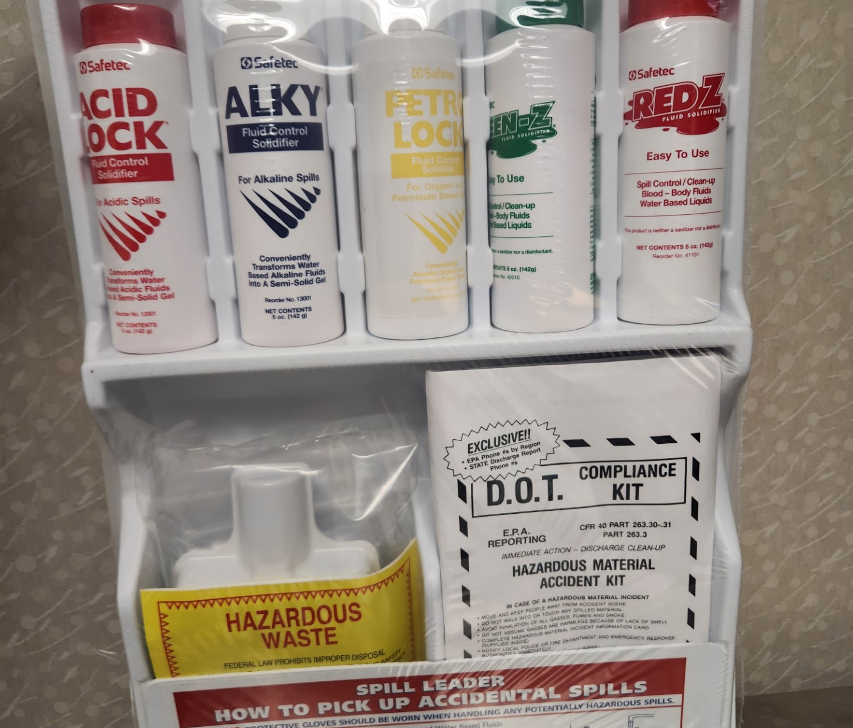
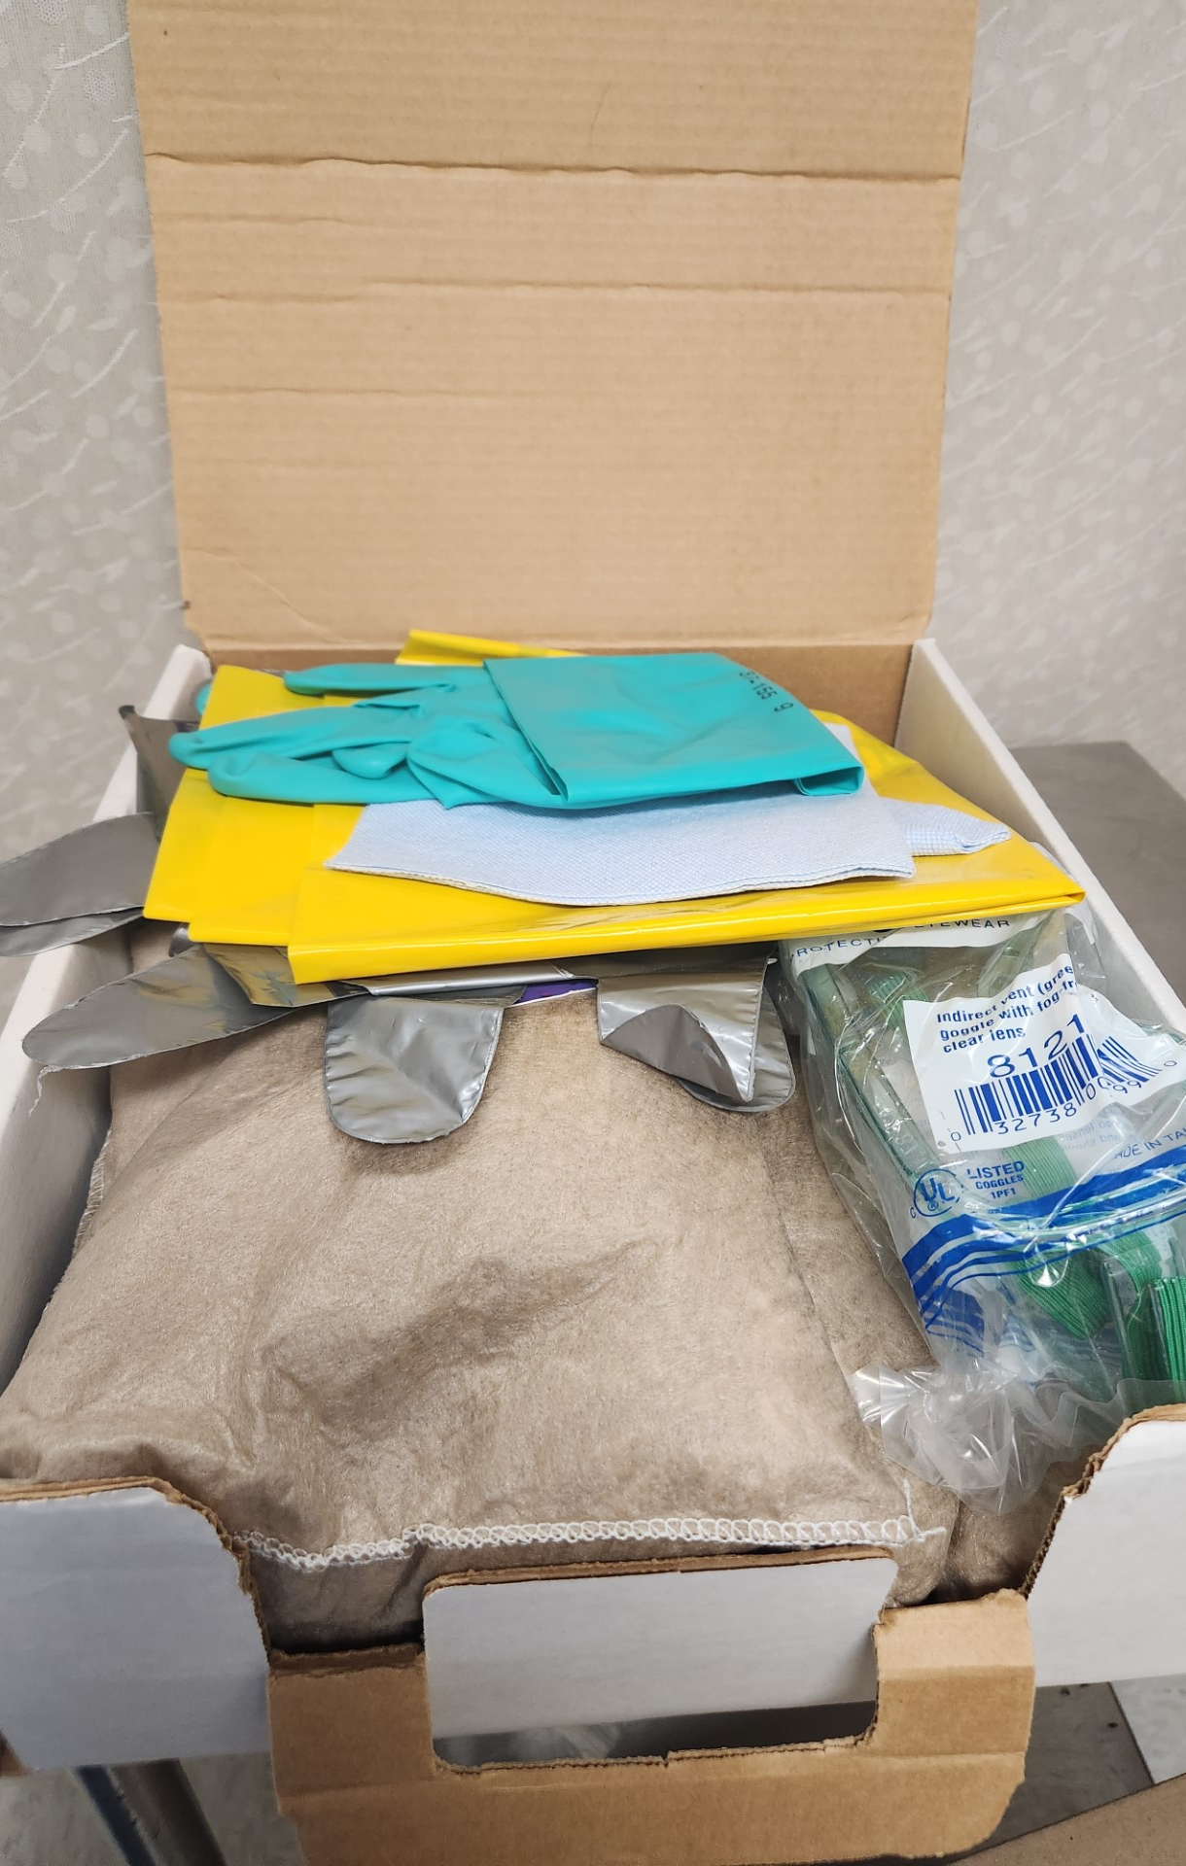
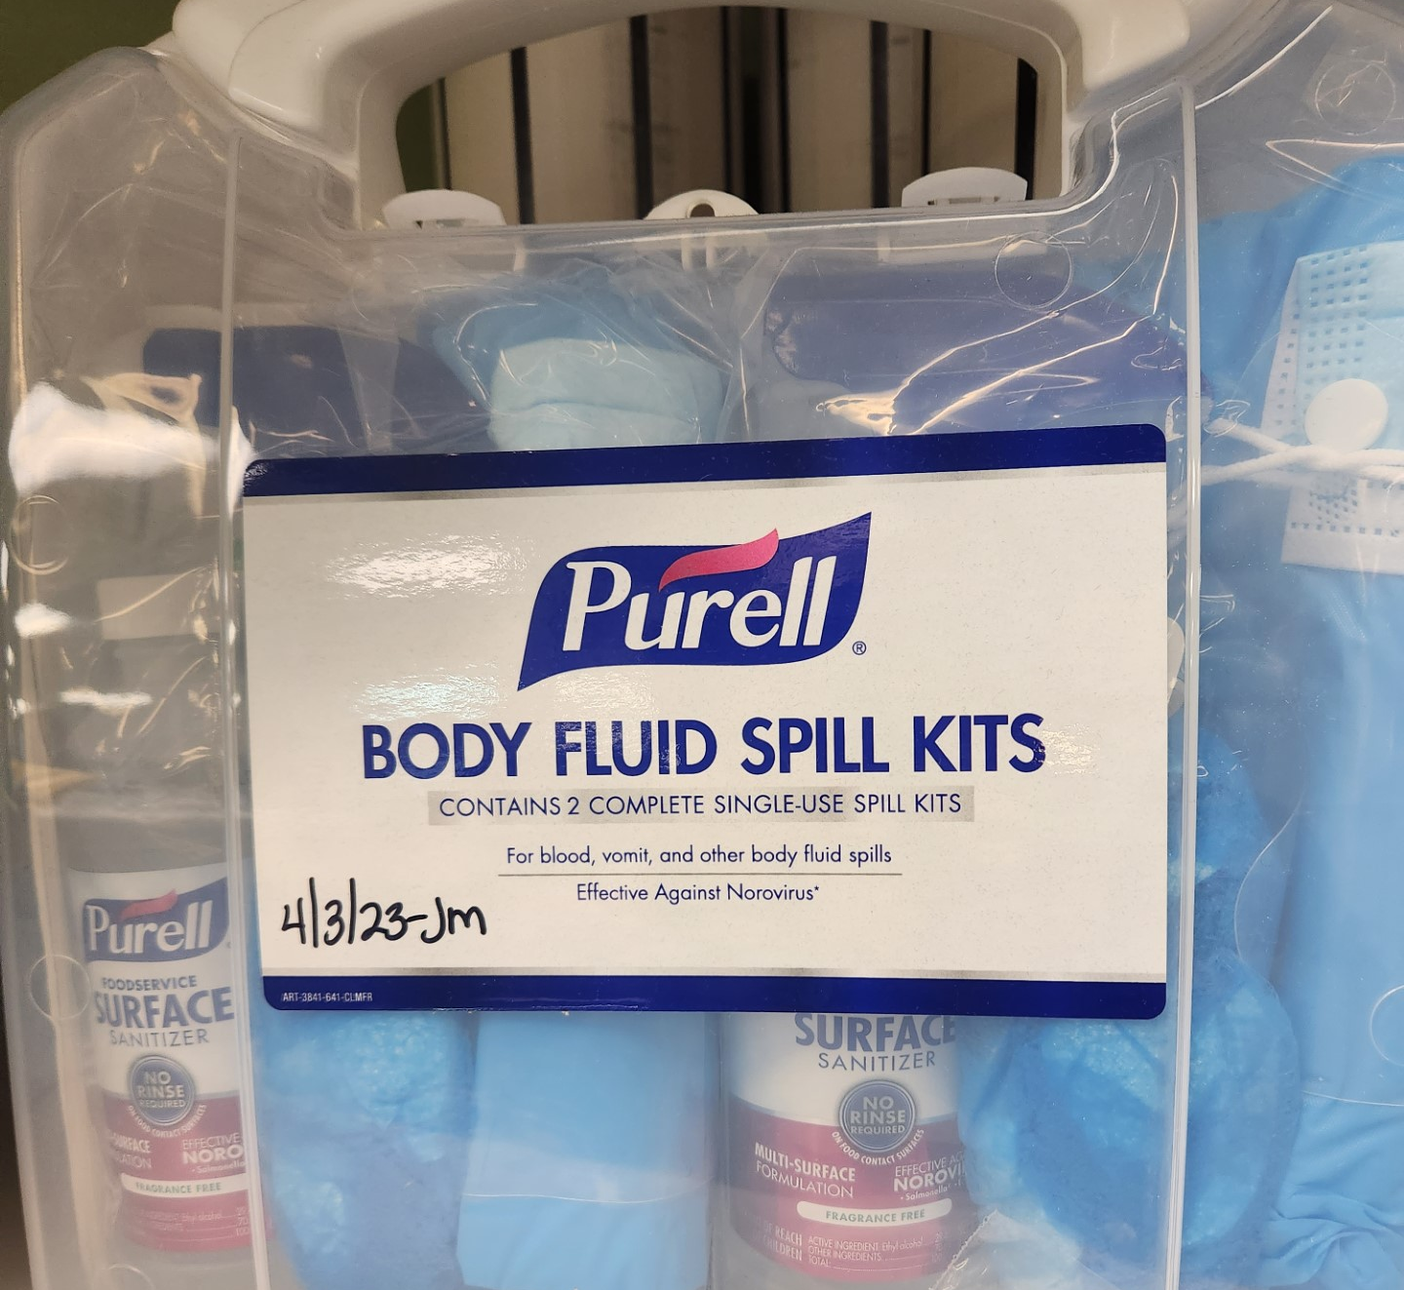
Where are the spill kits located?
What is the first step before cleaning up a chemical spill?
Who do you notify that a chemical spill has occurred?
Notes:
Where are the spill kits located? Spill kits are located in each department. For gen lab, they are located on the top of the education shelf. There are spill kits for chemicals and body fluids. What is the first step before cleaning up a chemical spill? Always consult the SDS before cleaning up a chemical spill. Who do you notify a chemical spill has occurred? Per policy, immediately notify lab staff, Risk Management, and Security. If it is an off shift, notify house supervisor so they can contact risk management.

Slide 16
What is the appropriate way to handle/store dry ice?
Use insulated gloves, safety goggles/glasses, and wear a lab coat to avoid exposing skin to the severe cold. Do not touch with bare hands.
Use dry ice tongs or a scoop to handle.
Containers used for the storage of dry ice should not be airtight.
Containers used for the storage and/or handling of dry ice should be designed for exposure to ultralow temperatures.
Dry ice should be handled in well-ventilated areas. Do not store in areas without adequate ventilation (walk-in refrigerators, for example).
Label any container used to hold dry ice.
Dry ice should not be placed directly onto bench tops, laminated countertops, or in ceramic sinks.
Do not put or dispose of dry ice in sewers, sinks, or toilets. Allow it to evaporate slowly in a well-ventilated area, preferably outdoors.
Notes:
What is the appropriate way to handle and store dry ice? Use insulated gloves and do not store in an air-tight container. Dry ice evaporates to form carbon dioxide gas, which does not support life. Exposure can cause respiratory distress and eventual suffocation. Be careful when using, please check on your co-workers if you see any signs of exposure.

Slide 17
What are the signs and symptoms of a chemical exposure?
Notes:
What are sign/symptoms of chemical exposure? (answers on next slide)

Slide 18
Signs/Symptoms
Symptoms of acute exposure to xylene include:
Irritation of eyes, skin, nose, throat
Dizziness, excitement, drowsiness, incoherence, staggering gait
Dermatitis
Symptoms of acute exposure to formaldehyde include:
Irritation of eyes, skin, nose, throat, respiratory system
Tearing
Coughing, sneezing, wheezing
Dermatitis
Notes:
These are the signs and symptoms of a chemical exposure involving xylene and formaldehyde as outlined in safety policy SM-10. If any of your histo friends are showing any of these symptoms please assist them in getting help.

Slide 19
How are permissible exposure limits monitored?
Notes:
Does anyone know how permissible exposure limits are monitored? (explanation on next slide)

Slide 20
How exposure limits are monitored
Monitors designed to measure time weighted average concentrations are used for either personnel or area monitoring.
In Anatomic Pathology areas, employees are monitored by use of passive badges which are given out at the start of the employee’s shift. Employee verification paperwork included in the badge monitoring container should be completed by the employee being tested before monitoring is started.
The badge is worn near the breathing zone (as close to inhalation point as possible) of personnel exposed or placed in the area to be monitored.
At the end of the shift, the badge should be placed in a sealed transporting bag along with the information paperwork (retain a copy prior to sealing).
Monitors are shipped via FedEx to the badge manufacturer for analysis and resulting.
Notes:
They are monitored in histology. A histology employee wears a monitor on their badge for an entire shift. The monitor is then shipped back to the manufacturer for analysis. This is to ensure employees are not being over exposed to chemicals.

Slide 21
PERMISSIBLE EXPOSURE LIMITS (PELs) are available on the OSHA website: https://www.osha.gov/annotated-pels
Notes:
If you want to learn more about permissible exposure limits for chemicals, please visit this website for more information.

Slide 22
How can you minimize your exposure risk to chemicals?
Notes:
How can you minimize your exposure risk to chemicals? By using standard PPE and by following proper handling and PPE guidelines found in the Chemical Hygiene Plan.

Slide 23
Questions?
Notes:
Any questions? Thank you everyone!

