Slide 1
Body Fluid Lining Cells
By: Victoria Jones
Lead Hematology
MLS(ASCP)
Date: 09/12/2024

Slide 2
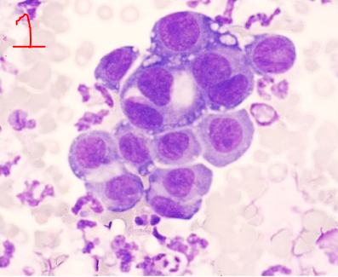
Mesothelial Cells
Mesothelial cells line the pleural, peritoneal, and pericardial spaces. The cells may shed individually or in clusters. The nucleus is round to oval with a definitive nuclear membrane and regular contour. Nuclear chromatin varies from dense to fine but is evenly distributed. Multiple nuclei remain of approximately equal size and shape, one or more nucleoli may be present. The nuclear-to-cytoplasmic ratio usually is less than 1:1 and the nucleus may be central or eccentrically placed. The cytoplasm is light to dark blue and may have grainy texture. The individual cells in the mesothelial cluster (seen in Image 1) maintain the round nucleus and generous basophilic cytoplasm that can be seen in individual mesothelial cells. The boundaries between cells are usually clear and distinct. This image contains two binucleate mesothelial cells in this mesothelial cluster.

Slide 3
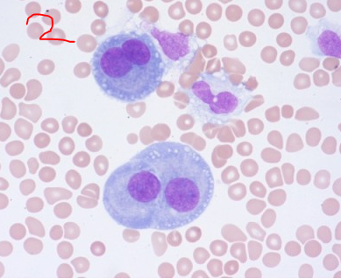
Mesothelial Cells
Binucleate mesothelial cells (seen in Image 2) are a normal variant found in any fluid with mesothelial cells. Rarely, trinucleate mesothelial cells can be seen; however, any fluid that has mesothelial cells with more than 3 nuclei is abnormal and should be sent for hematology or pathology review

Slide 4
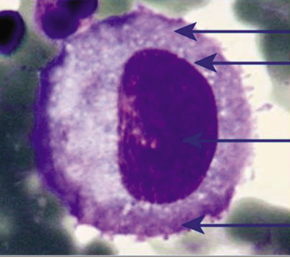
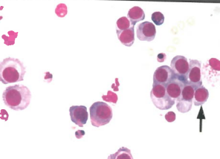
Mesothelial Cells

Slide 5
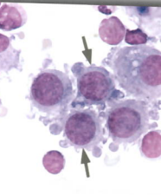
Reactive Mesothelial Cells
The arrowed cells expressed here are reactive mesothelial cells. They are large, with large nuclei and abundant cytoplasm. The nuclear chromatin is reticulated, and an occasional nucleolus is present. The round nuclei have a regular contour and prominent membrane. The cytoplasm is basophilic and grainy with an occasional degenerative vacuole. Prominent cytoplasmic blebs and pseudopod formation are evidence of cell degeneration.
These cells don’t need path review

Slide 6
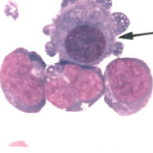
Reactive Mesothelial Cells
Reactive mesothelial cell with the three lymphoma cells. The mesothelial cell is large with a low nuclear-to-cytoplasmic ratio; the lymphoma cells have a much higher ratio. The nuclear chromatin is reticular and the nucleolus is apparent. However, the nuclear contour is round and regular, with a defined nuclear membrane. The small vacuoles and cytoplasmic “pseudopods” in the mesothelial cell represent degenerative/cytocentrifuge artifactual changes.

Slide 7
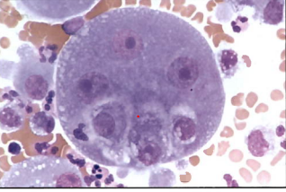
Benign vs Malignant Cells
In Malignant cells, the nuclear molding, or indentation of the nucleus in one cell by the nucleus of a separate cell, may occur. The arrangement maybe spheroidal in shape or can assume a linear file appearance.
Malignant clusters look like they “grew together” forming a morula-like or three-dimensional structure. It is difficult to tell where the cytoplasm of one cell stops and the other begins. The outer border of the cell cluster is continuous and smooth and may be darkly stained.
In Benign cells, the cells rarely show nuclear molding and contact between two nuclei is seen only with phagocytosis.
Clusters of benign cells look like they came together with demarcation lines or thin spaces. Adjacent mesothelial cells may have a “pincer-like” junction. The outer border of the cell cluster is discontinuous.

Slide 8
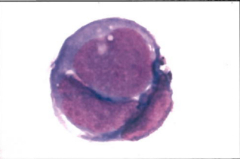
Malignant Mesothelial Cells
Notice the top photo is a tri-nucleated mesothelial cell which has engulfed three other mesothelial cells and a PMN. The nucleoli are much larger than you would expect in a reactive meso cell.
The bottom photo is a tight group of cells from a small cell lung carcinoma. The cells show cannibalism. The two cells in the center have been swallowed by a third whose nucleus molds to the engulfed contents.

Slide 9
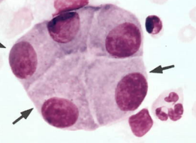
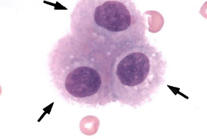
Ventricular Lining Cells
Cells lining the ventricles (ependymal cells) or (choroidal cells) may shed into the CSF, mostly in neonates or in the presence of a ventricular shunt. These cells are not clinically significant but must be distinguished from malignant cells.
In the top photo, notice the ventricular cells are in a small cluster. They are cuboidal, with round to oval nuclei, bland nuclear chromatin, inconspicuous nucleoli and a clearly defined nuclear membrane.
The bottom photo shows a group of ventricular cells that are very large in contrast to the red blood cells. They show round to oval nuclei, bland grainy nuclear chromatin, inconspicuous nucleoli, and a prominent smooth nuclear membrane. The cytoplasm has a grainy texture and is amphophilic (pink and blue). Notice the prominent microvilli, which suggest these cells are from the choroid plexus.

Slide 10
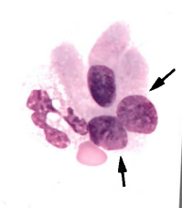
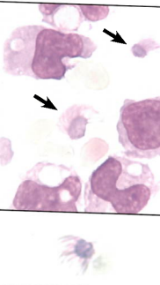
Bronchial Lining Cells
The elongated rectangular cell with the cilia at the end (indicated by the red arrow) is a bronchial lining cell. These cells are frequently present in BAL samples.
We are not including bronchial Lining Cells in our count. I just wanted to make sure everyone knew what they looked like.

Slide 11
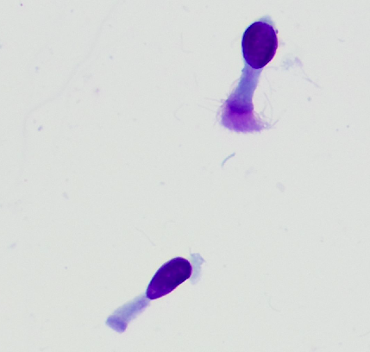
Bronchial Lining Cells
Ciliated bronchial lining cells may be obtained as a contaminant in bronchoalveolar lavage (BAL) fluid, indicating sampling from the bronchial tree. These cells have a unique appearance with a columnar shape, a basally placed oval to round nucleus, coarsely stippled chromatin, inconspicuous nucleolus, and amphophilic to pink cytoplasm with a row of cilia at one end. They are seen as single cells or in small clusters.

Slide 12
Follow This Chart For Reporting Lining Cells

