Slide 1

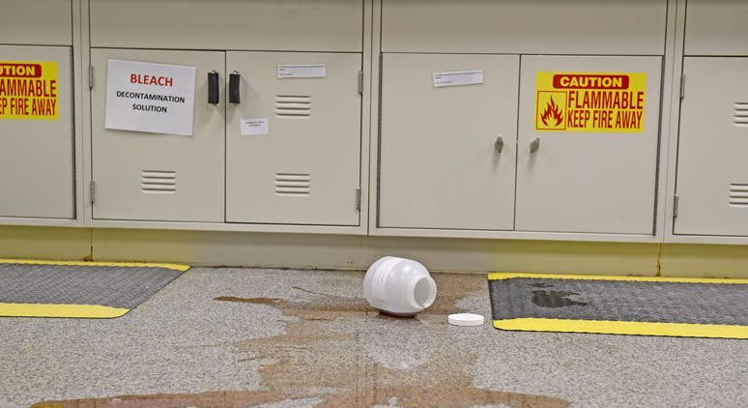
Annual Chemical Hygiene In-service
Notes:
Hello! Thank you for watching the 2024 Annual Chemical Hygiene In-service. Depending on your lab location, some of the information presented may not be applicable to your work environment.

Slide 2
Required Objectives
1. I know where to locate laboratory safety policies online and in my lab area.
2. I have read and understand the laboratory CHEMICAL HYGIENE PLAN, Policy SM-05.
3. According to OSHA, I have the right to know about chemicals I may be exposed to in my job. Therefore, I know where to locate:
SDS (online and downtime access)
Laboratory Annual Chemical Inventory, including health hazard information listed.
Copy of OSHA Laboratory Standard (on eSource below lab safety policies)
4. I CAN LOCATE SDS ON A SPECIFIC CHEMICAL, CLEANER, OR REAGENT AND HAS ASKED ME TO USE THIS TO EXPLAIN WHAT TO DO IN CASE OF A SPLASH OF THIS CHEMICAL INTO MY EYE.
5. I have been educated about the OSHA label requirements and symbols and the format of SDS sheets which aligns with the UN Globally Harmonized System of Classification and Labeling of Chemicals (GHS). I know that section two of the SDS is where to locate the hazard warnings, especially for chemical mixtures and reagents.
6. I know the location of my laboratory’s FLAMMABLE AND/OR ACID CABINETS, understand the allowable contents, and know how to locate the maximum capacity of chemicals. If applicable, I CAN POINT OUT THE MAXIMUM CAPACITY INFORMATION ON THE CABINET.
7. I understand the storage of CORROSIVES and proper handling of HAZARDOUS CHEMICALS. I know where to locate this information. If applicable, I CAN LOCATE THE FUME HOOD AND EXPLAIN ITS USE.
8. I know to immediately take measures to confine a CHEMICAL SPILL. I know where to locate and understand the use of LABORATORY SPILL KITS. I know to notify other lab staff, Risk Management, and Security if a CHEMICAL SPILL occurs. I know to refer to the SDS BEFORE cleaning up a spill.
9. I have read SM-16 and know that dry ice should not be put in sinks or toilets. I am aware that it should be handled in well-ventilated areas and not touched with bare hands.
10. I am aware of signs/symptoms of exposure to chemicals. If applicable, I have read laboratory safety policy SM-10 and understand signs of exposure specific to xylene and formalin, how exposure is monitored in the lab, and what the PELs are for each.
11. I know that I can look up PERMISSIBLE EXPOSURE LIMITS (PELs) on the OSHA website: https://www.osha.gov/annotated-pels
12. I am aware that I can minimize my exposure risk by using standard PPE and by following handling and additional PPE guidelines found in the Chemical Hygiene Plan.
Notes:
These are the required objectives as outlined in the Chemical hygiene policy SM-05. This is part of the safety policies that are checked off on your annual safety tour. Please pause the video and take a moment to review the objectives.

Slide 3
Review the following policies
SM-05 Chemical Hygiene Plan
SM-10 Formaldehyde/Xylene Vapor Monitoring
SM-16 Handling of Cryo Materials
Notes:
The following policies encompass Wellstar’s chemical hygiene plan and guidelines; system safety policies SM-05, SM-10, and SM-16. All lab staff are required to review these and it is part of the annual safety tour form.

Slide 4
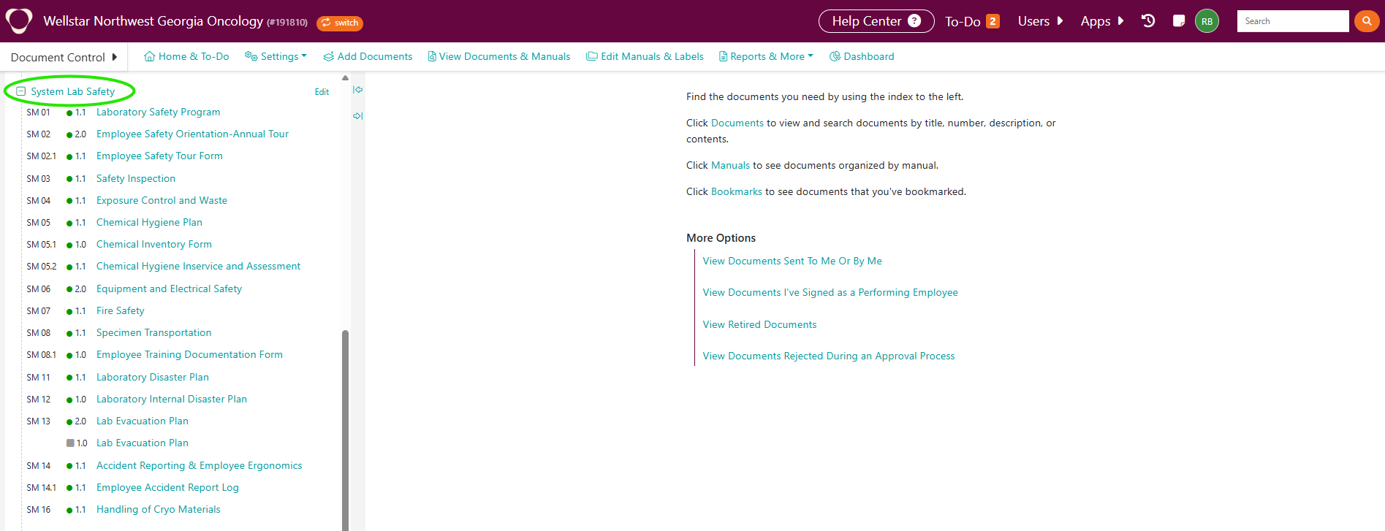
I know where to locate laboratory safety policies.
System safety policies are located in Media Lab in the manual “Lab Safety-System”.
Notes:
Does everyone know where to locate the system lab safety policies? They are located in MediaLab under the Lab Safety System manual.

Slide 5
You have the right to know about chemicals you may be exposed to in your job. Therefore, all team members should know where to locate the following:
SDS
Laboratory Annual Chemical Inventory, including health hazard information listed
Copy of OSHA Laboratory Standard
Located in Media Lab under System Lab Safety policies as a reference
Notes:
You have the right to know about any chemical that you could be exposed to in the lab. Online SDS are located on the HSI platform. To get to the SDS, go to the esource home page and scroll down to the bottom and click “safety data sheets”. There is an example on the next slide. The chemical inventory is performed annually and includes health hazard information. Depending on your location, copies of these may be stored electronically or in a binder. A copy of the OSHA lab standard is on Media Lab in the lab safety system policy manual.

Slide 6
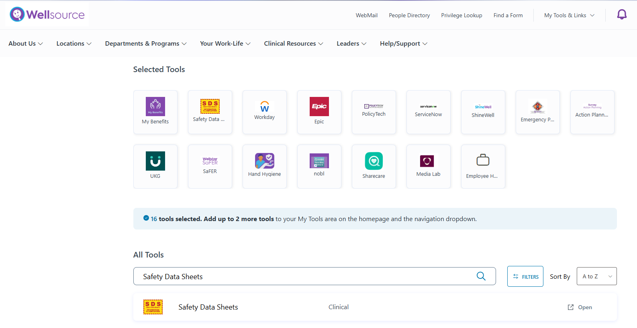



Locate SDS
Locate SDS in Wellsource, customize and add as selected tool or search “All Tools”
Notes:
To locate an SDS on the HSI Platform. Go to the bottom of the esource home page and select “safety data sheets”, this takes you directly to the HSI platform where you can search for a chemical. Let’s locate an SDS together.

Slide 7
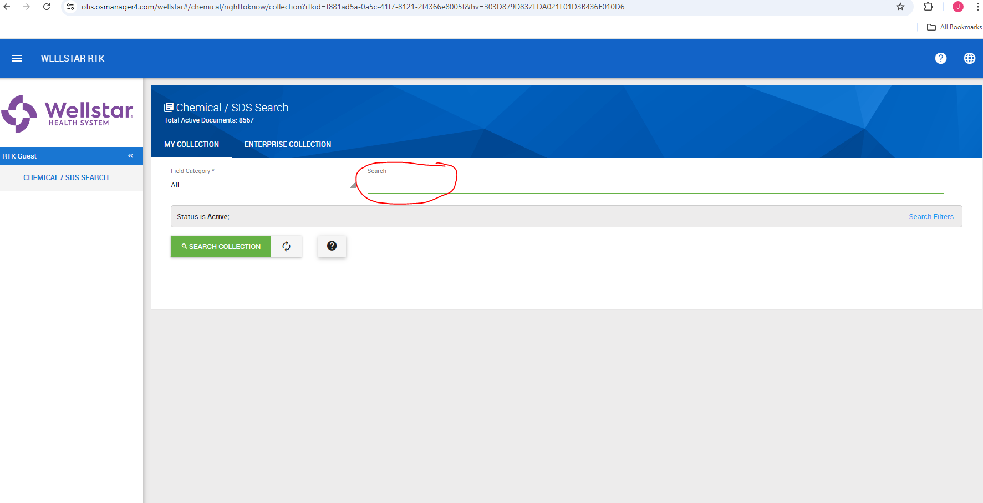
Search for the Chemical.
Notes:
After clicking on “safety data sheets”, you will be directed to the search screen on the HSI platform. Type in the chemical name and hit search collection. For this example, we will use the chemical bleach.

Slide 8
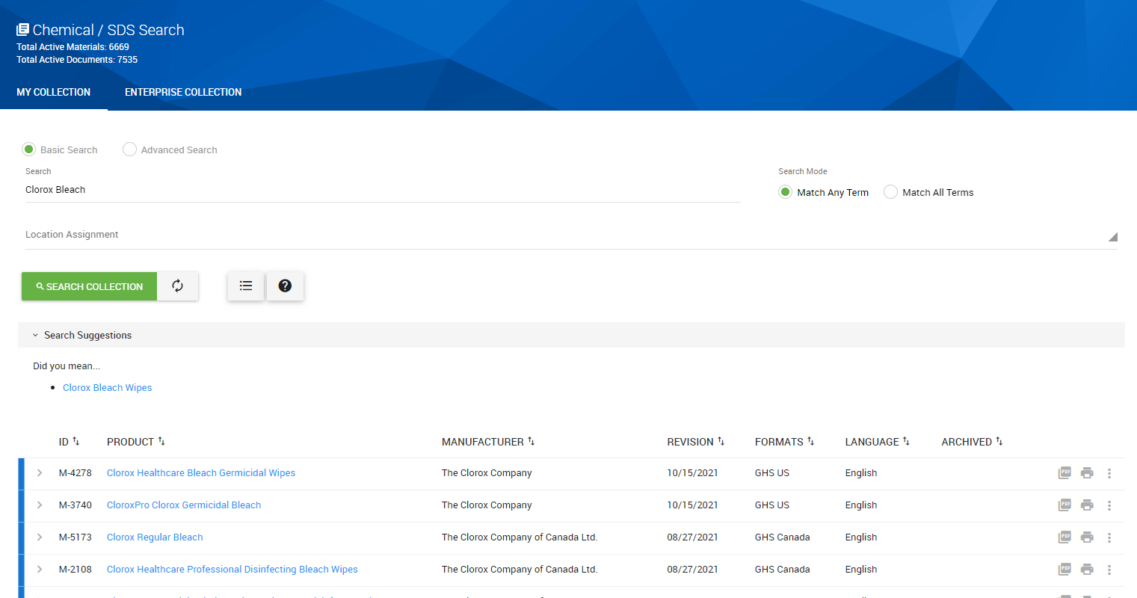
Clorox Bleach SDS
Notes:
You will likely have several options for chemicals with the same name, try to choose the one with the correct concentration. It will not likely change first aid for any employee, but it could change how a spill is cleaned up.

Slide 9
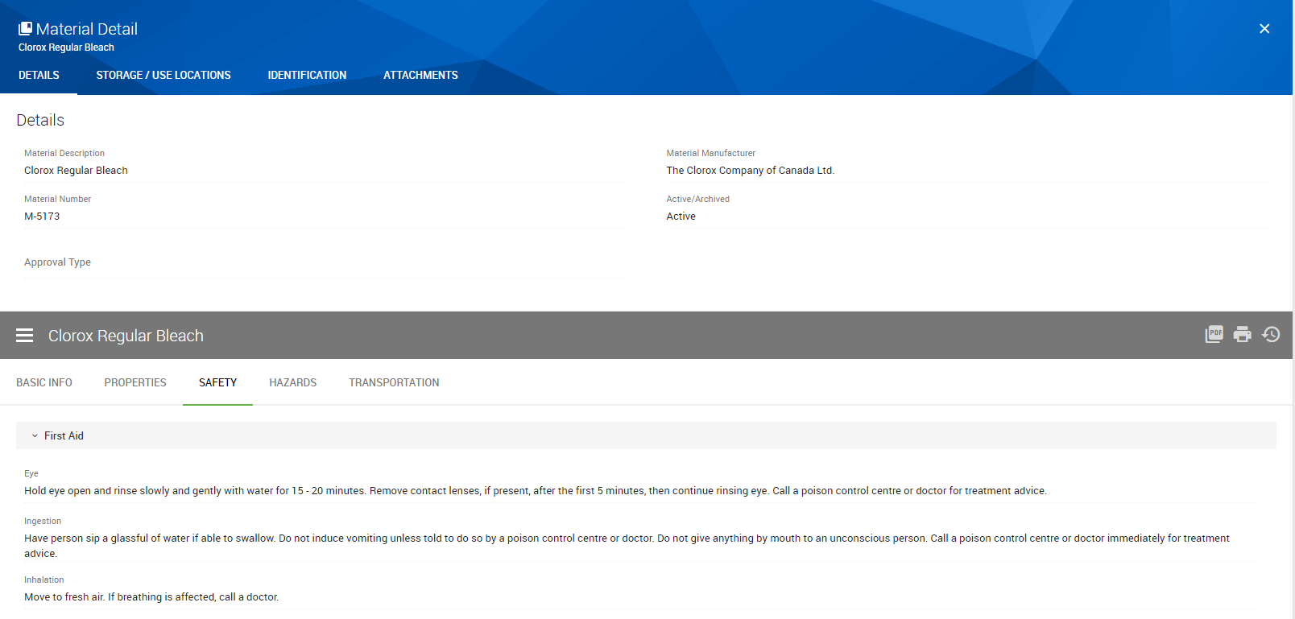
Notes:
After you select your chemical, the green tab will automatically default to basic info, you can click on safety, and it will take you to the immediate first aid measures. If you want to view the full SDS, just click on the gray PDF button on the right. You can also print any necessary secondary container labels from here by clicking on the print icon and following the prompts.

Slide 10
OSHA Labeling Requirements-Secondary Container
Product Identifier (chemical name)
Supplier Identification (manufacturer’s name, address, contact info)
Pictogram(s)
Signal Word
Precautionary Statements
Hazard Statements
Notes:
These are the OSHA labeling requirements for secondary containers. OSHA requires that the label contain the product identifier, supplier identification, pictogram, signal word, precautionary statements, and hazard statements.

Slide 11
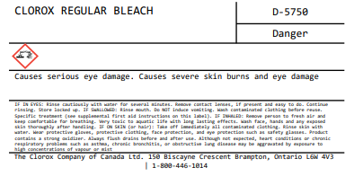
Secondary Container label example
Notes:
This is an example of a secondary container label. The secondary labels can be printed directly from the SDS program HSI. After you have located the correct chemical, select the print button, choose label size and print the number of labels needed. HSI will auto-populate the necessary information for the label.

Slide 12
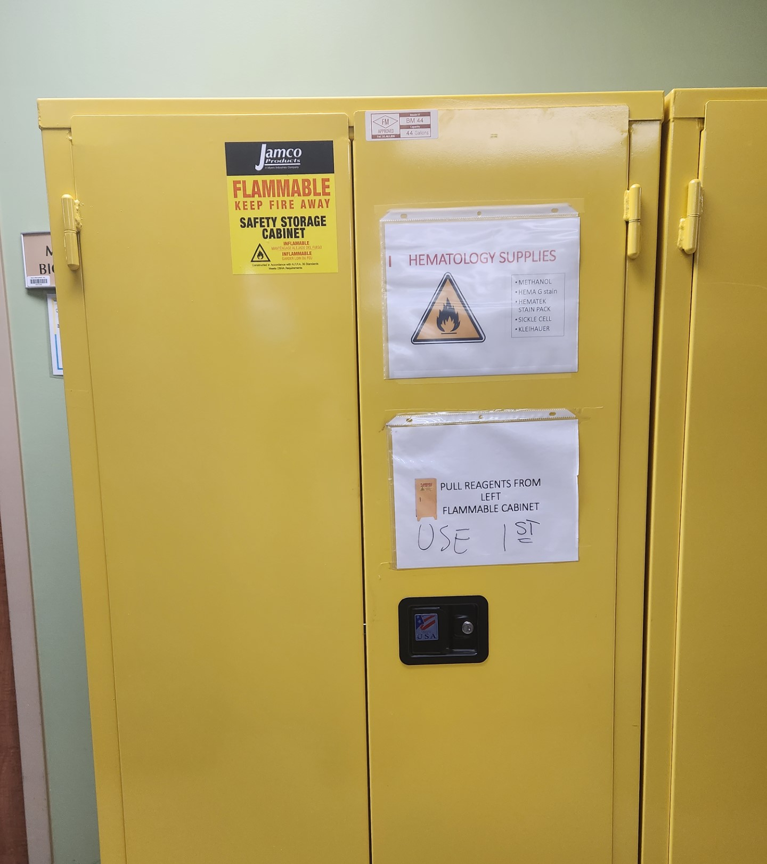
Where are the flammable storage cabinets located?
What is the purpose of a flammable storage cabinet?
Where can you find the maximum capacity on the cabinet?
Notes:
Please take a moment to locate the flammable cabinet at your location. The purpose of the flame cabinet is to protect flammable contents for a certain amount of time during fire conditions. This allows for extra time for evacuation and gives emergency responders more time to control the fire before it gets to the dangerous material. The maximum capacity information is located on the front of the cabinet. See picture on next slide for an example.

Slide 13
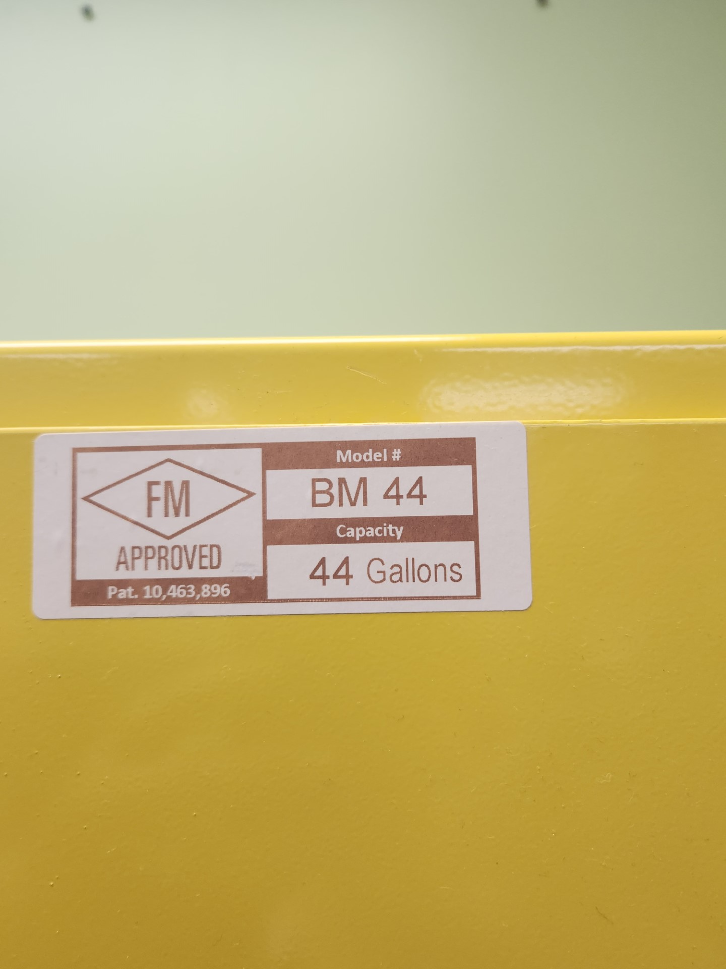
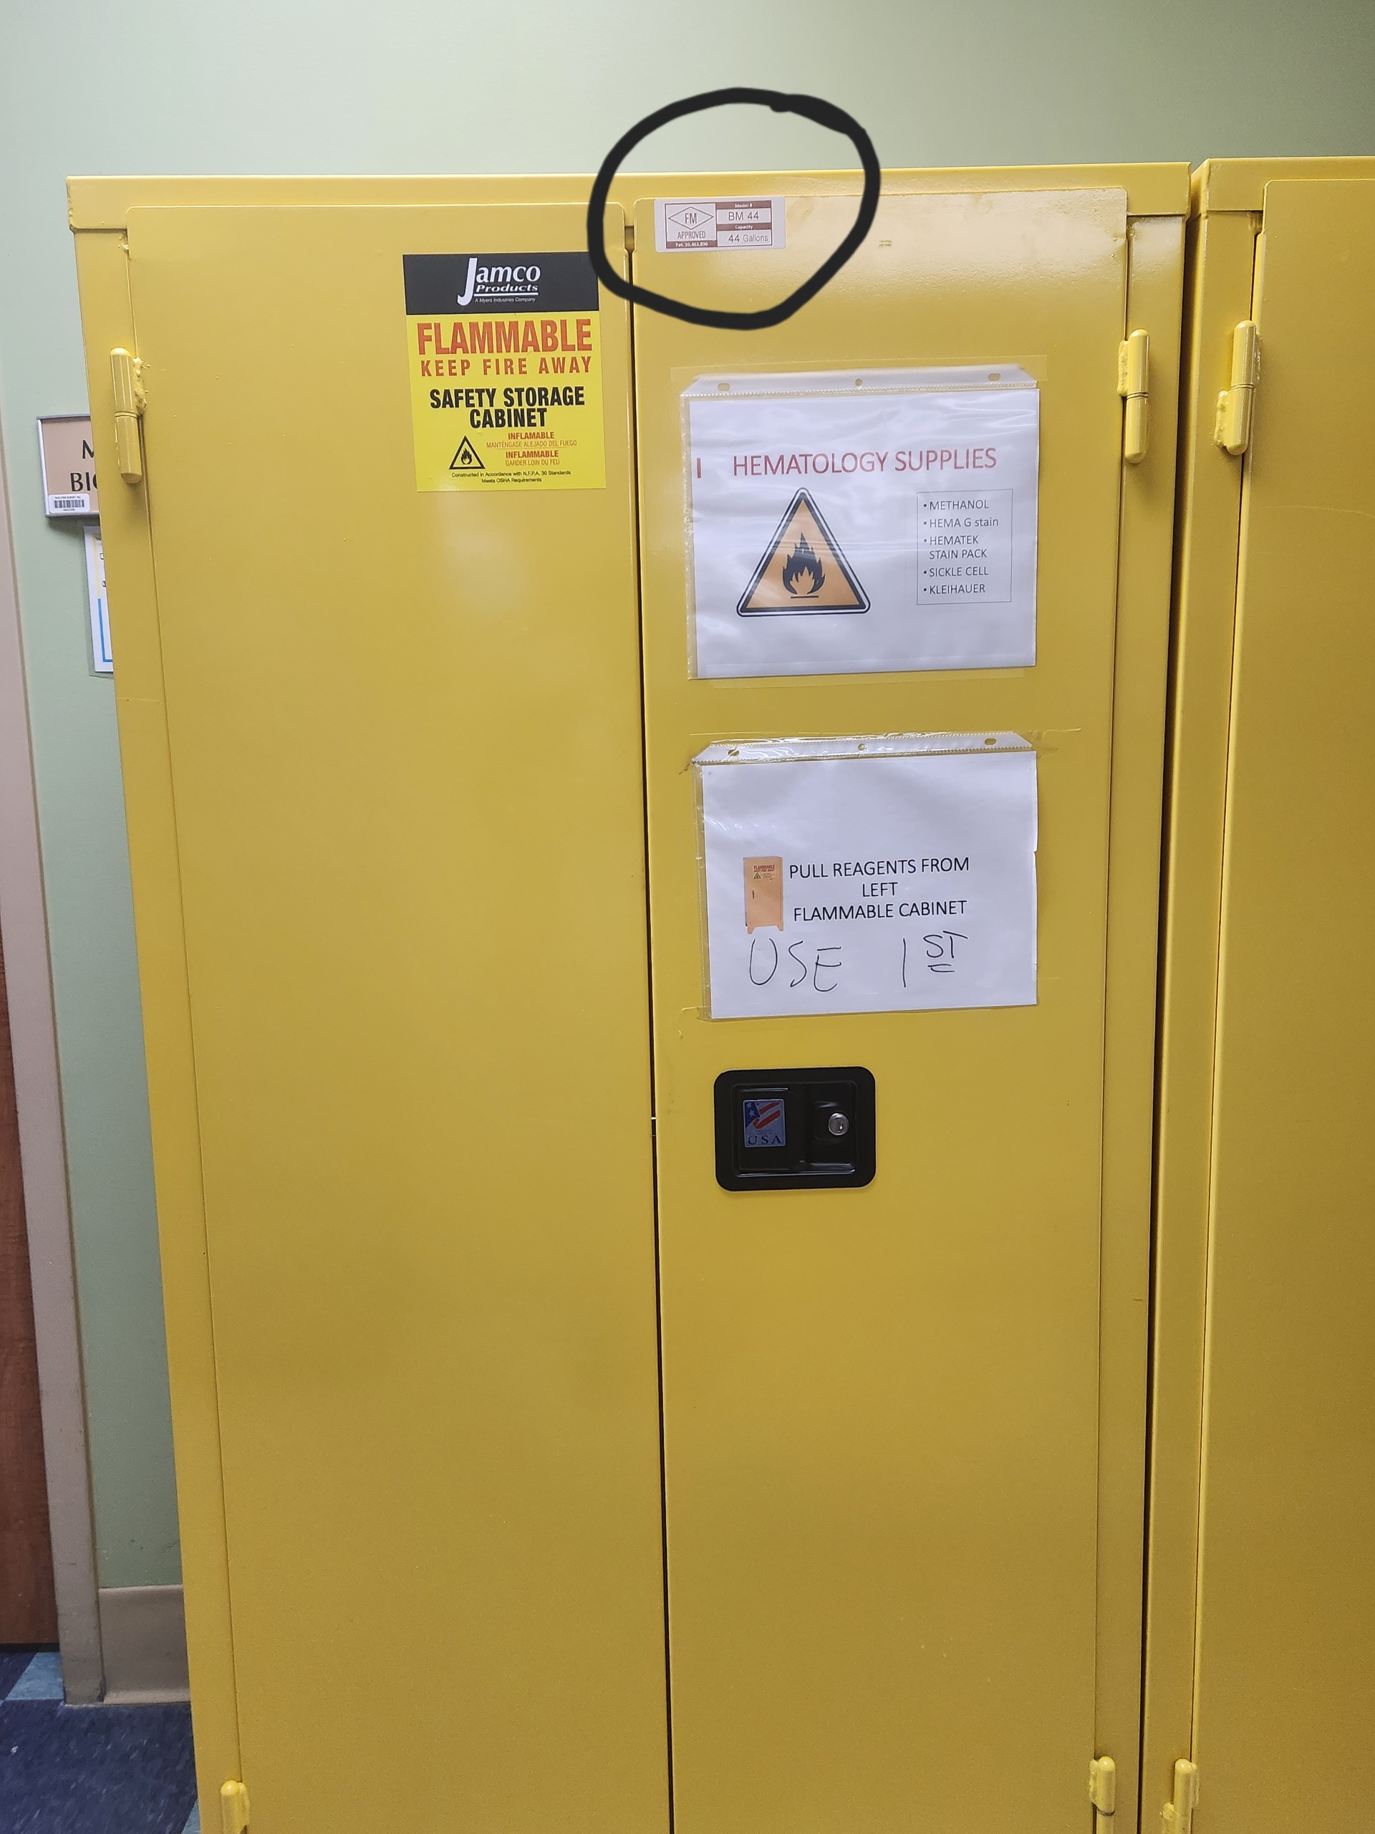
The storage capacity is typically on the front of the flame cabinet.
Notes:
The maximum capacity is typically located on the front of the cabinet or on the door on the inside of the cabinet.

Slide 14
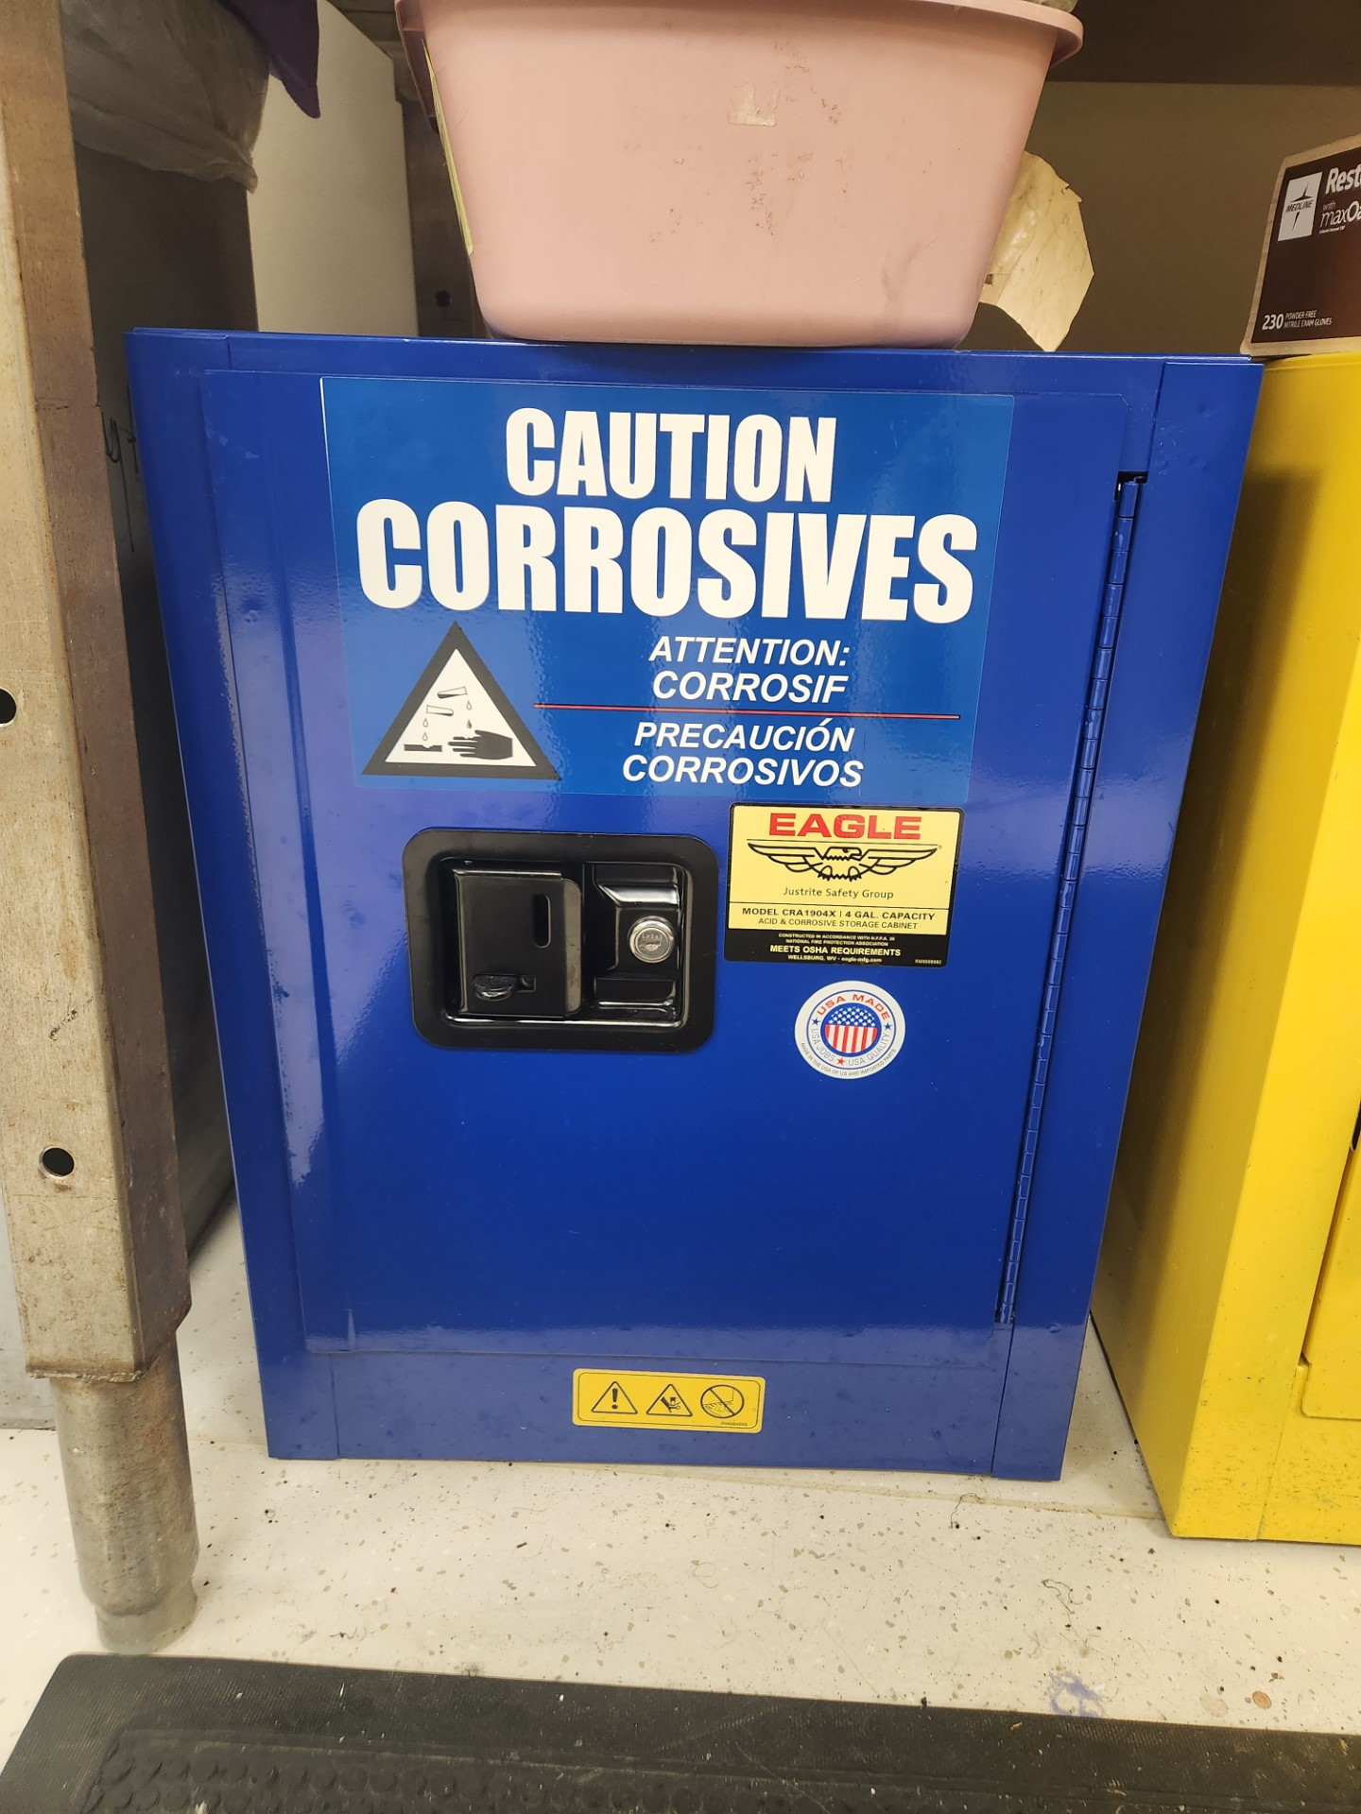
What is the significance of the blue flame cabinet? What makes it different from the yellow cabinets?
Notes:
What is the difference between the blue and yellow flame cabinets? The blue ones are used to store corrosive chemicals like acids, and they are vented to evacuate hazardous vapors. The yellow ones do not require ventilation.

Slide 15
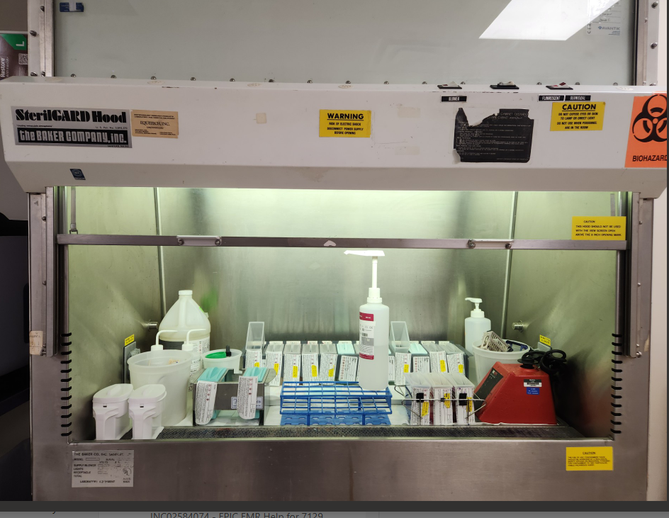
What is the purpose of a fume hood?
Notes:
The purpose of a chemical fume hood is to prevent the release of hazardous substances into the general laboratory space by controlling and then exhausting hazardous and/or odorous chemicals.

Slide 16
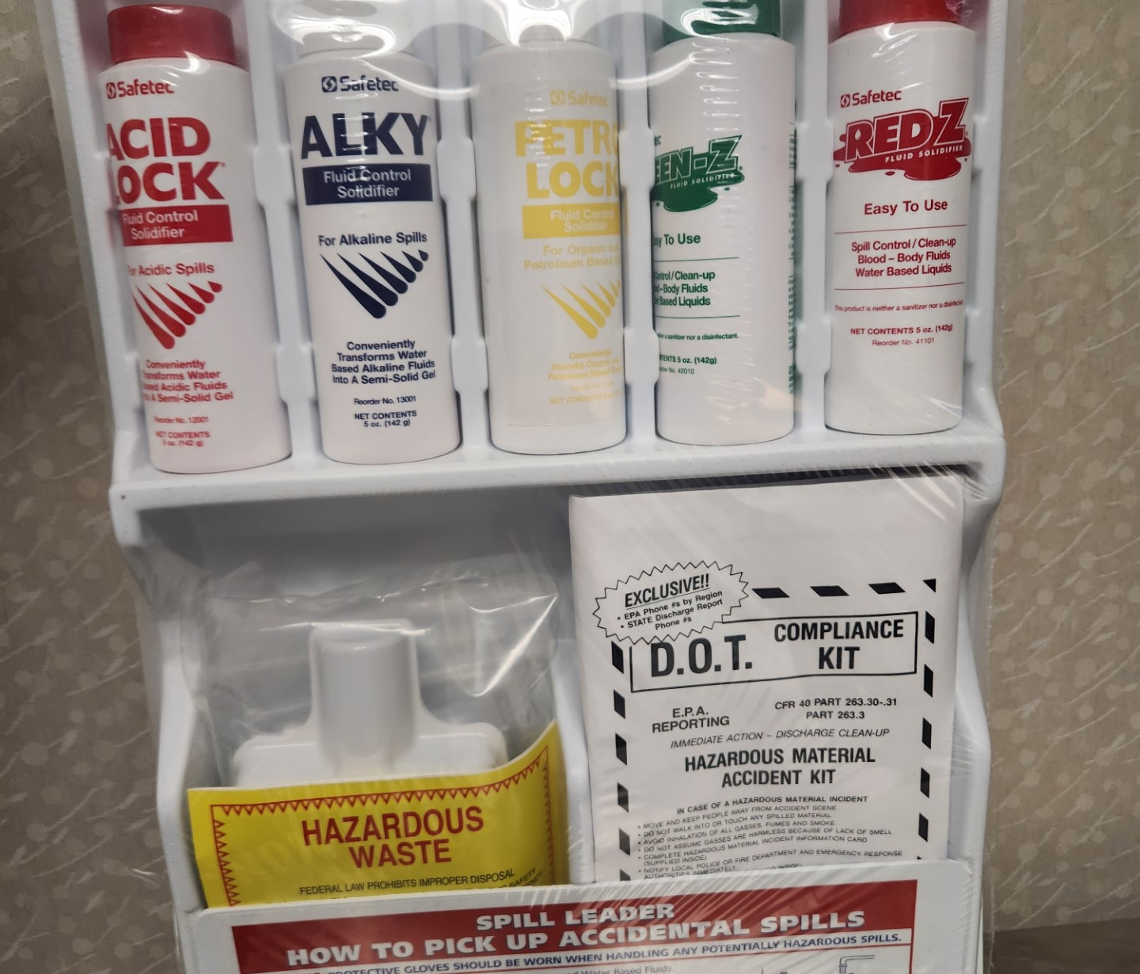
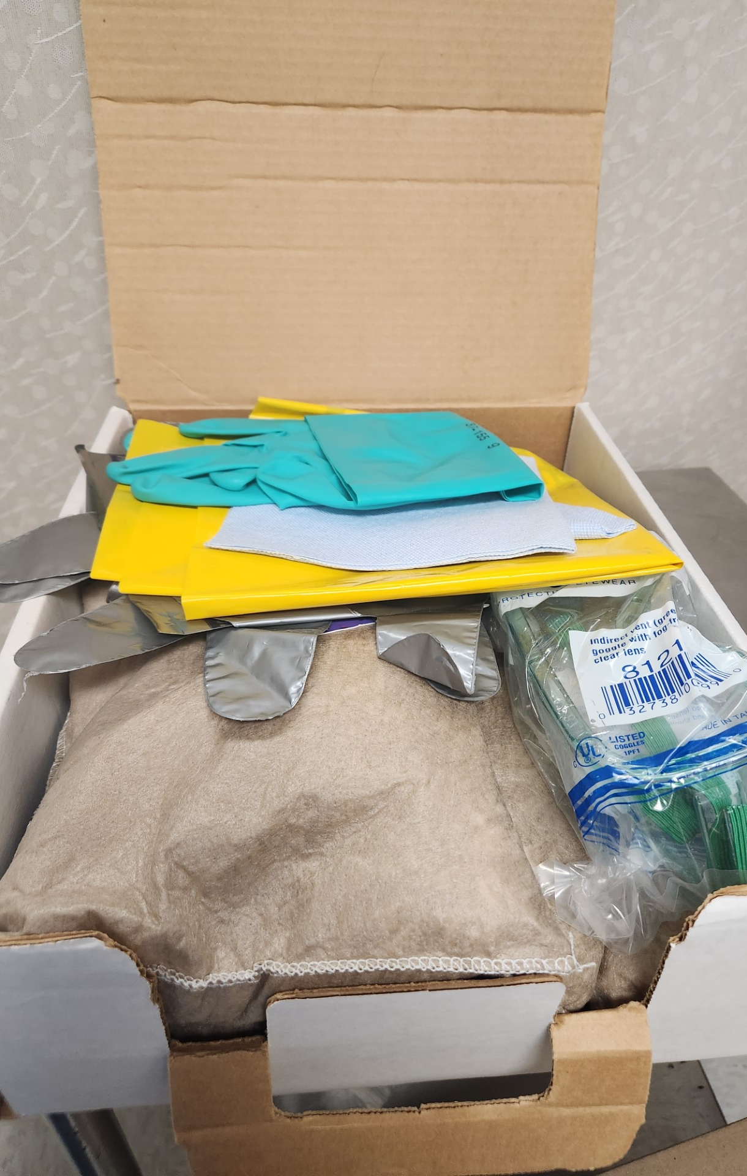
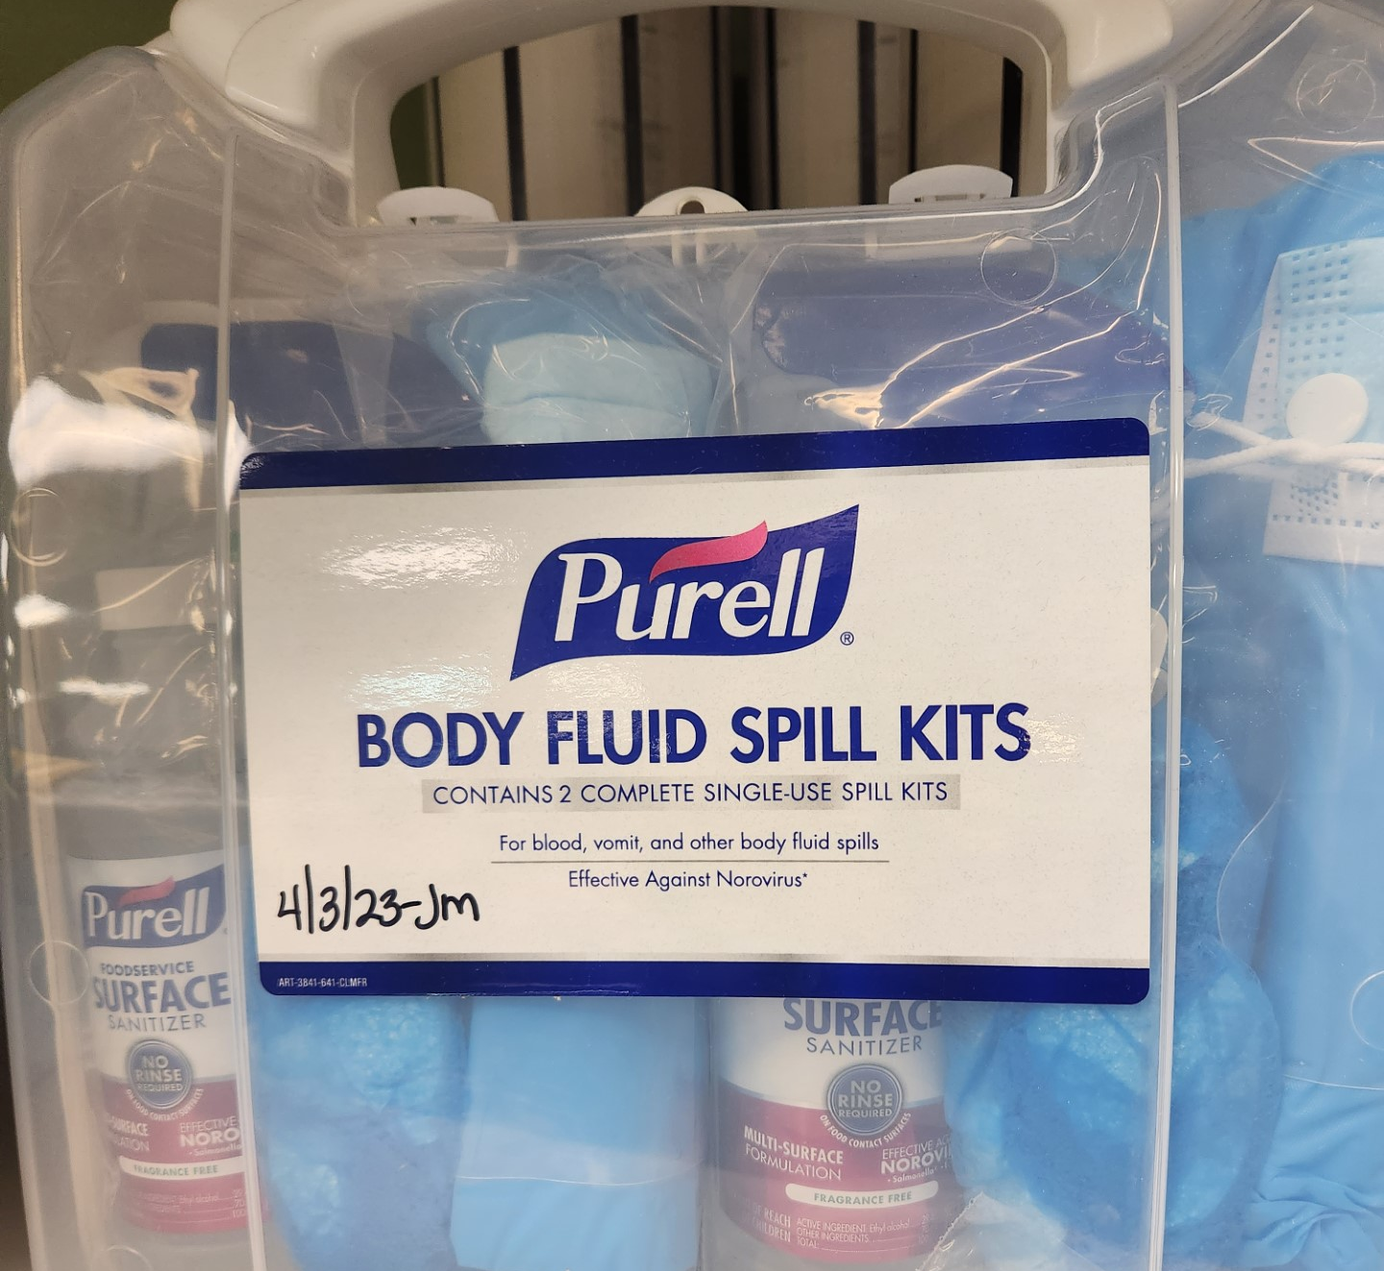
Where are the spill kits located?
What is the first step before cleaning up a chemical spill?
Who do you notify that a chemical spill has occurred?
Notes:
Please take a moment and locate the spill kit at your location. If a spill occurs, always consult the SDS before cleaning up a chemical spill. Per policy, immediately notify lab staff, Risk Management, and Security.

Slide 17

What is the appropriate way to handle/store dry ice?
Use insulated gloves, safety goggles/glasses, and wear a lab coat to avoid exposing skin to the severe cold. Do not touch with bare hands.
Use dry ice tongs or a scoop to handle.
Containers used for the storage of dry ice should not be airtight.
Containers used for the storage and/or handling of dry ice should be designed for exposure to ultralow temperatures.
Dry ice should be handled in well-ventilated areas. Do not store in areas without adequate ventilation (walk-in refrigerators, for example).
Label any container used to hold dry ice.
Dry ice should not be placed directly onto bench tops, laminated countertops, or in ceramic sinks.
Do not put or dispose of dry ice in sewers, sinks, or toilets. Allow it to evaporate slowly in a well-ventilated area, preferably outdoors.
Notes:
What is the appropriate way to handle and store dry ice? To handle dry ice, use insulated gloves and do not store in an air-tight container. Dry ice evaporates to form carbon dioxide gas, which does not support life. Exposure can cause respiratory distress and eventual suffocation. Be careful when using dry ice, please check on your co-workers if you see any signs of exposure.

Slide 18

What are the signs and symptoms of a chemical exposure?
Notes:
What are the signs and symptoms of chemical exposure?

Slide 19
Signs/Symptoms
Symptoms of acute exposure to xylene include:
Irritation of eyes, skin, nose, throat
Dizziness, excitement, drowsiness, incoherence, staggering gait
Dermatitis
Symptoms of acute exposure to formaldehyde include:
Irritation of eyes, skin, nose, throat, respiratory system
Tearing
Coughing, sneezing, wheezing
Dermatitis
Notes:
These are the signs and symptoms of a chemical exposure involving xylene and formaldehyde as outlined in safety policy SM-10. If any of your co-workers are showing any of these symptoms, please assist them in getting help.

Slide 20

How are permissible exposure limits monitored?
Notes:
How does the laboratory monitor exposure limits?

Slide 21
How exposure limits are monitored
Monitors designed to measure time weighted average concentrations are used for either personnel or area monitoring.
In Anatomic Pathology areas, employees are monitored by use of passive badges which are given out at the start of the employee’s shift. Employee verification paperwork included in the badge monitoring container should be completed by the employee being tested before monitoring is started.
The badge is worn near the breathing zone (as close to inhalation point as possible) of personnel exposed or placed in the area to be monitored.
At the end of the shift, the badge should be placed in a sealed transporting bag along with the information paperwork (retain a copy prior to sealing).
Monitors are shipped via FedEx to the badge manufacturer for analysis and resulting.
Notes:
Permissible exposure limits are monitored by histology staff. A histology employee wears a monitor on their badge for an entire shift. The monitor is then shipped back to the manufacturer for analysis. This is to ensure employees are not being over exposed to chemicals.

Slide 22
PERMISSIBLE EXPOSURE LIMITS (PELs) are available on the OSHA website: https://www.osha.gov/annotated-pels
Notes:
If you want to learn more about permissible exposure limits for chemicals, please visit this website for more information.

Slide 23

How can you minimize your exposure risk to chemicals?
Notes:
How can you minimize your exposure risk to chemicals? By using standard PPE and by following proper handling and PPE guidelines found in the Chemical Hygiene Plan.

Slide 24
Thank you!
Notes:
Thank you for watching! Please take the accompanying test for the annual chemical hygiene in-service.

