Slide 1
Canadian Blood Services’ New Insulated Shipping Containers
2015-06-18

Slide 2
Agenda
Overview
Benefits of New Insulated Shipping Containers
New Packing Configurations
Returning ISCs to Canadian Blood Services
Conditioning Requirements
ISCs Hospital Re-distribution
Next Steps, Discussion and Questions

Slide 3
Overview
Overview
Canadian Blood Services is developing new insulated shipping containers (ISCs) for transport of all products including RBCs, Platelets, Frozen Products, and Plasma Protein Products.
Objectives:
To establish shipping containers that are robust and meet performance requirements in the context of Canadian Blood Services’ current processes and shipping routes.
To standardize the refrigerant conditioning and ISC packing processes.

Slide 4
Benefits of New ISCs
New Insulated Shipping Containers
New shipping containers and packing configurations designed for Canadian Blood Services processes and shipping routes including challenging inter-provincial shipments.
Benefits include:
Packing configurations that are suitable for all seasons.
Increased capacity for RBCs and Platelets
Elimination of dry ice as a refrigerant for frozen product shipments
Phase Change Materials (PCMs) conditioned within product temperature ranges.
Accommodation of the current Tamper Indicator Device (TID)

Slide 5
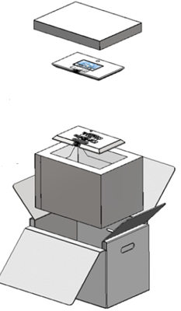
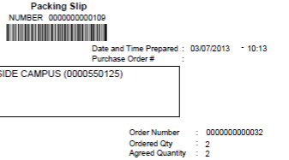
RBC - Short Journey
ISC Packing Configurations
Confirm Upon Receipt
8L Polyurethane Container with lid firmly seated
Two Series 4 Plates. One plate on top of RBCs, the other plate on the bottom
RBCs located below the red line found within the container
Packing Time to the Time of Receipt ≤17 hours
Refer to packing slip for packing time:

Slide 6
RBC - Long Journey
ISC Packing Configurations
Confirm Upon Receipt
8L Polyurethane Container with lid firmly seated
Six Series 4 Plates to form cube
RBCs located within cube
Packing Time to Time of Receipt ≤ 24 hours
Note: Washed and Deglycerolized RBCs will be sent with this packing configuration.

Slide 7
ISC Packing Configurations
RBC ISCs | Current | Future
Insulation | Expanded Polystyrene | Polyurethane (8L)
Refrigerants | Ice Packs and Gel Packs | 4ºC Phase Change Material Plates Short:2 Plates Long: 6 Plates
Capacity (No. of Units) | 10 RBCs | Short:16 RBCs Long: 12 RBCs
Empty Weight (Including PCMs) | 9 lbs | Short : 11 lbs Long : 17 lbs
Weight with Product | 16 lbs (10 units) | Short: 22 lbs (16 units) Long: 26 lbs (12 units)
Exterior Dimensions | 15” x 11.5” x 12” | 20.8” x 14.6” x 15”
Notes:
Note: The RBC container that will be used most often (Short Journey) is only 2lb heavier than the J82. Maximum overall weight is increased because we can accommodate more units in the shipping containers. (16 RBCs vs. 10 RBCs)

Slide 8
Platelet
ISC Packing Configurations
Confirm Upon Receipt
8L Vacuum Insulated Container with Vacuum Panels intact.
Six Series 22 Plates to form cube
Platelets located within cube
Packing Time to Time of Receipt ≤ 24 hours

Slide 9
ISC Packing Configurations
Platelet ISCs | Current | Future
Insulation | Polyurethane | Vacuum Insulated Panels
Refrigerants | 2-3 Gel Packs | 22ºC Phase Change Material Plates (6 plates)
Capacity (No. of Units) | 6 Platelets | 12 Platelets
Empty Weight (Including PCMs) | 17-21 lbs | 17 lbs
Weight with Product | 22-26 lbs (6 units) | 22 lbs (6 units)
Exterior Dimensions | 18.1” x 15.7” x 16.1” | 18” x 11.25” x 11.5”
Note: Typically < 6 platelet units are shipped at one time so the ISC weight with product is calculated with 6 units.

Slide 10
Frozen Products
ISC Packing Configurations
Confirm Upon Receipt
8L Expanded Polystyrene Container
Six Series 20M Plates to form a cube. The top plate will be placed directly on the frozen products. Packing material will be placed above the top plate, when required.
Packing Time to Time of Receipt ≤ 24 hours
Note: Plates will be at -20ºC or colder at the time of receipt. Gloves should be used to handle plates.

Slide 11
ISC Packing Configurations
Frozen Products | Current | Future
Insulation | EPS | EPS
Refrigerants | Dry Ice | -20ºC Phase Change Material Plates (6 plates)
Capacity (No. of Units) | Dependent on container used. | 10 Frozen Plasma Units
Empty Weight (Including PCMs) | Weight dependent on amount of dry ice used. | 21 lbs
Weight with Product |  | 26 lbs (10 FP)
Exterior Dimensions | 19.7” x 14.6” x 12.2” | 25.6” x 17.5” x 16”

Slide 12
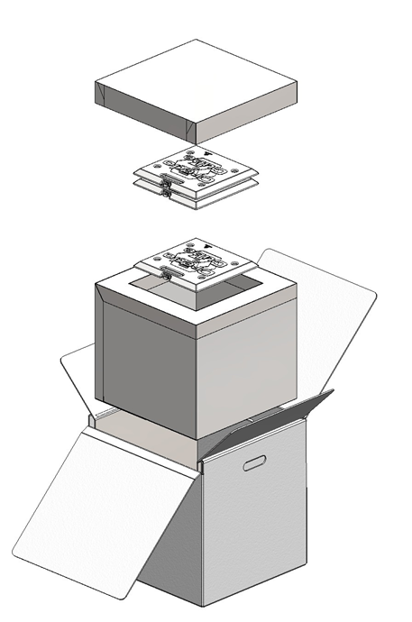
Room Temperature PPP
ISC Packing Configurations
Confirm Upon Receipt
Polyurethane Container with lid firmly seated
Three square Series 4 Plates. Two plates will be above product and one plate below product
Packing Time to Time of Receipt ≤ 24 hours
Note: Room temperature PPP may also be received in the original cartons if they are transferred in Canadian Blood Services’ vehicles where acceptable shipment temperatures can be confirmed.

Slide 13
Refrigerated PPP
ISC Packing Configurations
Confirm Upon Receipt
16L Polyurethane Container with lid firmly seated
Three square Series 4 Plates. One plate will be on the bottom, one plate will be on top of the insert and the third plate at the top of the ISC
Note: Product can be placed in the insert between the bottom plate and the middle plate and between the middle and top plate. If product is only packed in the insert the middle and top plates will be together on top of the insert.
Packing Time to Time of Receipt ≤ 24 hours.
RBC units can also be placed in this packing configuration along with refrigerated PPP.

Slide 14
ISC Packing Configurations
PPP ISCs | Current | Future
Insulation | Various | Polyurethane (16L)
Refrigerants | Various | 4ºC Phase Change Material Plates (3 Plates)
Capacity (No. of Units) | Dependant on container used. | Dependent on Product Mix
Empty Weight (Including PCMs) | Weight dependent on container and refrigerants used. | 20 lbs
Weight with Product |  | Dependent on Product Mix
Exterior Dimensions | Dependant on container used. | 20.6” x 18.5” x 20.6”
Note: If 2-25ºC PPP are being sent in original cartons via Canadian Blood Services transport vehicles, they will not be packed in insulated shipping containers.

Slide 15
Returning ISCs to Canadian Blood Services
New Insulated Shipping Containers
After removing products from ISC, plates should be packed immediately and the container should be fully closed.
For packing configurations in a cube format, plates will be kept in the cube format and any packing material that was used in the shipment can be placed in the cube to minimize plate movement.
For other packing configurations, plates will be placed flat on the bottom of the ISC and packing material can be placed on top of the plates to protect the lid from damage. The packing material provided in the original shipment can be used, if available.

Slide 16
Returning ISCs to Canadian Blood Services
New Insulated Shipping Containers
Phase Change Material fluid within the plates are non-hazardous, however, precautions (e.g., use of gloves) should be taken to avoid skin irritation if a leaky PCM plate is identified.
Any liquid in the ISC can be cleaned with absorbent material and discarded.
Leaky PCM plate will be double-bagged to ensure proper containment and returned to Canadian Blood Services. No special or dangerous goods transport requirements are necessary.
Safety Data Sheets for PCM will be provided with the Customer Letter

Slide 17
Conditioning Requirements
New Insulated Shipping Containers
New Phase Change Materials require a more rigorous and precise conditioning process to ensure protection against hot and cold temperature extremes.
Phase Change Materials for RBC and Platelet containers require a two stage process and standardized conditioning equipment. (e.g., freezers, incubators with step rate capability)
The cost of one set of the freezers and incubators required for conditioning the plates for RBC and Platelet containers is over $25,000.

Slide 18
ISCs for Redistribution
Hospital Redistribution
All provinces use Canadian Blood Services shipping containers for some portion of their redistribution activities.
The new containers will only be used for Canadian Blood Services distribution and will not be used for hospital re-distribution or transfers between hospitals.
The practice of using the current containers - Canadian Blood Services and other containers established by specific regions - will continue.
With the implementation of the new shipping containers, Canadian Blood Services will have an excess inventory of current containers that can be provided to hospitals. After the existing supply of containers is depleted, hospitals can order shipping containers from the current suppliers.

Slide 19
Implementation and Next Steps
Next Steps
Initial implementation in Edmonton is planned for November 30th.
Implementation will be monitored for a three-month period. Shipping data will be evaluated and feedback will be obtained from hospitals during this period.
Shipping containers will be rolled out sequentially to all other Canadian Blood Services sites in 2016 .
Next Steps for Hospitals:
Review Customer Letter and determine impacts for receiving processes.
Review management and inventory of ISCs for re-distribution.

Slide 20
Questions?

