Slide 1
General Privacy
&
Confidentiality
February 2017

Slide 2
Agenda
Introduction
Privacy vs. Confidentiality
Information types
Privacy Principles
Privacy Safeguards
Discussion and Examples
Additional privacy training options and information
Workshop evaluation

Slide 3
Objectives
You will learn during this workshop:
The difference between privacy and confidentiality
The different types of information
How to apply privacy principles
How to recognize privacy issues
What additional privacy training you may need to take

Slide 4
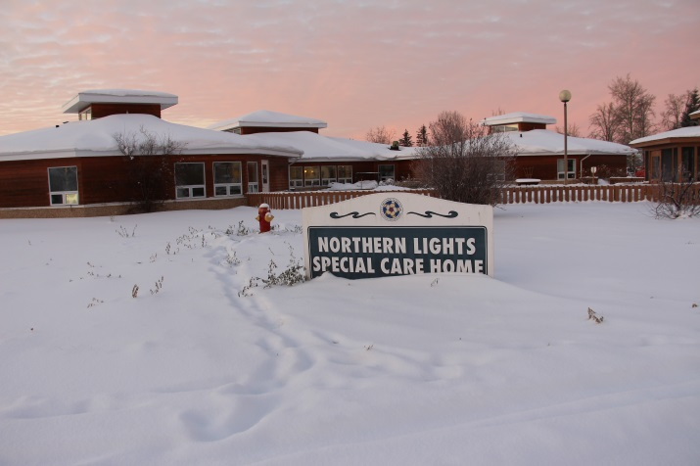
Energizer
Your name and role:
What do you expect from today’s session:
What does privacy and confidentiality mean to you:

Slide 5
versus
Privacy and Confidentiality
Privacy
A legislated right
About protecting clients
About the client’s information
Confidentiality
A job requirement
About protecting the organization
About any type of information-client, employee, government

Slide 6

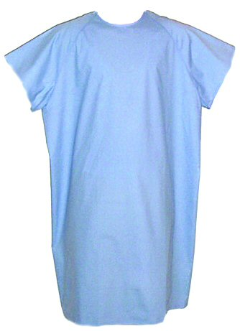
Privacy and Confidentiality
Privacy
Why is it important?

Slide 7



Privacy and Confidentiality
Confidentiality
Why is it important?

Slide 8
Privacy and Confidentiality
What applies to what information?
Notes:
Three types of information:
classified
personal
personal health

Slide 9

Privacy and Confidentiality
  What is classified information?
HR plans
Capital plans
Business Plans
Classified Information
Legal opinions
Contract Negotiations
Information System Architecture
Sensitive internal communications
Cabinet papers

Slide 10

Privacy and Confidentiality
  What is personal information?

Slide 11
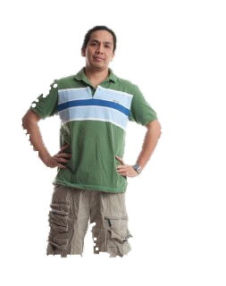
Privacy and Confidentiality
  What is personal information?
Name
Age
Address
Job
Financial info
Gender
Vehicle registration
S.I.N.
Purchase records

Slide 12

Privacy and Confidentiality
  What is personal health information?

Slide 13

Privacy and Confidentiality
  What is personal health information?
Counselling Notes
Medication Information
Clinic Notes
Operative Notes
Name, Date of Birth,
Address, Phone Number
Referrals and consultation reports
Personal Health Information
Lab and x-ray requisitions, and the test result reports
NWT Health Care Number

Slide 14
Privacy and Confidentiality
It is OUR RESPONSIBILITY TO:
Respect
Protect
Keep it
confidential
and private

Slide 15
Privacy and Confidentiality
Privacy Principles
Gather/use/share only the least amount of information you need to know to do your job
Gather/use/share identifiable information only when non-identifiable won’t do
Know why this information is needed now

Slide 16
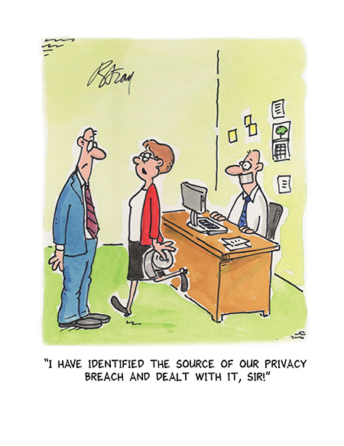
Privacy Issues
Privacy and Confidentiality
Privacy risks
&
Privacy breaches

Slide 17
In the News…
Privacy and Confidentiality
CANADA
June 2016 in N.L.: 34 patient records breached (accidental)
Physician’s car containing a briefcase with patient files was stolen
The briefcase and 29 patient files were recovered, but 5 remained missing
July 2016 in N.B.: 141 patient records breached (intentional)
a radiation oncologist accessed the personal health information of 141 females without their authorization during a two-year period; some of the females work at the hospital or at a restaurant where physician was a regular customer
Physician’s employment was terminated
October 2016 in N.L.: 19 patient records breached (accidental)
Patients’ information lost during an orthopedics traveling clinic
Missing information were partial patient files
WORLD
June – Nov 2013 in USA: three breaches with over 4 M patient records stolen
Patient records compromised incl. names, addresses, dates of birth, credit card numbers, clinical and health insurance information
Advocate Health Care Network responsible, pays $5.55 M settlement to US Health Department

Slide 18
Basic Privacy Safeguards
Privacy and Confidentiality
What you can do to protect client privacy:
Don’t store documents on your C:Drive or desktop
Don’t share passwords
Don’t throw private and confidential notes in the garbage
Don’t open attachments or click on links sent from unrecognized email addresses
Don’t chat about clients in the halls
Don’t use your personal email for work
Do keep your desk clean
Do think before you share information
Do keep records safe
Do lock up before you go
Do use VPN

Slide 19
Discussion
Privacy and Confidentiality
You are a transcriptionist ,working at an HSSA. This morning you heard two colleagues talking about Allison and her child’s blood results.
On the way home from work you stop at the grocery store to pick up a few things. You run into your friend Allison.
Allison says: “I’m so glad I ran into you. I know you work near the Lab, do you know if blood results are in? It would be great if I knew now so I could get a prescription tonight, so my daughter gets her meds sooner. ”
Consider:
What do you do at the HSSA?
Is Allison your patient?
Is information you heard about the same person? There could be another Allison in the NWT who has a child and came for testing…

Slide 20
Discussion
Privacy and Confidentiality
You are a new assistant at the reception. In your role you usually direct people to the right location, help visitors and other staff when needed, and handle only general information. This morning the reception is busy.
A clinic assistant just completed entering details about clients on a shared computer, but suddenly got distracted and leaves for a quick coffee break. You notice the clinic assistant did not sign out from the computer and the computer screen shows a patient’s health information.
Consider:
What do you do to respect the PHI?
What do you do to protect the patient?

Slide 21
Discussion
Privacy and Confidentiality
You are a nurse at a long-term care unit. In your role you usually check on clients in their rooms, administer medications and provide other assistance as needed. Today you check the health status of a client, Joanne, whose condition has significantly worsened over the past few days.
This afternoon you receive a phone call. The caller is Joanne’s best friend and is asking for information about her status.
Consider:
What do you do to respect the PHI?
What do you do to protect Joanne, while still wanting to help her?

Slide 22
Discussion
Privacy and Confidentiality
You are an administrative assistant working in the Child and Family Services Unit. Your supervisor asked you to file a copy of the unit’s financial plan.
Consider:
What do you do to respect the information?
What do you do to protect the organization?

Slide 23
Discussion
Privacy and Confidentiality
You are a translator. Your supervisor asks you to assist a Child Protection Worker.
During a meeting with their client you need to translate some information into one of the official languages.
Consider:
What do you do to respect the client’s privacy?
What do you do to protect your organization?

Slide 24
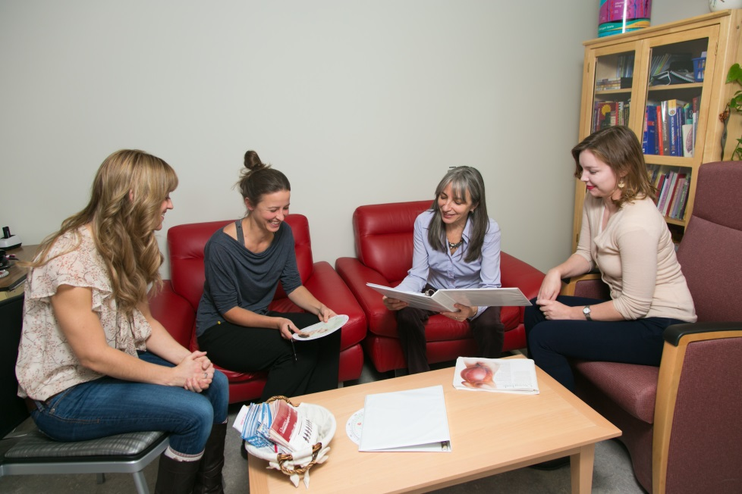
Training
Privacy and Confidentiality
You are:
Involved
Responsible
Required

Slide 25
Privacy and Confidentiality
Training
What training may you need based
on your job?
Mandatory & Mandatory Duties Dependent
What training could you attend?
Optional

Slide 26
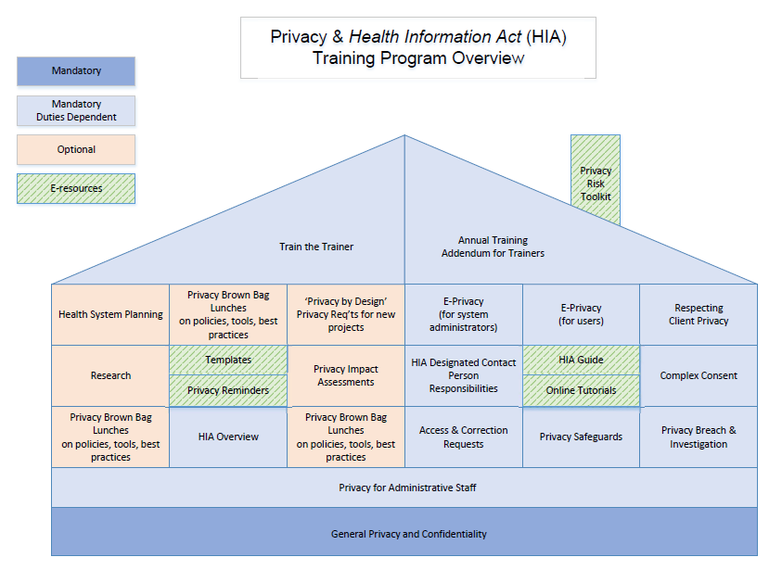
Privacy and Confidentiality

Slide 27
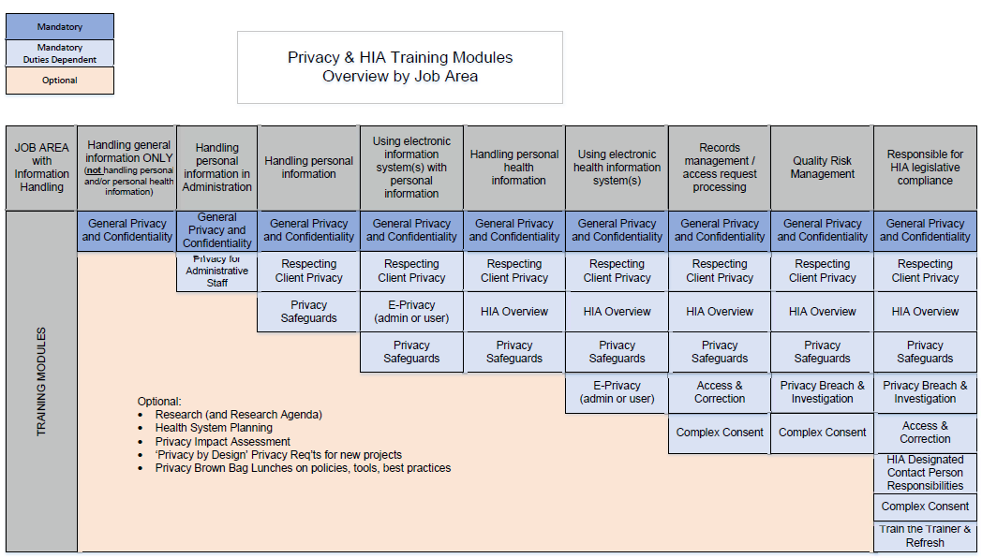
Privacy & HIA Training
Notes:
Review the table.
And move to next slide with the tone – so who does the training?

Slide 28
Additional Resources
For more information you can:
email HIA@gov.nt.ca
visit :
  http://www.hss.gov.nt.ca/en/services/protecting-your-health-information
  http://www.professionals.hss.gov.nt.ca/hia-tutorials
Ask your Quality Risk Manager / Educator

Slide 29
Summary
Privacy and Confidentiality
Today we discussed:
Privacy and Confidentiality
Information Types
Privacy Principles
Privacy Safeguards
Additional privacy training & resources

Slide 30

Privacy and Confidentiality
Questions?
Notes:
Any questions?

Slide 31

Privacy and Confidentiality
Notes:
Provide Quiz questions and ask to complete.

Slide 32
Privacy and Confidentiality
Quiz Questions
Review

Slide 33
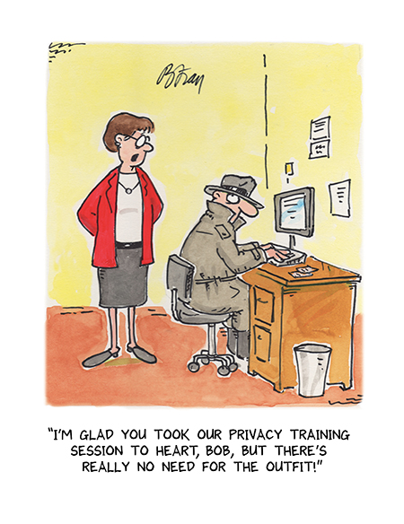
Privacy and Confidentiality
Workshop Evaluation
Thank you.

