Slide 1
Privacy Safeguards
December 2016

Slide 2
Agenda
Introduction
Introduction to Privacy Safeguards
Types of Privacy Safeguards
Case Study
Exercise
Workshop evaluation

Slide 3
Objectives
Define a privacy safeguard
Recognize different privacy safeguards around you
Identify safeguards in your workplace
Comply with privacy legislation and policies

Slide 4
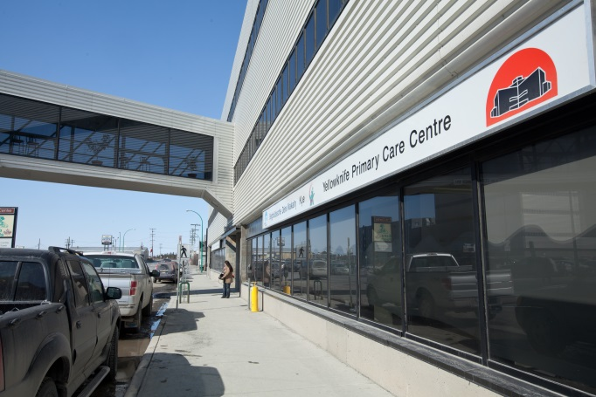
Energizer
Your name and role:
What do you expect from today’s session:
What privacy safeguards do you have in your workplace:

Slide 5
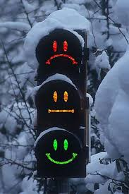
Privacy Safeguards
What is a privacy safeguard?
Why is it important?
Where can it be found?

Slide 6
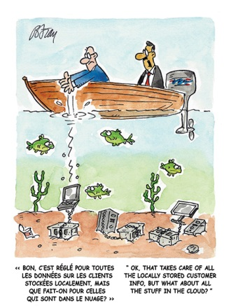
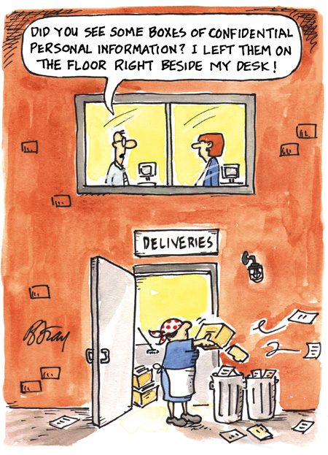
WHY do we need privacy safeguards?

Slide 7
Privacy Safeguards
You within your role are responsible to:
Protect information (private and confidential)
Assess any risks to the information
Prevent those risks from happening

Slide 8
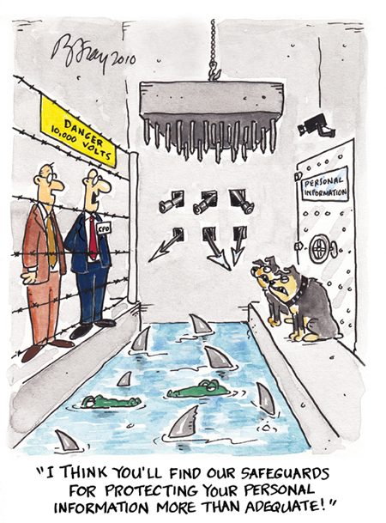
Privacy Safeguards
What types do we have?

Slide 9
Privacy Safeguards
3 types:

Slide 10
Privacy Safeguards
Administrative
Policies on collection, use and disclosure of information
Policies and procedures for access to records
Privacy training
Monitoring

Slide 11
Physical
Privacy Safeguards
Shredding documents
Locks and key control
Restricted access areas – fobs
Placement of computer monitors
Clean desk practices

Slide 12
Privacy Safeguards
Technical
Secure networks
Encryption
Role-based access
Passwords
Firewalls and antivirus

Slide 13
Privacy Safeguard
> Emailing information securely <
How you email securely:
send password protected/encrypted document
use subject line without PI/PHI
send minimum PI/PHI

Slide 14
Privacy Safeguard
> Portable devices Use <
How you use portable devices right:
use when necessary
transfer minimum PI/PHI
password protect or encrypt
use only property of GNWT/HSSA
store securely when not in use
erase securely after use

Slide 15
Privacy Safeguard
> Verification of Identification <
You must verify ID when client:
visits facility
attends appointment
How you verify ID:
Two identifiers
Witness

Slide 16
Privacy Safeguard
> Verification of Authority <
You must verify authority
when a person acts on someone’s behalf:
A parent or guardian
Power of attorney
A person named in a personal directive
A deceased person’s spouse
How you verify authority:
Documentation authorizes person
to act on someone’s behalf

Slide 17
>Verbal Release of Information<
Privacy Safeguard
Discuss with client at their first clinic visit
Verify identity of individual
Limit the information you provide
Make a note

Slide 18
Privacy Safeguard
Information
> Agreements <
3 types:
Information Management Agreement
Information Sharing Agreement
Research Agreement

Slide 19
Privacy Safeguard
Information Management Agreement
When do you need it?
Who is responsible for it?
What it must cover?

Slide 20
Privacy Safeguard
Information Sharing Agreement
When do you need it?
Who is responsible for it?
What it must cover?

Slide 21
Privacy Safeguard
Research Agreement
When do you need it?
Who is responsible for it?
What it must cover?

Slide 22
Privacy Safeguard
Compare Agreements

Slide 23
Privacy Safeguard
> De-identification <
What is it?
De-identify whenever identifiable information is not needed
How you de-identify:
estimate re-identification risk levels
apply suitable de-identification method

Slide 24
Privacy Safeguard
> Privacy Impact Assessment <
New communications technology or information system
Substantial change to a communications technology or information system

Slide 25
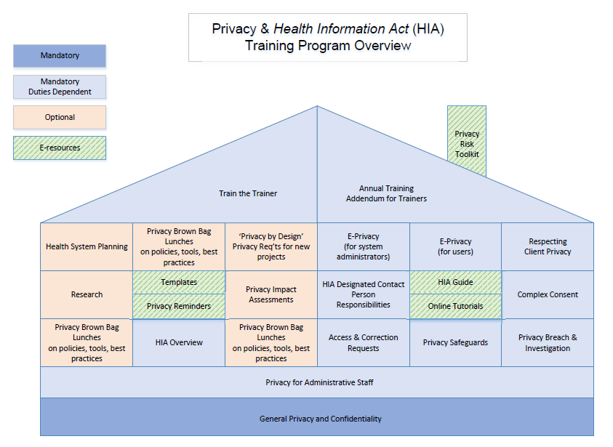
Training
Privacy Safeguard
You are:
Involved
Responsible
Required

Slide 26
Case Study
Privacy Safeguards
An employee at DHSS wants to set up a recurring data extract from NTHSSA to facilitate quarterly monitoring of a program implementation.

Slide 27
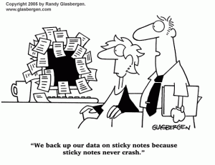
Privacy Safeguards
Case Study
An employee took some files home. She used her personal computer.
The computer crashed so she returned it to the store under warranty.
The computer was re-sold.
The new owner reported personal health information was on the computer.

Slide 28
Privacy Safeguards
Exercise
You are a frontline staff at a clinic.
John comes for a scheduled appointment.
What privacy safeguards can you apply
to ensure John is protected ?

Slide 29
Privacy Safeguards
Exercise
You are a nurse at a clinic.
John is your patient who came for a regular check-up.
John asks you to print a copy of recent blood results.
You need to print results and leave John in the room alone for a moment.
What privacy safeguards can you apply?

Slide 30
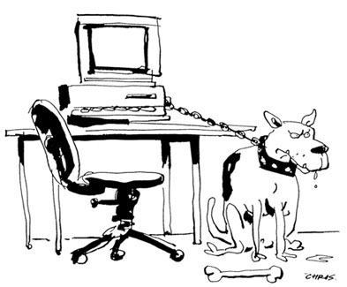
Privacy Safeguards Summary
3 types:
Today we discussed:
Emailing PI/PHI
Use of portable devices
Verification of Identification and Authority
Verbal Release of Information
Agreements (IMA, ISA, RA)
De-identification
Privacy Impact Assessment
Training

Slide 31
Privacy Safeguards
Questions ?

Slide 32
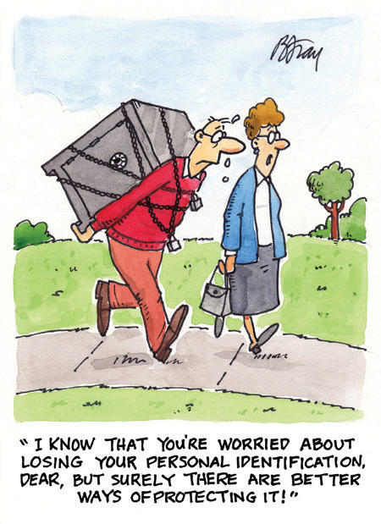
Privacy Safeguards
Workshop Evaluation
Thank you.

Slide 33
Health Information Act
HSS Professions site:http://www.professionals.hss.gov.nt.ca/hia-tutorials
HIA Guide and other resources: http://www.hss.gov.nt.ca/health/slides/health-privacy-protecting-your-health-information

