Slide 1
Respecting Client Privacy
December 2016

Slide 2
Agenda
Introduction
Proper use of information
What does ‘authorized’ mean
What is authorized and necessary
Snooping
Prevention
Workshop evaluation

Slide 3
Objectives
You will learn during this workshop:
How to respect client privacy
Know when you are authorized and when you are not
Prevent snooping
Apply privacy principles

Slide 4
Energizer
Your name and role:
What do you expect from
today’s session:
How does today’s session relate to You and Your job:

Slide 5
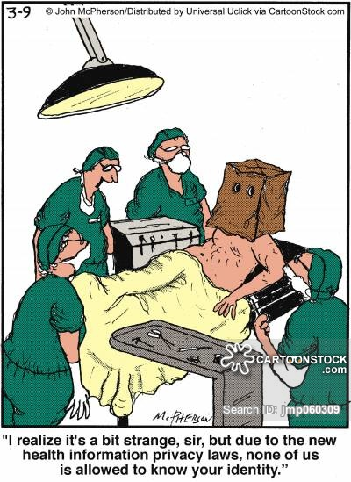
Respecting Client Privacy

Slide 6
versus
Respecting Client Privacy
Privacy
A legislated right
About protecting clients
About the client’s information
Confidentiality
A job requirement
About protecting the organization
About any type of information-client, employees, government

Slide 7
Respecting Client Privacy
Privacy Principles
Gather/use/share only the least amount of information you need to know to do your job
Gather/use/share identifiable information only when non-identifiable won’t do
Know why this information is needed now

Slide 8
“don’t tell + don’t look” Authorized - Necessary Access & Use What does it mean?
Respecting Client Privacy

Slide 9
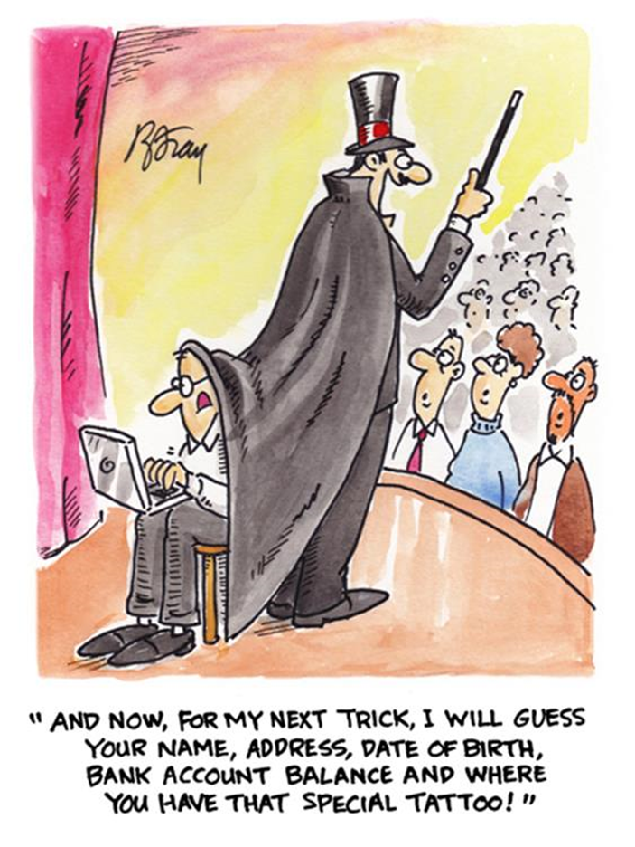
Respecting Client Privacy
unauthorized
access & use
Just because you can, doesn’t mean you should.

Slide 10
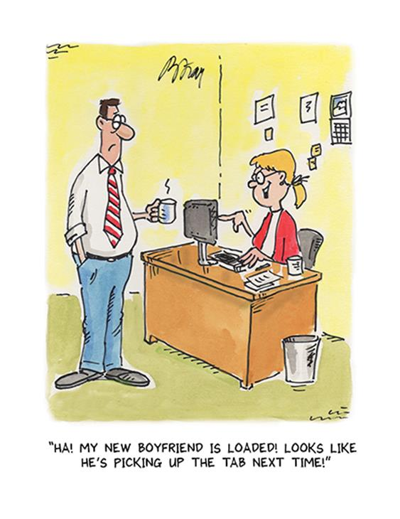
Respecting Client Privacy
unnecessary
access & use
Just because you can, doesn’t mean you should.

Slide 11
Snooping
Respecting Client Privacy
What is it?

Slide 12
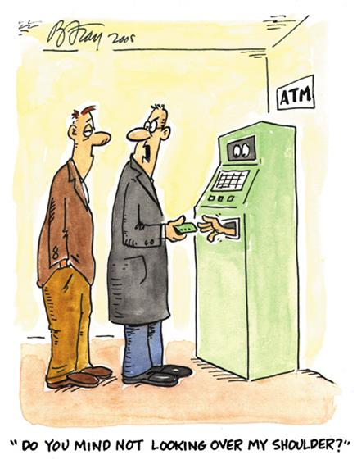
Snooping
Respecting Client Privacy
Types:
Shoulder surfing
Gaze
Grab

Slide 13
Snooping in the News
Respecting Client Privacy
WHERE | WHAT | CONSEQUENCE
USA | VIPs medical records | 10 years in prison and $250,000 fine
Canada, AB | medical records of boyfriend’s spouse | $10,000 fine
Canada, NS | medical records of family and friends | Loss of job
Canada, AB | medical records of family and friends | $15,000 fine
Canada, AB | Inappropriately accessing patient information | 1 Loss of job 47 Disciplined

Slide 14
Discipline Re-training Loss of job: Dismissal, Revocation of licenses $$$ - Fines Legal action and litigation Jail time
Respecting Client Privacy
Snooping is a breach of privacy.
Employee can face:

Slide 15
Respecting Client Privacy
What you can and cannot do scenarios:
Your colleague Emily has not been at work the last three days and you are worried about her.
You do not have her phone number, but you know her personal information is in the filing room.
You wait until your supervisor goes to lunch, go to filing room and look up Emily’s personal information in her record so you can contact her.
Actions You have taken: Is this authorized/allowed?

Slide 16
Respecting Client Privacy
What you can and cannot do scenarios:
You are a Technician at a Lab. You just processed a positive test for a patient.
You hear later that the patient was your friend’s ex.
You think this information could benefit your friend in court when applying for full custody of their son.
Sharing information with your friend:
Is this authorized/allowed?

Slide 17
Respecting Client Privacy
What you can and cannot do scenarios:
You are a Mental Health Worker and know your friend is getting counseling because you saw her name on the schedule.
You ask her how counseling is going when you see her next around town.
Asking your friend: Is this allowed?

Slide 18
Respecting Client Privacy
What you can and cannot do scenarios:
You know your dad has had a lot of medical appointments recently but he won’t tell you what for.
You are a clinic assistant and use your access to the EMR to see what appointments he has because you are worried about him.
Actions You have taken: Is this authorized/allowed?

Slide 19
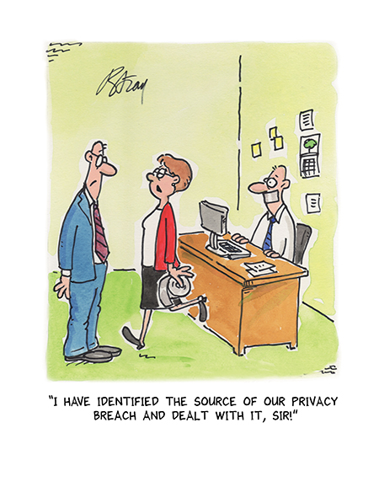
Prevention
Respecting Client Privacy
Know what privacy and confidentiality is
Know what authorized is
Apply privacy principles
Respect the client always
Ask, if you are not sure
Get trained
Read your Terms of Use Agreement
Don’t gossip, say “I don’t know”

Slide 20
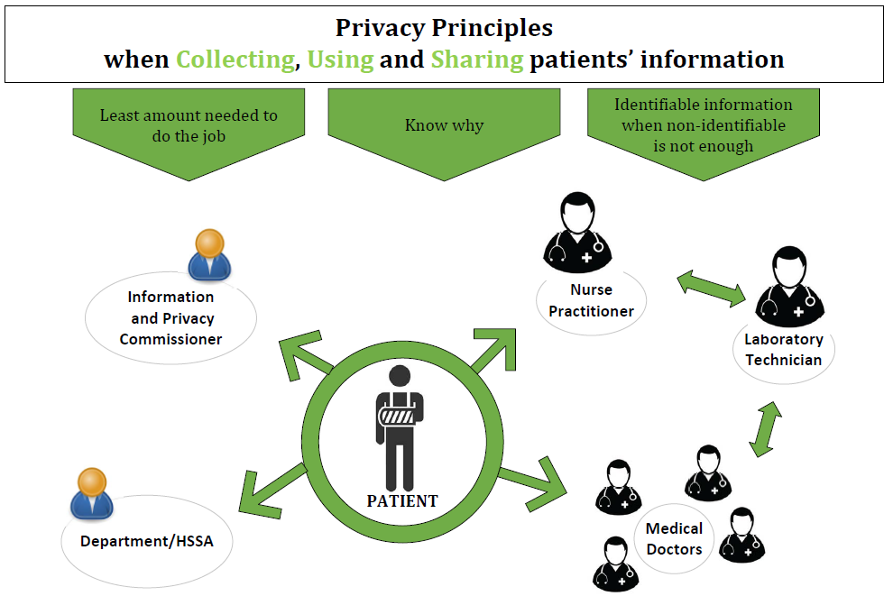

Slide 21
Respecting Client Privacy Summary
Today we discussed:
Authorized use
Unauthorized and unnecessary access & use
Types of snooping
Prevention

Slide 22
Respecting Client Privacy
Questions?

Slide 23
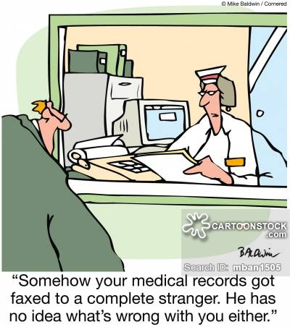
Respecting Client Privacy
Workshop Evaluation
Thank you.

Slide 24
Respecting Client Privacy
HSS Professions site:http://www.professionals.hss.gov.nt.ca/hia-tutorials
Resources for Privacy: http://www.hss.gov.nt.ca/health/slides/health-privacy-protecting-your-health-information

