Slide 1
Transportation of Dangerous Goods by Ground and Air
Training Module for Health Care Workers in the Northwest Territories

Slide 2
Relevant Documents
The material covered in this course is based on materials that are constantly evolving. Please ensure that you refer to the current versions of the following:
Transportation of Dangerous Goods Act
Transportation of Dangerous Goods Regulations
IATA Dangerous Goods Regulations
Emergency Response Guidebook

Slide 3
Course Outline
General Overview
Classification of Dangerous Goods
Shipping Names
Use of Schedules 1, 2 and 3
Documentation
Dangerous Goods Safety Marks
Means of Containment
Safe Handling and Transport Practices (Packing Instructions)
Emergency Response Assistance Plans
Reporting Requirements
Proper Use of Equipment for Handling or Transporting Dangerous Goods
Emergency Measures

Slide 4
General Overview
Section 1

Slide 5
Introduction
Dangerous goods are necessary for the delivery of quality health care in the Northwest Territories.
Given our location, these goods must travel in and out of the Northwest Territories by air or ground transportation.
These goods have very specific handling requirements to ensure the safety of people, the health care facility, and the environment.

Slide 6
Transport of Dangerous Goods Act and Regulations
The Transport of Dangerous Goods (TDG) Act and Regulations are in place to promote public safety.
Even though they have been in place in Canada for decades, hundreds of TDG related accidents and incidents still happen every year.

Slide 7
International Civil Aviation Organization (ICAO) Technical Instructions and International Air Transport Association (IATA) Dangerous Goods Regulations
ICAO
IATA
In Canada, TDG by air must comply with the ICAO Technical Instructions.
This document is part of an ongoing effort being made to harmonize regulations internationally.
Airlines that are members of IATA (such as Air Canada) use the IATA Dangerous Goods Regulations.
These regulations contain all of the requirements of the ICAO Technical Instructions and have included additional more restrictive requirements.
By following the IATA Dangerous Goods Regulations, we keep all of the shipment options available to us open.

Slide 8
Who Requires Training?
In order to help reduce accidents and incidents, TDG training is REQUIRED for everyone that handles packages containing dangerous goods.
If you,
Load packages
Unload packages
Pack or Unpack packages
You MUST complete TDG training or perform these activities in the presence of and under the direct supervision of someone that has.

Slide 9
Frequency of Training
According to Part 6 of the TDG Regulations, a training certificate expires:
24 months after the date of issuance for transport by aircraft
36 months after the date of issuance for transport by road vehicle
Additional training may be required if regulatory changes applicable to your duties occur before the training certificate expires.

Slide 10
Training Certificate
Once you have completed your training, take your proof of completion to Staff Education and Development.
They will give you a Dangerous Goods Training Certificate.
You and your Supervisor must then both sign it to make it valid.
Your certificate is only valid for your present employer and the job for which it was given.
REMEMBER:
Your Supervisor must keep a record of your training as well as a copy of the training certificate from the date it was issued until 2 years after the date it expires.
If an inspector requests a copy of your training record in writing, your Supervisor must be able to provide it within 15 days.
If an inspector asks you to provide a copy of your training certificate, you must be able to provide it immediately upon request.

Slide 11
Offences and Punishment
Every person in violation of any TDG Regulations in Canada:
May be fined up to $50,000 for a first offence
May be fined up to $100,000 for each additional offence (each day an offence is committed counts as an additional offence)
May be imprisoned for up to 2 years
May be responsible for the costs of clean up, damages to personal property and the environment, and funding research to develop and improve safety up to a maximum of $1,000,000 for each offence.

Slide 12
Due Diligence
TDG Regulations Part 1.13 states:
“a person must not be found guilty of an offence if it is established that the person took all reasonable measures to comply with the Act or prevent the commission of the
offence”
This training program is designed to provide you with the knowledge base you need to perform your TDG duties with all reasonable measures to safely handle dangerous goods.

Slide 13
Classification of Dangerous Goods
Section 2

Slide 14
Dangerous Goods
The Transportation of Dangerous Goods Act defines dangerous goods as:
A product, substance or organism included by its nature or by the regulations in any of the classes indicated in the schedule.

Slide 15
Schedule
Class | Description
Class 1 | Explosives, including explosives within the meaning of the Explosives Act
Class 2 | Gases: compressed, deeply refrigerated, liquefied or dissolved under pressure
Class 3 | Flammable and combustible liquids
Class 4 | Flammable solids; substances liable to spontaneous combustion; substances that on contact with water emit flammable gases
Class 5 | Oxidizing substances; organic peroxides
Class 6 | Poisonous (toxic) and infectious substances
Class 7 | Nuclear substances, within the meaning of the Nuclear Safety and Control Act, that are radioactive
Class 8 | Corrosives
Class 9 | Miscellaneous products, substances or organisms considered by the Governor in Council to be dangerous to life, health, property or the environment when handled, offered for transport or transported and prescribed to be in this class.

Slide 16
Classes of Dangerous Goods
Some of the hazard classes are further subdivided into hazard divisions due to the wide scope of the class.
The nine classes and their subdivisions will be described in the following slides.
The order in which they appear does not correlate with the level of danger of the goods in that class.
When a dangerous good can be classified under 2 different classes, the most dangerous class is the Primary Class and the less dangerous class is the Subsidiary Class.

Slide 17
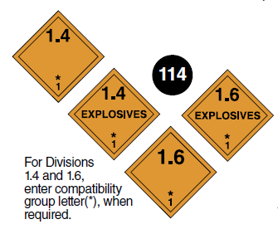
Class 1 - Explosives
Division | Description
1.1 | Mass Explosion hazard
1.2 | Projection hazard, but not a mass explosion hazard
1.3 | Fire hazard and either a minor blast hazard, or a minor projection hazard, or both, but not a mass explosion hazard
1.4 | No significant hazard
1.5 | Very insensitive substance with a mass explosion hazard
1.6 | Extremely insensitive articles with no mass explosion hazard
It is unlikely that Class 1 Dangerous Goods would be transported in a health care role.

Slide 18
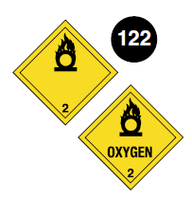
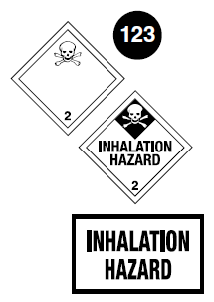
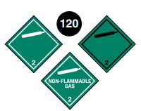
Class 2 - Gases
Division | Description
2.1 | Flammable Gas
2.2 | Non-flammable, non-toxic gases
2.3 | Toxic Gases

Slide 19
Class 3 – Flammable Liquid
There are no further divisions in this class.

Slide 20
Class 4 – Flammable Solids
Division | Description
4.1 | Flammable solids, self-reactive substances and solid desensitized explosives
4.2 | Substances liable to spontaneous combustion
4.3 | Water-reactive substances

Slide 21
Class 5 – Oxidizing Substances and Organic Peroxides
Division | Description
5.1 | Oxidizing substances
5.2 | Organic Peroxides

Slide 22
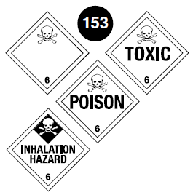
Class 6 – Toxic and Infectious Materials
Division | Description
6.1 | Toxic substances
6.2 | Infectious substances
Class 6.2 Infectious Substances will be covered in depth throughout this module as they are the most commonly shipped dangerous goods in health care

Slide 23
Class 7 – Radioactive Material
There are no further divisions in this class.
It is unlikely that Class 7 Dangerous Goods would need to be transported in an NWT health care role.

Slide 24
Class 8 - Corrosives
There are no further divisions in this class.

Slide 25
Class 9 – Miscellaneous Dangerous Goods
There are no further divisions in this class.
Dry ice is a Class 9 Dangerous Good.
Lithium batteries are a Class 9 Dangerous Good.

Slide 26
Shipper’s/ Consignor’s Responsibility
For the purposes of this training the words shipper and consignor will be used interchangeably.
Both the TDG Regulations and the IATA Dangerous Goods Regulations state that it is the shipper’s responsibility to identify and classify all dangerous goods intended for transport.
In addition, shipper’s are responsible for the selecting of proper packaging, appropriately packing the goods, using the correct marks, labels, and documentation and making any other legally required arrangements.
Section 14 of a product’s SDS is one source of this information.

Slide 27
Shipping Names and Special Provisions vs. Special Cases
Section 3

Slide 28
Proper Shipping Names
Ground Transport
Air Transport
TDG Regulations
Proper shipping names are shown in upper case letters in column 2 of Schedule 1
IATA Dangerous Goods Regulations
Proper shipping names are shown in bold type in column B of the List of Dangerous Goods (blue pages)
Every dangerous good can be identified by both the proper shipping name and UN number. The proper shipping name must be spelled EXACTLY as it appears in the documents referenced above.

Slide 29
UN Numbers
Ground Transport
Air Transport
TDG Regulations
UN numbers are shown in column 1 of Schedule 1
UN prefix has already been added
IATA Dangerous Goods Regulations
UN numbers are shown in column A of the List of Dangerous Goods (blue pages)
Add prefix UN to these 4 digit numbers
Every dangerous good can be identified by both the proper shipping name and UN number. The proper shipping name must be spelled EXACTLY as it appears in the documents referenced above.

Slide 30
What are Special Provisions?
Special provisions are used to clarify specific allowances for shipments of some dangerous goods.
They may:
Provide an exemption from certain portions of the regulations, or
Prescribe additional requirements

Slide 31
Special Provisions
Ground Transport
Air Transport
TDG Regulations
The presence of a number in column 5 of Schedule 1 indicates there is a special provision for the dangerous good
Read and follow the directions provided for the special provision in Schedule 2
IATA Dangerous Goods Regulations
The presence of a number preceded by the letter A in column M of the List of Dangerous Goods indicates there is a special provision for the dangerous good
Read and follow the directions provided for the special provision in Section 4.4 (between the blue and yellow pages)

Slide 32
Special Cases
If no Special Provisions apply to the dangerous goods, you may review the Special Cases in Part 1, Sections 1.15 to 1.49 to see if there is an exemption that can be used.
Special Cases will either exempt you from:
All of the requirements of the TDG Regulations
Some parts of the Regulations
Some sections of the Regulations, or
Give alternative ways of complying with the Regulations
If the conditions for using a Special Case are not strictly met, the entire TDG Regulations apply.

Slide 33
Special Cases Commonly Used in Health Care
1.17 Limited Quantities Exemption
1.17.1 Excepted Quantities Exemption
1.18 Medical Device or Article
1.39 Class 6.2, Infectious Substances, UN3373, BIOLOGICAL SUBSTANCE, CATEGORY B Exemption
1.41 Biological Products Exemption
1.42 Human or Animal Specimens Believed Not to Contain Infectious Substances Exemption
1.42.2 Blood or Blood Components Exemption
1.42.3 Medical or Clinical Waste
1.48 Air Ambulance Exemption

Slide 34
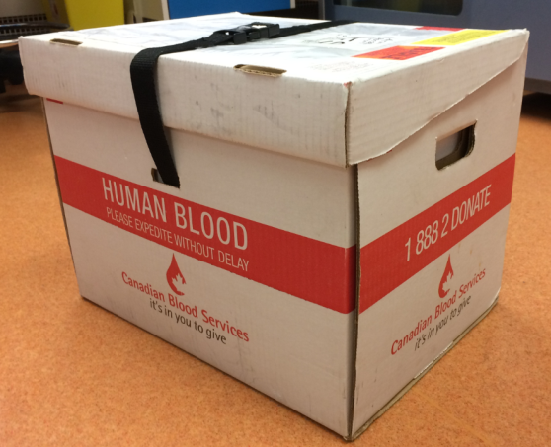
1.42.2 Blood or Blood Components Exemption
The following Special Case has been taken
directly from the regulations:
This is one example of how using Special Cases can facilitate the shipment of materials required for health care.

Slide 35
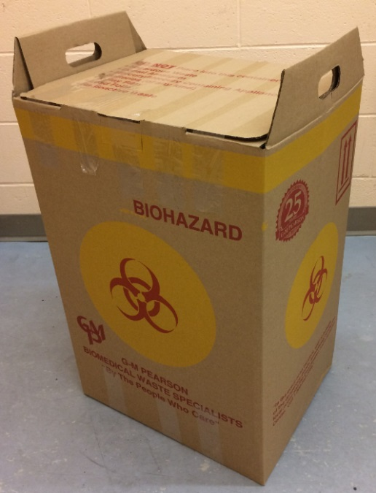
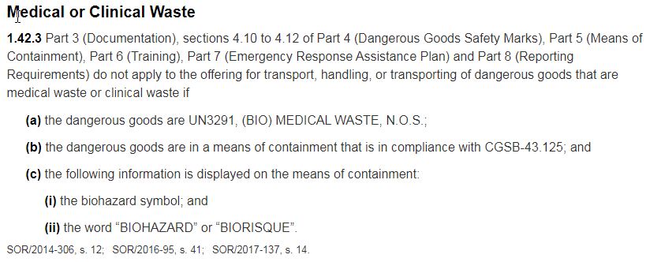
1.42.3 Medical or Clinical Waste

Slide 36
Health Care Workers are Special
This training module is designed to teach you how to use resources to determine how to safely transport Dangerous Goods – not to teach you each scenario individually.
Familiarize yourself with the Special Cases that apply to the Dangerous Goods that you may need to transport.
Special Cases are found in Part 1 of the TDG Regulations.
REMEMBER – In order to use a Special Case, you must comply with ALL the conditions listed. If you can’t, then you need to ship your Dangerous Goods fully regulated.

Slide 37
Use of Schedules 1, 2 and 3 Use of List of Dangerous Goods
Section 4

Slide 38
Transport by Ground
The Transportation of Dangerous Goods by ground is governed by the TDG Clear Language Regulations and TDG Schedules 1, 2 and 3.
These publications are available on the Transport Canada website and should always be used as your final reference.
https://www.tc.gc.ca/en/transport-canada/corporate/acts-regulations/regulations/transportation-dangerous-goods.html

Slide 39
Schedules 1, 2 and 3
Schedule 1 is the primary source of information you will need to ship goods by ground. It lists the Dangerous Goods in order by UN Number.
Schedule 2 provides the special provisions related to the shipment of Dangerous Goods
Schedule 3 lists Dangerous Goods in alphabetical order by Proper Shipping Name. It does not provide all of the required shipping information, but may help you determine the UN Number so you can find the appropriate entry in Schedule 1.

Slide 40
Schedule 1 (for training)
Col. 1 | Col. 2 | Col. 3 | Col. 4 | Col. 5 | Col. 6 |  | Col. 7 | Col. 8 | Col. 9
UN Number | Shipping Name and Description | Class | Packing Group/ Category | Special Provisions | 6(a) | 6(b) | ERAP Index | Passenger- Carrying Ship Index | Passenger-Carrying Road Vehicle or Passenger-Carrying Railway Vehicle Index
 |  |  |  |  | Explosive Limit and Limited Quantity Index | Excepted Quantities
UN1845 | CARBON DIOXIDE, SOLID; or DRY ICE | 9 |  | 18 | 0 | E0 |  |  | 200 kg
UN2789 | ACETIC ACID, GLACIAL; or ACETIC ACID SOLUTION, more than 80% acid, by mass | 8 (3) | II |  | 1 L | E2 | 3 000 |  | 1 L
UN2814 | INFECTIOUS SUBSTANCE, AFFECTING HUMANS | 6.2 | Category A | 16, 38, 84, 164 | 0 | E0 |  |  | 0.05 kg or 0.05 L
UN3082 | ENVIRONMENTALLY HAZARDOUS SUBSTANCE, LIQUID, N.O.S. | 9 | III | 16, 99 | 5 L | E1
UN3291 | CLINICAL WASTE, UNSPECIFIED, N.O.S.; (BIO) MEDICAL WASTE, N.O.S.; or REGULATED MEDICAL WASTE, N.O.S. | 6.2 | II | 128 | 0 | E0
UN3334 | AVIATION REGULATED LIQUID, N.O.S. | 9 |  | 16, 63 | 0 | E1
UN3373 | BIOLOGICAL SUBSTANCE, CATEGORY B | 6.2 | Category B | 38, 164, 165 | 0 | E0 |  |  | 4 kg or 4 L
UN3480 | LITHIUM ION BATTERIES (including lithium ion polymer batteries) | 9 |  | 34, 123, 137, 138, 149, 159 | 0 | E0 |  | 5 | 5 kg

Slide 41
Column 1 in Schedule 1
Column 1 shows the UN Number for the dangerous goods

Slide 42
Column 2 in Schedule 1
Column 2 shows the Proper Shipping Name (in upper case letters) of the dangerous goods.
Items may have more than 1 name or descriptions (lower case letters) included.
The name must appear on your documentation exactly as it is shown in upper case letters in this column.

Slide 43
Column 3 in Schedule 1
If the word FORBIDDEN appears in this column, you must NOT transport these goods.
Column 3 gives the primary class for the dangerous goods.
Subsidiary classes are listed underneath the primary class in brackets.

Slide 44
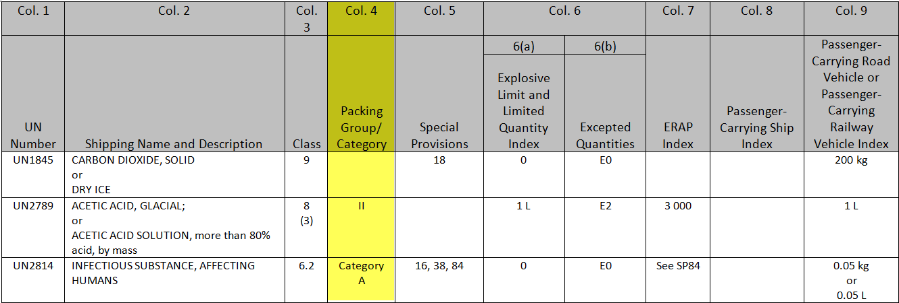
Column 4 in Schedule 1
The Packing Groups are shown in this column.
Packing Group I – great danger
Packing Group II – medium danger
Packing Group III – minor danger
Class 6.2 is assigned Categories instead of Packing Groups
Category A or B
Some items are not assigned a Packing Group or Category

Slide 45
Column 5 in Schedule 1
This Column indicates if there is a Special Provision for this dangerous good.
UN1845 DRY ICE has a special provision (18).
Go to Schedule 2 and see how to transport this material.

Slide 46
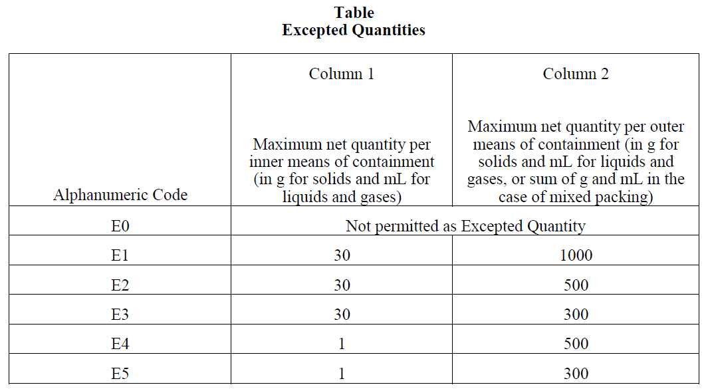
Column 6 in Schedule 1
Column 6(a) shows the Explosive Limit and Limited Quantity Index.
This shows the maximum amount of this item that can be shipped using Special Case 1.17 Limited Quantities Exemption.
Column 6(b) is the Excepted Quantity Index and is used to determine if Special Case 1.17.1 Excepted Quantities Exemption can be used.

Slide 47
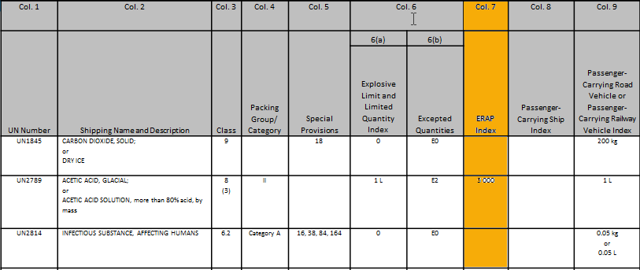
Column 7 in Schedule 1
This column gives the volume of goods above which an Emergency Response Assistance Plan is required. See Part 7 of the TDG Regulations.
If there is a zero in this column, an ERAP is ALWAYS required.
If the field is blank, an ERAP is not required.

Slide 48
Column 8/9 in Schedule 1
Column 8 indicates the maximum volume that can be transported on a passenger carrying ship (per means of containment)
Transport by ship is not covered in this training.
Column 9 indicates the maximum volume that can be transported on a passenger carrying road or railway vehicle (per means of containment)
If no index number is shown, there is no quantity limit.

Slide 49
Schedule 2
This schedule explains the Special Provisions that apply to dangerous goods.
The numbers of the Special Provisions correspond to the numbers in column 5 of Schedule 1.
Numbers preceded by SP in column 7 of Schedule 1 also correspond to Special Provisions in Schedule 2.
Each UN number that has a Special Provision against it is included in italics at the end of each Special Provision.

Slide 50
Schedule 3
Schedule 3 lists dangerous goods in alphabetical order by proper shipping name.
If you did not know the UN Number for DRY ICE, you could look it up in Schedule 3 so you could find the information you need in Schedule 1.
This schedule is also the only place that tells you if a dangerous good is a marine pollutant.

Slide 51
Transport by Air
Instead of using the TDG Regulations to find the information you need, when transporting by air the best resource is the current version of the IATA Dangerous Goods Regulations.

Slide 52
List of Dangerous Goods
In the IATA Dangerous Goods Regulations, the List of Dangerous Goods (found in the blue pages) provides you with the information you need to appropriately ship dangerous goods by air.
(Similar to Schedule 1 for Ground Transport)

Slide 53
List of Dangerous Goods (for training)
UN/ID no. A | Proper Shipping Name/Description B | Class or Div. (Sub Risk) C | Hazard Label(s) D | PG E | Passenger and Cargo Aircraft |  |  |  |  | Cargo Aircraft Only |  | S.P. see 4.4 M | ERG Code N
 |  |  |  |  | EQ see 2.6 F | Ltd Qty |  | Pkg Inst I | Max Net Qty/Pkg J | Pkg Inst K | Max Net Qty/Pkg L
 |  |  |  |  |  | Pkg Inst G | Max Net Qty/Pkg H
2789 | Acetic acid, glacial | 8 (3) | Corrosive & Flamm. liquid | II | E2 | Y840 | 0.5 L | 851 | 1 L | 855 | 30 L |  | 8F
3334 | Aviation regulated liquid, n.o.s. * † | 9 | Miscellaneous | III | E1 | Y964 | 30 kg G | 964 | 450 L | 964 | 450 L | A27 | 9A
3373 | Biological substance, Category B | 6.2 |  |  | E0 | Forbidden |  | See 650 | See 650 | See 650 | See 650 |  | 11L
1845 | Carbon dioxide, solid † | 9 | Miscellaneous |  | E0 | Forbidden |  | 954 | 200 kg | 954 | 200 kg | A48 A151 A805 | 9L
3291 | Clinical waste, unspecified, n.o.s | 6.2 | Infectious Subst. |  | E0 | Forbidden |  | 621 | No limit | 621 | No limit | A117 | 11L
3082 | Environmentally hazardous substance, liquid, n.o.s. * | 9 | Miscellaneous & Environmentally Hazardous | III | E1 | Y964 | 30 kg G | 964 | 450 L | 964 | 450 L | A97 A158 A197 A215 | 9L
2814 | Infectious substance, affecting humans * | 6.2 | Infectious Subst. |  | E0 | Forbidden |  | 620 | 50 mL | 620 | 4 L | A81 A140 | 11Y
3480 | Lithium ion batteries † (including lithium ion polymer batteries) | 9 | Miscellaneous Lithium batt |  | E0 | Forbidden |  | Forbidden |  | See 965 |  | A88 A99 A154 A164 A183 A201 A206 A213 A331 A334 A802 | 12FZ

Slide 54
List of Dangerous Goods Description (Columns similar to Schedule 1)
Only the 4 digit number is shown in column A – you will need to add UN to the front of it when completing documentation.
The List of Dangerous Goods are in alphabetical order by proper shipping name in column B.
Proper shipping names are indicated by bold text in the list (not UPPER CASE letters as in Schedule 1).
Columns C, E and F show the class, packing groups and excepted quantity codes discussed earlier.

Slide 55
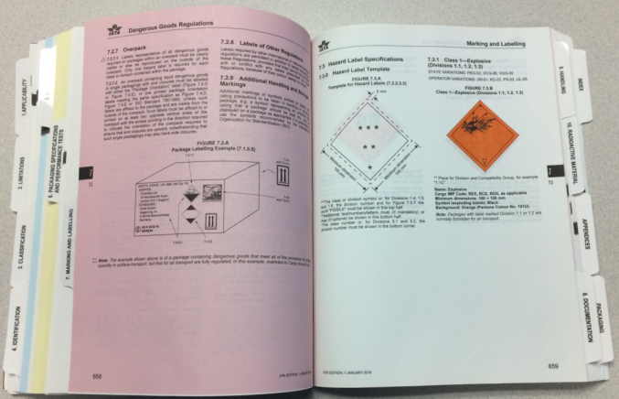
Column D Hazard Labels
Column D tells you which Hazard Labels you need to apply to the package.
Section 7 of the IATA Dangerous Goods Regulations explains how to apply the labels (pink pages) and shows pictures of the labels (white pages).

Slide 56
Columns G through L Packing Instructions and Maximum Quantities
Column H shows the maximum amount per package that can be shipped as a Limited Quantity (on Passenger and Cargo Aircraft). The packing instruction in Column G must be followed to ship this as a Limited Quantity.
Column J shows the maximum amount per package that can be shipped fully regulated (on a Passenger and Cargo Aircraft). The packing instruction in Column I must be used for this shipment.
Column L shows the maximum amount per package that can be shipped fully regulated (on a Cargo Aircraft Only). The packing instruction in Column K must be used for this shipment.

Slide 57
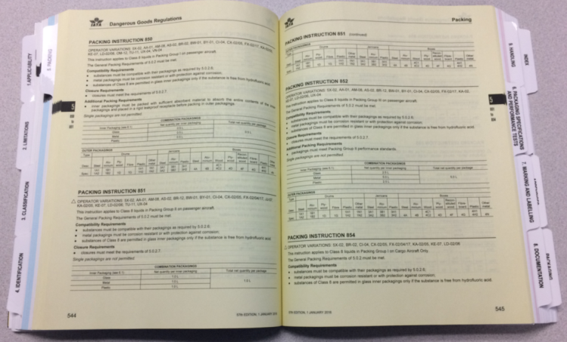
Packing Instructions
If you were shipping 1 L of the material shown by air on a Passenger and Cargo Aircraft, you would need to follow Packing Instruction 851.
Find the Packing Instruction in Section 5 Packing (yellow pages) and follow the directions given.

Slide 58
Column M Special Provisions
If there is a number preceded by A in this column, find it in Section 4.4 (the white pages between the blue and yellow pages).

Slide 59
Column N Emergency Response Drill Code
The Emergency Response Drill Code consists of a combination of letters and numbers, which represents the type of response that is expected to take place in the event of an incident involving this specific dangerous good.
It is listed here so the airline can include this when they notify the captain of the dangerous goods on board the aircraft.

Slide 60
Documentation
Section 5

Slide 61
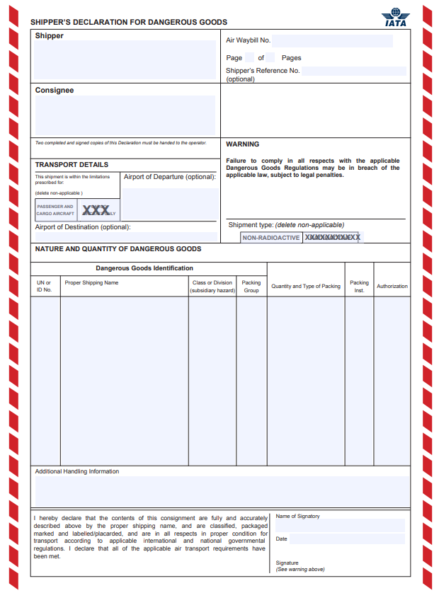
Shipping Documents
A shipping document is a paper document that contains required information about dangerous goods being handled, offered for transport or transported.
A shipping document is always required unless an exemption (Special Case or Special Provision) states otherwise.
Shipping documents may take on many forms for ground transport but, when you ship dangerous goods by aircraft, the shipping document must have red hatchings on the left and right margins (as shown).

Slide 62
Required Information
As a minimum, the shipping document must contain:
Shipper’s name and address
Date of shipment
Description of the dangerous goods in the following order:
UN number
Proper shipping name
Primary class (and subsidiary, if applicable)
Packing Group in roman numerals
If applicable, the words “toxic by inhalation” or “toxic – inhalation hazard” (See special provision 23)
The quantity in metric measurement
The “24 hour number” of an individual who can provide technical information on the dangerous goods
The consignor’s certification
In some cases more information may be required.
The information must be easy to identify, legible, in indelible print and in English or French.

Slide 63
Documentation Responsibilities
Shippers and carriers must be able to produce a copy of any shipping document for 2 years after the date the document was prepared and provide it to an inspector within 15 days of a written request.
Shipper
Carrier
Correctly classifying the dangerous goods
Correctly preparing the shipping documentation
Providing the shipping documentation to the carrier prior to transport
Provide the carrier with all applicable placards and safety marks
Checks documentation for accuracy
Compares safety marks to documents
Resolves any possible errors
Accepts documentation before taking possession
Keeps documentation in a specified location (in a pocket on the driver’s door or on the driver’s seat if out of the vehicle).
Each carrier must retain a copy of the documentation.

Slide 64
Example
Fillable forms can be found at:
https://www.iata.org/contentassets/a9f496cd8c87466b98142fa6d4cdb209/shippers-declaration-column-format-fillable.pdf

Slide 65
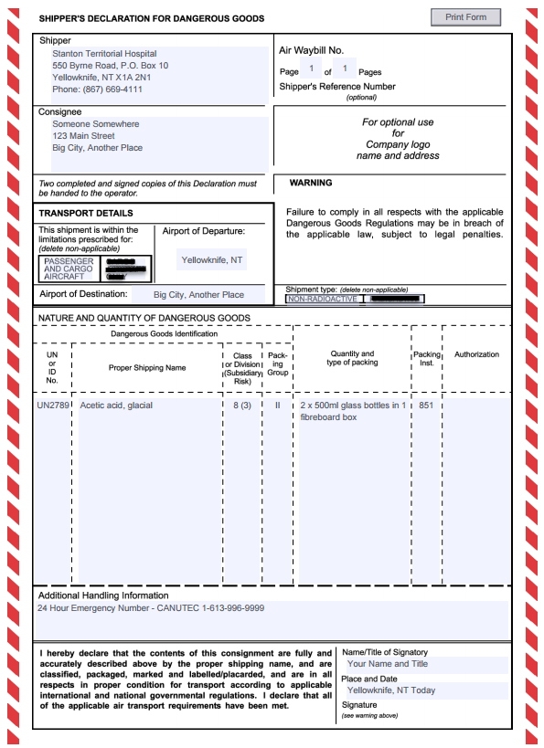
Here is the completed document (except for signature).
Remember that ALL required fields must be filled in.
Given our location, ensure that FOUR copies of this document are provided to the carrier. They must have the red borders and original signatures.
A fifth copy MUST be retained for your records.

Slide 66
Exempt Human Specimens Special Case 1.42 and IATA Exemption 3.6.2.2.3
In order to qualify for this exemption:
Specimens must be taken directly from a patient. Cultures must be classified as Category A or B.
Patient must not have any pre-existing infections (such as HIV or Hepatitis B).
Patient must not be symptomatic for infection (any samples being cultured or for viral testing must be classified as Category A or B).
Examples of specimens that qualify for this exemption:
Pregnancy tests
Blood glucose tests
Therapeutic drug monitoring
Fecal occult blood screening samples
Dried blood spots

Slide 67
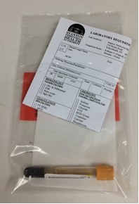
Packaging Exempt Human Specimens
Specimen must be in a leak-proof primary container.
Primary container must be placed in leak-proof secondary packaging.
Absorbent material must be placed between the primary container and secondary packaging.
Outer packaging must be of adequate strength for its contents.

Slide 68
Markings for Exempt Human Specimens
Exempt human specimens do not have a UN number or proper shipping name.
To claim this exemption, the phrase “Exempt Human Specimens” must appear on both the way bill and the outer package.
At least one surface of the package must measure at least 100 mm x 100 mm.
If other dangerous goods (such as dry ice or formalin) are shipped with exempt human specimens, the documentation requirements for the other dangerous goods must be followed.

Slide 69
Dangerous Goods Safety Marks
Section 6

Slide 70
TDG Safety Marks
Safety Marks provide important information about the goods being shipped.
Ensure that those transporting dangerous goods understand the hazards that have been identified.
Safety marks include:
Labels and placards
Orange panels
Signs
UN Numbers
Letters
Abbreviations
Words to identify dangerous goods
Words to show the nature of the danger

Slide 71
Safety Marks Must Be:
Made of durable and weather resistant material
Visible, legible and displayed against a background of contrasting colour
Of the proper size and colour indicated in the regulations
The responsibility of the shipper

Slide 72
Misleading Safety Marks
You must not display a safety mark on a means of containment or means of transport if the mark is misleading to the presence or nature of the danger.
Do NOT display a safety mark if no dangerous goods are present.
Do NOT display the wrong safety mark.
Do NOT display any other mark that may be mistaken for a safety mark.

Slide 73
Other Safety Marks
The Safety Marks related to the Classes of Dangerous Goods were covered earlier in this module.
The following slides will cover some of the other safety labels and marks you may need to use.
More information can be found in:
Section 4 of the TDG Regulations (Ground Transport)
Section 7 of the IATA Dangerous Goods Regulations (Air Transport)

Slide 74
Labels
A label must always be displayed on a small means of containment (equal or less than 450 L) containing dangerous goods in transport.
Labels for primary and subsidiary classes can be displayed on any side other than the side on which it is intended to rest or to be stacked during transport, or on the shoulder of cylinders.
A small means of containment must also display the shipping name and UN number of the dangerous goods in transport.

Slide 75
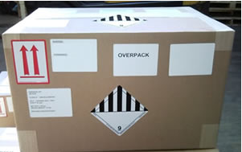
Overpack Safety Marks
Overpacks are used to consolidate fully compliant packages.
Any package placed in an overpack must be fully compliant with the regulations.
Any box can be used as an overpack as long as it is strong enough for its use and all items inside are compliant.
Each package in an overpack must be labeled as if it were being shipped alone. If these labels cannot be seen once placed in the overpack, they must be reproduced on the outside of the overpack along with the word OVERPACK.

Slide 76
Category B Mark
The Category B mark must be displayed on all small means of containment containing
UN3373, BIOLOGICAL SUBSTANCE, CATEGORY B instead of 6.2, Infectious Substances label.

Slide 77
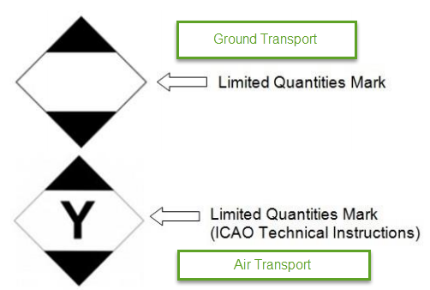
Limited Quantities Mark
When complying with the Limited Quantities Exemption (Section 1.17), the limited quantities mark must be displayed on one side of the means of containment.
As of January 1, 2021, you must display one of these marks.
The words “Limited Quantity”, “Ltd. Qty.”, “Consumer Commodity” can no longer be used.

Slide 78
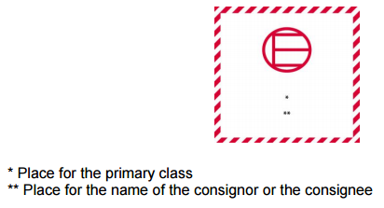
Excepted Quantities Mark
When shipping excepted quantities by ground and air respectively:
Excepted Quantities Exemption (Section 1.17.1), OR
Dangerous Goods in Excepted Quantities (Section 2.6)
the excepted quantities mark must be displayed on one side of the means of containment.

Slide 79
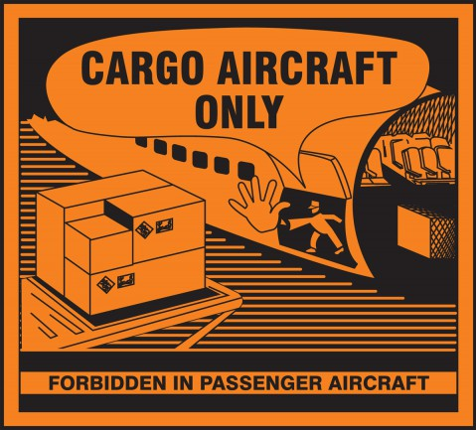
Cargo Aircraft Only
Dangerous Goods that are shipped by air and exceed the maximum quantity allowed on a passenger carrying aircraft MUST have this label affixed to one side of the package.

Slide 80
Lithium Battery Label
This label is required for shipping lithium batteries by aircraft.
It is FORBIDDEN to ship damaged, defective, recalled or recycled lithium batteries by aircraft. This ban applies whether or not they are contained in equipment.

Slide 81
Orientation Label
Orientation labels (when required) must be placed on 2 opposing sides of a package.

Slide 82
Means of Containment
Section 7

Slide 83
Means of Containment
Both the TDG Regulations and IATA Dangerous Goods Regulations require dangerous goods to be contained in a safe means of containment.
A means of containment is a container or packaging designed to prevent the release of dangerous goods that could constitute a danger to life, health, property or the environment under normal conditions of transport.

Slide 84
Small, Large and Intermediate
Small Means of Containment
Volume equal or less than 450 L
May be drums, jerricans, boxes, pails, bags, barrels, cylinders
Large Means of Containment
Volume greater than 450 L
Intermediate Bulk Container
Volume greater than 450 L but less than or equal to 3000 L

Slide 85
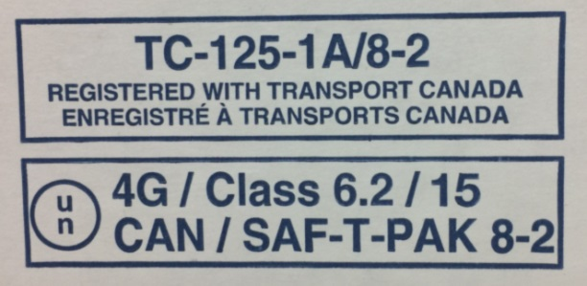
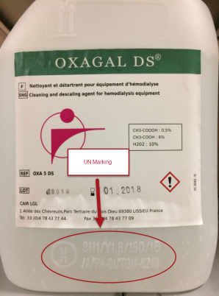
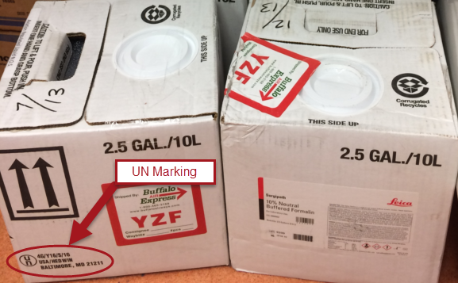
Compliance Marks
All standardized means of containment bear compliance marks to indicate that they were manufactured in compliance with a standard.
All compliance marks must be durable, visible, legible and easily accessible for inspection.
Most means of containment standards in Canada are based on the United Nations (UN) Recommendations.
UN standardized means of containment are internationally recognized and can be used anywhere in the world and by any mode of transport.
Some means of containment standards are specific to Canada and will display a TC marking.

Slide 86
UN Compliance Marks

Slide 87
Mode of Transport
Refer to Part 5 of the TDG Regulations for more information regarding means of containment for road transport.
Refer to Part 6 of the IATA Dangerous Goods Regulations for more information regarding means of containment for air transport.

Slide 88
Packaging for Infectious Substances

Slide 89
Type P620 Packaging
A Type P620 container is a triple packaging system consisting of:
Watertight primary receptacle(s)
Watertight secondary packaging
Absorbent material
Outer packaging

Slide 90
Packing Instruction 620
The following video shows how to appropriately pack a Category A Infectious Substance according to Packing Instruction 620
https://www.youtube.com/watch?v=cA4qYHg3U_M&feature=youtu.be
REMEMBER:
If you alter the packaging bearing UN markings, you may be fined as the packaging is no longer compliant with the regulations and standards.

Slide 91
Indicative List of Category A Infectious Substances

Slide 92
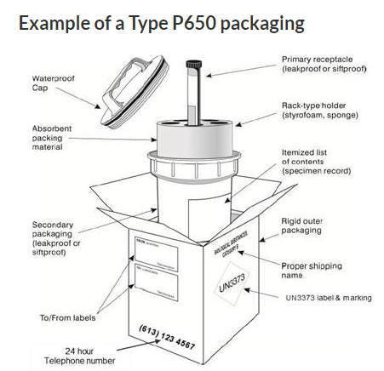
Type P650 Packaging
A Type P650 container is typically used for UN3373 Biological Substance – Category B, but it can also be used for the transport of certain Category A Infectious Substances.
If you were shipping a sputum sample for TB testing, this would be a Category B package.
A positive TB culture, however, would require Category A packaging.
(See previous slide – Indicative List of Category A Infectious Substances)

Slide 93
Packing Instruction 650
The following video shows how to appropriately pack a Category B Biological Substance according to Packing Instruction 650
https://youtu.be/segYrsI6qAA
REMEMBER:
Failing to declare and ship Category A or Category B infectious substances appropriately can result in fines of up to $50, 000.

Slide 94
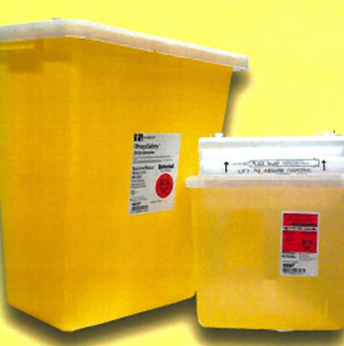
Standardized and Non-standardized Packaging Permitted in Part III of the CAN-CGSB-43.125 Standard
Part III packaging is single or combination packaging suitable for transporting most biomedical waste. There are 3 options:
Single Packaging (Intermediate Bulk Container or Drum)
Combination Package (Bag inside a Box)
Bag and box must meet strength tests as per CAN/CGSB-43.125
Sharps Container
Must meet requirements of CAN/CGSB-43.125
No certification marks are required for a Part III Container.

Slide 95
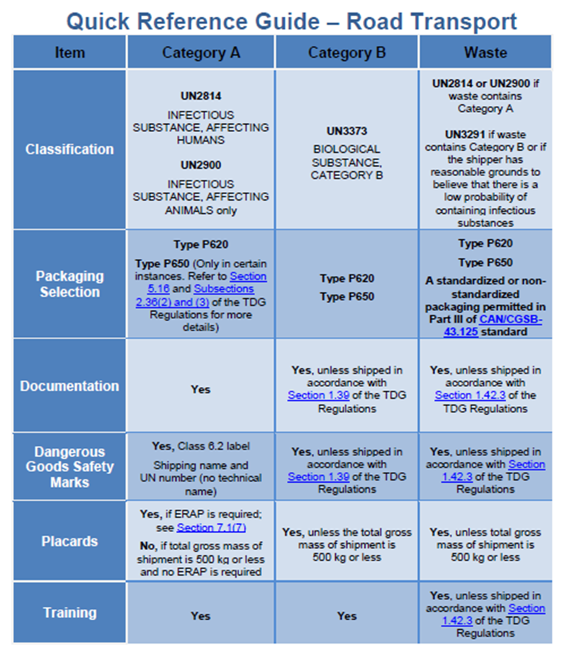
Quick Reference Guide for Road Transport

Slide 96
Transporting Waste Containing Category A Infectious Substances
There is NO EXEMPTION for waste containing Category A infectious substances.
Anyone handling, offering for transport or transporting these materials must comply with the Regulations.
Must complete the appropriate shipping documents
Must display the appropriate safety marks
Must use a P620 package
Must be appropriately TDG trained and hold a valid training certificate
Must have an approved Emergency Response Assistance Plan (ERAP)
P620 packages are not large enough for items such as personal protective equipment, gowns, gloves, linen, waste, etc.
As such, we may need to apply for an Equivalency Certificate in order to transport the waste in a non-standard means of containment. (See Part 14 of the TDG Regulations)
Contact your Infection Control Coordinator, Hazardous Waste Specialist and Biological Safety Officer immediately to help facilitate this application.
Transport Canada can be contacted with questions at:
1-855-298-1520
tdgapprovals@tc.gc.ca

Slide 97
Checklists
Supervisors/Managers should provide checklists for your area to ensure all appropriate requirements are met for your dangerous goods shipment.
Recommended checklists are available in the back of the IATA Dangerous Goods Regulations if one is not available.
Packaging Checklist
Item | Category A | Category B | Exempt Patient Specimens
Manufacturer’s instructions followed | □ | □ | □
Good quality packaging | □ | □ | □
Primary receptacles properly closed and leak-proof | □ | □ | □
Primary receptacles secured with secondary means | □ | Recommended | Recommended
Multiple receptacles wrapped individually | □ | □ | □
Sufficient absorbent inside each secondary packaging | □ | □ | □
Secondary packaging properly closed and leak-proof | □ | □ | □
Primary receptacle or secondary packaging 95 kPa pressure compliant | □ | □ | N/A
Itemized list of contents between secondary and outer packaging | □ | □ | N/A
Outer package displays UN specification mark | □ | N/A | N/A
Outer package displays TC-125-1A | □ | N/A | N/A
Outer package displays TC-125-1B | N/A | □ | N/A
Rigid outer packaging | □ | □ | N/A
Minimum external dimensions of outer packaging | □ | □ | □
Marking and Labeling Checklist
Item | Category A | Category B | Exempt Patient Specimens | Dry Ice | Formalin
Address of shipper | □ | □ | □ | □ | □
Address of receiver | □ | □ | □ | □ | □
Hazard label/mark affixed | □ | □ | N/A | □ | □
Proper shipping name or other designation | □ | Already on mark | □ | □ | □
Technical name | Optional | N/A | N/A | N/A | N/A
Quantity of dangerous goods | If shipped with dry ice | N/A | N/A | □ | □
Name and telephone number of responsible person | □ | □ | □ | □ | □

Slide 98
Safe Handling and Transport Practices
Section 8

Slide 99
General Safety Information
With all of the various hazards, different materials present, and with some materials presenting more than one hazard, it is important to know the nature of each material you handle.
Safe handling information can be found in your area’s Standard Operating Procedures (SOPs). Make sure you follow these SOPs at all times. Shortcuts may lead to accidents.

Slide 100
WHMIS
The Workplace Hazardous Materials Information System (WHMIS) legislation requires your employer to ensure hazard warning labels and Safety Data Sheets (SDSs) provide the information you need to safely handle the hazardous materials in your area.
If a container label does not provide you with the information you need, check the SDS. The SDS provides detailed specific information.

Slide 101
Shipping Documents
TDG hazard information is also found on a material’s shipping document. These may also be called the material’s Bill of Lading, Shipping Order, Manifest, Invoice or Shipper’s Declaration.
Shipping documents will have the UN number, proper shipping name, TDG class and emergency contact numbers.

Slide 102
Personal Protective Equipment (PPE)
Hazardous materials can enter your body and harm you in 4 ways:
Absorption
Ingestion
Inhalation
Injection
A hazardous material’s SDS lists the appropriate PPE for handling that material.
Do not substitute or improvise equipment. Wear the PPE recommended and be sure to wear it correctly.

Slide 103
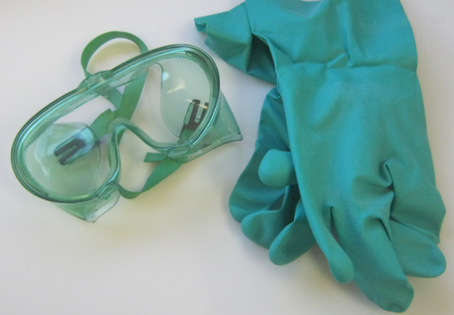
Goggles and Gloves
When working with hazardous materials, you will most likely need eye protection for splash, fume and particulate hazards. Goggles and face shields are often the appropriate eye and face protection.
Vinyl, rubber or other synthetic gloves are often used when handling hazardous chemicals. If required, you can tape or fold the cuffs of your gloves to prevent liquids from running inside your glove.
Be sure to always check the SDS and your department’s SOPs for PPE requirements.

Slide 104
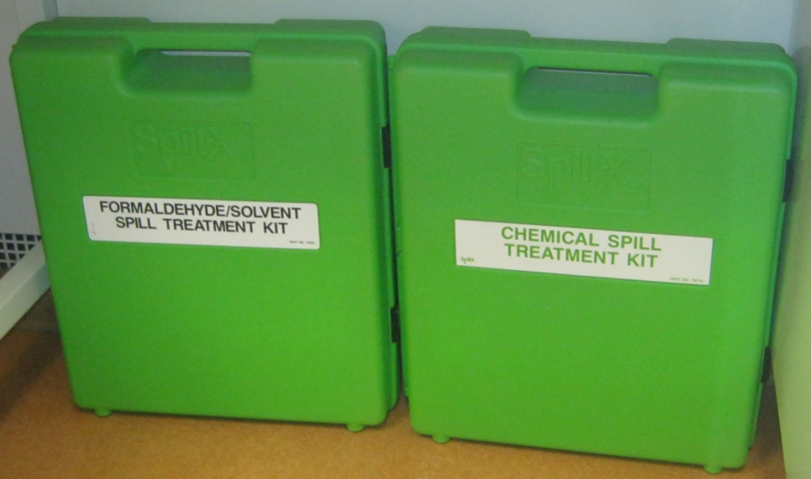
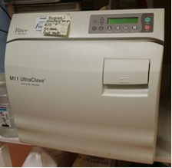
Decontamination
Whenever you finish working with hazardous materials, you need to decontaminate.
Decontamination may be physical or chemical.
Physical decontamination methods include scrubbing; diluting; absorbing; vacuuming; vaporizing; and sandblasting.
Chemical methods of decontamination include neutralizing; dissolving; sterilizing; and disinfecting.
Some decontamination processes need a combination of physical and chemical methods.

Slide 105
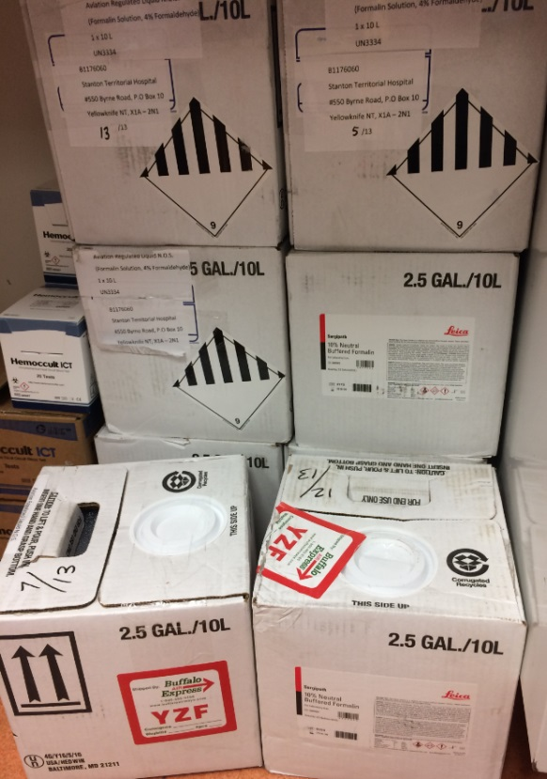
Container Handling
Good housekeeping is essential. Update illegible labels, make sure containers are stored safely when not in use, and be sure to stack them carefully so they will not fall.

Slide 106
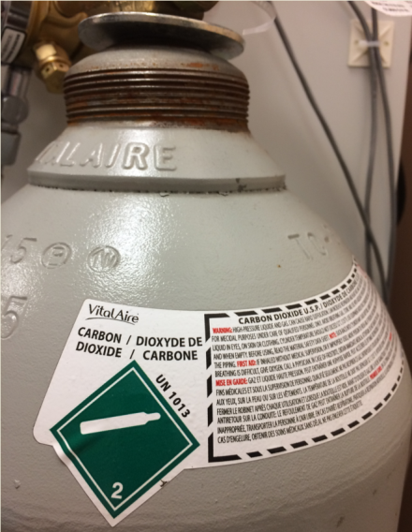
Compressed Gases
Treat compressed gases as potentially explosive. Do not expose them to temperatures above 120°C.
Secure cylinders with straps or chains to move or store them.
When you empty a cylinder, remove the regulator and cover the valve with a protective cap.

Slide 107
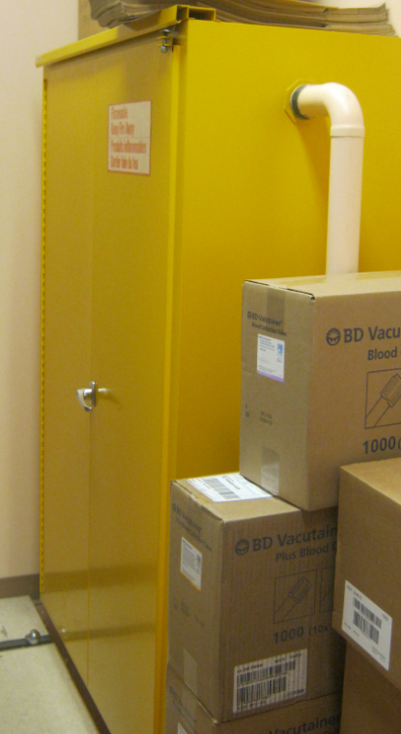
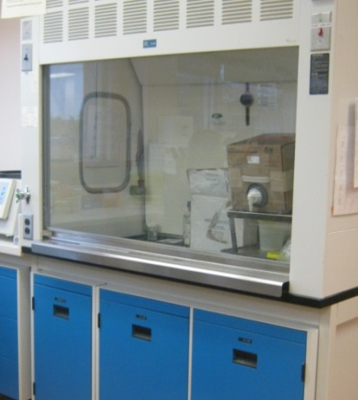
Flammable Chemicals
Store flammable chemicals in an appropriate storage cabinet.
Keep ignition sources away from flammable materials and use static grounding procedures when transporting.
Avoid handling hazardous materials in dusty atmospheres as they are more prone to fire hazard.

Slide 108
Emergency Response Assistance Plans
Section 9

Slide 109
What is an ERAP?
An ERAP or Emergency Response Assistance Plan is a plan that describes what is to be done in the event of a transportation accident involving certain higher risk dangerous goods.
The ERAP is required by the Transportation of Dangerous Goods Regulations (TDGR) for dangerous goods that require special expertise and response equipment to respond to an incident.
The plan is intended to assist local emergency responders by providing them with technical experts and specially trained and equipped emergency response personnel at the scene of an incident.

Slide 110
When Do You Need an ERAP?
A person must have an approved ERAP before offering for transport or importing certain dangerous goods above a quantity specified in Column 7 of Schedule 1 of the Transport of Dangerous Goods Regulations. If no number (or reference to a special provision) appears in column 7, an ERAP is not required. If a number appears in column 7 of Schedule 1, then we must refer to Section 7.1 of the TDG Regulations.

Slide 111
Class 6.2 Infectious Substances that Require an ERAP
A person who offers for transport or imports any quantity of the Class 6.2 Infectious Substances (shown to the right), or any substance that exhibits characteristics similar to these substances must have an approved ERAP.

Slide 112
Part 7 TDG Regulations
Due to the low likelihood of requiring an ERAP, the process will not be further discussed in this training.
In the event that an ERAP is required, consult with safety personnel in your facility and follow the instructions provided in Part 7 of the TDG Regulations.

Slide 113
Reporting Requirements
Section 10

Slide 114
Reportable Events
The release or anticipated release of dangerous goods being offered for transport, handled or transported by road vehicle, railway vehicle or ship
The release or anticipated release of dangerous goods that are being offered for transport, handled or transported by aircraft
Undeclared or misdeclared dangerous goods that are being offered for transport, handled or transported by aircraft
The loss or theft of dangerous goods
Unlawful interference with dangerous goods

Slide 115
Emergency Reports (Ground)
You are required by law to report to the local authority any release or imminent release of dangerous goods in excess of the amounts shown in the following table.
Northwest Territories Local Authority – (867) 920-8130
Class | Packing Group or Category | Quantity
1 | II | Any quantity
2 | Not applicable | Any quantity
3, 4, 5, 6.1 or 8 | I or II | Any quantity
3, 4, 5, 6.1 or 8 | III, or without packing group | 30 L or 30 kg
6.2 | A or B | Any quantity
7 | Not applicable | A level of ionizing radiation greater than the level established in section 39 of the Packaging and Transport of Nuclear Substances Regulations, 2015
9 | II or III, or without packing group | 30 L or 30 kg

Slide 116
Information Included in an Emergency Report
Name and contact information of the person making the report
Date, time and location of incident and release of dangerous goods
Mode of transport
Shipping name and/or UN number
Total quantity of dangerous goods being shipped and the estimated quantity released
Type of incident leading to the release

Slide 117
Release or Anticipated Release Report (Ground)
As soon as possible after making an emergency report, the person who made the report must also report the incident to:
CANUTEC
1-888-CANUTEC (1-888-226-8832) or 613-996-6666
The shipper of the dangerous goods
In addition to the information in the Emergency Report the following details must be provided (if applicable):
The name and location of any road, railway or waterway that was closed
The means of containment of the dangerous goods
The number of people evacuated or sheltered in place
The number of deaths and the number of persons who sustained injuries that required immediate medical treatment by a health care provider

Slide 118
30 Day Follow Up Report
The person who made the reports discussed earlier (or the person’s employer) must make a follow up report in writing to the Director General within 30 days.
See 8.7 of the TDG Regulations for more information.
If changes to the information provided in the 30 day follow up report change within 1 year of its submission, the person that made the report must notify the Director General as soon as possible.
The report must be kept for 2 years.
A copy of the report must be provided to an inspector within 15 days of receiving the request in writing.

Slide 119
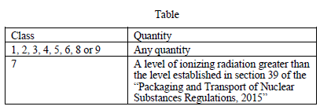
Dangerous Goods Accident or Incident Report (Air)
This report is very similar to the report required for ground transport and requires a 30 day follow up report.
This type of report would typically be completed by airport/airline personnel.
The major difference is the quantity of the release that would trigger the report.

Slide 120
Undeclared or Misdeclared Dangerous Goods Report (Air)
In the event that dangerous goods are discovered at an airport, air cargo facility, or on board an aircraft without the appropriate documentation or dangerous goods marks, they are required to report this to CANUTEC as soon as possible.
Ensure that all dangerous goods shipments have been appropriately declared and labeled.

Slide 121
Loss or Theft Report
In the event that ANY infectious substances included in Class 6.2 are lost or stolen in transport it MUST be reported to CANUTEC as soon as possible.
If the goods are later found, this discovery must also be reported to CANUTEC.
Many other dangerous goods are reportable if lost or stolen, but it is unlikely that they would be shipped in a health care role.
See Part 8 of the TDG Regulations for more information.
Information to be included in a Loss or Theft Report:
Name and contact information of the person making the report
Shipper, receiver and carrier contact information
Whether the goods were lost or stolen
Shipping name and/or UN number
Quantity of goods lost or stolen
Description of the means of containment for the lost or stolen goods
Approximate date, time and location of the loss or theft.

Slide 122
Security Plans
Security plans are required for all goods listed on the Indicative List of High Consequence Dangerous Goods.
Transport of specimens is part of the Referral Laboratory contract.

Slide 123
Notification of Shipment
In compliance with the Human Pathogens and Toxins Act and Regulations and to guard against loss or theft of high consequence dangerous goods, the Biological Safety Officers of the licenced shipping and receiving facilities are notified in writing whenever a Category A infectious substance is being transported.

Slide 124
Unlawful Interference Report
If there has been unlawful interference (tampering) with dangerous goods while they were being imported, offered for transport, handled or transported, the person who was responsible for the goods must report the unlawful interference to CANUTEC as soon as possible after discovery.
The report must include:
The name and contact information of the person making the report
Names and contact information of the shipper, receiver and carrier
Detailed description of the unlawful interference
Shipping name and/or UN number of the dangerous goods
Description and quantity of the means of containment
Approximate date, time and location of the unlawful interference

Slide 125
Proper Use of Equipment for Handling Dangerous Goods
Section 11

Slide 126
Equipment for Handling Dangerous Goods
Many different types of equipment may be used for handling and transporting dangerous goods.
As these may vary depending upon your workplace, they will not be covered in this module.
If specific equipment is used for this purpose in your work area, it is the responsibility of your Manager/Supervisor to provide you with the related Standard Operating Procedures and training.
Once this has been completed and documented, the “Use of Equipment” box can be checked on your Dangerous Goods training certificate.

Slide 127
Emergency Measures
Section 12

Slide 128
Emergency Response
Even if you are careful, accidents can still occur.
That is why it is important to know what to do in an emergency, before it happens.
For incidents within the facility, procedures for handling different types of emergencies can be found in the Code Binder.
Transport Canada also publishes the Emergency Response Guidebook to assist in the event of a transportation incident involving dangerous goods.

Slide 129
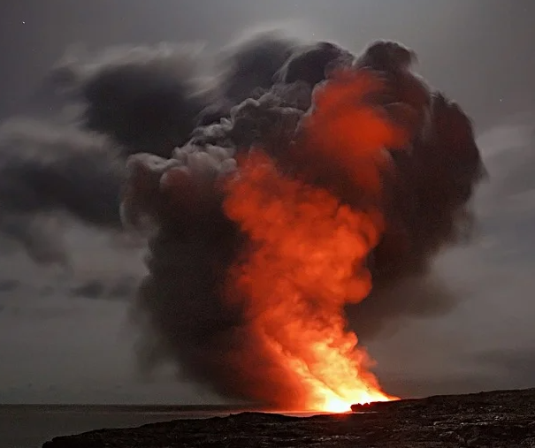
Step 1 – APPROACH CAUTIOUSLY FROM UPWIND, UPHILL AND/OR UPSTREAM
Stay clear of Vapor, Fumes, Smoke and Spills.
Keep vehicle at a safe distance from the scene.

Slide 130
Step 2 - SECURE THE SCENE
Isolate the area and protect yourself and others.

Slide 131
First Responders
First Responders MUST be trained in the use of the guidebook.
If responding to an emergency is expected to be part of your duties, your Supervisor/Manager needs to ensure that this training occurs.

Slide 132
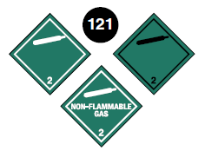
Step 3 – IDENTIFY THE HAZARDS USING ANY OF THE FOLLOWING:
Placards
Container labels
Shipping papers
Rail Car and Road Trailer Identification Chart
Safety Data Sheets (SDS)
Knowledge of persons on scene
Consult applicable guide page
NEVER touch, smell or taste any spilled material to identify it.
If you can see a placard or label, you can use the guidebook to find the correct emergency response in the orange pages.

Slide 133
Step 4 - ASSESS THE SITUATION
Is there a fire, a spill or a leak?
What are the weather conditions?
What is the terrain like?
Who/what is at risk: people, property or the environment?
What actions should be taken – evacuation, shelter-in-place or dike?
What resources (human and equipment) are required?
What can be done immediately?
Report any information you have been asked to provide to the response team members.
They will use this information to help determine what level of response is required and what resources are needed.

Slide 134
Step 5 - OBTAIN HELP
Advise your headquarters to notify responsible agencies and call for assistance from qualified personnel.

Slide 135
Step 6 - RESPOND
Enter only when wearing appropriate protective gear.
Rescue attempts and protecting property must be weighed against you becoming part of the problem.
Establish a command post and lines of communication.
Continually reassess the situation and modify response accordingly.
Consider safety of people in the immediate area first, including your own safety.
REMEMBER:
Do not assume that gases or vapors are harmless because of lack of a smell – odorless gases or vapors may be harmful.
Use CAUTION when handling empty containers because they may still present hazards until they are cleaned and purged of all residues.

Slide 136
Notification Process
Follow the steps outlined in your organization’s standard operating procedures and/or local emergency response plan for obtaining qualified assistance. Generally, the notification sequence and requests for technical information beyond what is available in this guidebook should occur in the following order:
Notify your Organization/Agency
Call the Emergency Response Telephone Number on the Shipping Paper
National Assistance
Provide as Much Information as Possible
See Page 5 of the Emergency Response Guidebook for further details.

Slide 137
Safety
The most important part of emergency response is SAFETY.
Do what is within your ability and training and no more.
Safe work practices combined with emergency preparedness makes a good combination for a safe work environment with hazardous materials.

