Slide 2
Monthly Meeting
JULY 2024
AdventistHealthcare.com

Slide 3
AGENDA
Devotional
  Mission Reflection
Excellence in Motion Highlight
  Leadership System Overview
  System Process Portal Now Live
Team Highlights
“We extend God’s care through the ministry of physical, mental and spiritual healing.”
3

Slide 4
DEVOTIONAL
We extend God’s care through the ministry of physical, mental and spiritual healing.
At Adventist HealthCare, our Mission to extend God’s care, is our reason for being. It serves as a ‘north star’ to guide our decision making and shape our organization. Our Mission expresses who we are, why we exist and the purpose behind what we do.
Discussion
Why are we here in the first place?
What does our community need most that we are uniquely able to provide?
What are we willing to sacrifice in order to fulfill our Mission?
How can we all be on this Mission together?
“We extend God’s care through the ministry of physical, mental and spiritual healing.”
4

Slide 5
DEVOTIONAL
Keep looking straight ahead, without turning aside.
Know where you are headed, and you will stay on solid ground.
Quote:
Proverbs 4:25, CEV
Bible Verse:
A small body of determined spirits fired by an unquenchable faith in their mission
can alter the course of history.
Mahatma Gandhi
Prayer:
God, may we never lose sight of our purpose to care for our patients, their families and each other with deep care and compassion. May our words and actions demonstrate
the power of our Mission. AMEN.
“We extend God’s care through the ministry of physical, mental and spiritual healing.”
5

Slide 6
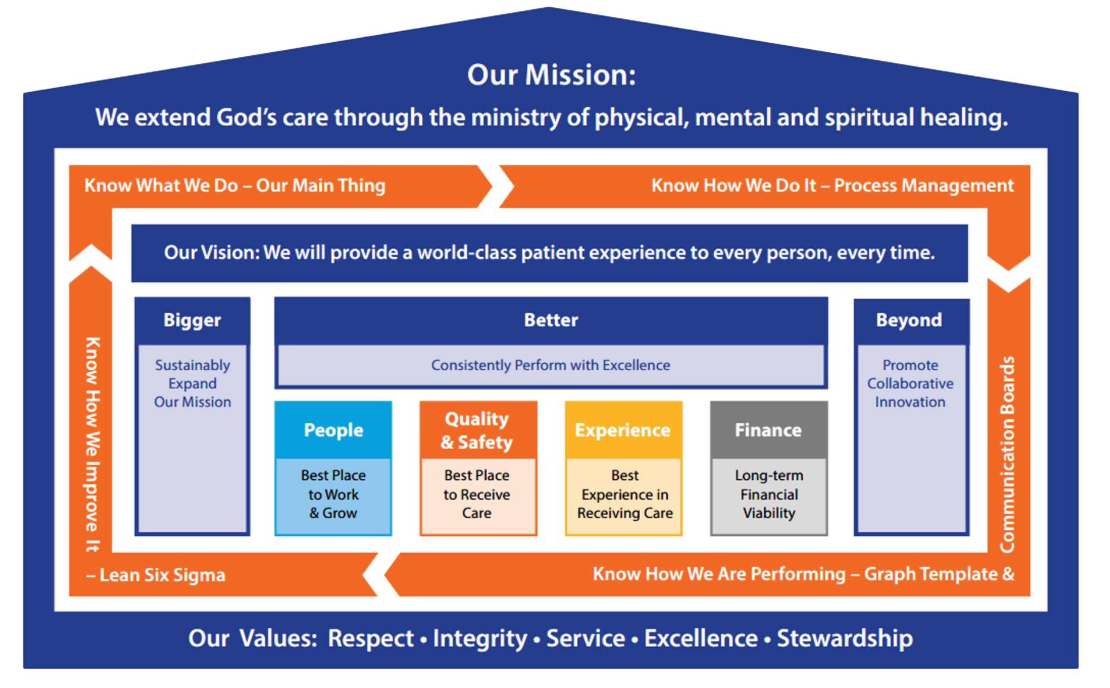
AHC’S LEADERSHIP SYSTEM
AHC Trivia!
Can you name this foundational
component of our “recipe for success”?
Next slide is the answer
1
6

Slide 7
AHC’S LEADERSHIP SYSTEM
1
7

Slide 8
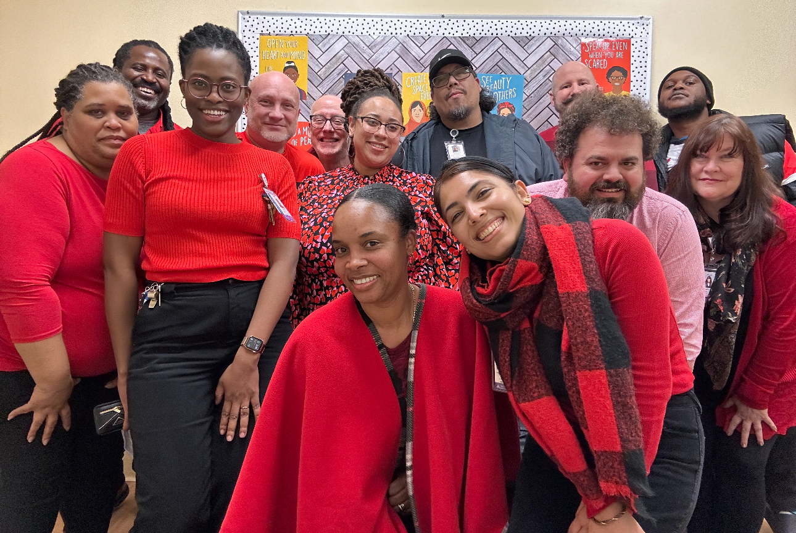
OPERATIONAL EXCELLENCE SUCCESS STORY
We Do Our Best Everyday to Exceed Expectations
Team Picture
  Sharing AHC Best Practices
The Ridge School Behavioral Support Room (BSR) started as a way to reduce physical restraints and seclusions. Now, it is time to keep the kids in the learning environment.
  How Did They Improve?
How Did They Do?
Train each staff member on how to avoid the conflict cycle with students
Create a relaxation station within the classroom
Make expectations clear surrounding the steps students (and staff) should take before exiting the classroom
Graph with at least
3 data points
“We extend God’s care through the ministry of physical, mental and spiritual healing.”
8
Notes:
After reducing physical restraints and seclusion to nearly zero for several years, the Ridge School is up for their next challenge, reducing the use of the Behavioral Support Room (BSR), the place where children go when they start to have challenges or feel stressed. The problem was that children were sometimes going there to hang out and get away from class, or teachers were sending children there the moment challenges began, before attempting in-class interventions. Either way, the child looses valuable class content from the missed in-class time. The result of the project has increased awareness by staff on why students were utilizing the BSR, how to appropriately intervene and how to re-direct behavior before utilizing the BSR, which has overall reduced the utilization of the BSR, with more improved results expected.
How might this translate to your work?
Putting steps in place to make sure customers are receiving the care and treatment they need, in the most appropriate place, at the most appropriate time, in the most appropriate way, so that they may achieve success.

Slide 9
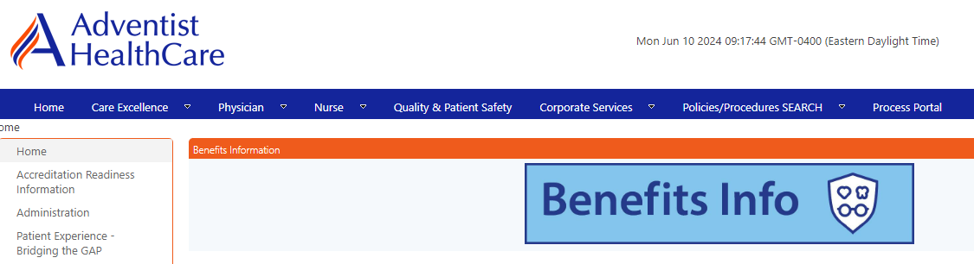
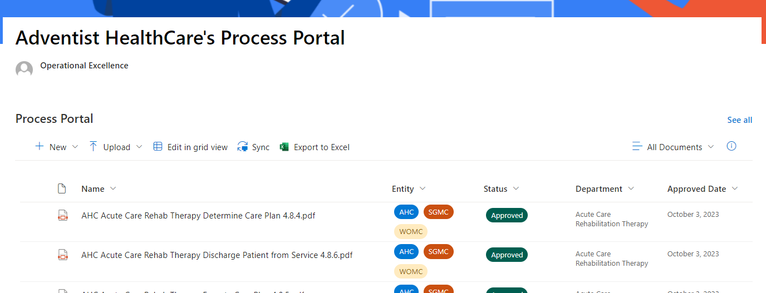
System Process Portal is LIVE!
Accessible portal with all AHC Process Maps (PACS and IT have unique sites with links on portal)
  Portal Location
Intranet Home page on top blue bar, under “Process Portal”
Operational Excellence Website, located on quick links
https://adventisthealthcare.sharepoint.com/sites/DEPT-Operational_Excellence/SitePages/Process-Portal.aspx
  Finding a Map
All AHC maps are located on the portal (excluding PACS and IT services)
Filter by entity, APQC, department, or keyword
  Adding/updating maps
OE advisors are working with departments to upload approved maps to the portal
All maps will be required to have an annual review; first due date 12/31/2025
OE advisors will notify department leaders of review due dates
If a department needs to edit currently uploaded maps or creates a new map, please notify your OE advisor for portal upload
“We extend God’s care through the ministry of physical, mental and spiritual healing.”
9

Slide 10




















COMMUNITY BULLETIN
How We Give Back to the Community
Spring 2024 Awardees
In the spring of 2024, through our Community Partnership Fund (CPF), AHC awarded 19 grants and 1 sponsorship to 20 local non-profit organizations. Through CPF we fund programming that:
aligns with our mission
addresses needs identified in our Community Health Needs Assessment
addresses documented health disparities or inequities
focuses on populations in our service areas
Funded programs are addressing:
access to care (primary, specialty, and mental health) for low-income and uninsured/underinsured individuals
educational equity for youth
housing stability, quality, and safety
workforce development
chronic disease prevention and management
food access and physical activity
Learn more at: www.adventisthealthcare.com/cpf
“We extend God’s care through the ministry of physical, mental and spiritual healing.”
10

Slide 11
TEAM HIGHLIGHTS
Discuss 6 Dashboard Graphs
Continue the Monthly Meeting discussing information for your department.
“We extend God’s care through the ministry of physical, mental and spiritual healing.”
11

Slide 12
FWMC TEAM HIGHLIGHTS 7/16/24
Please take the blood bank training…. Blood bank QC in computer.
DPMO Reviewed… Follow instructions, Timely performance, do good second review.
If the room temp in lab out of range stop testing.
Metrics look good!
Morning run samples coming down late. Rob will speak with Dr. Fisher. Vanessa will help.
Dress Code. FWMC wears DK Blue Scrubs. It is okay to replace with Amazon scrubs, they are much less expensive.
Please complete MTS updates before 7/22 for the GEC inspection follow up. QA-12 Temp and Humidity Quality Control. Room temp 20-25C in testing area, Stop testing if out of range, notify Lab Admin and Nursing Admin.
Zanetta following up with Ash regarding new chairs.
Staffing at FWMC is looking good. Please treat staff with respect and kindness. Let’s retain our staff.
“We extend God’s care through the ministry of physical, mental and spiritual healing.”
12

Slide 13
SGMC/ GEC TEAM HIGHLIGHTS 7/23/24
Call outs will be monitored by supervisors.- All supervisors to follow up
Staff must be proactive with MTS, competency, Empower- All supervisors to follow up
Phlebotomy staff must login into there vocera properly, prior to their shift- Nontechnical supervisors will follow up
Staff should park on designated area only which is in the parking garage 2nd floor and up- Security is monitoring this very closely.
Cleanness of laboratory- Facility will do floor brushing and waxing on August 4 evening shift - Technical supervisors to follow up.
Staffs working in chemistry should use correct action comments in Unity. Each shift needs to do bench review in Unity - Technical supervisors will follow up on this.
Lack of blood culture bottles – update given by Rob.
Staff reminded that breaks are for only 30 minutes. Some staff are not badging out for lunch until they are ready to sit down and eat. Staff who are in charge and notice employees taking extended breaks will let management know immediately.
Supply issues raised- staff to notify management when supplies need to be moved and be proactive when you see supplies running low (before they run out). - Huddles to be conducted with staff to discard empty boxes of reagents from refrigerators.- Technical supervisors to follow up
Employee recognition in response to Glint survey is to do a Purple Star Award. People will make nominations via email to Rob. The person must not be on any disciplinary action or delinquent on any mandatory assignments.
“We extend God’s care through the ministry of physical, mental and spiritual healing.”
13

Slide 14
WOMC TEAM HIGHLIGHTS July 9, 2024
Reviewed the CAP DPMO metric with staff; metric needs improving. Encouraged staff to carefully read the sample handling instructions and pay close attention to CAP sample stability. Thanked staff for other metrics being met.
Rob reviewed, in detail, the temperature issue at GEC. Explained to staff that when the temperature is out of range, the medical director must be notified, as he will determine if patient testing must be suspended or if we can continue testing given other parameters, such as running QC every two hours, etc. Staff were also informed about the proper way to document corrective action for temperature issues. Corrective action needs to tell a story and follow up is necessary.
Reviewed with staff the importance of completing MTS assignments and competencies on time.
Reviewed with staff the multiple ways in which they can communicate with management; phone calls, text, email, in person.
Staff encouraged to take next survey which is coming out in August, possibly September of this year.
Announced/celebrated the promotions of April, Javeriya and Colyn.
“We extend God’s care through the ministry of physical, mental and spiritual healing.”
14

Slide 15

WE WANT TO HEAR FROM YOU!
Do you have a great idea for performance improvement?
Talk to your manager
Contact your entity leadership
Write to OE@AdventistHealthCare.com
“We extend God’s care through the ministry of physical, mental and spiritual healing.”
15

