Slide 2
Monthly Meeting
November 2024
AdventistHealthcare.com

Slide 3
AGENDA
Devotional
  Excellence Reflection
Excellence in Motion Highlight
  Leadership System Overview
  How is AHC getting Better
Team Highlights
“We extend God’s care through the ministry of physical, mental and spiritual healing.”
3

Slide 4
DEVOTIONAL
EXCELLENCE
We do our best every day to exceed expectations.
At Adventist HealthCare, we pursue excellence by doing our best every day to exceed expectations. We recognize that many people strive for and achieve excellence despite facing great difficulties and barriers while pursuing their goals.
Discussion
How might societal expectations or stereotypes affect an individual’s ability to pursue excellence, particularly among underrepresented groups?
What strategies might you use to help someone who faces barriers in their personal or professional journey overcome them and achieve success?
“We extend God’s care through the ministry of physical, mental and spiritual healing.”
4
Notes:
10 Amazing College Success Stories of Students Who Overcame Obstacles (universities.com)

Slide 5
DEVOTIONAL
Quote:
“Success isn’t about how much money you make, it’s about the difference you make in people’s lives.”
Michelle Obama
Bible Verse:
“Whatever you do, work at it with all your heart, as working for the Lord, not for human masters.”
Colossians 3:23 (NIV)
Prayer:
God, help us to recognize our strengths and do our best, even when facing challenges, so that we may achieve our Mission. Amen.
“We extend God’s care through the ministry of physical, mental and spiritual healing.”
5

Slide 6
STRATEGY SPOTLIGHT: GET BETTER
120 Day Challenge: How AHC is Consistently Performing with Excellence
Many AHC entities participated in an exercise to identify $8.3M worth of efficiency enhancements and cost saving opportunities throughout the organization.
Majority of savings expected to be realized in 2024. Some savings identified will carry into future years.
Timing of 120-day period varied by entity. SGMC has two months remaining in their initiative.
The teams were very energized and, those that completed their “burst”, produced results greater than their targets!
CONGRATULATIONS TO ALL TEAMS FOR OUTSTANDING RESULTS!
“We extend God’s care through the ministry of physical, mental and spiritual healing.”
6

Slide 7
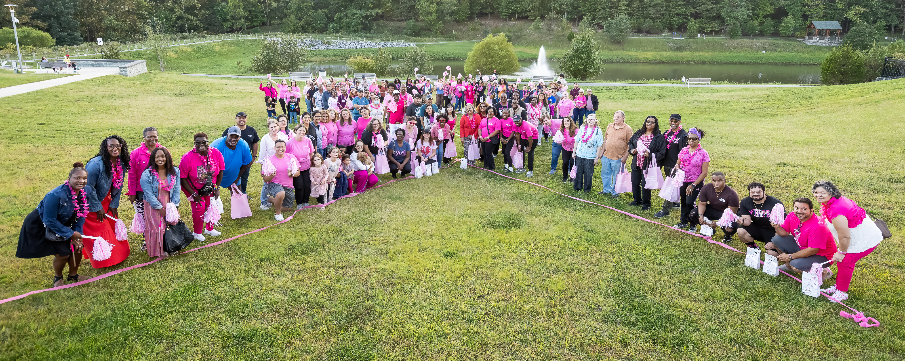
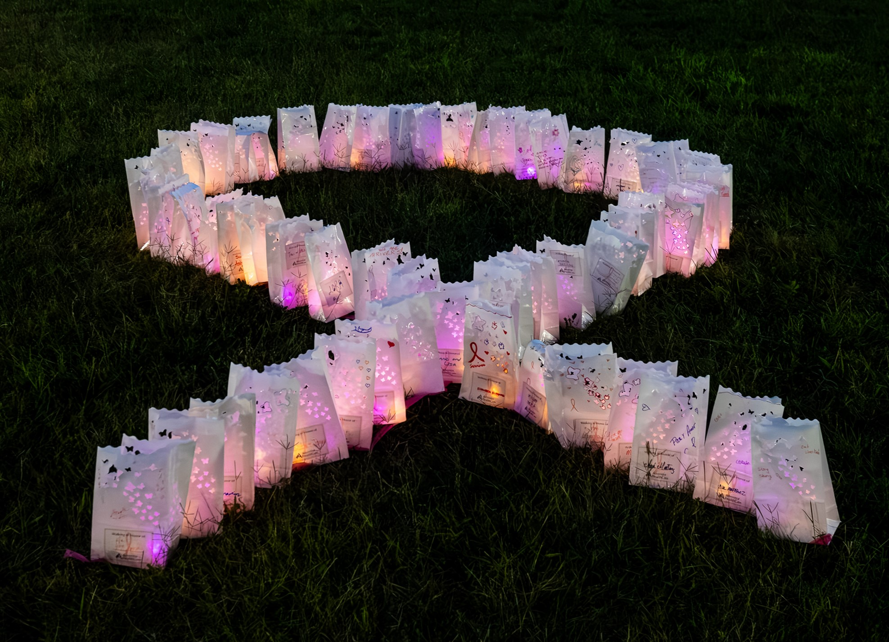
COMMUNITY BULLETIN
How We Give Back to the Community
Breast Cancer Awareness Month
Recognizing Breast Cancer Survivors
AHC’s ninth annual Breast Cancer Survivor celebration took
place on Sunday, Sept. 22. Recognizing survivors in all stages of their
cancer journey, this event offered inspiration and encouragement for
honorees and their loved ones. Featuring an 'In Your Survivor Era' theme, the evening included friendship bracelet making, rock painting, churros, an honor walk and luminary display. Participants were also invited to share their cancer journey at a story telling booth.
Party in Pink Zumba
To celebrate Breast Cancer Awareness Month, an evening of Zumba was held at the Rio lakefront on Monday, Oct. 7. In addition to dancing, this party in pink featured resources from Adventist HealthCare Imaging, and of course fun items to light up the night! A highlight of the evening was the donated luminaries illuminating the stage, honoring breast cancer survivors.
Did you know AHC has a FREE and fast online breast cancer health risk assessment?
“We extend God’s care through the ministry of physical, mental and spiritual healing.”

Slide 8
TEAM HIGHLIGHTS
FWMC and WOMC
Review AHC slides… RISES value of the month is Excellence. We how we can support one another on our journey toward excellence and overcome factors that hinder our progress. Some of those factors we may need to overcome on our journey are race, gender, orientation, other prejudices, or biases. We must provide support and encouragement as well as lending a hand or sharing knowledge and experience. Encouragement and acknowledgement that that struggles exists on this journey toward excellence is very important. Be steadfast and you will achieve your goals.
We review the Leadership System slide in full and discussed the importance of achieving results, how we achieve those results, and action we take when we fall short of our targets.
FWMC achieving all metrics except for CAP DPMO. CAP DPMO is our one area we need to finish 2024 with laser focus. We need to improve for 2025 and get our DPMO down.
Rob discussed how big a difference the phlebotomy team is making at FWMC by collecting the blood cultures. FWMC was really struggling and the ED Director Brittany requested our help with BC collections due to contamination. The contamination rate has dropped dramatically, and it is help the FWMC greatly, better patient care and lower costs. Great work team!
“We extend God’s care through the ministry of physical, mental and spiritual healing.”
8

Slide 9
TEAM HIGHLIGHTS
SGMC and GEC
Discussed excellence as part of the RISES, as we all are from different cultural backgrounds and places, understanding each other's strength is a value for all of us to work as a team and AHC leadership system.
Discussed lab metrics; we emphasize to work on CAP DPMO for the reminder of the year as the result from December will rollover to the new year and this will impact the target for next year. Also mentioned that the CAP DPMO target will be tighter for next year.
Staff mentioned some areas we need to work as a team, like processing batching sample during shift changes. this will be addresses by Maria and Kat. Also discussed not answering phones timely, clocking in and socializing to much. Hollie acknowledged that we are working on addressing some concerns with all the parties involved in the above-mentioned situations. She also mentioned the role of TIC in achieving a smooth working environment.
Reminder to complete MTS, competency and AHC training by the end of the month.
“We extend God’s care through the ministry of physical, mental and spiritual healing.”
9

Slide 10
TEAM HIGHLIGHTS
Reminders:
11/30 Competency & MTS
12/1 AHC COE’s – This is critical, AHC will suspend staff for 5 days without pay and terminate anyone that does not complete within that five-day suspension.
Stephanie announced there is a blood bank MTS out that blood bankers need to complete
Glint Survey Results – From our internal prize tracking we had >90% participation. The final numbers will come out on 12/11. We will be giving away prizes and having parties at all sites. Everyone demonstrated how engaged they are and let their opinions be heard. Results will be shared with every once they come out.
PTO Change Discussion – for everyone’s minutes.—SEE NEXT SLIDE
“We extend God’s care through the ministry of physical, mental and spiritual healing.”
10

Slide 11
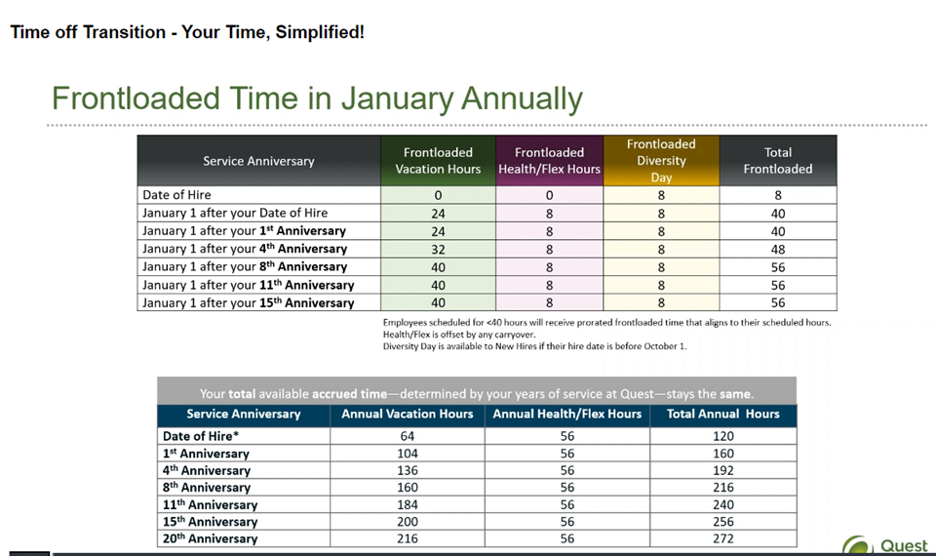
TEAM HIGHLIGHTS
“We extend God’s care through the ministry of physical, mental and spiritual healing.”
11

Slide 12
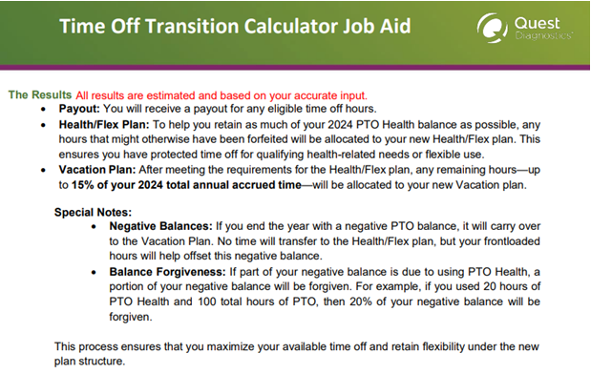
TEAM HIGHLIGHTS
Notes
“We extend God’s care through the ministry of physical, mental and spiritual healing.”
12

Slide 13
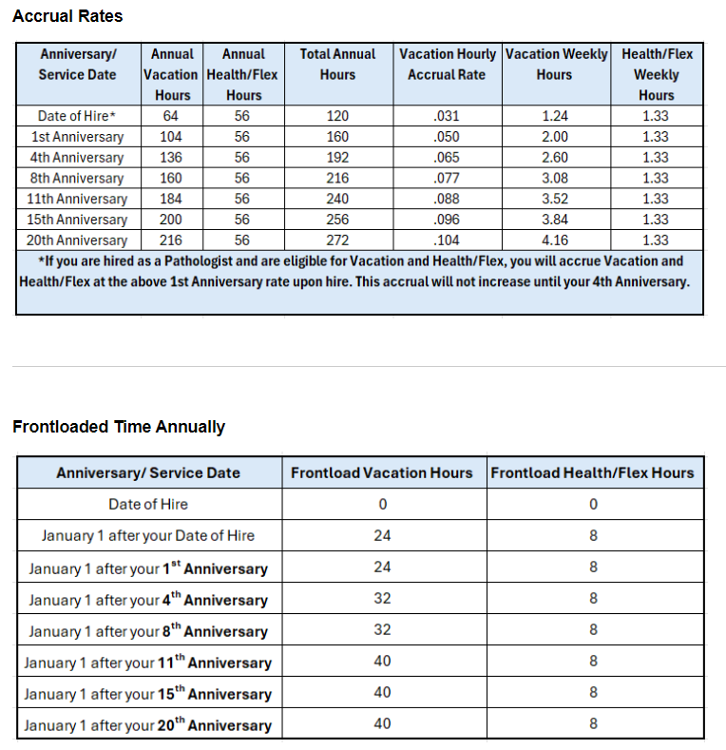
TEAM HIGHLIGHTS
“We extend God’s care through the ministry of physical, mental and spiritual healing.”
13

Slide 14
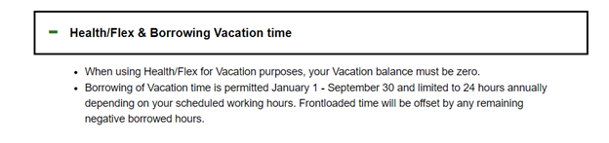
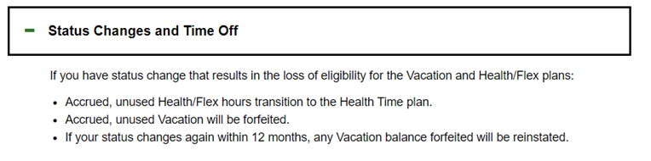
TEAM HIGHLIGHTS
Only allowed to borrow 24 hours Maximum and cutoff date is September 30.
When someone leaves, they are no longer paid out.
“We extend God’s care through the ministry of physical, mental and spiritual healing.”
14

Slide 15
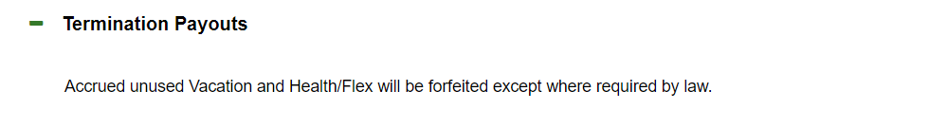
TEAM HIGHLIGHTS
Only allowed to borrow 24 hours Maximum and cutoff date is September 30.
When someone leaves, they are no longer paid out.
“We extend God’s care through the ministry of physical, mental and spiritual healing.”
15

Slide 16
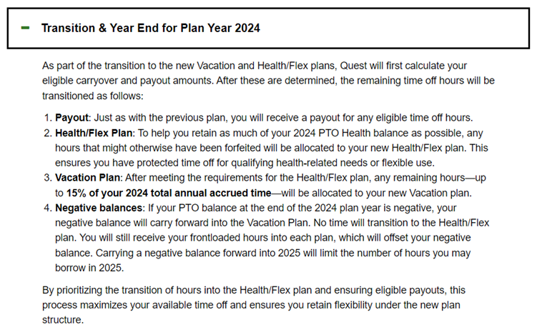
TEAM HIGHLIGHTS
“We extend God’s care through the ministry of physical, mental and spiritual healing.”
16

Slide 17
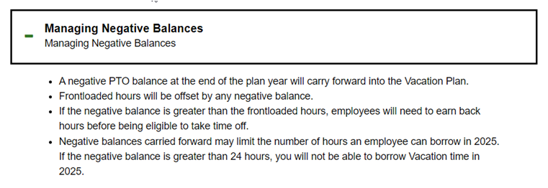
TEAM HIGHLIGHTS
Negative PTO balance will be subtracted from frontload.
“We extend God’s care through the ministry of physical, mental and spiritual healing.”
17

Slide 18
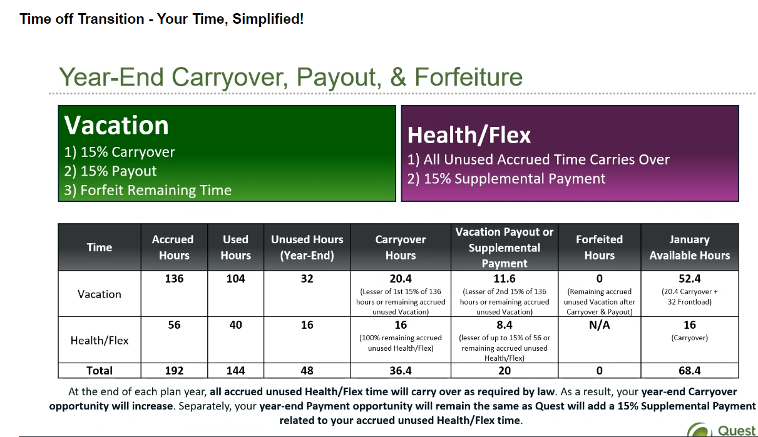
TEAM HIGHLIGHTS
Example
“We extend God’s care through the ministry of physical, mental and spiritual healing.”
18

Slide 19

WE WANT TO HEAR FROM YOU!
Do you have a great idea for performance improvement?
Talk to your manager
Contact your entity leadership
Write to OE@AdventistHealthCare.com
“We extend God’s care through the ministry of physical, mental and spiritual healing.”
19

