Slide 2
Monthly Meeting
January 2025
AdventistHealthcare.com

Slide 3
AGENDA
Devotional
  Mission Reflection
Excellence in Motion Highlight
  Leadership System Overview
  How is AHC getting Bigger?
Team Highlights
3
“We extend God’s care through the ministry of physical, mental and spiritual healing.”

Slide 4
Mission
We extend God’s care through the ministry of physical, mental, and spiritual healing.
At Adventist HealthCare, we have a shared mission to extend God’s care through the ministry of physical, mental and spiritual healing. Every day, we come together around this single purpose, to fulfill the promise to our patients and their families that we will do our best to provide the highest-quality, compassionate care in keeping with our values and faith foundation.
Every day, our Mission is in motion to make a difference in our world.
Discussion Questions
How does a shared mission unify a team?
Our AHC Mission defines who we are, why we exist, and the purpose behind what we do.
How does “extending God’s care” show up in you and the work that you do?
DEVOTIONAL
4

Slide 5
Mission (Continued)
Quote:
  If everyone is moving forward together around a shared mission and vision, then success takes care of itself.
  Henry Ford, automotive industrialist
Bible Verse:
Two are better than one, because there is a good reward for their labor together.
Ecclesiastes 4:9, MEV
Prayer:
God, we take seriously the call you have given to extend Your care. Through our words and through the actions of our hands, may we be an instrument of Your care and compassion. Amen.
DEVOTIONAL
5

Slide 6



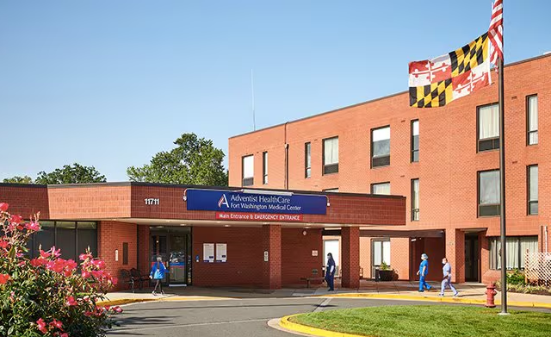
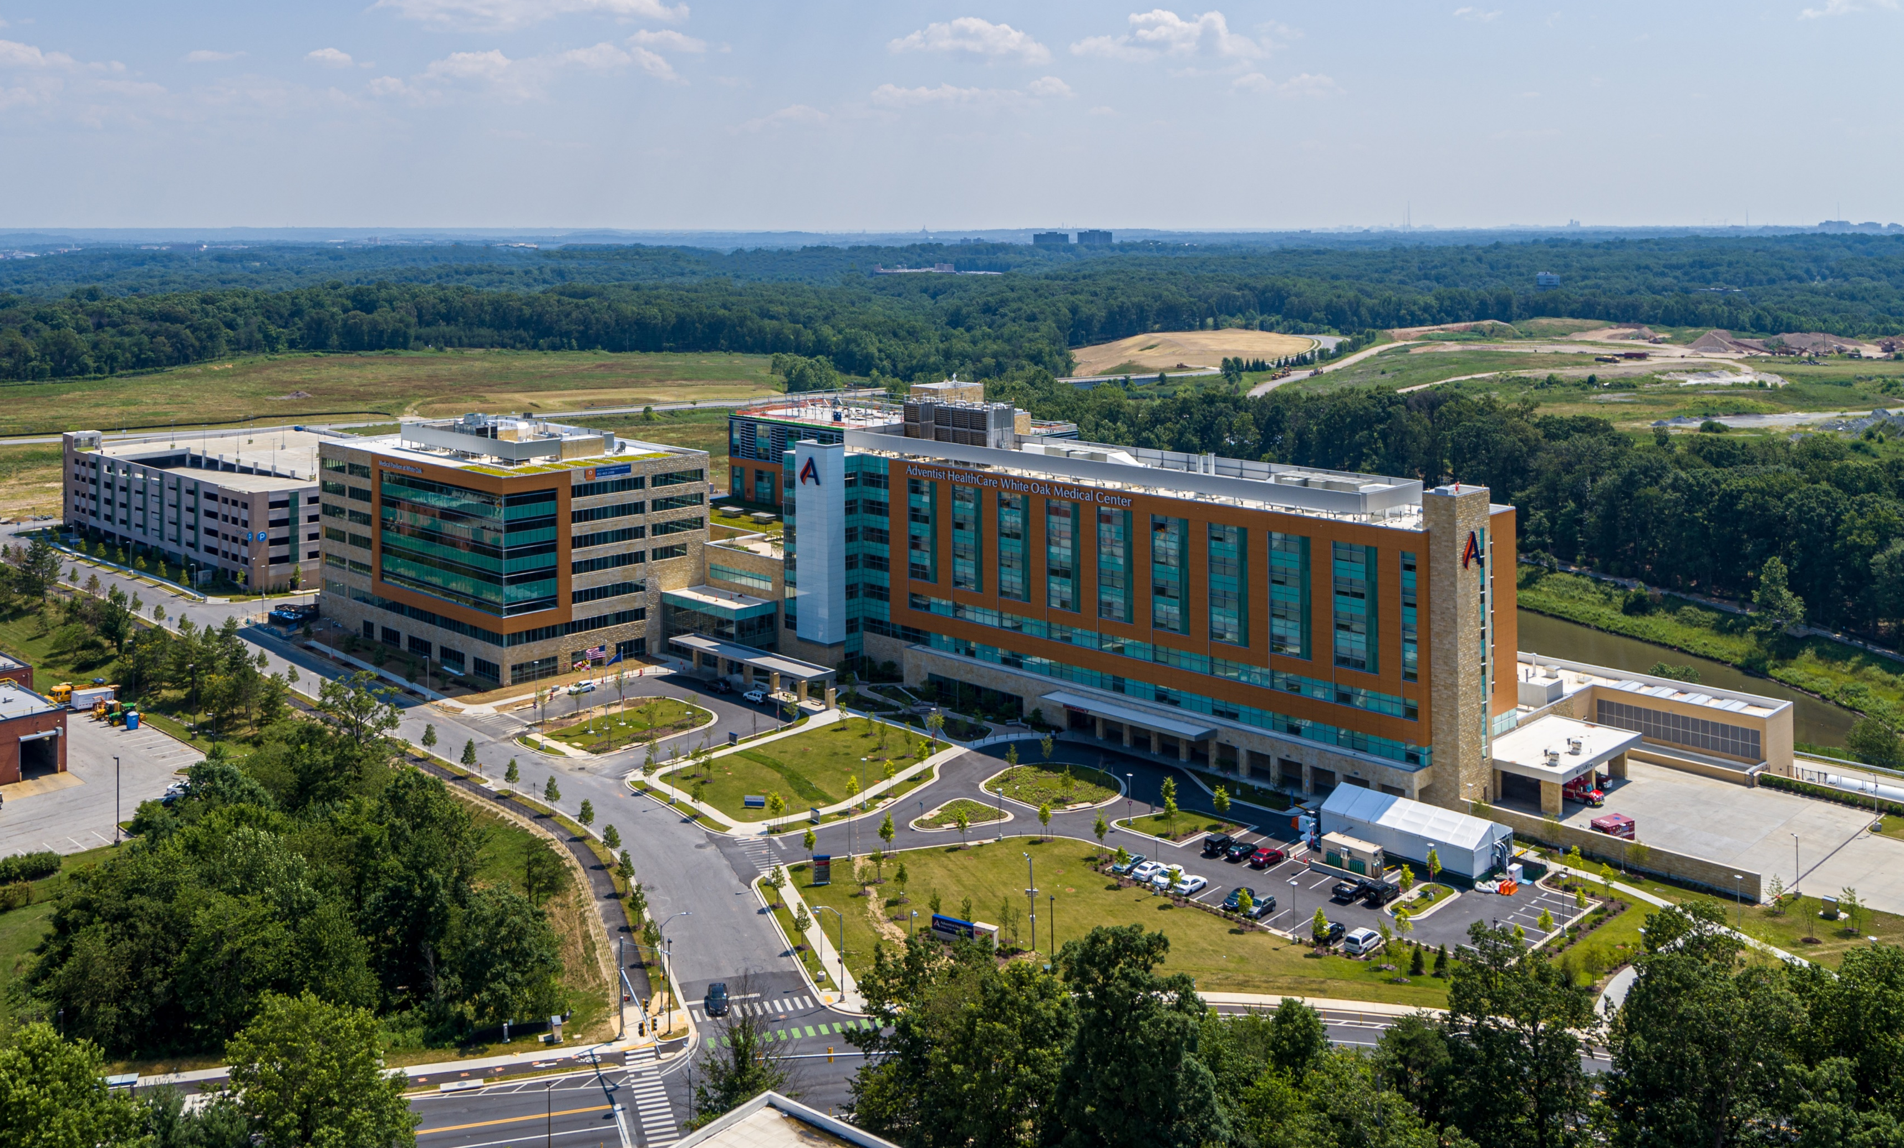


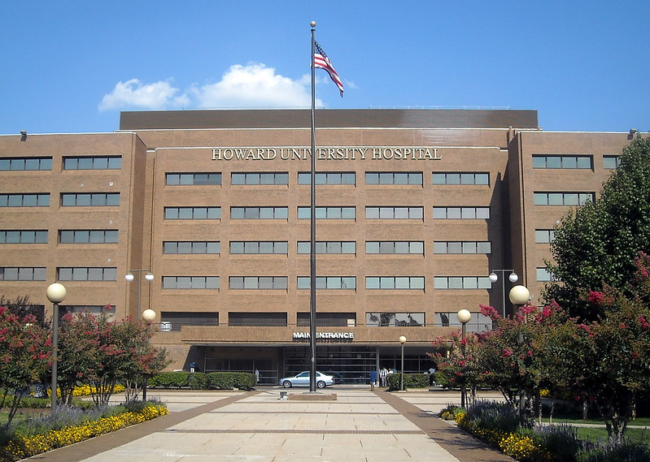

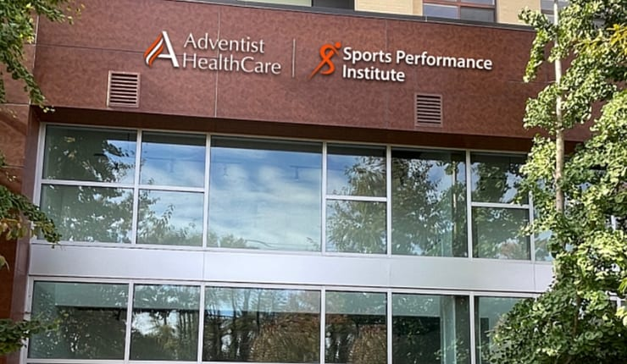
Bigger
Some Highlights of How We got Bigger
and Expanded our Mission in Our Last Five-Year Cycle
  Opened White Oak Medical Center and Medical Pavilion
  Acquired Fort Washington Medical Center
  Acquired Cardiac Associates
  Brought Medical Faculty Associates services in-house
  Launched White Oak Cancer Center
  Expanded Rehab and opened Sports Performance Institute
  Started construction of Shady Grove Medical Center Tower
  Grew system revenue over $237M
  Opened National Harbor Ambulatory Surgery Center
  Signed Master Service Agreements for Howard University Hospital and Howard University Faculty Practice Plan
Progress
Next Steps
  Look for our Vision 2030 Strategic Plan that will be announced early January 2025!
STRATEGY SPOTLIGHT
6
Notes:
Accomplishments were recorded in June 2024

Slide 7
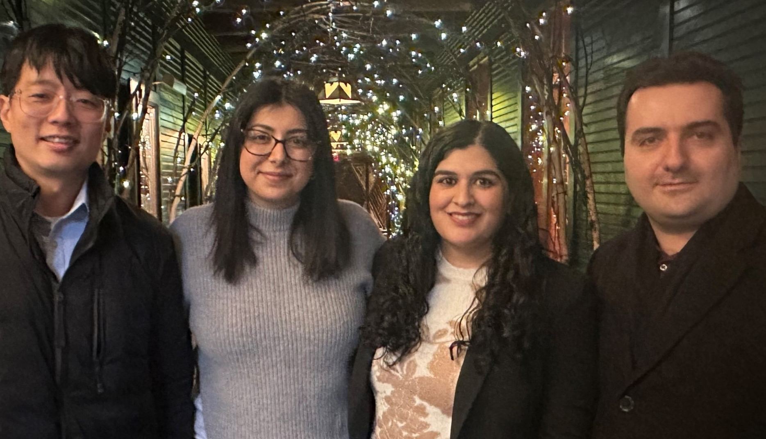
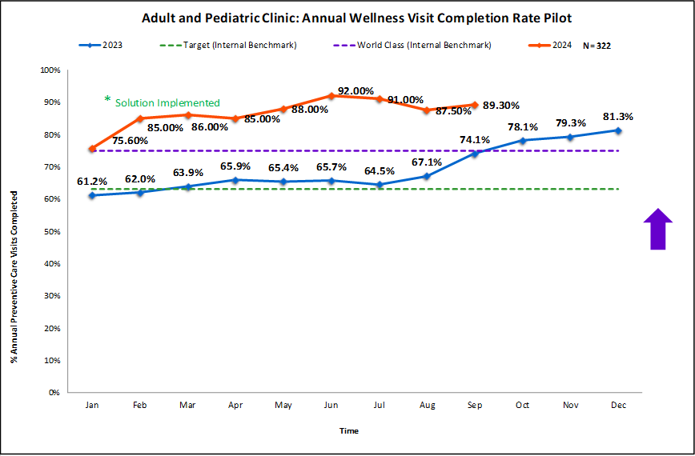
PE Business Analytics Annual Preventive Care Visit Rate Improvement
  Sharing AHC Best Practices
Annual Preventive Care (APC) Visits are essential for many patients and allow providers an opportunity to evaluate their patient's health on an annual basis and be more proactive with their care. Higher completion of preventive care visits leads to increased revenue for practices ($150-$200 /patient) and increased closure of quality gaps in care ultimately affecting shared savings performance and payout.
How Did They Do?
  How Did They Improve?
Implemented a new Cloud-based process in Physician Alliance Practices to streamline and improve APC visit compliance.
Implementing Cloud-based collaborative list for APC Gaps to ensure providers could identify and prioritize those patients
  Success Story Highlights:
Exceeded World Class results for 8 months and won “Most Innovative Idea” for 2024 Sharing Days!!
OPERATIONAL EXCELLENCE SUCCESS STORY
7

Slide 8
TEAM HIGHLIGHTS
Discuss 6 Dashboard Graphs
Continue the Monthly Meeting
discussing information for your department.
8
“We extend God’s care through the ministry of physical, mental and spiritual healing.”

Slide 9
TEAM HIGHLIGHTS- Fort Washington
Talked about D-dimer QC. Seeing slight shift (running low) in level 1 QC, but QC is still within acceptable range. Ash is investigating and working with Stago.
New PTO policy health time vs vacation time. Employees responsible for putting in their request.
Blood bank training: Staff are encountering some uncommon issues in Blood Bank. Stephanie to set up a staff meeting to discuss. In addition, Stephanie assigned a case study in MTS.
Sharps containers were full inpatient rooms. Staff notified charge nurse on both day and night shift.
Showed staff how to put a ticket request in at AHC
9
“We extend God’s care through the ministry of physical, mental and spiritual healing.”

Slide 10
TEAM HIGHLIGHTS- Shady Grove
Discussion:
Drop in Lactic and results at 8am. - New initiatives discussed.
The new PTO system and Plan was discussed, and staff reminded about training.
Reminded staff of Lab Star nominations and recognition via Quest portal.
Encouraged all staff to attend the Monthly meeting to share suggestions and feedback and to be more engaged in laboratory decisions.
Properly managing breaktimes and more importantly adhering to the Attendance Policy.
Discussion on GEC coverage for Call-outs (On-Call)
Tech-in-Charge Authority over laboratory operations in their shift. RESPECT the position! Supervisors intervene if with pushback.
Proactiveness on replenishing Atellica reagents.
10
“We extend God’s care through the ministry of physical, mental and spiritual healing.”

Slide 11
TEAM HIGHLIGHTS- White Oak
Discussion:
Derrick asked to add staffing issues, issues with the tube station, and floors requesting supplies as issues to the “Received By 0700” graphs
Derrick/Paulette will train NT staff to enter tickets for tube station outages
Derrick/Paulette will follow up with Nursing Admin in reference to the excessive supply requests that hit processing during AM collections
Technical Team stated the drop in Lactic, is attributed to focus on TNIH
Technical Team will focus on CAP sample handling in order to make the 2025 DPMO
The new PTO system and Plan was discussed, and staff reminded about training and the GO LIVE scheduled for 1/16/25
Reminded staff of Lab Star nominations
11
“We extend God’s care through the ministry of physical, mental and spiritual healing.”

