Slide 2
Monthly Meeting
May 2025
AdventistHealthcare.com

Slide 3
AGENDA
Devotional
  Excellence Reflection
Excellence in Motion Highlight
  Leadership System Overview
  How is AHC getting Better?
Team Highlights
3
“We extend God’s care through the ministry of physical, mental and spiritual healing.”

Slide 4
Excellence
We do our best every day to exceed expectations
At Adventist HealthCare, we pursue excellence by understanding and exceeding the expectations of our patients and team members. We create a lasting impact by consistently tailoring the services and care we provide to those we serve. We demonstrate excellence by diligently working towards our mission, regardless of the challenges we face.
DISCUSSION
Think of a time when you were treated exceptionally well. What did you appreciate about that experience? How can you apply those same things to your work at AHC?
What does the word exceed mean to you? How can your team exceed the expectations of your patients and other stakeholders?
How can your leaders inspire you to do ordinary things extraordinarily well?
DEVOTIONAL
4

Slide 5
Excellence (Continued)
Quote:
Excellence is doing ordinary things extraordinarily well.
John W. Gardner, author, public official
Bible Verse:
Work with enthusiasm, as though you were working for the Lord rather than people.
Remember that the Lord will reward each one of us for the good we do.
Ephesians 6:7-8, NLT
Prayer:
God, Thank you for your exceptional love and care of all people. In our everyday interactions, may the care and compassion we extend to our patients, their families, and each other always exceed their needs and expectations.
DEVOTIONAL
5

Slide 6


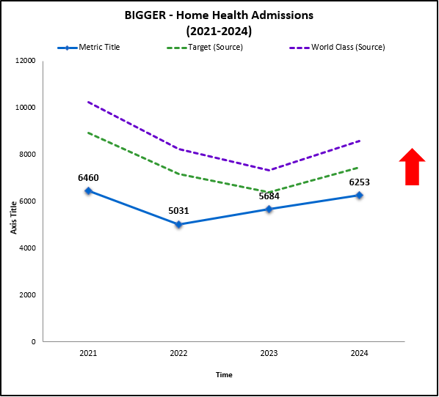

What is Post-Acute Care doing to contribute to the expansion of our Mission and Vision as we progress with Vision 2030?
  Home Health will grow by expanding its mission and establishing itself as the market leader in AHC’s primary service areas and in adjacent and emerging markets.
  Focus on Capacity – Increased clinical staffing by welcoming 48 new team members to home health in 2024 and reduced new hire turnover by 25%
Focus on Efficiency – Updated pre-admission team territory assignments and reduced waste in their workflows resulting in more timely and seamless transitions of patients from the inpatient settings
Focus on Customer – Strengthened referral relationships through increased presence at daily marketplace rounds and enhanced collaboration with inpatient care navigation
Progress
  Continue to increase capacity
  Build new relationships with community providers and other facilities
  Increase brand awareness
Next Steps
STRATEGY SPOTLIGHT
“We will be the trusted choice for exceptional care in every community we serve.”
Want to learn more? Visit Team.AHC.Link/Strategy
6
Notes:
Accomplishments were recorded in June 2024

Slide 7
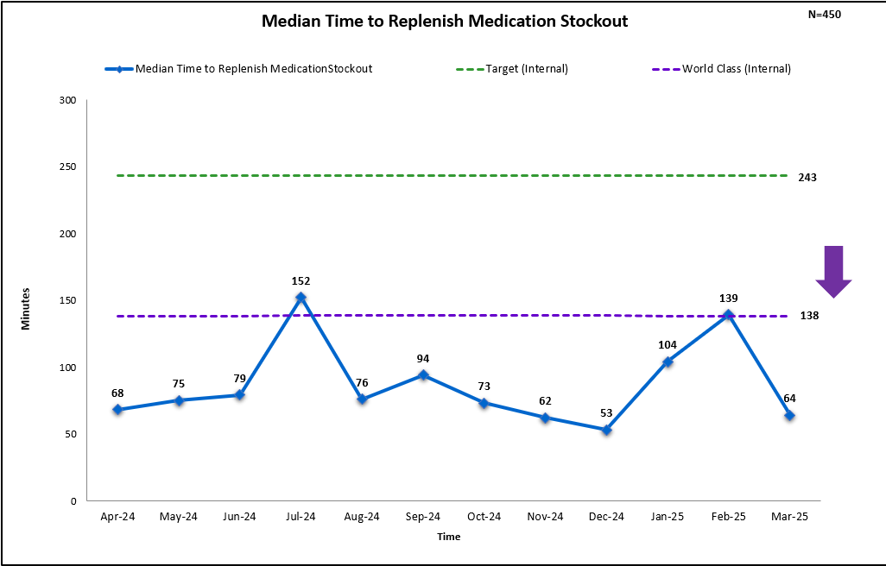
HUH Pharmacy Pyxis Optimization Restock Time
  Sharing AHC Best Practices
Data from October - December 2023 showed the median time for Pharmacy to replenish a medication to an empty bin in Pyxis machines was greater than 3.5 hours. This delay in replenishment slowed throughput in the ED, delayed discharges, and caused work inefficiencies by increasing phone call volume.
How Did They Do?
  How Did They Improve?
Implemented shift-specific outdate technician monthly to reduce incidences allowing front-line team members to focus their drive on other tasks
Evaluated PAR levels for purchasing and adjust higher if warranted
Evaluated all pre-packaged medications and have PAR levels created
Shared data of improvements with Team to keep up momentum
Graph with at least
3 data points
  Success Story Highlights:
Started with a baseline of 319 median minutes and saw a dramatic change in turnaround time to refill empty medication pockets.
Morale has improved as result of this, and furthermore avenues have been opened to achieve goals previously thought unattainable.
Exceeded World Class results for 10 months and won “Most Likely to Break World Class Record” for 2024 Sharing Days!!
OPERATIONAL EXCELLENCE SUCCESS STORY
7

Slide 8


In a world full of change, finding calm starts with a single step.
Need Confidential Help? Call the EAP – 24/7 – for free support at 1-877-252-8550
Want to Explore Resources? Discover your path forward at Team.AHC.Link/LWS-MentalHealth
Looking for Support Groups or Classes? Visit AdventistHealthCare.com/Calendar
Want Encouragement? Check out Wellness Wednesdays by email or at Team.AHC.Link/NewsBriefs
Need a Provider? Learn options for telehealth or providers at Team.AHC.Link/Benefits
Crave Spiritual Support? Reach out to our chaplains at 240-826-6112
SYSTEM UPDATE
8
Notes:
In a world full of change, finding calm starts with a single step.
Explore valuable resources and events offered by LifeWork Strategies during Mental Health Awareness Month as part of a Mental Health Tool Kit at Team.AHC.Link/LWS-MentalHealth
… or explore any of the many options that Adventist HealthCare offers to support your total well-being.
Adventist HealthCare’s LifeWork Strategies and the Equity, Diversity and Inclusion team are partnering for Wear Green Day on Thursday, May 16. To help raise mental health awareness and show support, submit a photo of yourself or your team looking great in green by Friday, May 17, at 3 p.m. to be entered into a prize drawing! Check out AHC NewsBriefs for all the details!

Slide 9
TEAM HIGHLIGHTS- SGMC/GEC
We discussed Excellence from the RISES values
New AHC Vision discussed with the staff " We will be the trusted choice for exceptional care in every community we serve"
Best practices from pharmacy team, shared.
The metrics for April look good and we encouraged everyone to continue to work hard to meet targets.
Reminded staff to complete competency, MTS, empower and workday assignments.
Discussed labeling reagents and calibrators once “in use” is a big challenging process and needs improvement. Staff must work together to address this issue.
Glint survey result is shared.
Staff recognition ideas discussed.
Lab star award winner announced, Lekeaka Nkanyi.
9
“We extend God’s care through the ministry of physical, mental and spiritual healing.”

Slide 10
TEAM HIGHLIGHTS- FWMC
The things that were discussed:
Training documents must be filled out correctly and reviewed thoroughly by supervisors before turning in.
Finding ways to better communicate with staff.
Informing staff of recognition Quest and different ways to acknowledge employees/ colleagues.
Lab Star Award Winner was awarded, the person who won the Lab star award is Lekeaka Nkanyi
Metrics.
Blood culture contamination rates.
Glint results
Compassionate care award nomination
10
“We extend God’s care through the ministry of physical, mental and spiritual healing.”

Slide 11
TEAM HIGHLIGHTS- WOMC
The things that were discussed:
The critical call back change is live
Completely and correctly fill out training documents. Review thoroughly by supervisors before turning in.
Discussed ways to better communicate with staff.
Informed staff of recognition Quest and different ways to acknowledge employees/ colleagues.
Lab Star Award Winner was awarded, the person who won the Lab star award is Lekeaka Nkanyi
Went over Metrics.
New hire Leslie Lyles also was introduced.
11
“We extend God’s care through the ministry of physical, mental and spiritual healing.”

