Slide 2
Monthly Meeting
September 2025
AdventistHealthcare.com

Slide 3
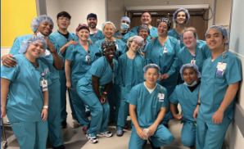
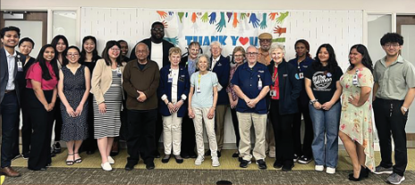
AGENDA
Devotional
Integrity Reflection
Excellence in Motion Highlight
Leadership System Overview
How is AHC getting Better
Team Highlights
3
“We extend God’s care through the ministry of physical, mental and spiritual healing.”

Slide 4
Integrity
We are conscientious and trustworthy in everything we do.
Integrity is shaped in the quiet moments—when we choose honesty, extend respect, and do what’s right. These decisions may go unnoticed by many, but our patients and colleagues will feel their impact. The difference is real, and it matters.
DISCUSSION
What are some examples of integrity in your workplace?
What are some common obstacles to living with integrity?
How can we support each other in growing in integrity?
DEVOTIONAL
4

Slide 5
Integrity (Continued)
Quote:
Integrity is making sure that the things you say and the things you do are in alignment.
[Katrina Mayer, writer]
Bible Verse:
Our purpose is to do what is right, not only in the sight of the Lord, but also in the sight of others.
[2 Corinthians 8:21, GNT]
Prayer:
God, as we extend Your care, may all our patients, their families, and team members, feel Your touch of compassion through our words and actions. Amen.
DEVOTIONAL
5

Slide 6

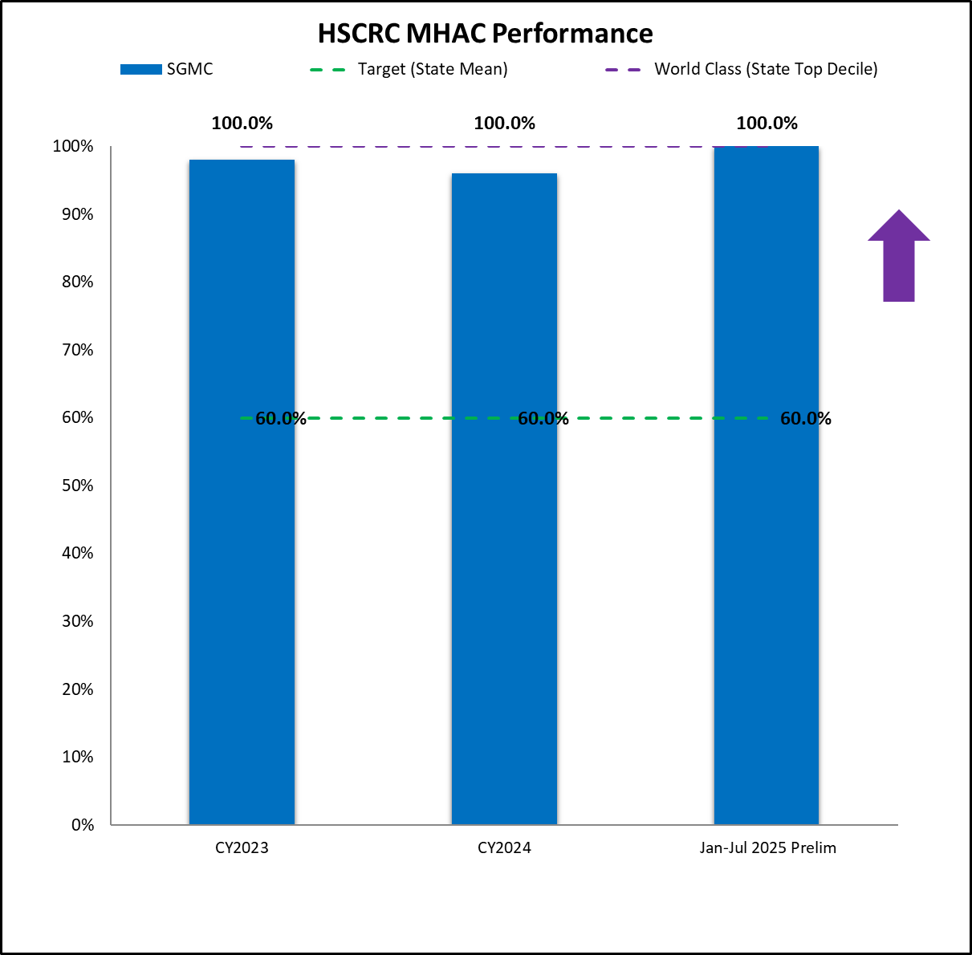

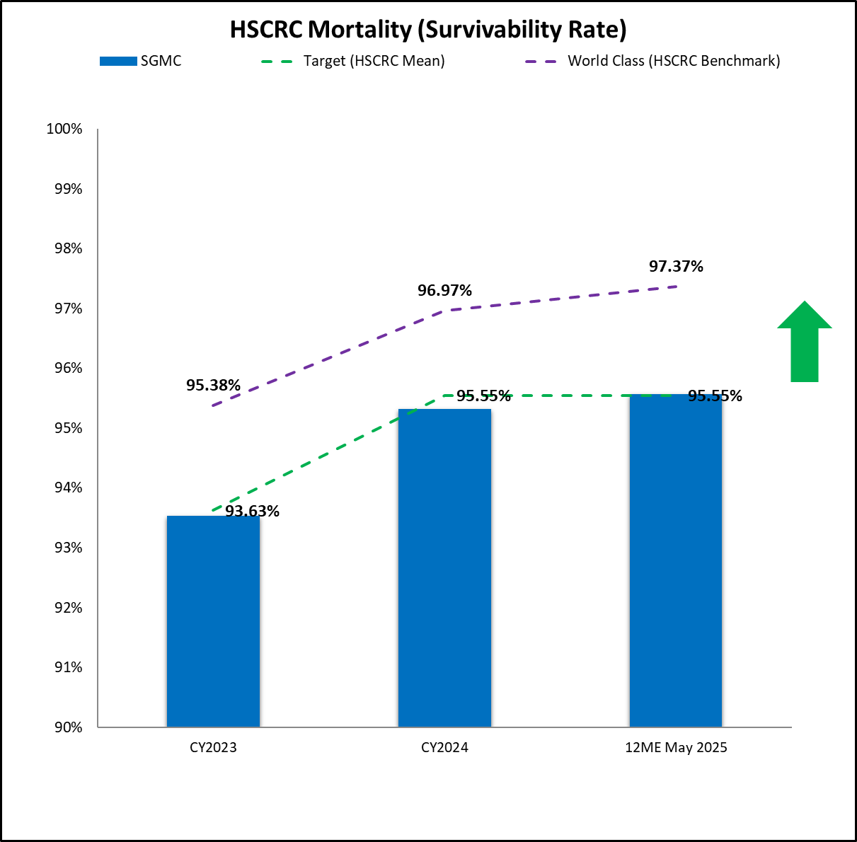

What is Shady Grove Medical Center doing to Achieve consistent excellence as a High Reliability Organization?
SGMC is aiming for Excellence as a HRO through collaboration with physicians and clinical teams:
Through the Complication Improvement Committee to identify, review, and work to resolve potential Maryland Hospital Acquired Conditions and Patient Safety Indicators
Expansion of the Hospice program to provide the ideal level of care for eligible patients and to improve all-cause mortality
Implementation of a High-Risk Discharge Clinic and U-Turn Processes for ED and Behavioral Health patients to reduce readmissions
Progress
Next Steps
Develop remote patient monitoring capabilities to support patients at home and further reduce readmissions
Incorporate Hospice team members into high-risk readmissions reviews
Optimize Case Mix Index to ensure patient risk for adverse events and readmissions is captured correctly
STRATEGY SPOTLIGHT
“We will be the trusted choice for exceptional care in every community we serve.”
Want to learn more? Visit Team.AHC.Link/Strategy
6
Notes:
Accomplishments were recorded in June 2024

Slide 7
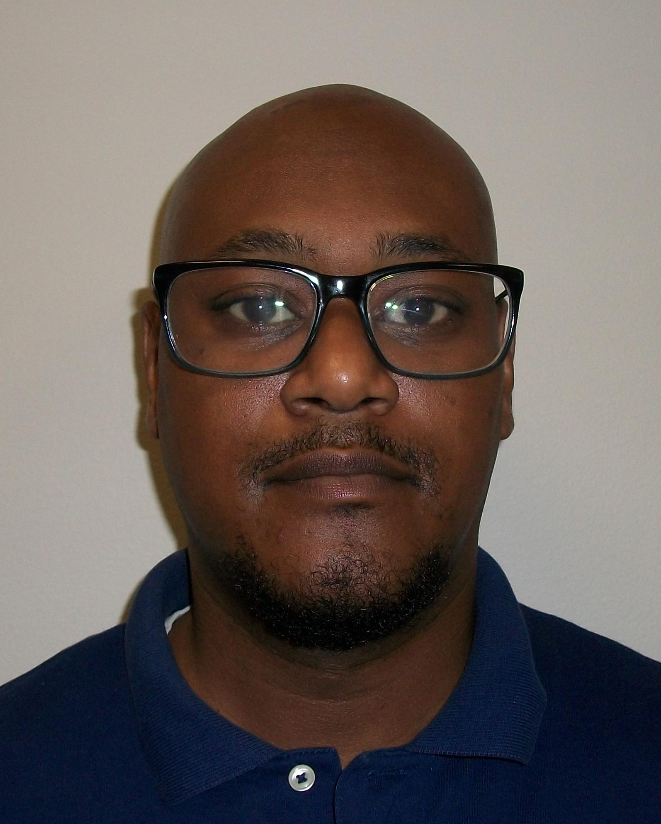
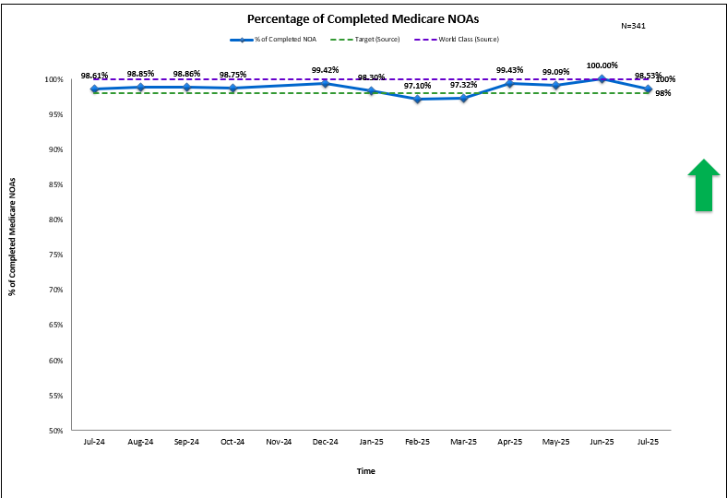
PACS Reimbursement Improve Timely Submission for Notice of Admission (NOA)
Sharing AHC Best Practices
Project Leader
Austin Henderson
Reimbursement
Supervisor
Discovery during an Accounts Receivable review uncovered a decrease in timely Notice of Admission (NOA) submissions. This delay led to an increase in penalties accrued. Quarter 1 2024 showed an average 20-day submission delay for outstanding NOAs. Regulations require a submission within 5 days from start of care visit. The total estimated penalties from 2023 to 2024 is up to $15,000.
How Did They Improve?
How Did They Do?
Updated the regulations for the PECOS enrollment process
Mapped process for non-billable or updated claim to avoid incorrect NOA
Corrected and updated the HCHB system for incorrectly displayed NOAs
Educated team on PECOS enrollment, correction process, and billing process
Created unique Teams channel for open, live communication
Graph with at least 3 data points
Success Story Highlights:
Expanded knowledge on NOA console. Improved timely submission of NOA to reduce denials.
Baseline for NOA submission was 85% and is now maintaining target and often world class performance.
Write Off percentage went from over 28% to 0.2% for July 2025
OPERATIONAL EXCELLENCE SUCCESS STORY
7

Slide 8

SYSTEM UPDATE
8
Notes:
Previous Stand Strong Workplace Violence Prevention webinars have been highly attended and discussed topics such as AHC’s strengthened contraband and security policy as well as our incident response, UKG Pay Codes and workplace violence trends in our region and throughout the U.S.
During this year’s webinar, a range of Workplace Violence topics will be discussed – including Code Bronze, Code Green, What to do after an event if you are a peer or a leader, the importance of reporting and support resources.
Check your Outlook for invitations for the Stand Strong webinar that will be held in October and mark your calendar now for which session you would like to attend.
Find resources at Team.AHC.Link/StopWorkplaceViolence
And, as always, please don’t hesitate to reach out to Occupational Health at 301-315-3399, our Forensic Medical Unit (FMU) at 240-826-6225, our Employee Assistance Program (EAP) at 1-877-252-8550 and Spiritual Care at 240-826-6112. We are committed to supporting your physical, mental and spiritual health.

Slide 9



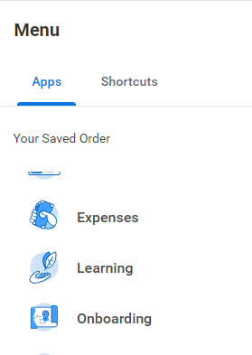
Time to Learn!
Go to Workday
Learning
Required for You
Leaders:
Click “Links”
Incumbent Team Members – Assignments are due Dec. 1.
New Team Members – Assignments are due within 90 days of hire date. Check your Workday Inbox and “Required for You” in your Learning App.
Leaders – Assess your direct reports’ compliance from the Learning Homepage and work with Human Resources to align with AHC Policy 2.20.
Have Questions? See the FAQs on Team.AHC.Link/RequiredLearning.
Still Need Help? Submit all technical/access issues, assignment questions or requests for Learning support in Ivanti, our IT Ticketing System platform.
SYSTEM UPDATE
9
Notes:
Required Learning
Alternative:
Leaders (with direct reports)
From the Learning Homepage, run a report to assess your team members compliance
Follow up with Human Resources to ensure compliance in alignment with AHC Policy 2.20

Slide 10
WOMC Laboratory TEAM HIGHLIGHTS
The following topics were discussed in the WOMC monthly staff meeting:
Quest Compliance training
QuantiFERON labs due 9/30/2025
Flu shot season is in place please get shots by 11/1
Lab Star Award and nomination – Lab Star is to recognize and say thank you, it has nothing to do with favoritism. This award was requested by staff from the Glint survey.
Recognition Quest
MTS and Competency
CAP Survey review and failures – a lot of them are attributed to the Testing Personnel and their mishandling of the samples before, during and after testing
Reminded night shift Technical/Non-Technical that they need to do an effective shift hand off
Tube station was attributed as reason for labs not being received by 7a, Phlebotomy Supervisors said they will keep a tally of when the tube station goes down
10
“We extend God’s care through the ministry of physical, mental and spiritual healing.”

Slide 11
SGMC Laboratory TEAM HIGHLIGHTS
The following topics were discussed in the SGMC monthly staff meeting on Sept 23rd:
AHC mission/vision discussed.
Metrics for August discussed and we are in a good track. KEEP UP THE GOOD WORK!
Glint survey discussion regarding feedback and comments
RISES values: Integrity
WOMC/GEC Workload increased – looking into what we can do for staffing for these changes
UHC / Health Insurance changes - Please inform Rob/Hollie/Jonathan/Meaza of issues and concerns regarding some inaccessibility of benefits
Butterfly set issue for Phlebotomist - Will find alternative product that is more use friendly
Critical values - hospitalists/doctors/departments not taking it - escalated to Dr. Roy
Outpatient staffing - changes to come.
How to process properly mislabeled samples.
MTS/Empower/WorkDay/Compliance Training 2025
Flu vaccine deadline: November 4, 2025
Competency November 30, 2025
TB test - October 10, 2025
11
“We extend God’s care through the ministry of physical, mental and spiritual healing.”

Slide 12
FWMC Laboratory TEAM HIGHLIGHTS
The following topics were discussed in the SGMC monthly staff meeting on Sept 16th:
Working on effective communication between the team. Use your chain of command but we are still willing to help and listen.
Discussion of Katrice in the process of training on doing counts at FWMC.
Vanessa invited staff to participate in events such as community fair on the weekend of 09/20/2025.
Diana concerned about turn around time in the blood bank. They’ve been busy- Rob is investigating workload in blood banks.
Cynthia mentioned Cap inspection window, make sure you cross your t’s and dot your “i”s.
Rob discussed United Healthcare insurance concerns and still fighting for proper insurance coverage
12
“We extend God’s care through the ministry of physical, mental and spiritual healing.”

