Slide 2
Monthly Meeting
December 2025
AdventistHealthcare.com

Slide 3
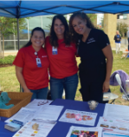
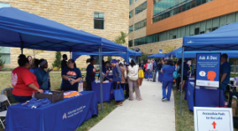
AGENDA
Devotional
Stewardship Reflection
Excellence in Motion Highlight
The AHC Way Overview
How is AHC getting Better
Team Highlights
3
“We extend God’s care through the ministry of physical, mental and spiritual healing.”

Slide 4
Stewardship
We take ownership to efficiently and effectively extend God’s care.
At Adventist HealthCare, stewardship means taking care of and protecting what is worth preserving. For us, that’s the sacred act of extending God’s care to our patients, families, and community. Our Value of Stewardship calls us to take ownership and deliver care efficiently, effectively, and with unwavering excellence.
Discussion
Stewardship means the careful and responsible management of someone or something entrusted into one’s care. How does stewardship apply to the work you do?
If stewardship also means protecting something considered worth caring for, what is worth caring for in your department?
What can you do to help create a culture of stewardship at Adventist HealthCare?
DEVOTIONAL
4

Slide 5
Stewardship(Continued)
Stewardship is about service to something greater, about choosing service over self-interest. It begins with a willingness to be deeply accountable for a body larger than yourself – for a team, an organization, a community.
Quote:
[Jesse Lyn Stoner, Author and Organizational Consultant]
Bible Verse:
Choose a good reputation over great riches; being held in high esteem is better than silver or gold.
[Proverbs 22:1, NLT]
Prayer:
God, today we commit ourselves to being good stewards of what you have given us. Help us to be grateful, accountable, generous and willing to give back with increase. Enable us to make stewardship a way of life. Amen.
DEVOTIONAL
5

Slide 6



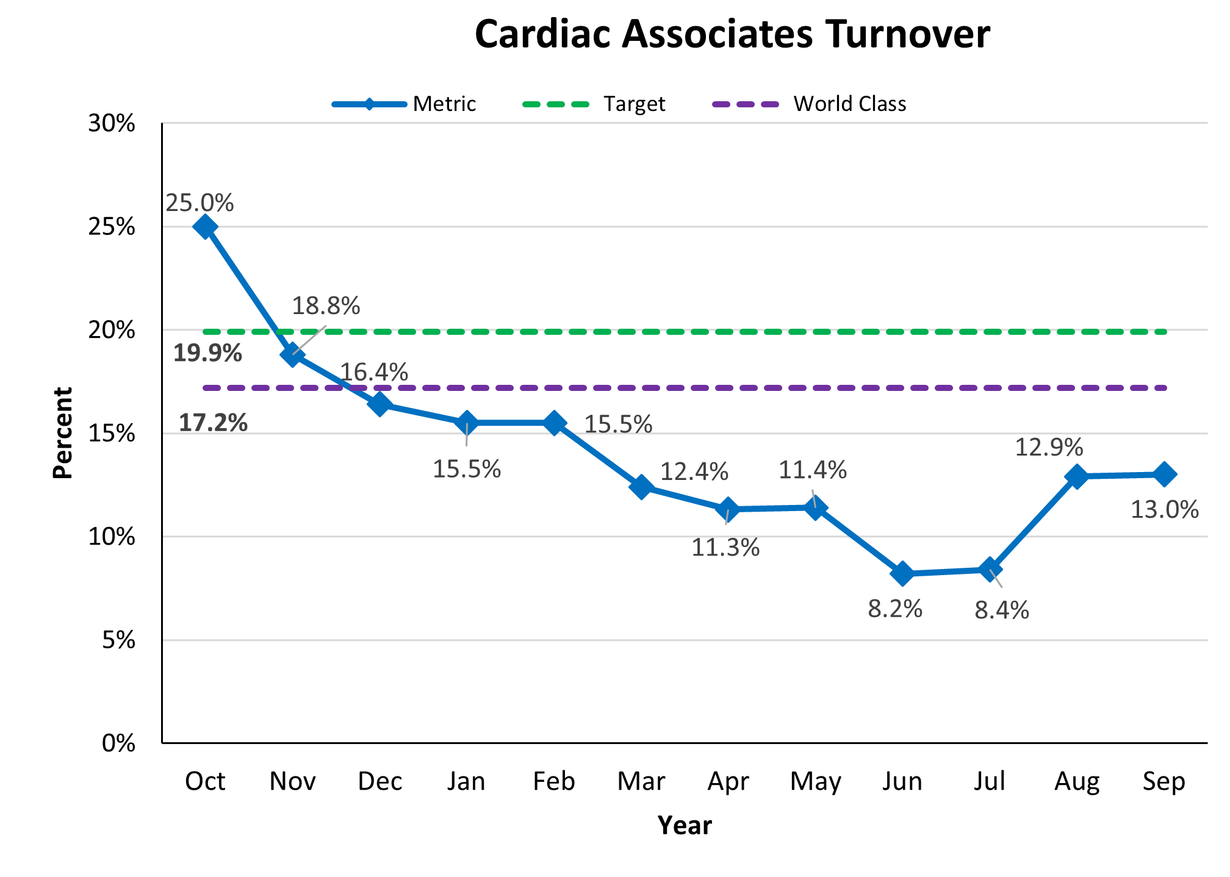


What is Physician Enterprise doing to Be a Top workplace for people to work and grow?
Physician Enterprise reduced turnover at Cardiac Associates from 25% to 13% by implementing a comprehensive retention strategy focused on employee engagement and role clarity.
Initiative
n = 97
Stay & Exit Interviews: Implemented structured interviews to understand why employees stay or leave and used insights to address pain points proactively.
Compensation Adjustments: Conducted market analysis and made competitive pay adjustments to align with industry benchmarks and retain top talent.
Mandatory 30/60/90-Day Manager Check-ins: Required managers to meet with new hires at 30, 60, and 90 days to strengthen relationships and resolve onboarding challenges early.
Post-Interview Job Shadows: Introduced job shadowing after interviews to ensure role clarity and reduce mismatched expectations.
Progress
Implement Success across all Practices
Develop a Continues Engagement Program
Next Steps
STRATEGY SPOTLIGHT
“We will be the trusted choice for exceptional care in every community we serve.”
Want to learn more? Visit Team.AHC.Link/Strategy
6
Notes:
Accomplishments were recorded in June 2024

Slide 7
TEAM HIGHLIGHTS
Discuss 6 Dashboard Graphs
Continue the Monthly Meeting discussing information for your department.
Discuss one or two process vulnerabilities or RL event themes (including good catches and near misses) identified in your department this month. Non-clinical examples may include delays in ancillary services, billing issues, or incorrect registration information.
7
“We extend God’s care through the ministry of physical, mental and spiritual healing.”

Slide 8
TEAM HIGHLIGHTS- FWMC
Discuss 6 Dashboard Graphs- Drilled down on Troponin TAT. We are within 5% of target. Supervisors to review and follow up on outliers with staff.
Discussed Glint survey. Although staff participation was down 2% from last time, we still had great participation. Supervisors will review results and follow up with their teams.
Mentioned that we are now in the CAP inspection window
Process vulnerability: Staffing concerns; weekend staff issues with tracking samples and following up on problem logs; tracking butterfly utilization.
8
“We extend God’s care through the ministry of physical, mental and spiritual healing.”

Slide 9
TEAM HIGHLIGHTS—SGMC Dec. 23, 2025
Discuss 6 Dashboard Graphs
Discussed AHC mission and vision
Discussed Rises Value: Stewardship
Process vulnerability: AM Accessions- Processing staff mentioned that on weekends, some of the newer processors are not accustomed to, or quick, receiving morning draw specimens, resulting in failing to meet received by 0700 metric. The supervisors, K. Dam and S. Sitikhu to follow up.
9
“We extend God’s care through the ministry of physical, mental and spiritual healing.”

Slide 10
TEAM HIGHLIGHTS- WOMC December 9, 2025
Discuss 6 Dashboard Graphs
Employee Engagement: Staff were encouraged to join the Employee Engagement Team to assist with initiatives such as Lab Week, birthday celebrations, GLINT events, and other activities. It was emphasized that employee engagement is beneficial to the laboratory, and that meaningful changes can only be made when employees actively share feedback and voice their concerns.
Staffing: Approval was granted for a full-time evening shift technical position, along with the addition of phlebotomists to the Emergency Department.
Communication: Staff were encouraged to communicate their staffing needs so adjustments can be made, including reallocating personnel as necessary to help accommodate staffing shortages.
Accountability: Staff were reminded of their responsibility for their assigned work areas and the importance of maintaining cleanliness and organization. Additionally, staff should be able to account for all specimens received within their respective areas.
Continued on next slide
10
“We extend God’s care through the ministry of physical, mental and spiritual healing.”

Slide 11
TEAM HIGHLIGHTS- WOMC continued December 9, 2025
Discuss 6 Dashboard Graphs
Tracking: Non-technical supervisors have been monitoring butterfly needle usage. Phlebotomists were encouraged to use professional judgment when selecting butterfly needles and to document the circumstances and rationale for their use.
Optimization: The Quest Optimization Team will be visiting to evaluate laboratory and phlebotomy processes to ensure best practices are being followed and that staffing levels and supplies are appropriately optimized.
Reminders: Staff were reminded that self-evaluations are due by January 5, 2026. The laboratory holiday meal is scheduled for December 10, 2025. The quarterly network downtime will occur from December 9, 2025, into December 10, 2025. Staff were also encouraged to use Recognition Quest to acknowledge and recognize one another.
11
“We extend God’s care through the ministry of physical, mental and spiritual healing.”

