Slide 2
Downtime Discussion
January 2026
AdventistHealthcare.com

Slide 3
Downtime
Planned downtime – Notify ahead of time the TIC / Supervisor on the shift affected by the downtime.
Unplanned downtime – TIC Immediately notify Supervisor, Admin-On Call, Manager of the site, and Lab Director. Inform LIS On-Call. Inform Nurse Admin.
Print pending list on all benches before and after the downtime.
3
“We extend God’s care through the ministry of physical, mental and spiritual healing.”

Slide 4
Downtime
2 types:
  1. Only CERNER is DOWN but Sunquest is online (partial downtime).
    LIS Team will activate printers in ED/ICU and other stations prior to downtime.
  2. BOTH CERNER and Sunquest is down (complete downtime).
In both occasions, all samples SHOULD accompany a downtime form.
If nurses call for a result – ask for their location fax number, print the result and fax it to them.
4
“We extend God’s care through the ministry of physical, mental and spiritual healing.”

Slide 5
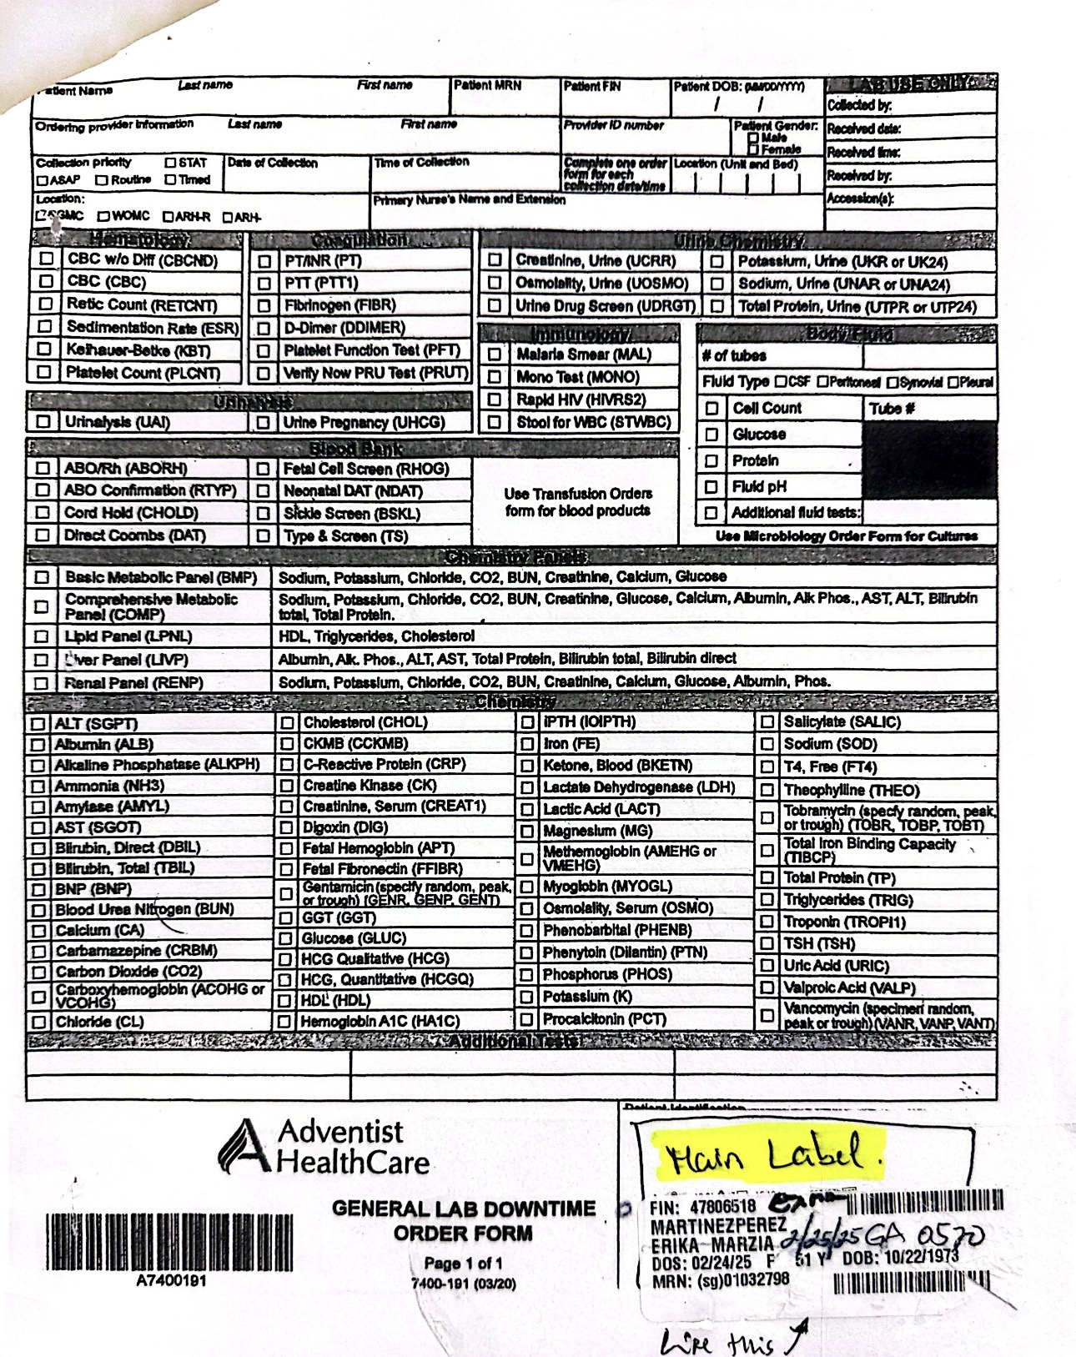

Slide 6
Downtime
Downtime Form include:
  Full name
  MRN / FIN
  Birthdate
  Gender
  Location
  Tests ordered
  Downtime accession number
  Tech Code of person receiving
  STAT specimen will contain a Stat label.
6
“We extend God’s care through the ministry of physical, mental and spiritual healing.”

Slide 7
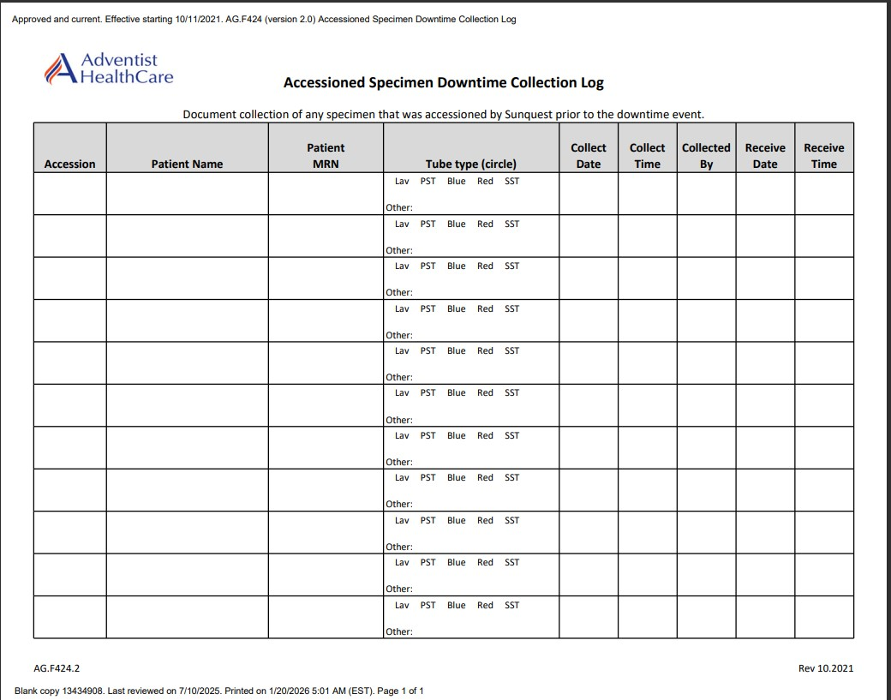
Downtime Forms
7
“We extend God’s care through the ministry of physical, mental and spiritual healing.”

Slide 8
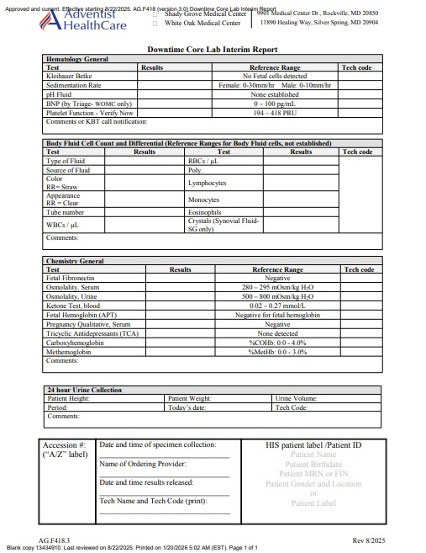
Downtime Forms
8
“We extend God’s care through the ministry of physical, mental and spiritual healing.”

Slide 9
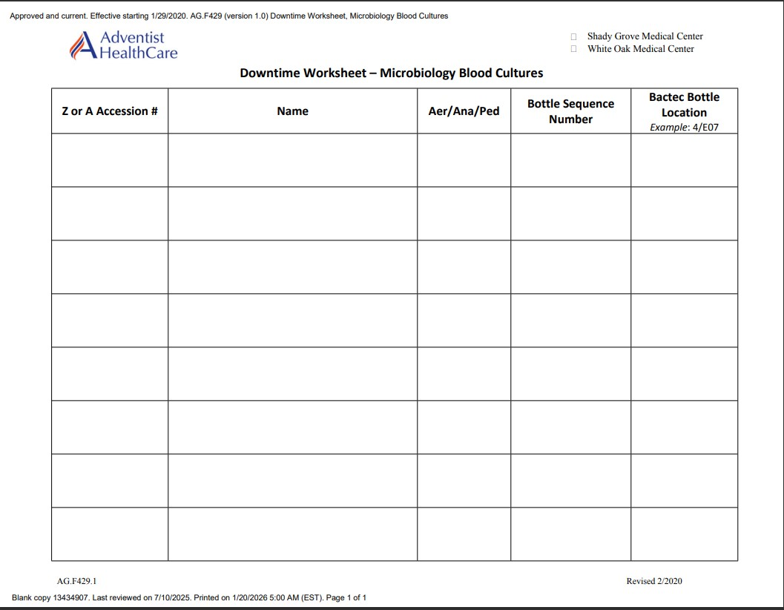
Downtime Forms

Slide 10
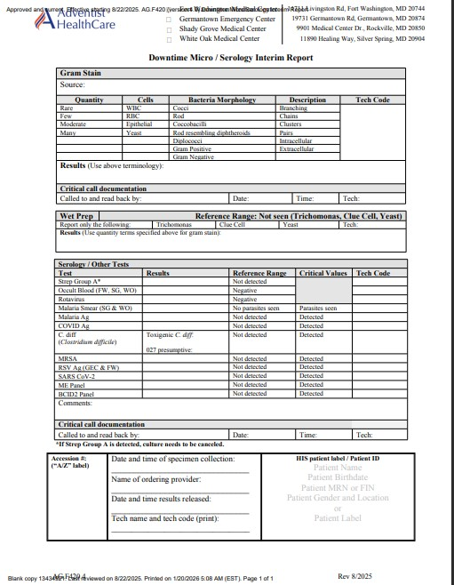
Downtime Forms

Slide 11
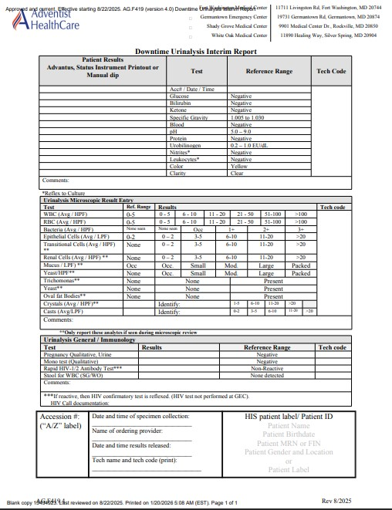
Downtime Forms

Slide 12
Downtime – CERNER is down but Sunquest is Online
2 Scenarios:
1. Samples with MRN
2. Samples without MRN
12
“We extend God’s care through the ministry of physical, mental and spiritual healing.”

Slide 13
Downtime – CERNER is down but Sunquest is Online
AdventistHealthcare.com

Slide 14
Downtime – CERNER is down but Sunquest is Online
Samples without MRN
Go to Sunquest
Go to Order Entry
Use FIN Number (Billing account number)
Create Patient – Write the name, last name, DOB, etc
Click on Save
Go to Order Entry again
Use FIN Number (Billing account number)
Select the correct patient
Create orders – CBC, Chemistry, UA, etc – With different accession numbers for each.
Print labels with accession number and attach to the correct samples
Route to the respective Bench
14
“We extend God’s care through the ministry of physical, mental and spiritual healing.”

Slide 15
Downtime – CERNER is down but Sunquest is Online
Samples with MRN
Go to Order Entry
Use MRN
Select correct patient
Create orders – CBC, Chemistry, UA, etc – With different accession numbers for each.
Print labels with accession number and attach to the correct samples
Route to the respective Bench
15
“We extend God’s care through the ministry of physical, mental and spiritual healing.”

Slide 16
Downtime – BOTH CERNER and Sunquest are DOWN
AdventistHealthcare.com

Slide 17
Downtime – BOTH CERNER and Sunquest are DOWN
No MRN, Only FIN
Go to DI
Select Specimen Management
Select Patient and Order Management
Complete all Patient Information
Complete Specimen Information
Order Test
Scan the label for each accession number
Attach the label on each sample.
17
“We extend God’s care through the ministry of physical, mental and spiritual healing.”

Slide 18
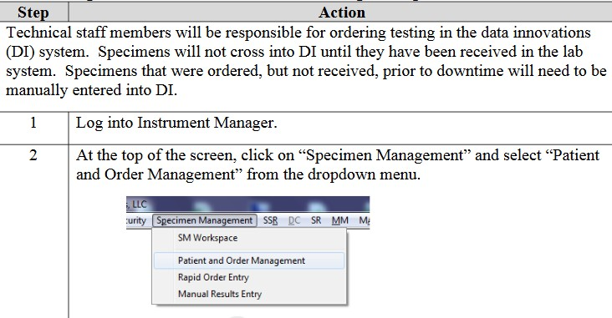

Slide 19
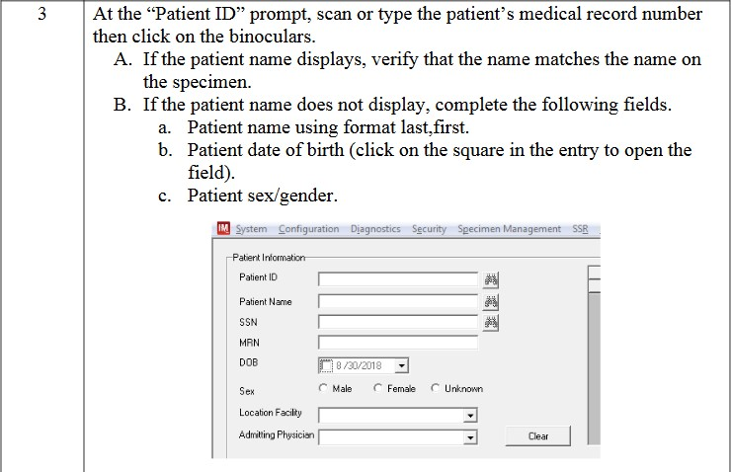

Slide 20
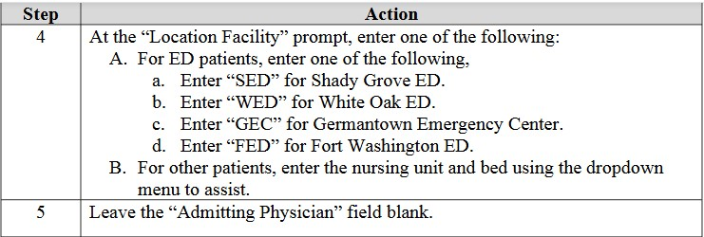
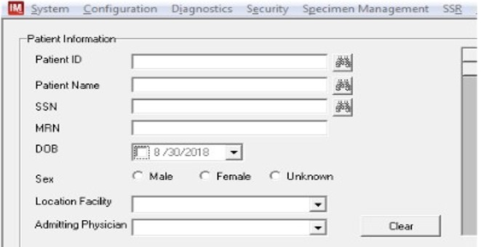

Slide 21
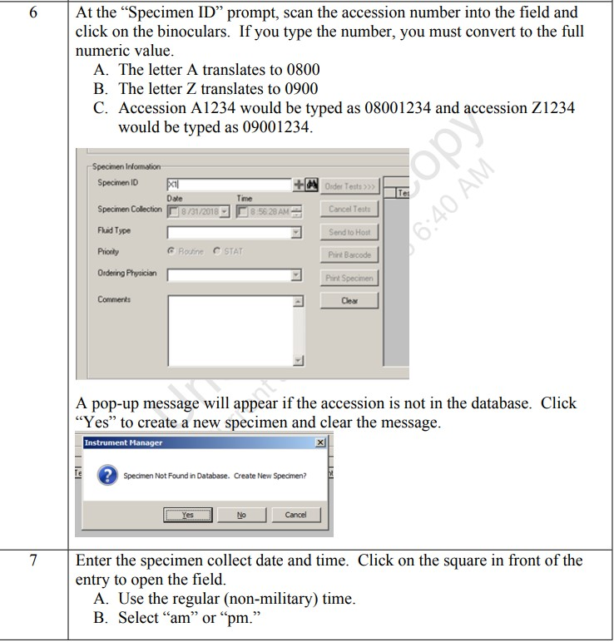
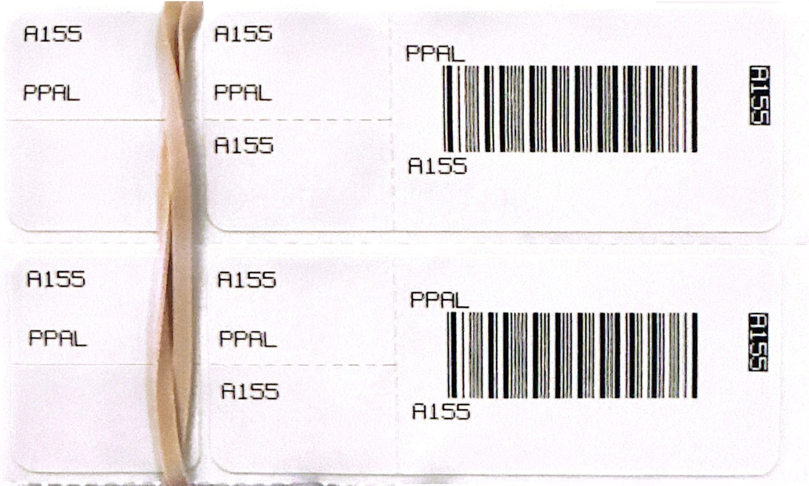

Slide 22
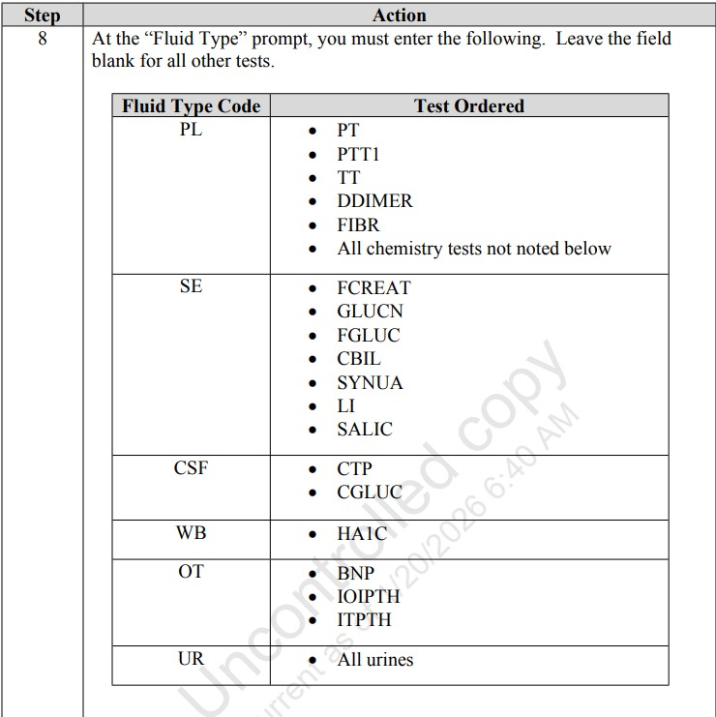
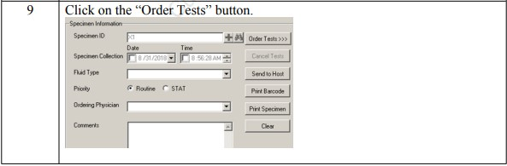
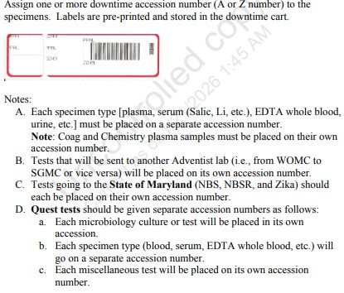

Slide 23
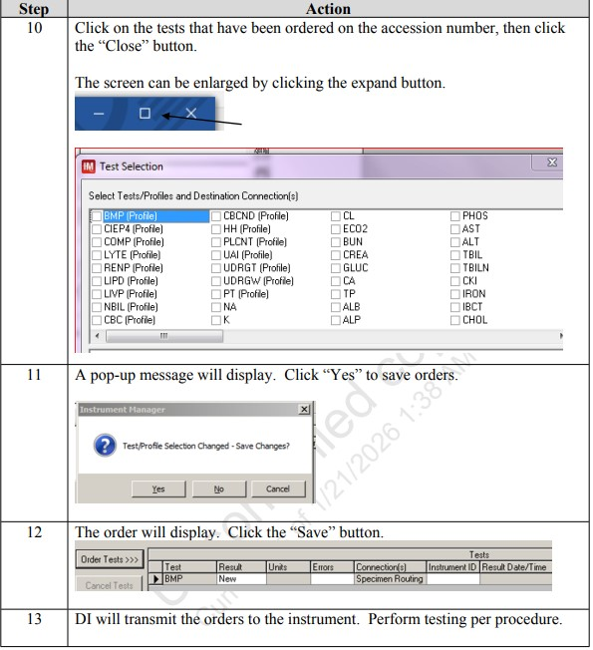

Slide 24
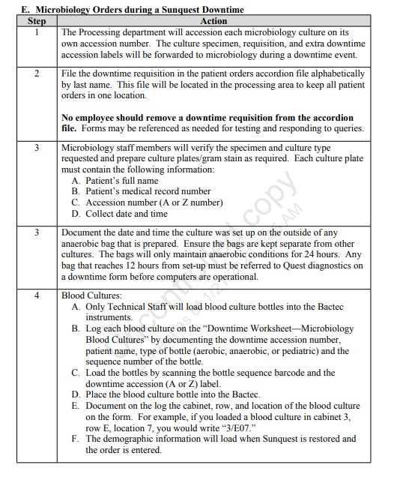

Slide 25
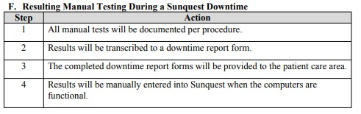

Slide 26
Thank you

