Slide 1
Central Coast Laboratory Services
Kurt Strubeck 2018

Slide 2
AIDET COMPETENCY PROGRAM
AIDET Competency Program Goals
Patient Care
Satisfied Patients who feel safe and secure in our care.
Teamwork
Treating each other with respect and backing each other up
Improving Communication
Collaboration
Good Business Practices that encourage growth
Professional Attitudes
Professional Actions
Professional Care

Slide 3
AIDET COMPETENCY PROGRAM
Have you ever had your blood drawn at an Outpatient collection center, made a visit to the Emergency Room or stayed in a Hospital?
What do you think the key components to acceptable customer service are?
What do you think the key components to exceptional customer service are?

Slide 4
AIDET COMPETENCY PROGRAM
When you are the customer
(in any industry),what is
Exceptional service to you?
What affects your willingness
To return next time?
What affects your willingness
To recommend that service to
Your family and friends?

Slide 5
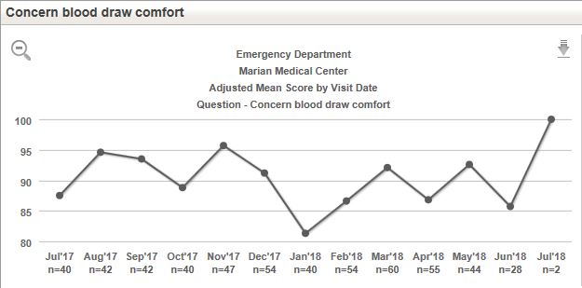
Customer Service Drives Our Business

Slide 6
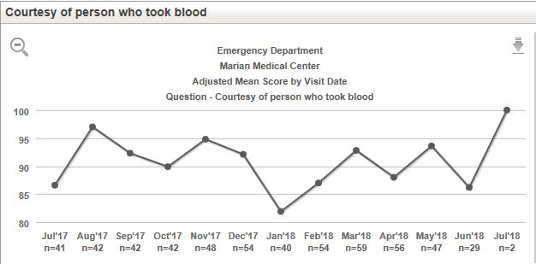
Customer Service Drives Our Business

Slide 7
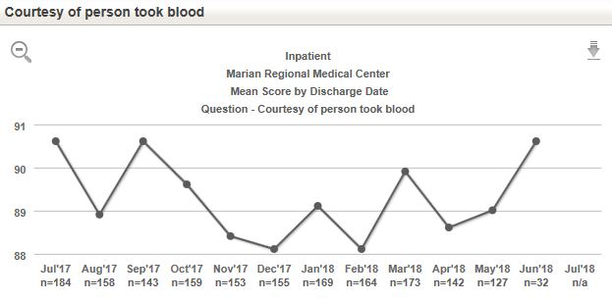
Customer Service Drives Our Business

Slide 8
Arroyo Grande-Question Skill of Techs/Therapists/Nurses
Lab

Slide 9
Arroyo Grande Question- Courtesy of Person Who Took Blood?

Slide 10
A-AIDET-Acknowledge
Smile
Make Eye Contact
Let the Patient (or Customer
or Coworker) know that He/She
is your focus for the moment

Slide 11
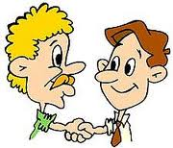
I-AIDET-INTRODUCE & IDENTIFY
INTRODUCE YOURSELF
&
IDENTIFY YOUR PATIENT
Proactively involve the patient
Name
Date of Birth

Slide 12
D-AIDET- DISCUSS DURATION
Examples of Duration Discussions:
The procedure will only take about five minutes to complete
Please hold for just one moment while I notify ________ to answer your call
Keep the patient informed if they are waiting on a phlebotomist or a tech
COMMUNICATION…COMMUNICATION…COMMUNICATION

Slide 13
E-AIDET-EXPLAIN the PROCEDURE
Examples of Explanation Dialogs:
This is our Phlebotomy Dashboard, we use this to assist us in active patient identification. Your labels will print when I scan your wristband.
I am here to collect a blood specimen for tests your physician has ordered.
The tests ordered are to guide your physician on the best care for you. Please speak with your nurse and doctor for more specific information.
We always scan your identification wristband to make certain that we are collecting blood from the right patient, for the right tests, at the right time.
I am labeling the specimens in your presence to make certain that they are labeled correctly.
COMMUNICATION…COMMUNICATION…COMMUNICATION

Slide 14
T-AIDET-THANK THE PATIENT
THANK YOU FOR CHOOSING MARIAN REGIONAL MEDICAL CENTER
WE APPRECIATE YOU CHOOSING US!
THANK YOU FOR YOUR TIME

Slide 15
EXCEPTIONAL CUSTOMER CARE-OUR MISSION
_____________________________________
Exceptional Customer Service is a Core Requirement of Your Job:
It’s Our Mission
It’s the right thing for the patient
Intense desire to serve the patient
It’s Non-negotiable

Slide 16
HANDWASHING

Slide 17
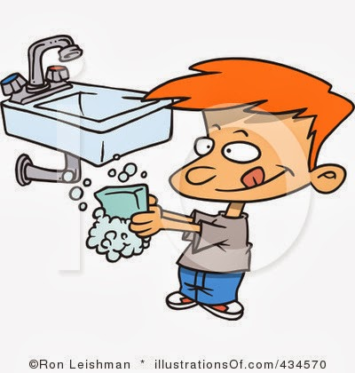
Does the Patient Know You are Washing?
Prior to gloving state:
“Let me cleanse my hands”
as you are applying hand sanitizer in front of the patient, and apply again upon glove removal.
Remember policy states you must use soap and water when your hands are visibly soiled
When hand washing, apply soap and water and rub for at least 15 seconds covering all surfaces of the hand before rinsing

Slide 18
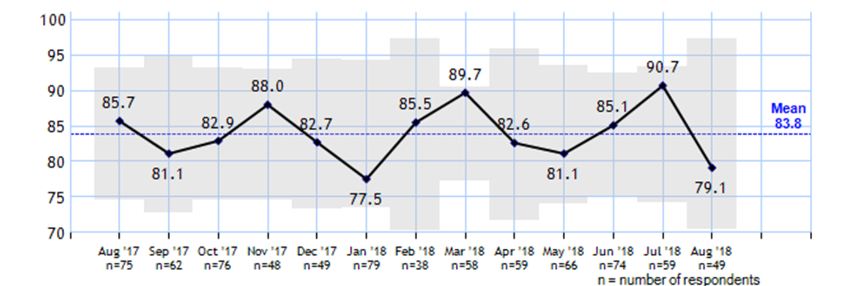
Arroyo Grande-Emergency Question-Saw staff clean hands before caring

Slide 19
Laboratory Main areas of Focus
Skill and Experience
Professional Appearance-Clean & well groomed: neat uniform, hair, and nails
Confident Introduction and Skillful procedure
Attention to Detail-take time to properly dress the phlebotomy venipuncture
Attentiveness
Does the patient know that he/she is important to you?
Do you take time to listen and respond to the patient?
Does the patient have a positive experience from your visit
Politeness
Professional, Courteous, and Kind

Slide 20
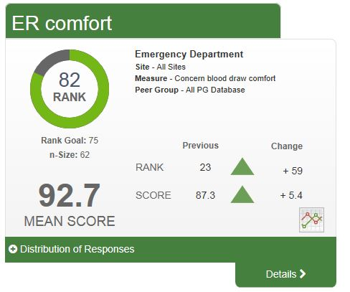
How Do We Compare (Comfort ER)?

Slide 21
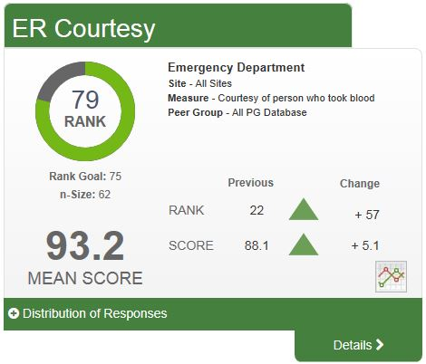
How Do We Compare (Courtesy ER)

Slide 22
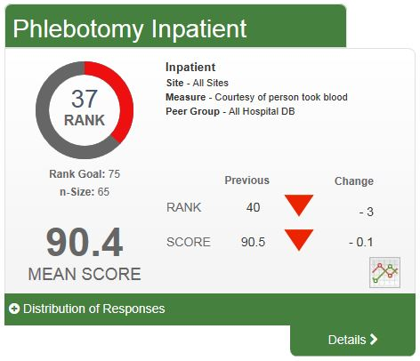
How Do We Compare (Courtesy Inpatient)?

Slide 23
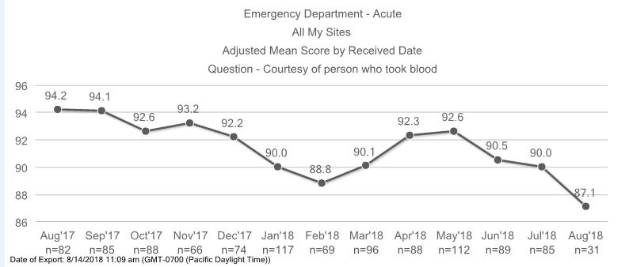
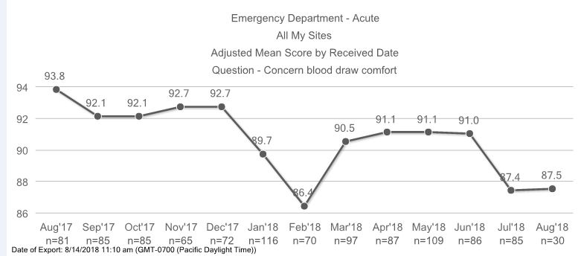
DARE TO IMPROVE
Where can we strive to be? 98%-100%?
It’s about the patient!
Every Patient, Every Time

Slide 24
It Begins with Me, Myself, and I…
__________________________________
Manage up self, it starts with me, myself and I.
I cannot control those around me, but… I can influence others by how I think, act, and do.
Manage up skill set, experience and certifications
Be an active learner…strive for more.
Manage up department, co-workers.
Back up your team…Be the best
Manage up our hospitals, Nursing, Respiratory, Imaging, Admitting, Administration- We are the same team.
Collaboration…It’s Contagious

Slide 25
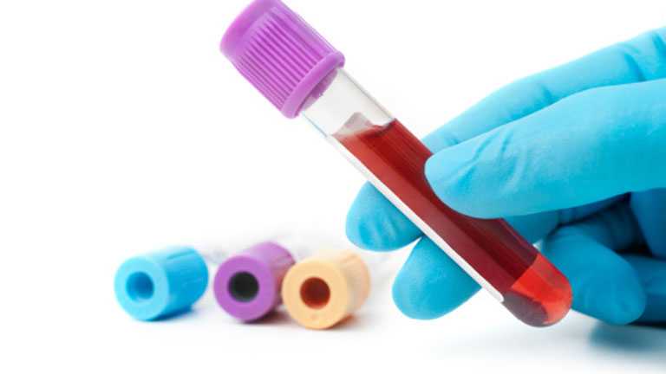
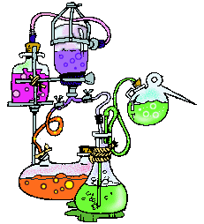
WHEN WE DO OUR BEST
Patients feel better about the
care they are receiving
Patients feel more at ease
with the handoff, and
coordination of care
Your co-worker has a head start
Winning confidence

Slide 26
Good Service vs. Great Service
It’s about the Patient!!
It’s up to ME and YOU
It’s about Dignity Health Clinical Laboratory Services

Slide 27
Thank you for making a difference…
Every Patient
Every Time…

