Slide 1
INDICATIONS FOR SPECIAL TRANSFUSION REQUIREMENTS IN BLOOD PRODUCT TRANSFUSIONS
ERIN PEREZ, CLS, MT (ASCP), SBB
Erin.Perez@DignityHealth.org
Transfusion Service

Slide 2
WHAT ARE SPECIAL TRANSFUSION REQUIREMENTS?
A patient’s medical need for blood components which have been modified
Modifications include:
Leukocyte reduced
CMV Negative
Irradiated
Washed

Slide 3
Leukocyte Reduced
Blood Component is filtered in order to reduce the number of white blood cells
Filtration may occur after collection, in the laboratory, or at the bedside
RBC’s and Platelets are the only products that are leukocyte reduced
Leukocyte reduced RBC’s contain <5.0 x 10⁶ residual leukocytes
Leukocyte reduced Platelets contain <8.3 x 10⁵ residual leukocytes

Slide 4
Benefits of Leukocyte Reduced Red Blood Cells and Platelets
Reduction of Febrile Non Hemolytic Transfusion Reactions
Reduce the risk of transfusion transmitted CMV infection when CMV Negative blood products are unavailable
Reduce the incidence of HLA alloimmunization
ALL RBC’S AND PLT’S PROVIDED BY UBS ARE LEUKOCYTE REDUCED

Slide 5
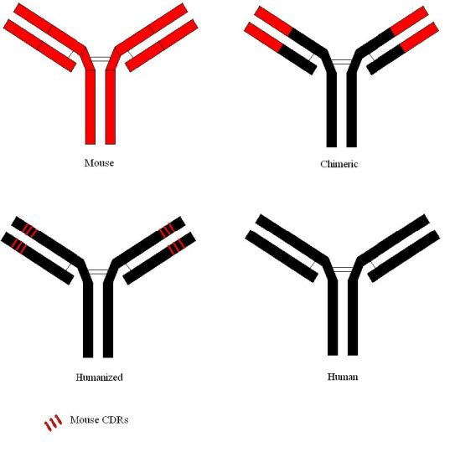
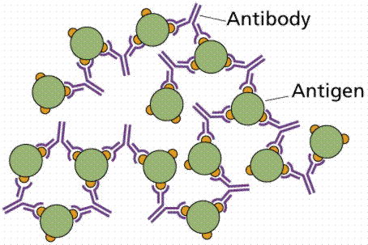
Febrile Non Hemolytic Transfusion Reactions (FNHTR)
Patient Antibodies Bind to Donor Antigens present on platelets and white blood cells
Patient AB
Donor Ag

Slide 6
FNHTR Continued..
Cytokines are released from the Donor platelets and white blood cells causing a fever in the recipient
Recipient leukocyte AB bound to Donor Ag on Plt’s, WBC’s
Release of cytokines from Donor Plt’s, WBC’s
Recipient develops a fever

Slide 7
FNHTR Continued..
Leukocyte reduction reduces the number of white blood cells and platelets present in RBC’s and Plt’s.
Therefore reducing interactions between recipient antibody and donor antigens which can prevent the release of cytokines from donor cells and reduce the incidence of FNHTR’s.
FNHTR’s may also be caused by the accumulation of cytokines in RBC’s and Plt’s.

Slide 8
Cytomegalovirus Transmission
Cytomegalovirus (CMV) is a lipid enveloped DNA virus belonging to the Herpesviridae family
CMV causes lifelong infection, however the virus may remain latent
CMV may be transmitted through blood transfusion due to intact white cells present in cellular blood components (RBC’s, Plt’s)
Immunocompromised patients who may be at risk for a potentially fatal CMV infection include neonates, and CMV-seronegative recipients of solid organ or allogeneic hematopoietic cell transplants
If CMV negative RBC’s and Plt’s are unavailable, then notify the ordering physician and the medical director for approval.
Suggest CMV safe units, which are Leukocyte Reduced RBC’s and Plt’s in order to reduce the risk of transfusion associated CMV infection.

Slide 9
Barcode indicates the product is
Negative for antibodies to CMV

Slide 10
HLA Alloimmunization
The HLA system function is to distinguish self from non self
HLA antigens are present on all nucleated cells
Recipient develops antibodies towards the donors HLA antigens which are present on nucleated cells
HLA alloimmunization can occur following pregnancy, transfusion, or organ transplantation

Slide 11
Effects of HLA Alloimmunization
HLA Alloimmunization is responsible for Febrile Non Hemolytic Transfusion Reactions (FNHTR), Transfusion Related Acute Lung Injury (TRALI), Transfusion Associated- Graft vs. Host Disease (TA-GVHD) and Platelet Refractoriness
Incidence of HLA Alloimmunization may be reduced by transfusing Leukocyte reduced RBC’s and Plt’s

Slide 12
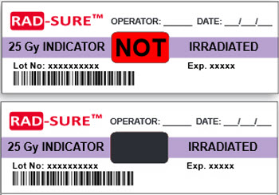
What is Irradiation?
Irradiated blood components are exposed to gamma rays which prevent proliferation of viable T lymphocytes
Irradiation-sensitive labels are placed on RBC’s and Plt’s before irradiation
The center of the purple label turns black to indicate that the minimum dose of 25 Gy was achieved

Slide 13
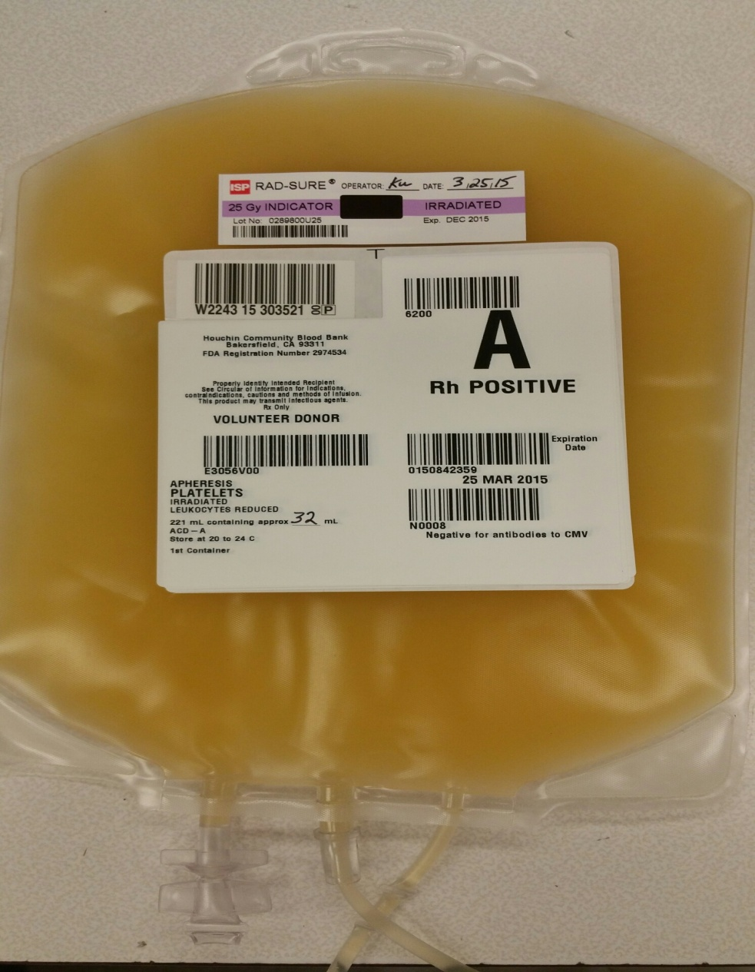
Irradiation Sensitive label
Standard Product Code
Irradiated

Slide 14
Transfusion Associated-Graft vs. Host Disease (TA-GVHD)
In immunocompetent patients the recipient would recognize the donor T lymphocytes as foreign and destroy the donor T lymphocytes
In immunocompromised patients the recipient is unable to recognize the donor T lymphocytes as foreign and therefore the donor cells engraft into the recipients tissues and cause an immune response

Slide 15
Signs and Symptoms of TA-GVHD
Maculopapular rash
Fever
Pancytopenia
Enterocolitis with watery diarrhea
Elevated liver function tests
Marrow aplasia
Death

Slide 16
TA-GVHD Continued..
Signs and symptoms occur between 3 and 30 days post transfusion with non-irradiated blood components
The average onset is between 8 to 10 days post transfusion
Death can occur within 1 to 3 weeks after the onset of the first symptoms

Slide 17
Indications for Irradiated Components
Intrauterine transfusion and exchange transfusion recipients
Bone marrow or peripheral blood stem cell transplantation
Patients with congenital immunodeficiencies
Donors who are blood relatives to the recipient
Immunosuppressed patients at risk for GVHD
Patients being treated with chemotherapy and/or radiation
Patients with bone marrow suppression
Premature infants < 1200 grams

Slide 18
Indications for Irradiated Components Continued..
Patients receiving HLA matched platelets or granulocytes
Hematologic malignancies or solid tumors such as neuroblastoma, sarcoma, and Hodgkin’s Disease
Patients being treated with cytotoxic agents for a malignancy
Newborns with erythroblastosis fetalis

Slide 19
Prevention of TA-GVHD
The ONLY prevention for Transfusion Associated Graft vs. Host Disease is IRRADIATION of cellular components

Slide 20
Washed RBC’s and Plt’s
RBC’s and Plt’s are washed with normal saline in order to remove plasma proteins
Indications for washed RBC’s and Plt’s
IgA deficient recipients who developed Anti-IgA
Patients with a history of developing severe allergic reactions to plasma containing components
Transfusion of maternal blood for a neonatal transfusion when the mother has Anti-HPA-1a

Slide 21
Neonates < 4 months old
Neonates are considered immunocompromised and have special transfusion requirements.
When a neonate has a Type and Screen or Product Requisition the following Transfusion Requirements must be entered into Cerner:
CMV Negative
Irradiated
Hgb S Neg
If the patient returns when they are > 4 months old and the physician does not request or there are no clinical indications for special transfusion requirements, then the transfusion requirements can be removed after discussion with the ordering physician as stated in policy 7540.BB.CC.104 Evaluating Requests for Special Products - CMV Negative, Irradiated, or HGB S negative

Slide 22
Special Transfusion Requirements on Product Requisition

Slide 23
Product Requisition Verification
CMV Neg needs to be added
In Result entry scan or type in the accession number for the product requested.
Review the paper requisition with the electronic order in Cerner.
If there are special transfusion requirements that are not visible in the patient
profile, then add them through the Result Entry screen
Verify the product order BEFORE selecting units for transfusion

Slide 24
Product Requisition Review
The product requisition is the mode of communication between the physician and the CLS for special transfusion requirements.
Each order for products must be thoroughly reviewed by the CLS prior to selecting units for transfusion.
If the product requisition includes special transfusion requirements, then enter the needs in Cerner immediately.
If the special transfusion requirements are not entered in Cerner by the CLS, then Cerner cannot provide the level of security necessary for safe transfusion.
Transfusion of products that do not meet a patient’s special transfusion requirements is a FDA reportable event.

Slide 25
Entering Special Transfusion Requirements in Cerner
From the Cerner App Bar select one of the
following icons:
Barcode or type the patient’s Medical Record Number
Select the filing cabinet icon
OR <View> from the menu bar then select <Transfusion Requirements, Antibodies, Antigens>
Note: You can also use Result Entry during verification of the product requisition.

Slide 26
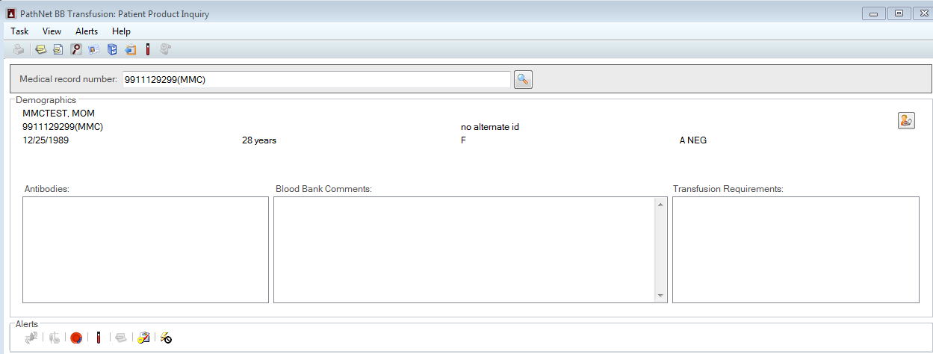
Step 2
Step 1

Slide 27
Ensure the Transfusion Requirements button is selected

Slide 28
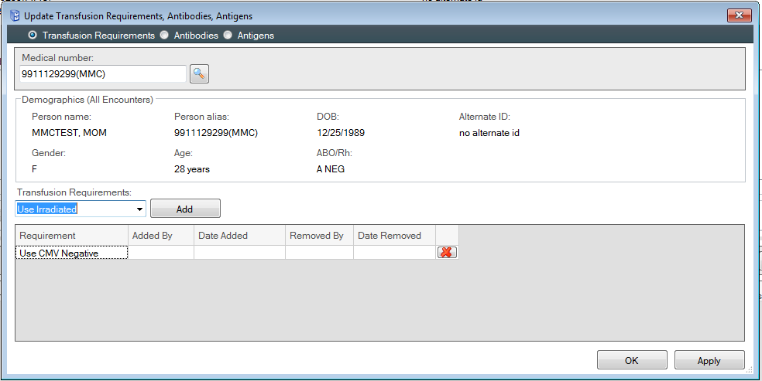
Use the drop down box underneath the Transfusion Requirements:
Select the requirement and then click the Add button
The added requirement will appear in the grid
Once all requirements have been added then select the Apply button
and then OK

Slide 29
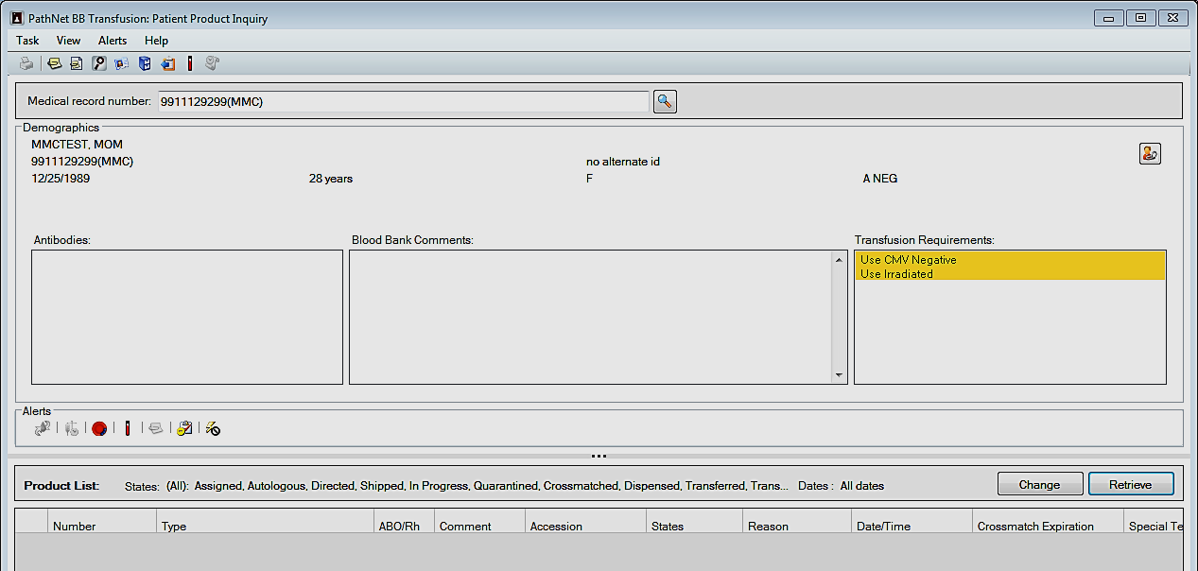
The patient’s profile will be updated with the special transfusion
requirements.

Slide 30
Cerner will display an exception box if a product is selected for crossmatch that does not meet special transfusion requirements.
DO NOT OVERRIDE

Slide 31
Cerner will warn the user if a product does not meet special transfusion requirements during assignment.
DO NOT CONTINUE

Slide 32
Cerner will display an exception box if the product selected for dispense does not meet special transfusion requirements.
DO NOT OVERRIDE

Slide 33
Special Needs Product Availability
CMV negative, irradiated and washed products must be ordered from United Blood Services at the time of the request, if there are no products currently available in inventory.

Slide 34
Questions or concerns..
Questions or concerns please contact Erin Perez, CLS, MT(ASCP), SBB Transfusion Service Area Supervisor
Erin.Perez@DignityHealth.org

Slide 35
References
AABB, the American Red Cross, America’s Blood Centers, and the Armed Services Blood Program. Circular of information for the use of human blood and blood components. Bethesda, MD: AABB, 2018.
Fung M, ed. Technical Manual. 19th ed. Bethesda, MD: AABB 2017.
Levitt J, ed. Standards for blood banks and transfusion services. 31st ed. Bethesda, MD: AABB, 2018.

