Slide 1
SBAR Training for Laboratory Associate

Slide 2
Definition of SBAR
SBAR is an acronym that stands for Situation, Background, Assessment, and Recommendation.
It is a standardized way of communicating a problem across the organization.
Associates and providers can use SBAR to share patient information in a concise and structured format.
It improves efficiency and accuracy in the care of patients and workplace environment.

Slide 3
Definition of SBAR
Situation-Who you are and who, what, and where is the immediate problem
Background-A brief description of relevant history related to the current situation or condition
Assessment-Your view of the situation and your perception of the urgency of action
Recommendation-Your suggestion about the action that should be taken to solve the problem or your request for guidance on what the action should be

Slide 4
History of SBAR
SBAR was originally developed by the US Navy as a communication technique that could be used on nuclear submarines.
The airline industries began to use SBAR in the 1980s after a series of airline crashes in which investigators determined that communication was contributing factor.

Slide 5
SBAR Communication
Saint Agnes Hospital has adopted this form of communication for all associates. (Please reference hospital policy SYS HOS 68 Hand-off Communication).
SBAR can be used:
During change of shift
Notification of alert lab values to providers
Notification of discrepant laboratory results/information
Communication regarding instrument downtime
Communication of unacceptable specimens to providers

Slide 6
Why is SBAR Important
A program that facilitates effective communication is mandated by regulatory and accrediting agencies such as The Joint Commission and CAP.
Identify patients correctly.
Efficient communication between associates.
Identify patient safety risks.

Slide 7
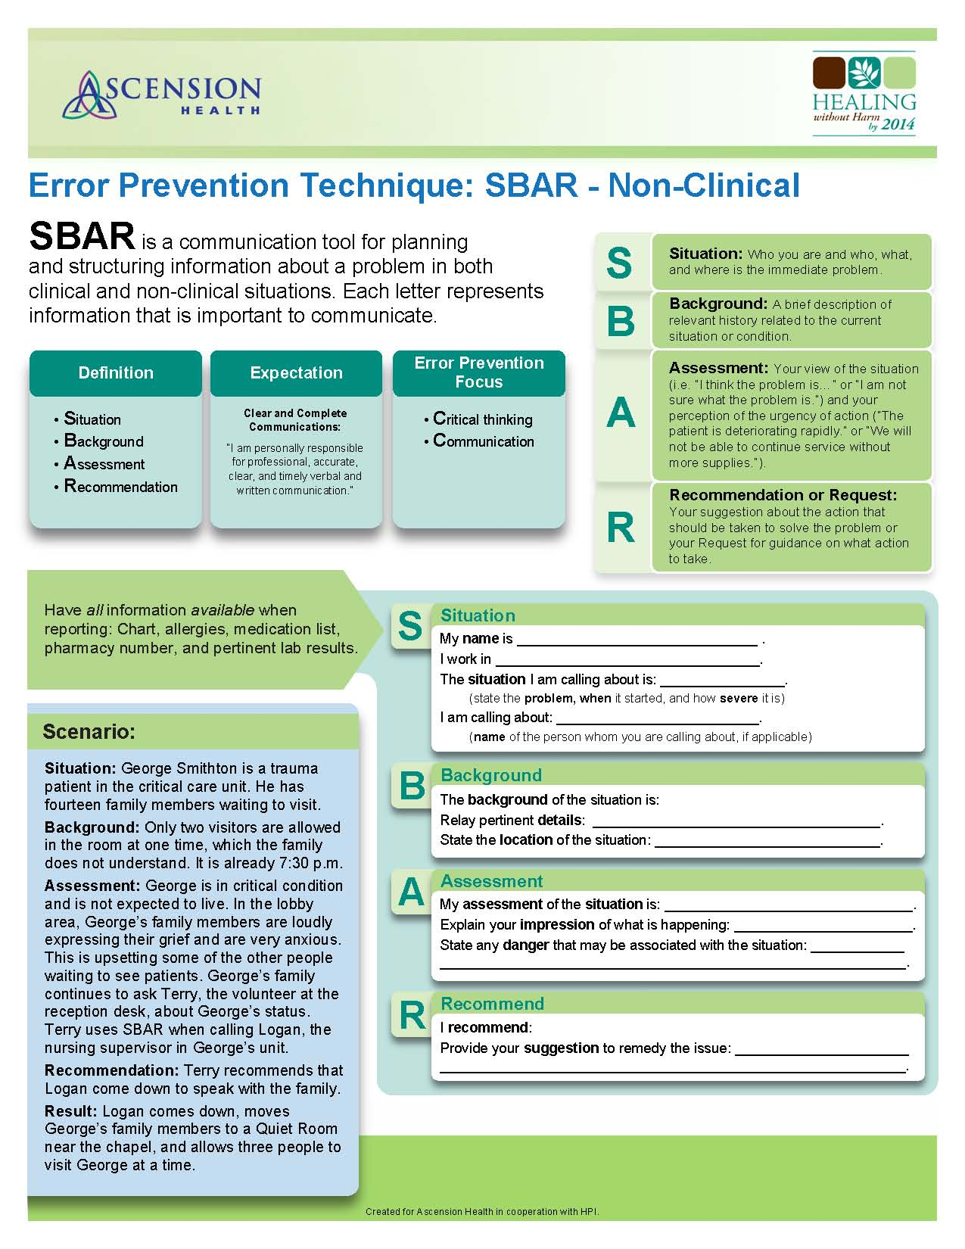

Slide 8
Example Scenario 1
A specimen labeled for patient John Doe was received with a requisition for patient Joseph Hunt from GI. Specimen is irretrievable.

Slide 9
Use of SBAR
Situation: Hi, this is [name] from the Histo Department. We received a requisition for patient Joseph Hunt, however the specimen is labeled for John Doe.
Background: Specimen bottle labels and requisition has two different names. They do not match.
Assessment: The laboratory will not be able to process the specimen until this issue is corrected.
Recommendation: Please send someone to retrieve specimen and requisition for correction.

Slide 10
Example Scenario 2
Xylene has spilled in the Processing room and it is 5:30p in the evening. Spill has been evaluated to be small enough self cleaning. You report spill to Lead/Supervisor.

Slide 11
Use of SBAR
Situation: Stacey or Scott, a small amount of Xylene spilled in the Processing room.
Background: Xylene container was accidently bumped and some spilled on the floor.
Assessment: Spill is very small and the spill procedures can be used to appropriately clean and discard materials.
Recommendation: Use caution when cleaning and check spill response supplies for replacement of used materials.

