Slide 1
SBAR Training for Laboratory Associate

Slide 2
Definition of SBAR
SBAR is an acronym that stands for Situation, Background, Assessment, and Recommendation.
  It is a standardized way of communicating a problem across the organization.
  Associates and providers can use SBAR to share patient information in a concise and structured format.
  It improves efficiency and accuracy in the care of patients and workplace environment.

Slide 3
Definition of SBAR
Situation-Who you are and who, what, and where is the immediate problem
Background-A brief description of relevant history related to the current situation or condition
Assessment-Your view of the situation and your perception of the urgency of action
Recommendation-Your suggestion about the action that should be taken to solve the problem or your request for guidance on what the action should be

Slide 4
History of SBAR
SBAR was originally developed by the US Navy as a communication technique that could be used on nuclear submarines.
The airline industries began to use SBAR in the 1980s after a series of airline crashes in which investigators determined that communication was contributing factor.

Slide 5
SBAR Communication
Saint Agnes Hospital has adopted this form of communication for all associates. (Please reference hospital policy SYS HOS 68 Hand-off Communication).
SBAR can be used:
  During change of shift
  Notification of alert lab values to providers
  Notification of discrepant laboratory results/information
  Communication regarding instrument downtime
  Communication of unacceptable specimens to providers

Slide 6
Why is SBAR Important
A program that facilitates effective communication is mandated by regulatory and accrediting agencies such as The Joint Commission and CAP.
Identify patients correctly.
Efficient communication between associates.
Identify patient safety risks.

Slide 7
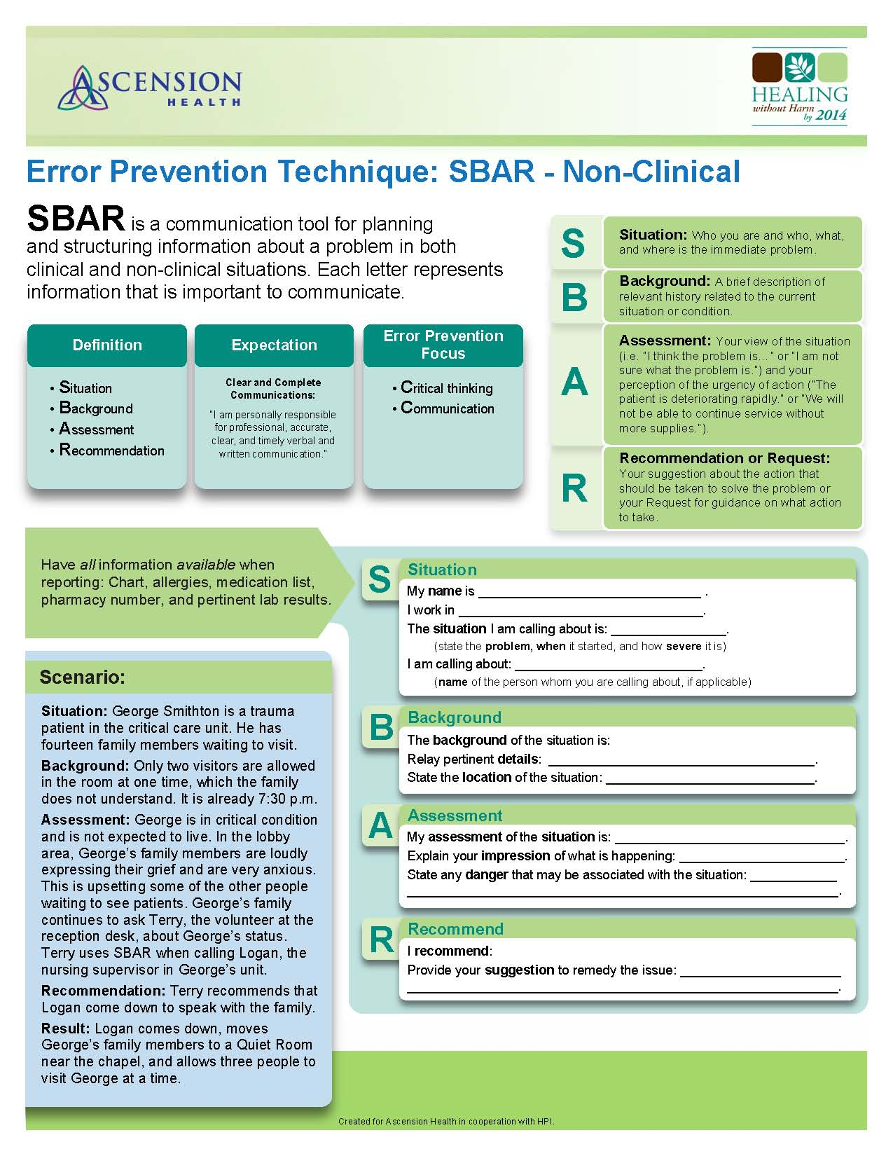

Slide 8
Example Scenario
31 y/o L&D patient [identifier] admitted for induction delivery. Type and Screen was tested and found to be positive. Patient subsequently has labor complications and doctor orders two units of RBCs to be ready for emergency c-section.

Slide 9
Use of SBAR
Situation: Hi, this is [name] from the Transfusion Services. There is a request for two units of blood for [patient identifiers] but the patient has a positive antibody screen.
Background: Patient is going for an emergency section. Patient’s prenatal testing was negative and an antibody identification would be required to identify and test for compatible blood.
Assessment: Antibody identification and the finding and testing of compatible blood could take several hours.
Recommendation: I recommend that the physician be made aware of the circumstances and be prepared for emergency released blood if necessary.

