Slide 1
SBAR Training for Laboratory Associate

Slide 2
Definition of SBAR
SBAR is an acronym that stands for Situation, Background, Assessment, and Recommendation.
  It is a standardized way of communicating a problem across the organization.
  Associates and providers can use SBAR to share patient information in a concise and structured format.
  It improves efficiency and accuracy in the care of patients and workplace environment.

Slide 3
Definition of SBAR
Situation-Who you are and who, what, and where is the immediate problem
Background-A brief description of relevant history related to the current situation or condition
Assessment-Your view of the situation and your perception of the urgency of action
Recommendation-Your suggestion about the action that should be taken to solve the problem or your request for guidance on what the action should be

Slide 4
History of SBAR
SBAR was originally developed by the US Navy as a communication technique that could be used on nuclear submarines.
The airline industries began to use SBAR in the 1980s after a series of airline crashes in which investigators determined that communication was contributing factor.

Slide 5
SBAR Communication
Saint Agnes Hospital has adopted this form of communication for all associates. (Please reference hospital policy SYS HOS 68 Hand-off Communication).
SBAR can be used:
  During change of shift
  Notification of alert lab values to providers
  Notification of discrepant laboratory results/information
  Communication regarding instrument downtime
  Communication of unacceptable specimens to providers

Slide 6
Why is SBAR Important
A program that facilitates effective communication is mandated by regulatory and accrediting agencies such as The Joint Commission and CAP.
Identify patients correctly.
Efficient communication between associates.
Identify patient safety risks.

Slide 7
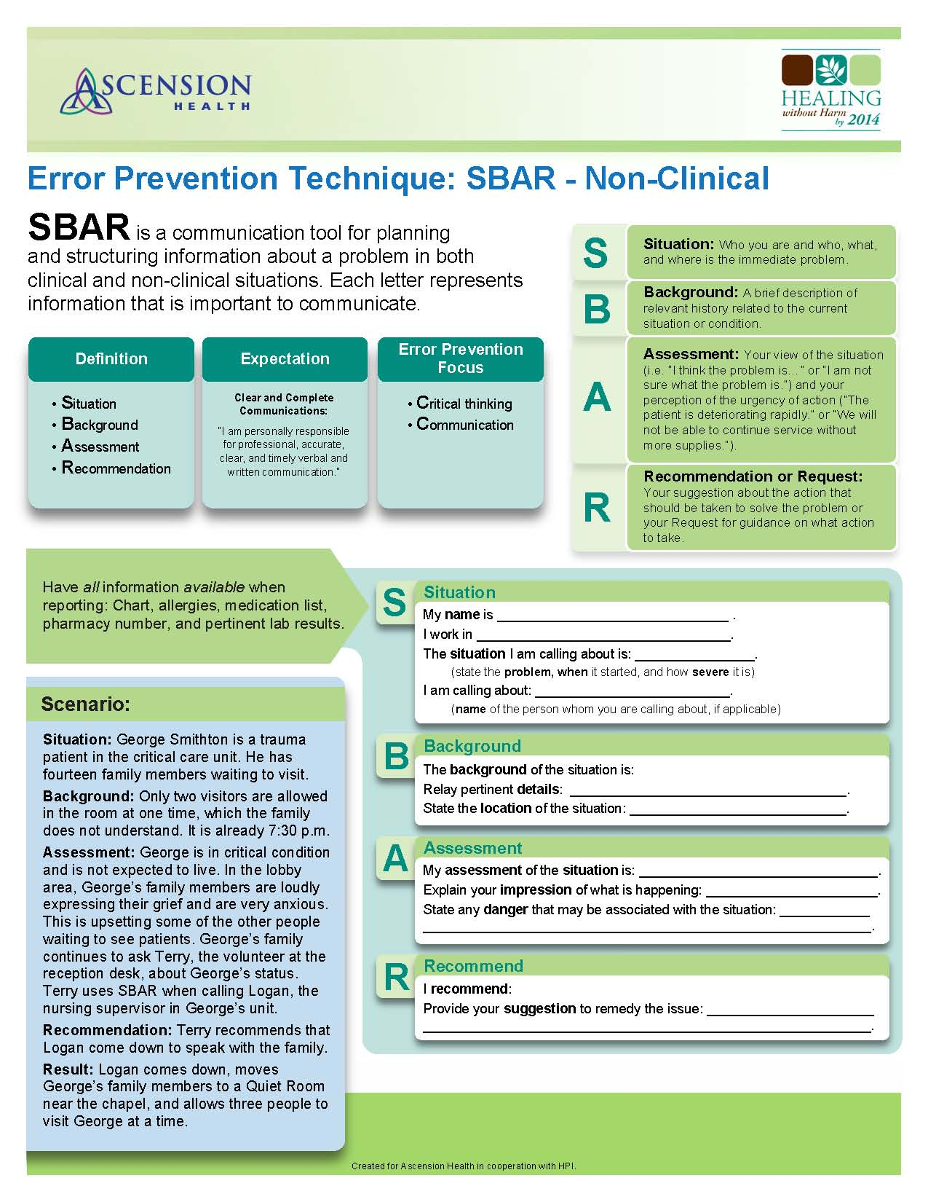

Slide 8
Example Scenario #1
A requisition for patient A was received but no specimens. At the same time specimens for patient B were received but no requisition from Dr. Madrid’s office.

Slide 9
Use of SBAR
Situation: Hi, this is [name] from Saint Agnes Laboratory. We received a requisition for patient A but no specimens and specimens drawn from patient B but no requisition.
Background: The requisition for patient A is checked off for urinalysis and CBC. We did not receive a urine or a lavender top tube for patient A. The samples drawn from patient B are two yellow top SSTs, one green top SST and a lavender top tube, but no requisition.
Assessment: This doesn’t appear to be a mislabeling but needs confirmation. We will be unable to process your request or perform patient testing until we have the specimens for patient A and the requisition for patient B.
Recommendation: I recommend that you check your workspace for the missing paperwork and specimens and verify whether any patient or specimen identification errors were made.

Slide 10
Example Scenario #2
You are performing phlebotomy at Geipe Road. The patient has become unresponsive during a blood draw. Phlebotomist has called 911.

Slide 11
Use of SBAR
Situation: Hi this is [your name] from [location of drawing station]. I have a patient who has become unresponsive during a blood draw.
Background: Patient is a [age] year old [sex] here for a fasting blood draw. The patient complained of dizziness, started sweating and slumped in the chair right before they passed out.
Assessment: The patient is currently unresponsive and in a safe location.
Recommendation: I request immediate EMT assistance.

