Slide 1
Qualified Professional Collector (QPC)

Slide 2

About Your Instructor
Jan Kornmann has work in the drug and alcohol industry since the beginning of the mandated drug testing- 1988
Owner of a drug and alcohol testing firm specializing in consulting, training and educating.
Master Qualified Professional Collector Trainer (M-QPCT)
Breath Alcohol Technician (BAT) Master Trainer (M-BATT)
Screening Testing Technician (STT) Trainer (M-STTT)
Certified Designated Employer Representative (C-DERT)
Notes:
Make your own slide with your information..

Slide 3
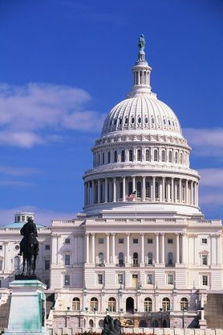


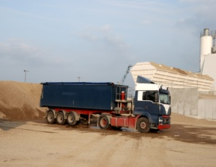



History of drug testing
9-15-86 Pres. Reagan signed Executive Order 12564 - the goal for Drug- Free Federal Workplace
1987 Public Law 100-71 required HHS to follow:
  Certify that each agency developed drug free workplace
        Establish standards
        Specify drugs to be tested
        Establish standards on labs
1983 NTSB recommended that the DOT issue rules on Drugs & Alcohol by 1988 DOT started the program
1991 Omnibus Transportation mandated the alcohol testing
4-11-96 Dept. of Transportation published procedures
12-19-00 Final Rule 49 CFR Part 40 (effective 8-1-01) Previous rules at that time no longer were in effect
Mandated Federal gov’t employees under DHHS Guidelines- environmental Protection Agency, Small Business Admin, & DOT
2008-2010 Changes in DOT rules and HHS rules
2018 Changes
Notes:
History of drug testing
9-15-86 Pres. Reagan signed Executive Order 12564 - the goal for Drug- Free Federal Workplace
1987 Public Law 100-71 required HHS to follow:
Certify that each agency developed drug free workplace
Establish standards
Specify drugs to be tested
Establish standards on labs
1983 NTSB recommended that the DOT issue rules on Drugs & Alcohol by 1988 DOT started the program
1991 Omnibus Transportation mandated the alcohol testing
4-11-96 Dept. of Transportation published procedures
12-19-00 Final Rule 49 CFR Part 40 (effective 8-1-01) Previous rules at that time no longer were in effect
Mandated Federal gov’t employees under DHHS Guidelines- environmental Protection Agency, Small Business Admin, & DOT

Slide 4
Governance of Drug Testing
DHHS mandated
DOT regulations (49 CFR Part 40)
Non mandated- company policy
    State laws
    Municipal laws
    Union bargaining
    Tribal
Notes:
Governance of Drug Testing- Different situations that drug and alcohol testing can occur in a company:
DHHS mandated- All Federal employees fall under this category
DOT regulations (49 CFR Part 40) Transportation departments- FAA, FRA,FTA, FMCSA, PHMSHA, USCG,
Non mandated- company policy- must follow the following :
State laws
Municipal laws
Union bargaining
Federal supersedes State then it is municipal and then union negotiation.

Slide 5
Office of Drug & Alcohol Policy & Compliance- Federal Regulations
Revised rules effective 1-18-2018
Summary next slide
October 1,2011
  Prior to this was rules effective August 1,2001
Previous editions become obsolete
For DOT interpretation, contact:
  Web: https://www.transportation.gov/odapc
  Fax on Demand: (800) 225-3784
  Telephone: 855-368-4200
Notes:
Office of Drug & Alcohol Policy & Compliance- Federal Regulations
Revised rules effective October 1,2011
Prior to this was rules effective August 1,2001
Previous editions become obsolete
For DOT interpretation, contact:
Web: www.dot.gov/ost/dapc
Fax on Demand: (800) 225-3784
Telephone: (202) 366-3784

Slide 6
Part 40 Final Rule - DOT Summary of Changes
Today, November 13, 2017, the Department of Transportation (DOT) published a final rule in the Federal Register (82 FR 52229). The rule, among other items, added four semi-synthetic opioids (i.e., hydrocodone, oxycodone, hydromorphone, oxymorphone). It also added methylenedioxyamphetamine (MDA) as an initial test analyte and removed the testing for methylenedioxyethylamphetaime (MDEA).
When is the final rule effective?
The final rule is effective January 1, 2018.
What does this mean for employees?
You will also be tested for four semi-synthetic opioids (i.e., hydrocodone, oxycodone, hydromorphone, oxymorphone). Some common names for these semi-synthetic opioids include OxyContin®, Percodan®, Percocet®, Vicodin®, Lortab®, Norco®, Dilaudid®, Exalgo®. In addition, you will no longer be tested for MDEA.

Slide 7
What does this mean for employers and Consortium/Third Party Administrators (C/TPA)?
As an employer or C/TPA, you will no longer be required to submit blind specimens to laboratories.
What does this mean for urine collectors?
The shy bladder process has been modified so that the collector will discard any specimen provided during the collection event when the employee does not provide a sufficient specimen by the end of the three hour wait period.
What does this mean for laboratories?
As an HHS-certified laboratory you will:
Add four semi-synthetic opioids: hydrocodone, oxycodone, hydromorphone; oxymorphone to your DOT testing panel;
Add MDA as an initial test analyte;
Remove testing for MDEA;
Add three more fatal flaws to the list of reasons when a laboratory would report a ‘rejected for testing’ specimen; and
Need to modify the reports [in Appendix B & C] you provide to employers and the DOT.

Slide 8
What does this mean for Medical Review Officers (MRO)?
Several of your MRO drug test review processes have been modified. For example:
The term ‘prescription’ has been clarified;
You have authority to conduct D,L stereoisomer and THC-V testing; and
The timing when you communicate a significant safety risk has been modified.
What does this mean for alcohol technicians?
The list of NHTSA-approved Alcohol Screening Devices and Evidential Breath Testing Devices will appear on ODAPC’s website.
What does this mean for service agents?
Collectors, alcohol testing technicians, MROs, and Substance Abuse Professionals will be required to subscribe to ODAPC's list-serve at: https://www.transportation.gov/odapc/ListServe_Notices.
Unauthorized use of DOT-branded items (such as logos or emblems) on a service agent’s website, publications, etc., could be a basis for the DOT to initiate a Public Interest Exclusion proceeding.

Slide 9
What are some of the other changes to Part 40?
The DOT added a new section reiterating that, in the DOT testing program, only urine specimens can be collected and analyzed at HHS-certified laboratories.
The DOT added language further emphasizing the existing DOT prohibition on the use of DNA testing on DOT drug-testing specimens.
The final rule made minor modifications to certain section headings.
The final rule moved the list of Substance Abuse Professional certification organizations from the rule text to ODAPC's website.
The final rule moved the MIS instructions from Appendix H to ODAPC’s website.
Outdated compliance dates were removed and links were updated.
Appendices B, C, D, and H were updated.
Where can I find a copy of the final rule?
You can view the final rule on ODAPC’s web site www.transportation.gov/odapc/frpubs.
NOTE: This document informally summarizes some of the important effects of the rule, but it is not a substitute for the rule and should not be relied upon to determine legal compliance with the rule. ODAPC encourages affected entities, including employers and service agents, to review the final rule.

Slide 10
Qualified Professional Collector
Jan Kornmann, BSM, MQPCT, MBATT
KorManagement Services LLC
605-237-1357 or 605-758-2325

Slide 11
Qualified Professional Collector
Understanding the Collection Process
QPC’s must be familiar with entire testing process
Correction of flaws, fatal flaws, and problem tests
Notes:
Understanding the Collection Process
CPC’s must be familiar with entire testing process
Correction of flaws, fatal flaws, and problem tests

Slide 12
Objectives & Overview
Train how to collect urine specimen according to DOT and DHHS mandatory
Critically important to maintain security and integrity of the specimen, while ensuring modesty and privacy of donor
49 CFR Part 40.33 b4: “the collector’s responsibility for maintaining the integrity of the collection process, ensuring the privacy of employees being tested, ensuring the security of the specimen, and avoiding conduct or statements that could be viewed as offensive or inappropriate”. (page 14 of 49 CFR Part 40)
Notes:
Objectives & Overview
Train how to collect urine specimen according to DOT and DHHS mandatory guidelines using DATIA standards
Critically important to maintain security and integrity of the specimen, while ensuring modesty and privacy of donor
49 CFR Part 40.33 b4: “the collector’s responsibility for maintaining the integrity of the collection process, ensuring the privacy of employees being tested, ensuring the security of the specimen, and avoiding conduct or statements that could be viewed as offensive or inappropriate”. (page 14 of 49 CFR Part 40)

Slide 13
Overview
Responsibility of collector- Expectations on collector from employers
  trusting collectors
  improve safety
    absentee reduction,
    quality improvement, &
    loss control
  regulatory compliance,
Professionalism (modesty & privacy)-
  NO conduct or remarks that might be construed as
    accusatorial or
    otherwise offensive or inappropriate
Process according to DHHS Mandatory guidelines & DOT’s 49 CFR Part 40
Instructions on CFR 49 Part 40
(after completing this course- read handbook, DOT regs, DHHS guidelines, state laws, instructions of equipment & clear up any confusion you might have.)
Notes:
Overview
Responsibility of collector- employer’s program (trusting you ); improve safety & regulatory compliance,
Improve safety -absentee reduction, quality improvement, & loss control
Professionalism (modesty & privacy)-NO conduct or remarks that might be construed as accusatorial or otherwise offensive or inappropriate
Expectations on collector from employers
Process according to DHHS Mandatory guidelines & DOT’s 49 CFR Part 40
Instructions on CFR 49 Part 40
(after completing this course- read handbook, DOT regs, DHHS guidelines, state laws, instructions of equipment & clear up any confusion you might have.)

Slide 14
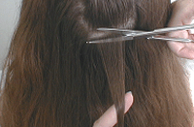
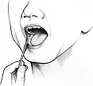
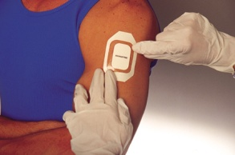
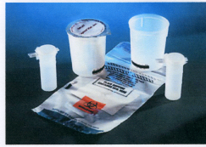
Specimen type.. properties, detection windows:
Hair
  Longest detection
  Pre-employment, random, return to duty, follow-up, criminal justice, child custody,
Oral fluids
  Shortest detection
  Pre-employment, random, reasonable suspicion, post accident, return to duty, follow-up
  Use within hours
  DOT will be allowing this testing
Sweat
  Return to duty, follow-up, criminal, justice, child custody
Urine
  Pre-employment, random, reasonable suspicion, post accident, return to duty, follow-up
  DOT approved- ONLY
Notes:
Specimen type..
properties, detection windows:
Hair
Longest detection
Pre-employment, random, return to duty, follow-up, criminal justice, child custody,
Oral fluids
Shortest detection
Pre-employment, random, reasonable suspicion, post accident, return to duty, follow-up
Use within hours
DOT will be allowing this testing
Sweat
Return to duty, follow-up, criminal, justice, child custody
Urine
Pre-employment, random, reasonable suspicion, post accident, return to duty, follow-up
DOT approved- ONLY

Slide 15
DOT
Federal Aviation Administration FAA
Federal Motor Carrier Safety Administration FMCSA
Federal Railroad Administration * FRA
Federal Transit Administration FTA
Pipeline & Hazardous Materials Safety Administration
PHMSA
United States Coast Guard USCG
  to do Pre-employment, random, post-accident, follow-up, and return to duty tests
*FRA post accident has different collection rules - RR representative supplies specific collection instructions & kits
Notes:
DOT
Federal Aviation Administration
Federal Motor Carrier Safety Administration
Federal Railroad Administration *
Federal Transit Administration
Pipeline & Hazardous Materials Safety Administration
United States Coast Guard
to do Pre-employment, random, post-accident, follow-up, and return to duty tests
*FRA post accident has different collection rules - RR representative supplies specific collection instructions & kits

Slide 16



Drugs to be tested
(under CFR 49 Part 40 reg’s)
Marijuana
Cocaine
Opiates
Codeine/
Morphine
Hydrocodone/
Hydromorphone
Oxycodone/
Oxymorphone
6-Acetylmorphine
Amphetamines
Amphetamine/
Methamphetamine
MDMA⁴/MDA⁵
Phencyclidine
49 CFR--PART 40
View Printed Federal Register page 82 FR 52244 in PDF format.Amendment(s) published November 13, 2017, in 82 FR 52244
Effective Dates: Jan. 1, 2018
Notes:
Drugs to be tested
(under CFR 49 Part 40 reg’s)
Marijuana
Cocaine
Opiates
Amphetamines
Phencyclidine

Slide 17
Urine Specimen Collection Guidelines United States Department of Transportation Office of Drug and Alcohol Policy and Compliance Revised January 2018
https://www.transportation.gov/sites/dot.gov/files/docs/resources/partners/drug-and-alcohol-testing/2567/urine-specimen-collection-guidelines-january-2018.pdf

Slide 18
The Collector
Part 40 defines a collector as a trained person
*instructs and assists employees at the collection site,
*receives and makes an initial inspection of the urine specimen provided by those employees
*initiates and completes the Federal Drug Testing Custody and Control Form (CCF)
Notes:
The Collector (which we will be covering in the next slides)
Who can and cannot serve as a collector?
Who may perform direct observation collections?
Who may perform monitored collections?
Training requirements
Collector identification

Slide 19
Qualified Services
Collection Site Personnel Training Requirements:
Qualified as “Collector”
Qualified as “BAT/STT”
  Basic information
  Qualification training
  Initial proficiency demonstration
  Refresher training
  Error correction training
Collectors meeting the requirements of Subpart C 40.31 are the only persons authorized to collect urine specimens for DOT drug testing
Notes:
Qualified Services
Collection Site Personnel Training Requirements:
Qualified as “Collector”
Qualified as “BAT/STT”
Basic information
Qualification training
Initial proficiency demonstration
Refresher training
Error correction training
Collectors meeting the requirements of Subpart C 40.31 are the only persons authorized to collect urine specimens for DOT drug testing

Slide 20
Any individual, who has received training specified in 49 CFR Part 40 (c:40.33) for conducting the required collection procedure, may serve as a collector except in the following situations
1. The immediate supervisor may not do collection unless no other collector is available (The immediate supervisor may act as a monitor or observer (same gender )
2. An employee -safety-sensitive position and subject to the DOT drug testing rules should not be a collector, an observer, or a monitor for co-workers who are in the same testing pool or who work together with that employee on a daily basis.
3. An individual working for an HHS-certified drug testing laboratory (e.g., as a technician or accessioner) may not act as a collector
4. The employee may not be the collector of his or her own urine specimen.
5. To avoid a potential conflict of interest, a collector should not be someone that is related to the employee (e.g., spouse, ex-spouse, relative) or a close personal friend (e.g., fiancée).

Slide 21
Continued…
Appropriate identification
Provide if requested by the employee.
No requirement to have picture I.D. or to provide his or her driver's license with an address or telephone number.
Not required to provide any certification
Must provide this documentation on request to
  DOT agency representatives and to
  Employers
  Service agents (SA) or Consortium/Third Party Administrators (C/TPAs) who are using or negotiating to use that collector’s services.
The employer must provide the collector with the name and telephone number of the appropriate Designated Employee Representative (DER) and C/TPA
Notes:
Coworker
Relation or close friend
Different gender when directly observed
Different gender for monitored collection unless medical professional
Collector needs to have ID : collector’s name & name of collection company. The only organization you must give certificates to are: DOT agency representatives, employers and SA (service agent) or, C/TPA’s

Slide 22
Required Components in training – Appendix A
Basic information- 49 CFR Part 40 Subpart C 40.33& knowledgeable about current “DOT Urine Specimen Collection Procedures Guidelines”
web site: http://www.transportation.gov/odapc.
****You must subscribe to the ODAPC list-serve: https://www.transportation.gov/odapc/get-odapc-email-updates.
Qualification training:
        Complete collection and Chain of custody-completion and transmission
        Problem collections: shy bladder, attempted adulteration,
        Fatal flaws, correctable flaws, and how to correct problems
  The collector’s responsibility for maintaining the integrity of the collection process, ensuring the privacy of the donor, ensuring security of the specimen, and avoiding conduct or statements that could be viewed as in appropriate or offensive.
Notes:
Basic information- 49 CFR Part 40 Subpart C 40.33& knowledgeable about current “DOT Urine Specimen Collection Procedures Guidelines”
Qualification training:
Complete collection and Chain of custody-completion and transmission
Problem collections: shy bladder, attempted adulteration,
Fatal flaws, correctable flaws, and how to correct problems
The collector’s responsibility for maintaining the integrity of the collection process, ensuring the privacy of the donor, ensuring security of the specimen, and avoiding conduct or statements that could be viewed as in appropriate or offensive.

Slide 23
Initial Proficiency Demonstration: 5 (two uneventful, one temp out of range, one insufficient quantity, and one donor refusal to sign)
  Monitor
  evaluate in person or by means of that provides
  “real time observation and interaction”
  attest that mock collections are “error free”.
  Monitor must be qualified collector who has demonstrated necessary knowledge, skills, and abilities by:
    Collector for DOT collections for at least one year
    Conduct collector training under this part for one year
    Successfully competed a “train the trainer” course
Notes:
Monitor must evaluate in person or by means of that provides “real time observation and interaction” attest that mock collections are “error free”.
Monitor must be qualified collector who has demonstrated necessary knowledge, skills, and abilities by:
Collector for DOT collections for at least one year
Conduct collector training under this part for one year
Successfully competed a “train the trainer” course

Slide 24
Refresher training- no less frequently than every five years
must meet same requirements as initial training.
Error correction training- if you make a mistake as a collector that cancels (fatal flaw, uncorrected flaw).
  Within 30 days
  Cover subject matter with the error was caused
  Error free mock collections (two on error)
Documentation
  Collector must maintain to show current requirements meet
  Must provide on request to:
    DOT agency representatives
    Employers and C/TPA’s who are using or negotiating to use your services
Notes:
Refresher training- no less frequently than every five years
must meet same requirements as initial training.
Error correction training- if you make a mistake as a collector that cancels (fatal flaw, uncorrected flaw).
Within 30 days
Cover subject matter with the error was caused
Error free mock collections (two on error)
Documentation
Collector must maintain to show current requirements meet
Must provide on request to:
DOT agency representatives
Employers and C/TPA’s who are using or negotiating to use your services

Slide 25
Collector Training
Collectors responsible for maintaining integrity of the collection process, ensure privacy of the donor, security of specimen, and be professional (avoid conduct or statements that could be viewed as inappropriate or offensive behavior).

Slide 26
HHS Mandated Testing (Federal Workplace Drug Testing Programs)
Who may serve as collector
  Immediate supervisor
  The hiring official of applicant
  A co-worker who is in the same testing pool or who works with an employee on a daily basis
  An applicant or employee must not collect their own
  Individuals at HHS Instrumented Initial Test Facility (IITF) or laboratory may not serve as collectors if that individual can link the donor with the specimen.
  No personal relationship with the employee
  Gender requirements
  Read and understand HHS Mandatory Guidelines for Federal Workplace Drug and Alcohol Testing Programs (Mandatory Guidelines)
  Read and understand any guidance provided by the Federal agency- consistent with mandatory guidelines
  Receive training from a qualified trainer
  Collector Identification
Notes:
Immediate supervisor may not collect unless there is no feasible alternative. A supervisor serving as a collect must be a trained collector.
The hiring official of applicant may not serve as the collector, unless there is no feasible alternative. A hiring official serving as a collector must be a trained collector.
A co-worker who is in the same testing pool or who works with an employee on a daily basis must not serve as a collector.
An applicant or employee must not collect their own
Individuals at HHS Instrumented Initial Test Facility (IITF) or laboratory may not serve as collectors if that individual can link the donor with the specimen.
An individual who has a personal relationship with the employee must not serve as a collector.
Gender requirements
Read and understand HHS Mandatory Guidelines for Federal Workplace Drug and Alcohol Testing Programs (Mandatory Guidelines)
Read and understand any guidance provided by the Federal agency- consistent with mandatory guidelines
Receive training from a qualified trainer
Collector Identification

Slide 27
Training requirements
  Receive training from a qualified trainer for collectors on the following topics
    CCF steps on proper completion and distribution
    Problem collections
    Fatal and correctable flaws
    Collectors responsibilities to maintain security and integrity of the specimens, to protect privacy of the donor, and maintain proper conduct.
    Demonstrate proficiency – 5 mocks
    Compete refresher training at least every five years
    Have documentation of completion
    Maintain training documentations and provide to Federal Agency upon request
Notes:
Training requirements
Read and understand HHS Mandatory Guidelines for Federal Workplace Drug and Alcohol Testing Programs (Mandatory Guidelines)
Read and understand any guidance provided by the Federal agency- consistent with mandatory guidelines
Receive training from a qualified trainer for collectors on the following topics
CCF steps on proper completion and distribution
Problem collections
Fatal and correctable flaws
Collectors responsibilities to maintain security and integrity of the specimens, to protect privacy of the donor, and maintain proper conduct.
Demonstrate proficiency – 5 mocks
Compete refresher training at least every five years
Have documentation of completion
Maintain training documentations and provide to Federal Agency upon request
Collector Identification

Slide 28
Non Mandated testing
We recommend - adhere to DOT’s guidelines.
  Who can serve as a collector
  Requirements for training
  Observed by same gender
  Monitored by same gender unless monitor is licensed medical professional
Notes:
Non Mandated testing
We recommend - adhere to DOT’s guidelines.
Who can serve as a collector
Requirements for training
Observed by same gender
Monitored by same gender unless monitor is licensed medical professional

Slide 29

Question reviews
        ???
answer

Slide 30
The Collection Site- for DOT, HHS, and non mandated
Definition of a collection facility
Privacy issues
Work area requirements
Requirements for specimen security and integrity
Storage issues
Collection site may be temporary or permanent. The term “collection site” is entire facility used to collect specimen.
Notes:
The Collection Site- for DOT, HHS, and non mandated – covering in the next few slides:
Definition of a collection facility
Privacy issues
Work area requirements
Requirements for specimen security and integrity
Storage issues
Collection site may be temporary or permanent. The term “collection site” is entire facility used to collect specimen

Slide 31
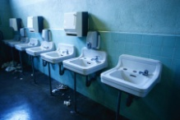

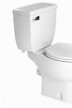
Requirements For Collection Site
Privacy enclosure for urination
          Single toilet room preferred
          Multi-stall (monitored)
Toilet or void receptacle
Water source for hand washing, preferably outside privacy enclosure
Suitable clean surface for work area to complete required paperwork
Donor Privacy must be assured
Notes:
Requirements For Collection Site
Privacy enclosure for urination
Single toilet room preferred
Multi-stall (monitored)
Toilet or void receptacle
Water source for hand washing, preferably outside privacy enclosure
Restricted access during collection

Slide 32
The Collection Site
LIMIT access to the area- NO one but the donor present in the room during collection except when observed.
Restrict access- no unauthorized access (D 40.43)
Procedures -unauthorized access to the collection materials/supplies.
Procedure -authorized persons are under collector supervision
  Lawyer collectors
  Union training collectors
  DER
Specimen security- donor to collector to lab (collector has direct control)
Secure storage area
Per HHS guidelines: “Specimens should NOT be exposed to high temperatures for an extended time. These conditions may affect the test results of a urine specimen.” (page 4 of HHS handbook)
(see DOT’s 10 step collection site security and integrity )
Notes:
The Collection Site found at Subpart D 40.41
Privacy: single toilet-full privacy or multi-stall which must be secured and be monitored collections
Source of Water for Hand washing- external source or secure if not available. Or use of wipes to wash hands.
Work area- clean and suitable for writing
LIMIT access to the area- NO one but the donor present in the room during collection except when observed.
Restrict access- no unauthorized access (D 40.43)
Procedure to ensure that all authorized persons are under collector supervision when permitted into the site
Specimen security- donor to collector to lab (collector has direct control)
Secure storage area
Per HHS guidelines: “Specimens should NOT be exposed to high temperatures for an extended time. These conditions may affect the test results of a urine specimen.” (page 4 of HHS handbook)
(see DOT’s 10 step collection site security and integrity )

Slide 33
Collection Supplies
For each DOT drug test, a collection kit meeting the requirements listed at Appendix C of these guidelines.
Federal Drug Testing Custody and Control Forms (CCF).
Bluing (coloring) agent to add to the toilet bowl/water tank to prevent an employee from diluting the specimen.
The collector should have available tamper-evident tape for securing faucets, toilet tank tops, and other appropriate areas, and signs, when necessary, that can be posted to prevent entry into collection areas.
Note: Single use disposable gloves are recommended for use by collectors while handling specimens.
Notes:
For each DOT drug test, a collection kit meeting the requirements listed at Appendix C of these guidelines.
Federal Drug Testing Custody and Control Forms (CCF).
Bluing (coloring) agent to add to the toilet bowl/water tank to prevent an employee from diluting the specimen.
The collector should have available tamper-evident tape for securing faucets, toilet tank tops, and other appropriate areas, and signs, when necessary, that can be posted to prevent entry into collection areas.
Note: Single use disposable gloves are recommended for use by collectors while handling specimens

Slide 34
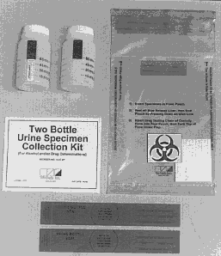
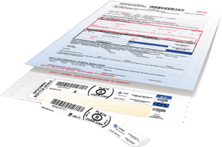
Collection Supplies
Necessary supplies for collections
How supplies work - e.g., how tamper evident tape works
Collection kit standards
Notes:
Collection Supplies (show kits, CCF’)
Necessary supplies for collections
How supplies work - e.g., how tamper evident tape works
Collection kit standards

Slide 35
Collection Supplies
Appendix C
Single use collection container, hold at least 55 mls
  Must be marked with graduated volume and able to check temperature (90-100 F/ 32-38 C)
  Individually wrapped -tamper proof
  May be made available separately at collection site for several voids
Plastic specimen bottles
  hold > 35 ml
  Screw on or snap on cap
  Clear levels – 30 ml & 15 ml
  Designed so tamper- evident bottle seals on CCF fit with no damage when employee initials, not overlap, conceal printed information
  Designed to write on for date and initials
  Must be wrapped together in sealed bag or shrink wrapped- tamper evident
Plastic bag - Leak proof and leach resistant-(2 compartments) Leak resistant bag-
Absorbent material- two compartments, can’t be tampered with
Shipping container
Notes:
Collection Supplies
Single use collection container, hold at least 55 mls
Must be marked with graduated volume and able to check temperature (90-100 F/ 32-38 C)
Individually wrapped -tamper proof
May be made available separately at collection site for several voids
Plastic specimen bottles
hold > 35 ml
Screw on or snap on cap
Clear levels – 30 ml & 15 ml
Designed so tamper- evident bottle seals on CCF fit with no damage when employee initials, not overlap, conceal printed information
Designed to write on for date and initials
Must be wrapped together in sealed bag or shrink wrapped- tamper evident
Plastic bag - Leak proof and leach resistant-(2 compartments) Leak resistant bag-
Absorbent material- two compartments, can’t be tampered with
Shipping container

Slide 36
Federal Drug Testing Custody & Control form- unique ID #
Tamper evident tape-secure facets, toilet tanks tops, trash receptacles, paper towel dispensers
Bluing (coloring) agent -to add to toilet (if blue is not used note on CCF under remarks)
Collector ID
Collector must have appropriate ID
Storage box, area, or place
Standard written instructions/ poster
Single use disposable gloves
DER & C/TPA contact information (40.35)
Notes:
Federal Drug Testing Custody & Control form- unique ID #
Tamper evident tape-secure facets, toilet tanks tops, trash receptacles, paper towel dispensers
Bluing (coloring) agent -to add to toilet (if blue is not used note on CCF under remarks)
Collector ID
Collector must have appropriate ID
Storage box, area, or place
Standard written instructions/ poster
Single use disposable gloves
DER & C/TPA contact information (40.35)

Slide 37
FEDERAL DRUG TESTING CUSTODY AND CONTROL FORM
The CCF must be used to document every urine collection required by the DOT drug testing program.
The CCF must be a five-part carbonless manifold form.
CCFs are also available from a number of different sources - usually part of the urine collection kits provided by a laboratory.
The CCF consists of the following five copies:
Copy 1. Test Facility Copy - accompanies the specimen to the laboratory
Copy 2. Medical Review Officer Copy - sent to the MRO
Copy 3. Collector Copy - retained by the collector
Copy 4. Employer Copy - sent to the employer
Copy 5. Employee Copy - given to the employee
Notes:
The CCF must be used to document every urine collection required by the DOT drug testing program.
The CCF must be a five-part carbonless manifold form. This form may be viewed on the DOT web site [ http://www.dot.gov/odapc/ ] or the Department of Health and Human Services (HHS) web site [ http://workplace.samhsa.gov/ ].
CCFs are also available from a number of different sources (e.g., laboratories, service agents) although they are usually part of the urine collection kits provided by a laboratory.
The CCF consists of the following five copies:
Copy 1. Test Facility Copy - accompanies the specimen to the laboratory
Copy 2. Medical Review Officer Copy - sent to the MRO
Copy 3. Collector Copy - retained by the collector
Copy 4. Employer Copy - sent to the employer Copy 5. Employee Copy - given to the employee

Slide 38
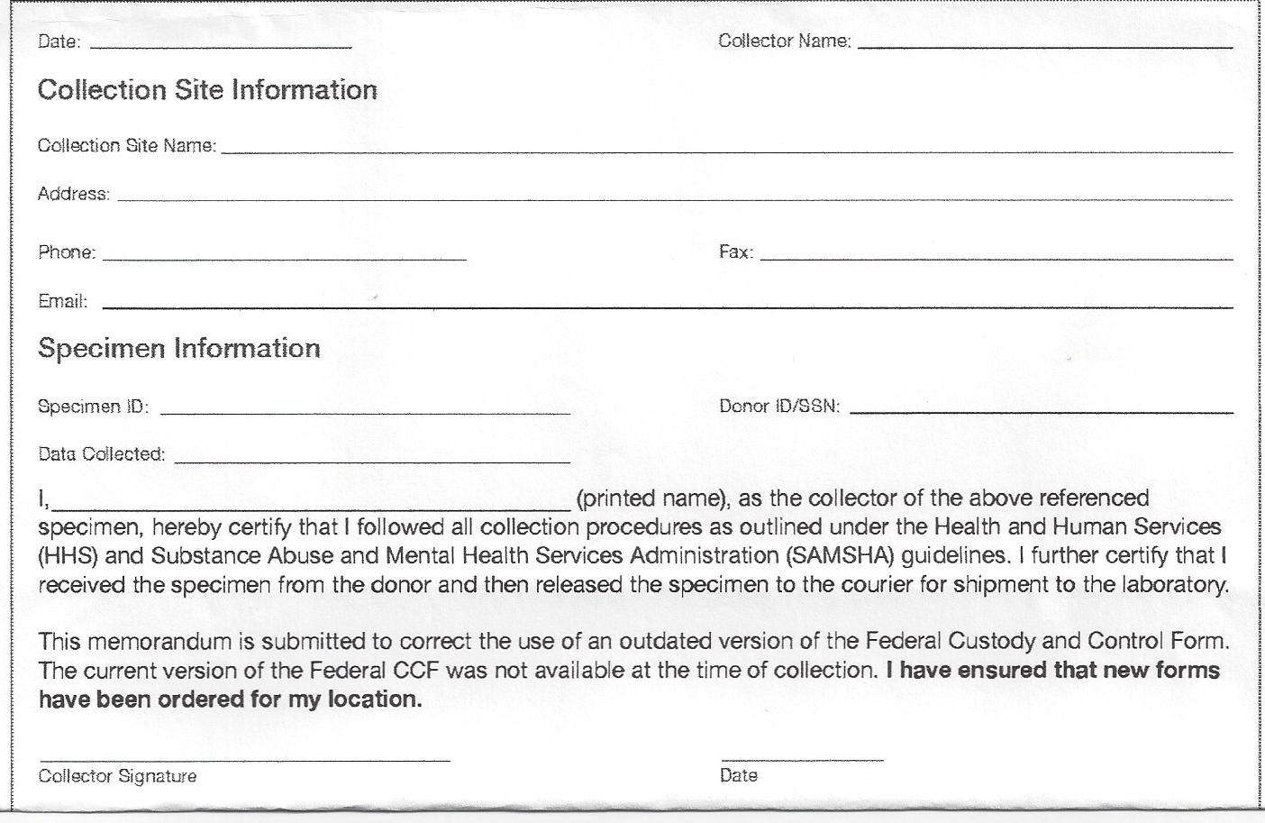
Federal Drug Test Custody and Control Form (CCF)
Effective January 1, 2018
New CCF- The revised CCF includes the following changes:
In Step 1D:
  Removal of the checkbox, the letters “DOT” and hash line in front of the text “Specify DOT Agency”
In Step 5A:
  Addition of four new analytes: oxycodone (OXYC), oxymorphone (OXYM), hydrocodone (HYC), and hydromorphone (HYM),
  Removal of the analyte methylenedioxyethylamphetamine (MDEA).
Five part carbonless form
Note: The collector is permitted to use the old CCF until June 2018
When using expired send a MFR with specimen, otherwise must send when requested “that day”
Information on eCCF: https://www.transportation.gov/odapc/eCCF_Collector_Notice
Notes:
Federal Drug Test Custody and Control Form (CCF)
Effective October 10, 2010 (CCF OMB No. 0930-0158, Exp Date: 8/13/2013 )
Five part carbonless form
Note: The collector is permitted to use the old CCF until December 30,2011
However, when the old CCF is used – collector:
Under remarks: section in step two-on copy one specific agency designation
Example: DOT-FMCSA/ DOT/FAA, DOT/FRA, DOT/ FAA, DOT/ FTA, DOT/ USCG or HHS/EPA, HHS/DOT etc.

Slide 39
Collection facility name
Address of collection
Notes:
). This step is completed by the collector or employer representative prior to the employee providing a urine specimen.
The employer and MRO names, addresses, and telephone and fax numbers may be preprinted or handwritten.
If the employer has designated a service agent to receive the results from the MRO, the employer’s address may be omitted and the service agent’s address may be used
The specific employer’s name, telephone and fax numbers must be included. A clinic or collection site name may not be used in lieu of an employer name.
The collector enters the employee’s social security number or employee’s ID number after verifying the employee’s identity.
The collector also marks the reason for the test and type of drug tests to be performed (all DOT drug tests are for five drugs).
The collector is to check the DOT Agency whose authority the specimen is collected

Slide 40
Notes:
Step 2 (Copy 1). This step is completed by the collector after receiving the specimen from the employee and observing the temperature of the specimen. This step requires the collector to mark the appropriate box to indicate if the temperature of the specimen is within the required temperature range. This step also requires the collector to indicate whether it is a split specimen or single specimen collection, to indicate if no specimen was collected and why, and to indicate if it was an observed collection and why. Note: Because all DOT collections are split specimen collections, the collectors should ALWAYS check the split specimen box

Slide 41
Notes:
Step 3 (Copy 1). This step instructs the collector to seal and date the specimen bottles, to date the bottles seals after placing them on the bottles, to have the employee initial the bottle seals after placing them on the bottles, and then instruct the employee to complete step 5 on the MRO copy (Copy 2).
Step 5 (Copy 2). This step is completed by the employee (listed as donor on the CCF). The employee reads the certification statement, prints his or her name, provides date of birth, daytime and evening telephone numbers, date of collection, and signs the form. After the employee completes this portion of the CCF, the collector reviews it to ensure that all the required information was provided.

Slide 42
Notes:
Step 4 (Copy 1). This step is initiated by the collector and then completed by the laboratory after the laboratory accessions the specimen. This step requires the collector to sign the form to certify that the specimen was collected, labeled, sealed, and released for shipment to the laboratory in accordance with Federal requirements. The collector is also required to note the time of the collection, the date of collection, and the specific name of the delivery service to whom the specimen is released for shipment to the laboratory. Note: There is no requirement for couriers, express carriers, or postal service personnel to add additional documentation to the chain of custody for the specimens during transit because they do not have direct access to the specimens or the CCF. Chain of custody annotations resume when the shipping container/package is opened and accessioned at the laboratory

Slide 43
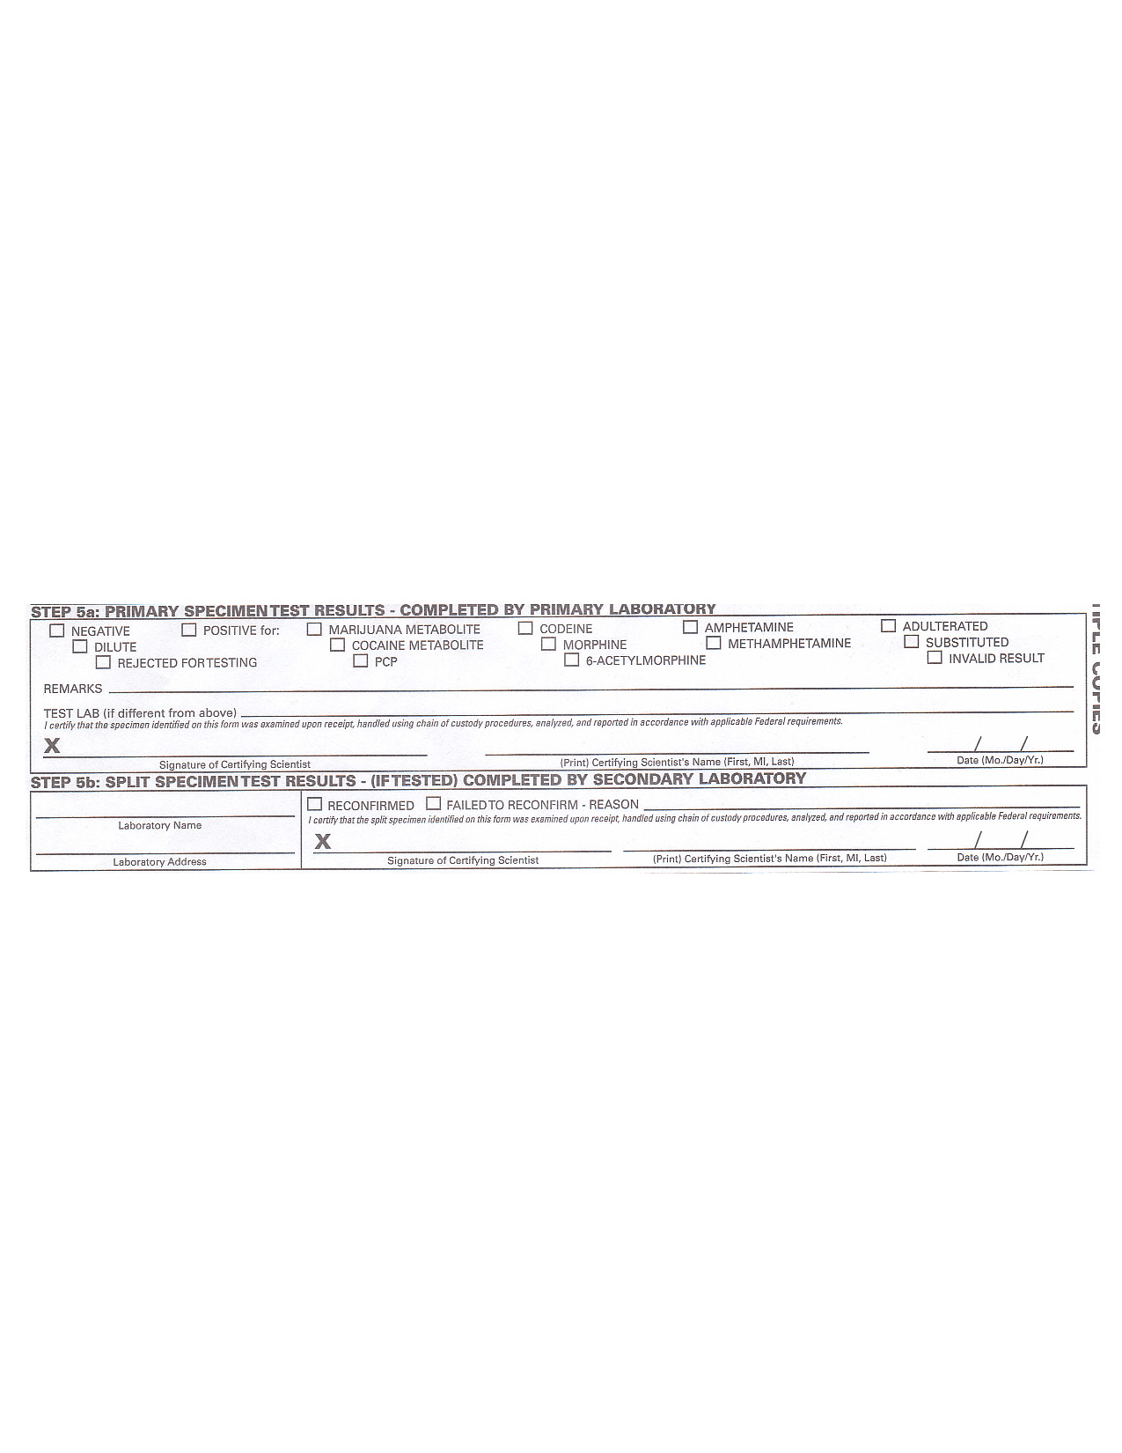

Slide 44
CCF COPIES
COPY 1 –Test Facility Copy- Accompanies the specimen to the laboratory
-(Beginning October 1,2010 for an HHS collection, the collector (when appropriate) can send the specimen to an IITF( Instrumental Initial Test Facility)
COPY 2- Medical Review Officer – send to MRO – same day of next business day
COPY 3 – Collector copy- retained by collector – DOT for 30 days / HHS – 2 years
COPY 4-Employer Copy- send to employer
COPY 5- Employee/ Donor copy- give to person at completion of collection
Notes:
COPY 1 –Test Facility Copy- Accompanies the specimen to the laboratory
-(Beginning October 1,2010 for an HHS collection, the collector (when appropriate) can send the specimen to an IITF( Instrumental Initial Test Facility)
COPY 2- Medical Review Officer – send to MRO – same day of next business day
COPY 3 – Collector copy- retained by collector – DOT for 30 days / HHS – 2 years
COPY 4-Employer Copy- send to employer
COPY 5- Employee/ Donor copy- give to person at completion of collection

Slide 45
Is the collection process any different when I use the eCCF?
Nothing has changed in the collection process. When you use an eCCF, you will still collect and document the same information as you would when using the paper version of the CCF. The only difference is how you document the information (in an electronic format) and the medium in which you distribute the form (e.g., electronically or combination of electronic and paper). For example, you may need to print Copy 1 – Test Facility Copy and/or Copy 5 – Donor Copy.

Slide 46
NO consent forms are to be used in doing the urine drug collection for Federal mandated drug testing. As well as: release or waiver of liability, or indemnification agreements.
Notes:
NO consent forms are to be used in doing the urine drug collection for Federal mandated drug testing. As well as: release or waiver of liability, or indemnification agreements.
NO OTHER FORMS CAN BE USED- ONLY CCF AS IT IS CHAIN OF CUSTODY.

Slide 47
INFORMATION EMPLOYERS PROVIDE TO COLLECTORS
49 CFR Part 40 requires the employer or its service agent – for example a C/TPA -- to ensure the collector has the following information when conducting a urine specimen collection for it:
(a) Full name of the employee being tested.
(b) Employee SSN or ID number.
(c) Laboratory name and address (can be pre-printed on the CCF).
(d) Employer name, address, phone number, and fax number (this can be pre-printed on the CCF at Step 1-A).
(e) DER name and telephone number (and C/TPA, where applicable).
(f) MRO name, address, phone number, and fax number (can be pre-printed on the CCF at Step 1-B).
(g) The DOT Agency that regulates the employee’s safety-sensitive duties (the checkmark can pre-printed in the appropriate box on the CCF at Step 1-D)
(h) Test reason, as appropriate: Pre-employment; Random; Reasonable Suspicion/Reasonable Cause; Post-Accident; Return-to-Duty; and Follow-up.
(i) Whether the test is to be observed or not [see 40.67(a) & (b)]. (j) (Optional) C/TPA name, address, phone, and fax number (can be pre-printed on the CCF).

Slide 48
. EMPLOYEE IDENTIFICATION
1. A photo identification (e.g., drivers license, employee badge issued by the employer, or any other picture identification issued by a Federal, state, or local government agency), or
2. Identification by an employer or employer representative, or
3. Any other identification allowed under an operating administration’s rules.
Note: If the employee cannot produce positive identification, the collector must contact a DER to verify the identity of the employee. The collection should not proceed until positive identification is obtained.
Owner/operator or other self-employed individual does not have proper identification, the collector should record in the remarks section that positive identification is not available.
  Two items of identification bearing his/her signature.
  The collector then proceeds with the collection.
  When the donor signs the certification statement, the collector should then compare the signature on the CCF with the signatures on the identification provided previously
  If the signature does not match signatures on the identification presented, the collector should make an additional note in remarks section stating "signature identification is unconfirmed."

Slide 49

Unacceptable forms of identification include:
Co –worker or another donor
ID by another safety-sensitive employee
Single non photo ID card
Faxes or photocopy of ID card
Notes:
NOT acceptable for donor ID
Co –worker or another donor
ID by another safety-sensitive employee
Single non photo ID card
Faxes or photocopy of ID card

Slide 50
Question reviews
        ???
answer

Slide 51
Specimen Collection
Guidelines
Notes:
Specimen Collection
Guidelines

Slide 52
COLLECTION PROCEDURES-
The collector must do the following before each collection to deter potential tampering, adulteration, alteration, or substitution of the specimens:
Secure
Secure any water sources or otherwise make them unavailable to employees (e.g., turn off water inlet, tape handles to prevent opening faucets);
Ensure
Ensure that the water in the toilet and tank (if applicable) has bluing (coloring) agent in it. Tape or otherwise secure shut any movable toilet tank lid, or put bluing in the tank;
Ensure
Ensure that no soap, disinfectants, cleaning agents, or other possible adulterants are present;
Inspect
Inspect the site to ensure that no foreign or unauthorized substances are present;
Ensure
Ensure that undetected access (e.g., through a door or window not in your view) is not possible;
Secure
Secure areas and items (e.g., ledges, trash receptacles, paper towel holders, under-sink areas, dropped ceilings) that appear suitable for concealing contaminants; and
Recheck
Recheck items (1) through (6) following each collection to ensure the site’s continued integrity.

Slide 53
If the collection site uses a facility normally used for other purposes,
1. Access to collection materials and specimens is effectively restricted; and
2. The facility is secured against access during the procedure to ensure privacy to the employee and prevent distraction of the collector. Limited-access signs must be posted.
ONLY ONE donor at a time- (except is shy bladder: the employee with the shy bladder must be monitored to ensure the continued integrity of the test
Note: See “DOT’s 10 Steps to Collection Site Security and Integrity” at Appendix B.

Slide 54
APPENDIX B – COLLECTION SITE SECURITY AND INTEGRITY DOT’s 10 Steps to Collection Site Security and Integrity Office of Drug and Alcohol Policy and Compliance U.S. Department of Transportation
Pay careful attention to employees throughout the collection process.
Ensure that there is no unauthorized access into the collection areas and that undetected access (e.g., through a door not in view) is not possible.
3. Make sure that employees show proper picture ID.
4. Make sure employees empty pockets; remove outer garments (e.g., coveralls, jacket, coat, hat); leave briefcases, purses, and bags behind; and wash their hands.
5. Maintain personal control of the specimen and CCF at all times during the collection.
6. Secure any water sources or otherwise make them unavailable to employees (e.g., turn off water inlet, tape handles to prevent opening faucets, secure tank lids).
7. Ensure that the water in the toilet and tank (if applicable) has bluing (coloring) agent in it. Tape or otherwise secure shut any movable toilet tank top, or put bluing in the tank.
8. Ensure that no soap, disinfectants, cleaning agents, or other possible adulterants are present.
9. Inspect the site to ensure that no foreign or unauthorized substances are present.
10. Secure areas and items (e.g., ledges, trash receptacles, paper towel holders, under-sink areas, ceiling tiles) that appear suitable for concealing contaminants.

Slide 55

When a specific time for an employee's test has been scheduled, or the collection site is at the employee’s work site, and the
employee does not appear at the collection site at the scheduled time,
  the collector must contact the DER to determine the appropriate interval within which the DER has determined the employee is authorized to arrive.
  If the employee's arrival is delayed beyond that time, the collector must notify the DER that the employee has not reported for testing

Slide 56
Note: For a pre-employment test, if an
  employee fails to appear,
  fails to provide a urine specimen, or
  fails to remain at the collection site,
this is not considered a refusal provided
  the employee left the testing site or
  did not provide a specimen before the testing process commenced (i.e., the employee was given the collection kit or cup by the collector).
  Note: There is no requirement for a collector to inform the employee that failure to remain at the collection site or otherwise fails to cooperate with the testing process constitutes a refusal. It is a best practice for the collector to inform the employee that such behavior could lead an employer to determine that a refusal occurred.

Slide 57
Urine Split Specimen Collection
“Laboratory Based Testing”
(the only type of collection allowed under DOT and HHS regulations)
Notes:
Urine Split Specimen Collection
“Laboratory Based Testing”(the only type of collection allowed under DOT and HHS regulations)

Slide 58
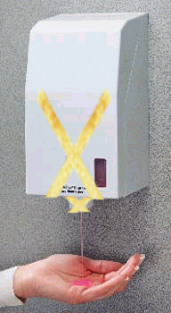
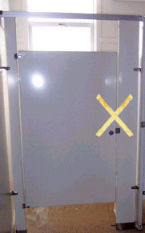
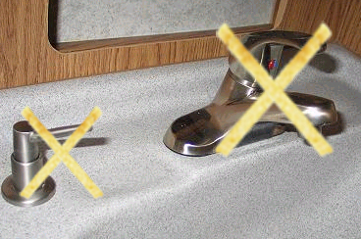

1. PREPARE COLLECTIONSITE:
Securing the Collection Site
Tape placed over water sources and dispensers or receptacles.
Notes:
Securing the Collection Site
Tape placed over water sources and dispensers or receptacles.

Slide 59
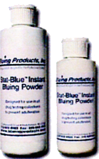
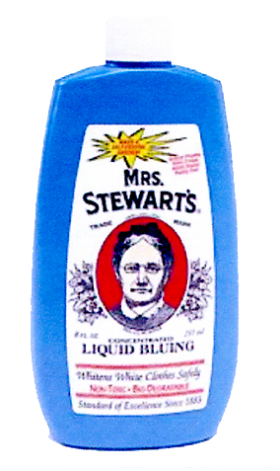

Securing the Collection Site
Bluing agent placed in toilets
Notes:
Bluing agent placed in toilets

Slide 60
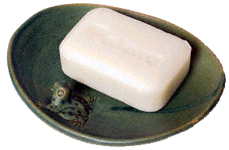


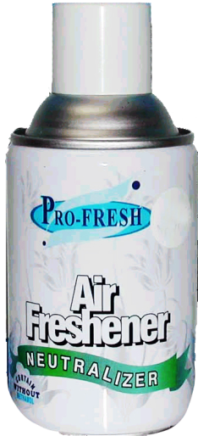
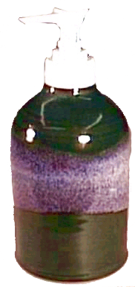
Securing the Collection Site
Items removed which could be used to dilute, adulterate or hide a specimen
Notes:
Items removed which could be used to dilute, adulterate or hide a specimen

Slide 61
2. BEGIN WITHOUT DELAY
Do not wait
In most cases, employees who state they cannot provide a specimen will, in fact, provide sufficient quantity to complete the testing process.
Note: If an alcohol breath test is also scheduled, the alcohol test should be conducted first, if practicable, though the rule (§40.61(b)(1)) example suggests some situations where there can be an exception to this normal process.
Notes:
Do not wait because the employee is not ready or states he or she is unable to urinate.
In most cases, employees who state they cannot provide a specimen will, in fact, provide sufficient quantity to complete the testing process.
Note: If an alcohol breath test is also scheduled, the alcohol test should be conducted first, if practicable, though the rule (§40.61(b)(1)) example suggests some situations where there can be an exception to this normal process.

Slide 62
Steps for Urine Split Specimen Collection
1. Collector positively ID’s donor
2. Collector explains the collection process- reviews back of CCF ( can be reinforced by displaying using DOT 10 steps poster)
3. Collector examines Custody and Control Form (CCF)
      Ensure correct form used
      Check laboratory information
      Id numbers checked
Collector completes administrative part of CCF
      Employer name, address, fax #, phone #
      MRO name, address, fax#, phone#
      Collection site name, address of collection location, fax#, phone#
      DOT or HHS test is done for (old CCF write under remarks)
      Donor SSN or ID number
      Reason for test
      Test to perform
      DER name and phone #
Notes:
Steps for Urine Split Specimen Collection (have the attendees follow along with the proficiency forms)
Collector begins the collection without delay
Collector positively ID’s donor
Collector explains the collection process- reviews back of CCF ( can be reinforced by displaying using DOT 10 steps poster)
Collector examines Custody and Control Form (CCF)
Ensure correct form used
Check laboratory information
Id numbers checked
Collector completes administrative part of CCF
Employer name, address, fax #, phone #
MRO name, address, fax#, phone#
Collection site name, address of collection location, fax#, phone#
DOT or HHS test is done for (old CCF write under remarks)
Donor SSN or ID number
Reason for test
Test to perform
DER name and phone #

Slide 63

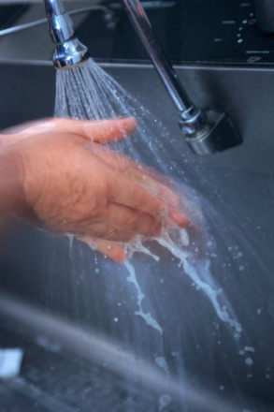
Employee Briefing
Collection Process
Collector is the first person to look out for adulterants & substitutions, therefore:
4. Donor removes any unnecessary outer clothing
5. Donor- Empty pockets and display contents
  Allow employee to keep wallet, footwear.
  Secures briefcase, purses or personal belongings,
6. Donor- Washes hands
“Refusal to test”-
not co-operating
Notes:
Employee Briefing
Collection Process
Collector is the first person to look out for adulterants & substitutions, therefore:
6. Donor removes any unnecessary outer clothing
7. Donor- Empty pockets and display contents
Allow employee to keep wallet, footwear.
Secures briefcase, purses or personal belongings,
8. Donor- Washes hands
Refusal to test”-
not co-operating

Slide 64

Steps in the Collection Process
7. Collection container is selected
8. Donor takes collection container to toilet area
9. Collector instructs the donor:
      Do not flush the toilet
      Fill cup to at least 45 mls
      Collector may set a reasonable time for voiding
      Come out as quickly as possible as temperature has to be read within 4 minutes- if out of temp range the next collection will need to be observed.
    Provides specimen in private-
Notes:
Collection container is selected
10. Donor takes collection container to toilet area, provides specimen in private- collector instructs the donor:
Do not flush the toilet
Fill cup to at least 45 mls
Collector may set a reasonable time for voiding
Come out as quickly as possible as temperature has to be read within 4 minutes- if out of temp range the next collection will need to be observed.
11. Donor returns specimen to collector within 4 minutes of collection

Slide 65
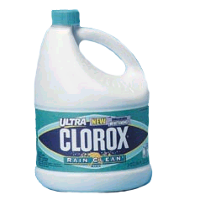

Urine Specimen Collection Procedures (Cont’d)
10.Donor returns specimen to collector
  Collector checks specimen temperature -4 minutes (90-100 degrees F) inspects collection area
  Check specimen for adequacy (at least 45 ml)
  Inspect specimen for signs of tampering or adulteration
    Appearance (foam, bubbles, etc)
Collector Complete step 2 of the CCF
Notes:
12. Collector checks specimen temperature and inspects collection area
Check specimen temperature within 4 minutes.
Temperature (90-100 degrees)
Inspect specimen for signs of tampering or adulteration
Appearance (foam, bubbles, etc)
Check specimen for adequacy (at least 45 ml)
Volume (minimum 45 mls)
13. Collector Complete step 2 of the CCF

Slide 66
§40.193 What happens when an employee does not provide a sufficient amount of urine for a drug test?
* * * * *
(b) * * *
(4) If the employee has not provided a sufficient specimen within three hours of the first unsuccessful attempt to provide the specimen, you must discontinue the collection, note the fact on the “Remarks” line of the CCF (Step 2), and immediately notify the DER. You must also discard any specimen the employee previously provided to include any specimen that is “out of temperature range” or shows signs of tampering. In the remarks section of the CCF that you will distribute to the MRO and DER, note the fact that the employee provided an “out of temperature range specimen” or “specimen that shows signs of tampering” and that it was discarded because the employee did not provide a second sufficient specimen.

Slide 67
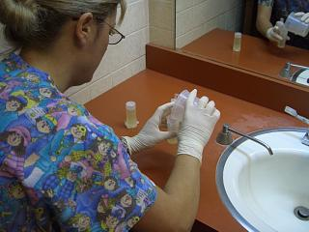
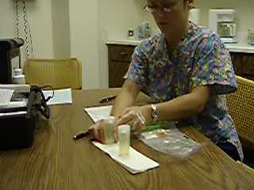
Urine Specimen Collection Procedures (Cont’d)
The collector continues to monitor the integrity of the specimen - MAINTAIN VISUAL CONTACT OF SPECIMEN
10. Collector transfers specimen to bottles for a split sample into two bottles (primary Bottle A- 30 ml and split – minimum of 15 ml in Bottle B). Do NOT top off
11.Collector affix seals, labels, and dates the bottles in full view of the employee-
12. Employee initials labels (after labels are applied to bottles)
Notes:
The collector continues to monitor the integrity of the specimen
14. Collector transfers specimen to bottles for a split sample into two bottles (primary Bottle A- 30 ml and split – minimum of 15 ml in Bottle B). Do NOT top off
15. Collector affix seals, labels, and dates the bottles in full view of the employee-
16. Employee initials labels (after labels are applied to bottles)

Slide 68
Tamper-evident label/seal problems:
corrective procedures:
(a) Broken while being removed from the chain of custody form or during the application of the first seal on the primary bottle, the collector should transfer the information to a new CCF and use the seals from the second form.
(b) If one seal is already in place on a bottle and the second seal is broken
initiate a new CCF
comment on the “Remarks”
placed perpendicular to the original seals
the original seals and must be initialed by the employee (both sets of employee initials should match).
draw a line through the Specimen ID number and bar code (if present
NEVER pour the specimen into new bottles.
(c) original (first) CCF are destroyed or disposed of properly (e.g., shredded, torn into pieces).
(d) If inadvertently reverses the seals - Laboratories have procedures that permit them to “re-designate” the bottles
NOTE in the “Remarks”
- .
Note: There is no corrective procedure available if the seal is broken after the employee leaves the collection site.
13. Note: Since the specimen bottle is now sealed with tamper-evident tape and does not have to be under the employee's direct observation, the employee is allowed to wash his or her hands if he or she desires to do so
Notes:
Occasionally, the tamper-evident label/seal provided with the CCF will not properly adhere to the specimen bottle because of environmental conditions (e.g., moisture, temperature, specimen bottle material) or may be damaged or broken during the collection process
Note:. When this occurs, the collector should use the following corrective procedures:
(a) If the seal is broken while being removed from the chain of custody form or during the application of the first seal on the primary bottle, the collector should transfer the information to a new CCF and use the seals from the second form.
(b) If one seal is already in place on a bottle and the second seal is broken while being removed from the CCF or is broken during application on the second bottle or while the employee is initialing either seal, the collector should initiate a new CCF and provide an appropriate comment on the “Remarks” line in Step 5. The seals from the second CCF should be placed perpendicular to the original seals to avoid obscuring information on the original seals and must be initialed by the employee (both sets of employee initials should match). The collector should draw a line through the Specimen ID number and bar code (if present) on the original seals to ensure that the DOT Urine Specimen Collection Guidelines 18 Office of Drug and Alcohol Policy and Compliance Revised – January 2018 laboratory does not use that number for reporting the results. The collector should not pour the specimen into new bottles.
(c) In both cases, the collector should ensure that all copies of the original (first) CCF are destroyed or disposed of properly (e.g., shredded, torn into pieces).
(d) If the collector inadvertently reverses the seals (i.e., places the “A” bottle seal on the split bottle and vise-versa) and the collector subsequently notices this, the collector should note this in the “Remarks” line and continue the collection process. Laboratories have procedures that permit them to “re-designate” the bottles.
Note: There is no corrective procedure available if the seal is broken after the employee leaves the collection site.
Note: Since the specimen bottle is now sealed with tamper-evident tape and does not have to be under the employee's direct observation, the employee is allowed to wash his or her hands if he or she desires to do so

Slide 69
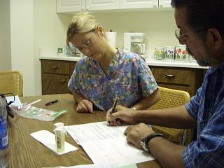
Urine Specimen Collection Procedures (Cont’d)
14. Employee reads, signs, and provides requested information on step 5 copy 2 MRO copy
  (Refusal to sign – specimen is sent to the lab- Collector AT THE MIMINUM prints donors name and writes under “remark”- refused to sign. THIS IS NOT A REFUSAL TO TEST)
15 Complete Step 4 on the CCF (Copy 1)
  Print name
  Date
  Time of the collection (when handed specimen),
  Sign
  Enter courier
Notes:
Employee reads, signs, and provides requested information on step 5 copy 2 MRO copy of CCF. (Refusal to sign is not a refusal to test – and specimen is sent to the lab- Collector prints donors name and writes under “remark”- refused to sign.)

Slide 70
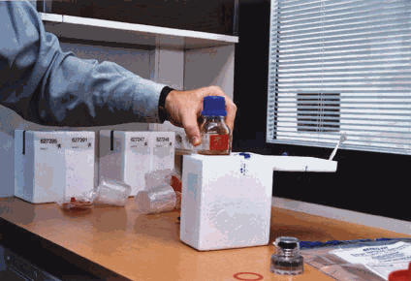
Collection Process Steps, Cont’d
16.Collector ensures all copies are legible and complete
17.Collector gives donor copy of CCF and informs donor about listing medications
18.Specimen bottles and lab copy (1) of CCF placed in bag to be shipped
19. Discard excess urine ( this could have been done when specimens are put into bottles)
There is one exception to this requirement:
    clinical tests (e.g., protein, glucose) physical examination required by a DOT agency regulation. .
20. Place specimen in bags in shipping container, place in secure area
(donor may leave now)
Notes:
Collector ensures all copies are legible and complete
19. Collector gives donor copy of CCF and informs donor about listing medications
20. Specimen bottles and lab copy (1) of CCF placed in bag to be shipped
21. Discard excess urine-( this could have been done when specimens are put into bottles)
22. Place specimen in bags in shipping container, place in secure area
(donor may leave now)

Slide 71
23. Distribution of Copies
Copy
Copy 1 Placed in pouch and sent to laboratory w/specimens- within 24 hours or next business day
Copy
Copy 2 Faxed or the scanned image is sent securely to the MRO within 24 hours or next business day
Copy
Copy 3 Collector Copy- keep 30 days for DOT / 2 years for HHS
Copy
Copy 4 Employer Copy sent (Within 24 hours or next business day
Copy
Copy 5 Given to Donor (Note: Donor may list any medications they are taking)
Notes:
23. Distribution of Copies
Copy 1 Placed in pouch and sent to laboratory w/specimens- within 24 hours or next business day
Copy 2 Faxed/given to MRO within 24 hours or next business day
Copy 3 Collector Copy- keep 30 days for DOT / 2 years for HHS
Copy 4 Employer Copy sent (Within 24 hours or next business day
Copy 5 Given to Donor (Note: Donor may list any medications they are taking)

Slide 72
Uneventful mock

Slide 73
Normal collection
ID
Instructions reviews
Complete Step one
Remove outer garments
Empty pockets
Wash hands
Pick collection cup
Instruct donor
Amount 45 ml
2 minutes
Don’t flush
Specimen to collector / check:
Temperature
For adulteration
Volume
Complete Step 2 & 3 CCF
Collector unwraps specimen bottles
Collector transfers specimen, affixes specimen bottle seals, dates each seal.
Donor initials
Complete step 5 on copy 2
Complete step 4 on copy 1
Package specimen in bag
Inform donor that he/she is free to go.
Places the sealed package into a shipping container.
Distribute the copies

Slide 74
Special Circumstances
Shy Bladder: Donor provides specimen less than required 45 mls. 3 hour time limit and only 40 ounces of liquid.
Observed Collection: attempt to tamper; temperature out of range; invalid test. Return-to-duty and follow-up testing will be mandatory observed collections effective November 1, 2008.
Monitored Collection: Facility cannot be completely secured.
Notes:
Special Circumstances
Observed Collection: attempt to tamper; temperature out of range; invalid test. Return-to-duty and follow-up testing will be mandatory observed collections effective November 1, 2008.
Monitored Collection: Facility cannot be completely secured.
Shy Bladder: Donor provides specimen less than required 45 mls. 3 hour time limit and only 40 ounces of liquid.

Slide 75
SHY BLADDER COLLECTION- / Insufficient quantity
Subpart I 40.193 (b)
Upon arrival
  cannot provide a specimen, the collector
  must still begin the collection procedure regardless of the reason given.
Tell the employee that most individuals can provide 45 mL of urine, even when they think they cannot urinate, and
Direct the employee to make the attempt to provide the specimen.
Notes:
SHY BLADDER COLLECTION- / Insufficient quantity -- Subpart I 40.193 (b
3 Hours
Supervision required
Liquids
No specimen requires medical evaluation
No attempt (Refusal)

Slide 76
Shy Bladder Procedure:
1. Request the employee to go into the rest room and try to provide a specimen.
Note: The employee demonstrates his or her inability to provide a valid specimen when the employee comes out of the rest room with an insufficient quantity of specimen or an empty collection container.
2. If the employee provided an initial insufficient specimen, the collector discards the insufficient specimen.
      Under “Remarks” line records the time “shy bladder” collection process starts.
      Use the same CCF and continues to document subsequent collections on the same form.
Note: If the insufficient specimen is also out of temperature range (assuming there was sufficient specimen to activate the temperature strip) or shows evidence of adulteration or tampering, the collector completes the collection process, does not discard the specimen, but instead sends the insufficient specimen (temperature out of range or adulterated) to the laboratory and immediately initiates another collection under direct observation. (See information – if < 45 mls occurs at end of 3 hrs)

Slide 77
3. Explain process for a shy bladder collection
Urges the employee to drink up to 40 ounces of fluids,
  Distributed reasonably through a period of up to three hours, or until the individual has provided a sufficient urine specimen, whichever occurs first.
  Not a refusal to test if declines to drink.
Note: Collectors should be sensitive to how frequently they should ask the employee to provide a specimen. For example, asking the employee to provide a specimen every half hour may not produce sufficient specimen, although in total, the amount would have been at least 45 mL. In this case, the collector needs to determine if a longer time is needed for the employee to consume fluids and produce a sufficient volume of specimen.
  Refused to drink fluids, is not considered a refusal to test
    although the collector should explain to the employee that not drinking sufficient fluids may result in the employee’s inability to provide a sufficient specimen and would require a medical evaluation.
NEVER “combine” urine collected
Notes:
3. Explain to the employee the process for a shy bladder collection and urges the employee to drink up to 40 ounces of fluids,
Distributed reasonably through a period of up to three hours, or until the individual has provided a sufficient urine specimen, whichever occurs first.
It is not a refusal to test if the employee declines to drink.
Note: Collectors should be sensitive to how frequently they should ask the employee to provide a specimen. For example, asking the employee to provide a specimen every half hour may not produce sufficient specimen, although in total, the amount would have been at least 45 mL. In this case, the collector needs to determine if a longer time is needed for the employee to consume fluids and produce a sufficient volume of specimen.
If the employee refuses to drink fluids, this is not considered a refusal to test, although the collector should explain to the employee that not drinking sufficient fluids may result in the employee’s inability to provide a sufficient specimen and would require a medical evaluation.
Under no circumstances can a collector “combine” urine collected from separate voids to create one specimen of sufficient volume.

Slide 78
4. If the employee refuses
  to make the attempt to provide a new urine specimen or
  leaves the collection site before the collection process is completed,
must discontinue the collection,
note the fact on the “Remarks” line of the CCF (Step 2),
immediately notify the DER.
This is a refusal to test.
Note: As with other collections situations, there is no requirement for the collector to inform the employee in a shy bladder situation that failure to remain at the collection site or otherwise fails to cooperate with the testing process constitutes a refusal. It is a best practice for the collector to inform the employee that such behavior could lead an employer to determine that a refusal occurred.

Slide 79
5. Not provided a sufficient specimen within three hours of the first unsuccessful attempt to provide the specimen
  discontinue the collection,
  note the fact on the “Remarks” line of the CCF (Step 2) and
  immediately notify the DER.
6. Discard any specimen the employee provided (to include any specimen that is “out of temperature range” or “shows signs of tampering”).
“out of temperature range specimen” or “specimen that shows signs of tampering”, note in the “Remarks” section that it was “discarded because the employee did not provide a second sufficient specimen”.
Note: The collector should maintain a record in the “Remarks” line on the CCF of the time of each attempt, whether there was any specimen provided or the quantity of specimen provided, and the amount of fluids that the employee was given to drink.
During the waiting period - must monitored to ensure the continued integrity of the test.
While, as noted above, there is no requirement for the collector to do so, it is a good practice for the collector to inform the employee that he or she is not permitted to leave the collection site and that doing so could lead an employer to determine that a refusal occurred

Slide 80
7. Send within 24 hours or the next business day :
  Copy 2 of the CCF to the MRO
  Copy 4 to the DER.
This is done even if the employee did not provide any specimen in order to notify the MRO and the DOT Urine Specimen Collection Guidelines 22 Office of Drug and Alcohol Policy and Compliance Revised – January 2018 employer of the problem.

Slide 81
Insufficient mock

Slide 82
Shy Bladder collection
ID
Instructions reviews
Complete Step one
Remove outer garments
Empty pockets
Wash hands
Pick collection cup
Instruct donor
Amount 45 ml
2 minutes
Don’t flush
Specimen to collector / check:
Temperature
For adulteration
Volume
Less than 45 ml collected-
Complete Step 2- NO SAMPLE – mark NONE PROVIDED
Step 3 CCF – go directly to step 5
Print donor name on step 5 on copy 2-
Complete step 4 on copy 1
Immediately notifies the designated employer representative (DER)
Distribute the copies
Instruct donor they can have 40 oz of liquid and they have 3 hours to produce sample
RECORD UNDER THE REMARKS SECTION: RECORD TIME, AMOUNTS OF FLUID,
AND ATTEMPS.

Slide 83


Directly Observation Collections
When direct observation collections are allowed/required
Appropriate procedures for direct observation collections
Who can act as an observer for a direct observation collection?
Handling and documentation of original specimen
Ask Donor there sex to determine who to have as a observer, document under remarks (under DOT- HHS look at ID)
Notes:
Direct Observation Collections
When direct observation collections are allowed/required
Appropriate procedures for direct observation collections
Who can act as an observer for a direct observation collection?
=
Handling and documentation of original specimen

Slide 84
DIRECT OBSERVATION MANDATORY
Observer directly watches the urine go from the employee’s body into the collection container.
Observer must be the same gender--- no exceptions
Note: See “DOT’s Direct Observation Procedures” at Appendix D. An observed collection is required when:
The employer/DER directs the collector (or collection site) to conduct a collection under direct observation.
  1. The laboratory reports an invalid specimen and the MRO reports that there was not an adequate medical explanation for the result.
  2. Because the split specimen test could not be performed (e.g., split lost, inadequate volume).
  3. The MRO reports a negative-dilute result with a creatinine concentration greater than or equal to 2 mg/dL but less than or equal to 5 mg/dL.
  4. The test is a return-to-duty or follow-up test.
Note: An employee may not “volunteer” to have his or her specimen collected under direct observation
Notes:
Direct Observation
Employer /DER requires direct observation:
Lab reports invalid test and MRO states no medical reason
Split test could not be preformed
MRO reports negative-dilute with creatinine >2 mg/dl or < = 5mg/dl
The test is a RETURN TO DUTY test
Collector:
Observe action indicating attempt to tampered
Temperature out of range
Specimen appears to have been tampered with

Slide 85
  Collector goes to Direct Observation when:
  1. Materials brought to the collection site - Attempt to tamper
  2. The temperature on the original specimen was out of range
  3. The specimen appeared to have been tampered with.
  Note: The collector may serve as the observer when the collector is the same gender as the employee. If not, the collector must call upon another individual (who is the same gender as the employee) to act as the observer.
Must verbally instruct the observer
inform the observer not to take the specimen from the employee
have the employee bring it to the collector.
It is recommended that the collector have a short written outline of the direct observation procedures to provide to and review with the observer.

Slide 86
An observed collection procedure:
1. Explain procedure
2. Complete a new CCF with the same information
3. Checks the “Observed, (Enter Remark)”
4. Reason in the “Remarks” line (Step 2) and the
5. Name of the observer if it is someone other than the collector.
In a case where two sets of specimens – tampered or temp out of range
Enters on the “Remarks” line
for each specimen a notation :
1 of 2 CCF # 2= ___________
2 of 2 CCF #1= ____________
Cross reference CCF #
Notes:
An observed collection is conducted in the following manner:
1. The collector must explain to the employee why a directly observed collection is being conducted. If the directly observed collection is requested by the employer, the collector may state the reason (if known) or may only state that the employer requested a directly observed collection.
2. The collector must complete a new CCF for the directly observed collection and mark the “reason for test” block (Step 1) the same as for the first collection (unless it is a return-to-duty or follow-up test).
3. The collector then checks the “Observed, (Enter Remark)” box and enters the reason in the “Remarks” line (Step 2) and the name of the observer if it is someone other than the collector.
4. In a case where two sets of specimens are being sent to the laboratory because of suspected tampering with the first specimen, the collector enters on the “Remarks” line of the CCF (Step 2) for each specimen a notation to this effect (e.g., collection 1 of 2, or 2 of 2) and the CCF specimen ID number of the other specimen.

Slide 87
6. Same gender observer
  request the employee to raise his or her shirt, blouse, or dress/skirt, as appropriate, above the waist or navel, and lower clothing and underpants sufficient to show the observer – by turning around – that the employee does not have a prosthetic device.
  If no device found, the observer may permit the employee to return clothing to its proper position
  Conduct the observed collection. WATCH URINE LEAVE BODY AND GO INTO THE COLLECTION CONTAINER.
Note: There are three basic types of devices employees could “wear.” [Of course, there could be other devices, here are examples of some devices]:
  1. One device has a long plastic tube connected to a bottle containing heated urine.
  2. Another device consists of a short plastic tube attached to a battery heated plastic bag.
  3. One device goes a step further by replacing the tube with very realistic prosthetic genitalia designed to match the employee’s skin tone.
Notes:
The collector, if the same gender as the employee, or the same gender observer enters the restroom or facility where urination occurs with the employee. The observer must request the employee to raise his or her shirt, blouse, or dress/skirt, as appropriate, above the waist or navel, and lower clothing and underpants sufficient to show the observer – by turning around – that the employee does not have a prosthetic device. After the observer has determined that the employee does not have such a device, the observer may permit the employee to return clothing to its proper position and then conduct the observed collection.
Note: There are three basic types of devices employees could “wear.” [Of course, there could be other devices, here are examples of some devices]:
1. One device has a long plastic tube connected to a bottle containing heated urine.
2. Another device consists of a short plastic tube attached to a battery heated plastic bag.
3. One device goes a step further by replacing the tube with very realistic prosthetic genitalia designed to match the employee’s skin tone.

Slide 88
6. Watch urine leave donor and go into collection cup.(use of mirrors or video cameras is not permitted).
Note: If it is a multi-stall restroom, the observer must enter the stall with the employee.
Stop collection if donor:
1. Declines directly observed collection
2. Fails to follow the observer’s instructions
3. Possesses or wears a prosthetic or other device
Notify the DER as soon as possible.
Notes:
6. The observer must watch the employee urinate into the collection container. Specifically, the observer must personally and directly watch the urine go from the employee’s body into the collection container (use of mirrors or video cameras is not permitted).
Note: If it is a multi-stall restroom, the observer must enter the stall with the employee. Note: With respect to direct observation collections, the following situations are considered refusals to test: DOT Urine Specimen Collection Guidelines 24 Office of Drug and Alcohol Policy and Compliance Revised – January 2018
• The employee declines to allow a directly observed collection required or permitted by Part 40 to occur.
• The employee fails to follow the observer’s instructions to raise and lower their clothing and to turn around to permit the observer to determine if the employee has a prosthetic or other device that could be used to interfere with the collection process.
• The employee possesses or wears a prosthetic or other device that could be used to interfere with the collection process. In either of these situations, the collector discards any specimen the employee provided previously and notifies the DER as soon as possible.

Slide 89
7. Donor hands the collection container directly to the collector.
If the collector learns that a directly observed collection should have taken place, but was not, the collector must inform the employer that the employee must be directed to return for an immediate recollection under direct observation.

Slide 90


Slide 91
“Beat the Test”
What People do to beat a test??????
$150.00 ea Whizzinator
“Best Thing Out There, Don't Be Fooled By Those Drinks This Works Every Time.” -The Eggfella, CA
“I have literally spent thousands of dollars on cleansers and 24 hr. formula's. NOTHING worked until whizzanator. Thanks for the freedom.” -Greg, CA
"You guys did a great job! It works super!"
-Naien A., Herndon, VA

Slide 92

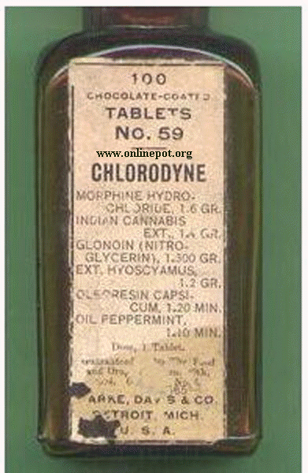

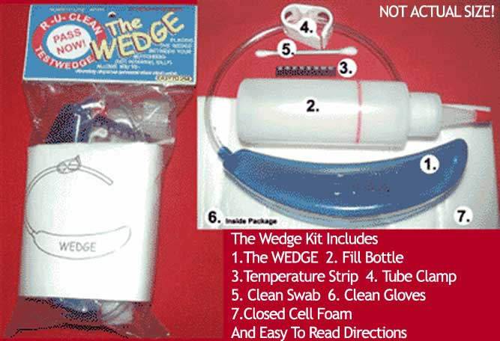
“Beat the Test”

Slide 93

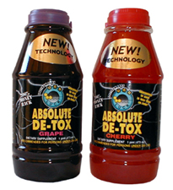
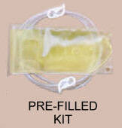

“Beat the Test”
Money Back Guarantee!!!

Slide 94
HHS Direct Observation- differences
Collector must first contact a supervisor to concur with a decision to perform a Directly Observed collection
Observer has to be Trained in Direct Observed specific collections
Observer watches urine leave the donor’s body and into container- no lifting up or lowering of clothes for proof of prosthetic devices.
No requirement for HHS regarding return to duty and follow up testing
Notes:
HHS Direct Observation- differences
Collector must first contact a supervisor to concur with a decision to perform a Directly Observed collection
Observer has to be Trained in Direct Observed specific collections
Observer watches urine leave the donor’s body and into container- no lifting up or lowering of clothes for proof of prosthetic devices.
No requirement for HHS regarding return to duty and follow up testing

Slide 95
Temperature out of control mock

Slide 96
Temperature out of range
ID
Instructions reviews
Complete Step one
Remove outer garments
Empty pockets
Wash hands
Pick collection cup
Instruct donor
Amount 45 ml
2 minutes
Don’t flush
Specimen to collector / check:
Temperature
For adulteration
Volume
Complete Step 2 MARK “NO UNDER TEMPERATURE- MAKE REMARKS- 1 OF 2 #2 SPECIMEN ID =
& COMPLETE - 3 CCF
Collector unwraps specimen bottles
Collector transfers specimen, affixes specimen bottle seals, dates each seal.
Donor initials
Complete step 5 on copy 2
Complete step 4 on copy 1
Package specimen in bag
They must wait for the next collection- cannot leave yet
Places the sealed package into a shipping container.
START THE 2ND COLLECTION- DIRECT OBSERVATION. COMPLETE NEW CCF-

Slide 97
Donor REFUSES initials both specimen bottle seals,
After confirming that specimen ID numbers on CCF and seals match. Collector notes under remarks “donor refused to initial specimen bottles”.
Collector turns to MRO copy of CCF and instructs the donor to complete step 5 to read the certification statement and sign Donor Refused to sign and provide his/her daytime phone number, evening phone number, date of birth, today's date and prints and signs his/her name.
Collector writes under Remarks
“DONOR REFUSED TO SIGN ON STEP 5”
Collector PRINTS donors’ name.

Slide 98
Temperature out of range- 2^{nd collection:} direct observed
Pick new collection cup
Instruct donor
Up, down, turn around
Observer watches urine leave body and go into collection cup
Hand specimen to collector
Complete new CCF
Same information
Under remarks
2 of 2 #1 Specimen ID =
3. Mark direct observation
Complete step 5 on copy 2
Complete step 4 on copy 1
Package specimen in bag
Inform donor that he/she is free to go.
Places the sealed package into a shipping container.
Distribute the copies
Immediately notifies the designated employer representative (DER)
Specimen to collector / check:
Temperature
For adulteration
Volume
Complete step 2
COMPLETE - 3 CCF
Collector unwraps specimen bottles
Collector transfers specimen, affixes specimen bottle seals, dates each seal.
Donor initials

Slide 99
Question reviews
        ???
answer

Slide 100
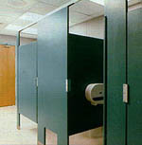
Monitored Collections
40.69
When monitored collections are performed
Gender requirements of monitor
Correct procedures to follow
Notes:
Monitored Collections
When monitored collections are performed
Gender requirements of monitor
Correct procedures to follow

Slide 101
A monitored collection procedure:
Secure room
2. Monitor must be the same gender
  *unless the monitor is a medical professional (e.g., nurse, doctor, physician’s assistant, technologist or technician licensed or certified to practice in the jurisdiction in which the collection takes place).
The monitor can be a different person from the collector and need not be a qualified collector for DOT.
Notes:
A monitored collection is one that is conducted under less than completely private conditions, utilizing a multi-stall restroom. If there is no practicable work place outside of the restroom, the collector may set up an area within the multi-stall restroom to be used as a work area and for finalizing the required paper work. (A collection which is not monitored may also be conducted in a multi-stall restroom, provided that the collector secures all of the stalls (bluing agent, etc.), secures all water sources and other potential sources of adulterants (soap dispensers) in the restroom, and posts signs or otherwise secures the restroom from entry by unauthorized personnel.)
A monitored collection is conducted in the following manner:
1. The collector must secure the room being used for the monitored collection so that no one except the employee and the monitor can enter it until after the collection has been completed.
2. The monitor must be the same gender as the employee, unless the monitor is a medical professional (e.g., nurse, doctor, physician’s assistant, technologist or technician licensed or certified to practice in the jurisdiction in which the collection takes place).
The monitor can be a different person from the collector and need not be a qualified collector.

Slide 102
3. Verbally instructs donor and monitor
  A monitor stands outside the stall and does not watch the employee urinate.
  If the monitor hears sounds or makes other observations indicating an attempt to tamper with a specimen by the employee, there must be an additional collection conducted under direct observation.
  (b) A monitor must ensure that the employee takes the collection container directly to the collector as soon as the employee has exited the enclosure.
4. When someone besides the collector has acted as the monitor, the collector must note that person’s name in the “Remarks” line of the CCF (Step 2).
5. If the employee declines to permit a collection authorized under Part 40 to be monitored, it is a refusal to test.
Notes:
. If someone other than the collector is to monitor the collection procedure (i.e., the collector is not a medical professional), the collector must verbally instruct that person to use the following procedures (if the collector is the monitor, the collector must also follow these procedures):
(a) A monitor stands outside the stall and does not watch the employee urinate. If the monitor hears sounds or makes other observations indicating an attempt to tamper with a specimen by the employee, there must be an additional collection conducted under direct observation.
(b) A monitor must ensure that the employee takes the collection container directly to the collector as soon as the employee has exited the enclosure.
4. When someone besides the collector has acted as the monitor, the collector must note that person’s name in the “Remarks” line of the CCF (Step 2).
5. If the employee declines to permit a collection authorized under Part 40 to be monitored, it is a refusal to test.

Slide 103
. PROBLEM COLLECTIONS
CATHETERIZATION
EXTERNAL URINE BAG
TEMPERATURE.
SPECIMEN VOLUME
ADULTERATION OR SUBSTITUTION

Slide 104
Refusal to Test
Fail to --
  Appear
  Remain at site
  Provide urine specimen when required
  Permit directly observed or monitored collection, fail to raise shirt, blouse, or dress/skirt above the waist and lowering clothing and underpants to show donor has no prosthetic device.
  Decline to take a 2d test as directed
  Provide sufficient urine (w/no med. explanation)
  Undergo medical evaluation- DER will know this not the collector
  Cooperate with testing process
  Donor found with prosthetic or other device
  Donor admits to collector or MRO he/she attempted to adulterate or substitute the specimen
Notes:
Refusal to Test Remember the collection is only to write under the remarks sections what occurs- DO NOT say “refusal to test”- but give the example of what occurs- example did not stay to complete the second collection under observation or did not cooperate with procedure – would not wash hands.
Fail to --
Appear
Remain at site
Provide urine specimen when required
Permit directly observed or monitored collection, fail to raise shirt, blouse, or dress/skirt above the waist and lowering clothing and underpants to show donor has no prosthetic device.
Decline to take a 2d test as directed
Provide sufficient urine (w/no med. explanation)
Undergo medical evaluation- DER will know this not the collector
Cooperate with testing process
Donor found with prosthetic or other device
Donor admits to collector or MRO he/she attempted to adulterate or substitute the specimen

Slide 105
CORRECTING COLLECTION PROBLEMS
Any event that prevents the completion of a valid test or collection (e.g., a procedural or paperwork error),
Correct the problem promptly, if doing so is practicable.
May initiate another collection as part of this effort.
There is one exception: when the collector learns that a directly observed collection should have been conducted, but was not, the collector must notify the employer to direct the employee to return for an immediate recollection under direct observation.

Slide 106
If another collection is necessary, the collector must begin the new collection procedure as soon as possible
  new CCF
  new collection kit.
Note: If the collector becomes aware of a problem that can be corrected, but which has not already been corrected, the collector must take all practicable actions to correct the problem so that the test is not cancelled.
If the problem resulted from the omission of required information
  supply in writing the missing information and a statement that it is true and accurate.
Must supply this information on the same business day on which he or she is notified of the problem, transmitting it by fax or courier.
Notes:
If another collection is necessary, the collector must begin the new collection procedure as soon as possible, using a new CCF and a new collection kit.
Note: If the collector becomes aware of a problem that can be corrected, but which has not already been corrected, the collector must take all practicable actions to correct the problem so that the test is not cancelled.
3. If the problem resulted from the omission of required information, the collector must, as the person responsible for providing that information, supply in writing the missing information and a statement that it is true and accurate.
For example, suppose the collector forgot to make a notation on the “Remarks” line of the CCF that the employee did not sign the certification. The collector would, when the problem is called to his or her attention, supply a signed statement that the employee failed or refused to sign the certification and that the collector’s signed statement is true and accurate.
The collector must supply this information on the same business day on which he or she is notified of the problem, transmitting it by fax or courier.

Slide 107
If used
  non-Federal CCF
  expired Federal form
Provide a signed statement (e.g., a memorandum for record).
The memorandum must also list the steps the collector took to prevent future use of nonFederal or expired Federal CCFs for DOT tests.
This information must be supplied to the laboratory on the same business day
Must maintain a copy of the written and dated documentation of correction with the appropriate CCF.
Must also mark the CCF in such a way (e.g., stamp noting correction, written notation) that it would be obvious on the face of the CCF that the corrected (missing) information was supplied.
Notes:
4. If the problem is the use of a non-Federal CCF or an expired Federal form, the collector must provide a signed statement (e.g., a memorandum for record).
The documentation must state that the incorrect form contains all the information needed for a valid DOT drug test, and that the incorrect CCF was used inadvertently or as the only means of conducting a test, in circumstances beyond the collector’s control.
The memorandum must also list the steps the collector took to prevent future use of nonFederal or expired Federal CCFs for DOT tests.
This information must be supplied to the laboratory on the same business day that the collector is notified of the problem, and DOT Urine Specimen Collection Guidelines 29 Office of Drug and Alcohol Policy and Compliance Revised – January 2018 may be transmitted by fax or courier. The use of a non-Federal form does not, in and of itself, present a reason for the laboratory to reject the specimen for testing or for the MRO to cancel the test.
5. The collector must maintain a copy of the written and dated documentation of correction with the appropriate CCF. The collector must also mark the CCF in such a way (e.g., stamp noting correction, written notation) that it would be obvious on the face of the CCF that the corrected (missing) information was supplied.

Slide 108
Correctable Flaws
Which flaws can be corrected
Use of “Remarks” line of Custody and Control Form to note specific problems
Print and print small but legible
Use of Memorandum for Record to correct some errors and omissions
Requirements for documentation of corrections
Notes:
Which flaws can be corrected
Use of “Remarks” line of Custody and Control Form to note specific problems
Use of Memorandum for Record to correct some errors and omissions
Requirements for documentation of corrections

Slide 109
Fatal Flaws
(c) Lab inspects each specimen and CCF for the following “fatal flaws:”
(1) There is no CCF;
(2) In cases where a specimen has been collected, there is no specimen submitted with the CCF;
(3) There is no printed collector's name and no collector's signature;
(4) Two separate collections are performed using one CCF;
(5) The specimen ID numbers on the specimen bottle and the CCF do not match;
(6) The specimen bottle seal is broken or shows evidence of tampering, unless a split specimen can be redesignated (see paragraph (h) of this section);
(7) There is an insufficient amount of urine in the primary bottle for analysis, unless the specimens can be redesignated (see paragraph (h) of this section).
Notes:
Fatal Flaws
Specimen ID number on CCF does not match ID number on bottle’s seal
Insufficient quantity of urine and the specimens cannot be re-designated
The specimen bottle seal is missing, broken, or shows signs of tampering
No printed collector’s name and no collector’s signature on CCF

Slide 110
Time frames to remember:
40.71 40.73
Shipment of specimen to lab must be within 24 hours or the next business day
CCF MRO & DER copy- fax within 24 hours or the next business day
CCF Collector copy- keep for at least 30 days for DOT
HHS Collector copy- keep for 2 years
Notes:
Time frames to remember:40.71 40.73
Shipment of specimen to lab must be within 24 hours or the next business day
CCF MRO & DER copy- fax within 24 hours or the next business day
CCF Collector copy- keep for at least 30 days for DOT
HHS Collector copy- keep for 2 years

Slide 111
Responsibility for Error Correction Training
MRO or MRO Assistant must communicate the error to the DER or C/TPA
DER is not responsible for ensuring that error correction training happens
Notes:
Responsibility for Error Correction Training
MRO or MRO Assistant must communicate the error to the DER or C/TPA
DER is not responsible for ensuring that error correction training happens

Slide 112
Normal collection
ID
Instructions reviews
Complete Step one
Remove outer garments
Empty pockets
Wash hands
Pick collection cup
Instruct donor
Amount 45 ml
2 minutes
Don’t flush
Specimen to collector / check:
Temperature
For adulteration
Volume
Complete Step 2 & 3 CCF
Collector unwraps specimen bottles
Collector transfers specimen, affixes specimen bottle seals, dates each seal.
Donor initials
Complete step 5 on copy 2
Complete step 4 on copy 1
Package specimen in bag
Inform donor that he/she is free to go.
Places the sealed package into a shipping container.
Distribute the copies

Slide 113
Inspections
DOT –
(1) more effective monitoring by collection site parent companies and
(2) on site audits and inspections of collection sites by DOT agencies, including mock collections and more clandestine inspections provide oversight to determine collection site adherence to DOT’s requirements.
* Unlike HHS – inspect 5% or up to max of 50 collection sites each year/ investigate and report/ take appropriate action
Notes:
Record retention
DOT – copy 3- collector copy keep for 30 days
* Unlike HHS requirement of 2 years
Inspections
DOT –
(1) more effective monitoring by collection site parent companies and
(2) on site audits and inspections of collection sites by DOT agencies, including mock collections and more clandestine inspections provide oversight to determine collection site adherence to DOT’s requirements.
* Unlike HHS – inspect 5% or up to max of 50 collection sites each year/ investigate and report/ take appropriate action

Slide 114
Other types of testing NOT DOT approved:
Different states laws for on different types of collections:
              Hair
              Oral fluid
              Sweat
              On site testing
Notes:
Other types of testing NOT DOT approved:
Different states laws for on different types of collections:
Hair
Oral fluid
Sweat
On site testing

Slide 115
Alternative Specimen Testing
Basic principles of all collections:
  Some sort of CCF
  Collector must perform one collection at a time
  Specimen must be sealed in a tamperproof method
  Chain of custody from collection to testing to result must be maintained
Notes:
Alternative Specimen Testing
Basic principles of all collections:
Some sort of CCF
Collector must perform one collection at a time
Specimen must be sealed in a tamperproof method
Chain of custody from collection to testing to result must be maintained

Slide 116
Terminology
49 CFR Part 40
Adulterated Specimen ( abnormal presence)
Aliquot ( amount used for testing)
Cancelled or Invalid (problem with no correction)
Chain -of-Custody (procedure uses CCF)
Notes:
Terminology
49 CFR Part 40
Adulterated Specimen ( abnormal presence)
Aliquot ( amount used for testing)
Blind sample or blind performance test specimen (quality control)
Cancelled or Invalid (problem with no correction)
Chain -of-Custody (procedure uses CCF)

Slide 117
Collection Container, collection site, collector
Confirmatory test (2nd test to id & quantify presence of drug at certain cut off levels) confirmed by MRO
Designated Employer Representative (DER)
Dilute Specimen (low specific gravity /creatinine)
DHHS (Dept. of Health & Human Services),SAMHSA (Substance Abuse Mental Health Services Association, formerly NIDA
Notes:
Collection Container, collection site, collector
Confirmatory test (2nd test to id & quantify presence of drug at certain cut off levels) confirmed by MRO
Designated Employer Representative (DER)
Dilute Specimen (low specific gravity /creatinine)
DHHS (Dept. of Health & Human Services),SAMHSA (Substance Abuse Mental Health Services Association, formerly NIDA

Slide 118
DOT (Dept. of Transportation): USCG,FAA,FRA,FMCSA,FTA,RSPA
Error correction training (due to cancel test
Initial test & initial validity testing
ODAPC (Office of Drug & Alcohol Policy & Compliance)
Medical Review Officer (MRO)
Memorandum for Record (MFR)
Monitored Collection
Primary Specimen (1st tested)
Qualification training ( to qualify to do DOT)
Notes:
DOT (Dept. of Transportation): USCG,FAA,FRA,FMCSA,FTA,RSPA
Error correction training (due to cancel test
Initial test & initial validity testing
ODAPC (Office of Drug & Alcohol Policy & Compliance)
Medical Review Officer (MRO)
Memorandum for Record (MFR)
Monitored Collection
Primary Specimen (1st tested)
Qualification training ( to qualify to do DOT)

Slide 119
Refresher training- periodically collectors, BAT’s, STT’s training. 49CRF outlines
Rejected for testing: fatal flaw or unrecoverable error
Split specimen-
Substituted specimen
Tamper-evident label / seal
Temporary Storage
Verified test
CFR 49 Part 40 regulations
Notes:
Refresher training- periodically collectors, BAT’s, STT’s training. 49CRF outlines
Rejected for testing: fatal flaw or unrecoverable error
Split specimen-
Substituted specimen
Tamper-evident label / seal
Temporary Storage
Verified test
CFR 49 Part 40 regulations

Slide 120
Questions?
Submit evaluation form
Submit exam
Take Proficiency tests
GOOD LUCK AND THANKS FOR ATTENDING!
Notes:
Questions? Submit evaluation form
Submit exam
Take Proficiency tests
GOOD LUCK AND THANKS FOR ATTENDING!

