Slide 1
Proficiency Testing
Faisal Ibrahim, MBA, MT(ASCP)
International Program Manger
Clinical and Laboratory Standards Institute
Global Health Partnerships

Slide 2
Proficiency Testing
“A program in which multiple samples are periodically sent to members of a group of laboratories for analysis and/or identification; whereby each laboratory’s results are compared with those of other laboratories in the group and/or with an assigned value, and reported to the participating laboratories and others.” (CLSI)

Slide 3
Proficiency Testing Process
Central organization sends out challenge specimens for testing
Laboratories analyze specimens, return results to central organization
Results evaluated, laboratories sent scores, performance report
Laboratories take appropriate corrective actions and document

Slide 4
Proficiency Testing / External quality Assessment
Required by regulatory and accreditation bodies
Not available for all tests, because:
  Analytes unstable
  Insufficient volume or demand
  Hazards of transportation
  Not affordable
When PT is not available alternative assessment procedures need to be used.

Slide 5
Proficiency Testing
PT may detect problems/errors that were not detected by the internal QC system.
When level of analyte in PT materials can be traced to a reference method, a laboratory is better able to determine the accuracy of its analysis.
Participation in a PT program enables a laboratory to compare its performance against other laboratories using similar methods/reagents/instruments.

Slide 6
Limitations of QC
QC is not perfectly sensitive or specific; it does not detect all instances of special cause variation, and it sometimes inappropriately flags variation inherent in the testing process (i.e. false rejection).
QC does not necessarily assess test trueness (closeness of agreement between the average value obtained from a large series of test results and an accepted reference value )
QC does not assess comparability of results with other laboratories.

Slide 7
Scheduling and grading of PT, cont
For cytology, each individual who examines gynecologic preparation must be tested once per year (ten slides per test) and obtain a passing score of 90%
ABO/RH and compatibility 100%

Slide 8
Handling PT Samples
Treat in the same way as patient samples
Rotate staff responsible for testing
Only test to the extent possible in your laboratory
Follow instructions provided
Submit results before required deadline
Check for transcription errors before submittingx

Slide 9
Handling PT Results
Laboratory Director has responsibility and needs to see results and sign.
All staff involved in testing need to see results
Store records for future reference
Investigate and troubleshoot any unacceptable results

Slide 10
Investigating Unacceptable Results
Systematically investigate all aspects of the testing process
Include an assessment of impact of the problem on patient results
Investigate root cause of problem, implement corrective action and follow up to ensure corrective action was effective.

Slide 11
Ask Questions
  Was the testing material received in satisfactory condition?
  Was the appropriate sample tested?
  Were procedures for sample preparation followed?
  Was the appropriate method used for analysis?
  Was the method performed according to documented procedures?
  Were appropriate reagents and controls used?
  Was equipment operated according to documented procedures?
  Was equipment appropriately maintained?
  Was QC acceptable at the time of testing PT samples?
  Were results interpreted appropriately?
  Has this problem occurred previously with PT samples?
  Did repeat testing on the properly stored residual sample produce similar results?
  Were patient results acceptable at the time of PT testing?

Slide 12
Classifying the Problem
Classes of possible causes of unacceptable results may include the following:
clerical error;
methodologic problem;
equipment problem;
technical problem;
problem with proficiency testing materials;
problem with evaluation of results; and
no explanation after investigation.

Slide 13
Possible Clerical Errors
Result was not correctly transcribed from the instrument tape or read-out to the report form (e.g., results for samples copied in reverse order or one line off all the way down)
The PT sample was mislabeled;
An incorrect instrument or method was reported on the form
Incorrect units were reported
A decimal point was misplaced
An incorrect reporting code was selected on the report form.

Slide 14
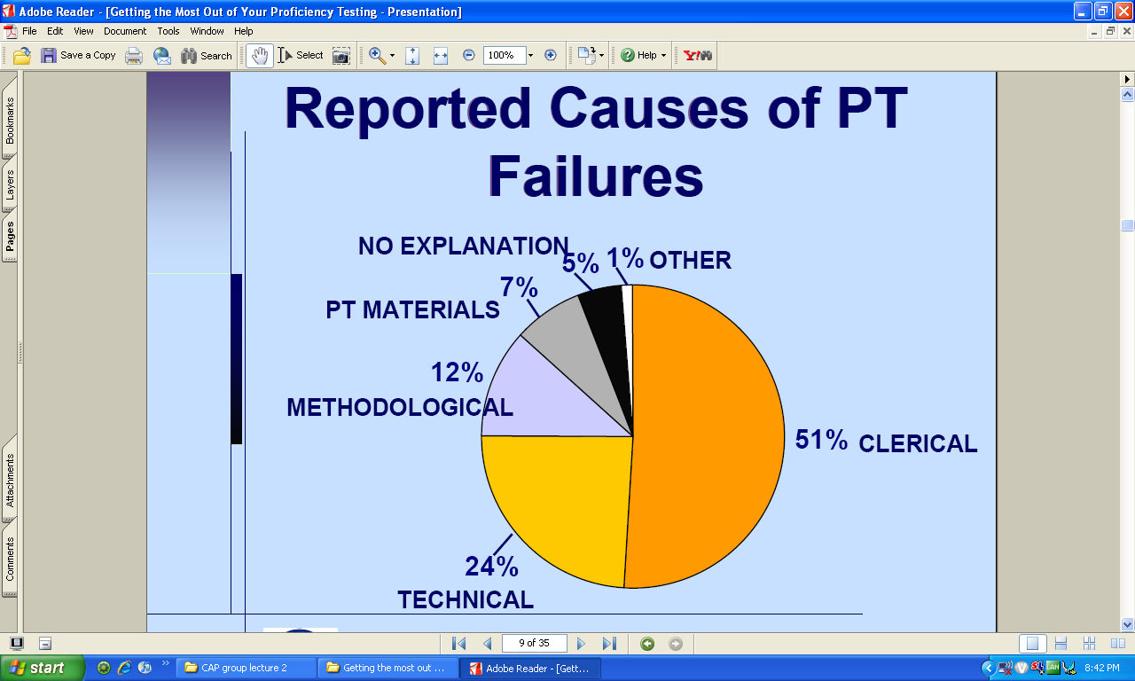

Slide 15
Methodologic Problems
No written procedure or poorly written procedure for staff to follow;
Procedure not in accordance with current standard of practice
Problem in manufacture of reagents or reference materials;
Imprecision due to result being close to detection limit of method;
Imprecision due to variation between reagent lots;
Incorrect assignment of calibrator value
Calibration is unstable;
  Result not within measuring range (linearity) for instrument or reagent system;
  Method is biased, lacks sensitivity or specificity;
  Carry-over from previous sample(s);
  Inappropriate incubation conditions (time, temperature, and/or atmosphere);
  Method used without validation;
  Inappropriate reference intervals applied; or
  Failure of culture system to recover organism.

Slide 16
Equipment Problems
Misalignment of instrument probes;
  Obstruction of instrument tubing/orifice by clot or protein;
Problem with instrument data processing functions;
Problem in manufacture of reagents or reference materials
Problem with instrument settings specified by manufacturer;
Automatic pipettor not calibrated to acceptable precision and accuracy;
Equipment malfunction;
Errors or omissions in programming of equipment software applications; and
Scheduled instrument maintenance not performed appropriately.

Slide 17
Technical Problems
Failure to follow recommended instrument function checks (e.g., temperatures, blank readings, pressures);
Incorrect reconstitution or storage of reference materials or reagents;
Improper reconstitution, preparation, or storage of PT material;
Delay in testing after reconstitution of PT material, causing evaporation or deterioration;
Failure to follow written procedures;
Failure to follow PT instructions;
Pipetting or dilution error;
Failure to act on QC results that indicate a method problem;
Calculation error;
Misinterpretation of organism, cell, or tissue morphology during microscopic examination;
Misinterpretation of microscopic observation based on inappropriate staining reaction;
Misinterpretation of test reaction;
Failure to observe a mixed population of cells or a mixed culture of organisms;
Contamination of PT sample during processing; and
selection of inappropriate culture media, antibiotics, and/or reagents.

Slide 18
Problems with PT Materials
Sample deteriorated in transit (if time- or temperature-sensitive)
  Bacterial contamination
  hemolysis
  nonviable sample received
  nonhomogeneous sample;
Sample has weak or borderline reaction; and
Sample contains interfering factors (which may be method-specific).

Slide 19
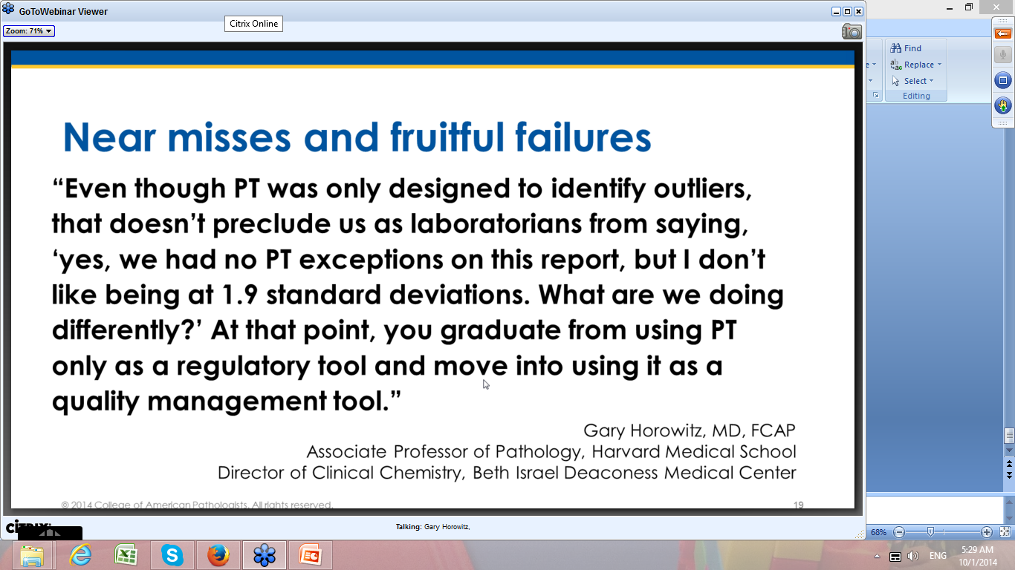

Slide 20
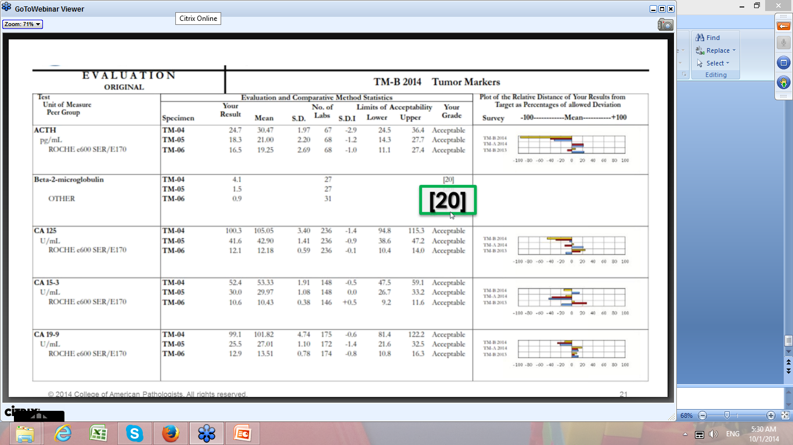
Notes:
20 = the committee couldn’t grade it – there is no appropriate target to evaluate
Do your own self assessment and look at the PT summary report and see if there is any method look near your method and you can do an alternative assesmment

Slide 21
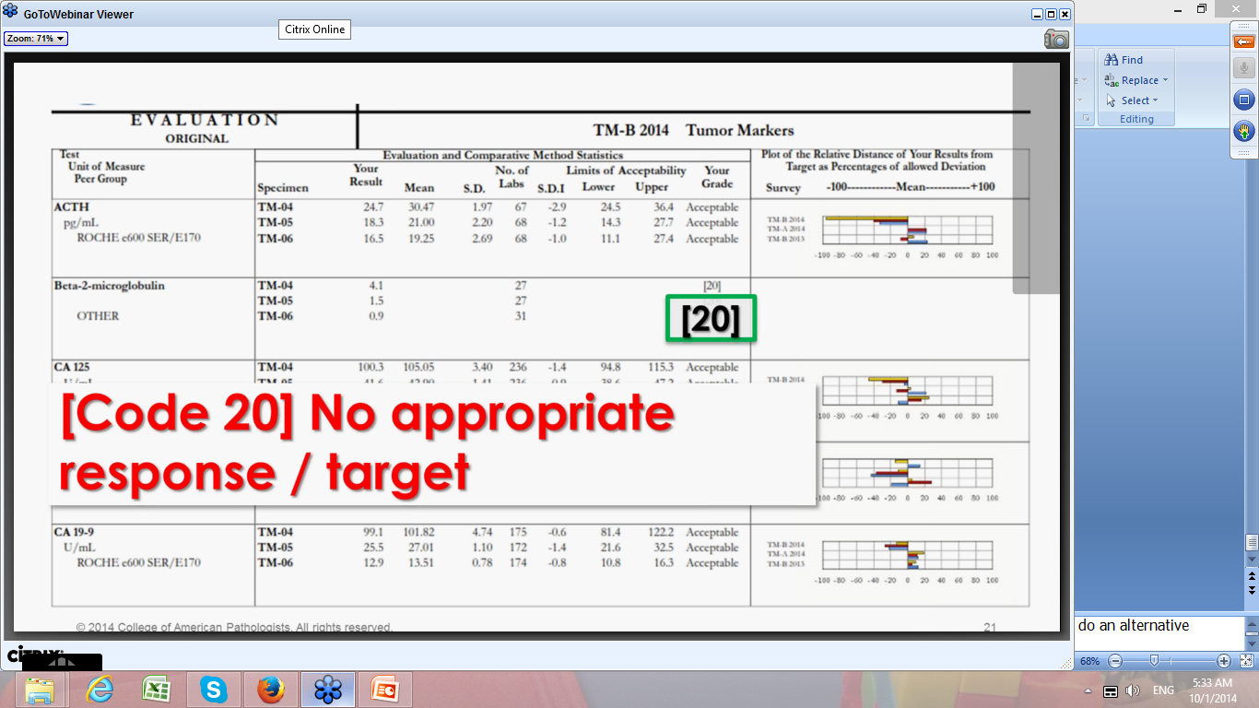

Slide 22
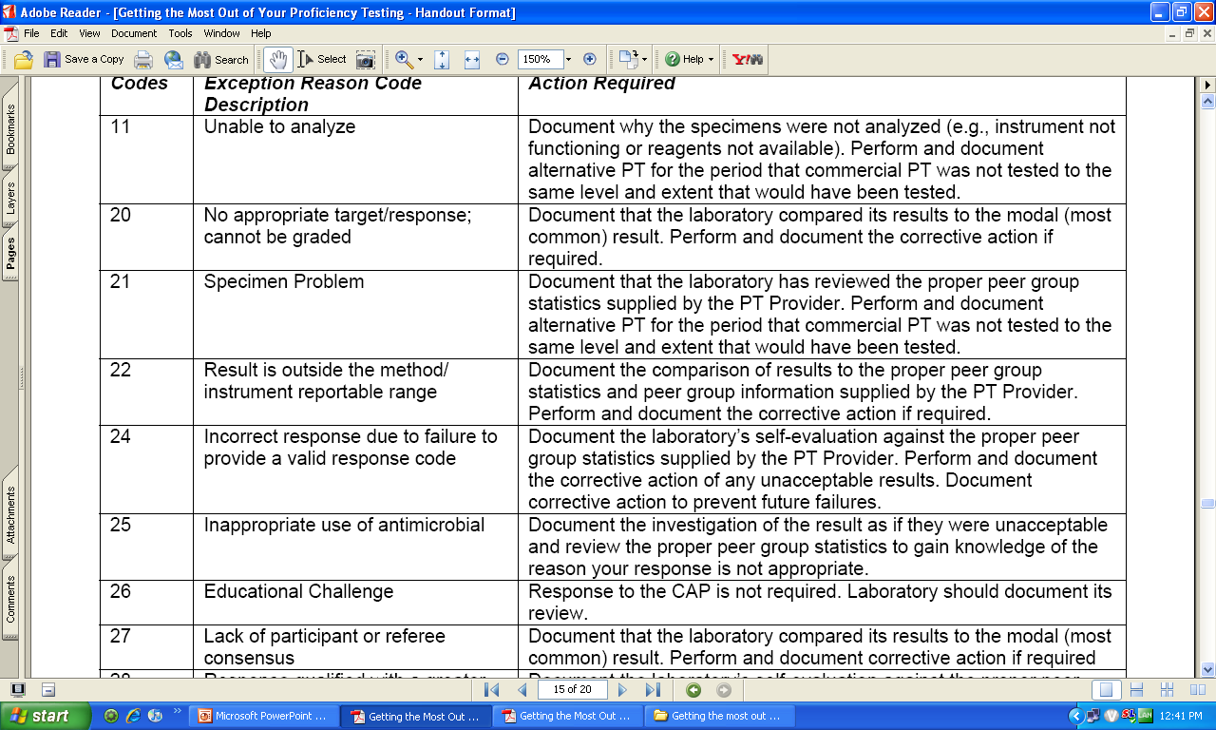

Slide 23
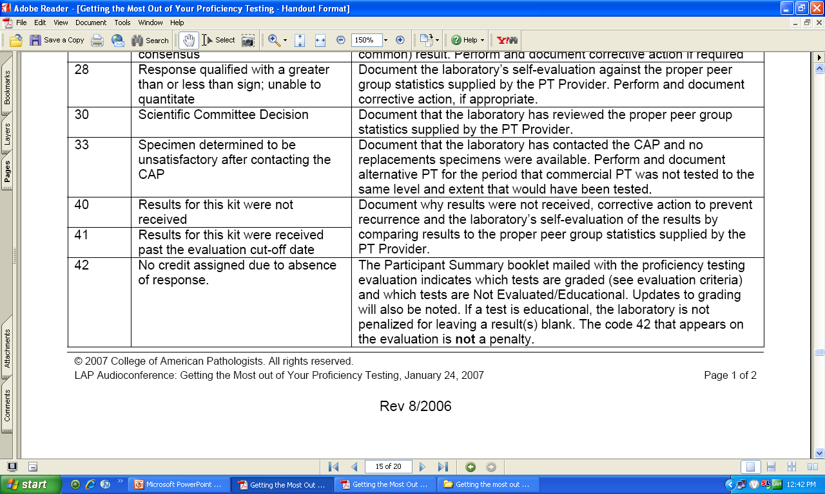

Slide 24
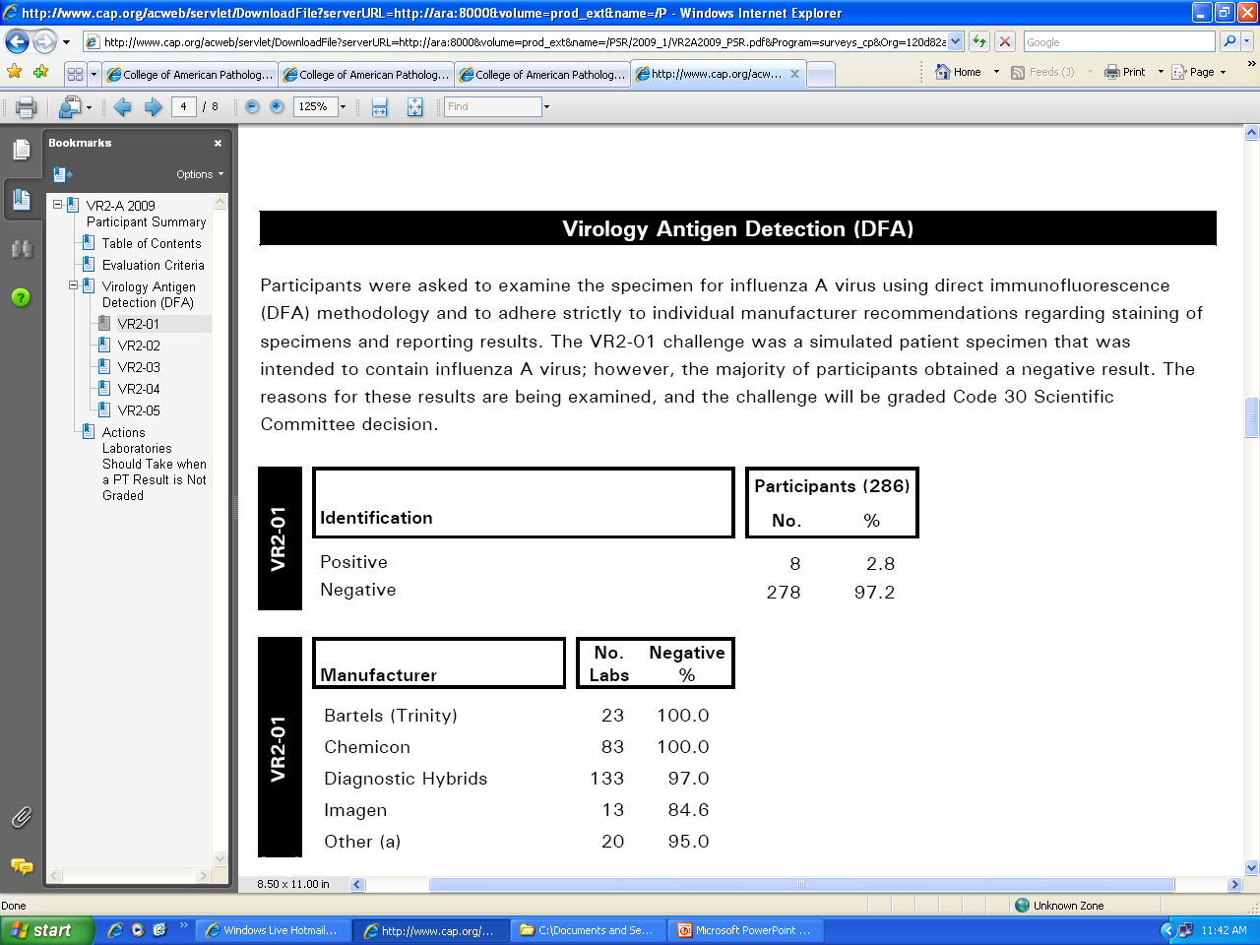

Slide 25
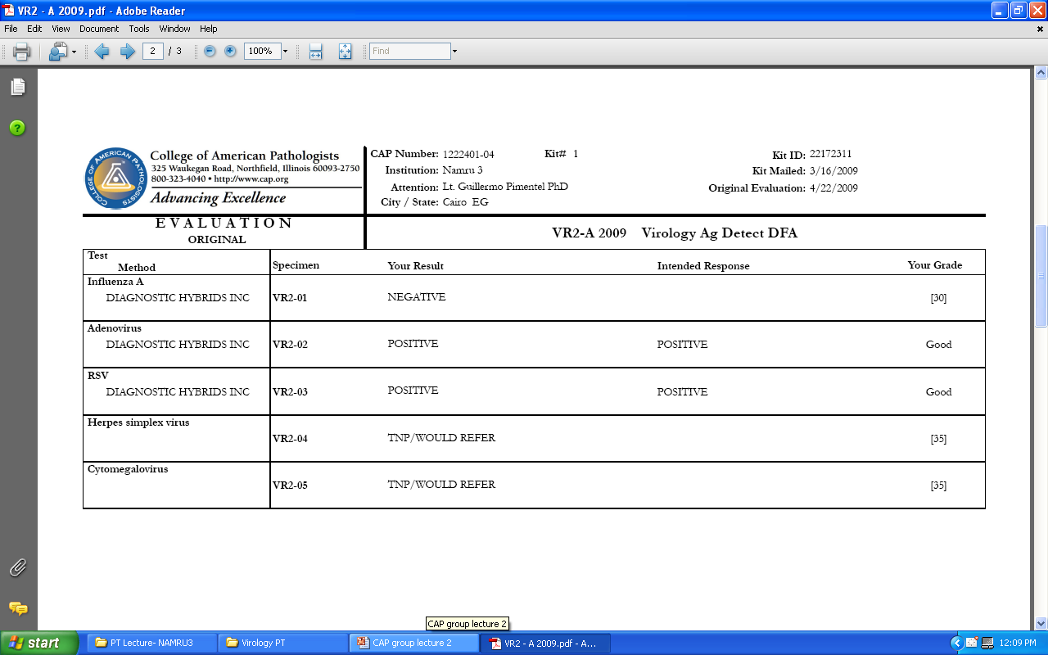

Slide 26
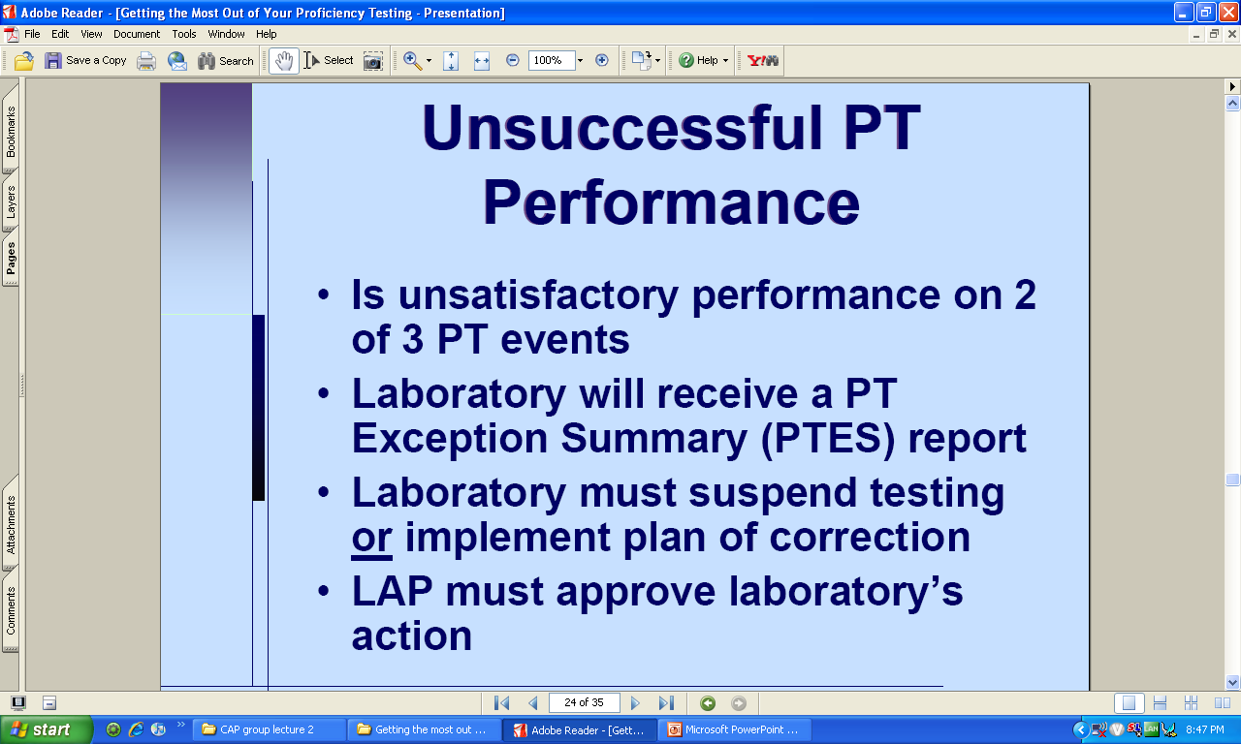

Slide 27
PT as an Education Tool
After results of a survey have been received and any troubleshooting done, remaining PT materials may be used
Comparison of individual results
Discussion of results
Sharing and distribution of information received from PT provider.

Slide 28
Alternative Assessment Procedures
List tests in need of alternative assessment
Split samples
  With another laboratory
  Within the laboratory and with different operators
Second person interpretation
Document procedures and results

Slide 29
Split sample testing protocol
Name the test to be performed
Establish a testing schedule twice a year, at a time mutually convenient to both facilities; such as January and July
Determine how the sample will be chosen; for example only healthy non-medicated adults
Choose a minimum of five such specimens
Make two even aliquots of each sample
Transport the samples to other testing facility following accepted medical protocol

Slide 30
Split sample testing protocol, cont
Have each facility perform the required test and record results following approved laboratory policy and procedure
Analyze test results according to accepted laboratory statistical techniques, such as SD or CV
Establish proven ranges for acceptance of test results, such as 2 SD or a CV of less than 15%
Keep careful record

