Slide 1
Introduction to-
Laboratory Quality Management System
&
ISO 15189 Accreditation
Kannan S Das, MSc
Quality Assurance Department
National Reference Laboratory

Slide 2
Learning Objectives
At the end of this activity, participants will be able to:
Explain the importance of a quality management system
List the quality system essential elements
Describe the history of development of quality principles
Discuss relationship of this quality model to ISO 15189 and CLSI standards

Slide 3
Essential to all aspects of health care are laboratory results that are
Accurate,
Reliable, and
Timely

Slide 4
Aspects needed for the medical laboratory
Pre-examination aspects
  advice on relevant tests
  guidelines for sampling
  transportation
Examination aspects
  internal and external quality assessment
  traceability
Post - examination aspects
  short turn around time
  reporting with adequate reference ranges
  advice about the meaning of the outcome

Slide 5
Quality Management System Definition
Coordinated activities to direct and control an organization with regard to quality (ISO,CLSI).
All aspects of the laboratory operation need to be addressed to assure quality; this constitutes
a quality management system.

Slide 6
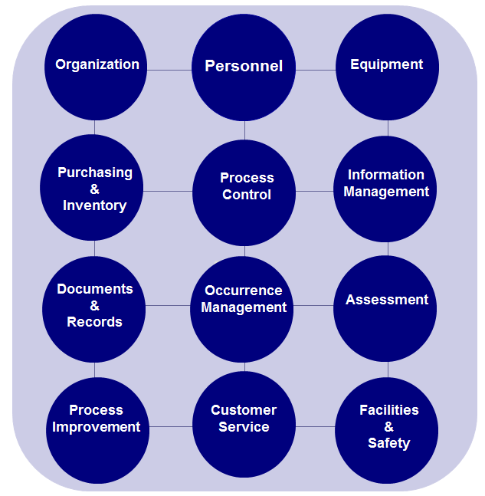
Twelve Quality System Essentials

Slide 7
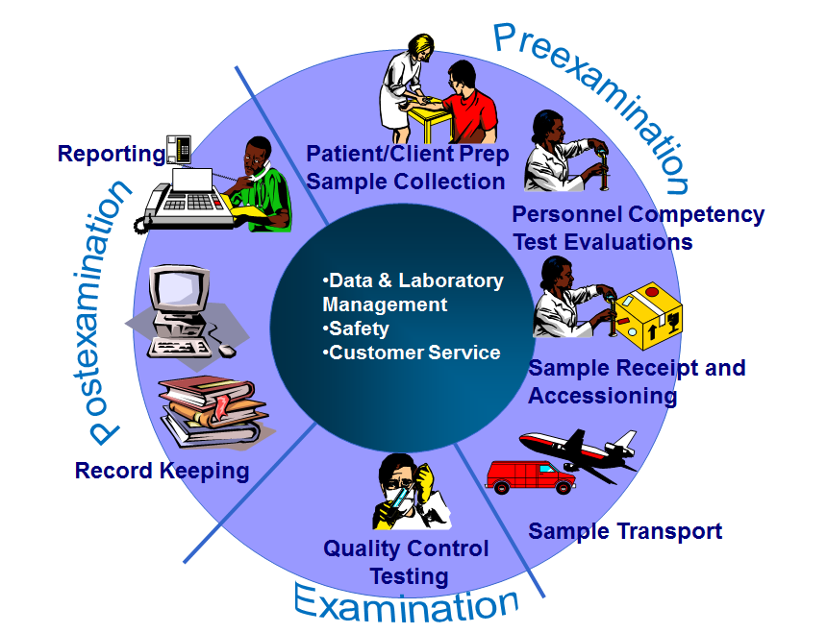
Complexity of a Laboratory System

Slide 8
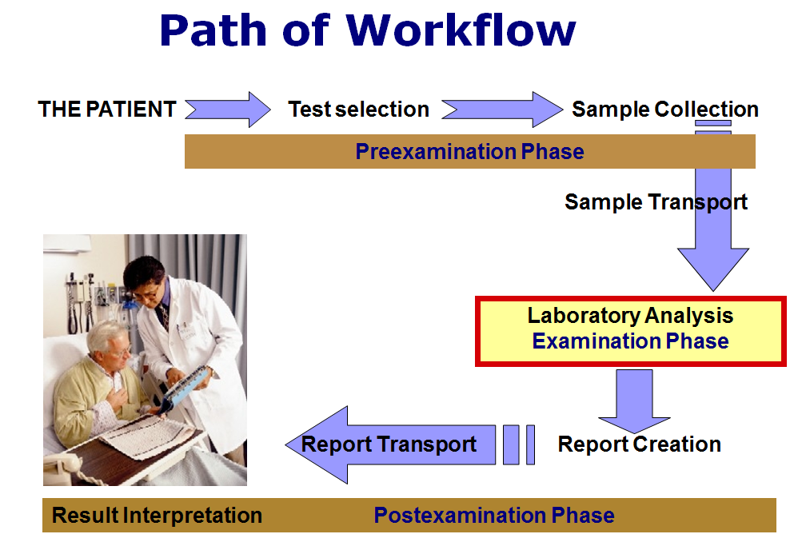

Slide 9
Laboratory tests are influenced by
Laboratory environment
Knowledgeable staff
Competent staff
Reagents and equipment
Quality control
Communications
Process management
Occurrence management
Record keeping

Slide 10
Organization
Responsibilities, Authorities
Communication
Provision
of
resources
Quality Policy

Slide 11
Personnel
Human resources
Job qualifications
Job descriptions
Orientation
In-service training
Competency assessment
Professional development
Continuing education

Slide 12
Equipment
Acquisition
Installation
Validation
Maintenance (PPM & NPPM)
Calibration
Troubleshooting
Service and repair
LOTO
Records

Slide 13
Purchasing and Inventory
Vendor qualifications (PQQ, Annual Evaluations)
Supplies and reagents
Critical services
Contract review
Inventory management
Reagent receipt ,storage
Vendor re-calls

Slide 14
Process Control
Quality control
  Internal QC
  External QC – PT & Alternative assessments
  IQCP
Sample management
Method validation
Method verification

Slide 15
Information Management
Confidentiality
Requisitions
Logs and Records
Reports Review
  Verification
  Auto verification
Computerized laboratory information systems (LIS)
Reports resulting/publishing

Slide 16
Document Management
Q-Pulse document Management System
  Policies
  Procedure
  Guidelines
  Forms
  Reports
  Posters
Record retentions

Slide 17
Occurrence Variance Report (OVR) & CAPA
Complaints/Concerns from Clients
Mistakes and problems
Documentation- Creating CAPAs in Q-pulse
Root cause analysis
Immediate actions
Corrective actions
Preventive actions
Monthly Quality Concern reviews

Slide 18
Laboratory Assessment
Internal Assessments | External Assessments
Quality Indicators-KPIs | External Proficiency testing
Internal Audits -QA | External Audits –LabCorp and 3rd party
QA Verifications-Monthly | External Regulatory Inspections – DHA/HAAD/OSHAD
Internal Inspections –QA | Accreditation Inspections – CAP & DAC ISO 15189
Notes:
18
Proficiency Testing is the equivalent of External Quality Assessment (EQA).

Slide 19
Process Improvement
Quality Circle & OHS Monthly Meeting
Annual QMS & OHSMS review meeting
Opportunities for improvement (OFIs)- Internal CAPAs
Stakeholder feedback- Staff Feedback
Problem resolution
Risk assessment-Technical and Safety
CAPA

Slide 20
Customer Service
Customer support
Customer needs
  Customer agreement for the services required
  Providing collection consumables
  Guiding the sample collection requirements
Customer feedback-Satisfaction Survey

Slide 21
Facilities and Safety
Occupational Health and Safety Management System (OHSMS) for a safe working environment
Transport management
Security
Containment
Spill Management
Daily disinfection schedules
Waste management- Biohazardous and Domestic waste
Laboratory safety trainings
Ergonomics assessment
Noise testing
Electrical safety checks
Water Quality Checks
Air Quality testing
Evacuation drills
Illuminance testing
Infection Control and Universal precautions
Risk assessments
OHS incident reporting
Post exposure prophylaxis

Slide 22
History of ISO 15189
ISO/TC 212 – Clinical laboratory testing and in vitro diagnostic systems (1995)
ISO 15189:2003 (1st Edition)
ISO 15189:2007 (minor alterations re IS0 17025 - 2nd Edition)
ISO 15189 (major review is taking place with a publication date of 2013)
22

Slide 23
Written by medical laboratory professionals
Responsibility of ISO/TC212 WG1
Requirements for quality and competence
It has its origins in two ISO Standards- ISO 9001 and ISO 17025
EN ISO 15189:2007
“Medical laboratories — particular requirements for quality and competence”
has been developed specifically to address the requirements for accreditation of medical laboratories.

Slide 24
ISO 15189 - content
1-3 about: Scopes, Normative references, terms and definitions.
4. Management requirements
    4.1 organisation and management
    4.2 quality management system
    4.3 document control
    4.4 review of contracts
    4.5 examination by referral laboratories
    4.6 external services and suppliers
    4.7 advisory services

Slide 25
ISO 15189 - content
    4.8 resolution of complaints
    4.9 identification and control of non conformities
    4.10 corrective action
    4.11 preventive action
    4.12 continual improvement
    4.13 quality and technical records
    4.14 internal audits
    4.15 management review

Slide 26
ISO 15189 – content
5. Technical requirements
    5.1 personnel
    5.2 accommodation and environmental condition
    5.3 laboratory equipment
    5.4 pre-examination procedures
    5.5 examination procedures
    5.6 assuring quality of examination procedures
    5.7 post-examination procedures
    5.8 reporting of results
    5.9 Release of results
    5.10 laboratory Information Management

Slide 28
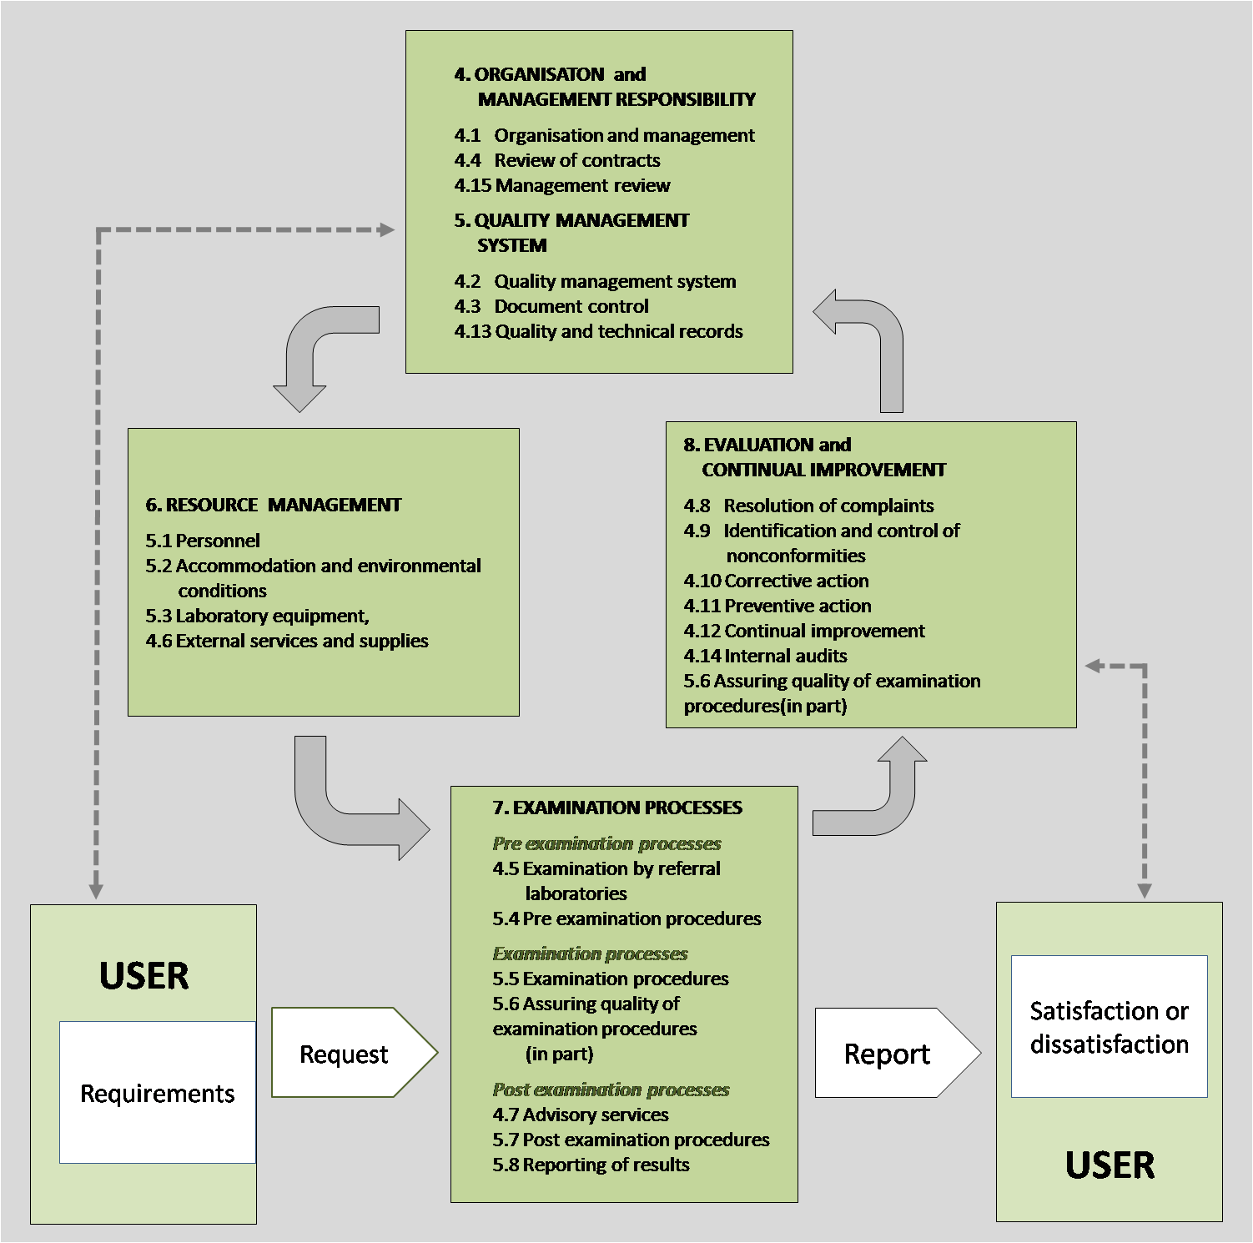
…into the ‘process based model’ of ISO 9000:2000

Slide 30
4.1.1.3 Ethical Conduct
NRL management has created an open, honest and accepting environment the standards of which all employees are expected to adopt and uphold. Key mandates are the following:
a)employees will not be involved in any activities that would diminish confidence in the laboratory’s competence, impartiality, judgment or operational integrity both from an internal and external perspective
b)management and personnel are free from any undue commercial, financial, or other pressures and influences that may adversely affect the quality of their work
c)where potential conflicts in competing interests may exist, they shall be openly and appropriately declared
d)there are appropriate procedures to ensure that staff treat human samples, tissues or remains according to relevant legal requirements
e)confidentiality of information is maintained at all times and within all venues
The following documents apply:
• Human Resources Department- Employee handbook
• Human Resources Workplace guidelines
• Code of Ethics and Confidentiality
• Confidentiality Agreement
• Mubadala code of conduct training
• Laboratory collection manual
• Notifying communicable diseases to HAAD – SOP

Slide 31
4.1.1.4 Laboratory Director
The NRL’s Laboratory Director meets the qualifications as described in the HAAD and CAP requirements and has responsibility to formulate and lead the professional, scientific, consultative, advisory, administrative, and educational components of the organization. The specific duties and responsibities of which are clearly delineated in the Laboratory Director’s job description.

Slide 32
The Laboratory Director’s responsibilities include, but are not limited to, directly implementing and/or overseeing the following:
Effective leadership of the medical laboratory service, including budget planning and financial management, in accordance with institutional assignment of such responsibilities.
Relate and function effectively with applicable accrediting and regulatory agencies, appropriate administrative officials, the healthcare community, providers of formal agreements and the patient population served.
Ensure that the appropriate number of employees with the required education, training and competence are available to provide services that meet the needs and requirements of the patients, clients and business. NRL annually conducts a workload study to ensure the staff is sufficient for the volume and business needs. Additionally the laboratory orientation and training policy in combination with the competency evaluation policy ensures that the requirements of the QMS are effective
The annual review of the QMS to discuss, review, document and demonstrate continuous quality improvement. Additionally, monthly department verification audits are performed by Quality Assurance personnel to further secure the sustainability of the QMS.

Slide 33
Implement a safe laboratory environment in compliance with good practice and applicable requirements. The NRL is certified by Abu Dhabi Occupational Safety and Health Center (OSHAD).
Serving as a contributing member of the medical staff for all NRL facilities
Provide clinical advice with the respect to the choice of examinations, use of the service and interpretation of examination results. In addition, NRL’s Directory of Services is a resource regarding availability of tests and appropriate acquisition of the associated specimen.
Delegated the function of selection and monitoring of suppliers to the Supply Chain Management Director (Delegation of Duties and Responsibilities procedure and Duties Memo). Additionally, the laboratory scientific team continuously monitors the test-down monthly report to assess and monitor the suppliers who fail to provide stocks on a timely manner. Moreover, the Vendor Resource Qualification explains in details the how NRL verify the qualification of the vendor representative.
Select referral laboratories and monitor the quality of their service through evaluating and selecting Referral Laboratory procedure and form.

Slide 34
Provide professional development programs for laboratory staff and opportunities to participate in scientific and other activities of professional laboratory organizations. NRL annually sends most of the technical staff to Arab Health conference in Dubai. Additionally, NRL periodically sends laboratory staff to other local and vendor specific training activities. On-line enrollment is available for all staff to participate in mandatory annual safety training in addition technical quizzes with certificates upon successful completion.
Define, implement and monitor standards of performance and quality improvement of the medical laboratory service. NRL developed standardized Key Performance Indicators (KPIs) across all managed and owned laboratories, which are reviewed monthly.
Monitor all work performed in the laboratory to determine that clinically relevant information is being generated. The QA team in collaboration with the laboratory supervisors conducts monthly audits referred to as QA Verification to review the performance and documentation of QA activities.
Address any complaint, request or suggestion from staff and/or users of laboratory services. NRL have several policies, procedures and meetings to address staff suggestions and complains.
Design and implement a contingency plan to ensure that essential services are available during emergency situations or other conditions when laboratory services are limited or unavailable. Contingency plans are being tested periodically as addressed in the Emergency Management Policy.

Slide 35
4.1.2 Management responsibility
4.1.2.1 Management commitment
The NRL management is committed to the development and implementation of the quality management system and continually improve its effectiveness by:
Communicating to laboratory personnel the importance of meeting the needs and requirements of users as well as regulatory and accreditation requirements as stipulated in this QM through in-service training, verbal and e-mail communication, in addition to internal audits with corrective action plans and evidence of compliance (EOC) documents.
Establishing the quality policy as stipulated in this manual.
Ensuring that quality objectives and planning are established through the annual QMS review meetings, monthly QA verification audits, and monthly KPI reviews as discussed in the Quality Circle Meeting.
Defining responsibilities, authorities and interrelationships of all personnel through NRL organization chart, job descriptions, and delegation of duties and responsibilities procedure and memo.
Establishing communication processes via several means including meetings, newsletters, emails, and hand-off communication shift register.
The appointment of a QA Director.
Conduting period management reviews.
Ensuring that all personnel are competent to perform their assigned activities which are addressed in the New Employee Orientation and Training Policy and the Training and Competency Assessment Program. The Orientation, Competency and Training Flowchart provide an overview of this program.
Ensuring availability of adequate resources to enable the proper conduct of pre- examination, examination and post-examination activities. NRL has developed a back-up plan to the SOPs to ensure the continuity of services. Additionally, the laboratory staff has access to several document controlled text books and images as available resources to assist with the diagnostic needs.

Slide 36
4.1.2.2 Needs of users
Laboratory management ensures that laboratory services, including appropriate advisory and interpretative services, meet the needs of patients and those using the laboratory services. The laboratory Clinical Consultation/ Technical Support Policy explains in details how a client can access NRL scientific team to answer any queries.
4.1.2.3 Quality policy
NRL is committed to continual improvement of laboratory processes and services to achieve ongoing customer satisfaction. It is therefore our policy and commitment to:
•Consistently comply with national and international standards to ensure quality referral laboratory testing services, and to continually improve the effectiveness of the Quality Management System.
•Ensure that all personnel are competent and qualified for the tasks they perform, and that all personnel familiarize themselves with quality system documentation in order to implement the policies and procedures in their work.
•NRL is committed to good professional practice and examination that are fit for intended use.
•Professionally and effectively perform referral laboratory testing services to produce accurate, reliable, timely and precise results.
•NRL reviews its quality policy for continuing suitability in order to keep abreast with knowledge and technological developments.
•It is NRL’s goal to encourage active participation of all employees in quality planning and continual improvement efforts to meet all quality, service and cost needs.

Slide 37
4.1.2.4 Quality objectives and planning
•NRL management establishes quality objectives, including those needed to meet the need and requirements of users, at relevant functions and levels within the organization. Many of the quality objectives are measurable such as through KPIs which are discussed in monthly Quality Circle Meetings and annually during the QMS Review meeting.
•NRL management ensures the quality planning of QMS is carried out to meet the requirements and the quality objectives. During the Annual QMS Review meeting the laboratory scientific team reviews the QMS activities to ensure the outcome meets the quality objectives.
•NRL management ensures the integrity of the QMS is maintained when changes to the QMS are planned and implemented.
4.1.2.5 Responsibility, authority and interrelationships
NRL management defined the responsibilities, authorities and interrelationships in the laboratory organization chart and job descriptions. Deputies for key managerial and technical positions were appointed. See table below for deputies:

Slide 38
KEY FUNCTION / ACTIVITY | POSITION | DEPUTY
NRL Administration | Chief Executive Officer (CEO) | Chief Financial Officer (CFO)
Clinical Laboratory | Chief Medical Officer | Consultatnt Pathologist /Technical Department specific Directors(if any)
Clinical Laboratory Technical activites | Technical Director | During absence either CMO or Pathologist will takeover the responsibilities .This will be communicated via email.
Clinical Laboratory –Pathology | Pathologist | Refer toPathologist Coverage section in NRL-QA-SOP-064
Clinical Laboratory Operations | Director of Techical Operations/ Laboratory Manager/Department Manager | Laboratory supervisor(s)
Clinical Laboratory Operations | Laboratory Supervisor(s) | Lead Tech/Senior Medical Technologists This will be communicated via email during supervisor absence.
Quality Assurance | QA Director | QA Assistant Manager
Laboratory Information System | IT Director | IT Manager
Human Resources | Director of Human Resources | Assistant Manager Human Resources
Business Development | Director of Business Development | Business Development Manager
Finance | Chief Financial Officer (CFO) | Finance Manager
Insurance | Chief Financial Officer (CFO) | Insurance Supervisor
Project Management | Director of Project Management Office (PMO) | PMO officer
Supply Chain | Chief Financial Officer (CFO) | Supply Chain Manager
Facilities | Director of Project Management Office (PMO) | Facilities Officer
Technical Support | Director of Techical Operations | Technical Support Specialist
Marketing | Director of Business Development | Marketing Manager

Slide 39
4.1.2.6 Communication
Laboratory management has a robust communication process established within the laboratory, through the following process (not limited)
•Quality Concerns meeting minutes
•Quality Circle and OHSMS meeting minutes
•Annual QMS review
•Shift register/hand off communication
•Regular section meetings with technical staff
•Email communication
•Health Headlines
•Project specific meetings when applicable (i.e Auto-verification meeting notes)
4.1.2.7 QA Director
The QA Director is responsible and authorized to:
a. Ensure that processes needed for the quality management system are established, implemented, and maintained.
b. Report to the laboratory management, at the level at which decisions are made on laboratory policy, objectives, and resources, on the performance of the quality management system and need for improvement.
c. Ensure the promotion of awareness of user’ needs and requirements throughout the laboratory organization.

Slide 40
4.2 Quality Management System
4.2.1 General requirements
The laboratory Leadership team establishes, documents, implements, and maintains a QMS and continually improves its effectiveness in accordance with the requirements of the national and international standards.
NRL QMS provides for the integration of all processes required to fulfil its quality policy and objectives and to meet the needs and requirements of users. NRL QMS is committed to the following:
Determine the processes needed for the quality management system and ensures their application throughout the laboratory. These processes are explained in the QMS Management Review procedure.
Determine the sequence of interaction of these processes through NRL SOPs, processes, and policies. Development of workflows and flowcharts have also been established in all phases of laboratory testing to include, but not limited to, pre-examination, examination and post examination phases.
Monthly QA Verification audits will ensure that both the operation and control of these processes are effective.
Ensure the availability of resources and information necessary to support the operation and monitoring of these processes whose responsibilities primarily function under Technical Operations and Supply Chain/Finance teams.
Monitor and evaluate these processes through monthly KPI data collection and review, internal audits such as the monthly QA Verification and ongoing preparation efforts for periodic third party audits/inspections.
Implement actions necessary to achieve planned results and continual improvement of these processes such as continual KPI monitoring and Corrective Action Preventive Action (CAPA) procedures.

Slide 41
4.2.2 Documentation requirements
4.2.2.1 General
The NRL QMS documentation include:
Statement of a quality policy and quality objectives as demonstrated in this QM.
Quality Manual.
Procedures and records as required by national and international standards which is documented in various procedures by mentioning compliance with ISO 15189, CAP, HAAD, OSHAD and DHA requirements.
Documents and records to ensure the effective planning, operation and control of the processes as stated in the Document Management System Policy and available in Q-Pulse software.
Copies of regulations, standards, and text books are document controlled.

Slide 42
4.3 Document Control
Document is any information or instruction in softcopy or hardcopy that is included in NRL’s Document Management System SOP. NRL is using Q-Pulse software application. Documents that are relevant and used by the laboratory department are listed in the laboratory Master List.
Records are archived internally and externally as per the requirements of NRL Retention of Specimen and Laboratory Records SOP.
NRL has a documented procedure which ensures the following:
a.All documents issued as part of the quality management system are reviewed and approved by authorized personnel before issue.
b.All documents are identified to include:
  i.A title
  ii.A unique identifier on each page
  iii.The date of the current edition
  iv.Page number to total number of pages
  v.Authority of issue
c. The master documents list can be exported to excel from Q-pulse at any time
d. NRL staff can only access current documents. The only authorized person to access obsolete documents is the document controller.
e. Since all documents are available electronically, no documents can be amended by hand. Copy holders can raise a change request through Q-Pulse.
f. All changes to laboratory documents are authorized and clearly identified at the end of the SOP.
g. All documents remain legible.
h. All documents are reviewed and updated biennially, exception is OHS SOPs which are reviewed and updated annually.
I. Obsolete controlled SOPs are stored in a separate register in Q-pulse with restricted access.
j. Obsolete documents are indefinitely retained for a specified period in accordance with NRL Document Management System SOPs guidelines.

Slide 43
4.4 Service agreement
4.4.1 Establishment of service agreement
The NRL has two type of agreements with its clients:
  The Service Level Agreement (SLA) which is a contractual agreement between the laboratory and the health care centers/hospitals. The SLA will include several details including the test menu, agreed TAT, KPIs, handling of STAT requests, and samples transport agreement.
  Any electronic or manual request for tests is considered as an agreement. The laboratory will honor the agreement by performing the requested tests or rejecting the samples and commuicate the information to the clients.
The laboratory services available are defined within the NRL Directory of Services and NRL Collection Manual which is available in the intra-net and at the laboratory website www.nrl.ae.
The masterlist of external customers is maintained by the Director of Business Development.
The following conditions will be met before the NRL enters into service agreements:
  The requirements of NRL clients are defined, documented, and understood.
  NRL ensures that the capablities and resources are available.
  NRL ensures that laboratory personnel have the skills and expertise necessary for the performance of the intended examination.
  Examination procedures selected are appropriate and meet the customers needs.
  Clients will be informed by any deviations from the agreement which may impact upon the examination results i.e, specimen rejection, instrument breakdown, etc.
  Reference will be made if NRL send samples to any referral laboratory.
4.4.2 Review of service agreement
Review of agreements to provide medical laboratory services will include all aspects of the agreements. Records of these review will include any changes to the agreement and any pertinent discussions amongst the Business Development, Supply Chain/Finance and Leadership teams.
If a contract needs to be amended after it has commenced on the instruction of either party, the same contract review process as detailed in the previous section will be repeated and any amendment will be communicated to internal and external customers accordingly.

Slide 44
4.5 Examination by referral laboratories
4.5.1 Selecting and evaluating referral laboratories and consultants
Evaluating and Selecting Referral Laboratory SOP delineates referral laboratories selection process. Additionally, the SOP ensures the following:
NRL is responsible for selecting the referral laboratory, monitoring the quality performance, and ensures that the referral laboratories are competent to perform the requested examinations.
Arrangements with referral laboratories are reviewed and evaluated periodically to ensure that they meet national and international accreditation requirements.
NRL maintains the records of referral laboratories such as updated accreditation certificate and proficiency Testing score cards.
NRL maintains the referral laboratories list.
Requests and results are maintained as delineated in the Retention of Specimen and Laboratory Records SOP.

Slide 45
4.5.2 Provision of examination results
The laboratory is responsible for all tests performed by another laboratory on patient samples that are referred. The laboratory will select referral laboratories according to pre-defined criteria as delineated in the SOP titled “Evaluating and Selecting Referral Laboratory SOP”.
It will be the quality committee’s responsibility to designate the laboratories and/or companies with whom they will subcontract tests or calibration. These will be listed and kept in a folder with all documents referring to the subcontractors.
Subcontracting of samples may occur under any of the following circumstances:
• test not performed routinely by the laboratory
• instrument breakdown or reagents not available
• workload restrictions
• Client requested turnaround time cannot be met.
The laboratory ensures and can demonstrate that its subcontractor is competent to perform the activities in question.
NRL when referring samples to referral laboratories will ensure that examination results of the referral laboratory are provided to the person making the request.
NRL will not alter results sent by referral laboratories. The results will be clearly marked as tests perform at reference laboratory.
NRL carefully monitors referral laboratories TAT and rejection rate to ensure providing appropriate service to clients.

Slide 46
4.6 External services and supplies
NRL Supply Chain Management Department define practice for the selection and use of external services, equipment, and consumable as delineated in the Vendor Assessment and Selection SOP.
NRL Supply Chain Department in collaboration with the Scientific Team and the Finance Department select and approve suppliers based on their abilities to supply external services, equipment, reagents and consumable supplies in accordance with the laboratory’s requirements.
NRL Supply Chain Department maintain an updated approved vendors list.
Purchasing information describes the requirements and specifications for the product or services and it is a Mubadala policy to review at least three venders.
NRL monitors the performance of suppliers to ensure that purchased services consistently meet the laboratory requirements. NRL Vendor Evaluation SOP delineates the extent and frequency of evaluation.

Slide 47
4.7 Advisory Services
The NRL established communication with users on the following:
as explained in the Director of Services and NRL Collection Manual, NRL advise on choice of examination and use of the services, inculding required type of sample, clinical indications and limitations of examination procedure and the frequency of requesting the examination
advising on individual cases as delineated in the Consultation Policy
ensuring staff competency and qualification to provide professional judgments on the interpretation of the results of examination
to promote the effective utlizatoin of laboratory services the scientific team regularly hold continuing education events to clients, review test utilization report, conduct scientific committee meeting, and update the information in the application module at NRL website
If a sample failed to meet acceptance critieria the rejection will be communicated to clients as delineated in the Specimen Rejection Policy. Moreover the incident reporting process will capture any unexpected incidents trends which will be addressed by the QA Department.
Consultation procedures are further described in Clinical Consultation/Technical Support Policy (NRL-CC-SOP-002)

Slide 48
4.8 Resolution of Complaints
NRL has developed a Non Conformity Incident Report Quality Concern Policy for the management of complaints or other feedback received from clinicians, clients, patients, laboratory staff and/or other parties. Records are maintained within the Corrective Action Preventive Action (CAPA) module within Q-Pulse, NRL’s electronic quality management system for incident reporting. All internal and external complaints and their investigations are documented with necessary action taken to alleviate and correct the concern.

Slide 49
4.9 Identification and Control of Nonconformities
Within the Non Conformity Incident Report Quality Concern Policy, the laboratory defines the process of how to identify and manage nonconformities in any aspect of the quality management system, including pre-examination, examination or post-examination processes. Additionally, CAPA Module in Q-Pulse Guidelines are available to provide a step-by-step procedure on how to use the system.
The procedure and CAPA module include the following information:
The responsibilities and authorities for handling nonconformities are designated and assigned as per the oversight of the QA department
The immediate actions to be taken are defined in the factual description stage
The extent of the nonconformity is determined in the corrective action and root cause analysis stages
In instances where examinations need to be halted and reports withheld as necessary as per the scientific committee decision, the medical significance of any nonconforming examinations is considered and, where appropriate, the requesting clinician or authorized individual responsible for using the results is informed.
The medical significance of any nonconforming examinations is considered and, where appropriate, the requesting clinician or authorized individual responsible for using the results is informed
The results of any nonconforming or potentially nonconforming examinations already released are recalled or appropriately identified, as necessary. Refer to corrected/revised report procedure for further details.
The responsibility for authorization of the resumption of examinations is defined within the Validation and Verification Guidelines: Quantitative and Qualitative Assays. Refer to “intermittent testing” section for further details.
Each episode of nonconformity is documented and recorded, with these records being reviewed at regular specified intervals to detect trends and initiate corrective action.
Nonconforming incidents occur in many different areas and are categorized within the CAPA module to include external quality concerns such as clinician or client complaints or internal quality concerns such as QC indications, instrument calibrations, checking of consumable materials, inter-laboratory comparisons, staff comments, reporting and safety related incidents.

Slide 50
4.10 Corrective action
Remedial corrective action is taken to reduce and/or eliminate the cause(s) of nonconformities. Corrective actions are appropriate to the effects of the nonconformities encountered.
Action taken at the time of the nonconformity to mitigate its immediate effects is considered “immediate” action. Action taken to remove the root cause of the problem that is causing the nonconformities is considered “corrective” action.
The Non Conformity Incident Report Quality Concern Policy includes the following:
QA department reviews the nonconformities to assign the concern accordingly to the correct department/designated staff for investigation
Supervisory/management staff determine the root cause(s) of nonconformities based on the investigation and facts available
Monthly CAPA data is evaluated to ensure that nonconformities do not recur
Supervisory/management staff determine and implement necessary corrective action(s)
All stages of the concern and corrective action with applicable documented evidence are uploaded (when available) in the CAPA module in Q-Pulse as NRL’s record
During the Monthly Quality Concern Meeting, representatives from the various departments meet to review the CAPA data and effectiveness of the corrective action(s) taken.

Slide 51
4.11 Preventive action
Preventive action is a proactive process for identifying opportunities for improvement rather than a reaction to the identification of problems or complaints (i.e. nonconformities). In addition to review of the operational procedures, analysis of CAPA data, including trend and risk analyses and proficiency testing is monitored by NRL QA department.
Risk Assessment Audits are performed in the various sections of NRL and when new instrumentation is obtained. If it is determined that nonconformities in pre-examination, examination and post-examination processes could occur or that there is doubt about the laboratory’s compliance with its own procedures, the laboratory takes action to identify, document and reduce and/or eliminate the risk(s) in order to prevent their occurrence.
The Risk Assessment process includes the following:
Monthly review of KPIs and CAPA data (dashboard), monthly QA verification and periodic risk assessment audits provide information to determine where potential nonconformities exist
QA department in consultation with employees and stakeholders determine the root cause(s) of potential nonconformities
Evaluating the need for preventive action to prevent the occurrence of nonconformities is communicated through e-mails and CAPA module in Q-Pulse
Determining and implementing preventive action needed is discussed during meetings when appropriate and communicated through e-mails and CAPA module in Q-Pulse
Recording the results are available on the NRL Audit/Inspection Corrective and Preventive Action Response Form and CAPA module in Q-Pulse
The NRL Audit/Inspection Corrective and Preventive Action Response form is reviewed for the effectiveness of the preventive action taken and approved by QA Director and Medical Director.

Slide 52
4.12 Continual improvement
NRL continually improves the effectiveness of the quality management system, including the pre-examination, examination and post-examination processes through the use of the Annual Quality Management System Review to compare the laboratory’s actual performance in its evaluation activities, corrective actions and preventive actions with its intentions, as stated in the quality policy and quality objectives.
Process Improvement Root Cause Analysis Procedure was also developed to provide a process for investigating and determining the root cause of chronic incidents and/or serious events that had a negative impact upon laboratory testing and/or patient safety (for example, unexpected event involving death, or serious physical or psychological injury or risk considered as sentinel events). Additionally, the Laboratory Root Cause Analysis Table was developed to document and implement corrective/preventive actions as appropriate. The effectiveness of the actions taken are reviewed and approved by the QA Director, Technical Director and Medical Director.
Laboratory management ensures that the laboratory participates in continual improvement activities through KPIs targets and various projects within the organization (i.e. auto verification initiative). Laboratory management communicates to staff improvement plans and related goals through regular staff meetings and e-mail.

Slide 53
4.13 Control of records
The NRL established and implemented procedures for the control of quality and technical records. The procedure controls the identification, collection, indexing, accessing, storage, maintenance, amendment and safe disposal of quality and technical records. Records are created concurrently with performance of each activity that affects the quality of the examination.
The date along with the identity of personnel making the amendments is captured at NRL electronic document management system (Q-Pulse).
The Retention of Specimen and Laboratory Documents SOP defines retention period for various records including pre-examination, examination, and post-examination. The retention period defined in the SOP follows national and international retention criteria.
All records are safely stored in controlled areas to prevent damage. Electronic records are stored in remote server in a facility with a maximum security.

Slide 54
4.14 Evaluation and audits
4.14.1 General
NRL implemented an internal audit processes needed to:
demonstrate that the pre-examination, examination and post-examination and supporting processes are being conducted in a manner that meets the needs and requirements of users;
ensure conformity to the quality management system;
continually improve the effectiveness of the quality management system
4.14.2 Periodic review of requests, and suitability of procedures and sample requirements
NRL Scientific team periodically review tests ordering practices to ensure they are clinically appropriate for the requests received through the Operations Dashboard. Accordingly, continuing education seminars are held for clients to provide education on ordering practices and to introduce new tests.
NRL biennially reviews the NRL Collection Manual for sample volume, collection device and preservative requirements for blood, urine, other body fluids, tissue and other sample types, to ensure that neither insufficient nor excessive amounts of sample are collected and sample is properly collected to preserve the measurand.

Slide 55
4.14.3 Assessment of user feedback
The NRL is committed by the use of surveys to establishing a method of measuring customer satisfaction. At least one survey will be performed biennially. The survey can either be conducted by NRL or by centers/hospitals which hosts NRL.
4.14.4 Staff suggestions
Laboratory management encourages staff to make suggestions for the improvement of any aspect of the laboratory service as highlighted in Employee Quality Communication – Staff Suggestion Procedure. Suggestions shall be evaluated, implemented as appropriate and feedback provided to the staff through e-mail, meetings and Staff Suggestion Process Improvement Feedback Form. Records of suggestions and actions taken are maintained with the QA department.

Slide 56
4.14.5 Internal audit
QA department conducts regular, monthly internal QA Verification Audits for the various sections at all NRL sites to determine that activities in the quality management system, including pre-examination, examination, and post-examination:
conform to the requirements of this International Standard and to requirements established by the laboratory
are implemented, effective, and maintained
Additionally, Quality Management Audits are performed each calendar year by a LabCorp Quality representative. This process is coordinated by NRL’s QA department. Audits may be announced, targeted, or unannounced and may be conducted by direct observations of laboratory operations, reviewing laboratory policies, procedures and documentation, and interviewing staff and clients.
The audit programme shall take into account the status and importance of the processes and technical and management areas to be audited, as well as the results of previous audits.
The audit criteria, scope, frequency and methods shall be defined and documented.
Selection of auditors and conduct of audits ensure objectivity and impartiality of the audit process. Auditors, wherever resources permit, are independent of the activity to be audited.
Define the responsibilities and requirements for planning and conducting audits, and for reporting results and maintaining NRL Audit/Inspection Corrective and Preventive Action Response Form records.
Personnel responsible for the area being audited shall ensure that appropriate action is promptly undertaken when nonconformities are identified without undue delay to eliminate the causes of the detected nonconformities.

Slide 57
4.14.6 Risk Management
As part of the Environmental Health and Safety requirement, the NRL safety coordinator conducts regular risk assessments to evaluate the impact of work processes and potential failures on examination results as they affect patient safety, and will modify processes to reduce or eliminate the identified risks and document
decisions and actions taken. Risk managent measures will be put inplace thereafter to mitigate risks.
4.14.7 Quality Indicators
As delineated in the Key Performance Indicators SOP, NRL selected quality indicators to monitor and evaluate performance throughout critical aspect of pre-examination, examination, and post-examination processes.
The Key Performance Indicators SOP delineates the objectives, methodology, interpretation, limits, action plan, and duration of measurement. The indicators are reviewed periodically to ensure continued approriateness.
NRL reviews the TAT performance monthly and corrective measures are put in place whenever targets are not met. The TAT will be agreed upon during contract executions and are mentioned in the Service Level Agreement.

Slide 58
4.14.8 Reviews by External Organizations
Several accreditation inspections and corporate levels audits are conducted periodically. The NRL takes immediate actions and, as appropriate, corrective action or preventive action to ensure continuing compliance with the requirements of national and international standards. Example of inspection and audits includes:
CAP
ISO 15189
HAAD
OSHAD
JCI
Laboratory Corporation Audit
DHA

Slide 59
4.15 Reviews by external organizations
The laboratory scientific team annaully review the quality management system to ensure it continuing suitability, adequacy and effectiveness and support of patient care.

Slide 60
4.15.2 Review input
the periodic review of requests, and suitability of procedures and sample requirements (see NRL Collection Manual);
assessment of user feedback (see Client satisfaction survey records and Mubadala staff survey);
staff suggestions (see Employee Quality Communication Policy);
internal audits (see Monthly QA Verification records);
risk management (see Risk Assessment and Risk Management Forms);
use of quality indicators (see KPI records);
reviews by external organizations (see CAP/ISO and HAAD/DHA inspection records);
results of participation in interlaboratory comparison programmes (PT/EQA) (see PT evaluation records);
monitoring and resolution of complaints (see CAPA and Incident Reporting Process);
performance of suppliers (see Vendors Evaluations records);
identification and control of nonconformities (see CAPA and Incident Reporting Process);
results of continual improvement including current status of corrective actions and preventive actions (see CAPA and Incident Reporting Process);
follow-up actions from previous management reviews (see Annual QMS Review records);
changes in the volume and scope of work, personnel, and premises that could affect the quality management system (see Workload Assessment records);
recommendations for improvement, including technical requirements (see Annual QMS Review and QMS meeting minutes).

Slide 61
4.15.3 Review activities
NRL management reviews analyses the input information for causes of nonconformities, trends and patterns that indicate process problems. The review also includes assessing opportunities for improvement and the need for changes to the quality management system, including the quality policy and quailty policy objectives. Moreover, the review includes the evaluation of quality and appropriateness of the laboratory’s contribution to patient care.
4.15.3 Review output
The outcome of the management review is documented and incorporated into a record that documents decisions made and actions taken during management review related to:
improvement of the effectiveness of the quality management system and its processes;
Improvements of services to users;
Resources needs.
Action arising from management reviews are recorded and reported to laboratory staff in Q-Pulse.

Slide 62
5. Technical Requirements
5.1 Personnel
5.1.1 General : NRL has defined a comprehensive recruiting strategy to attain, train and ensure that the appropriate numbers of employees are secured to meet the requirements of the QMS.
5.1.2 Personnel Qualifications
All employees are qualified to perform their individual tasks based on their education, licensure, experience and training outcomes. The resumes/CVs of applicants are thoroughly reviewed to ensure that they meet requirements as outlined in the job description before an interview is scheduled. A thorough interview then takes place with the applicable department supervisor and/or manager.
5.1.3 Job Descriptions
Clearly delineated job descriptions for all employees, up to and including the Medical Director, and their associated qualifications are outlined for each work process and comply with local and national accrediting agency requirements. All employees participate in orientation, training, competency assessment and performance reviews, as appropriate.
5.1.4 Personnel Introduction to the Organizational Environment
Procedures are established to ensure that all new employees attain a level of comfort and stability in their new environment. A formalized orientation program is in effect. Each new employee is given a thorough tour of the facility and their immediate supervisor works with them to ensure their knowledge and familiarity with the overall workflow of the laboratory.

Slide 63
5.1.5 Training
NRL provides training for all personnel, which includes the quality management system, health and safety, assigned work processes and procedures, the laboratory information system, ethics and confidentiality.
The effectiveness of the training program is periodically reviewed.
The Quality Management System
B. Assigned Work Processes and Procedures
C. The Applicable Laboratory Information System
D. Health and Safety (OHSMS)
E. Ethics : Providing an environment of trust and ethical behavior and management is a central philosophy of the NRL. Ethical conduct expectations, dictated by management, provide an environment in which employees may flourish and; therefore, positive patient outcomes are enhanced.
F. Confidentiality of Patient Information : Polices are defined to ensure that all patient input data and their associated results are kept confidential. Employees at all levels of the organization are educated regarding the importance of patient and employee confidentiality in both written and verbal formats.

Slide 64
5.1.6 Competence Assessment
Sustained training practices are verified by means of a well-delineated competency assessment program for each individual (whether managerial or technical) and their respective responsibilities. The effectiveness of the program is reviewed periodically. Any deficiencies are documented and retraining instituted.
A. Direct Observation of Routine Work
Routine work processes and procedures are directly observed to ensure quality practices have been sustained after the initial training period. In addition and during the observation period, adherence to safety policies are observed.
B. Direct Observation of Equipment Procedures
During the competency assessment process the employee’s attention to appropriate equipment maintenance procedures is observed.
C. Monitoring the Recording and Reporting of Examination Results
D. Review of Work Records
The employee must ensure that they are following NRL policies as they relate to securing and maintaining accurate work records. These records are any work product generated by the employee during the course of their work day. The accuracy of work records is a component of the direct observation process.
E. Assessment of Problem Solving
It is important to observe how an employee works through an unexpected occurrence and how they integrate tools and the resources available to them to help resolve the issue. This includes not only tactical, problem resolution but also the efficient escalation and communication of a problem
F. Examination of Specially Provided Samples
Part of the assessment protocol includes a comparison analysis of results/outcomes. While the processes may be followed management must ensure that the outcome/result is correct. To that end, known samples are provided for analyses. These samples are previously examined, well-stabilized patient samples chosen for a particular examination process or any samples that may be part of a formal examination/comparison program.

Slide 65
5.1.7 Reviews of Staff Performance
There is a process in place for the regular and thorough evaluation of staff performance in the form of performance appraisals.
5.1.8 Continuing Education and Professional Development
NRL provides a continuing education program for management and employees to assist in their professional development and therefore, positively impact their current work processes. The program is both formal and informal with diversified content and delivery to appeal to differing modes of learning. NRL also encourages and assists employees to participate in advanced training programs, seminars, industry meetings and professional organizations.
5.1.9 Personnel Records
Records for current and historical reference are created and maintained for each employee. These records contain at minimum all relevant educational and professional qualifications, training and experience and assessments of competence that are unique to the individual.
At minimum, these records contain the following information listed below:
Educational and Professional Qualifications
Previous Work Experience
Job Descriptions
Introduction of New Staff to the Laboratory Environment
Training in Current Job Tasks
Competency Assessments
Records of Continuing Education and Achievements
Reviews of Staff Performance
Reports of Accidents and Exposure to Occupational Hazards
Immunization Status, When Relevant to Assigned Duties

Slide 66
5.2 Accommodation and Environmental Conditions
5.2.1 General Safety Requirements for Medical Laboratories
It is the commitment of National Reference Laboratory to provide and maintain a safe and adequate work environment that adheres to the policies of the safety program. Each laboratory follows the safety plan and proactively assesses space requirements as they relate to specimen volumes, employee complement and physical assets.
5.2.2 Laboratory and Office Facilities
A. Access to Areas Affecting the Quality of Examination is controlled : Only authorized employees may access the laboratory facility and their associated work spaces. Card keys are provided and a log is kept and maintained.
B. Medical Information, Patient Samples and Laboratory Resources are safeguarded : The process to receive, manage and protect all patient and employee related information is defined and communicated. Information flow from creation to dissemination and disposal has been defined and tested. The process ensures privacy and accurate transfer of information in verbal, paper and electronic formats and further ensures that access is provided to and attained solely by those authorized.
C. Facilities for Examination Allow for Correct Performance of Examinations : National Reference Laboratory is committed to a safe and sustainable work environment. Therefore, the physical laboratory provides adequate space to perform the testing services offered and complies with all local and accrediting agency standards. The laboratory has been designed, tested and maintained to ensure appropriate and sustainable environmental conditions exist to include: all energy sources, lighting that is suited to the particular work process, proper ventilation, noise abatement, water requirements that meet both consumption and testing standards and safe and timely waste disposal.
D. Communication Systems within the Laboratory are Appropriate: NRL has focused on reviewing and implementing a communication plan that both meets the needs of its employees and assists to enhance the patient safety goals of the laboratory by securing accurate and successful transmission of ideas and information. This is accomplished with attention to both electronic communications such as E-mail and meeting attendance where enhanced communications and meeting Minutes are disseminated.
E. Safety Facilities and Devices are provided and Their Functioning Regularly Verified: A comprehensive safety management program is in place that dictates the safety plans and equipment for all sections of the laboratory. This includes but is not limited to strategically placed hand washing and eye wash stations, fire extinguisher, emergency showers, biological safety hoods and cabinets, personal protective equipment and backup generators in case of power failures. All safety-related equipment is regularly checked to ensure it is in good working order and the associated verification data are recorded for historical reference. All employees are trained regarding the use of all of the safety equipment.

Slide 67
5.2.3 Storage Facilities
Storage space is allocated and conditions monitored to ensure the sustained continuity and integrity of patient samples, reagents, equipment and documents and records. Patient samples are stored at the appropriate temperature and in such a manner as to prevent any cross contamination. Manufacturer’s instructions are followed for storage of all reagents and supplies to include hazardous materials and appropriate containment devices.
5.2.4 Staff Facilities
The laboratory is designed to ensure the safety and comfort of all staff: rest rooms are adequate, drinking fountains are well-placed, and areas for meetings and lunch breaks are defined as are areas for the storage of personal items and activities associated with preparation for work.
5.2.5 Patient Sample Collection Facilities
All patient sample collection facilities have been designed to provide patients with privacy, comfort and adequate space for both the patient and any one accompanying him/her. There is sufficient room to perform all specimen collection functions to include preparation and transfer of specimens as needed. First aid materials are available as may be required.
5.2.6 Facility Maintenance and Environmental Conditions
The laboratories are on a regular cleaning and waste disposal schedule. They are physically designed to accommodate a streamlined workflow process in a climate controlled environment. Particular attention has been paid to air quality and handling as it relates to specific esoteric testing. Vibrations are minimized to ensure microscopes function appropriately. Manufacturers, before and at the time of installation, have evaluated the facility to ensure that their equipment operates according to optimum specifications.

Slide 68
5.3 Laboratory Equipment, Reagents and Consumables
5.3.1 Equipment
5.3.1.1 General
The Laboratory Directors identify the patient-related and business requirements for the acquisition and implementation of all equipment, reagents and consumables. Manufacturers and associated suppliers are selected based upon a thorough vendor review process and defined criteria. Procurement practices direct the acquisition, documentation and distribution of all receivables to include inventory acceptance criteria and storage guidelines.
5.3.1.2 Equipment Acceptance Testing
Equipment is not approved for use until it is formally tested and approved. A defined Installation procedure dictates that Laboratory analyzers are installed and verified by the vendor. This is the first step in the process to ensure that the instrument performs as it did at the manufacturer’s site and that it did not undergo alteration during the delivery process. Regarding analyzers, the vendor provides the laboratory with a document stating that the instrument meets the manufacturer’s specifications and the laboratory formally accepts the instrument into their qualification process through a certificate of acceptance. Smaller equipment is evaluated by the laboratory to ensure manufacturer’s specifications are met. All equipment receives a unique inventory/asset tracking number that remains with the instrument at all times and throughout its’ life with the NRL.
5.3.1.3 Equipment Instructions for Use
Only staff that has been trained on the safe and accurate use of any equipment may operate it. All documents supplied by the manufacturer for purposes of instrument use and maintenance are read by the applicable operators. The manuals and associated documents are retained with the equipment for ease of reference

Slide 69
5.3.1.4 Equipment Calibration and Metrological Traceability
Well-defined procedures are in place to secure the accurate operation of all equipment. The calibration process is a central component of each procedure and is written and monitored according to manufacturer’s guidelines and regulatory standards. At minimum, specific calibration procedures/processes are delineated for the following:
Taking into Account Conditions of Use and the Manufacturer’s Instructions : All manufacturers’ instructions are read and thoroughly understood before use. Calibration frequency and process are appropriate for the equipment and its intended use.
Recording the Metrological Traceability of the Calibration Standard and the Traceable Calibration of the Item of Equipment
Verifying the Required Measurement Accuracy and the Functioning of the Measuring System at Defined Intervals : Measurement accuracy is initially defined through the validation protocols and before the instrument is approved by the Medical Director for use. The validation protocol is designed to ensure the accuracy and stability of the measuring system and the accurate documentation thereof.
Recording the Calibration Status and Date of Recalibration : The importance of attaining and maintaining an accurate calibration history for each equipment cannot be overstated. All calibration data together with the associated date and the employee performing will be documented and retained.
Ensuring That, Where Calibration Gives Rise to a set of Correction Factors, the Previous Correlation Factors are Correctly Updated : The calibration process is tightly controlled. There are procedures that define the specific circumstances under which recalibration may be instituted. Recalibration requires approval and documentation thereof.
Safeguards to Prevent Adjustments or Tampering that Might Invalidate Examination Results : All safeguards are in place to prevent any changes to calibrations and any other functions of the instrument controlled system. Controls are held by select individuals to include the engineer. All calibration materials are traceable to a higher order reference material suggested by the manufacturer and used as a reference point by the vendor for traceability.

Slide 70
5.3.1.5 Equipment Maintenance and Repair
The NRL has a defined preventive maintenance program that is specific for each individual instrument/equipment. This program uses the manufacture’s recommendations as the minimum standard and further defines the schedules according to actual practice outcomes. All aspects of the instrument/equipment and reagent systems are delineated with attention to safe handling and preservation of instrument integrity. Defective equipment is taken out of service and is clearly marked as such. It is not re-integrated into the workflow until it passes revalidations. All previous examinations are reviewed and if corrections are required the associated protocols are implemented. Decontamination procedures are available.
5.3.1.6 Equipment Adverse Incident Reporting
Adverse incidents and accidents that can be attributed directly to specific equipment shall be investigated and reported to the manufacturer and appropriate authorities, as required.

Slide 71
5.3.1.7 Equipment Records
All equipment to include analyzers and ancillary support-related equipment are accurately tracked and monitored beginning at the time of acquisition. All associated data are retained as part of the history of the individual equipment. All performance records include copies of reports/certificates of all calibrations and/or verifications including dates, times and results, adjustments, the acceptance criteria and due date of the next calibration and/or verification. The equipment records processes include, at minimum, the following:
Identity of Equipment: A specific asset inventory number is assigned to all equipment. (Passport)
Manufacturer’s Name, Model and Serial Number, or Other Unique Identification
Contact Information for the Supplier or the Manufacturer
Date of Receiving and Date of Entering Into Service (contractual process)
Location: The asset list records and tracks the location of all instruments at all times.
Condition When Received
Manufacturer’s Instructions: Complete equipment instructions are provided by the manufacturer and are retained for the life of the instrument.
Records that Confirmed the Equipment’s Initial Acceptability: All documents/records relative to the equipment integration processes to include validations, suitability and performance are retained. (ie. Equipment Qualification of Laboratory Instruments)
Maintenance Carried Out and the Schedule for Preventive Maintenance
Equipment Performance Records That Confirm the Equipment’s Ongoing Acceptability for Use
Damage to, or Malfunction, Modification or Repair of Equipment

Slide 72
5.3.2 Reagents and Consumables
5.3.2.1 General
The accurate ordering, receipt, storage and tracking of reagents and consumables are essential to the quality foundation of the laboratory. All processes are securely delineated and monitored for continuous quality improvement.
5.3.2.2 Reagents and Consumables – Reception and Storage
Policies are delineated for the receipt and acceptance of all reagents and consumables. All products are stored according to manufacturer’s requirements.
5.3.2.3 Reagents and Consumables – Acceptance Testing
Prior to use, all reagents are verified for suitability and accuracy of performance. Each lot is tested and the results documented to ensure they perform according to manufacturer’s specifications and internal validation criteria. New lots of an approved reagent are checked against the old lots before use. Consumables that affect the quality of examinations are verified for performance before use.
5.3.2.4 Reagents and Consumables – Inventory Management
There is an inventory control system that ensures that only acceptable reagents and consumables are available for use and that uninspected items may not be selected.
﻿
5.3.2.5 Reagents and Consumables – Instructions for Use
Manufacturer’s instructions as well as operationally delineated instructions for reagent and consumables use are readily accessible.
5.3.2.6 Reagents and consumables – Adverse Incident Reporting
Adverse incidents and accidents that can be attributed directly to specific reagents or consumables shall be investigated and reported to the manufacturer and appropriate authorities, as required.

Slide 73
5.3.2.7 Reagents and consumables – Records
The importance of accurate identification, tracking and testing of reagents (also reagents made in-house if any) and consumables is discussed with all employees. Records are maintained for each reagent and consumable that contributes to the performance of examinations whether as part of an analyzer or manual testing system. The monthly audit performed by QA checks this process to ensure compliance.
A. Identity of the Reagent or Consumable
B. Manufacturer’s Name and Batch Code or Lot Number
C. Contact Name of the Supplier or Manufacturer
D. Date of Receiving, Date of Expiry, Date Entering into Service and where Applicable, the Date the Material was Taken out of Service
E. Condition When Received (e.g. acceptable or damaged
F. Manufacturer’s Instructions
G. Records that Confirmed the Reagent’s or Consumables Initial Acceptance for Use
H. Performance Records that Confirm the Reagent’s or Consumables ongoing Acceptance for Use

Slide 74
5.4 Pre-examination Processes
5.4.1 General
The NRL is committed to instituting and enforcing all workflow and associated policies that contribute to acquiring and ensuring the optimum integrity of a patient sample throughout all laboratory-related processes. It is the importance and success of the pre-examination policies that impact the accuracy of the examination process. All employees are frequently reminded of the NRL’s continued focus on the sustainability of the pre-examination procedures and policies. Key Performance Indicators (KPI) are defined to record and monitor specific components of these areas with the goal of continuous quality improvement and enhanced patient safety.

Slide 75
5.4.2 Information for Patients and Users
It is essential to provide accurate information to patients, clients, suppliers and all laboratory users in an understandable format. This information is relevant to successful communication, sample stability and business processes. The NRL provides communications in both written and electronic format that delineate guidelines for all clinical procedures to include specimen acquisition requirements, specific patient-related information and consent per assay if needed. In addition, the NRL has a Customer Care team that will provide verbal instructions/explanations for any questions a laboratory user may have. At minimum, the NRL provides the following information to patients and users:
The location of the Laboratory: This is available in the Location map and Directory of services
Types of Clinical Services Offered by the Laboratory Including Examination Referred to Other Laboratories
Opening Hours of the Laboratory
The Examinations Offered by the Laboratory Including, as Appropriate, Information Concerning Samples Required, Primary Sample Volumes, Special Precautions, Turnaround Time
Instructions for Completion of the Request Form
Instructions for Preparation of the Patient
Instructions for Patient-Collected Samples
Instructions for Transportation of Samples, Including any Special Handling Needs
Any Requirements for Patient Consent (e.g. consent to disclose clinical information and family history to relevant healthcare professionals, where referral is needed)
The Laboratory’s Criteria for Accepting and Rejecting Samples
A list of Factors Known to Significantly Affect the Performance of the Examination or the Interpretation of the Results
Availability of Clinical Advice on Ordering of Examinations and on Interpretation of Examination Results
The Laboratory’s Policy on Protection of Personal Information
The Laboratory’s Complaint Procedure

Slide 76
5.4.3 Request Form Information
Complete and accurate information, submitted on the test request form (TRF), is essential for specimen examination and the successful path of the sample through all of the Laboratory processes. Therefore, a test request form that is comprehensive in its design and which poses all of the correct questions and information will contribute to timely results for the client and patient. The NRL has delineated the request form, in both paper and electronic format, to comply with regulatory requirements to ensure that all of the information is available for a successful results outcome for the patient. All information on the form is considered confidential; e.g. family history, financial and clinically relevant information. Clients are provided guidance in the event that a request form is submitted that is incomplete. Further, a verbal request for examination policy is in place.
To ensure there are no delays in specimen processing and possible specimen rejection, he following information, at minimum, is requested on the TRF: first name, family name, date of birth, gender, patient height, patient weight, date of collection, time of collection, clinical notes and billing information.
If there is any issue with TRF, the accessioner will initiate the requisition in question (RIQ) process for resolution.
Patient Identification, Including Gender, Date of Birth and the Locations/Contact Details of the Patient, and a Unique Identifier
Name or Other Unique Identifier of Clinician, Healthcare Provider, or other Person Legally Authorized to Request Examinations or Use Medical Information, Together with the Destination for the Report and Contact Details
Type of Primary Sample and, Where Relevant, the Anatomic Site of Origin
Examinations Requested
Clinically Relevant Information about the Patient and the Request for Examination Performance and Result Interpretation Purposes
Date, and Where Relevant, Type of Primary Sample and, Where Relevant, Time of Primary Sample Collection
Date and Time of Sample Receipt

Slide 77
5.4.4 Primary Sample Collection and Handling
5.4.4.1 General
Documented procedures are in place for the proper collection and handling of primary samples which are readily available to every client and all internal and external phlebotomists.
Deviations from the required protocols will be documented for further review and the relative examinations and/or comments for client education will occur. All information as a result of these investigations will be communicated to the appropriate person and/or will be entered as part of the patient record during the examination process.
5.4.4.2 Instructions for Pre-collection Activities
The NRL’s instructions for pre-collection activities include, and are not limited to, the following:
A. Completion of Request Form or Electronic Request
B. Preparation of the Patient (e.g. instructions to caregivers, phlebotomists, sample collectors and patients
C. Type and Amount of the Primary Sample to be collected with Descriptions of the Primary Sample Containers and Any Necessary Additives
D. Special Timing of Collection, Where Needed;
E. Clinical Information Relevant to or Affecting Sample Collection, Examination Performance or Result Interpretation (e.g. history or administration of drugs)

Slide 78
5.4.4.3 Instructions for Collection Activities
Submitting the appropriate specimen for each examination is a critical process to attain a quality result. The NRL’s instructions for collecting a specimen include, at minimum, the following:
Determination of the Identity of the Patient From Whom a Primary Sample is Collected
Verification That the Patient Meets Pre-examination Requirements (e.g. fasting status, medication status [time of last dose, cessation] samples collection at predetermined time or time intervals, etc)
Instructions for Collection of Primary Blood and Non-blood Samples, With Descriptions of the Primary Sample Containers and Any Necessary Additives
In Situations Where the Primary Sample is Collected as Part of Clinical Practice, Information and Instructions Regarding Primary Sample Containers, Any Necessary Additives and Any Necessary Processing and Sample Transport Conditions Shall be Determined and Communicated to the Appropriate Clinical Staff
Instructions for Labeling of Primary Samples in a Manner That Provides an Unequivocal Link With the Patients From Whom They are Collected
Recording of the Identity of the Person Collecting the Primary Sample and the Collection Date, and, When Needed, Recording of the Collection Time
Instructions for Proper Storage Conditions Before Collected Samples are Delivered to the Laboratory
Safe Disposal of Materials Used in the Collection

Slide 79
5.4.5 Sample Transportation
Sample transportation must be a seamless, well-defined process whereby, at all times, the appropriate conditions must be attained to support the integrity of every sample and the associated tests requested. The NRL’s instructions for post-collection activities include specimen preparation and packaging guidelines and the monitoring of all specimen requirements during the actual transportation process. These guidelines ensure they are monitored, at minimum, within the following requirements:
Within a Timeframe Appropriate to the Nature of the Requested Examinations and the Laboratory Discipline Concerned
Within a Temperature Interval Specified for Sample Collection and Handling and With the Designated Preservatives to Ensure the Integrity of Samples
In a Manner that Ensures the Integrity of the Sample and the Safety for the Carrier, the General Public and the Receiving Laboratory, in Compliance with Established Requirements

Slide 80
5.4.6 Samples Reception
The NRL’s procedures for sample reception and accessioning ensure that each sample is accurately traceable through all points of the testing process and further, that any sub samples of a primary sample correlate exactly back to the primary sample. This is accomplished through procedure and policies that address the following conditions:
Samples are Unequivocally Traceable, by Request and Labeling, to an Identified Patient or Site
Laboratory-developed and Documented Criteria for Acceptance or Rejection of Samples are Applied
Where There are Problems with Patient or Sample Identification, Sample Instability Due to Delay in Transport or Inappropriate Container(s), Insufficient Sample Volume, or When the Sample is Clinically Critical or Irreplaceable and the Laboratory Chooses to Process the Sample, the Final Report Shall Indicate the Nature of the Problem and, Where Applicable, That Caution is Required When Interpreting the
All Samples Received are Recorded in an Accession book, Worksheet, Computer or Other Comparable System. The Date and Time of Receipt and/or Registration of Samples Shall Also be Recorded
Authorized Personnel Shall Evaluate Received Samples to Ensure That They Meet the Acceptance Criteria Relevant for the Requested Examination(s).
Where Relevant There Shall be Instructions for the Receipt, Labeling, Processing and Reporting of Samples Specifically Marked as Urgent. The Instructions Shall Include Details of any Special Labeling of the Request Form and Sample, the Mechanism of Transfer of the Sample to the Examination Area of the Laboratory, Any Rapid Processing Mode to be Used, and Any Special Reporting Criteria to be followed.

Slide 81
5.4.7 Pre-Examination Handling, Preparation and Storage
The NRL created detailed procedures and facilities that are equipped with all the necessary materials and accommodations to attain quality patient samples. These procedures delineate the process to maintain specimen integrity requirements including deterioration prevention and successfully track samples at all points of the pre-examination process; specifically during handling, preparation and storage. The procedures include time limits for requesting additional examinations or further examinations on the same primary sample.

Slide 82
5.5 Examination Processes
5.5.1 Selection, Verification and Validation of Examination Procedures
5.5.1.1 General
The Laboratory test menu has been defined and each examination is integrated into the workflow with instruction from the Medical Director according to applicable regulatory guidelines governing Performance Qualification acceptability requirements. All validations follow a defined procedure that meets regulatory standards to include formal, final approval for integration by the Medical Director.
5.5.1.2 Verification of Examination Procedures
There is a verification process for the integration of all examination procedures. Components of this process are defined in accordance with the appropriate manufacturers’ instructions and training guidance to ensure stated performance. The laboratory verifies the manufacturer’s performance specifications through a series of well-defined examinations/protocols that only well-trained technologists perform. Data generated from these protocols is documented, reviewed and archived. The Medical Director has responsibility for the final acceptance/sign-off before any examination/test method is added to the test menu.

Slide 83
5.5.1.3 Validation of Examination Procedures
The NRL’s validation protocols are comprehensive and they ensure the accuracy of the performance of an examination procedure. The scope of the protocols include, but are not limited to : measurement trueness, measurement accuracy, measurement precision including measurement repeatability and measurement intermediate precision; measurement uncertainty, analytical specificity, including interfering substances, analytical sensitivity, detection limit and quantitation limit, measuring interval, diagnostic specificity and diagnostic sensitivity.
Only well-trained technologists perform the validation testing. Data generated from these protocols is documented, reviewed and archived. The Medical Director has responsibility for the final acceptance/sign-off before any examination/test method is added to the test menu.
Should it occur that a previously validated examination procedure requires a change, the changes are recorded and, where appropriate, a new validation is conducted.
Potential validation categories are:
Non-Standard Methods – Not Applicable
Laboratory Designed or Developed Methods - Not Applicable
Standard Methods Used Outside Their Intended Scope - Not Applicable
Validated Methods Subsequently Modified - Not Applicable

Slide 84
5.5.1.4 Measurement Uncertainty of Measured Quantity Values
The NRL fulfills the requirement for measurement uncertainty by the following ways;
For each measurement procedure in the examination phase used to report measured quantity values on patients’ samples.
Test set up through validation studies
Calibration
Test results : well recognized test methods are used that employ kits or prepared reagents to determine qualitative tests. All components of the analysis fall under a package insert approved by FDA and CE marked.
Quality Control and Monitoring: The normal variation or imprecision associated with running the method repetitively is monitored and measured by running internal quality control (QC). The UM includes imprecision estimates such as standard deviation (SD) and coefficient of variation (CV).

Slide 85
5.5.2 Biological Reference Intervals or Clinical Decision Values
Biological reference intervals or clinical decision values are defined and their origins documented and communicated to users. All reference intervals are, at all times, a current representation of their relevant examination procedure.
5.5.3 Documentation of Examination Procedures
Examination procedures are well-documented and are all document controlled.
In addition to the document control identifiers, when applicable, the documentation includes the following:
  Purpose of the Examination
  Principle and Method of the Procedure Used for Examinations
  Performance Characteristics
  Type of Sample (e.g. plasma, serum, urine)
  Patient Preparation
  Type of Container and Additives
  Required Equipment and Reagents
  Environmental and Safety Controls
  Calibration Procedures (metrological traceability)
  Procedural Steps
  Quality Control Procedures
  Interferences (e.g. lipemia, haemolysis, bilirubinemia, drugs) and Cross Reactions
  Principle of Procedure for Calculating Results Including, Where Relevant, the Measurement Uncertainty of Measured Quantity Values
  Biological Reference Intervals or Clinical Decision Values
  Reportable Interval of Examination Results
  Instructions for Determining Quantitative Results When a Result is not Within the Measurement Interval
  Alert/Critical Values, Where Appropriate
  Laboratory Clinical Interpretation
  Potential Sources of Variation
  References

Slide 86
5.6 Ensuring Quality of Examination Results
5.6.1 General
The quality of examinations is ensured through established processes that are tested, controlled documented and monitored. Appropriate pre and post-examination processes support and are implemented as part of the Quality Management System.
5.6.2 Quality Control
The following documents apply:
Internal Quality Control
Calibration Records
Calibration Verification Linearity
5.6.2.1 General
Quality Control procedures are tested and implemented that verifies and supports the attainment of quality results.
5.6.2.2 Quality Control Materials
Quality Control materials are chosen that closely represent the integrity of a patient sample when analyzed in the testing system. The frequency of Quality Control placement for a given assay is determined based on the assay stability and the impact to the patient.
Concentrations of control materials are chosen, wherever possible, that are at or near the clinical decision values.
Use of independent third party control materials should be considered, either instead of, or in addition to, any control materials supplied by the reagent or instrument manufacturer as per directive from the Chief Medical Officer.

Slide 87
5.6.2.3 Quality Control Data
There is a procedure that outlines the process, in the event of a quality failure, that prevents the release of patient results. When the quality control results are outside the limits of acceptability patient results are not reported. The system is then re-evaluated and corrected to ensure accurate specifications are met. Only then will patient samples be re-examined. In addition, results from patient samples that were examined after the last successful quality control event are reviewed.
Quality control data is reviewed at regular intervals to ensure the quality of the examination system. Trends are noted for any required preventive actions. All Quality Control is documented and stored.

Slide 88
5.6.3 Interlaboratory Comparisons
The following documents apply:
  Alternative Assessment SOP
  Proficiency Testing SOP
5.6.3.1 Participation
The NRL participates in an Interlaboratory Comparison program appropriate to the examinations and interpretations of examination results. This program is documented and monitored for any corrective actions required and for continuous improvement opportunities.
There is a documented procedure for interlaboratory comparison participation that includes defined responsibilities and instructions for participation, and any performance criteria that differ from the criteria used in the interlaboratory comparison program. The program is designed to provide clinically relevant challenges that mimic patient samples and have the effect of checking the entire examination process, including pre-examination procedures, and post-examination procedures, where possible.
5.6.3.2 Alternative Approaches
Whenever an interlaboratory comparison is not available, another material is used to attain objective evidence for determining the acceptability of examination results.

Slide 89
5.6.3.3 Analysis of Interlaboratory Comparison Samples
Interlaboratory comparison samples are integrated into the routine workflow in a manner that follows, as much as possible, the handling of patient samples.
Interlaboratory comparison samples are examined by personnel who routinely examine patient samples using the same procedures as those used for patient samples. Communication with other participants in the interlaboratory comparison program about sample data is prohibited until after the date for submission of the data. Interlaboratory comparison samples are not referred for confirmatory examinations before submission of the data.
5.6.3.4 Evaluation of Laboratory Performance
The performance of interlaboratory comparisons are reviewed, monitored and discussed with relevant staff. When predetermined performance criteria are not fulfilled (i.e. nonconformities are present) relevant employees participate in the implementation and recording of all corrective actions. The effectiveness of the corrective actions is monitored. Results are reviewed for opportunities to prevent further occurrences and improve process. These process enhancements are monitored to ensure sustainability and effectiveness.

Slide 90
5.6.4 Comparability of Examination Results
There is a defined means of comparing procedures, equipment and methods used and establishing the comparability of results for patient samples throughout the clinically appropriate intervals. This applies to the same or different procedures, equipment, different sites, or all of these. When measurement results are metrologically traceable to the same reference, the results are described as having metrological comparability providing that calibrators are commutable. Users are notified of any differences in comparability of results, and implications for clinical practices are reviewed when measuring systems provide different measurement intervals for the same measurand (e.g. glucose) and when examination methods are changed.
The laboratory documents, records and, as appropriate, acts upon results from the comparisons performed. Problems or deficiencies identified and acted upon and records of all data and determinations are stored.

Slide 91
5.7 Post-Examination Processes
5.7.1 Review of results
Procedures ensure that authorized personnel review the results of examinations before release and evaluate them against internal quality control and, as appropriate, available clinical information and previous examination results. When the procedure for reviewing results involves automatic selection and reporting, review criteria are established, approved and documented.
5.7.2 Storage, Retention and Disposal of Clinical Samples
The NRL has a documented procedure for identification, collection, retention, indexing, access, storage, maintenance and safe disposal of clinical samples. A defined length of time clinical samples are to be retained is established. Retention time is defined by the nature of the sample, the examination and any applicable requirements.
Policies for the safe disposal of samples are designed according to local regulations and business edicts for responsible and appropriate waste management.

Slide 92
5.8 Reporting of Results
5.8.1 General
The results of each examination are reported accurately, clearly, unambiguously and in accordance with all instructions in the examination procedures. The format and medium of the report (i.e. electronic or paper) and the manner in which it is to be communicated from the NRL are well-defined. Procedures are implemented to ensure the correctness of transcription of laboratory results. Reports include the information necessary for the interpretation of the examination results. There is a process in place to notify the requester when an examination is delayed that could compromise patient care.
5.8.2 Report Attributes
The following components of the patient report effectively communicate laboratory results and meet the needs of all users:
Comments on Sample Quality that Might Compromise Examination Results
Comments Regarding Sample Suitability with Respect to Acceptance/Rejection Criteria
Critical Results, Where Applicable
Interpretive Comments on Results, Where Applicable, Which May Include the Verification of the Interpretation of Automatically Selected and Reported Results in the Final Report

Slide 93
5.8.3 Report Content
The report includes, but is not limited to the following:
A Clear, Unambiguous Identification of the Examination Including, Where Appropriate, the Examination Procedure
The Identification of the Laboratory That Issued the Report
identification of All Examinations That Have Been Performed by a Referral Laboratory
Patient Identification and Patient Location on Each Page
Name or Other Unique Identifier of the Requester and the Requester’s Contact Details
Date of Primary Sample Collection (and time, when available and relevant to patient care)
Type of Primary Sample
Measurement Procedure, Where Appropriate
Examination Results Reported in SI Units, Units Traceable to SI Units, or Other Applicable Units
Biological Reference Intervals, Clinical Decision Values, or Diagrams/Nomograms Supporting Clinical Decision Values, Where Applicable
Interpretation of Results, Where Appropriate
Other Comments Such as Cautionary or Explanatory Notes (e.g. quality or adequacy of the primary sample which may have compromised the result, results/interpretations from referral laboratories, use of developmental procedure)
Identification of Examinations Undertaken as Part of a Research or Development Program and for Which No Specific Claims on Measurement Performance are Available
Identification of the Person(s) Reviewing the Results and Authorizing the Release of the Report (if not contained in the report, readily available when needed)
Date of the Report, and Time of Release (if not contained in the report, readily available when needed)
Page Number to Total Number of Pages (e.g. “Page 1 of 5”, “Page 2 of 5”, etc.).

Slide 94
5.9 Release of Results
5.9.1 General
The NRL has established documented procedures for the release of examination results, including details of who may release results and to whom. The procedures ensure that the following conditions are met:
When the Quality of the Primary Sample Received is Unsuitable for Examination, or Could Have Compromised the Result, This is Indicated in the Report
When Examination Results Fall Within Established “Alert” or “Critical” Intervals:
  A physician (or other authorized health professional) is notified immediately [this includes results received on samples sent to referral laboratories for examination
  Records are maintained of actions taken that document date, time, responsible laboratory staff member, person notified and examination results conveyed, and any difficulties encountered in
Results Are Legible, Without Mistakes in Transcription, and Reported to Persons Authorized to Receive and Use the Information
When Results are Transmitted as an Interim Report, the Final Report is Always Forwarded to the Requester
There Are Processes for Ensuring that Results Distributed by Telephone or Electronic Means Reach Only Authorized Recipients. Results Provided Orally Shall be Followed by a Written Report. There Shall be a Record of All Oral Results Provided

Slide 95
5.9.2 Automated Selection and Reporting of Results
The laboratory system for automated selection and reporting of results has an established and documented procedure to ensure that:
The Criteria for Automated Selection and Reporting are Defined, Approved, Readily Available and Understood by the Staff
The Criteria are Validated for Proper Functioning Before Use and Verified After Changes to the System that Might Affect Their Functioning
There is a Process for Indicating the Presence of Sample Interferences (e.g. hemolysis, icterus, lipemia) That May Alter the Results of the Examination
There is a Process for Incorporating Analytical Warning Messages from the Instruments Into the Automated Selection and Reporting Criteria, When Appropriate
Results Selected for Automated Reporting Shall be Identifiable at the Time of Review Before Release and Include Date and Time of Selection
There is a Process for Rapid Suspension of Automated Selection and Reporting
5.9.3 Revised reports
When an original report is revised there is a specific, documented process in place to ensure the following requirements. Results that have been made available for clinical decision making and revised are retained in subsequent cumulative reports and clearly identified as having been revised. When the reporting system cannot capture amendments, changes or alterations, a record of such is kept.
The Revised Report is Clearly Identified as a Revision and Includes Reference to the Date and Patient’s Identity in the Original Report
The User is Made Aware of the Revision
The Revised Record Shows the Time and Date of the Change and the Name of the Person Responsible for the Change
D. The Original Report Entries Remain in the Record When Revisions Are Made

Slide 96
5.10 Laboratory Information Management
5.10.1 General
The flow of information is regularly monitored to ensure established patient safety requirements are met. The policies and procedures surrounding information flow comply with regulatory requirements. The relevant NRL employees have access to the data and information needed to provide a service which meets the needs and requirements of clients and their patients. The process ensures privacy and accurate transfer of patient information in paper, electronic and verbal formats. There is a procedure that ensures that the confidentiality of patient information is maintained at all times.
5.10.2 Authorities and Responsibilities
The information management policies ensure that the authorities and responsibilities for the management of the information system are defined, including the maintenance and modification to the information system(s) that may affect patient care.
There is a procedure in place for authorities and responsibilities of all personnel who use the system, in particular those who:
Access Patient Data and Information
Enter Patient Data and Examination Results
Change Patient Data or Examination Results
Authorize the Release of Examination Results and Reports

Slide 97
5.10.3 Information System Management
The results of examinations, associated information and comments are accurately reproduced, electronically and in hard copy where relevant, by the Information Systems external to the laboratory intended to directly receive the information (e.g. computer systems, fax machines, e-mail, website, personal web devices). When a new examination or automated comments are implemented, the laboratory verifies that the changes are accurately reproduced by the Information Systems external to the laboratory intended to directly receive information from the laboratory.
﻿
The system(s) used for the collection, processing, recording, reporting, storage or retrieval of examination data and information are secured through the following processes:
Validated by the Supplier and Verified for Functioning by the Laboratory Before Introduction, With Any Changes to the System Authorized, Documented and Verified Before Implementation
Documented, and the Documentation, Including That for Day to Day Functioning of the System, Readily Available to Authorized Users
Protected from Unauthorized Access
Safeguarded Against Tampering or Loss
Operated in an Environment that Complies With Supplier Specifications or, in the Case of Non-Computerized Systems, Provides Conditions Which Safeguard the Accuracy of Manual Recording and Transcription
Maintained in a Manner That Ensures the Integrity of the Data and Information and Includes the Recording of System Failures and the Appropriate Immediate and Corrective Actions
In Compliance With National or International Requirements Regarding Data Protection

Slide 98
Conclusion
ISO 15189 helps us to set up a system which assures that the laboratory provides good service for the patients

