Slide 1


NRL RISK MANAGEMENT

Slide 2
MEANING OF HAZARD, RISK,
AND
RISK ASSESSMENT

Slide 3
HAZARD
Something that has the potential to cause harm (loss).
Something that has the potential to cause harm (loss).
Hazards can include:
Articles, ex. Tools such as syringe
Substances and Chemicals such as samples originated from Human or Formaldehyde .
Analyzers , ex. Short circuit from machines.
Methods of work, ex. No PPEs during handling Biohazard substances.
Working Environment, ex. Cold environments such as a reagent storage warehouse.
Other aspects of work organization such as shift or lone working.

Slide 4
RISK
The likelihood of potential harm from a hazard being realized.”
Ex. The risk from a substance is the likelihood that it will harm a person in the actual circumstances of use and the severity of the harm it will cause.”
This will depend upon:
The hazard presented by the substance.
How it is controlled.
Who is exposed, to how much and for how long, and what they’re doing.

Slide 5
RISK ASSESSMENT
“Is an analytical process that identifies hazards, who may be harmed and in what way they may be harmed, and it also takes into account factors that make the risk more likely and those that make it less likely.”

Slide 6
DISTINCTION BETWEEN DIFFERENT TYPES OF INCIDENT
ILL-HEALTH
INJURY ACCIDENT
DANGEROUS OCCURRENCE
NEAR-MISS
DAMAGE-ONLY

Slide 7
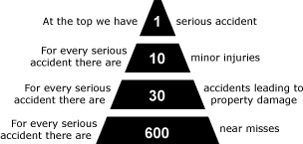
RATIOS OF INCIDENT OUTCOMES
FRANK BIRD ACCIDENT RATIO TRIANGLE

Slide 8
RISK ASSESSORS
COMPOSITION OF RISK ASSESSMENT TEAM
A typical risk assessment team would include:
Team Leader (From OHS Department)
First Line Manager (Department specific)
Worker Representative (Task/Department specific)

Slide 9
RISK ASSESSORS
Risk assessment must be carried out by a competence person:
Must be able to demonstrate H&S knowledge, experience that is relevant to organization,
Ability to apply these qualities to practical situations.
Ability to interpret technical information and standards,
Be systematic in their approach,
Be capable of communicating the findings in a comprehensive and relevant manner.
A “suitable” and “sufficient” risk assessment will identify all groups of people at risk.
In practice, this may mean noting groups or types of people at risk.

Slide 10
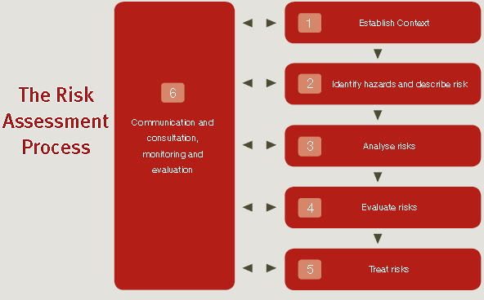
RISK ASSESSMENT
The risk management can be done by the following steps
1. Identify the hazards within the workplace (Risk Identification)
2. Assess the risk (Risk Analysis/Evaluation)
3. Eliminate or control the risk (Risk treatment)
4. Review controls (Monitoring and review)

Slide 11

IDENTIFYING HAZARDS

Slide 12
IDENTIFYING HAZARDS
The Safety Officer and Infection Control officer have to include the following for the identification of Risks which is to be mentioned in the OHS Register. Any hazard not appearing on the OHS Risk Register is to be added onto the register after identifying the hazard by the Safety Office/Infection Control officer
Identifying hazards prior to purchasing substances, equipment, introducing a contractor for specific tasks(eg: maintenance)
Audits
Workplace inspections
Consultation with employees & visitors
Hazard reports from NRL
Health surveillance
Observations during work
Task analysis
Incident reporting and investigation
When implementing specific hazard management procedures

Slide 13

JOB SAFETY AND TASK ANALYSIS:
INSTALLATION
NORMAL OPERATION
BREAKDOWN
CLEANING
ADJUSTMENT
DISMANTLING

Slide 14
Assessing the Risk
Risk Assessment is the process of determining the level of risk‟ associated with a hazard.
All risk assessments are to be conducted in consultation the QM committee and affected employees/visitor/client.
In determining the “level of risk”, the following must be taken into account:
the experience of the person exposed to the hazard;
the frequency and/or duration of the person’s exposure to the hazard;
any existing control measures (treatments);
contributing environmental conditions; and
Pre-existing hazards.
Risk assessments are to be documented using hazard specific hazard/risk management forms.

Slide 15
Evaluate the Risk
What is risk?
It is a measure of the likelihood of harm occurring and the severity of that harm.
Risk is a combination of two factors:
Likelihood.
Severity.

Slide 16
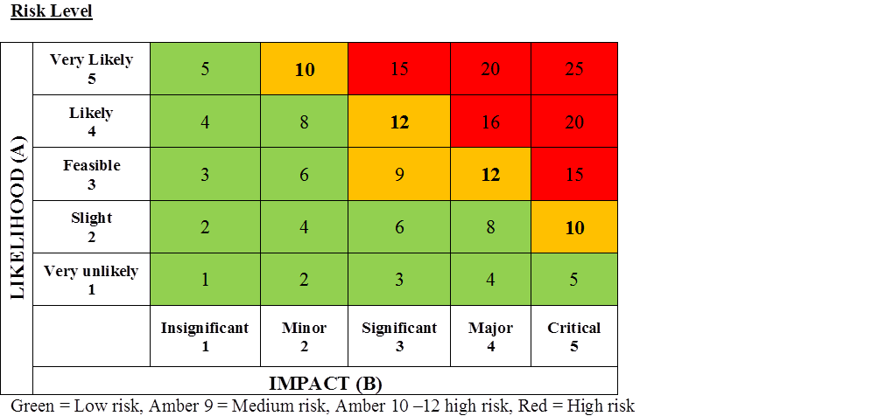
THE RISK EVALUATION CAN BE:
Qualitative
Uses words to describe likelihood and severity, e.g. acceptable or unacceptable.
Quantitative
Uses numbers to describe both likelihood and severity.
Likelihood X Severity = RISK RATING

Slide 17
Eliminate or Control the Risk
Once hazards have been identified and assessed, a control strategy to either eliminate or control the risk is to be developed and implemented. The procedure for controlling the risk and hazard management to an acceptable and as low as reasonably practicable (ALARP) level is as follows;
Elimination: Completely remove the hazard e.g. removal of hazardous substance from the workplace.
Substitution: Change a work practice, substance or piece of equipment to provide a safer environment e.g. substitute old, nonadjustable office chairs to ergonomic chairs to reduce the risk of injuries.
Engineering: Modify the design of the workplace or plant and/or environmental conditions e.g. the use of a fume extraction system to remove fumes generated by hazardous substance use in labs.
Administrative: Developing procedures and systems to control the interaction between people and hazards e.g. reducing the time of exposure to noise by requiring people to be remote from equipment during operation, providing manual handling training to persons so they are better able to identify/report/control/avoid hazards in the workplace.
Personal Protective Equipment (PPE): Implementing PPE to prevent physical contact between a person and hazard e.g. correct footwear, gloves etc.

Slide 18

The HIERARCHY of Control:
Eliminate hazard - most effective.
Reduce hazard.
Isolate hazard from people.
Control extent of exposure/contact.
Personal protective equipment.
Discipline (SSW, information, training, supervision and enforcement) - least effective.
Remember:
ERIC Prevents Death!

Slide 19

Monitor and Review Controls
1. The final step in the process will be to monitor and review the effectiveness of control measures that have been implemented. Control measures should be reviewed at 6 months intervals to make sure that they have had the desired impact in reducing the likelihood and/or consequences of a hazard occurring.
2. The OHS Risk Register should be reviewed when set triggers occur. The Safety Officer and the Quality Management Committee are to review the hazard and inherent risk rating in order to determine if the controls are effective in reducing the residual risk rating to a tolerable level. Consultation and feedback arrangements, in place with employees, will provide information on the application and effectiveness of controls at the workplace level.
3. The Safety Officer and the Quality Management Committee can use the residual risk rating to priorities risk control activities.
RECORD YOUR FINDINGS
The significant hazards.
The existing controls.
Those at risk.
Further actions necessary.

Slide 20
RISK ASSESSMENT SHOULD
BE PERIODICALLY REVIEWED
When the results of monitoring are adverse and not expected
Change in process, work methods or materials
Changes in personnel
Changes in legislation
Introduction of new plant or technology
New information becoming available
As time passes – the risk assessment should be periodically reviewed and updated. A common approached would be no longer than 5 years

Slide 21
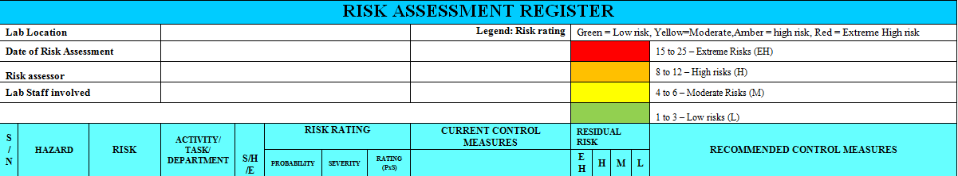
How a Risk Register looks !
NRL uses the below format for risk register
See this link for NRL General risk register
http://10.90.97.57/QPulseDocumentService/Documents.svc/documents/active/attachment?number=NRL-OHS-REC-009%2f2017

Slide 22
PROVIDING APPROPRIATE INSTRUCTION TO WORKERS
INFORMATION
TRAINING
INSTRUCTION
SUPERVISION

Slide 23



.

