Slide 1
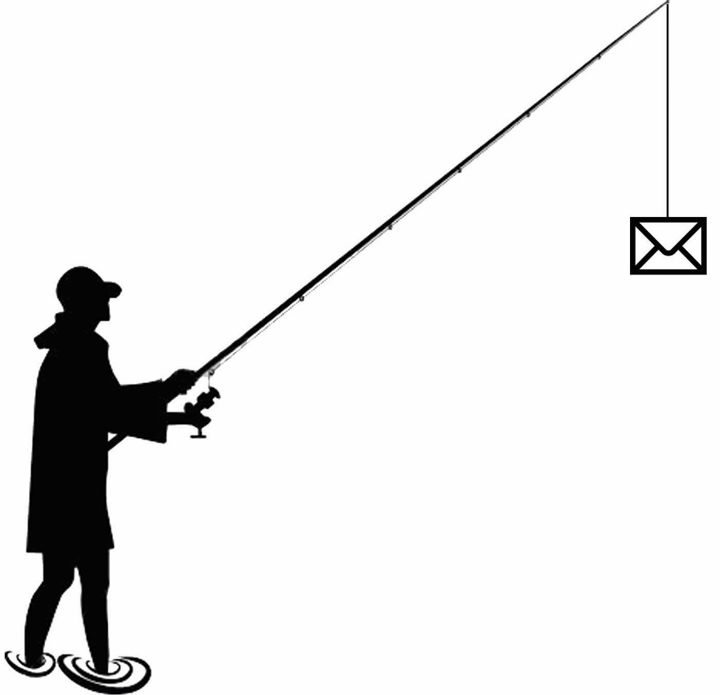
Information Technology Department
Phishing Awareness

Slide 2
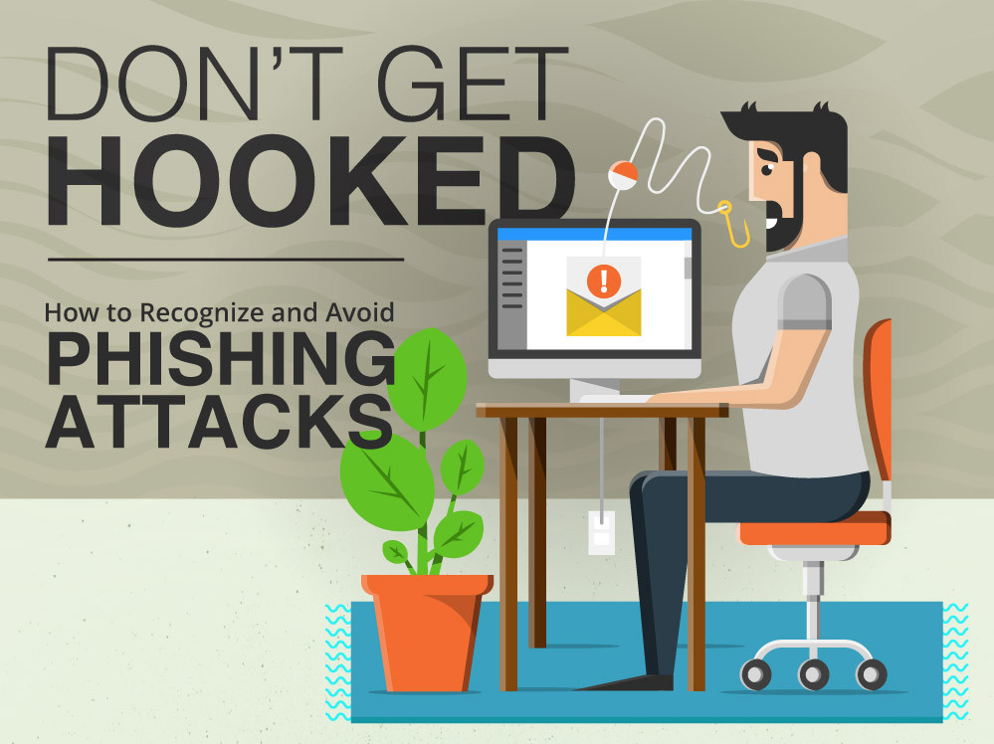

Slide 3
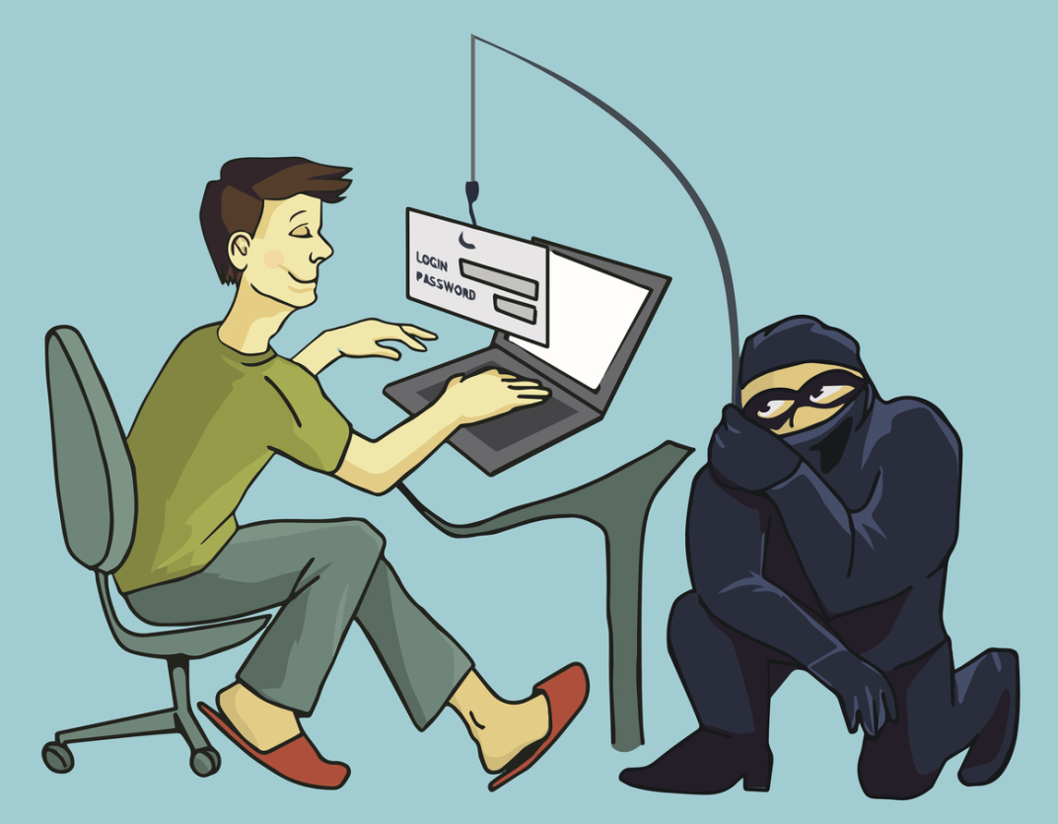
Phishing is on the rise!

Slide 5
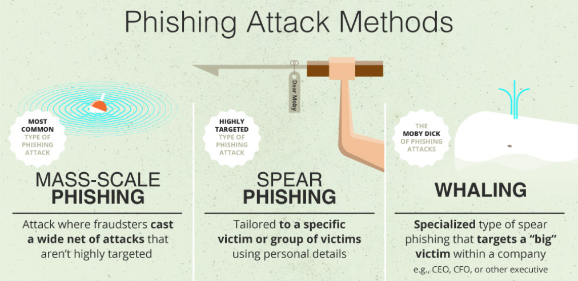

Slide 6
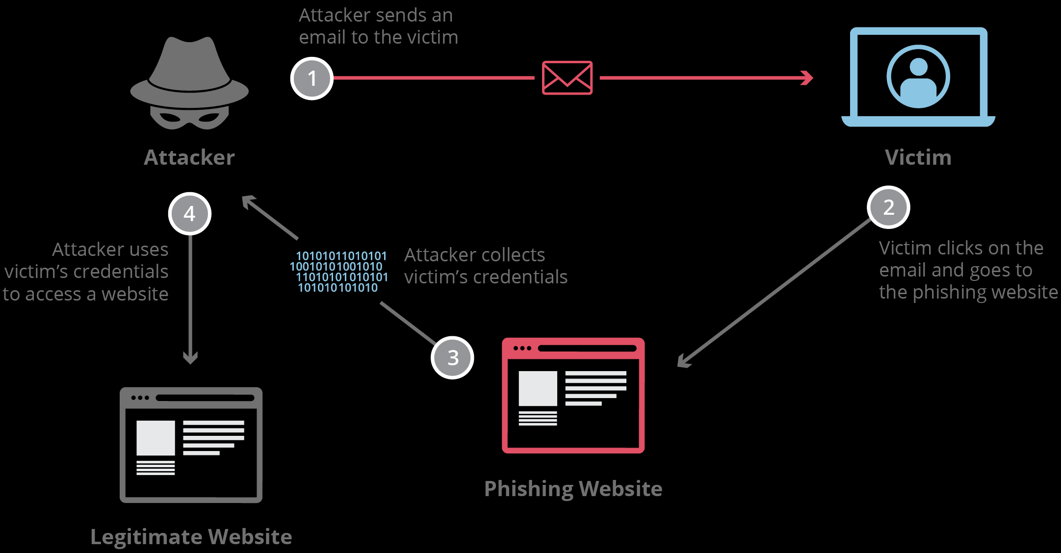

Slide 7
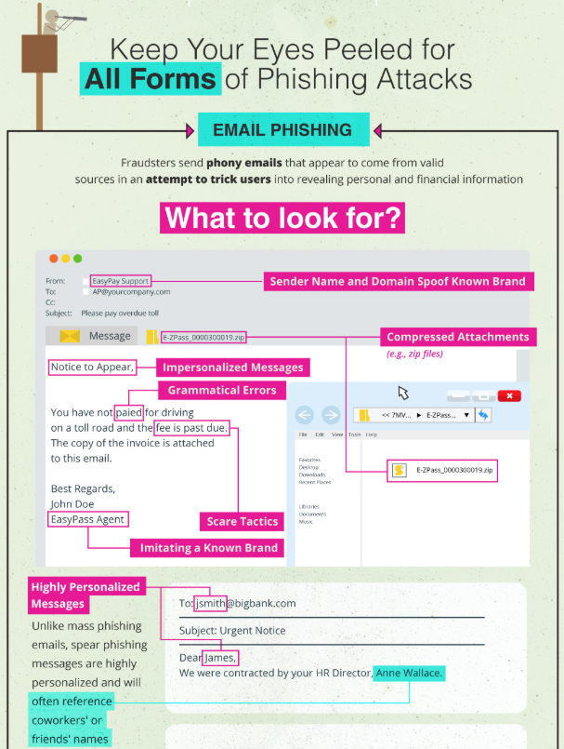

Slide 8
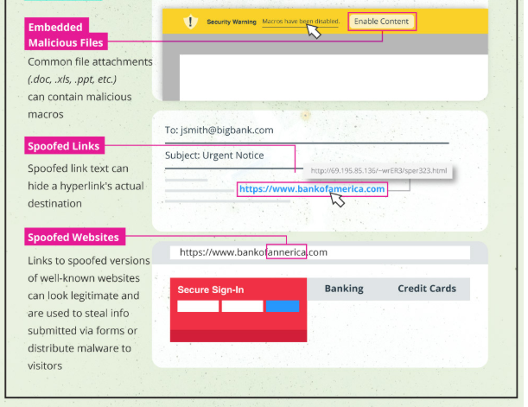

Slide 9
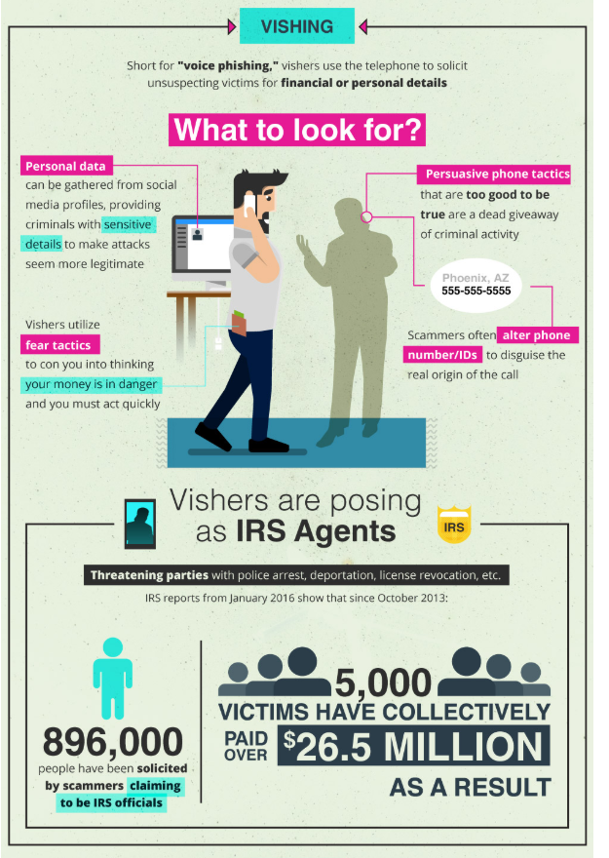

Slide 10
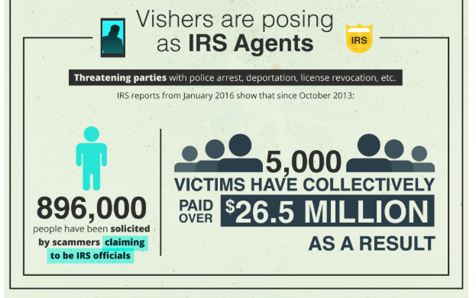

Slide 11
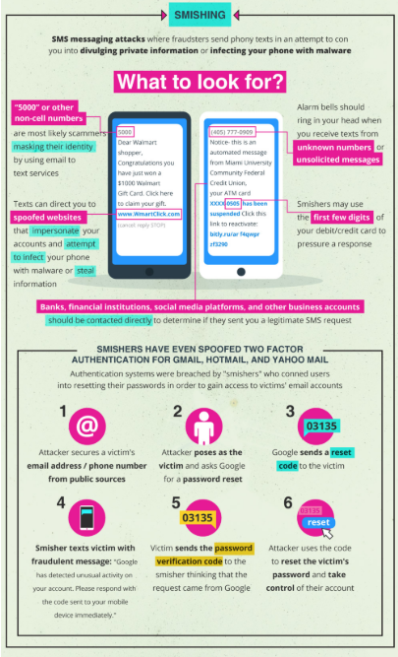

Slide 12
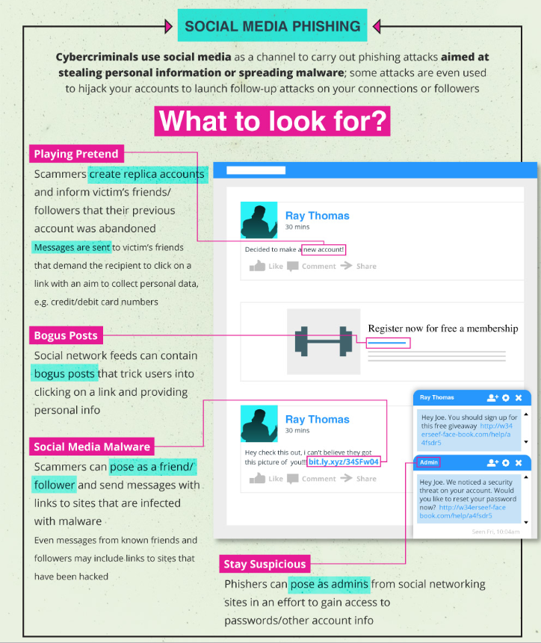

Slide 13
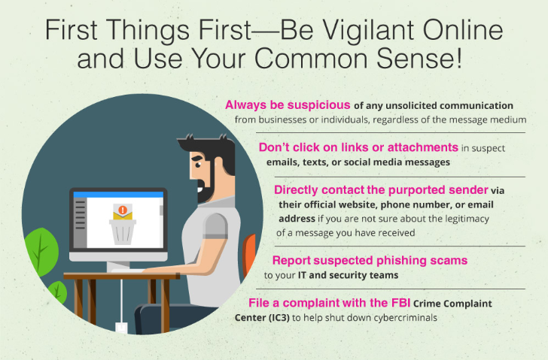

Slide 14
Phishing Quiz – Can you identify the threats??
The online quiz presents 7 emails. Some are valid. Some represent malicious phishing attempts. How well would YOU do? ⇒ Take the Phishing Quiz now!

Slide 15
6 Common Phishing Attacks and How to Protect Against Them

Slide 16
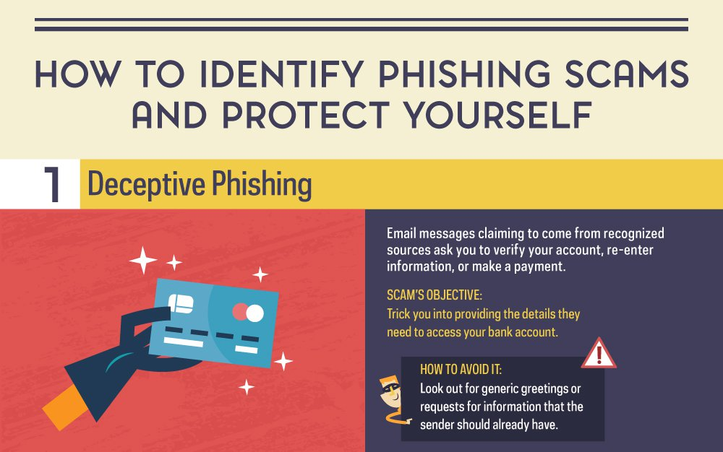

Slide 17
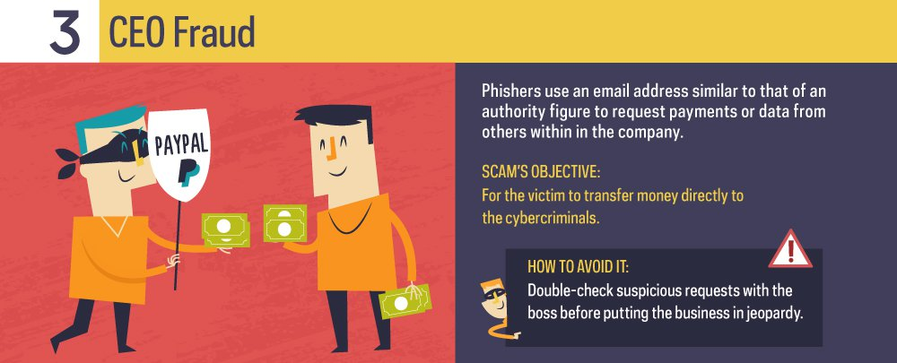

Slide 18
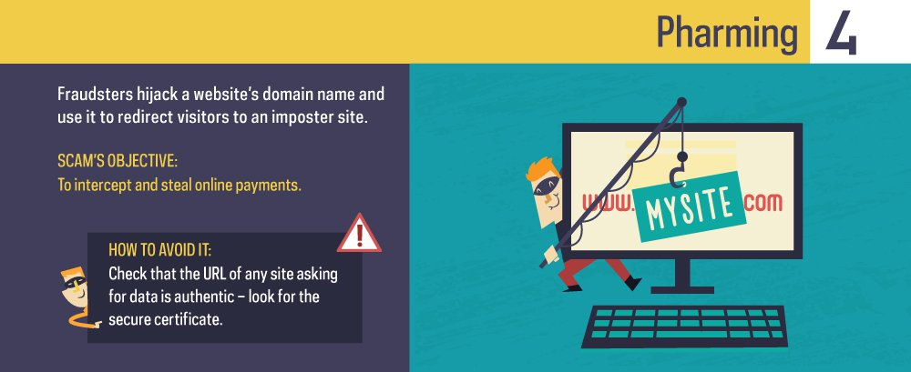
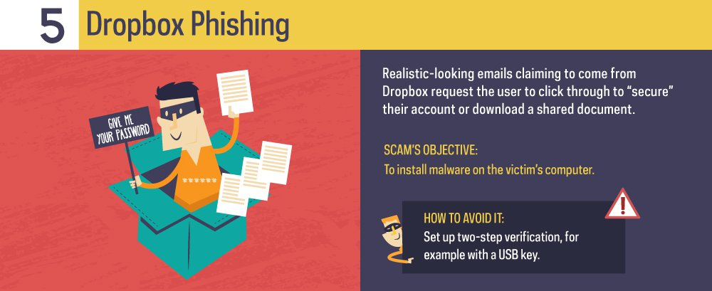

Slide 19
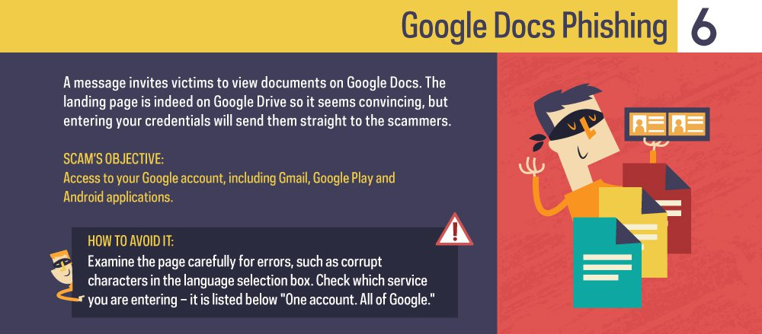

Slide 20
Additional Resources
https://gulfnews.com/business/sectors/technology/cybercrime-cost-uae-dh5-14b-this-year-1.1933736
https://www.tripwire.com/state-of-security/security-awareness/6-common-phishing-attacks-and-how-to-protect-against-them/
https://www.vadesecure.com/en/phishing-awareness-training-8-things-employees-understand/
https://blog.capterra.com/do-you-know-how-to-prevent-phishing-test-your-it-knowledge-with-these-5-phishing-quizzes/
https://www.valuewalk.com/2016/09/phishing-attacks-protect/

Slide 21
For more Information Please contact IT Service its@nrl.ae

