Slide 1
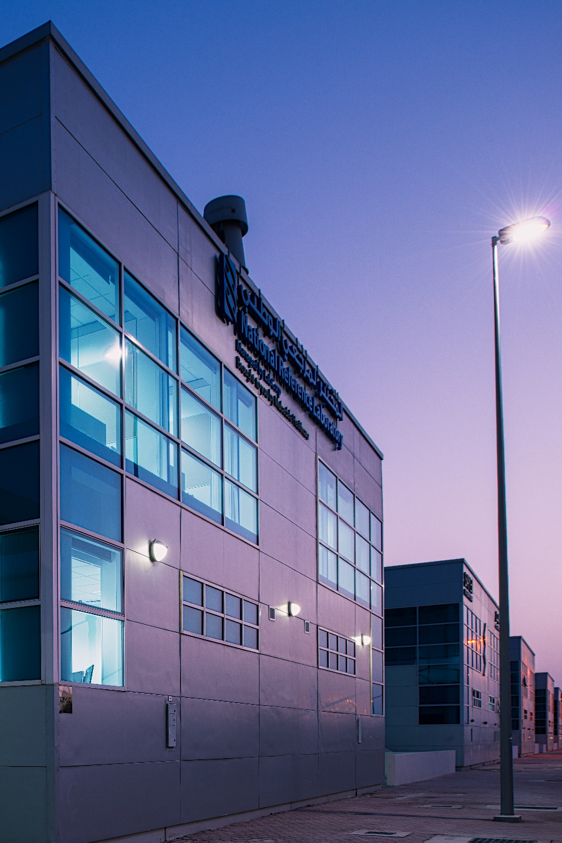
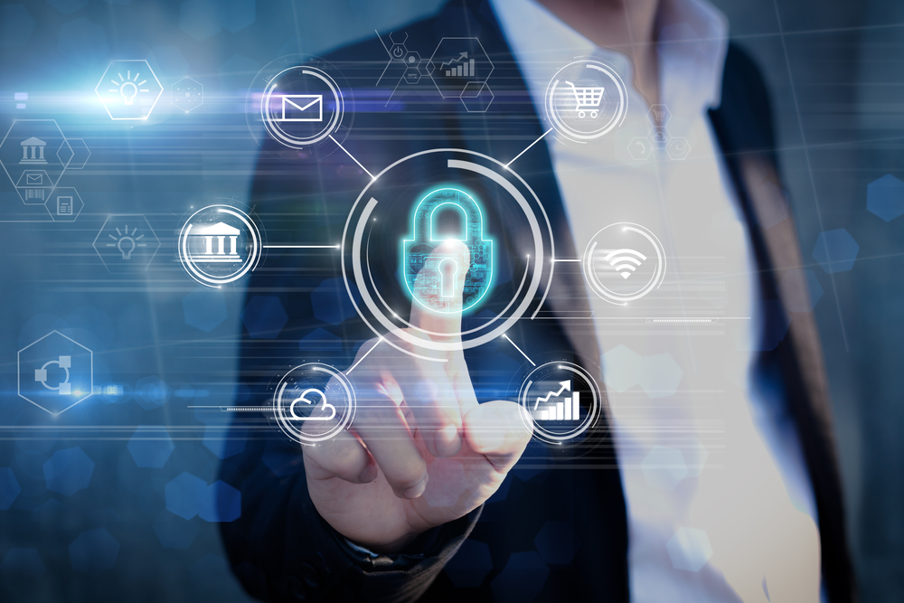
Information Security Awareness 2019
IT Department
[INSERT IMAGE]
March 2019

Slide 2
Overview
Information Security is Everyone’s Responsibility
Threats
Malware Sources
Smart Phone Security Threats
How to Insure Your Mobile Phone Security & Privacy
Social Engineering
Email Attacks
Clean Desktop Policy
Passwords Policy
Questions ?
Anti-Virus
Disposing Data
How to be in the Safe Side
Contact IT Department
Parental Control

Slide 3


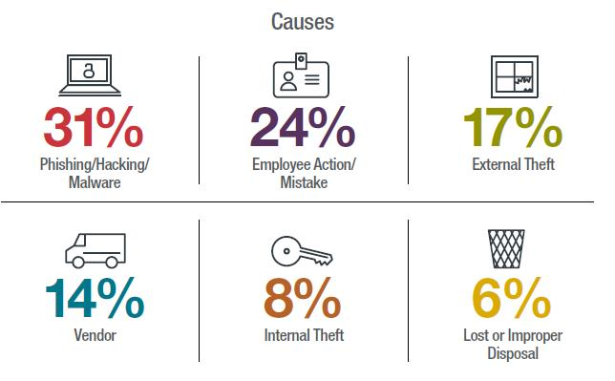

Information Security is Everyone’s Responsibility
Technology isn’t enough,
You are the best defense against breaches.
it’s Ethical &
our Responsibility
  To Protect Patients Information.
It’s Regulatory
  HIPAA, DOH, NESA, MUBADALA, GSI, and ISO
https://www.dataprivacymonitor.com/cybersecurity/deeper-dive-human-error-is-to-blame-for-most-breaches/

Slide 4
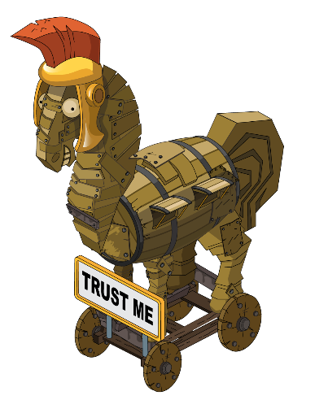

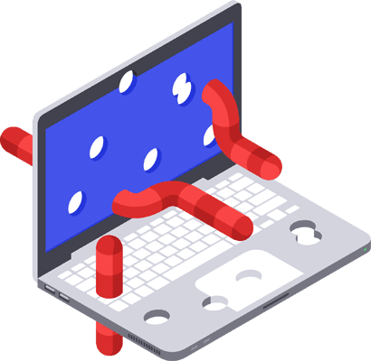
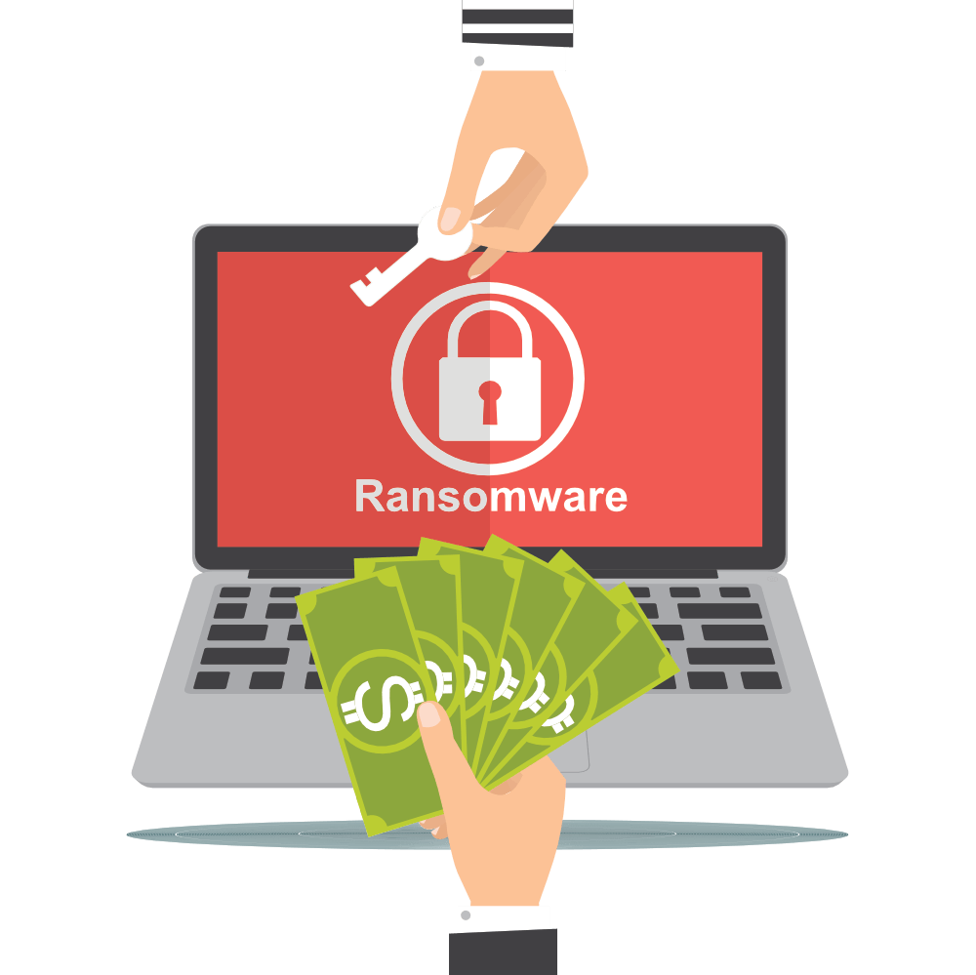
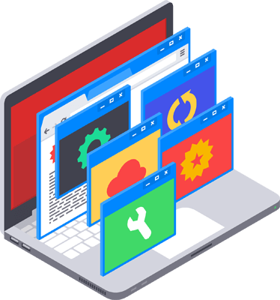
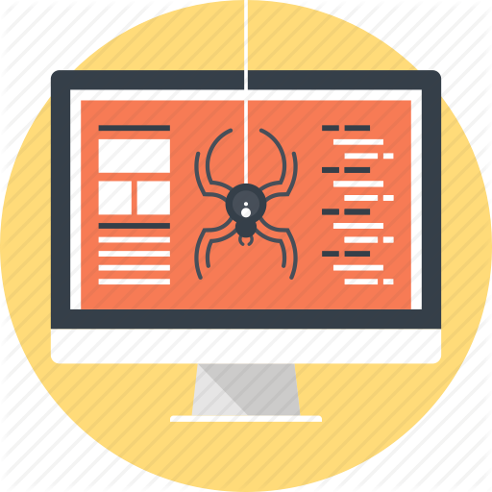
Threats: 5 Most Common Malware Variants
Trojan horse |  | Worms
Ransomware | Adware |  | Virus
Commonly known as a “Trojan,” is a type of malware that disguises itself as a normal file or program to trick users into downloading and installing malware.
Are among the most common types of malware. They spread over computer networks by exploiting operating system vulnerabilities
Is a form of malware that essentially holds
a computer system captive while demanding a ransom.
Is a type of malware that Keeps delivering advertisements.
Is a form of malware that is capable of copying itself and spreading
to other computers.
4
4

Slide 5
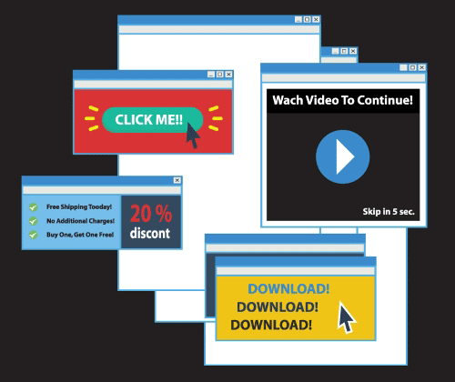

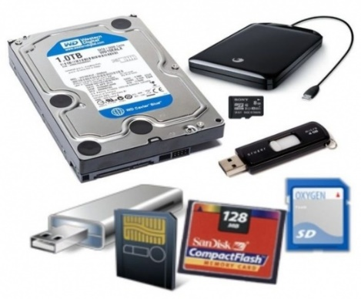
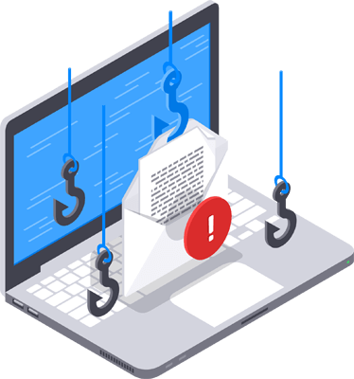
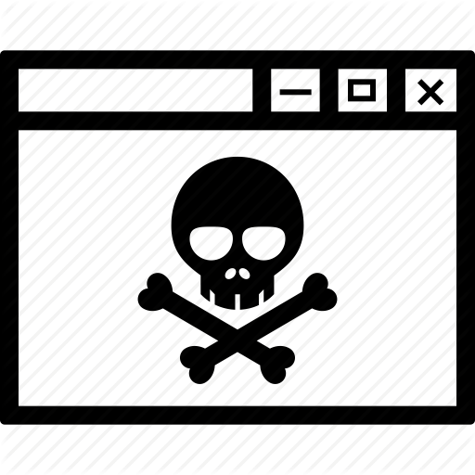


Malware Sources
  Ad’s
Removable Media
  File sharing programs
  Hacked websites or
  Visiting questionable
  websites
  Illegally downloading files
  Phishing attacks
  Public Wi-Fi

Slide 6
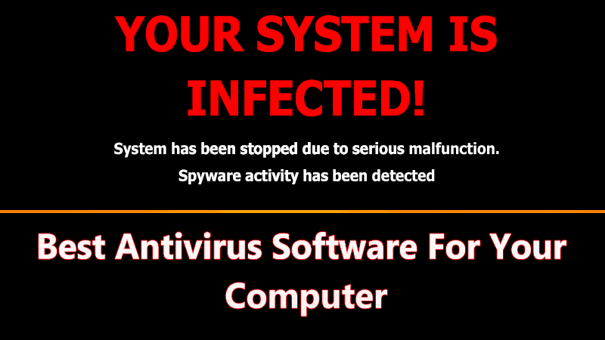

Slide 7
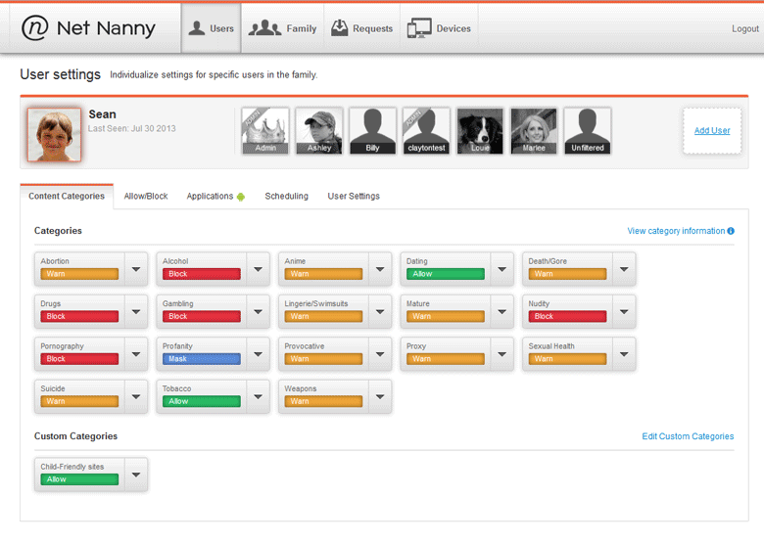

Parental Control
Net Nanny/Features:
Parental Control
Internet Filter
Limit exposure to ADULT content
Screen Time Management
Alerts and reporting
Remote access

Slide 8
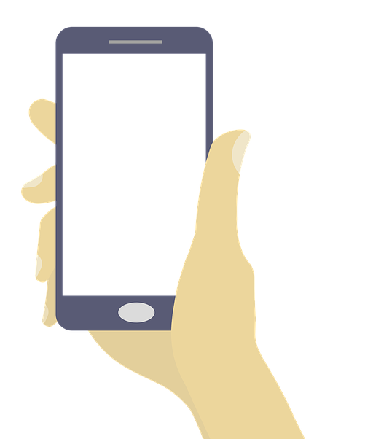

Smart Phone Security Threats
Downloadable Application Threats:
Malware
Spyware
Privacy
Zero Day Attacks
General Cyber Security Threats:
Phishing
Social Engineering
Drive By Downloads
Browser Flaws
OS Flaws
Net and WiFi Security Threats:
Network Exploits
WiFi Sniffing
Cross-Platform Attacks
BYOD
Physical Threat:
Loss / Theft

Slide 9
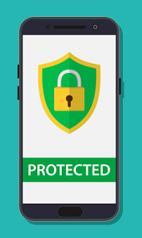
How to Ensure Your Mobile Phone Security & Privacy
Always password-protect your phone
Only Download safe Apps
Always read the terms and privacy policy
Turn off Bluetooth
Encrypt your phone
Setup remote locate wipe
Backup your data
Don’t Jailbreak or Root your phone
Update your operating system
Download anti-malware
Use public WiFi with caution

Slide 10




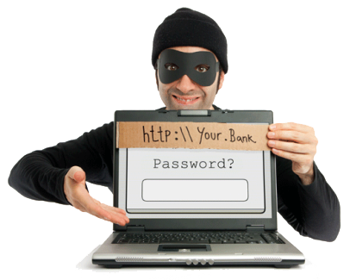


Social Engineering Techniques
Shoulder Surfing
Dumpster Diving
Impersonation
Phishing & Online Scams
Tailgating

Slide 11
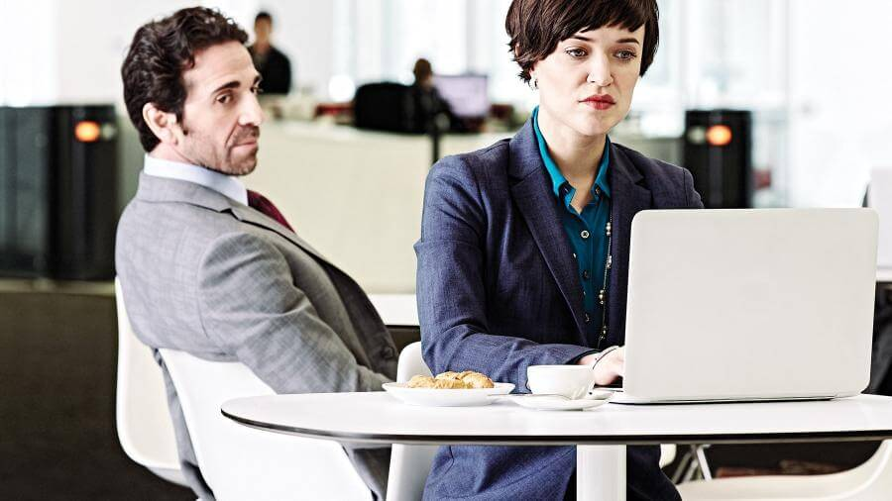
Social Engineering Techniques: Shoulder Surfing
Shoulder surfing is watching someone’s login credentials, social security number, ATM PIN or any other personal secret credentials by looking over their shoulder while they are using it.

Slide 12






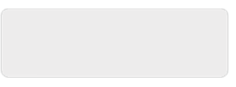
Social Engineering Techniques: Dumpster Diving
It is a method of stealing personal information by digging through a company’s dumpster or trash.
Login:
john
Password:
1234asd

Slide 13
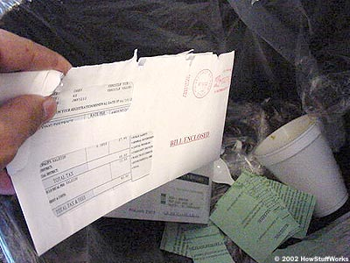
Social Engineering Techniques: Dumpster Diving
When dumpster diving, hackers are usually looking for:
IP Addresses
1
Passwords
2
Policy Manuals
3
Calendars for Events
4
Memos
5
Tapes, CD ROMs, Disks, etc.
6

Slide 14
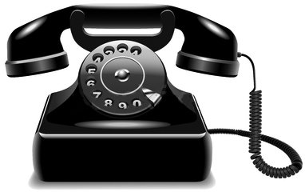



Social Engineering Techniques: Impersonating ITSD.
Calls Caregiver impersonating as IT Service Desk employee
User shares personal info (ID, Password, etc.) information
Use that information / compromise CCAD’s info

Slide 15
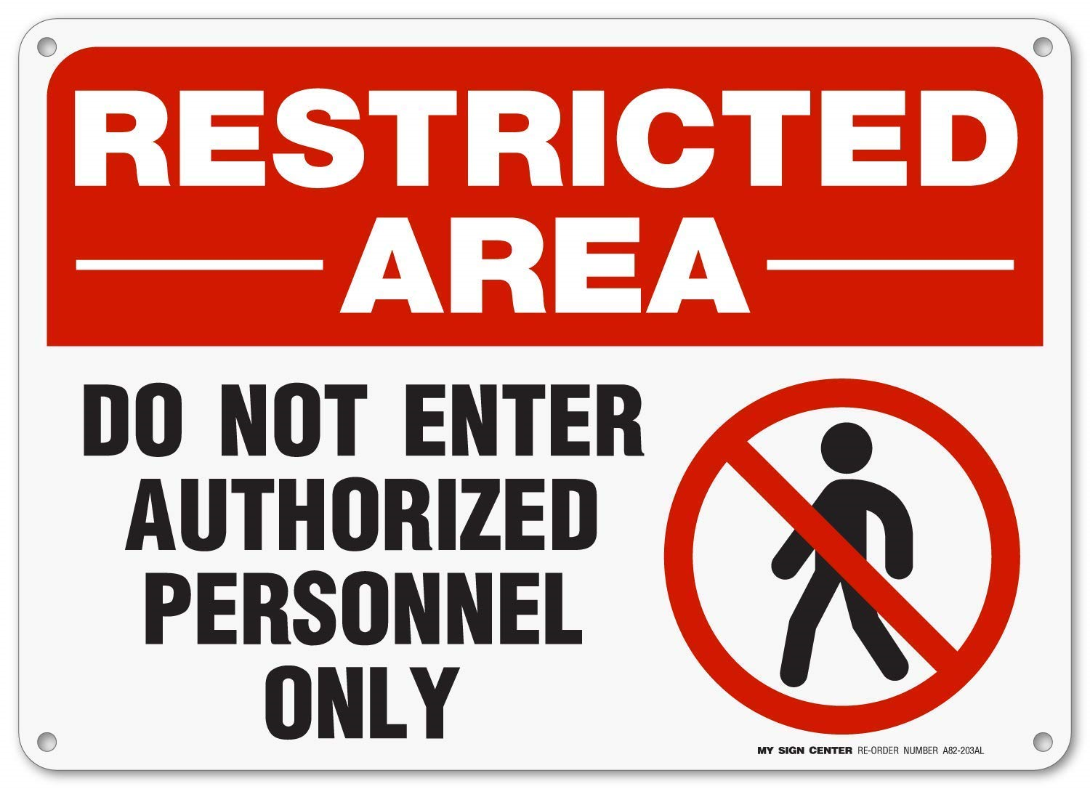
Social Engineering Techniques: Tailgating Attack

Slide 16
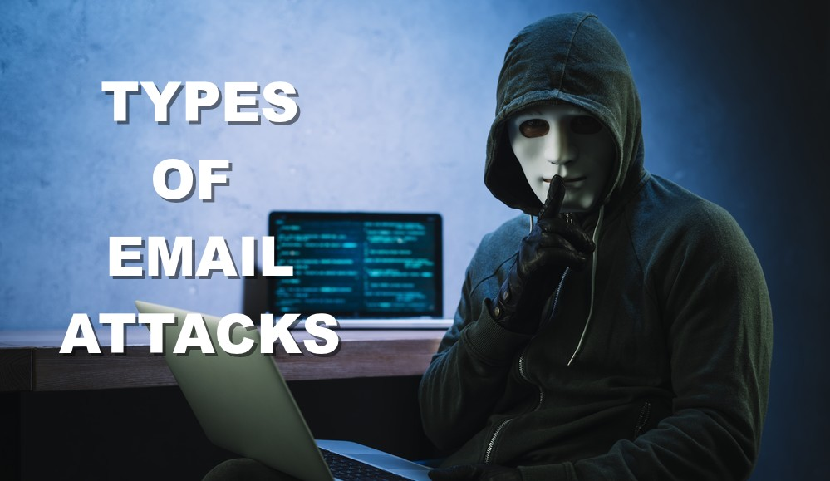
Email Attacks
Phishing
Social Engineering
Malicious Links
Malicious Attachments
Spam
Email Flooding

Slide 17
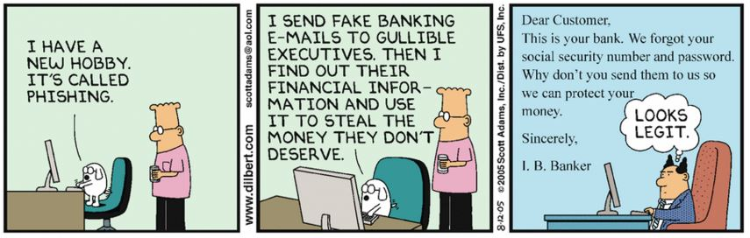
Phishing
Definition:
  The act of sending deceptive emails in order to steal your personal information
Emails are designed to evoke an emotional response

Slide 18

Identifying Phishing Email
Hello
As part of our security procedures, we closely monitor activities being performed in the Facebook system.
We recently discovered unusual Copyright activity linking to your account. We regret to inform you that your account has been suspended due to this activity. In order to re-activate your account, kindly verify usng following link:
www.faceb00k.com/re_activate
Note: If you do not re-activate your account, your account will be permanently blocked.
Regards,
Facebook Copyrights Team.
Spelling
External links
Threat
Popular
Company Name

Slide 19
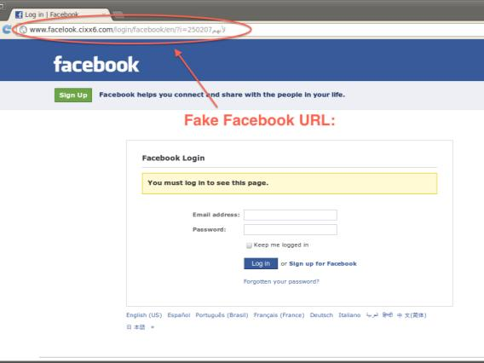
Phishing Website (EXAMPLE)
Fake website designed to harvest your login and password.

Slide 20
Email Security
Use strong passwords that are unique.
Using two-tier authentication.
Watch out for phishing emails
Never open unexpected attachments without scanning .
Avoid sending sensitive information over email but in case its necessary, use encryption.

Slide 21
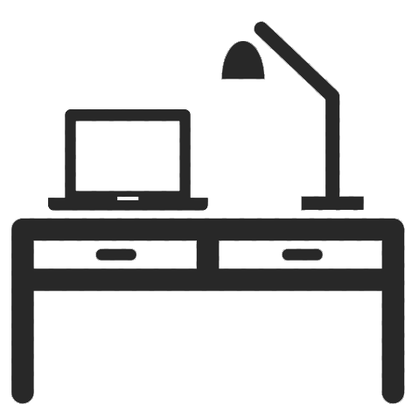
Clean Desktop Policy
YOUR PLACE IS NOT A GOOD PLACE TO KEEP YOUR PERSONAL INFORMATION

Slide 22
Disposing Data
01
  All confidential data must be destroyed when disposing off the media. Simply deleting data is not enough.
02
  Documents must be shredded.
03
  Hard drives and memory sticks must be wiped or physically destroyed.

Slide 23
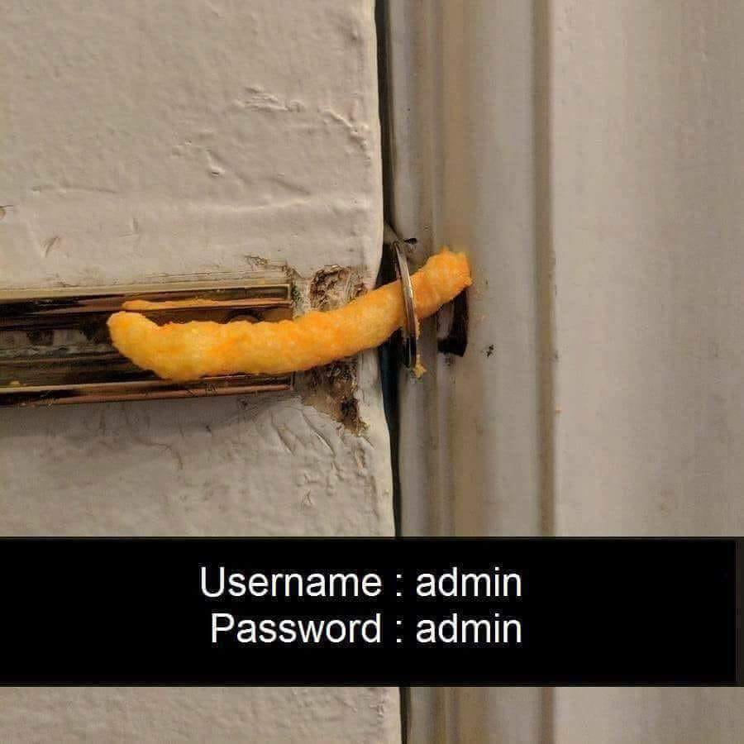
Password Policy
Password policy is designed to establish a standard to ensure creation, use, and protection of strong passwords.
Password policy consists of the following parts:
  Password creation guideline
    Describes the selection and intensity of characters including uppercase, lowercase, numbers, special characters and punctuation.
  Password protection guideline
    This part of the policy emphasizes on the measures needed to be taken for the protection of passwords

Slide 24
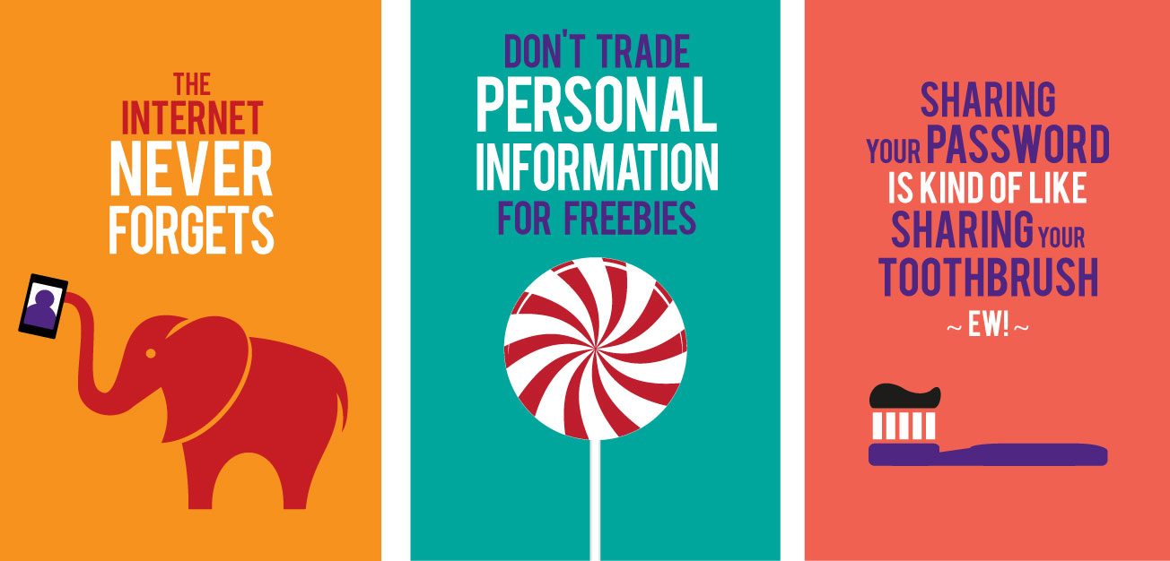
What to know about passwords?

Slide 25
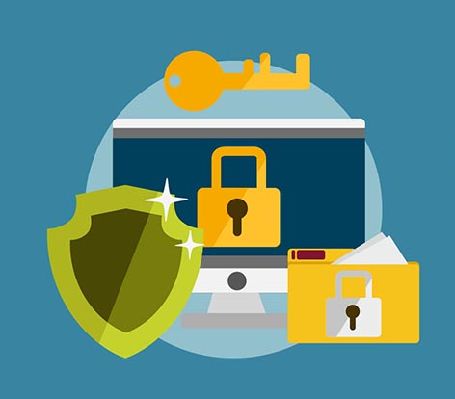
How to be in the Safe Side
1. Never leave devices unattended.
2. Defend against social engineering.
3. Limit Web browsing to work-related sites.
4. Be aware of evolving threats.
5. Avoid Phishing scams.
6. Clean Desk Policy.

Slide 26
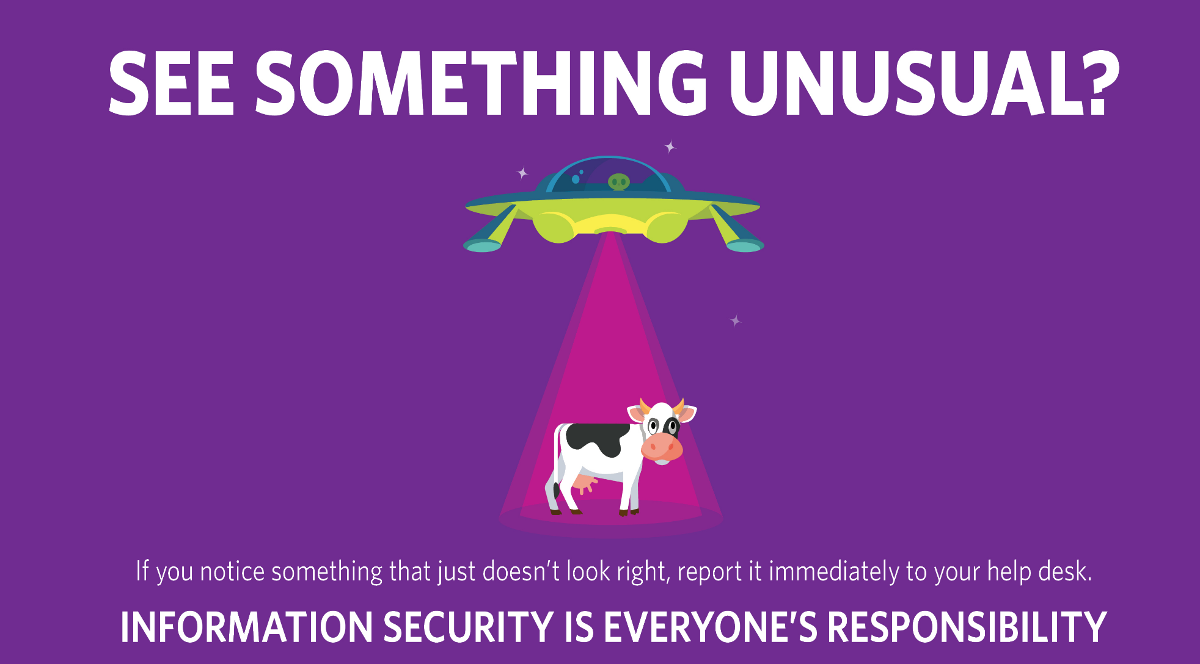
Contact IT Department / IT Service desk

Slide 27

Questions
Please email
IT Support
its@nrl.ae

Slide 28
Thank you

