Slide 1
Root Cause Analysis:
5 Whys
Kannan S Das
Date: February 18, 2020

Slide 2
OBJECTIVES:
Understand What is Root Cause Analysis
How does the 5 Whys system work
Guide you in your efforts to identify the root cause of a problem in order to improve the patient care provided and the customer satisfaction.
To achieve a stable Preventive action.

Slide 3
What is Root Cause Analysis
A root cause is defined as
a factor that caused a non-conformance and should be permanently eliminated through process improvement.
a collective term that describes a wide range of approaches, tools, and techniques used to uncover causes of problems.
Root cause analysis is part of a more general problem-solving process and an integral part of continuous improvement. Because of this, root cause analysis is one of the core building blocks in an organization’s continuous improvement efforts.
It's important to note that root cause analysis in itself will not produce any results. It must be made part of a larger problem-solving effort for quality improvement.

Slide 4
Root Cause Analysis Tools
Pareto Chart
The 5 Whys
Fishbone Diagram
Scatter Diagram
Failure Mode and Effects Analysis (FMEA)
We are focusing on the “5-WHYS” here

Slide 5
5 Whys
Uses a series of questions to drill down into successive layers of a problem.
The basic idea is that each time you ask why, the answer becomes the basis of the next why.
It’s a simple tool useful for problems where you don’t need advanced statistics, so you don’t necessarily want to use it for complex problems.
One application of this technique is to more deeply analyze the results of a Pareto analysis.
Of course, it may take asking why more than five times to solve the problem—the point is to peel away surface-level issues to get to the root cause.

Slide 6
Factors to consider when applying for EXTERNAL ASSESSMENT

Slide 7
Benefit of asking ‘why’
Asking WHY will lead you to the ROOT of the issue
Identify ONE reason and dive deeper to identify the ROOT CAUSE
If you identify multiple reasons, PLAN to implement change on only ONE reason at a time
If you fail to find a resolution, move on to the NEXT reason you identified

Slide 8
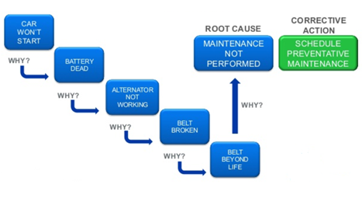
Root cause analysis using ‘5 whys’

Slide 9
EVENT INVESTIGATIONS
Is human error a root cause?
We need to know why the error occurred, and why the systems in place allowed for the error to occur.
Dangers of stopping the investigation at the human error cause:
The underlying systemic problem(s) will go unaddressed, leaving the same non-transitory environment in place that will allow a repeat of this same event - flaws in the systems and processes contribute to most mistakes.
It leads to punitive solutions.

Slide 10
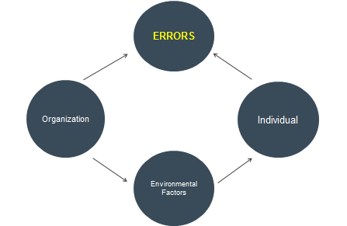
Contributory factors for error occurrence

Slide 11
The reason – ‘swiss cheese model’
The Swiss Cheese model of accident causation is a model used in risk analysis and risk management, including aviation safety, engineering, healthcare, emergency service organizations.
It likens human systems to multiple slices of swiss cheese, stacked side by side, in which the risk of a threat becoming a reality is mitigated by the differing layers and types of defences which are "layered" behind each other.
Consider the holes to be opportunities for a process to fail. An error may allow a problem to pass through a hole in one layer but in the next layer, the holes are in different places so the error should be caught.

Slide 12
Example Problem: Critical Report not received to Client
1. Why is critical report not resulted to client?
Ans: Tech missed to report
2. Why the Tech missed to report?
Ans: The critical result is not flagged as critical result in LIS
3. Why the result is not flagged as critical result in LIS
Ans: Patient age was missing so the result is not relating to the reference range set.
4. Why the patient age missing?
Ans: Data entry error
5. Why the data entry error is not identified at the time of data entry?
Ans: DOB is not a mandatory field in LIS, hence not flagged by the system.

Slide 13
Points to remember
You must FIRST identify the problem BEFORE jumping to a solution
We often jump to what we THINK is the problem and develop a “quick fix”
If you fail to identify the ROOT CAUSE, the problem will continue or reoccur
Determining WHEN it started may help you identify a change in practice that lead to the issue
Understanding WHY it happened will help you identify a solution
Identify a PROCESS, not an INDIVIDUAL
Avoid covering the problem with a BANDAID
Developing a PLAN to implement a change leads you to begin the Plan –Do –Study –Act (PDSA) cycle

Slide 14
Reference
https://www.beaconquality.com/blog/5-root-cause-analysis-tools-for-more-effective-problem-solving
https://asq.org/quality-resources/root-cause-analysis
Root Cause Analysis: 5 Whys
Heartland Kidney Network Quality Improvement Team

Slide 15
Thank You

