Slide 1
Software Overview:
To provide a synopsis of frequently used software tasks in order to utilize and navigate the ACL TOP Family analyzer for routine operation.

Slide 2
Software overview
The objective of this power point is to use the software effectively.
The following will be covered in this PowerPoint
Layout of software
Define key icons
Determine function of icon bars

Slide 3
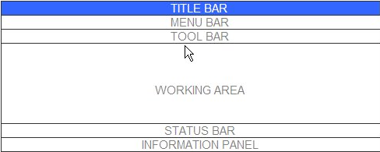
Layout
Each screen contains the following areas:
Title Bar
Shows screen name
Menu Bar
Toolbar
Working Area
Status Bar
Information Panel
Notes:
Title Bar - displays the instrument name and the screen name.

Slide 4
Layout

Slide 5
Menu bar
The ACL TOP 500 CTS main menu bar contains the following menu options:
Instrument: General instrument functions
Actions: Specific actions appropriate to screen displayed
QC: Options to review QC results and status
Calibration: Review or perform calibration
NPP: Review Normal Pooled Plasma results
Setup: Access areas of software to setup all functions
Help: Access online help (Operator’s Manual)

Slide 6
Tool Bar
The tool bar contains the main functional icons.
Operational Icons
Navigation Icons
Operational Icons are used to perform an action on a sample or group of samples
Navigational Icons are quick ways to go from one screen to another. Menu bar accomplishes this also.
Sample List Display- Customize the sample list screen
Access on-line help

Slide 7
Operational Icons
Validate Results
Upload Results
Transmit to LIS
Filter Sample List
Search Sample List
Sample Details
Test Details
Save
Add or Remove Tests
Navigational Icons
Previous Screen
Sample List
QC Result List
Calibration List
Sample Area
Reagent Area

Slide 8
Working Area
The working area is below the toolbar and contains a data table or a form. There are a number of different data tables and forms that can be displayed in the working area. Some examples are:
Sample Area
Reagent/Diluent Area
Sample List Area

Slide 9
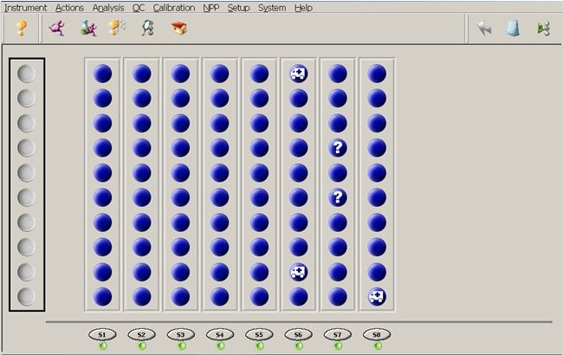
Sample Area
Sample Area shows placement of samples in the racks on the analyzer

Slide 10
Status Color Code
The status of a sample is indicated by color:

Slide 11
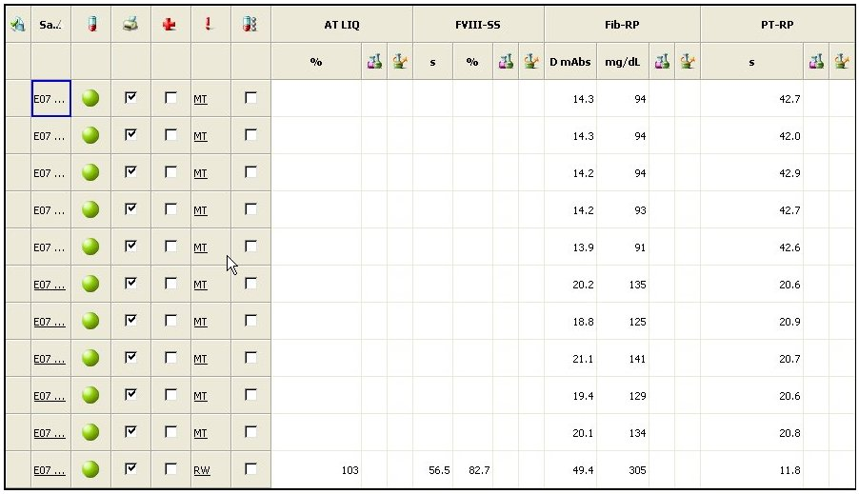
Sample List Area
The Sample List contains sample and test information.

Slide 12
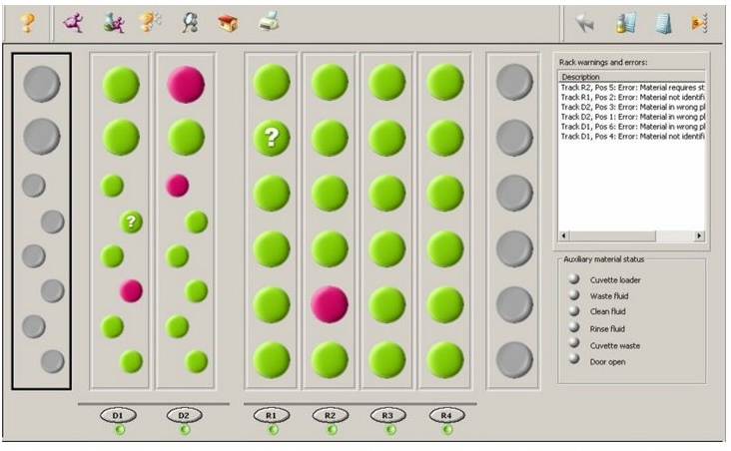
Reagent and diluent area
The reagent and diluent area shows the placement and status of reagents on the analyzer.

Slide 13
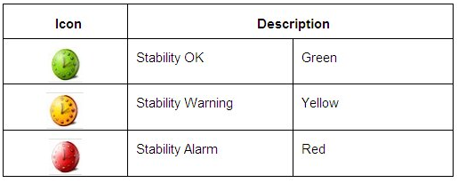
Reagent area
Reagent Status
Remaining Stability

Slide 14
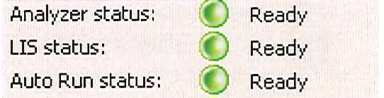
Status Bar
Located Below the working area and contains several buttons pertaining to the analyzer.
The first button is the General Log of the analyzer
The next section is the Analyzer general status.
This section allows the user to determine what function is being performed by the analyzer.
The common indicators are listed to the right->

Slide 15
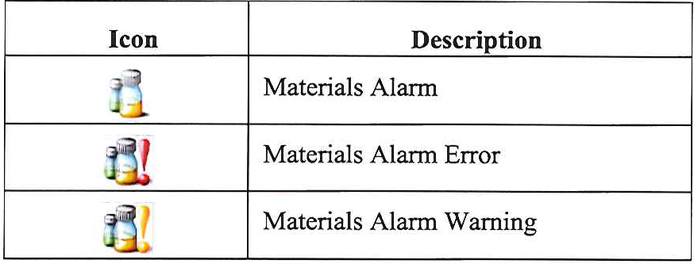
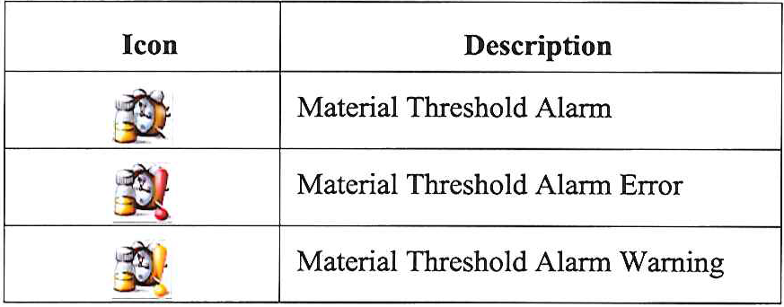
Status Bar
The Material Status button alerts the operator with the status of materials on board or required by the analyzer.
The Job Frequency button indicates that certain functions are coming close to expiration or have expired.
Incorrect position or out of reagent
Expired
Reagent Level Low
Near expiration

Slide 16
Status Bar
The Quality Control Button alerts the operator of QC warnings or alarms.
The Maintenance Button indicates when a maintenance procedure is due or overdue.
The Analyzer Button alerts the operator of analyzer warnings or alarms.
The LIS Button allows access to host communication log.

Slide 17
Informational Panel
The information panel located on the bottom of the screen always displays:
Time until completion
Numbers of entries in the Sample List
User currently logged in
Security level logged in user
Current date and time

