Slide 1
Analyzer Overview
To provide a synopsis of the ACL TOP Family analyzer

Slide 2
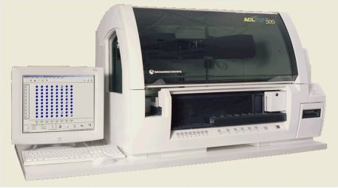
Overview
The ACL TOP 500 CTS is a mid- to large volume (80 sample capacity) bench-top, fully automatic, random-access analyzer that is intended for analysis using both open and closed (capped) sample tubes and having cap piercing capability.

Slide 3
Measured Parameters
The ACL TOP 500 CTS is used to perform the following types of tests:
Coagulometric (Turbidimetric) tests
used in the system to measure and record the amount of time required for a plasma specimen to clot. This technique assesses coagulation endpoint by measuring change in optical density.
Chromogenic (Absorbance) tests
Direct or indirect enzyme activity is then measured using a specific synthetic substrate.
Immunological tests
used on the system to directly measure and record the amount of an analyte.

Slide 4
Instrument Description
The ACL TOP 500 CTS system is composed of two modules:
Control Module (CM) - User interface and operation control
The CM provides the major functionality associated with the user interface (UI) including data management, data reduction, LIS (laboratory information system) communications, sample identification, test materials management, fluid management, reporting, test tracking and quality control (QC) management, and monitoring.
Analytical Module (AM) - Primarily sample and reagent handling hardware
The AM consists of the functionality required to handle and process reagents and auxiliary materials. It can perform coagulometric (turbidimetric), chromogenic (absorbance), and immunological measurements.

Slide 5
Instrument Description
Control Module (CM)
Analytical Module (AM)
The CM consists of the following:
Personal computer running Windows software
Keyboard
Touch screen display monitor
Mouse
Communications interfaces to the AM and external devices/systems.
The AM includes:
AM computer
Cuvette handling
Sample area
Reagent/Diluent Area
Bulk fluids
Waste handling
Sample handling
Reagent handling
Reaction and detection
Interconnect and power supply
Access-restricting cover with safety interlock
Instrument-supporting structure-chassis
Safety interlock for cuvette waste drawer

Slide 6
ACL TOP 500 CTS Model Analytical Module with Open Safety Cover
The cover:
enhances operator safety
reduces the effect of the external environment
minimizes the evaporation from samples and reagents.
maintains temperature control
reduces the effect of stray light on sample data acquisition.
The software controls the unlocking of the access cover.
The ACL TOP 500 CTS is able to detect whether the access cover is open or closed.
If it detects that the access cover is open, an emergency stop is automatically initiated. The instrument will not operate with the access cover open.
The locking access cover is designed to provide increased operating safety. The cover on the instrument must remain closed during system operation.

Slide 7
ACL TOP 500 CTS Model Analytical Module
AM Power Connector
The power switch is located on the right side of the analytical module, adjacent to the power cord connection.
This switch is for the main power supply and controls all power to the AM
During normal operation, the ACL TOP 500 CTS is powered on continuously.

Slide 8
Emergency Stop Button
The instrument has a red emergency stop button located on the AM to the far right below the bar code reader home position.
Use this button whenever the instrument must be stopped immediately.
Pressing this button while the instrument is operational causes an immediate cessation of all movements.
Any tests that were in progress will need to be restarted.
Emergency Stop Button

Slide 9
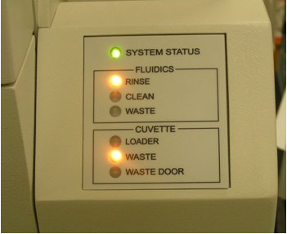
System Status Indicator
Displays a red error light when there levels are critical
Displays an amber warning light when levels will soon need action
Blue system status light displays when busy
Green system status light when system is in ready state

Slide 10
Bar Code Reader
The bar code reader (BCR) moves to each track position to allow for insertion of the sample, diluent or reagent racks. Bar coded information on sample tubes or diluent or reagent bottles is scanned into the instrument as the racks are inserted.
Move the bar code reader to the desired track using the track buttons on the front of the AM or by clicking the virtual track buttons displayed on the reagent area screen on the CM.
With the bar code reader positioned in front of the track position, insert the rack. A track guides the insertion of the rack into its correct position.
Barcode Reader
(in home position)
Track Button

Slide 11
Bar Code Reader
You can use the home button to move the bar code reader to its home position without having to wait for the BCR timeout.
You can also use the virtual home button displayed on the touch screen when the sample or reagent screen is displayed.
Home Button

Slide 12
Sample Area
On the left side of the AM is the sample area where patient samples are placed on the AM. The sample materials are placed on racks that are inserted through the bar code reader.
The sample area is at ambient temperature and can hold 8 racks, each capable of holding 10 samples for a total of 80 samples.
When the rack is in use (during aspiration of sample material) it is locked and an amber light emitting diode (LED) is displayed for the track position. When the rack is no longer in use the LED changes to green and the rack is released.

Slide 13
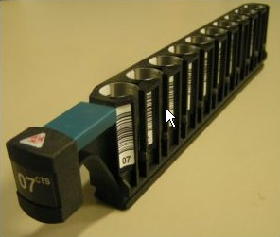
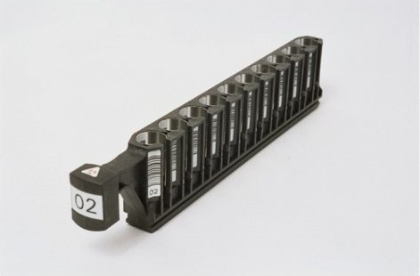
Sample Area
The sample rack holds both open sample tubes and sample cups for use with the non-CTS mode; you must use only closed tubes on CTS sample racks (racks identified with CTS on the front) with the CTS piercing mode enabled
CTS sample rack
non-CTS sample rack

Slide 14
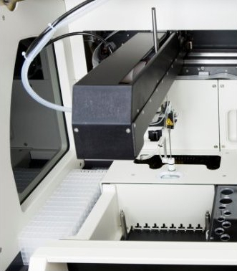
Sample Area
The probes are the vertical part of the sample and reagent arms that are in contact with the liquid.
Behind the rack areas are two incubators that are used for the sample and/or reagent incubation phase(s) of the test.
Sample Probe and Incubator Slots

Slide 15
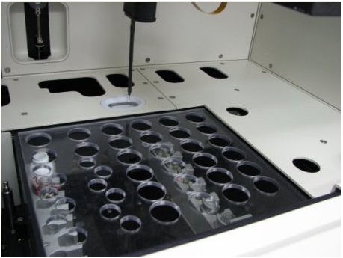
The Reagent Area
The reagent area is on the right side of the AM. There are 4 tracks, each with six reagent positions, that hold up to 24 reagents. As with samples, reagent racks are inserted into reagent tracks by means of the bar code reader.
Reagent Area Showing the Reagent Probe

Slide 16
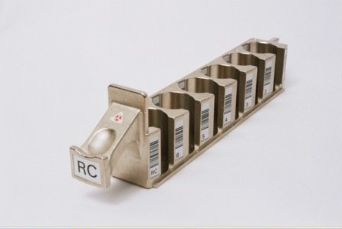
Reagent Area
As with samples, reagent racks are inserted into reagent tracks by means of the bar code reader.

Slide 17
Cuvette Loading Area
The cuvette loader can be filled with up to 20 clips of 10 cuvette strips each, for a maximum of 200 cuvette strips (800 cuvette cells).
A conveyor belt transports the cuvette clips to the front of the loading area.
The indexer pushes the cuvette clip to the right to position it so one strip can be picked up by the cuvette shuttle.
As the cuvette strips are used, new cuvette clips are brought forward and positioned for pickup. You can add more to the loading area while the analyzer is running.
The cuvette shuttle picks up a single cuvette strip from the cuvette clip and transports it from one position or slot to another.

Slide 18
Cuvette Indicator
Electrical sensors detect when additional cuvette clips need to be loaded onto the system, and inform the operator by means of an indicator on the front right of the instrument.
An amber LED for Cuvette Loader indicates the loader contains 3 or fewer clips.
A red LED indicates the loader is empty.

Slide 19
Cuvette Waste Drawer
The cuvette waste container is located on the lower right side of the instrument behind the cuvette waste door.
The cuvette waste module includes an accumulator that allows the cuvette waste drawer to be emptied without shutting down the instrument

