Slide 1
ACL Clot curves job aid:
What to do when your results fail

Slide 2
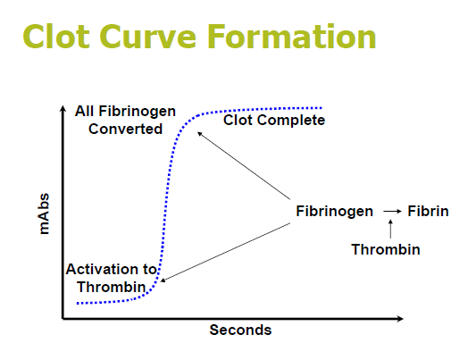
Clot Curve Definition
  Clot curve is visual representation of the reaction taking place in the cuvette or the change in absorbance over time
  This change in absorbance is a measure of the conversion of fibrinogen to fibrin in the presence of thrombin forming a clot.
Used to troubleshoot:
  Abnormal or questionable samples or results
  Errors or warnings

Slide 3
Sequence of events
Specimen loaded on analyzer
Sample and reagent added
Last reagent added to cuvette
Acquisition time starts
Data readings are taken ten times a second
Data plotted using Algorithm
Result obtained from clot curve

Slide 4
Algorithm
A formula or process used to convert the raw optical measurements into a clot time
  Defined in test definition
  Smoothes the data to display a visible line
Applies multiple checks to evaluate clot integrity
Data not passing criteria displayed with flag
  CE –Coagulation error
  CW –Coagulation warning

Slide 5
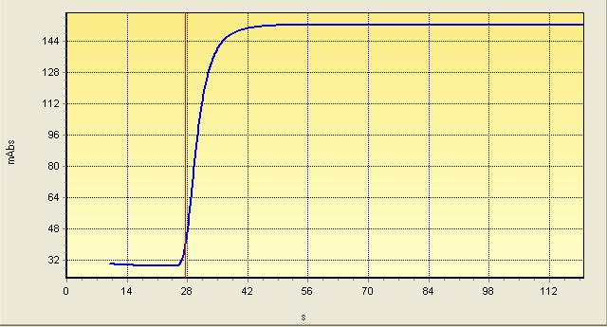
Basic Components of a normal clot curve
A typical normalized clot curve will have a baseline, an acceleration phase, a deceleration phase, and an endpoint.
Endpoint
Deceleration
Acceleration
Baseline

Slide 6
Curve Segments
Baseline
  the part of the curve before clotting occurs, therefore there is little change in absorbance
  It should be fairly flat.
Acceleration
  consists of the light readings during the clotting process.
  The curve should be very steep as clotting occurs very quickly.
Deceleration phase
  immediately follows acceleration and
  represents the decreasing rate of clot formation as all available fibrinogen converts to fibrin.
Endpoint
  consists of absorbance readings after all of the fibrinogen has been consumed and the sample is no longer clotting.
  The curve will flatten again because there little change in absorbance, but should remain stabile.

Slide 7
What affects Curve Appearance?
Sample Quality
  Improper Collection
  Clotted Sample
  Hematocrit Level
  Frozen Samples Thawed Incorrectly
Reagents- (Check your QC)
  Improper reconstitution
  Expired Reagents
  Reagent Contamination
Clinical Conditions of Patient
  Anticoagulant therapy
  Factor level deficiency
  DIC
  Sepsis
  Excessive lipemia
  Liver Disease
Instrument Issues

Slide 8
Curve Characteristics and possible Causes
Curve Characteristics | Possible Cause
Flat Curve | Lipemia or other interfering substance Low Fibrinogen Excessive Anticoagulant Sample Quality Reagent Quality
Shallow Acceleration | Slow Clot formation
Small Change in Absorbance | Short Clot time Noisy Baseline Low Fibrinogen concentration
Large Change in Absorbance | High Fibrinogen Concentration
Endpoint Drops | Unstable clot
Endpoint Rises | Clot still Forming
Acceleration Seen but no Endpoint | Clot didn’t form within testing time
Long Baseline | Prolonged/impaired clotting mechanism

Slide 9
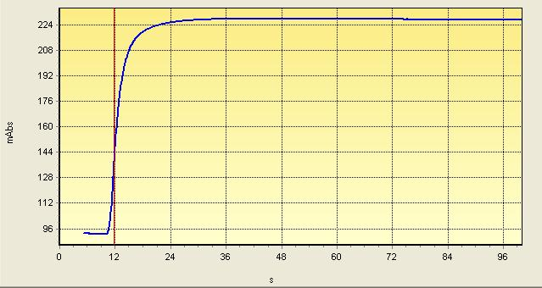
Normal Curve
Check each segment for:
  Starting point
  Ending point
  Slope
  Stability
Currently, we perform only 3 clotting tests: PT, PTT and TT.
These are the only tests that use the clotting curve.

Slide 10
Derivative Curves
Normalized clot curve
Derivative curve scale

Slide 11
Using Derivative Curves
The first derivative curves are colored in fuchsia on the graph.
  Defined as maximum velocity of curve
  Scale for the first derivative curve is on the right side “Y” axis
The second derivative curves are colored in light blue on the graph.
  Defined as maximum change in velocity (acceleration) of curve or fastest rate of fibrin formation
Note that the first and second derivative curve share the same “Y” axis derivative curve scale on the right.
Things to keep in mind when using this tool:
The normalized clot curve (dark blue line) should have the characteristic “S” shape
A distinct peak for the first derivative (fuchsia line) should be present for assays using this algorithm. This would be for PT-RP.
Both a distinct peak for the first derivative (fuchsia line) and second derivative (light blue line) should be present for aPTT-SS and TT5.
The first derivative curve for PT-RP and both derivatives curves for APTT-SS and TT5 must have peaks that are at least 10 in magnitude in order to meet the first and second derivative peak "change" criteria.

Slide 12
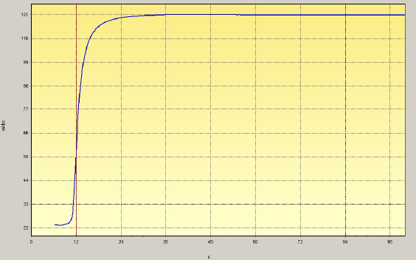
First derivative Curve
This a normal PT result. When the derivative curves are enabled you can see that the red line indicating the result of 12 is derived from the peak of the first derivative curve.
Normal PT curve with derivative curve displayed
Normalized PT curve

Slide 13
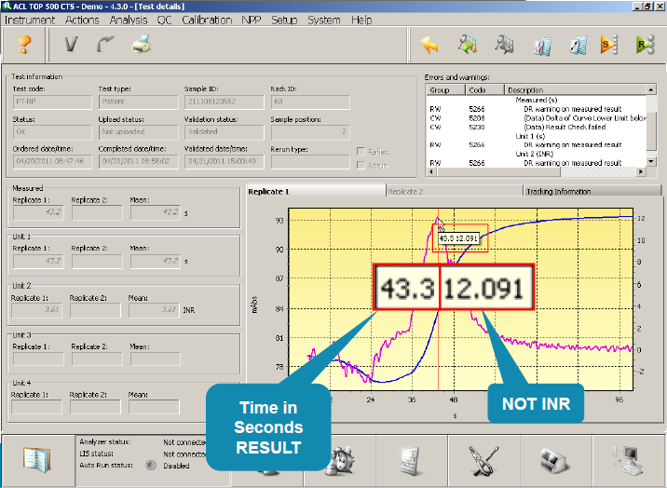
First derivative Curve
When you hover at the peak of the 1st derivative curve for PT you get the time in seconds but not the INR.
The INR has to be calculated manually using the formula:
INR = PT patient ^{ISI}
Pt mean

Slide 14
Extremely Lipemic sample PT
This sample illustrates a PT clot curve for an extremely lipemic sample
Note the Y Axis reading. The starting mAbs is in the 1800 range. Initial mABS measurements is based on the color and clarity of the sample but may be close to close to 0 mAbs.
The curve does not present the classic “S” form.
The 1st derivative line also presents an extreme amount of erratic bounce up and down with no distinct peak.
This highly lipemic sample resulted in a “Failed” reading with an error 5057 (Curve Min and Max not in correct order. Samples of this nature can be air centrifuged to obtain a testing aliquot.

Slide 15
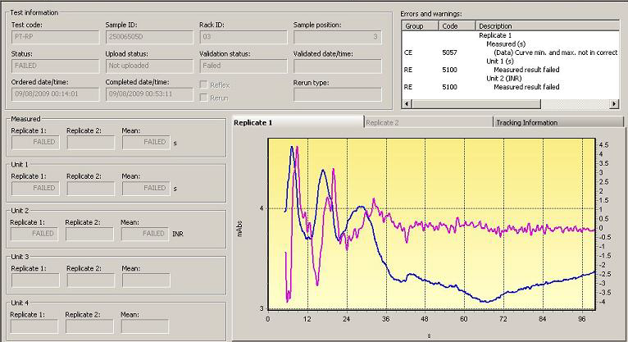
PT error: curve min and max not in correct sequence
This a PT on a sample that failed with error of curve min and max not in correct sequence. The ACL TOP will automatically retest the sample in the extended mode

Slide 16
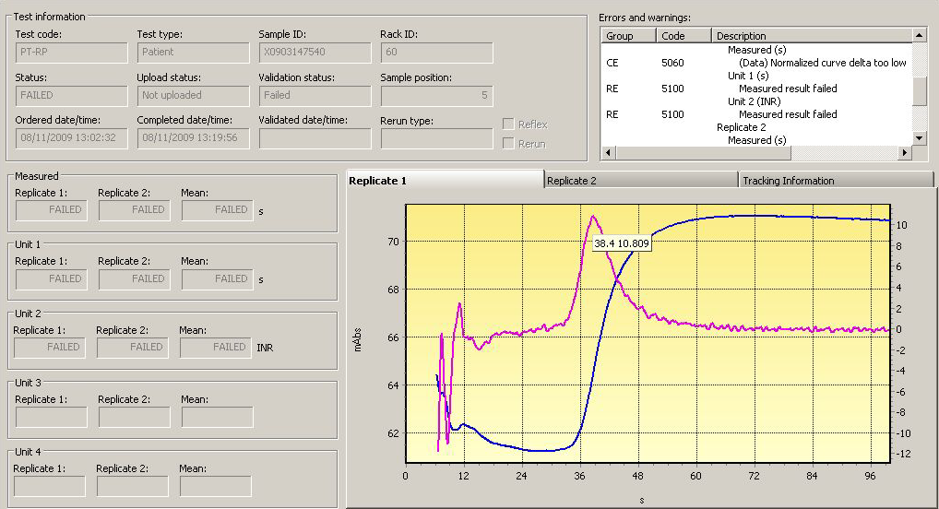
PT error: normalized curve delta too low
This is a sample that failed with an error of normalized curve delta too low. As you can see from the data on the y axis the delta change is from 61 to about 72 or a change of about 11. The extended results failed also with the same error. Once the derivative curves are enabled as in this graph, the mouse cursor can be positioned over the peak of the first derivative curve and the result of 38.4 can be observed.

Slide 17
Second Derivative Curve
The aPTT and TT tests uses the second derivative curve to obtain results.
You can utilize the mouse cursor to view the time by placing the cursor anywhere along the entire acquisition interval for the standard curve, First Derivative curve (fuchsia line), or in this case the Second Derivative curve (light blue line).
As you can see the red line indicating the result is taken from the peak of the second derivative curve and in this case is 60.7 sec.
Normal aPTT curve
This is a normal aPTT sample.
When the derivative curves are displayed you will now note that there are 2 derivative curves displayed.
The first derivative curve displayed in fuchsia and the second derivative curve displayed in light blue.
The second derivative curve is a derivative of the first derivative curve which is why both curves are displayed.
Normal aPTT curve with derivative curve displayed

Slide 18
Second Derivative Curve
If either the first derivative or the second derivative curve criteria are not met, the aPTT result will fail.
On a test using the second derivative curve – only the second derivative curve may be used to derive results.
If a first derivative curve is displayed but there is no distinctive second derivative curve, the first derivative curve may NOT be used to obtain a result.

Slide 19
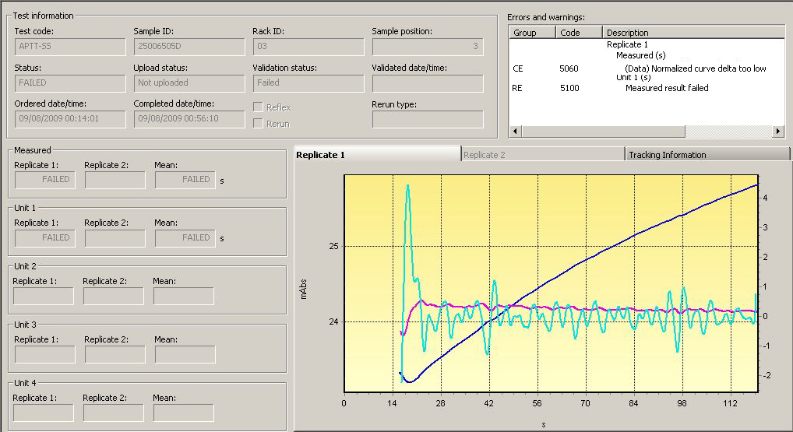
aPTT normalized curve delta too low
This specimen failed for aPTT with an error of normalized curve delta too low. This sample will be retested in the extended mode.

Slide 20
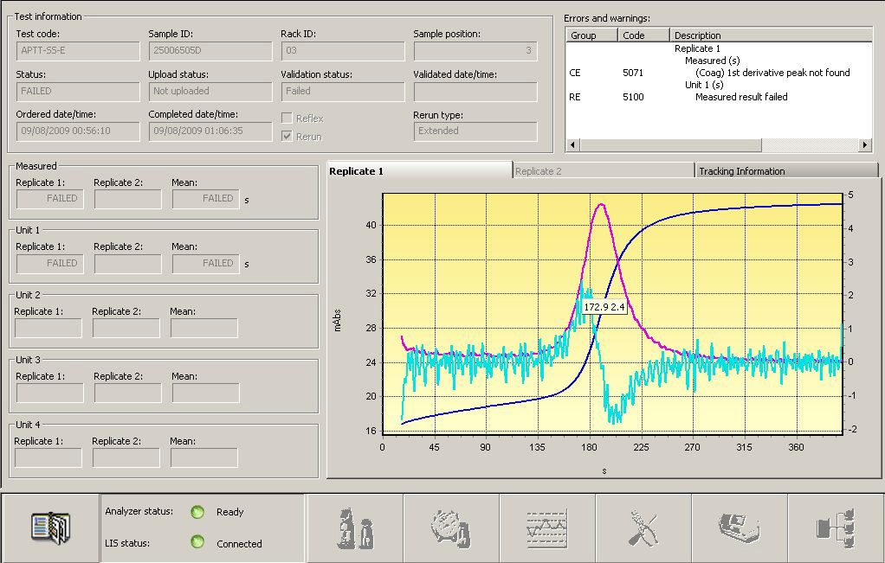
aPTT: first derivative peak failure
This is the extended of the previous sample. This time we see that the aPTT in extended mode also failed but there is a different error message.
This time the error is first derivative peak not found because the peak is not sharp enough and the change on the right hand “Y” axis is less than 10.
We can use the mouse cursor placed over the second derivative peak curve (light blue) and as depicted on the graph, the result would be 172.9.

Slide 21
Extended APTT Sample – Failed Result
In this example we can not use the derivative curves to derive a reportable result.
For this example, you will note the normalized clot curve (dark blue line) does not present the classic “S” shape.
In addition you will note there is no distinct peak for the second derivative (light blue line). This type of clot curve cannot be used to visually establish a clotting time. This example represents a sample with an extremely long clotting time.
Even though the derivative curves were not helpful in this case, we can tell that the result would be greater than 225 seconds.

Slide 22
Remember these all important points about Derivatives:
The normalized clot curve (dark blue line) should have the characteristic “S” shape
A distinct peak for the first derivative (fuchsia line) should be present for PT.
Both a distinct peak for the first derivative (fuchsia line) and second derivative (light blue line) should be present for PTT.

Slide 23
Steps to troubleshooting Failed Coag
STEP 1: Rule out preanalytical causes of inaccuracy
  Anticoagulant contamination due to blood collection from a venous or arterial line flushed with heparin is a common artifact
  Hemolyzed samples interfering with photo-optical clot detection methods
  Prolonged time lapse between specimen collection and performance of aPTT (>4 hours) and PT (>24 hours) assays
  An increase of the citrate:plasma ratio, which decreases the ionized calcium concentration [e.g., in samples from patients with high hematocrit (>55%) or samples collected in underfilled collection tubes]
If unacceptable follow rejection protocol, if acceptable go to next step.

Slide 24
Steps to troubleshooting Failed Coag
STEP 2: Repeat the test
  Most likely the analyzer will do this for you.
STEP 3: If still no result, check clot curve
  Does it have all 4 parts?
    If it does use the derivative curve to glean the correct patient result by hovering the mouse pointer over the peak of the 1st derivative curve for PT and the 2nd derivative curve for PTT
    If it does not have all four parts, look closely at the Y-axis.
      What parts are missing?
      Does it indicate a clot has been formed within standard or extended time?
      If the clot curve does not indicate a clot being formed during the acquisition time of the standard test or extended test, make sure with the floor that this is paralleling with the clinical symptoms of the patient and report the result as >120

Slide 25
Troubleshooting a Failed Coag sample
Patient Sample fails
Analyzer reruns
Get Results
If no flag Report result
If CW flag, verify consistent with previous and fits patient profile
No Result (still failed)
Check Sample for clots, proper filling, and hemolysis
Specimen Unacceptable
Specimen Acceptable
Follow Rejection Protocol
Look at Clot Curve (See next chart)

Slide 26
Troubleshooting a Failed Coag sample
Does curve have all four parts?
No…Does Y-axis indicate clot formation on extended test?
Yes, Compare Standard Test to Extended time, confirm no clot formation in the standard time
This indicates the Clot formed greater than standard time but less than extended time.
Yes… Review Derivatives Curves
Does the derivative curves have distinct peaks
The time is locate on the Y-axis if clot formation is over 120s report >120 and verify this fits the patient clinical diagnosis
Yes… For PT 1st Derivative Curve or for PTT 1st and 2nd Derivative Curve
Find the correct patient result by hovering the mouse pointer over the peak of the 1st derivative curve for PT and the 2nd derivative curve for PTT
Report the number at the peak of the derivative curve. (Calculate INR as this isn’t on the derivative curve)

