Slide 1
Poly stat Mono Test
Training Presentation

Slide 2
Summary and intended use
Infectious mononucleosis (IM) is an acute, self-limited lymphoproliferative disease caused by the Epstein-Barr virus.
Serological diagnosis if IM is demonstrated by the presence of heterophile and EBV antibodies in the sera of the patients.
Poly stat Mono test qualitatively detects infectious mononucleosis antibodies in human whole blood, serum, or plasma specimens.

Slide 3
Principle
Poly stat Mono one step antibody test for IM uses direct solid-phase immunoassay technology for the qualitative detection of IM heterophile antibodies.
For whole blood 25 μl of blood is collected in a capillary tube and spotted in the sample well. If any IM-specific heterophile antibody is present, it will be captured by the antigen band impregnated in the test membrane.
The developer buffer is added. Both sample and buffer move by capillary action to the antigen band.

Slide 4
Principle
The solution mobilizes the dye conjugated to the anti-human IgM antibodies.
Visualization of the antigen band at the test position occurs if the IM-specific heterophile antibody binds to the extracted antigen obtained from bovine erythrocytes.
The antibody dye conjugate continues along the test range and binds the band located in the control position. This control band will appear regardless of the presence of heterophile antibodies in the sample
The presence of two colored bands in the test and control position indicates a positive result. The presence of one colored band in the control position indicates a negative

Slide 5
Reagents and Materials
To perform a test you will need:
  One Poly stat Mono test device (cartridge)
  Developer buffer
  Sample transfer tube for whole blood (25 μL)
  Knowledge of the work instruction and/or package insert
Storage and Stability
  The storage condition and stability dating given by the manufacturer are appropriate as long as the kits is stored from 2°-30° C.

Slide 6
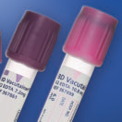
Specimen Acceptability
Anticoagulated whole blood is to be used.
If testing can not be performed immediately, the sample can be stored for 24 hours at 2°-8°C.

Slide 7
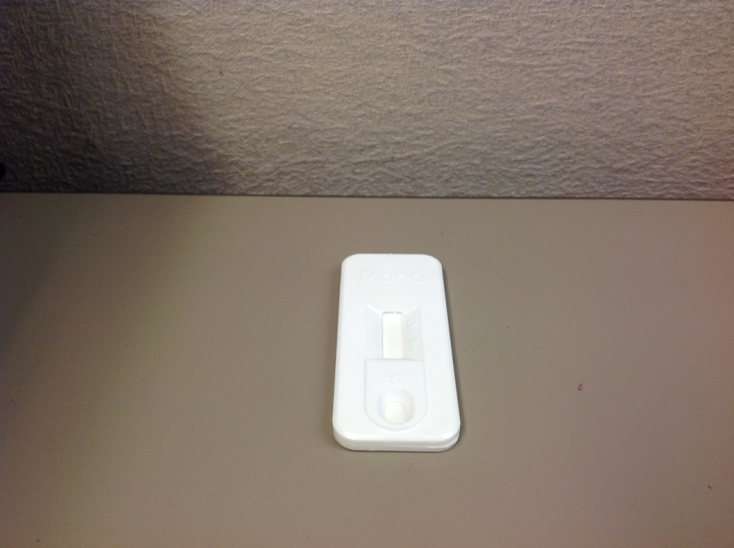
Test Procedure- step one
Remove device (cartridge) from pouch and place on a flat surface

Slide 8
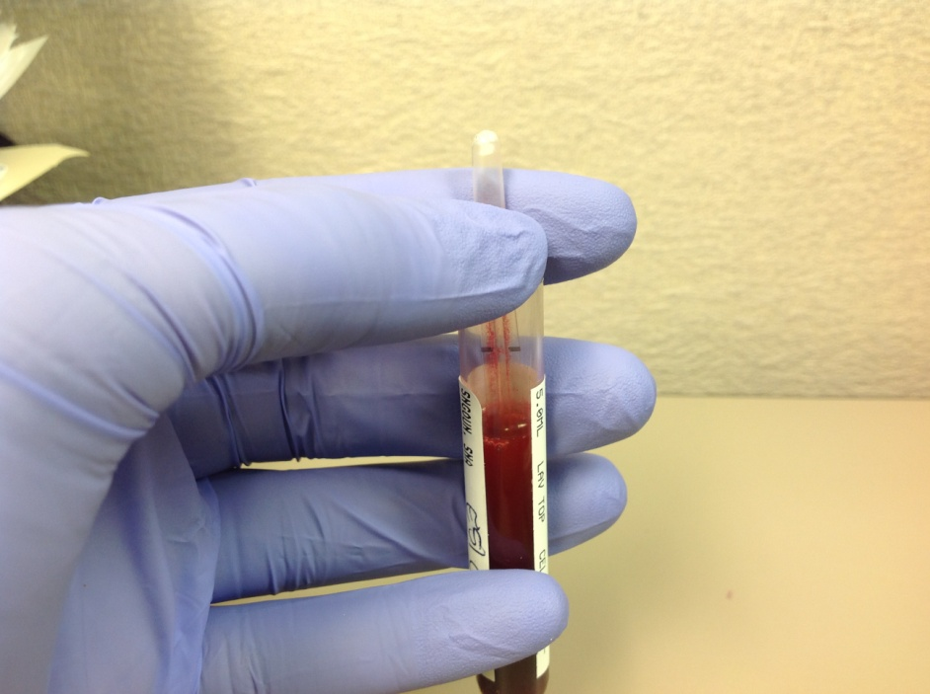
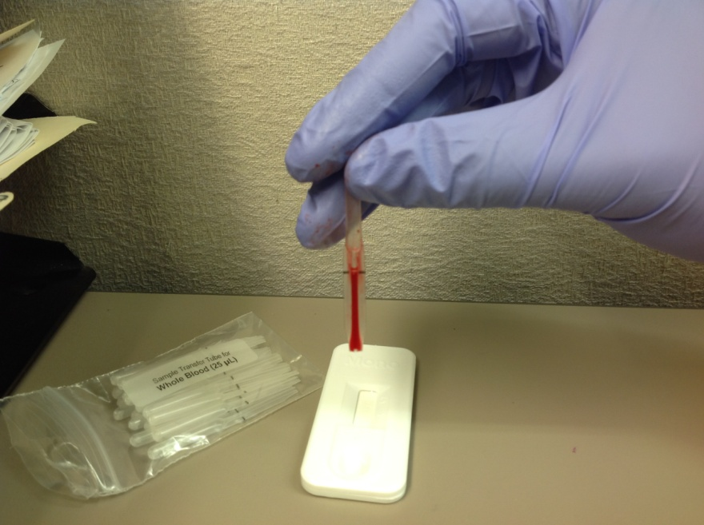
Test Procedure- Step 2a
Using a tube from the bag labeled “Sample Transfer tube for Whole Blood,” Draw the sample into the tube by touching the tip of tube to sample.
Capillary action will draw the sample to the fill line and stop.
  Never squeeze the tube while sampling

Slide 9

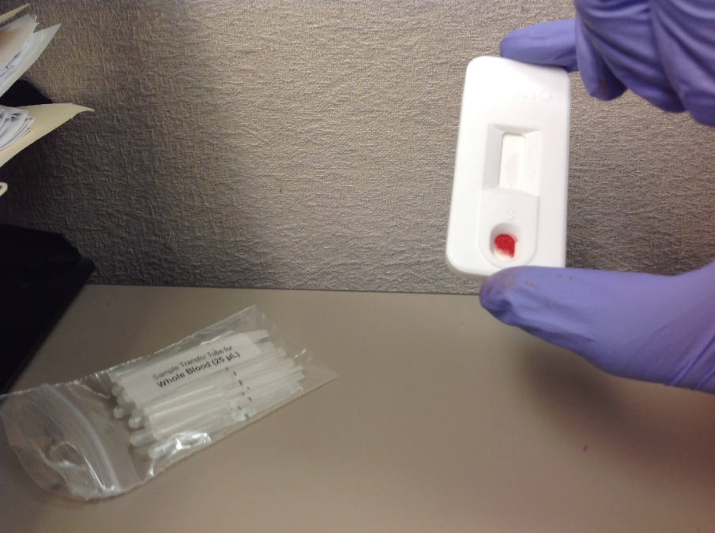
Test Procedure- step 2b
Squeeze the bulb to dispense sample into the UPPER END of the sample well of the device.
  If sample won’t expel cover the pinhole at the stem of the tub and squeeze the bulb again.

Slide 10
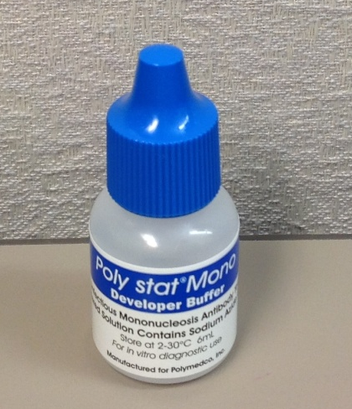
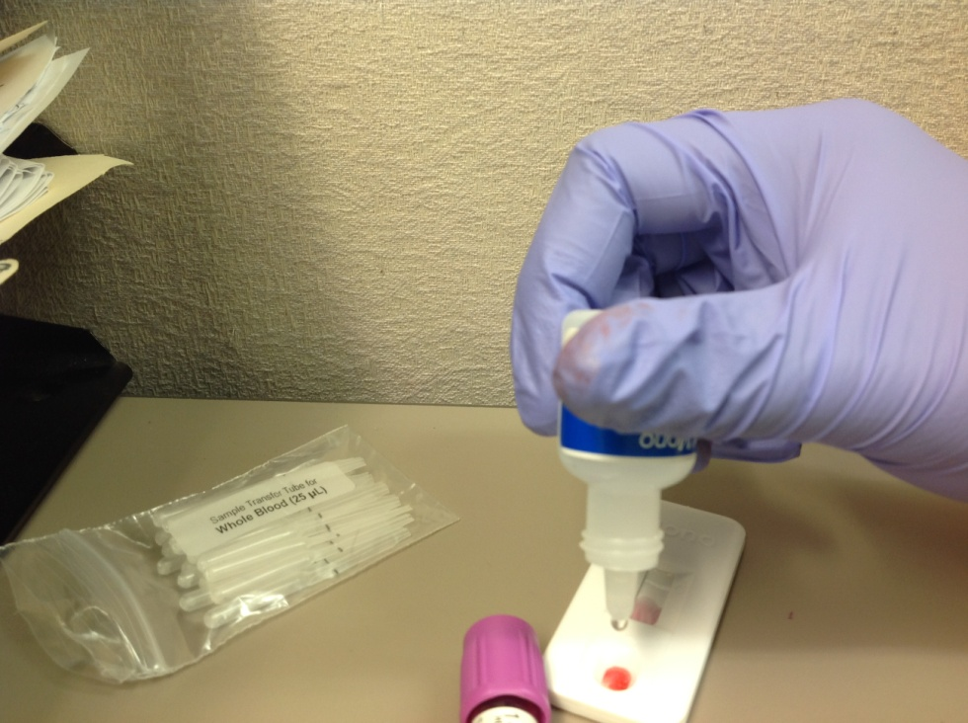
Test Procedure- Step 3
Hold dropper in a vertical position. Add 2-3 drops of developer buffer on to the lower area of the sample well.
  Do not touch the tip to skin or a test device.

Slide 11
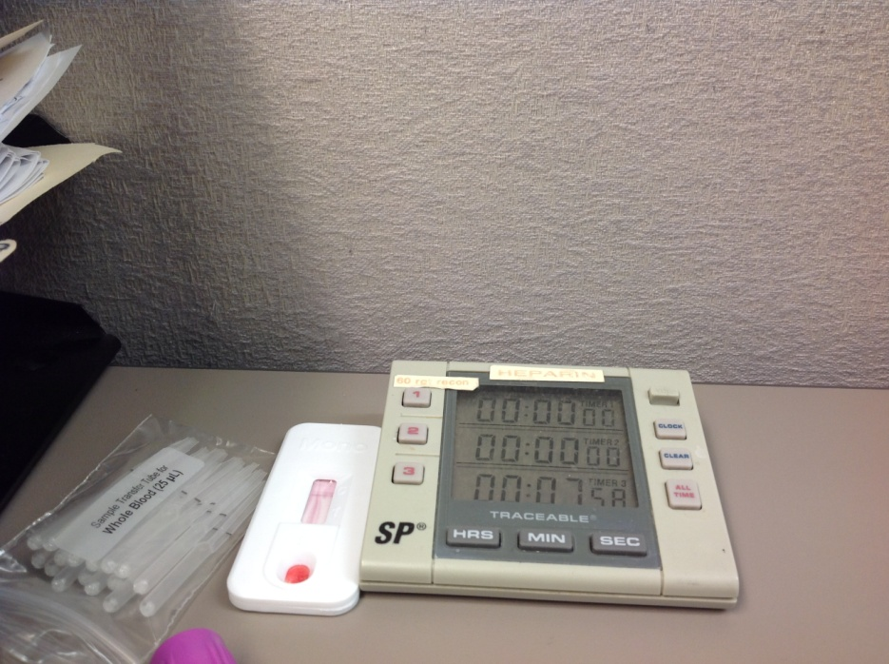
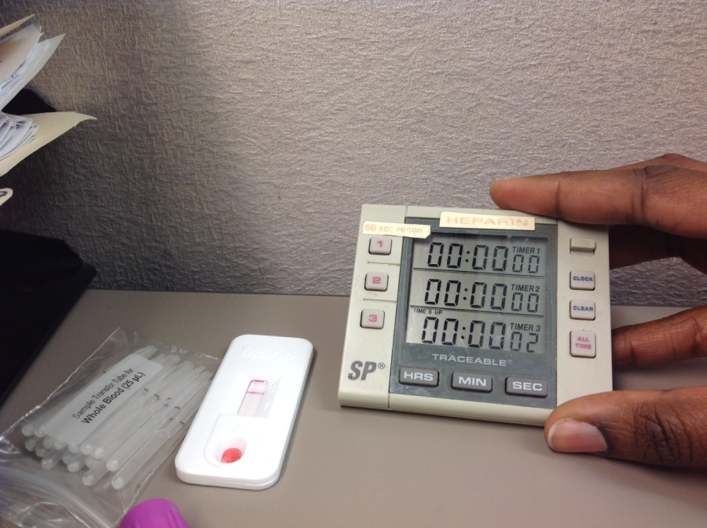
Test Procedure-Step 4
Read results at 8 minutes.
Do not read after 15 minutes.

Slide 12
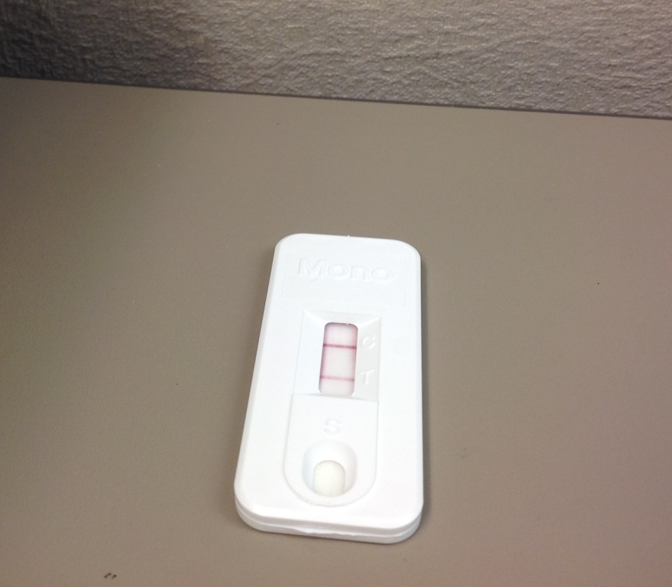
Interpretation of results
Positive- two pink-purple colored horizontal band, one at the test position and control position.
A positive result may be read at soon as it appears

Slide 13
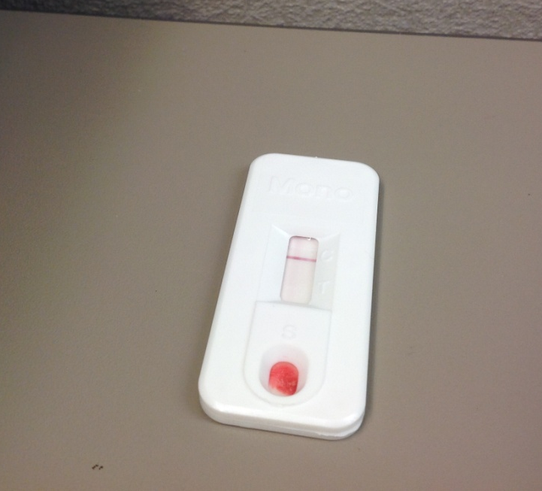
Interpretation of results
Negative- one pink-purple band at the control position.

Slide 14

Interpretation of results
Invalid- No bands at the control position.
If test is invalid, repeat testing and contact Polymedco, Inc. Technical Services immediately at 1-800-431-2123

Slide 15
Quality control
Internal QC
  The appearance of the band at the control position is considered the internal positive control.
  A clear background in the result window is considered an internal negative control.
External QC
  Step 1: Remove device from pouch and place on flat surface
  Step 2: Using the positive or negative external controls in place of patient sample, dispense 1 drop of control solution into the upper end of the sample well.
  Step 3: Add 2-3 drops of developer buffer on to the lower area of the sample well.
  Step 4: Read results at 8 minutes.

Slide 16
Procedural notes
Although most patients will have a detectable heterophile level within three weeks of infection, it may occasionally take longer than three months to develop a detectable level in some patients.
Some segments of the population will not produce measurable levels.
  Approximately 50% of children
Open or broken/damaged pouches may produce erroneous results due to kit instability from exposure to moisture.

