Slide 1
Bronchoalveolar Lavage Tutorial
12/9/2014

Slide 2
Lower Respiratory Tract Sampling
Done using bronchoscope
Bronchial washing: saline instilled into bronchus (proximal and larger airways) and then fluid is aspirated
Bronchoalveolar lavage (BAL): bronchoscope inserted into airways as far as possible and then distal airways are flushed with saline
Purpose of BAL: to sample the alveolar compartment of the lungs (the most distal part of the airway)
- useful to diagnose infections
- can also sometimes diagnose malignancy

Slide 3
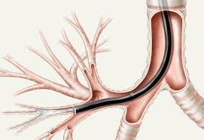
Bronchoalveolar lavage

Slide 4
Normal cellular components
Bronchial epithelial cells
Pneumocytes
Macrophages
Inflammatory cells (normally only a few)

Slide 5
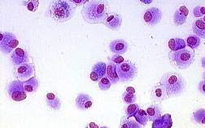
Macrophages
Often have numerous macrophages in BAL

Slide 6
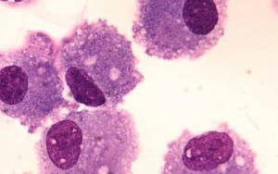
Macrophages
Oval to round nuclei, abundant bubbly or foamy cytoplasm

Slide 7
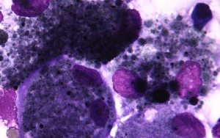
Macrophages
Often have pigment (anthracotic carbon pigment) usually and engulfed foreign material

Slide 8
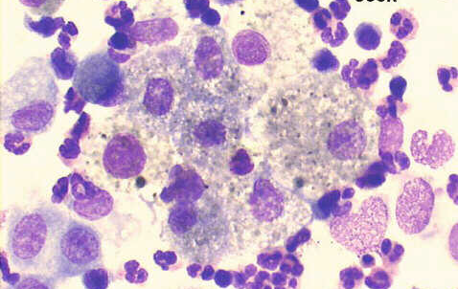
Macrophages

Slide 9
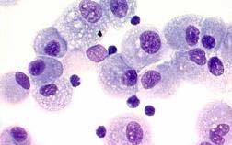
Foamy macrophages

Slide 10
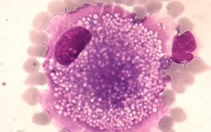
Foamy macrophage

Slide 11
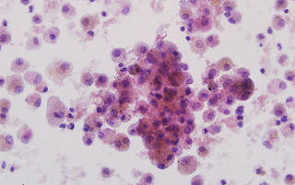
Macrophages

Slide 12
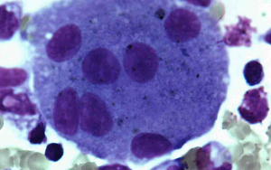
Multinucleated macrophage
Not specific – just need to be able to recognize it as a macrophage

Slide 13
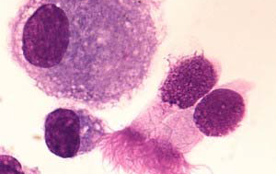
Bronchial epithelial cells
Bronchial epithelial cells with cilia

Slide 14
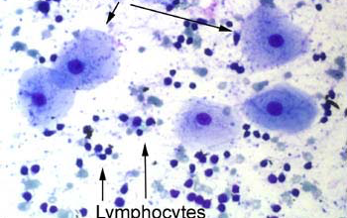
Squamous cells

Slide 15
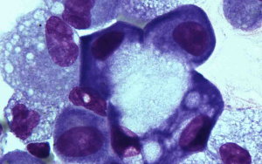
Reactive pneumocytes
Can mimic macrophages or even malignant cells

Slide 16
Abnormal findings for BAL
Lots of inflammatory cells
Infectious organisms – bacteria and a variety of fungal organisms
Malignant cells – not common (sensitivity to detect malignancy is low for BAL)

Slide 17
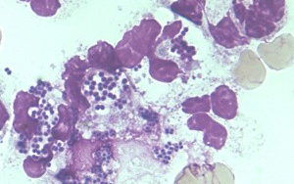
Neutrophils
Many bacteria (with cocci shape) are present also

Slide 18
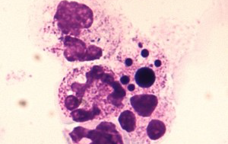
Neutrophils

Slide 19
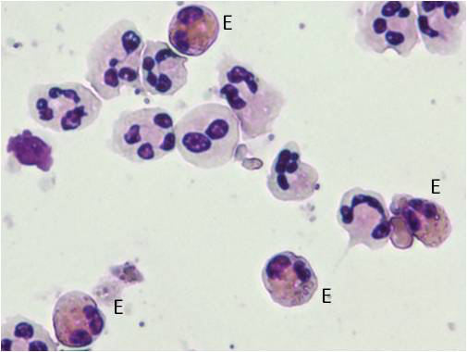
Eosinophils

Slide 20
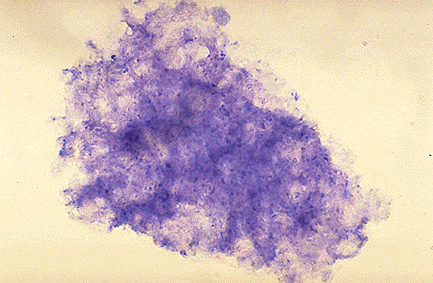
Pneumocystis

Slide 21
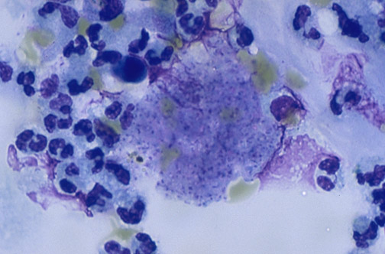
Pneumocystis

Slide 22
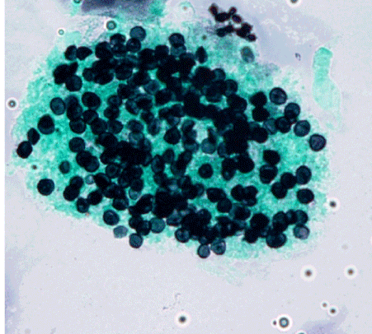
Pneumocystis – GMS stain

Slide 23
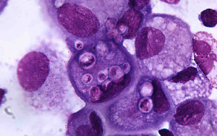
Cryptococcus

Slide 24
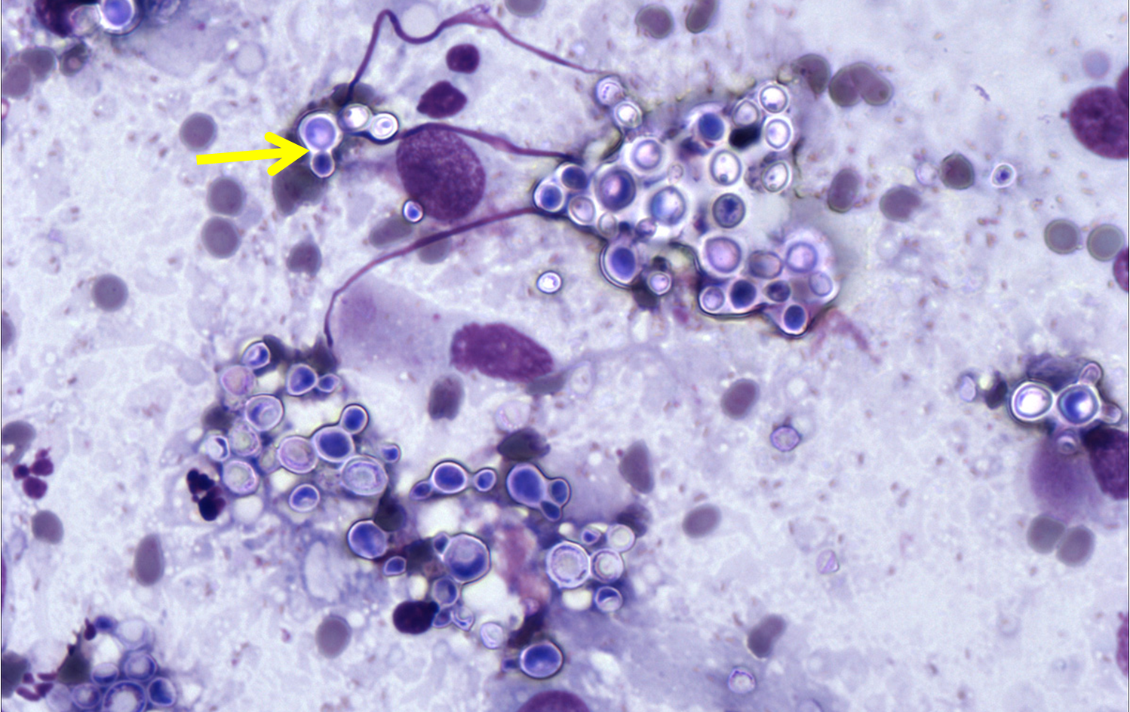
Cryptococcus

Slide 25
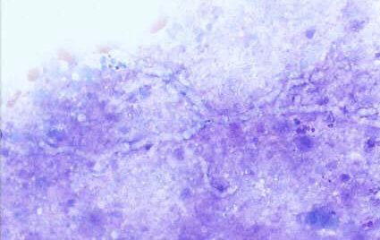
Aspergillus

Slide 26
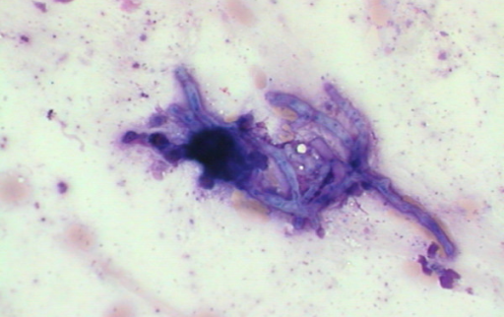
Aspergillus

Slide 27
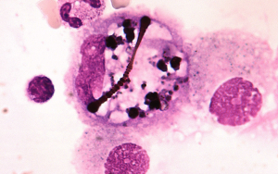
Asbestos body

Slide 28
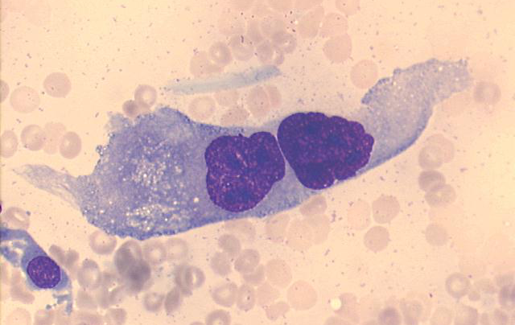
Malignant cell

Slide 29
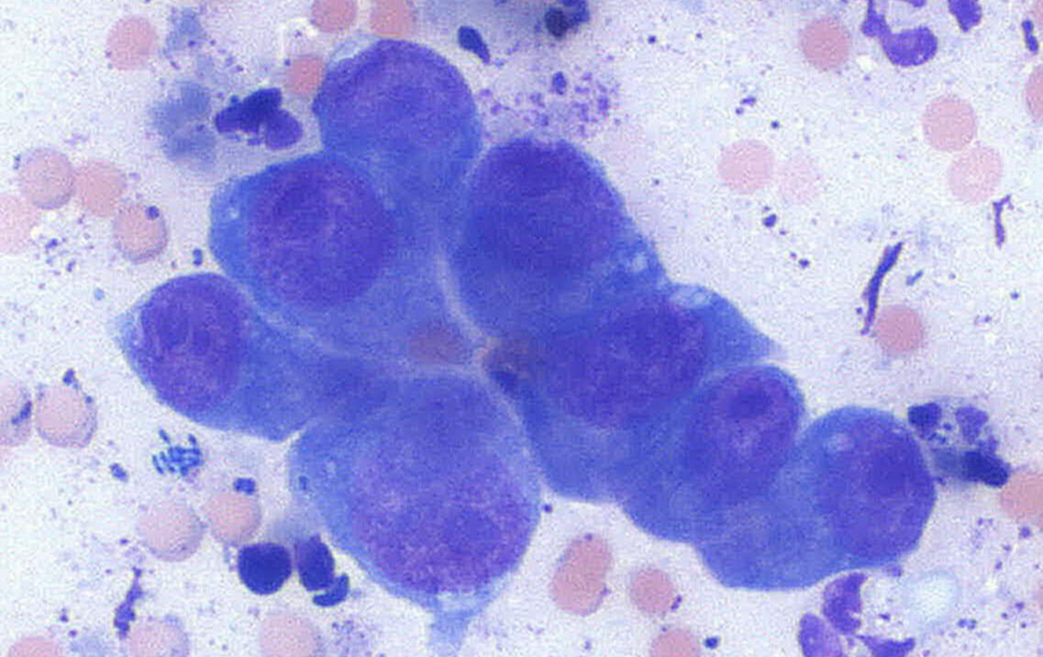
Malignant cells

