Slide 1


Lymphocytes
How do we classify them?
Look at the whole clinical picture:
Clinical History - Previous diagnosis or Path Review can greatly aid in the identification of abnormal lymphocytes.
WBC ↑, PLT ↓, Lymph# ↑, Smudge Cells (CLL, Viral)
Age - < 6 years: Acute Lymphoblastic Leukemia. Occasional lymphoblasts in premature newborns.
  - 14-24 years: Infectious Mononucleosis
  - > 55 years (Males higher risk): CLL, Lymphomas, Plasma Cell Neoplasms

Slide 2
Cell Type | Classification | Path Review
All cells recognizable as lymphocytes: Normal, Reactive, and Abnormal. | LYMPHOCYTES Add Result/Component level comment if applicable Reactive lymphs: “Reactive lymphocytes present.” Abnormal lymphs (1st Pres): .ATY or .IMPRPATH | Normal and Reactive: NO Abnormal: YES – 1st Pres/30 days
Lymphoblasts | BLASTS | YES – 1st Pres/7 days
Cells that cannot be classified by tech – Immature/blast-like or Abnormal cells not clearly recognizable as lymphs – No Clinical Hx/1st Pres | OTHER CELLS with Result/Component Level Comment: .IMPRPATH | YES
Plasmacytoid/Plasma cells – No Clinical Hx/1st Pres | OTHER CELLS with Result/Component Level Comment: Easily recognizable plasma cells – “Plasma Cells” Unsure of classification - .IMPRPATH | Rare, easily recognizable plasma cells: NO Significant number or unsure of classification: YES
Abnormal Lymphs or Plasmacytoid/ Plasma Cells – Confirmed by Pathologist | Abnormal Plasmacytoid/Plasma Cells: OTHER CELLS Abnormal Lymphs: OTHER CELLS or LYMPHOCYTES depending on case (examples to follow) Add appropriate Result/Component level comment: Use the wording from the most recent path review (or surgical path report if more recent) to describe cells. | YES – Every 30 days
Absolute Lymph count > 7.0 x 10³/µL in Adults (≥ 18 yrs) | Any Classification - Should be investigated to differentiate reactive from malignant processes | YES – 1st Pres/30 days
Smart Phrases
.ATY “Atypical cells, pending pathologist review.”
.IMPRPATH “Immature or abnormal cells present. Pathologist review to follow.”
Notes:
Classification Table
-New Path Review Criteria: Absolute Lymph count > 7.0 x 10³/µL, 1st presentation/30 days
Path Review Frequency: (Joren to confirm with other pathologist)
Blasts: 1st presentation/7 days
Abnormal Lymphocytes: 1st presentation/30 days

Slide 3
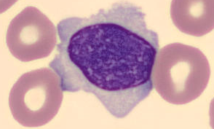
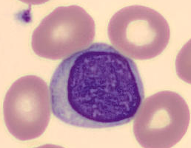
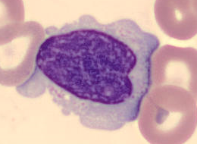
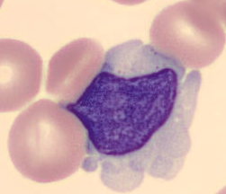
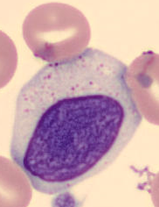
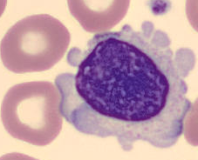
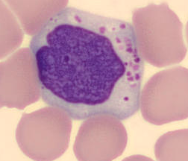
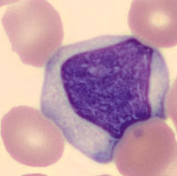
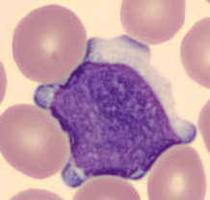
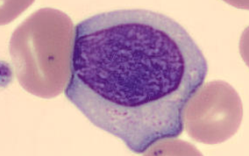
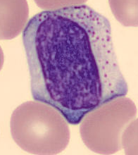
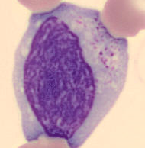
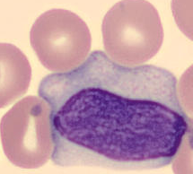
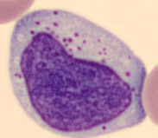
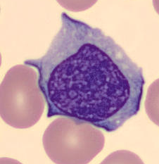
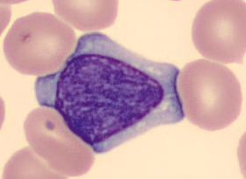
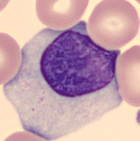
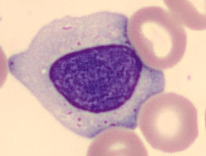
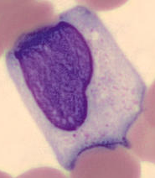
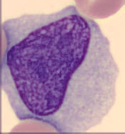
Lymphocytes exhibit a range of Normal Morphology

Slide 4
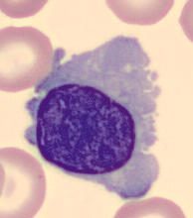
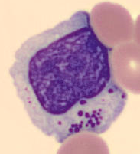
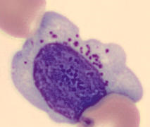
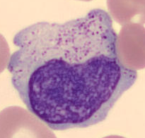
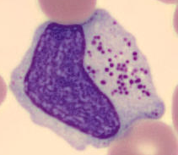
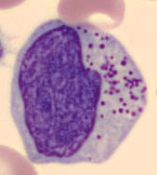
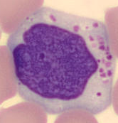
Benign Lymphs
Classification: Lymphocyte
Path Review: No
Characteristics:
Size: 7 – 20 µm, round to ovoid, N/C ratio of 5:1 – 2:1
Nucleus: Round to oval, may be slightly indented or notched. Chromatin is diffusely dense or coarse and clumped.
Nucleoli: Not visible, although some cells may exhibit a small, pale chromocenter that may be mistaken for a nucleolus.
Cytoplasm: Typically scant amount, pale blue to moderately basophilic. Edges may be slightly frayed or pointed due to artifacts induced during smear preparation (Images line 1). Usually nongranular, though a few azurophilic granules may be present (Images line 2) especially in association with reactive lymphocytes.
Notes:
Characteristics of normal lymphs

Slide 5
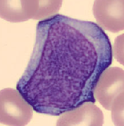
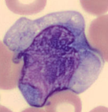
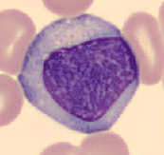
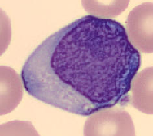
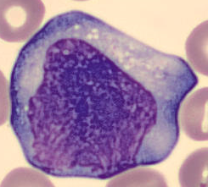
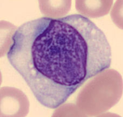
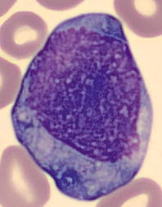
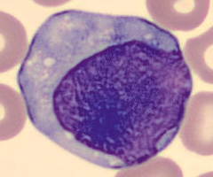
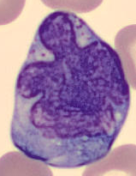
Reactive Lymphocytes
Classification: Lymphocytes
Path Review: Depends on Case
Key distinguishing feature:
Wide range of cellular sizes and shapes, as well as nuclear sizes, shapes, and chromatin patterns.
Viral illnesses (e.g. Mono, CMV, adenovirus, viral hepatitis, or acute HIV infection)
Protozoal infections (e.g. Toxoplasmosis)
Drug reactions
Connective tissue diseases
After major stress to the body’s immune system
Size: 10 – 25 µm, N:C ratio of 3:1 – 1:2
Nucleus: variable size, shape, and chromatin density
Cytoplasm: Abundant blue. Frequently amoeboid, partially surrounding adjacent RBCs. Basophilia radiating out from the nucleus may also be present.
Clinical Conditions
Characteristics:
Up to 5% of reactive lymph’s may be seen in clinically normal persons.
Notes:
Joren says he can find reactive lymphs on pretty much every slide. Your body is always reacting to something.

Slide 6
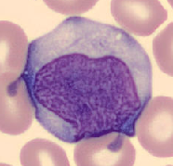
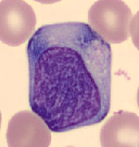
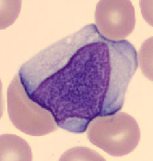
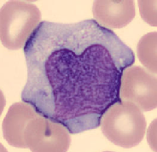
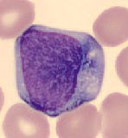
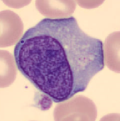
Case 1
Age: 16
WBC count: 9.7 x 10³/µL
Lymph#: 3.8 x 10³/µL
3+ smudge cells
Mono Diagnostic Scheme:
WBC & Lymph# count within reference range
Smudge cells
Age: 16-24
Typically >20% Reactive lymphs
Chart Review: Mononucleosis Screen POSITIVE
CLASSIFICATION: Lymphocytes
RESULT COMMENT: “Reactive lymphocytes present.”
Path Review: No
Notes:
Reactive Lymphocytes, Case 1
10013690232

Slide 7
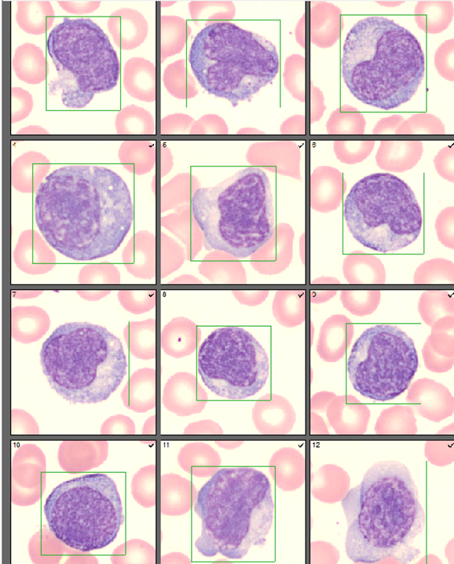
Age: 24
Case 2
WBC: 12.2
Lymph#: 8.3
2+ Smudge Cells
Dx: Infectious Mono
Path Review:
“Reactive lymphocytosis noted. May be seen in viral infections, including mononucleosis, drug reaction, etc. Thrombocytopenia noted.”
Reactive Lymphs can look Plasmactyoid!
1st Presentation –
Given the Dx of Mono (therefore, reactive lymphs)
CLASSIFICATION: Lymphocytes
RESULT COMMENT: “Reactive lymphocytes present.”
If no Dx:
CLASSIFICATION: Other Cells
RESULT COMMENT: .ATY “Atypical cells, pending pathologist review.”
After initial Path Review –
CLASSIFICATION: Lymphocytes
RESULT COMMENT: “Reactive lymphocytes present.”
Notes:
Reactive Lymphocytes, Case 2
10010438015

Slide 8
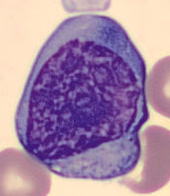
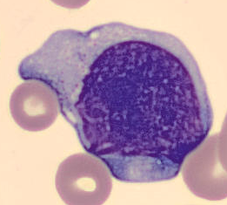
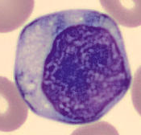
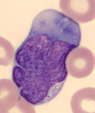
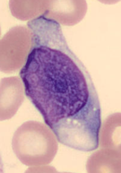
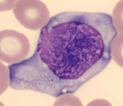
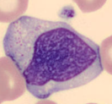




Case 3
F, 24 yrs
WBC: 18.5
Lymph#: 10.7
3+ Smudge Cells
Dx: Ebstein-Barr Virus
(Causative agent for Mono, some Lymphoma’s)
Path Review:
“Abnormal lymphocytosis noted. Suspicious for lymphoproliferative disorder. Consider flow cytometry of peripheral blood.”
1st Presentation –
CLASSIFICATION: Lymphocytes
RESULT COMMENT: .ATY “Atypical cells, pending pathologist review.”
After initial Path Review & Flow –
CLASSIFICATION: Lymphocytes
RESULT COMMENT: “Reactive lymphocytes present”
FLOW CYTOMETRY:
No abnormal B- or T- cells identified.
Case 4
F, 25 yrs
WBC: 14.0
Lymph#: 9.4
3+ Smudge Cells
Dx: FUO for 2 weeks, Postpartum
Path Review:
“Reactive lymphocytosis noted. May be seen in viral infections, including mononucleosis.“
1st Presentation –
CLASSIFICATION: Lymphocytes
RESULT COMMENT: .ATY “Atypical cells, pending pathologist review.”
After initial Path Review & Flow –
CLASSIFICATION: Lymphocytes
RESULT COMMENT: “Reactive lymphocytes present”
Notes:
Case 3 (10012909921)
Case 4 (10014576450)
Chart: Negative for Influenza A & B, COVID-19, Hep B, RPR, HIV. Not tested for Epstein-Barr or Mono

Slide 9


WBC: 15.40
Lymph#: 5.51
Dx: COVID-19
CLASSIFICATION: Lymphocytes
RESULT COMMENT: “Reactive lymphocytes present”
Path Rvw: No
Notes:
Known COVID-19 POS patient
10014774469
WBC: 15.40
Lymph%: 36
Lymph": 5.51

Slide 10
















Size: May be the same size as normal lymphs but are often slightly larger.
Nucleus: Typically round, although a small nuclear indentation may be present. Clumped chromatin that often appears “cracked” resulting in a nucleus that resembles a soccer ball.
Nucleoli: Inconspicuous.
Cytoplasm: Pale blue, scant amount
Classification: Lymphocyte
Characteristics:
Path Review: Yes
CLL
Individual CLL cells may be difficult to distinguish from normal lymphocytes. Clues to a Dx of CLL:
Leukocytosis (20 – 200 x 10³/µL) with absolute lymphocytosis (>5.0 x 10³/µL)
Homogenous appearance within a given patient
Patient > 50 years old
Decreased platelet count
Smudge Cells – Variable number (few to many)
Notes:
CLL morphology can be variable person to person but is homogenous within the same case/smear
Classification: Lymphocyte
Path Review: for Monotonous Lymph population and Lymph# > 7.0

Slide 11






Lymphoid Cells
Wide range of morphologic appearances depending on the lymphoma subtype. They can be mature or immature.
Clinical history: Previous diagnosis of lymphoma or path review
It may be difficult to distinguish lymphoma cells from reactive lymphs
Lymphoma Cells | Reactive Lymphocytes
Generally high N:C ratio (~7:1 -3:1) | Low N:C ratio (3:1 -1:2)
A more monotonous population of the abnormal lymphocytes in any individual case/same smear | Wide range of morphologic appearances within the same smear
Median age, 50-70 years
Infectious Mononucleosis
High Grade B-Cell
Lymphoma
Notes:
Lymphoid Cells vs Reactive

Slide 12

Follicular Lymphoma
Monotonous population of abnormal lymphocytes
Notes:
Follicular Lymphoma

Slide 13

Reactive Lymphs
Wide range of morphologic appearances within the same smear
Notes:
Infectious Mononucleosis

Slide 14
















Follicular Lymphoma
Classification: Lymphocytes
Result comment: “.IMPRPATH” 1st Pres
Size: slightly smaller than normal lymphocytes.
Nucleus: majority are clefted, indented, folded, convoluted, or even lobulated. The chromatin is moderately coarse to smooth.
Nucleoli: one or more may be present.
Cytoplasm: very scanty, almost invisible. Very high N:C ratio
Path Review: Yes
Characteristics:
Notes:
Path Review: “Abnormal Lymphocytosis with variant lymphocytes. Suspicious for lymphoproliferative Disorder. Consider flow cytometry of peripheral blood.”
.IMPRPATH “Immature or abnormal cells present. Pathologist review to follow.”

Slide 15
Follicular Lymphoma
M, 49 yrs
1st Presentation: 11/30/19
WBC: 18.4
HCT: 30%
PLT: 163
Manual Diff:
Seg Neuts%: 21
Lymph%: 13
Other Cells%: 63
Comment: Immature appearing Lymphocytes,
ID to be confirmed by Pathologist.
Mono%: 4
Eos%: 0
Baso%: 0
Lymph# (Lymph + Other Cells): 14.0
Path Review:
Abnormal lymphocytosis with variant
lymphocytes. Suspicious for lymphoproliferative disorder. Consider flow cytometry of peripheral blood.
12/3/19 Pathology Report
FLOW CYTOMETRY: Bone Marrow
Abnormal CD10 positive B-cell population identified. The coexpression of CD10 by the neoplastic B-cells is consistent with Follicular Lymphoma.
MICROSCOPIC DESCRIPTION: Peripheral Blood
Lymphocytes 79%. Lymphocytes are small with mature chromatin indented/irregular nuclei. Blasts are not identified.
Standardization
1st Presentation –
CLASSIFICATION: Lymphocytes RESULT COMMENT: .IMPRPATH
Path Review cover sheet: Mark [Abnormal Lymphocytes] as reason for review & write “immature appearing” next to it.
After initial Path Review & Flow –
CLASSIFICATION: Lymphocytes
RESULT COMMENT: “Abnormal lymphocytes present. Consistent with known history of Follicular Lymphoma.”
Notes:
The pathologist made no distinction between normal lymphs and neoplastic lymphs on diff.
.IMPRPATH “Immature or abnormal cells present. Pathologist review to follow.”

Slide 16

Notes:
Flow cytometry reported 12/3/19 after morning CBC.
The next slide review done after the diagnosis started classifying the cells as atypical lymphs.

Slide 17










Classification: Other Cells
Result comment: “.IMPRPATH” 1st Pres
Path Review: Yes
Mantle Cell
Lymphoma
Small to medium-sized lymphs, irregular nuclear contours, inconspicuous nucleoli, and scant cytoplasm. May resemble CLL or Follicular Lymphoma.
Large monocytoid pleomorphic lymphs, large nuclei, may have prominent nucleoli, and abundant pale cytoplasm.
Variable Morphology
Notes:
monocytoid cell: a cell having morphologic characteristics of a monocyte, but which is nonphagocytic.
.IMPRPATH “Immature or abnormal cells present. Pathologist review to follow.”

Slide 18
Clinical History: Mantle Cell Lymphoma, Dx in 2014. Was in remission.
M, 70 yrs
Mantle Cell Lymphoma
3/26/20 –
Lymph node biopsy: Mantle Cell Lymphoma
FLOW CYTOMETRY: Abnormal CD5-positive B cell population.
MICROSCOPIC DESCRIPTION:
Uniform population of intermediate sized cells with chromatin pattern and scant cytoplasm.
The overall morphologic and immunohistochemical findings are consistent with a mantle cell lymphoma.
Began Treatment
4/21/20 –
1st Presentation in Peripheral Blood
WBC: 6.7
HCT: 35%
PLT: 142
Manual Diff:
Seg Neuts%: 65
Lymphs%: 6
Atypical Lymphs%: 10
Mono%: 11
Eos%: 4
Basos%: 3
Promyelocytes%:
Lymph# (0.4)+ Atypical Lymph# (0.7) = 1.1
Path Review:
Consistent with known history of Mantle Cell Lymphoma undergoing therapy.
Standardization
1st Presentation –
CLASSIFICATION: Other Cells RESULT COMMENT: .IMPRPATH
Path Review cover sheet: large monocytoid looking cells.
After initial Path Review –
CLASSIFICAITON: Lymphocytes
RESULT COMMENT: ”Abnormal lymphocytes present. Consistent with known history of Mantle Cell Lymphoma undergoing therapy.”
Notes:
.IMPRPATH “Immature or abnormal cells present. Pathologist review to follow.”

Slide 19












Classification: Other Cells
Result comment: “.IMPRPATH” 1st Pres.
Path Review: Yes
B-Cell Lymphoma
These cells can be easily confused with blasts, and additional studies such as immunophenotyping are often necessary to make the correct diagnosis.
Size: Large, 8 – 30 μm
Nuclei: Generally round to oval. May be angulated, folded, indented, or convoluted. Variable chromatin density.
Nucleoli: 1 or more may be present.
Cytoplasm: Variable amounts of pale blue to dark blue, agranular. Vacuoles may be present.
Characteristics:
These cells may exhibit some of the most abnormal morphologic appearances.
Notes:
.IMPRPATH “Immature or abnormal cells present. Pathologist review to follow.”

Slide 20


High-Grade B-Cell Lymphpoma
M, 68 yrs
11/24/19
CLINICAL INFORMATION: Atypical lymphocytosis
Flow Cytometry:
Abnormal CD10 positive B-cell population identified:
Lymphocytes are 80.9% of white cells.
The abnormal B-cell population comprises 44.3% of lymphocytes and 35.4% of WBCs
1st Presentation: 11/23/19
WBC: 11.1
HCT: 33%
PLT: 46
Manual Diff:
Seg Neuts%: 7
Lymphs%: 55
Other Cells%: 30
Comment: Atypical lymphocytes and
Immature Cells with large nucleus,
prominent nucleolus, and a high N:C
ratio present.
Mono%: 6
Meta%: 2
Lymph# (6.1) + Other Cells# (3.6) = 9.7
Path Review:
Atypical large lymphocytes and possible blasts. Suggest flow.
11/25/19
FINAL DIAGNOSIS: HIGH-GRADE B-CELL LYMPHOMA
Bone Marrow: 90% diffuse involvement of a markedly hypercellular marrow
Peripheral blood: Large abnormal lymphoid/blast-like cells with slightly immature chromatin, prominent nucleoli, and scant amount of basophilic cytoplasm with vacuoles are identified.
Subsequent Path Reviews: Large abnormal lymphoid cells
Standardization
1st Presentation –
CLASSIFICATION: Other Cells RESULT COMMENT: .IMPRPATH
Path Review cover sheet: Mark [Abnormal Lymphocytes] as reason for review & write “Immature cells with large nucleus, prominent nucleolus, and a high N:C ratio present.” next to it.
After initial Path Review & Report:
CLASSIFICATION: Other Cells RESULT COMMENT: “Large abnormal lymphoid cells”
Notes:
.IMPRPATH “Immature or abnormal cells present. Pathologist review to follow.”
100 Cell Diff on the peripheral blood by the pathologist:
18% lymphocytes
60% large abnormal lymphoid cells

Slide 21












Classification: Blasts
Path Review: Yes
Lymphoblasts
Clinical Conditions:
Acute Lymphoblastic leukemia (ALL) or Burkitt Lymphoma
Lymphoid blasts crisis of Chronic Myelogenous Leukemia (CML)
Occasional lymphoblasts sometimes seen in a newborn, particularly if premature.
Characteristics:
Size: 9 – 20 µm
Nucleus: round to ovoid, with a N:C ratio of 7:1 – 4:1
Cytoplasm: slightly to moderately basophilic
No auer rods
Variable Morphology
Small and homogenous lymphoblasts: dense but not clumped chromatin, inconspicuous or absent nucleoli, scanty cytoplasm.
Large and heterogeneous lymphoblasts: finely dispersed chromatin, variable numbers of distinct nucleoli, and moderate amounts of cytoplasm, closely resembling myeloblast.
Notes:
Lacey chromatin, scant deep blue cytoplasm. Variable morphology. May or may not have a nucleoli.
Acute Lymphoblastic Leukemia (ALL) is primarily a disease of children <6 years old but also occurs in adults (this case is an adult with ALL)
Pancytopenia typically present, particularly low PLT count. WBC count may be decreased, normal, or increased.

Slide 22

Post Treatment
Blasts
Notes:
Send for path review again if unsure of change in morphology even with clinical history.

Slide 23

Classification: Other Cells
Result comment: “Plasma Cells” or “.IMPRPATH”
Mature Plasma Cells
Path Review: Yes, if:
A significant number present, no clinical history
Unsure of classification
Rare circulating plasma cells may be seen in healthy patients.
Characteristics:
Size: 10 – 20 µm, often oval shaped. N:C ratio 1:2.
Nucleus: eccentric; round, oval, or indented; Prominently coarse and clumped chromatin is often arranged in a clock-face pattern.
Nucleoli: Absent
Cytoplasm: Typically relatively abundant. Gray-blue to deeply basophilic with a clear area next to the nucleus (perinuclear halo/hof). Cytoplasmic granules are absent, and scattered vacuoles of varying size may be seen.
If only 1 is present: may report the Auto Diff if all other criteria for Auto Diff reporting are met.
If ≥ 2 are present, report Manual Diff, Cell Classification: Other, result level comment*
If > 5 are present and no clinical history, consider sending it for Path Review.
*Add result (component) level comment:
Easily recognizable plasma cells – “Plasma Cells”
Unsure of Classification – “.IMPRPATH”
Notes:
.IMPRPATH “Immature or abnormal cells present. Pathologist review to follow.”

Slide 24
Malignant Plasma Cells
Classification: Other Cells
Result comment: “.IMPRPATH” 1st Pres
Path Review: Yes
Characteristics:
Variable maturity – A single case may include some or all forms of:
  Plasmablasts
  Immature plasma cells
  Mature plasma cells.
Wide spectrum of morphologic features – The cells range from those that are:
  Easily recognized as plasma cells
  Difficult to classify without ancillary studies or clinical data.
Clinical Conditions:
Multiple Myeloma (Plasma Cell Myeloma)
Plasma Cell Leukemia
Lymphoplasmacytic lymphoma (Waldenstrom macroglobulinemia)
Amyloidosis
Autoimmune disorders
Infections (bacterial, viral, protozoal)
Plasma Cell Neoplasm: Median age of onset is about 65 years old
Notes:
Malignant plasma cells in the peripheral blood may be numerous in cases of plasma cell leukemia.
Plasma Cell Leukemia: > 2 x 10³/µL suggests Plasma Cell Leukemia

Slide 25
























Classification: Other Cells
Result comment: “.IMPRPATH” 1st Pres
Path Review: Yes
Plasma Cell
Leukemia
Normal
Lymphs
Notes:
Tingle, Zoe
F, 58 yrs
Path Review: Atypical Plasmacytoid cells, concerning for plasma cell leukemia.
Bebber, William
M, 76 yrs
Path Review: Atypical plasmacytoid cells, consistent with plasma cell leukemia given the history of myeloma.

Slide 26
Plasma Cell Leukemia
F, 58 yrs
1st Presentation: 11/11/19
WBC: 20.2
HCT: 20%
PLT: 11
Manual Diff:
Seg Neuts%: 14
Lymphs%: 63
Atypical Lymphs%: 18
Mono%: 4 (auto 65%)
Basos%: 1
Lymph#: 16.4 (Lymphs + Aty Lymphs)
Path Review:
Atypical plasmacytoid cells, concerning for plasma cell leukemia.
11/12/19 Pathology Report
Flow cytometry: Abnormal plasma cell population identified.
FINAL DIAGNOSIS: Peripheral Blood
Plasma cell leukemia, 50% circulating plasma cells
100 Cell Diff:
18% Neutrophils
26% Lymphocytes
50% Plasma Cells
5% Monocytes
1% Myelocytes
Standardization
1st Presentation –
CLASSIFICATION: Other Cells RESULT COMMENT: .IMPRPATH
Path Review cover sheet: Mark [Abnormal Lymphocytes] as reason for review & write description of abnormal cells i.e. plasmacytoid.
After initial Path Review and Flow –
CLASSIFICATION: Other Cells RESULT COMMENT: “Atypical plasmacytoid cells”
Notes:
Tingle, Zoe
F, 58 yrs

Slide 27
Clinical Conditions &
Significance :
Smudge Cells
Smudge cells are usually lymphocytes but can be any white cell.
They are most commonly seen in disorders characterized by lymphocyte fragility:
Malignant:
Chronic Lymphocytic Leukemia
Non-Malignant –
Viral conditions
Chronic inflammatory diseases
When to report smudge cells:
When the amount of smudge cells causes the manual diff to be discrepant with the auto diff.
  The hematology analyzer will accurately count fragile cells, still intact in the specimen, and include them in the diff.² These fragile cells then disintegrate on smear making causing a discrepancy with the auto diff.
  Manual Diff – Original Slide: Smudge cells should be identified and put in a separate category, but not be reported as part of the diff. (Cellavision does this automatically). Perform slide estimates if indicated and RBC/PLT morphology.
      - Albumin Slide: Perform differential
Known CLL cases – if significant amount present, regardless of if albumin slide was needed.
How to report smudge cells:
Now: “3+”
After new Beaker build: “Present”

Slide 28

Smudge Cells in Mono Patient

Slide 29

3+ smudge cells, all cell lines
Notes:
10014773588
>112 smudge cells, all cells lines
Abnormal lymphs and immature myeloid cells
Path review: Scattered variant lymphocytes, favor reactive.

Slide 30

CLL – Original Slide
72 Smudge Cells
Notes:
72 smudge cells on the original slide

Slide 31



CLL – Albumin Slide
9 Smudge Cells
Notes:
Only 9 smudge cells on the albumin slide

Slide 32

Whole Blood : Albumin Ratio
Ideal ratio - 9 drops of EDTA whole blood : 1 drop of albumin
Good morphology

Slide 33

Whole Blood : Albumin Ratio
5 drops of EDTA whole blood and 1 drop of albumin
Morphology OKAY. Few cells with artificially induced changes
Notes:
No audio. Transitions after 5 seconds or on mouse click

Slide 34

Whole Blood : Albumin
Ratio
3 drops of EDTA whole blood and 1 drop of albumin
OVERALBUMINIZED –
Induces artificial changes that can resemble Blasts or Lymphoma cells.
Notes:
No audio. Transitions after 5 seconds or on mouse click
(This is how the lymphs often look on body fluid cytospin slides.)

Slide 35

Whole Blood : Albumin Ratio
1 drop of EDTA whole blood and 1 drop of albumin
OVERALBUMINIZED – Artificial changes in morphology
Notes:
No audio. Transitions after 5 seconds or on mouse click

Slide 36
Conclusion
Do your research
Clinical Hx: Previous Dx, Path Review, Heme/Onc consult
Surgical Path Report: Final Dx, bone marrow, flow cytometry, microscopic description of peripheral blood, 100-Cell Diff by pathologist.
Write on Path Review cover sheet:
Any Clinical Hx you’re aware of
Description of any abnormal morphology
Summary of changes:
-No more Atypical Lymph classification: All cells recognizable as Lymphs: normal, reactive, & abnormal will be classified as lymphocytes.
-New Path Review Criteria: Absolute Lymph count > 7.0 x 10³/µL, 1st presentation/30 days
Path Review Frequency:
  Blasts: 1st presentation/7 days
  Abnormal Lymphocytes: 1st presentation/30 days
-When and how to report smudge cells
-Blasts can be identified on an albumin slide IF the correct ratio to whole blood is used.
Notes:
Changes to POLICIES
Peripheral Smear Preparation:
CURRENT:
-Blasts should never be identified on an albumin slide.
-Morphology should never be determined on an albumin slide.
CHANGE
-Blasts can be identified on an albumin slides IF the correct ratio to whole blood is used. Slides made from overalbuminized blood can induce artificial changes to cell morphology that can resemble blast or lymphoma cells.

Slide 37
Cell Type | Classification | Path Review
All cells recognizable as lymphocytes: Normal, Reactive, and Abnormal. | LYMPHOCYTES Add Result/Component level comment if applicable Reactive lymphs: “Reactive lymphocytes present.” Abnormal lymphs (1st Pres): .ATY or .IMPRPATH | Normal and Reactive: NO Abnormal: YES – 1st Pres/30 days
Lymphoblasts | BLASTS | YES – 1st Pres/7 days
Cells that cannot be classified by tech – Immature/blast-like or Abnormal cells not clearly recognizable as lymphs – No Clinical Hx/1st Pres | OTHER CELLS with Result/Component Level Comment: .IMPRPATH | YES
Plasmacytoid/Plasma cells – No Clinical Hx/1st Pres | OTHER CELLS with Result/Component Level Comment: Easily recognizable plasma cells – “Plasma Cells” Unsure of classification - .IMPRPATH | Rare, easily recognizable plasma cells: NO Significant number or unsure of classification: YES
Abnormal Lymphs or Plasmacytoid/ Plasma Cells – Confirmed by Pathologist | Abnormal Plasmacytoid/Plasma Cells: OTHER CELLS Abnormal Lymphs: OTHER CELLS or LYMPHOCYTES depending on case (examples to follow) Add appropriate Result/Component level comment: Use the wording from the most recent path review (or surgical path report if more recent) to describe cells. | YES – Every 30 days
Absolute Lymph count > 7.0 x 10³/µL in Adults (≥ 18 yrs) | Any Classification - Should be investigated to differentiate reactive from malignant processes | YES – 1st Pres/30 days
Smart Phrases
.ATY “Atypical cells, pending pathologist review.”
.IMPRPATH “Immature or abnormal cells present. Pathologist review to follow.”

Slide 38
Notes from Dr. Keylock
GOALS OF THE CHANGES:
Less interobserver variation and more consistency
Simplicity with less confusion – less categories for lymphocytes
Be more comfortable with reactive lymphocytes – can probably find reactive lymphocytes on any peripheral smear
THINGS TO DO:
Review lymphocyte morphology – wide range of changes can be seen with normal and reactive lymphocytes, and these are all very common
Look at the entire picture – use all the information on the peripheral smear, other cell counts (like platelets and RBCs), clinical history, and other lab tests – use your resources
We are worried about leukemia/lymphoma – BUT most of these new leukemia cases have lots of abnormal cells and also cytopenias (like low platelets, anemia, and/or neutropenia)
Work as a team - ask for help if you have trouble classifying certain cells – if you are not confident, ask your colleagues and/or ask your local friendly pathologist, use the “other” category if you don’t know
Please do not be afraid to submit slides for path review that you are struggling with or that you are worried about – we are here to help and some of these cases can be very challenging (even for the pathologist) – please include the reason for the path review on the review sheet
Special thanks to Kati for creating this wonderful presentation!

Slide 39

Created and Narrated by Kati Schwartz
Lymphocytes
How do we classify them?

